Slide 1
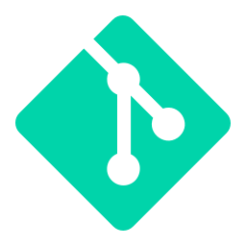
GitOps with ArgoCD
Git as the single source of truth for your infrastructure

Slide 2
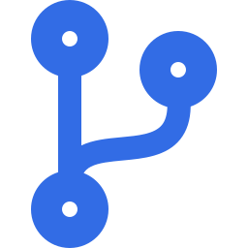
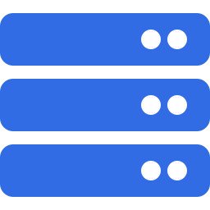



Learning Objectives
Understand GitOps principles and why they matter
Master the push vs pull deployment models
Learn ArgoCD architecture and core components
Deploy applications using the Application CRD
Implement automated sync, self-healing, and pruning policies
Manage multi-environment deployments with ArgoCD

Slide 3
What is GitOps?
Declarative infrastructure as code with Git as the source of truth
GitOps Principles
Why GitOps?
Declarative: Infrastructure is declared in Git, not imperative commands
Versioned: All changes tracked in Git with full audit trail and history
Automated: Systems auto-sync when Git state changes, no manual deployment
Self-Healing: Detects and corrects drift from desired state automatically
Transparent: All changes visible, auditable, and reversible in Git
Git is the single source of truth, not your cluster state
All changes are auditable and reversible (git history)
CI/CD pipelines push to Git, not directly to clusters
Continuous deployment: any Git change triggers auto-sync
Operational visibility and rollback by reverting commits
Reduced manual steps and human error in deployments

Slide 4
GitOps vs Traditional CI/CD
Push model vs Pull model for deployments
Traditional CI/CD (PUSH)
GitOps (PULL)
• CI pipeline builds app → pushes to registry
• Git repo holds all desired state manifests
• CI pipeline directly deploys to cluster via kubectl/Helm
• ArgoCD in cluster continuously pulls from Git
• No continuous verification of cluster state
• Automatic sync: Git state = cluster state
• Manual approval gates in CI before deployment
• Git is audit trail and single source of truth
• Harder to track what's actually running vs intended
• Declarative: no imperative commands needed
• Cluster drift: runtime changes vs desired state
• Self-heal: drift detected and corrected automatically

Slide 5
What is ArgoCD?
Declarative continuous delivery for Kubernetes
ArgoCD Basics
Key Features
Declarative GitOps continuous delivery tool for Kubernetes
Runs inside your cluster as a set of controllers
Watches Git repositories for manifest changes
Continuously syncs cluster state to Git state
Supports plain manifests, Helm charts, and Kustomize
Provides web UI for visibility and manual overrides
Automated deployment: commit to Git = deploy to cluster
Self-healing: detects manual changes, reverts to Git state
Progressive delivery: sync policies, sync waves, health checks
Multi-environment: different Git branches/repos per env
Audit trail: all changes tracked in Git history
Built-in Kubernetes-native: Application CRD, easy integration

Slide 6
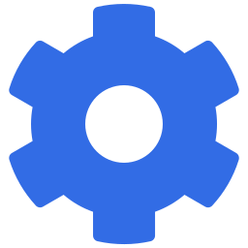
ArgoCD Architecture
Components and workflow
API Server
Repo Server
Application Controller
Redis
Web UI, gRPC API, authentication. Port 8080.
Clones Git repos, renders templates (plain YAML, Helm, Kustomize).
Watches Application CRDs, continuously syncs cluster to Git.
Cache and session store for performance.

Slide 7
The Application CRD: ArgoCD's Core Resource
apiVersion: argoproj.io/v1alpha1
kind: Application
metadata:
name: my-app
namespace: argocd
spec:
project: default
source:
repoURL: https://github.com/org/repo
targetRevision: main
path: manifests/
# OR for Helm:
# helm:
# valueFiles:
# - values-prod.yaml
destination:
server: https://kubernetes.default.svc
namespace: production
syncPolicy:
automated:
prune: true # Delete resources removed from Git
selfHeal: true # Revert manual cluster changes

Slide 8


How ArgoCD Works: The Continuous Sync Loop
1
Developer commits manifest changes to Git repository
2
ArgoCD Repo Server polls Git at regular intervals (or via webhook)
3
Repo Server detects changes and renders templates (Helm, Kustomize, etc.)
4
Application Controller compares rendered manifests to cluster state
5
If mismatch detected, controller applies changes via Kubernetes API
6
Self-heal monitors: drift detected, resources auto-reverted to Git state
7
ArgoCD UI shows sync status, health, and resource tree in real-time

Slide 9
Hands-On Labs

