Slide 1
Prometheus and Grafana

Slide 2
Agenda
Prometheus
Grafana

Slide 3
Prometheus - Open-Source Monitoring for Cloud Native Environments
What is Prometheus?
Prometheus is a tool that watches over the systems and collects important information, like CPU usage, memory usage, or number of errors, so we can know what is happening and fix problems quickly
Prometheus collects, stores, and lets you query data about your systems in real-time.
Features:
Open-source systems monitoring and alerting toolkit originally built at SoundCloud
Joined the Cloud Native Computing Foundation (CNCF) in 2016 as the second hosted project after Kubernetes
Designed specifically for dynamic container environments
Collects and stores metrics as time series data
Features a powerful query language for data analysis and alerting
Highly adopted in cloud-native ecosystems, especially with Kubernetes

Slide 4
High Level Workflow in Prometheus
[ Application or Systems ] [ Exporter ] [ Prometheus ] [ Alert or Dashboard ]
Applications or System: The running applications (e.g., a web server, a java application etc.) or servers / kubernetes nodes on which the application runs
Exporter: A tiny helper that gives Prometheus the app's data in the format it understands.
Prometheus: It regularly pulls the data and stores it.
Alerting: Prometheus can send alerts if something goes wrong.
Visualization: Use Grafana or Prometheus’s built-in graphs to see the data.

Slide 5
Key Concepts
Term | Meaning
Target | A system/app that Prometheus watches
Scraping | The action of Prometheus asking a target for data
Exporter | A helper that gives data to Prometheus
Metric | A piece of data like CPU usage, memory, etc.
Time Series | The value of a metric over time (like a graph of CPU usage over 1 hour)

Slide 6
Prometheus Time Series Data Model
Prometheus record the data in timeseries format.
Think of time series data like a continuous recording of measurements.
Each measurement has four key components:
A metric name
A timestamp
A numerical value
Labels (key-value pairs that add dimensions)
Labels enable multi-dimensional data representation and powerful queries
Data is stored chronologically, allowing time-based analysis

Slide 7
Example of CPU Monitoring via Prometheues
Let's use a real example of CPU usage monitoring:
Suppose I query node_cpu_seconds_total on Prometheus and get below response
node_cpu_seconds_total{cpu="0",mode="idle",instance="node-1"} 25.8 1634728140
node_cpu_seconds_total{cpu="0",mode="idle",instance="node-1"} 26.1 1634728200
node_cpu_seconds_total{cpu="0",mode="idle",instance="node-1"} 26.4 1634728260
Breaking this down:
Metric name: node_cpu_seconds_total
Timestamps: 1634728140, 1634728200, 1634728260
Values: 25.8, 26.1, 26.4
Labels:
cpu="0" (which CPU core)
mode="idle" (CPU state)
instance="node-1" (which node)

Slide 8
Prometheus vs. Traditional Monitoring (Nagios)
Feature | Prometheus | Nagios
Data Collection | Continuous time series with exact values | Periodic checks with state changes (OK, WARNING, CRITICAL)
Data Storage | Stores every measurement with timestamp | Primarily stores current state and state changes
Granularity | Detailed labels for multi-dimensional analysis | Generally aggregated views with thresholds
Historical Data | Full history of all values | Mainly state changes and event history
Query Capability | Powerful PromQL for trend analysis e.g., rate(node_cpu_seconds_total{mode="idle"}[5m]) | Limited to state change analysis
Collection Method | Pull-based (scrapes targets) | Agent-based push or check execution

Slide 9
Example of CPU Monitoring via Nagios
Nagios CPU Monitoring Approach, Check Script Execution:
#!/bin/bash
CPU_IDLE=$(top -bn1 | grep "Cpu(s)" | awk '{print $8}')
WARNING_THRESHOLD=80
CRITICAL_THRESHOLD=90
if [ ${CPU_IDLE%.*} -gt $CRITICAL_THRESHOLD ]; then
echo "CRITICAL - CPU usage is high! Idle: $CPU_IDLE%"
exit 2
elif [ ${CPU_IDLE%.*} -gt $WARNING_THRESHOLD ]; then
echo "WARNING - CPU usage rising! Idle: $CPU_IDLE%"
exit 1
else
echo "OK - CPU usage normal. Idle: $CPU_IDLE%"
exit 0
fi
State-Based Storage:
Instead of storing continuous measurements like Prometheus, Nagios would store:
Host: node-1
Service: CPU Usage
State: OK/WARNING/CRITICAL
Last Check: 2023-12-06 10:00:00
Next Check: 2023-12-06 10:05:00
Last Value: CPU Idle 74.2%

Slide 10
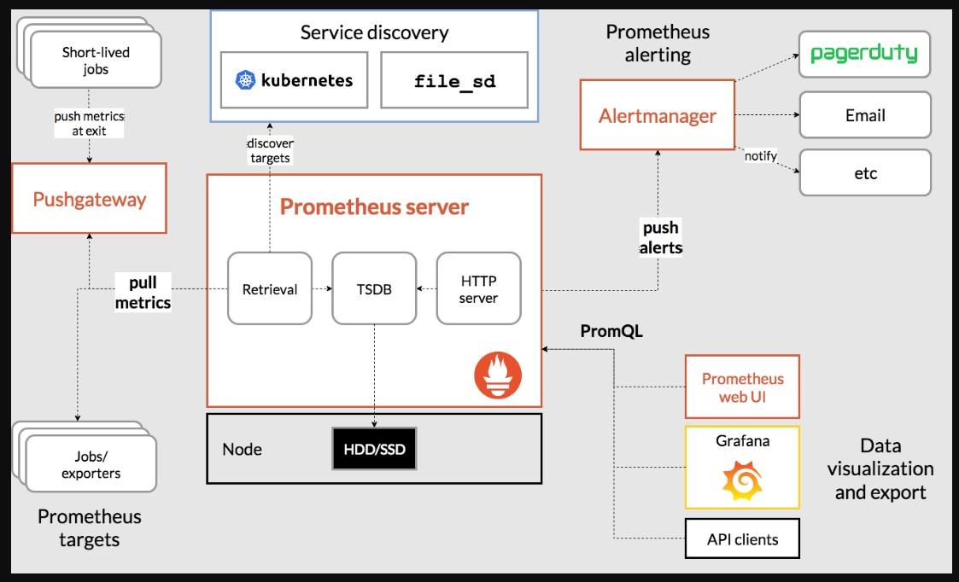
Prometheus Architecture Components
Prometheus Server: The central component that collects, scrapes and stores time series data
Includes: Data retrieval, storage, PromQL processing
Service Discovery: Automatically finds targets to monitor
Supports: Kubernetes, AWS, file-based, etc.
Alert Manager: Handles alerting and routing of notifications
Manages: Grouping, routing, silencing, inhibition of alerts
Push Gateway: Allows short-lived jobs to push metrics
Use case: Batch jobs that exit before being scraped
PromQL (Query Language): How you query and aggregate time series data
e.g.: rate(http_requests_total[5m])

Slide 11
Setup workflow in Prometheus
Collection:
Deploy exporters: Exporters expose metrics on /metrics endpoint
Or Application expose their metrices directly on /metrics endpoint
Prometheus scrapes targets on configured intervals
Data stored in local TSDB
2. Processing: Configure Prometheus to scrape them
PromQL queries analyze and aggregate data
Results visualized in Grafana or Prometheus UI
3. Alerting: Set up alerts
Alert rules evaluated against metrics
Alert Manager handles notification routing
Integrates with various notification channels (email, Slack, PagerDuty)
4. Dashboard: Connect visualization tools
Setup and integrate with Grafana for visualization

Slide 12
Exporters: Bridges to Various Systems
Exporters convert metrics from third-party systems into Prometheus format
Some Common exporters:
Node Exporter: Hardware and OS metrics (CPU, memory, disk, network)
kube-state-metrics: Kubernetes objects metrics (deployments, pods, nodes)
cAdvisor: Container-level metrics (CPU, memory, disk usage)
Database Exporters: MySQL, PostgreSQL, MongoDB, Redis, etc.
Application Exporters: JMX, NGINX, HAProxy, etc.
Cloud Exporters: AWS, GCP, Azure metrics
All expose metrics on HTTP endpoints for Prometheus to scrape

Slide 13
Installation Steps
Navigate to promethues\Installation-Guide.txt in the shared git repo

Slide 14
Kubernetes Monitoring with Prometheus
Prometheus can automatically discover and monitor Kubernetes components using “kubernetes_sd_configs” configuration:
1.) API Server: Control plane metrics
e.g: API server request: ratesum(rate(apiserver_request_total[5m])) by (code, resource)
2.) Nodes: Hardware and OS metrics via node-exporter
e.g.: CPU usage by node: 100 - (avg by (instance) (rate(node_cpu_seconds_total{mode="idle"}[5m])) * 100)
3.) Pods: Application metrics via annotations (reference to use client library: https://prometheus.github.io/client_python/)
prometheus.io/scrape: "true"
prometheus.io/path: "/metrics"
prometheus.io/port: "8080"
e.g: HTTP request rate for annotated pods: sum(rate(http_requests_total{kubernetes_pod_name=~"my-app-.+"}[5m])) by (pod, path)
4.) cAdvisor: Container metrics built into kubelet
e.g.: Container CPU usage: sum(rate(container_cpu_usage_seconds_total{container!="POD", container!=""}[5m])) by (pod, container)
5.) Object state: Metrices using kube-state-metrics exporter
e.g: Count of pods by status phase: sum(kube_pod_status_phase) by (phase)

Slide 15
Sample PromQL Queries for Kubernetes
# Node CPU Usage Percentage
100 - (avg by(instance) (rate(node_cpu_seconds_total{mode="idle"}[5m])) * 100)
# Pod CPU Usage
sum(rate(container_cpu_usage_seconds_total{container!=""}[5m])) by (pod)
# Top 5 Pods by CPU Usage
topk(5, sum(rate(container_cpu_usage_seconds_total{container!=""}[5m])) by (pod))
# CPU Usage by Namespace
sum(rate(container_cpu_usage_seconds_total{container!=""}[5m])) by (namespace)
# CPU Throttling
sum(rate(container_cpu_cfs_throttled_seconds_total[5m])) by (pod)
# Node Memory Usage Percentage
(1 - (node_memory_MemAvailable_bytes / node_memory_MemTotal_bytes)) * 100

Slide 16
Alert Manager
AlertManager handles alerts sent by Prometheus, performs deduplication, grouping, and routes them to receivers like email, Slack, or PagerDuty.
Think of Prometheus as the monitoring system that detects issues, while AlertManager is your notification dispatch system.
Installation and handson: AlertManager\Installation-Guide.txt
The flow is as follows:
Deploy Alert Manager in Kubernetes
Specify its endpoint in Prometheus ConfigMap
Configure Rules in Prometheus config to send alerts to Alert Manager
Configure alertmanager.yml with details like email settings, slack settings, sender, receivers and further alert level configurations
handson:
Trigger a test alert using Prometheus and validate in AlertManager and further validate by receiving an email

Slide 17
Alert Flow in Prometheus Ecosystem
Prometheus Server:
Evaluates alert rules against metrics
Generates alerts when conditions are met
Sends alerts to AlertManager
AlertManager:
Receives alerts from one or more Prometheus servers
Deduplicates similar alerts
Groups related alerts
Routes notifications based on configurations
Handles silencing and inhibition
Receivers:
Email
Slack
PagerDuty
OpsGenie
Microsoft Teams
Webhook integrations

Slide 18
Grafana
Grafana is an open-source observability platform used for visualizing metrics, logs, and traces. They also have an enterprise version.
It enables users to:
Query, visualize, and understand metrics
Create custom dashboards
Analyze data from multiple sources
With a lot of features like:
Multi-platform support
Pluggable data source architecture
Rich visualization options
User authentication and authorization
Template variables for dynamic dashboards
It can be integrated with Prometheus, AWS CloudWatch, Azure Monitor and many other data sources.
Installation Guide: Grafana\Installation-Guide.txt

Slide 19
Integrate Grafana with Prometheus
Add Data Source:
Now since Grafana is up and running, next step is to integrate it with a data source.
To add a new Data Sources, Go to:
connections -> Data Sources -> Add data source
So, lets integrate Prometheus with Grafana:
URL: http://prometheus:9090
Access: Server (default)
Scrape interval: 15s

Slide 20
Import the Grafana Dashboard
A lot of dashboards are already pre-existing and shared by the contributors
Steps to Import: Search for an available dashboards for the Open Source Grafana version: https://grafana.com/grafana/dashboards
Select any dashboard from here.
e.g.:
Add a node exporter dashboard - https://grafana.com/grafana/dashboards/1860-node-exporter-full/
Open & Click on Copy ID to Clipboard
Goto -> Dashboards -> New -> Import
Go to the section where following is mentioned: Find and import dashboards for common applications at grafana.com/dashboards
Add the Dashboard ID in it & Click on Load
Select the Prometheus Data Source and provide a name
Click on Import
Add a Kubernetes Dashboard - https://grafana.com/grafana/dashboards/8588-1-kubernetes-deployment-statefulset-daemonset-metrics/
Open it
Click on Copy ID to Clipboard
and then perform the same steps as mentioned above

Slide 21
Create New Dashboards from scratch
Steps to create a dashboard in Grafana:
- Go to Dashboards -> New dashboard & Save it by giving a name
- Add visualization & Select Prometheus Data Source
- Enter Promql queries w.r.t your requirement
like:
Node CPU Usage:
sum(rate(node_cpu_seconds_total{mode!="idle"}[5m])) by (instance) * 100
Node Memory Usage:
(node_memory_MemTotal_bytes - node_memory_MemAvailable_bytes) / node_memory_MemTotal_bytes * 100
Pod CPU Usage:
sum(rate(container_cpu_usage_seconds_total{container!=""}[5m])) by (pod)
Pod Memory Usage:
sum(container_memory_working_set_bytes{container!=""}) by (pod)
When creating panels in Grafana:
Click "Add panel"
Select "Add a new panel"
Choose Prometheus as the data source
Copy-paste the relevant PromQL query
Adjust visualization settings as needed
Save the panel

