Slide 1

Exploring Customer Behavior and Predicting Sales Patterns in Retail Environment By Aryan Mainkar
Unveiling the intricate dance of customer behavior and predicting the rhythm of sales patterns in retail environments – where data meets insight, and insight shapes strategy.

Slide 2
Contents
INTRODUCTION
DATA
FEATURE ENGINEERING AND MODEL TRAINED
QUESTIONS AND FINDINGS
SUMMARY

Slide 3

Introduction
In the ever-changing world of retail, knowing how customers behave and predicting what they'll buy is like having a superpower for businesses. Our project, named "Understanding Customer Habits and Predicting Sales in Stores," takes a closer look at the data behind shopping to reveal secrets that can help stores sell smarter and make better decisions.
Here's a quick peek at what we've got:
Customer Data (df1):Stuff about the people who shop, like who they are, how old they are,who they identify as, and how they like to pay. Helps us understand who's buying and what they like.
Sales Data (df2):Details about every sale, from what was bought to how much it cost and where it happened. Gives us the lowdown on what's selling and its location.

Slide 4
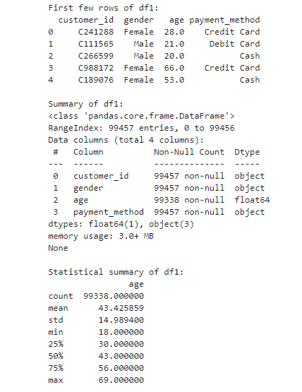
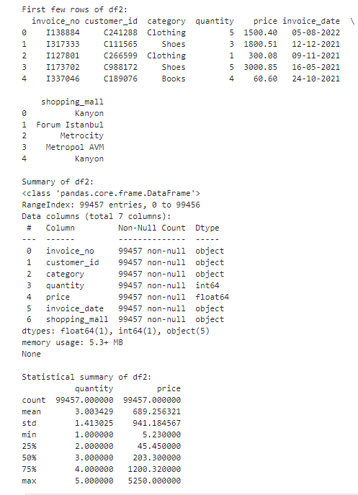
Data : Statistical Summary
Let us dive deeper into the summary for the data so that we can understand the analysis better

Slide 5
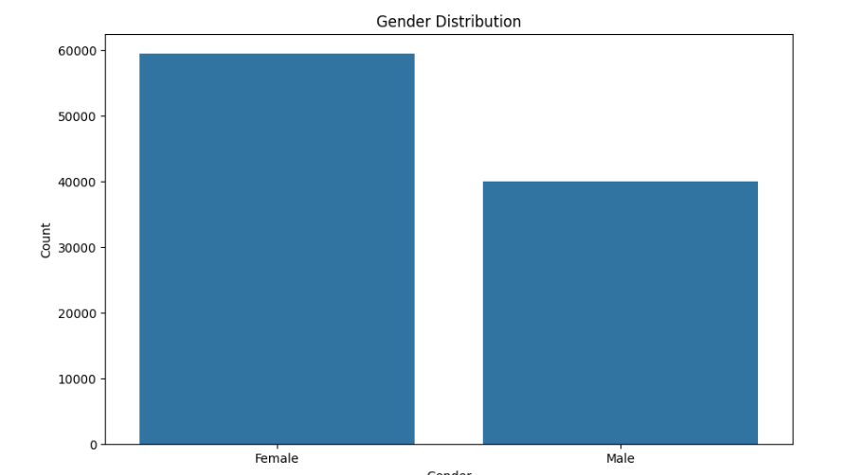
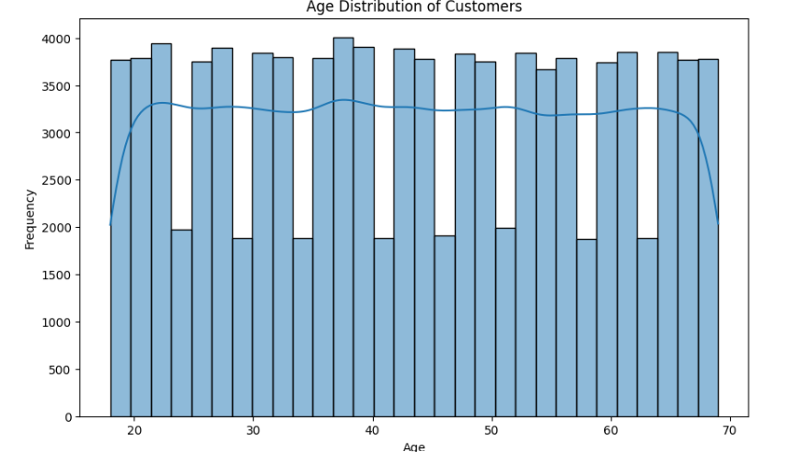
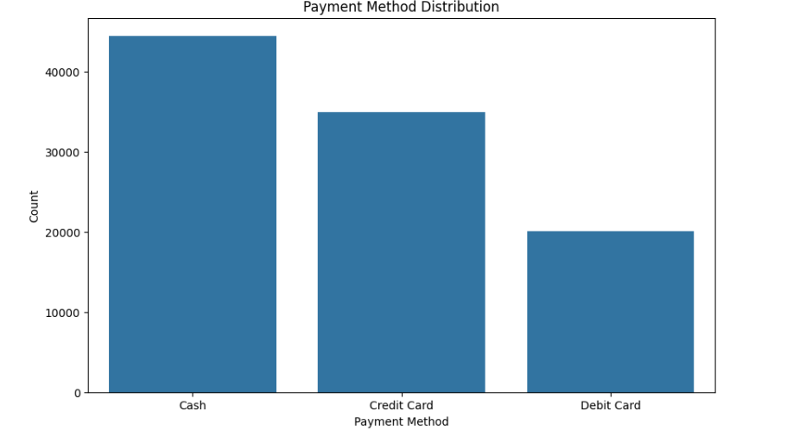
Data
EXPLORATORY DATA ANALYSIS (EDA) FINDINGS FOR DF1 :
In our customer dataset (df1), we have records for 99,457 customers, including details such as gender, age, and payment methods. The average age is around 43 years, with a slightly skewed distribution peaking in the mid-40s. Gender distribution is nearly balanced, with 60% females and 40% males. The preferred payment method is predominantly cash.

Slide 6
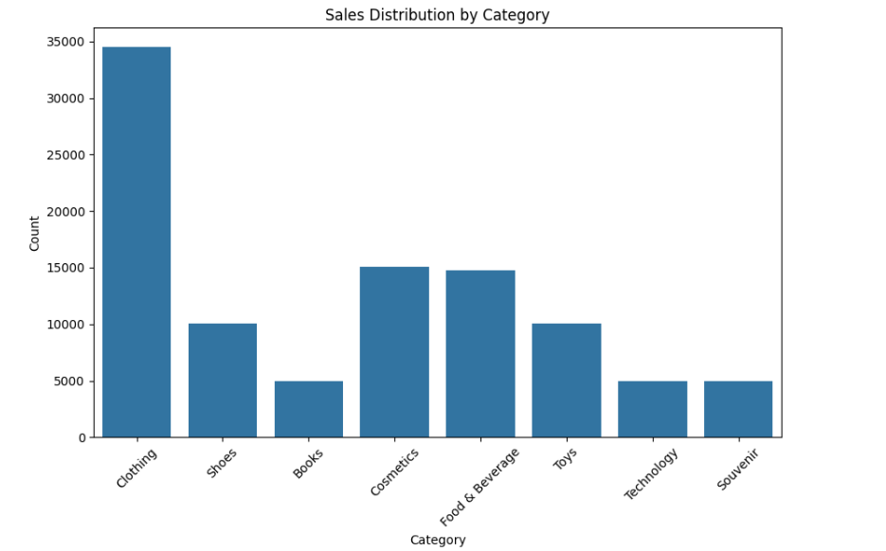
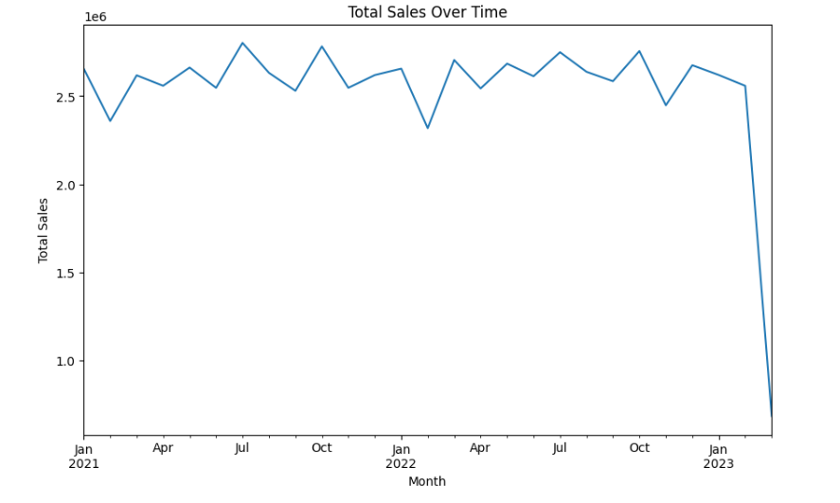
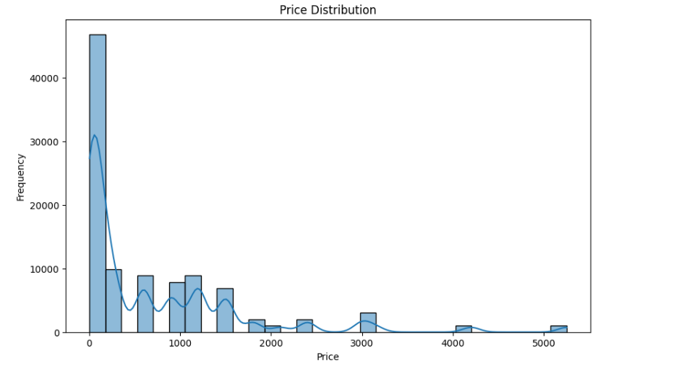
Data
EXPLORATORY DATA ANALYSIS (EDA) FINDINGS FOR DF2 :
In the sales dataset (df2), comprising 99,457 entries, we observed diverse categories, with Clothing being the most sold. The average price is $689, and most transactions involve quantities of 3. Sales are evenly spread across various shopping malls.

Slide 7
Model : RANDOM FOREST REGRESSION ANALYSIS
Random Forest Regression is a powerful machine learning technique that leverages the strength of multiple decision trees to make accurate predictions. It constructs a "forest" of trees during training and combines their outputs to produce a robust and reliable regression model. By averaging the predictions of individual trees, Random Forest Regression minimizes overfitting and enhances the model's performance, making it well-suited for complex datasets and predictive tasks in various domains.
During the creation of model, we did have to clean the data as df2 contained some missing values. As far as the handling of missing values id before building the model is concerned in df2 we replaced the NaN also known as null values with the average mean values.
We merged df1 and df2 on a common key known as customer_id.
Once the merge was successful the aggregated df contained both df1 and df2 values. Once we had the data frame we applied one hot encoding required for training the machine learning model. This is done to ensure that category values are converted to binary values. For example gender attributes were converted into 0 and 1 for the missing entries
After one hot encoding was successful, we further moved on to the process of feature engineering where we calculated the total spending per customer.
For training purposes, the test size was 0.2 which corresponds to an 80% training set and 20% test set.

Slide 8
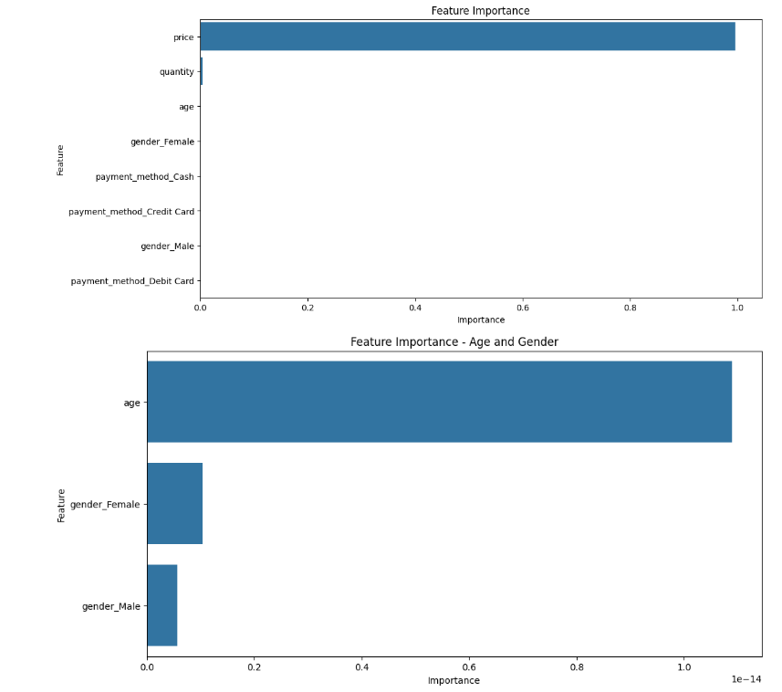
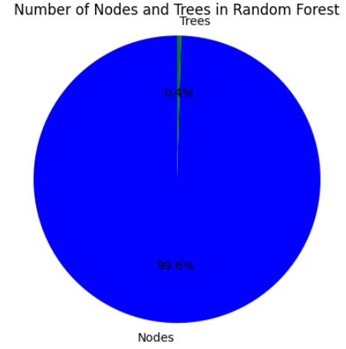
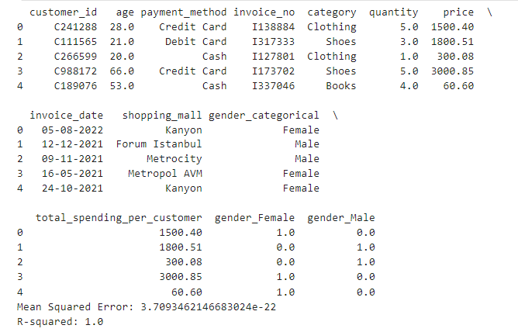
Cont :Random forest regression insights
TREES AND NODES
Aggregated Data Frame

Slide 9
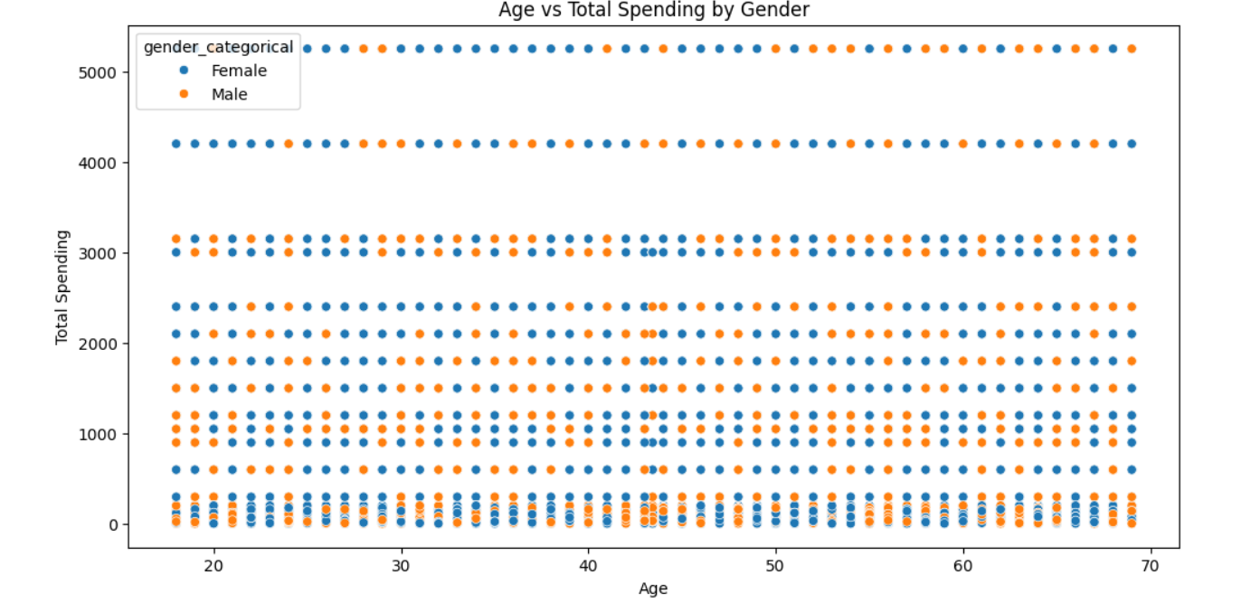
Does Age Affect Purchasing Decisions?
We looked at how different ages affect what customers buy. Our customer data (df1) showed ages ranging from 18 to 69. We used numbers like mean and standard deviation to understand how ages vary among customers.
To see how age influences buying choices, we used machine learning, specifically decision trees.
The results gave us clear patterns and connections, helping us suggest smart marketing strategies for different age groups. Visuals like age distribution histograms and decision tree insights make it easy to see how age is a key factor in shaping customer behavior..

Slide 10
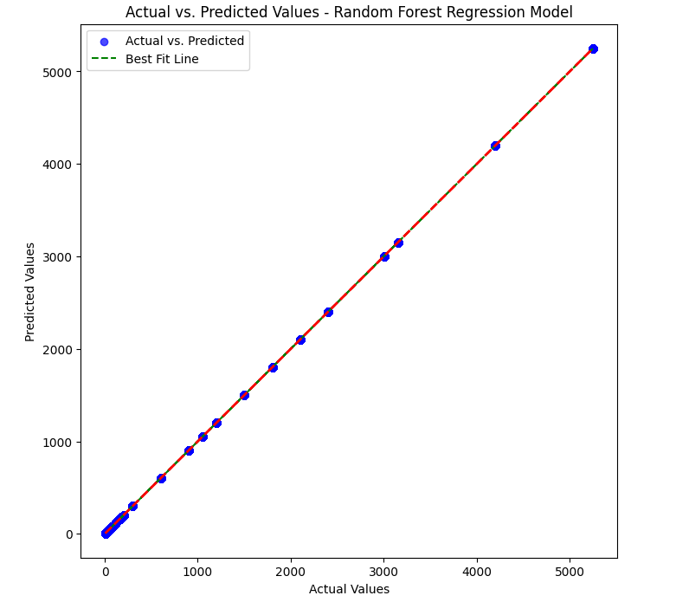
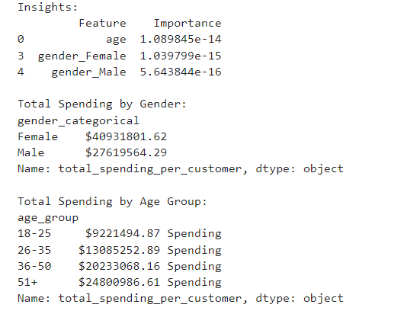
Does Gender Affect Purchasing Decisions?
Looking at how much people spend based on gender and age tells us important things for our business. Female customers spend more, around $40.9 million, compared to male customers who spend $27.6 million.
When we look at different age groups, those aged 36-50 spend the most, totaling $20.2 million.

Slide 11

SUMMARY
Our detailed analysis using the Random Forest Regression model highlights that age significantly influences how much people spend, with a very high importance value. On the other hand, the impact of gender, whether female or male, is less noticeable, as shown by their lower importance values.
In understanding what influences what people buy, we find that age matters more than gender. Retailers should pay close attention to age when planning marketing strategies because it plays a bigger role in shaping customer preferences and behaviors.

