Slide 1
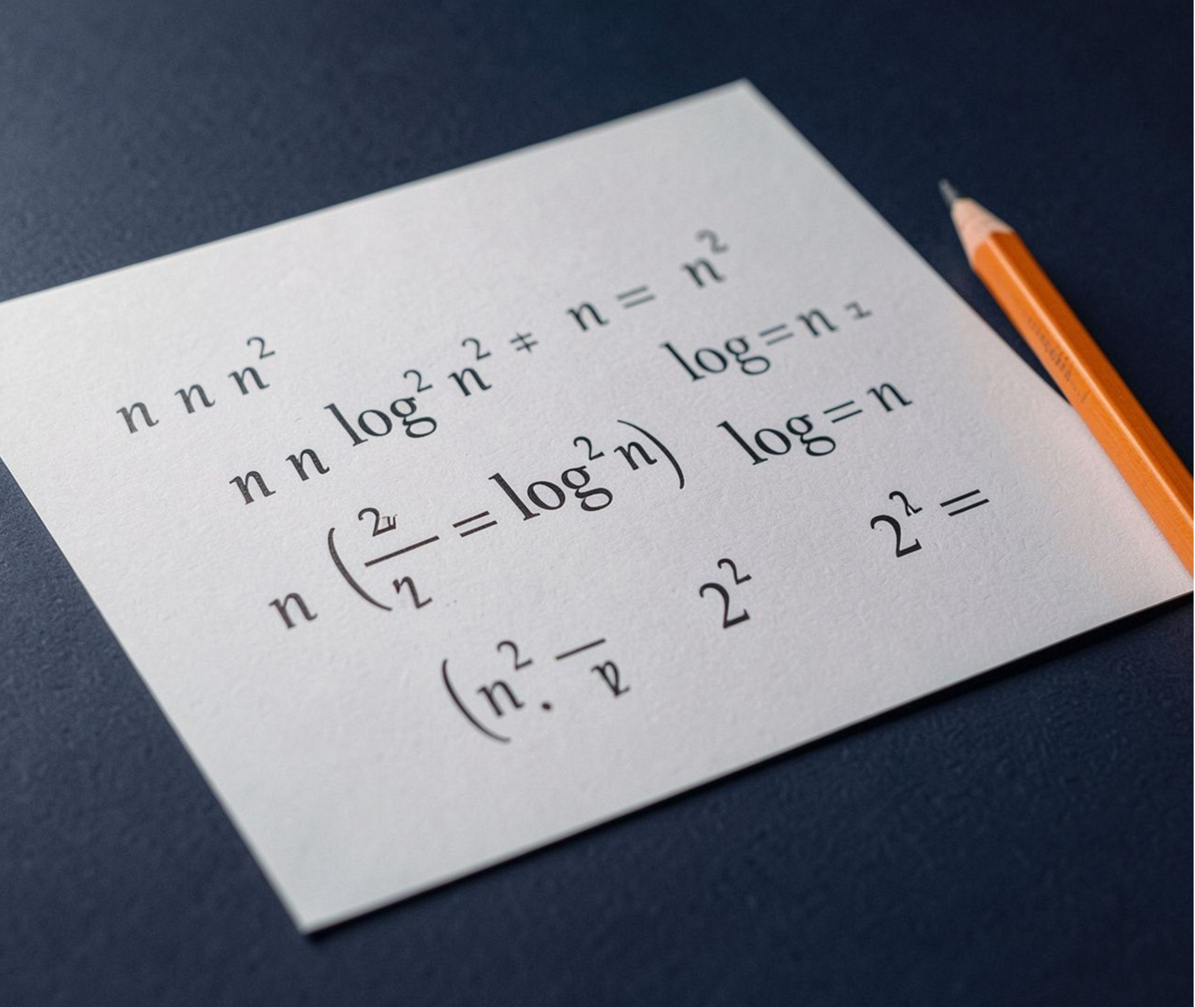
ALGORITHMS
Asymptotic Notation
and Growth of Functions
How algorithms scale when input size becomes very large.
Design and Analysis of Algorithms

Slide 2
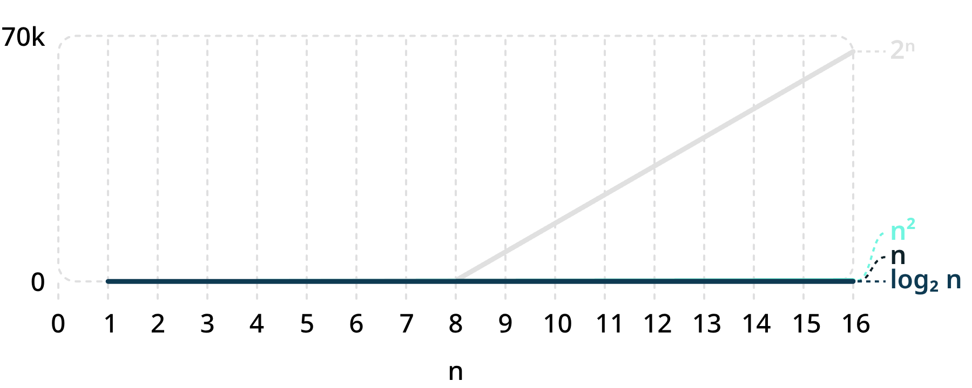
01 · WHY GROWTH MATTERS
Growth matters when n becomes very large
We study how running time grows as input size n becomes very large. The dominant term eventually tells the story.
Growth of common functions
Dominant term in 3n² + 5n + 2
n | 3n² + 5n + 2 | Share from 3n²
10 | 352 | 85%
100 | 30502 | 98.4%
1000 | 3005002 | 99.8%
Conclusion: ignore constants and lower-order terms.
Asymptotic Notation and Growth of Functions
02

Slide 3

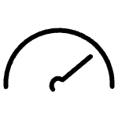

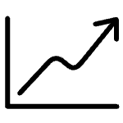
02 · UPPER BOUNDS
Big O describes an upper bound
n₀
f(n) = O(g(n)) if there are constants c > 0 and n₀ such that f(n) ≤ c·g(n) for all n ≥ n₀.
Think: f(n) grows no faster than a constant multiple of g(n).
c·g(n)
f(n)
F(N) ≤ C·G(N)
Example: 3n + 10 ≤ 4n for n ≥ 10, so 3n + 10 = O(n).
Asymptotic Notation and Growth of Functions
03

Slide 4






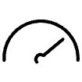


03 · BOUNDS TOGETHER
Ω is a lower bound; Θ is a tight bound
A tight bound captures both the ceiling and the floor of f(n).
Ω · LOWER BOUND
Θ · TIGHT BOUND
f(n) ≥ c·g(n)
c₁·g(n) ≤ f(n) ≤ c₂·g(n)
n₀
c·g(n) Comparison
c₂·g(n)
f(n) Above
f(n)
Threshold n₀
c₁·g(n)
Example: 3n + 10 = Ω(n).
Example: 3n + 10 = Θ(n).
Θ means both O and Ω.
Asymptotic Notation and Growth of Functions
04

Slide 5
04 · A TIGHT-BOUND PROOF
Compare the symbols, then prove a tight bound
One expression, three readings
For n ≥ 1: 3n² + 5n + 2 ≤ 10n², so it is O(n²).
For n ≥ 1: 3n² + 5n + 2 ≥ 3n², so it is Ω(n²).
Therefore 3n² + 5n + 2 = Θ(n²).
Symbol | Meaning | Example
O(g(n)) | At most | 3n + 10 = O(n)
Ω(g(n)) | At least | 3n + 10 = Ω(n)
Θ(g(n)) | Exactly this order; tight | 3n + 10 = Θ(n)
Asymptotic Notation and Growth of Functions
05

Slide 6
05 · RULES OF THUMB
Six useful properties
These identities make asymptotic reasoning faster and cleaner.
01
02
03
Reflexive
Transitive
Symmetric for Θ
f = Θ(f)
f = O(g) and g = O(h) give f = O(h)
f = Θ(g) if and only if g = Θ(f)
04
05
06
Transpose symmetry
Sum rule
Product rule
f = O(g) if and only if g = Ω(f)
O(f) + O(g) = O(max(f, g))
O(f)·O(g) = O(f·g)
Asymptotic Notation and Growth of Functions
06

Slide 7
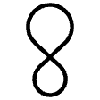
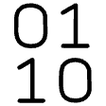
06 · COMMON RUNNING TIMES
Logarithmic and polynomial times
Both are useful because they grow slowly enough for many practical inputs.
Polynomial — O(n), O(n²), O(n³)
Logarithmic — O(log n)
Binary search halves the remaining range at every step.
1,000,000 items ≈ 20 steps
Doubling n adds only one step.
Linear search, nested loops, simple sorting, and matrix multiplication fit this family.
Doubling n makes n² four times larger
Polynomial algorithms are generally considered efficient.
Asymptotic Notation and Growth of Functions
07

Slide 8
THE EXPONENTIAL WALL
Exponential time becomes impossible quickly
n = 10
2¹⁰ = 1,024 operations
Trying all subsets takes O(2ⁿ) operations. Adding one element doubles the work.
n = 100
2ⁿ
2¹⁰⁰ ≈ 1.27 × 10³⁰ operations
Exponential growth can overwhelm any practical computer.
Each new element
Adding one element doubles the work.
Asymptotic Notation and Growth of Functions
08

Slide 9
Simplify
08 · THE TAKEAWAY
Ignore constants and lower-order terms for large n.
Remember the growth order
log n < n < n² < 2ⁿ
Classify
Use O for upper bounds, Ω for lower bounds, and Θ for tight bounds.
Function | n = 10 | n = 100
log₂ n | 3.3 | 6.6
n | 10 | 100
n² | 100 | 10,000
2ⁿ | 1,024 | 1.27 × 10³⁰
Choose
Prefer slower-growing algorithms when inputs can become large.
Asymptotic Notation and Growth of Functions
09

Slide 10
DESIGN AND ANALYSIS OF ALGORITHMS
Thank You
Questions and discussion.
By Aryan Marghade
PRN: 25070521215

