Slide 1



MENTORNESS INTERNSHIP PROGRAM
Fast Tag Fraud Detection
Name:
Roll No:
MIP-ML-07
Mathur Aryan Attarsingh

Slide 2
Table of Content
Problem Statement
Dataset Description
Project Objectives
Challenges
Evaluation Criteria
Deliverables
Conclusion

Slide 3
Project Definition
This project focuses on leveraging machine learning classification techniques to develop an effective fraud detection system for Fast tag transactions. The dataset comprises key features such as transaction details, vehicle information, geographical location, and transaction amounts. The goal is to create a robust model that can accurately identify instances of fraudulent activity, ensuring the integrity and security of Fast tag transactions

Slide 4
Dataset Description
Transaction ID: Unique identifier for each transaction.
Timestamp: Date and time of the transaction.
Vehicle Type: Type of vehicle involved in the transaction.
Fast Tag ID: Unique identifier for FastTag.
Toll Booth ID: Identifier for the toll booth.
Lane Type: Type of lane used for the transaction.
Vehicle Dimensions: Dimensions of the vehicle.
Transaction Amount: Amount associated with the transaction.

Slide 5
Dataset Description
Amount paid: Amount paid for the transaction.
Geographical Location: Location details of the transaction.
Vehicle Speed: Speed of the vehicle during the transaction.
Vehicle Plate Number: License plate number of the vehicle.
Fraud indicator: Binary indicator of fraudulent activity (target variable).

Slide 6
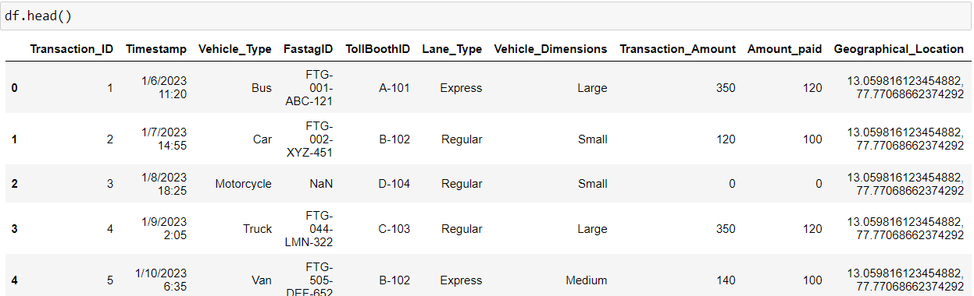
DataSet Description

Slide 7
Project Objectives
Data Exploration: - Explore the dataset to understand the distribution of features and the prevalence of fraud indicators.
Feature Engineering: - Identify and engineer relevant features that contribute to fraud detection accuracy.
Model Development: - Build a machine learning classification model to predict and detect Fastag transaction fraud. - Evaluate and fine-tune model performance using appropriate metrics.

Slide 8
Project Objectives
Real-time Fraud Detection: - Explore the feasibility of implementing the model for real-time Fastag fraud detection.
Explanatory Analysis: - Provide insights into the factors contributing to fraudulent transactions.

Slide 9
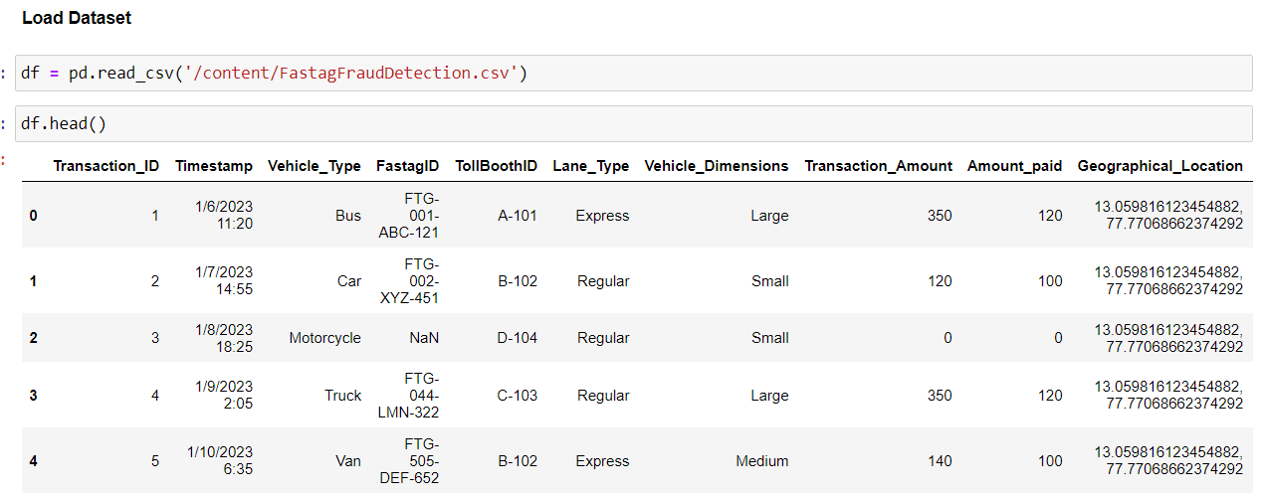
Load DAtaset

Slide 10
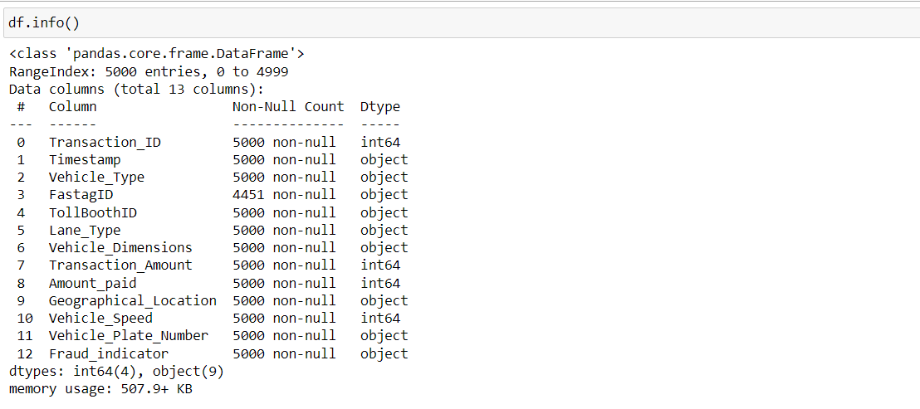
Dataset information

Slide 11
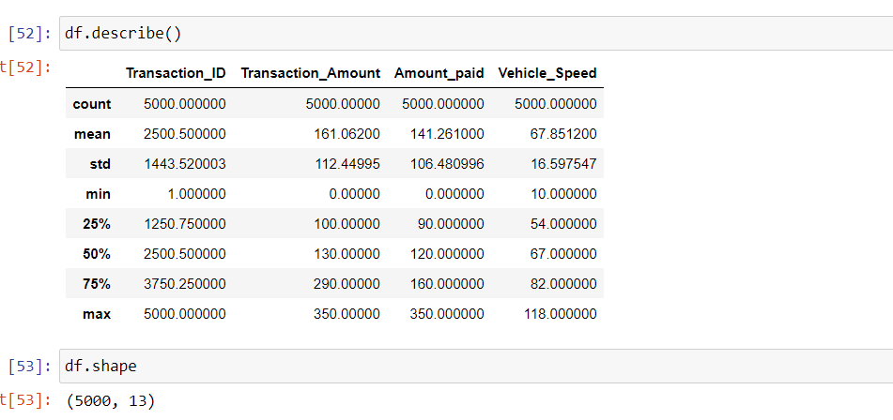
Dataset Description

Slide 12
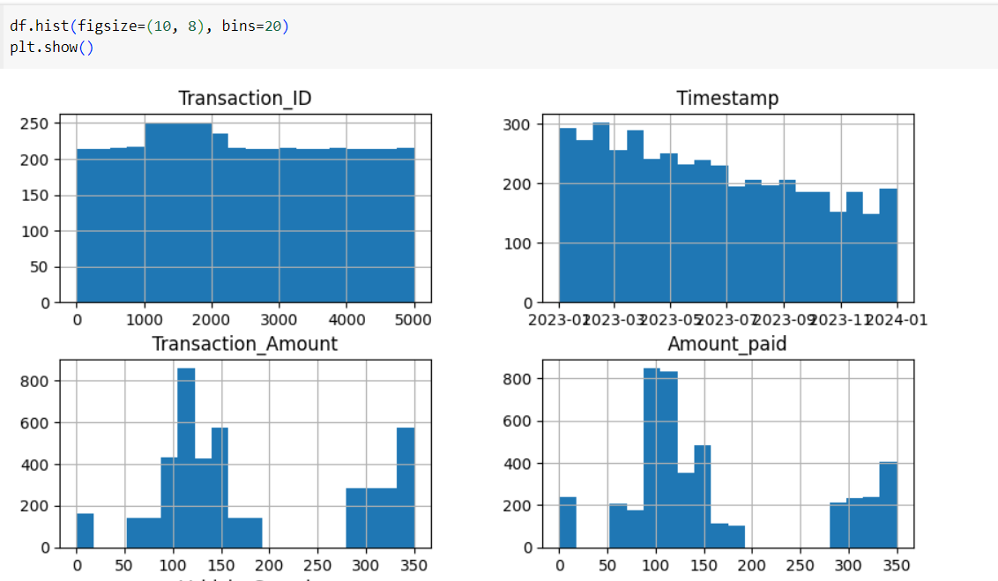
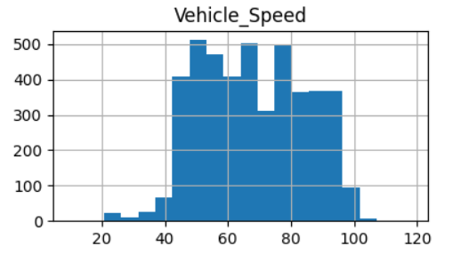
Dataset visualization

Slide 13
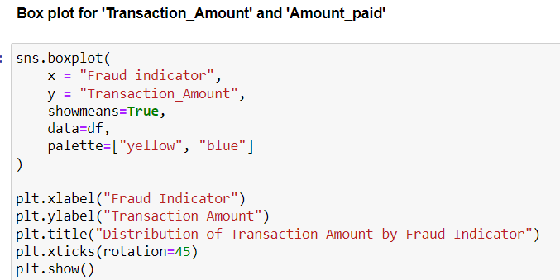
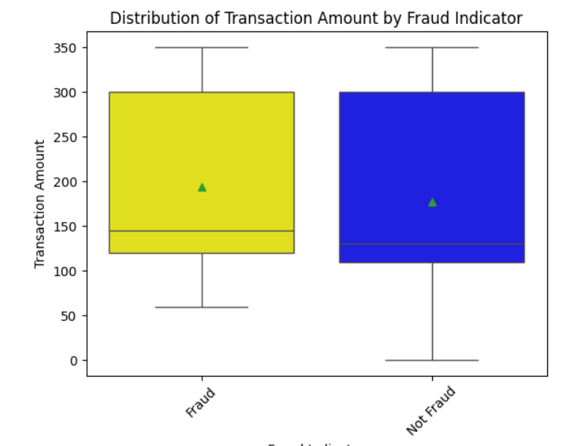
BoxPlot

Slide 14
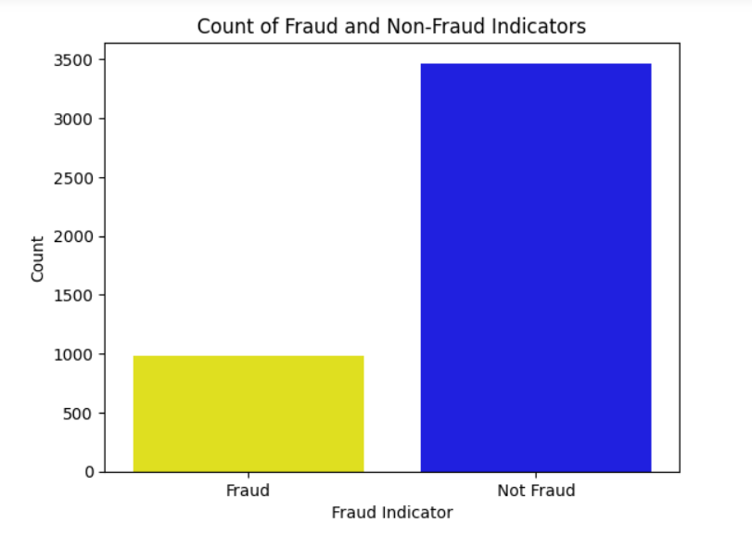
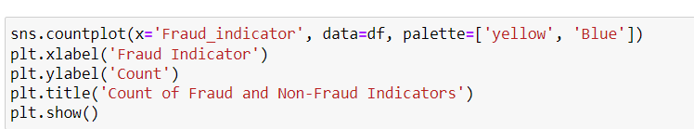
BArPlot

Slide 15
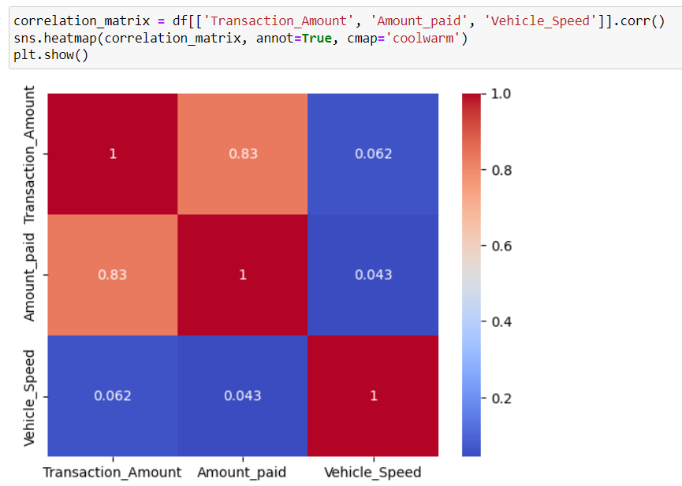
HEatmap

Slide 16
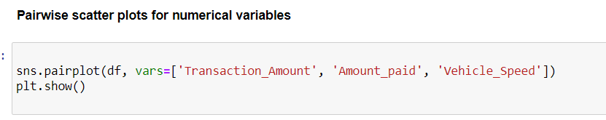
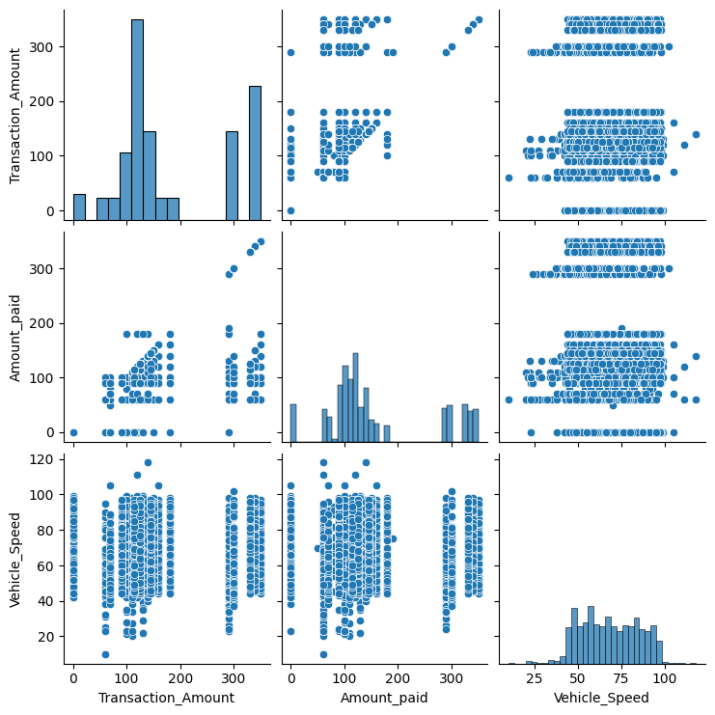
Pairwise scatter plots for numerical variables

Slide 17
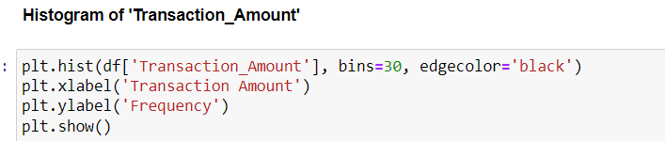
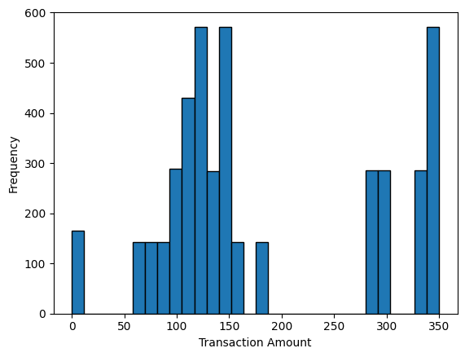
Histogram

Slide 18
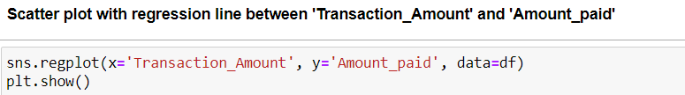
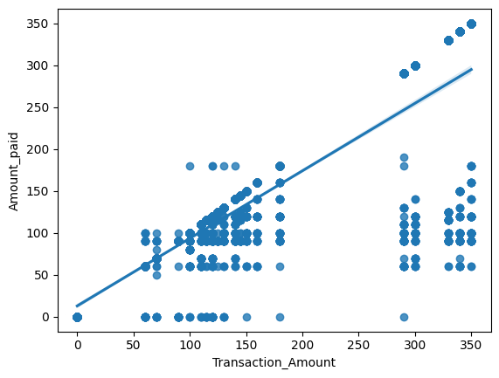
scatterplot

Slide 19
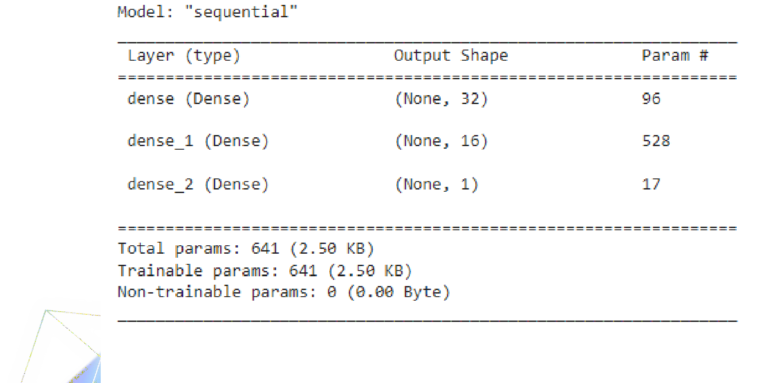
Model devlopment

Slide 20
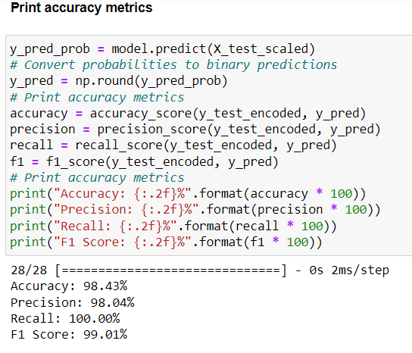
Accuracy

Slide 21
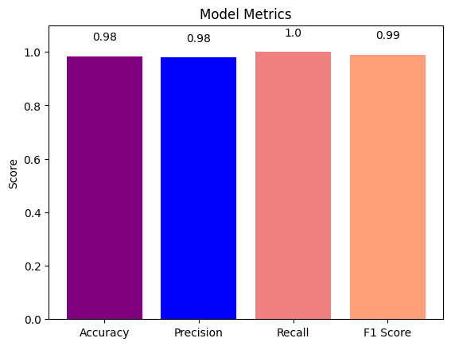
Accuracy Graph

Slide 22
Thank You

