Slide 1
Intel 8085 Microprocessor Architecture

Slide 2
Introduction of 8085
Microprocessor is CPU on a Chip.
Introduced in 1976 and is a 8 bit processor.
Intel 8085 is an NMOS microprocessor.
It is a 40 pin IC package fabricated on a single LSI chip.
It uses +5 V for its operation.
Its clock speed is about 3 MHz and clock cycle is 320 ns.
It has 80 basic instructions and 246 opcodes.
Intel has produced large number of peripheral devices for microprocessor based system.

Slide 3
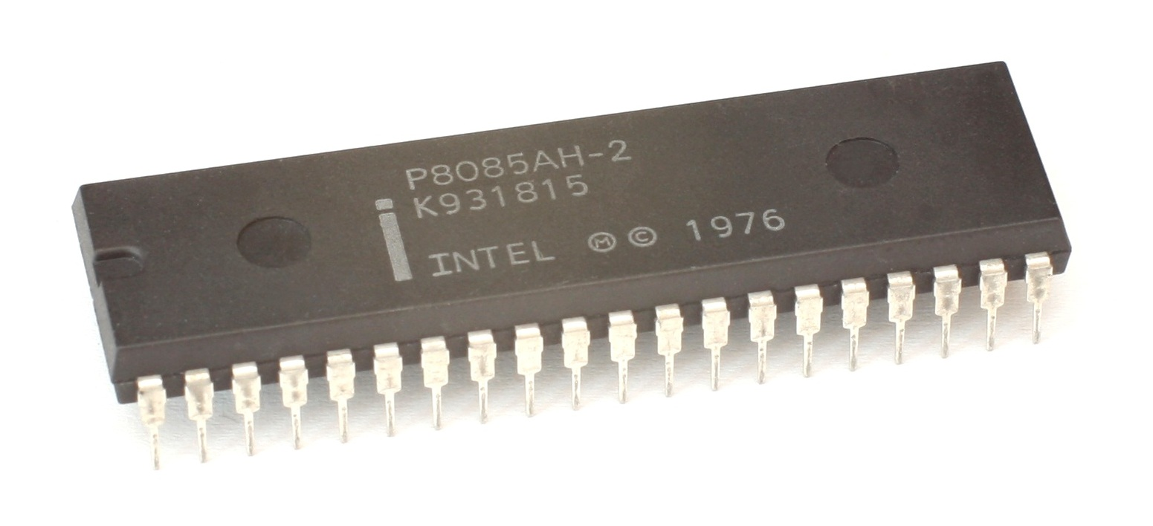
Figure 1. Intel 8085 40 pin chip

Slide 4
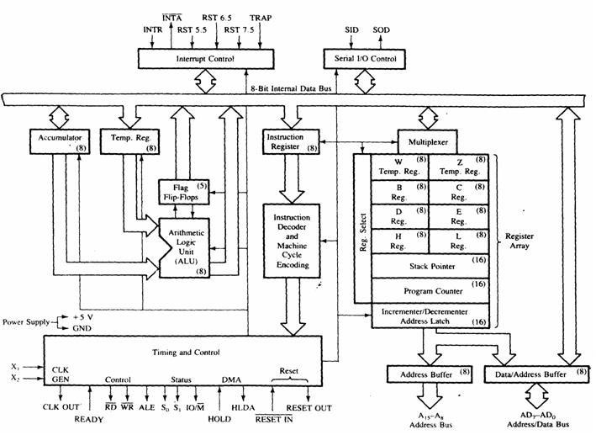
Figure 2. Block Diagram of Intel 8085

Slide 5
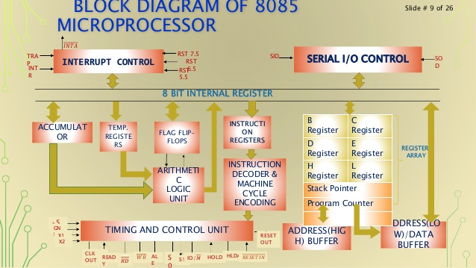

Slide 6
The block diagram shows three important sections:
Arithmetic and Logic unit
Timing and control unit
Set of registers
Arithmetic and Logic Unit
It performs various arithmetic and logical operations which includes:
Addition | Logical AND
Subtraction | Logical OR
Increment | Complement
Decrement | EX-OR

Slide 7
Timing and Control Unit
It acts as a brain of the computer system.
It generate timing, control and status signals which are required for the operations of processor, memory and I/O devices.
It controls data flow between processor, memory and peripheral devices.
X₁
Timing and Control Unit
X₂
Crystal oscillator

Slide 8
Registers
Registers are used by the microprocessor for temporary storage and manipulation of data and instructions.
Data remains in the registers till they are sent to the memory or I/O devices.
Intel 8085 has following set of registers
Accumulator, i.e. register A
General purpose register, i.e. B, C, D, E, H, L
Stack Pointer
Program Counter
Instruction register
Temporary register
Status Flags

Slide 9
Accumulator
It is an 8 bit register associated with the ALU.
It holds one of the operands of the arithmetic and logical (AL) operation.
The other operand is stored in the memory or in the general purpose registers.
The final result of AL operation is placed in the accumulator.
These are true for general cases, not for some typical or special cases.

Slide 10
Case-I
Some logical instructions need only one operand.
Example-
INR – The content of the accumulator are incremented by one.
RAL – The content of the accumulator are rotated left by one bit.
Some instruction has operand which is of 16 bit.
Example-
DAD – 16 bit addition
One of the operand is in H-L pair and the other is in B-C or D-E pair. Result is placed in H-L pair.

Slide 11
General Purpose registers
The 8085 microprocessor has six 8-bit GPR, i.e. B, C, D, E, H, L.
To hold 16 bit data a combination of two 8-bit registers can be employed.
The combination of two 8 bit register is known as register pair.
There are three register pairs, i. e. B-C, D-E, H-L.
H-L pair is the default memory or data pointer.
The general purpose registers and accumulator are accessible to the programmers.

Slide 12
Special purpose registers
Program counter –
It is a 16 bit register which contains or hold the address of next instruction to be executed.
It takes care of the program flow or control.
Instruction register –
It is a 8 bit register
It holds the opcode of the instruction which is being decoded and executed.

Slide 13
Opcode and Operand
Instruction contains two parts: operation code (opcode) and operand.
Opcode – It specifies the task to be performed by the computer.
Operand – It specifies the data to be operated on. It can be in various forms, i.e.
8 bit or 16 bit data
8 bit or 16 bit address
Register

Slide 14
Instruction decoder and Machine cycle Encoder
After the instruction is fetched in the IR, it is decoded into this block with the help of Micro program.
Micro program is a program written by chip designer (manufacturer) to make the processor understand what a instruction is or it indicates the type of operation to be performed for an instruction.
Number of Machine cycles are assigned according to the type of instruction.

Slide 15
Temporary register
It is a 8 bit register associated with the ALU.
It holds the data during an arithmetic and logical operation.
It is used by the microprocessor in some instructions.
They are not accessible by the users.
W, Z are 8 bit temporary registers.
Stack pointer
It is a 16 bit register which contains the address of the data present at top of the stack.
It points to top of stack.

Slide 16
Stack
It is a part of R/W memory.
Stores the content of accumulator, flags, program counter, GPR during the execution of the program.
Stores the content of Program counter when subroutines are used.
Any portion of the memory can be used as stack.
It is based on LIFO (last in first out).

Slide 17
Flag register
The 8085 microprocessor contains five flip-flops to serve as status flags.
The FF are set/reset according to the condition which arises during an AL operation.
The five flags of 8085 microprocessor are:
Carry flag – 1; if there is a carry out of D₇bit.
0; o/w
D₇ | D₆ | D₅ | D₄ | D₃ | D₂ | D₁ | D₀
S | Z | X | AC | X | P | X | CY

Slide 18
Parity flag – 1; if the no. of binary one is even in A.
0; if the no. of binary one is odd in A.
Auxiliary carry – 1; if there is a carry from D₃ bit to D₄ bit.
0; o/w
Zero flag – 1; if the result of AL operation is zero.
0; o/w
Sign flag- 1; if the result of AL operation is negative.
0; o/w.
Sign flag is judged according to the D₇ bit of accumulator.

Slide 19
Program status word (PSW)
It is not a separate register, it contains five bits of status flags and three bits are undefined.
PSW and accumulator are treated as a 16 bit unit for stack operation.

Slide 20
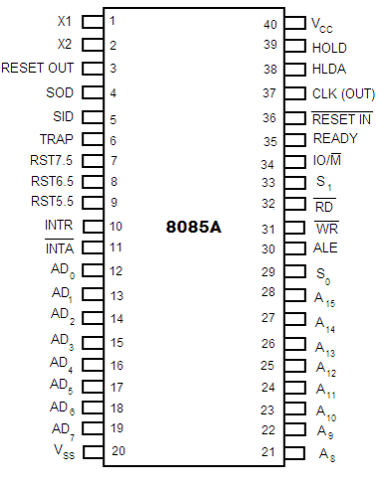
Figure 3. Intel 8085 Pin Configuration

Slide 21
INTERFACE SECTION
Number of pins in the interfacing section of the microprocessor depends on the technology of that date.
Cost of an IC depends on the number of pins and the technology of that date.
8085 microprocessor developed in 1976 has 40 pins.
In today’s scenario technology support 256 pins or more for interfacing with external world, i.e. memory and I/O devices.
Through pins different control signals are being communicated.

Slide 22
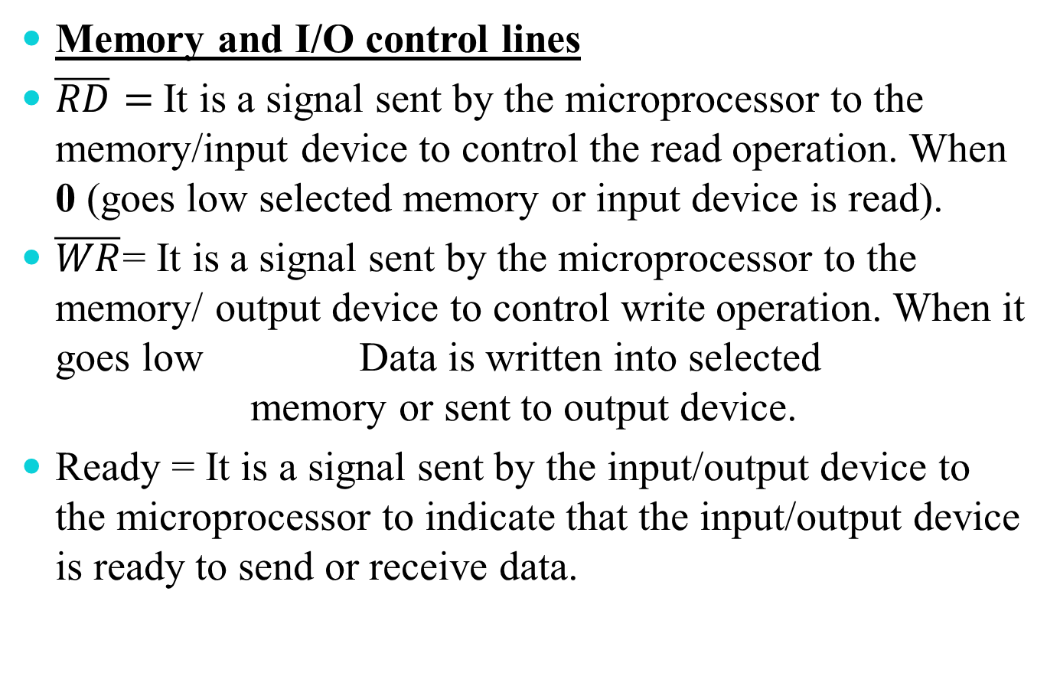
Memory and I/O control lines
$\overline{RD}=$It is a signal sent by the microprocessor to the memory/input device to control the read operation. When 0 (goes low selected memory or input device is read).
$\overline{WR}$= It is a signal sent by the microprocessor to the memory/ output device to control write operation. When it goes low Data is written into selected memory or sent to output device.
Ready = It is a signal sent by the input/output device to the microprocessor to indicate that the input/output device is ready to send or receive data.

Slide 23

ALE = It is a address latch enable signal.
A₈-A₁₅ = These are address bus and are used for the most significant bits of the memory address or I/O address.
AD₀-AD₇ = These are time multiplexed address/data bus, i.e.
ALE=1 | All 16 lines are used as address bus
ALE=0 | A₁₅-A₈ = Address bus
 | AD₇-AD₀=Data bus
First clock cycle of machine cycle | Least significant bits of memory or I/O address
Second and Third clock cycle | Used for data transfer
$IO/\overline{M}$=It is a status signal which distinguishes whether the address is for memory or I/O.

Slide 24
Status lines (S₀ and S₁) = These are the signals sent by the microprocessor to distinguish various types of operations.
CPU and BUS Control lines
HOLD = When another device of the computer system, requires address/data bus for data transfer, it sends HOLD signal to the microprocessor.
S₁ | S₀ | Operation
0 | 0 | HALT
0 | 1 | WRITE
1 | 0 | READ
1 | 1 | FETCH

Slide 25
HLDA = It is a HOLD acknowledge signal sent out by the microprocessor after receiving the HOLD signal.
RESET IN = It reset the program counter, interrupt enable, HLDA flip-flops and instruction register.
RESET OUT = It indicates that the CPU is being reset.
Memory
Microprocessor
DMA Controller
I/O device

Slide 26
Interrupt
Interrupt is an internal or external signal which may disturb or alter the sequence of execution of processor.
It is a method by which an I/O device informs the processor that it requires services of the processor.
Interrupt can be classified as:
Maskable – Interrupt which can be avoided.
Non-Maskable - Interrupt which cannot be ignored or avoided.
Vectored – Interrupt which has specific address location in the memory.
Non-vectored – Interrupt which do not have specific address location in the memory.

Slide 27
Priority | Interrupt | Type of Triggering | Vector Address
1 | TRAP |  | 0024 H
2 | RST 7.5 |  | 003C H
3 | RST 6.5 |  | 0034 H
4 | RST 5.5 |  | 002C H
5 | INTR
V
E
C
T
O
R
E
D
M
A
S
K
A
B
L
E
Level Triggering
Edge Triggering

Slide 28
Crystal and serial I/O lines
X₁ and X₂ = These are the terminals connected to external crystal oscillator which drives an internal circuitry of the microprocessor.
SID = It is a data line for serial input. The data on this line is loaded into the 7th bit of the accumulator when RIM is executed.
SOD = It is a data line for serial output. The 7th bit of the accumulator is output on SOD line when SIM instruction is executed.

Slide 29
Utility lines
V_{cc} = +5 V supply
V_{ss} = ground reference
Clock = It is a output for user, which can be used for other digital ICs.

Slide 30
INSTRUCTION
An instruction is a command given to the microprocessor to perform a given task on specified data.
Instruction have two parts:
Opcode (Operation code)- It specifies the task to be performed.
Operand – It specifies the data to be operated on and is defined in various forms such as:
8 bit or 16 bit data
8 bit or 16 bit address
Internal register or a memory location

Slide 31
Instruction Word Size
Instructions in 8085 microprocessor are classified into the following three groups according to the word (byte) size:
One byte instruction
Two byte instruction
Three byte instruction

Slide 32
One byte instruction
An one byte instruction includes the opcode and operand in the same byte.
Task | Opcode | Operand | Binary code | Hex code
Copy the contents of the accumulator in register C | MOV | C, A | 0100 1111 | 4FH
Add the contents of register B to the contents of the accumulator | ADD | B | 10000000 | 80H
Invert each bit in the accumulator | CMA |  | 0010 1111 | 2FH

Slide 33
Two Byte instruction
In a two byte instruction, the first byte specifies the operation code and the second byte specifies the operand.
Task | Opcode | Operand | Binary code | Hex Code
Load an 8 bit data in the accumulator | MVI | A,32H | 0011 1110 00110010 | 3E 32
Load an 8 bit data in register B | MVI | B,F2H | 00000110 11110010 | 06 F2

Slide 34
Three byte instruction
In a 3 byte instruction, the first byte represent the opcode and the second and the third byte represents the operand (16 bit address).
Task | Opcode | Operand | Binary code | Hex Code
Load the contents of the memory 2050H into A | LDA | 2050H | 0011 1010 0101 0000 0010 0000 | 3A 50 20
Transfer the program sequence to memory location 2085H | JMP | 2085H | 1100 0011 1000 0101 0010 0000 | C3 85 20

Slide 35
Writing a Simple Program in 8085
A program is a sequence of instructions written to tell a computer to perform a specific function.
Steps
Divide the problem in small steps or prepare a flowchart.
Translate these steps into instructions, i.e. mnemonics of 8085.
Convert the mnemonics into Hex code either manually or hand assembly.

Slide 36
Manual Assembly Process
The Monitor program stored in the Read-Only memory (EPROM) convert the Hex code into binary code.
Manual Lookup
Monitor Program
Flowchart
Hex code
To Memory for Storage
8085
Mnemonics
Binary
code

Slide 37
Addition of two numbers
Problem statement
Write a program to load two hexadecimal numbers 32H and 48H in register A and B. Add the numbers and display the sum at the LED output port.
Problem Analysis
Load the numbers in the registers
Add the numbers
Display the sum at the output port.

Slide 38
Translate each step in mnemonics
From Assembly Language to Hex code
MVI A,32H | Load register A with 32H
MVI B, 48H | Load register B with 48H
ADD B | Add two bytes and save the sum in A
OUT 01H | Display accumulator contents at port 01H
HALT | End
MVI A,32H | 3E | 2 byte instruction
 | 32
MVI B, 48H | 06 | 2 byte instruction
 | 48
ADD B | 80 | 1 byte instruction
OUT 01H | D3 | 2 byte instruction
 | 01
HALT | 76 | 1 byte instruction

Slide 39
Storing in memory and converting from Hex code to Binary code
Reset the system by pressing RESET key.
Enter the memory address using Hex keys where the program is to be stored.
Execute the program.
Mnemonics | Hex code | Memory contents | Memory Address
MVI A, 32H | 3E | 0011 1110 | 2000
 | 32 | 0011 0010 | 2001
MVI B, 48H | 06 | 0000 0110 | 2002
 | 48 | 0100 1000 | 2003
ADD B | 80 | 1000 0000 | 2004
OUT 01H | D3 | 1101 0011 | 2005
 | 01 | 0000 0001 | 2006
HLT | 76 | 0111 1110 | 2007

Slide 40
Microprocessor Communication and Bus timings
A program constitutes a set of Instructions. The processor fetches one instruction from the memory at a time and executes it.
The necessary steps that a processor carries out to fetch an instruction and data from memory and I/O devices, constitutes an instruction cycle.
Fetch cycle | Processor fetches opcode from memory
Execute cycle | Processor gets data from memory or I/O devices and perform specific operation
Instruction cycle | Fetch cycle+ Execution cycle

Slide 41
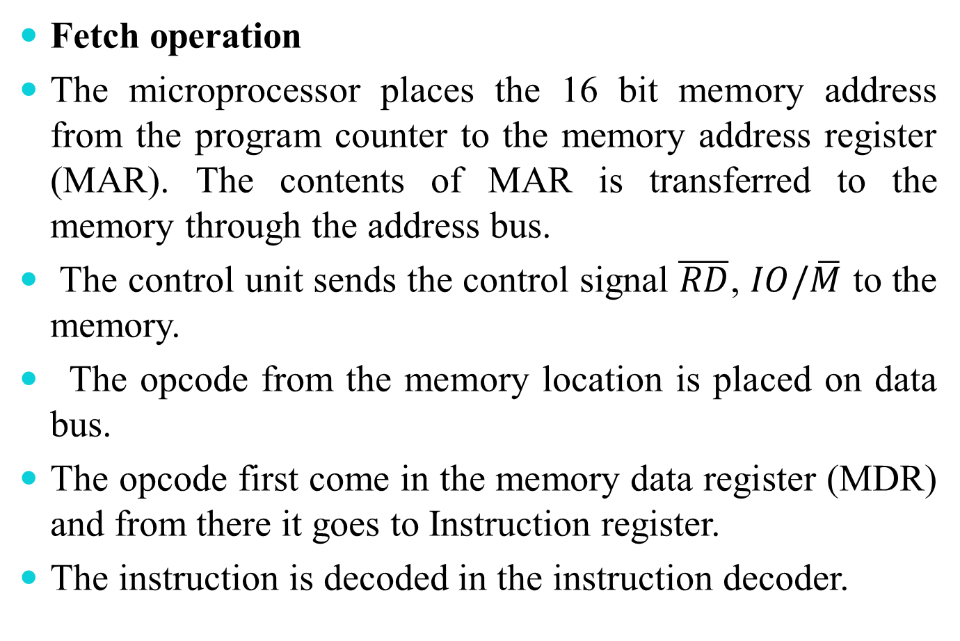
Fetch operation
The microprocessor places the 16 bit memory address from the program counter to the memory address register (MAR). The contents of MAR is transferred to the memory through the address bus.
The control unit sends the control signal $\overline{RD}$, $IO/\overline{M}$ to the memory.
The opcode from the memory location is placed on data bus.
The opcode first come in the memory data register (MDR) and from there it goes to Instruction register.
The instruction is decoded in the instruction decoder.

Slide 42
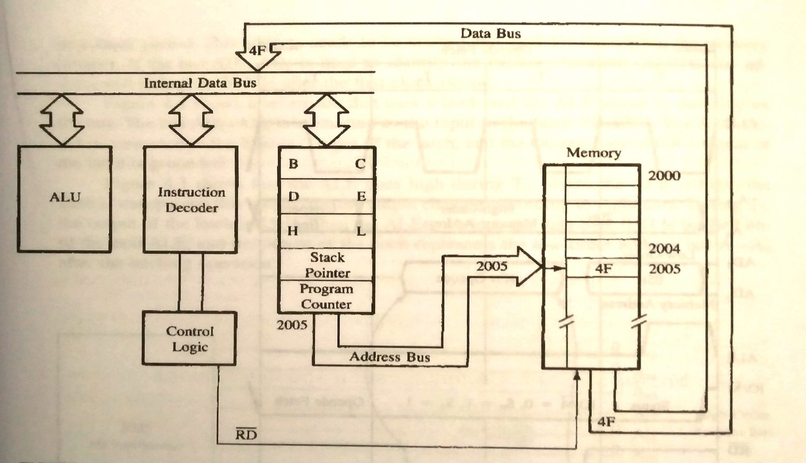
Data Flow from memory to the Microprocessor

Slide 43
Memory Data Bus
Instruction Register
MDR
Memory Address Bus
Instruction Decoder
Control
Program
Counter
MAR
Flow of Instruction code
Clock
Memory gets opcode from memory location
Transfer opcode to processor
Send address
to memory
Time
Fetch Cycle

Slide 44
Execute Operation
After the instruction is being decoded, execution begins.
If the operand is in the GPR (one byte instruction), then execution is immediately performed and the time taken is one clock cycle.
If the instruction contains data or memory address (two or three byte instruction).
Processor performs read operation and gets data from the memory.
In some instruction write operation is performed.
Execution cycle contains one or more read cycles.

Slide 45
Instruction cycle – Time required to complete the execution of an instruction.
Machine cycle – Time required to complete one operation of either accessing memory, I/O device. Example- Fetch, Read, Write.
T-state- One sub division of the operation performed in one clock cycle. T-state and clock period are often used synonymously.
Instruction cycle
Clock
Fetch cycle
Execute cycle
Instruction cycle showing FC, EC, IC

Slide 46
Add (a) C9 H and F8 H
(b) 98 H and 7F H
(c) 9EH and 77H
(d) 55H and AAH

Slide 47
Demultiplexing the Bus
The address/data bus transmits data and address at different moments.
Address /data bus are time multiplexed.
The demultiplexing is done through latch and the ALE signal.
When ALE is high Output changes according to the input signal.
When ALE is low The bus is used for carrying the data.

Slide 48
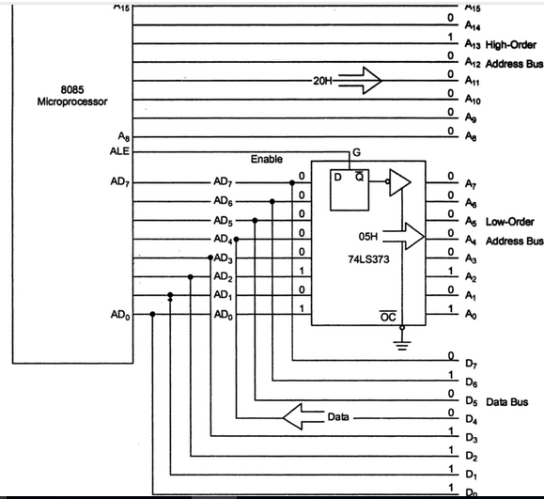
Schematic of Latching Low-Order Address Bus

Slide 49
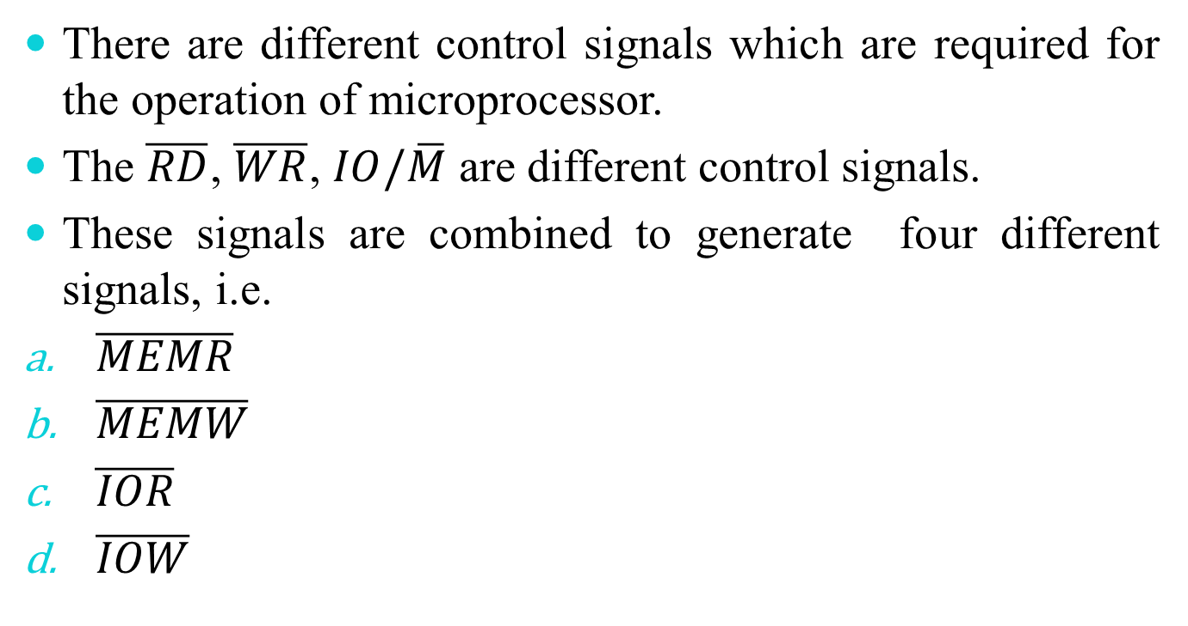
Generating Control Signals
There are different control signals which are required for the operation of microprocessor.
The $\overline{RD}$, $\overline{WR}$, $IO/\overline{M}$ are different control signals.
These signals are combined to generate four different signals, i.e.
$\overline{MEMR}$
$\overline{MEMW}$
$\overline{IOR}$
$\overline{IOW}$

Slide 50
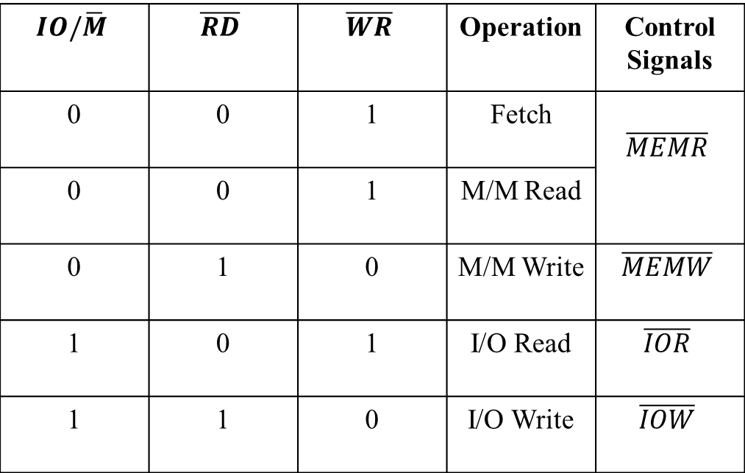
8085 Control Signals
$$IO/\overline{M}$$ | $$\overline{RD}$$ | $$\overline{WR}$$ | Operation | Control Signals
0 | 0 | 1 | Fetch | $$\overline{MEMR}$$
0 | 0 | 1 | M/M Read
0 | 1 | 0 | M/M Write | $$\overline{MEMW}$$
1 | 0 | 1 | I/O Read | $$\overline{IOR}$$
1 | 1 | 0 | I/O Write | $$\overline{IOW}$$

Slide 51







74LS32
8085
$$IO/\overline{M}$$
$$\overline{MEMR}$$
$$\overline{RD}$$
$$\overline{WR}$$
$$\overline{MEMW}$$
74LS04
$$\overline{IOR}$$
74LS32- quadruple two input OR gate
74LS04-Hex Inverter
$$\overline{IOW}$$
Schematic to Generate Read/Write Control Signals for Memory and IO

Slide 52
A₁₅
A₈
ALE
AD₇
AD₀
A₁₅
A₈
Address Bus
EN
A₇
A₀
Latch
74LS32
D₀
D₇
Data Bus
$$IO/\overline{M}$$
$$\overline{MEMR}$$
$$\overline{RD}$$
$$\overline{WR}$$
$$\overline{MEMW}$$
74LS04
$$\overline{IOR}$$
$$\overline{IOW}$$
8085 Demultiplexed Address and Data Bus with Control Signals

Slide 53
Interfacing
Designing logic circuits (hardware) and writing instructions (software) to enable the microprocessor to communicate with peripherals is called interfacing.
In large and minicomputers, the memories and I/O devices are interfaced to CPU by the manufacturer.
In microprocessor based system the designer has to select compatible memories & I/O devices to interface.
Additional electronic circuit resolve the incompatibility issue and interface memory & I/O device with processor.

Slide 54
Memory
I/O Device
Microprocessor
Address Bus
Data Bus
Control Bus
Memory and I/O Interfacing

Slide 55

Several memory chips and I/O devices are connected to a microprocessor.
Address decoding circuit is required to select the required I/O device or memory chip.
I/O device select signals
Memory chip select signals
Y0
Y0
Input device
Y1
PROM
Y1
Input device
PROM
Y2
Y2
Output device
RAM
Y3
Decoder-1
Y3
Output device
RAM
Decoder-2
Y4
Y4
RAM
Y5
Y5
RAM
Unused
Reserved for
future
$$IO/\overline{M}$$
Enable
Y6
Y6
Enable
Y7
Y7
Unused
Reserved for
future

Slide 56
Memory Interfacing
The address of the memory location and control signals are sent by the microprocessor to initiate a read or write operation.
Interfacing process involves designing a circuit that will match the memory requirement with microprocessor signals.
Decoding circuit selects the corresponding memory chip or I/O device.
Decoding can be performed by decoder, comparator, PLA.

Slide 57

74LS138 (i.e. 1 to 8 lines decoder)
A15
A
Y0
EPROM 1
A14
B
Y1
EPROM 2
A13
C
Y2
RAM 1
Y3
RAM 2
74LS138
5V
G1
Y4
RAM 3
$$IO/\overline{M}$$
G_{2A}
Y5
RAM 4
G_{2B}
Y6
RAM 5
V_{cc}
Y7
RAM 6
GND
Interfacing of Memory chip using 74LS138
G1, G2A, G2B are Enable signals
A, B, C are select lines

Slide 58
I/O Interfacing
The address of an I/O device is of 8 bits, thus only A₈-A₁₅ lines of address bus are used for I/O addressing.
A_{8,} A_{9,} A₁₀ are the select lines.
A₁₁-A₁₅ are applied to NAND gates.

Slide 59

A₁₀
A
Y0
Input device 1
A₉
B
Y1
Input device 2
A₈
C
Y2
Input device 3
A₁₅
Y3
A₁₄
Output device 1
Y4
Output device 2
A₁₃
G_{2B}
74LS138
Y5
Output device 3
A₁₂
Y6
A₁₁
G_{2A}
Unused for future Expansion
GND
Y7
$$IO/\overline{M}$$
G₁
V_{cc}
GND
GND
Interfacing of I/O devices using 74LS138

Slide 60
RAM and EPROM Interfacing
The interfacing process involves designing a circuit that will match the memory requirements with the microprocessor signals.
R/W and EPROM memory stores binary information.
Chip packaging
Address lines
Data lines
Chip Enable
Output Enable
Read/ Write control signals (R/W)

Slide 61





Input Data
Input Buffer
$$\overline{WR}$$
EPROM
4096X8
$$\overline{CS}$$
A10
Internal Decoder
Internal Decoder
A11
R/W
Memory
2048X8
A0
A0
Output Buffer
Output Buffer
$$\overline{CS}$$
$$\overline{RD}$$
$$\overline{RD}$$
Output Data
Output Data
R/W Static Memory
EPROM

Slide 62
Buffer – It is a logic circuit that amplifies the current or power. It has one input and one output line. It increases the driving capability of a logic circuit.
Read enable the output buffer and write enable the input buffer.
Basic concepts in interfacing
Microprocessor should be able to select the chip.
It identify the register.
It enable the appropriate buffer.

Slide 63
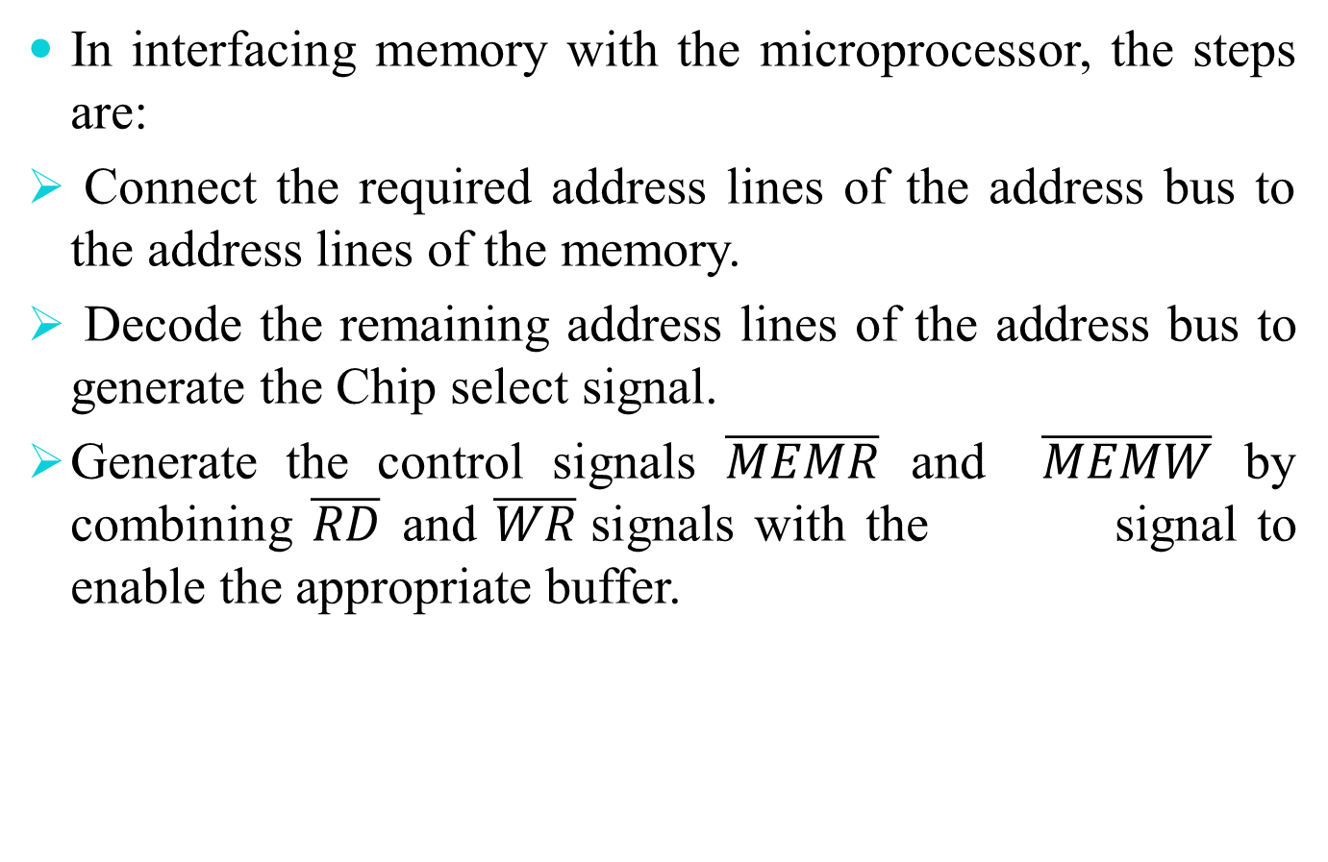

In interfacing memory with the microprocessor, the steps are:
Connect the required address lines of the address bus to the address lines of the memory.
Decode the remaining address lines of the address bus to generate the Chip select signal.
Generate the control signals $\overline{MEMR}$ and $\overline{MEMW}$ by combining $\overline{RD}$ and $\overline{WR}$signals with the signal to enable the appropriate buffer.
$$IO/\overline{M}$$

Slide 64


Address Decoding
The process of address decoding should result in identifying a register for a given address.
A15
GND
A15
$$\overline{E}1$$
$$\overline{E}2$$
E3
A14
A14
A13
O7
A13
A12
3 to 8 Decoder
A12
Address decoding using (a)NAND Gate (b) 3 to 8 decoder

Slide 65







Interfacing the 2732 EPROM
$$\overline{\text{MEMR} }$$
$$IO/\overline{M}$$
$$\overline{RD}$$
GND
+5V
A15
$$\overline{CE}$$
$$\overline{OE}$$
$$\overline{E1}$$
$$\overline{E2}$$
E₃
A11
A11
A14
3-to-8
Decoder
74LS138
2732
EPROM
4096X8
A13
A12
O₀
A0
A0
O7
O0
D7
Data Bus
Output Lines
D0

Slide 66









Interfacing R/W Memory
A14
A15
$$IO/\overline{M}$$
$$\overline{RD}$$
$$\overline{WR}$$
A13
$$\overline{E1}$$
$$\overline{E2}$$
E₃
A12
$$\overline{CE}$$
$$\overline{OE}$$
$$\overline{WE}$$
3-to-8
Decoder
74LS138
A11
A10
O1
$$\overline{MESL1}$$
6116
R/W Memory
2048 x 8
A0
D7
D0
Data Lines

Slide 67
Interfacing the 8155 Memory Segment
The SDK-85 is a single-board microcomputer designed by Intel and widely used in college laboratories.
It consists of
8085 microprocessor
8155 comprises of multiple devices on the same chip which includes R/W memory, programmable I/O ports and a timer.

Slide 68
















$$IO/\overline{M}$$
Port A
$$IO/\overline{M}$$
Logic to Generate control signals
$$\overline{MEMW}$$
256 X 8
Static RAM
A
$$\overline{WR}$$
$$\overline{RD}$$
$$\overline{MEMR}$$
Port B
$$\overline{CE}$$
B
$$\overline{CE}$$
ALE
ALE
$$A7$$
$$\overline{RD}$$
8155
Port C
Static RAM
256 X 8
$$\overline{WR}$$
$$AD7$$
Latch
$$A0$$
RESET
Timer
C
$$AD0$$
TIMER CLK
$$V_{cc}$$
$$V_{ss}$$
$$\overline{TIMER OUT}$$
(a)
(b)
8155 Memory Section (a) Block Diagram (b) Internal Structure

Slide 69




A15
+5V
A14
E1
E2
E3
A13
O4
$$\overline{CE}$$
A12
3-to-8
Decoder
$$IO/\overline{M}$$
A11
ALE
256 X 8
Static
R/W Memory 8155
8205
$$\overline{RD}$$
$$\overline{WR}$$
RESET
$$AD7$$
$$AD0$$
Interfacing the 8155 Memory Schematic from the SDK-85 System

Slide 70
Absolute vs. Partial Decoding
Absolute decoding- All the high-order address lines were decoded to select the memory chip, and the memory chip is selected only for the specified logic level on these high order address lines.
Partial decoding- Some of the address lines were not decoded, resulting in multiple addresses.
Advantage of partial decoding- Cost Saving

