Slide 1

Dr. B. R. Ambedkar National Institute Of Technology, Jalandhar
Department of Computer Science and Engineering
MAJOR PROJECT PRESENTATION
ON
AUTOMATIC NUMBER PLATE RECOGNITION SYSTEM
PRESENTED BY:
ARYAN (22103031)
GANDLA SAI SHIVANI (22103054)
UJALA GUPTA (22103155)
AYUSH RAJ (22103035)
YUVRAJ SINGH (22103166)
ARSHIT (22103028)
UNDER THE SUPERVISION OF:
DR. RENU DHIR
PROFESSOR

Slide 2
INDEX
S. No. | Content | Page No.
1. | INTRODUCTION | 3
2. | RESEARCH OBJECTIVE | 4
3. | LITERATURE SURVEY | 5
4. | PROBLEM STATEMENT | 6
5. | PROPOSED METHODOLOGY | 7
6. | DATASET DESCRIPTION | 8
7. | TECHNOLOGY STACK | 9
8. | MODEL PERFORMANCE | 10
9. | RESULT | 11
10. | LIMITATIONS OF PROPOSED SOLUTION | 12
11. | CONCLUSION AND FUTURE SCOPE | 13
12. | REFERENCES | 14

Slide 3
INTRODUCTION
Automatic Number Plate Recognition (ANPR) is a computer vision technology that automatically detects and recognizes vehicle number plates from images or video streams using deep learning, image processing, and OCR techniques.
ANPR systems are widely used in traffic monitoring, parking management, toll collection, and security surveillance. These systems help automate vehicle identification and reduce manual effort in monitoring vehicles.
The use of ANPR improves accuracy, speed, and efficiency in vehicle tracking and entry management. It also enhances security and provides a reliable solution for modern intelligent transportation systems.

Slide 4
RESEARCH OBJECTIVE
The main objective of this project is to develop an Automatic Number Plate Recognition (ANPR) system capable of detecting and recognizing vehicle number plates in real time at the college main gate. The system focuses on automating vehicle entry monitoring using deep learning and OCR techniques.
The proposed system aims to reduce manual effort and human errors while improving the overall efficiency and security of vehicle management. It automatically extracts and stores vehicle number plate information for monitoring and record-keeping purposes.

Slide 5
LITERATURE SURVEY
S. No. | Paper | Year | Purpose | Key Findings
1. | Automatic Number Plate Recognition: A Detailed Survey of Relevant Algorithms [1] | 2021 | Reviewed traditional image processing techniques used in ANPR systems. | Traditional methods were sensitive to lighting, shadows, and environmental noise.
2. | Bangla License Plate Recognition Using Convolutional Neural Networks (CNN) [2] | 2018 | Proposed a CNN-based license plate recognition framework. | CNN models improved recognition accuracy compared to traditional machine learning methods.
3. | Automatic License Plate Recognition System for Vehicles Using CNN [3] | 2021 | Developed an ANPR system using CNN for character recognition and preprocessing techniques. | CNN-based systems achieved good recognition accuracy but required high computational resources.
4. | A Robust Real-Time Automatic License Plate Recognition Based on the YOLO Detector [4] | 2018 | Developed a YOLO-based ANPR system for real-time license plate detection. | YOLO significantly improved detection speed and localization accuracy in real-world scenarios.
5. | An Efficient and Layout-Independent Automatic License Plate Recognition System Based on the YOLO Detector [5] | 2019 | Proposed a layout-independent ANPR system capable of handling multiple license plate formats. | Improved recognition accuracy across different datasets and plate layouts.
Table 1 : Research Paper Findings

Slide 6
PROBLEM STATEMENT
Vehicle entry at the college main gate is currently not monitored through an automated system, making it difficult to identify and track vehicles efficiently. The absence of a proper monitoring mechanism can reduce security and make vehicle verification more challenging, especially when a large number of vehicles enter the campus.
To address this issue, there is a need for an automated system capable of detecting and recognizing vehicle number plates in real time. An Automatic Number Plate Recognition (ANPR) system can help improve vehicle monitoring, support real-time surveillance, and enhance overall security at the college main gate while maintaining vehicle logs for security purposes.

Slide 7
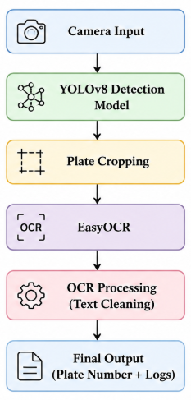
PROPOSED METHODOLOGY
Step-by-Step Workflow:
Image/Video Capture: Capture input from a camera installed at the college main gate for real-time monitoring.
Number Plate Detection: Use a trained YOLOv8 deep learning model to detect and localize the number plate in the frame with high accuracy.
Plate Region Extraction: Crop the detected number plate region (ROI) from the image for further processing.
Text Recognition (OCR): Apply EasyOCR to extract alphanumeric characters from the cropped number plate.
Text Post-Processing: Clean and format the extracted text using regular expressions to match standard Indian number plate formats.
Output & Logging: Display the detected plate number and store it with timestamp for entry monitoring and record keeping at the college gate.
Fig. 1 : Solution Workflow

Slide 8
DATASET DESCRIPTION
Dataset : Indian License Plate Dataset
Parameter | Description
Size | ~4000 Images
Image Resolution | 640 X 640
Annotation Format | YOLO
Training Set | 3430 Images
Validation Set | 330 Images
Test Set | 164 Images
Preprocessing | Auto Orientation, Brightness Adjustment
Table 2 : Dataset Description

Slide 9
TECHNOLOGY STACK
Category | Technologies Used
Programming Language | Python
Deep Learning Model | YOLOv8 (Ultralytics), PyTorch
OCR (Text Recognition) | EasyOCR
Computer Vision | OpenCV
Web Framework | Flask
Data Processing | NumPy, Pandas
Development Environment | VS Code
Table 3 : Technology Stack

Slide 10
MODEL PERFORMANCE
Model | YOLOv8 + EasyOCR (proposed solution) | WPOD-NET + OCR | YOLOv8 ALPR
Precision | 0.97 | 0.751 | 0.984
Recall | 0.95 | 0.796 | 1.000
F1 Score | 0.96 | 0.796 | 0.992
mAP@50 | 0.99 | 0.78 | 0.992
mAP@50-95 | ~0.82 | 0.50 | 0.995
Inference Speed | ~12 ms | ~35 ms | ~26ms
Fig. 4 : Model Performance

Slide 11
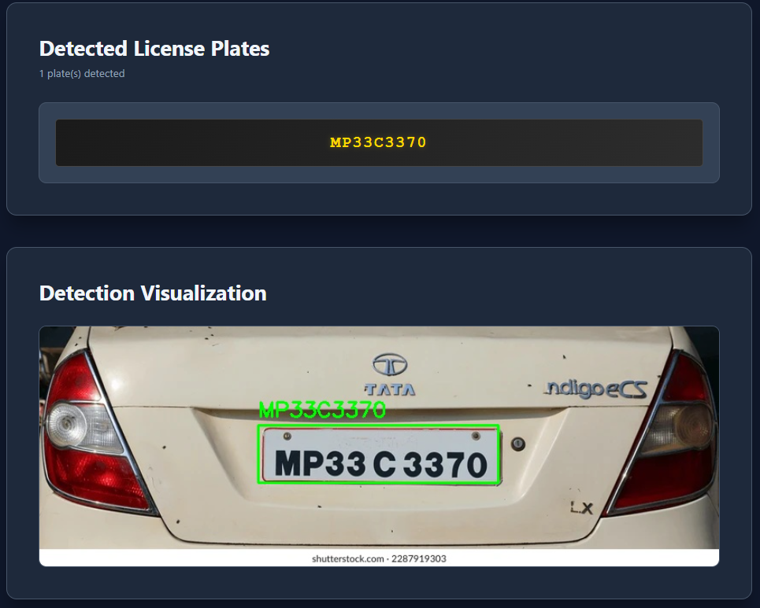
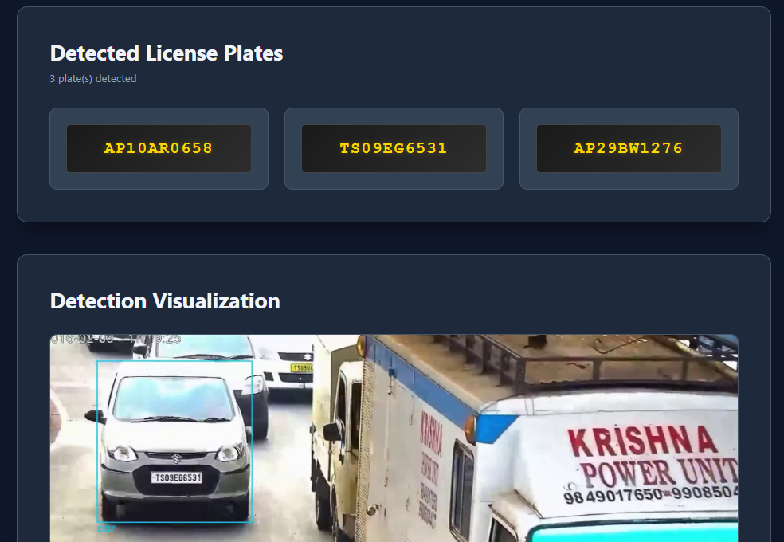
RESULT
Fig. 2 : Plate detection from image
Fig. 3 : Plate detection from video

Slide 12
LIMITATIONS OF PROPOSED WORK
OCR accuracy may decrease for blurred, tilted, or low-light number plates.
System performance depends heavily on camera quality and viewing conditions.
Detection and recognition accuracy may reduce during night-time or glare-heavy scenarios.
The system does not use advanced vehicle tracking, which may cause multiple OCR variations in videos.
Limited dataset diversity may affect performance on uncommon plate styles or extreme real-world conditions.

Slide 13
CONCLUSION & FUTURE SCOPE
Conclusion
The proposed Automatic Number Plate Recognition (ANPR) system successfully detects and recognizes Indian vehicle number plates from images and videos using YOLOv8 and EasyOCR. The system provides an efficient web-based solution for automated vehicle monitoring and logging at the college main gate, reducing manual effort and improving surveillance.
Future Scope
The system can be enhanced by integrating it with the college vehicle database.
It can be implemented with real-time CCTV monitoring support.
The project can be extended for automatic gate control and traffic rule violation tracking.

Slide 14
REFERENCES
[1] Automatic Number Plate Recognition: A Detailed Survey of Relevant Algorithms : https://pmc.ncbi.nlm.nih.gov/articles/PMC8123416/
[2] Bangla License Plate Recognition Using Convolutional Neural Networks (CNN) : https://arxiv.org/abs/1809.00905
[3] Automatic License Plate Recognition System for Vehicles Using CNN : https://www.techscience.com/cmc/v71n1/45359/html
[4] A Robust Real-Time Automatic License Plate Recognition Based on the YOLO Detector : https://arxiv.org/abs/1802.09567
[5] An Efficient and Layout-Independent Automatic License Plate Recognition System Based on the YOLO Detector : https://arxiv.org/abs/1909.01754

