Slide 1




HEALTHIFY
Aryan (42223210009)
Prince Panwar(42223210014)
Garvit Jhamb (42223210021)

Slide 2

TABLE OF CONTENT
INTRODUCTION & CONTEXT
PROBLEM STATEMENT & OBJECTIVES
TECHNOLOGY STACK
SYSTEM ARCHITECTURE & DESIGN
MODULES & FEATURES
UI SCREENSHOTS & DEMO
TESTING, SECURITY & CHALLENGES
CONCLUSION & FUTURE WORK

Slide 3

INTRODUCTION TO HEALTHIFY
Healthify is a smart, AI-powered healthcare website that helps users with two key needs:
Understanding prescriptions
Identifying diseases from symptoms
Using advanced tools like OCR (Optical Character Recognition), Healthify makes healthcare easier for people who may not have quick access to a doctor or find medical language confusing.
With a user-friendly design, you can:
Upload a photo of a prescription, and Healthify will read it for you—highlighting the medicine names, doses, and instructions.
Enter your symptoms, and the AI will suggest possible diseases and helpful guidance.

Slide 4
WHY THIS PROJECT?
There is a growing demand for efficient and accessible healthcare.
Many individuals lack access to proper diagnosis and preventive care.
AI presents opportunities to bridge these gaps and improve health outcomes.

Slide 5

SCOPE OF THE PROJECT
Key Features:
Latest Healthcare news
AI-Powered Analysis
Image & Text Processing
Healthcare Blog
Community Review System
Target Areas:
Early diagnosis
Patient engagement
Health information management

Slide 6

PROBLEM STATEMENT
Challenges in Current Healthcare:
Lack of accessibility in rural or underdeveloped regions
Inadequate personalization in treatment
High costs and slow service delivery
Fragmented data handling and information flow

Slide 7

TARGET AUDIENCE
General Public
Anyone looking to understand their prescriptions better.
Individuals who want quick health assessments based on symptoms.
Patients with Chronic Illnesses
People who regularly receive prescriptions and want an easy way to keep track of their medicines.
Elderly Users
Older adults who may struggle with reading doctor’s handwriting or navigating medical terms.
People in Rural or Remote Areas
Individuals with limited access to doctors or medical professionals.
Can use Healthify as a first-level tool before deciding to travel for treatment.
Non-English Speakers
Users who need prescriptions or diagnoses translated into their native language.
Caregivers & Family Members
Those managing medication or health concerns for others—like parents, grandparents, or children

Slide 8
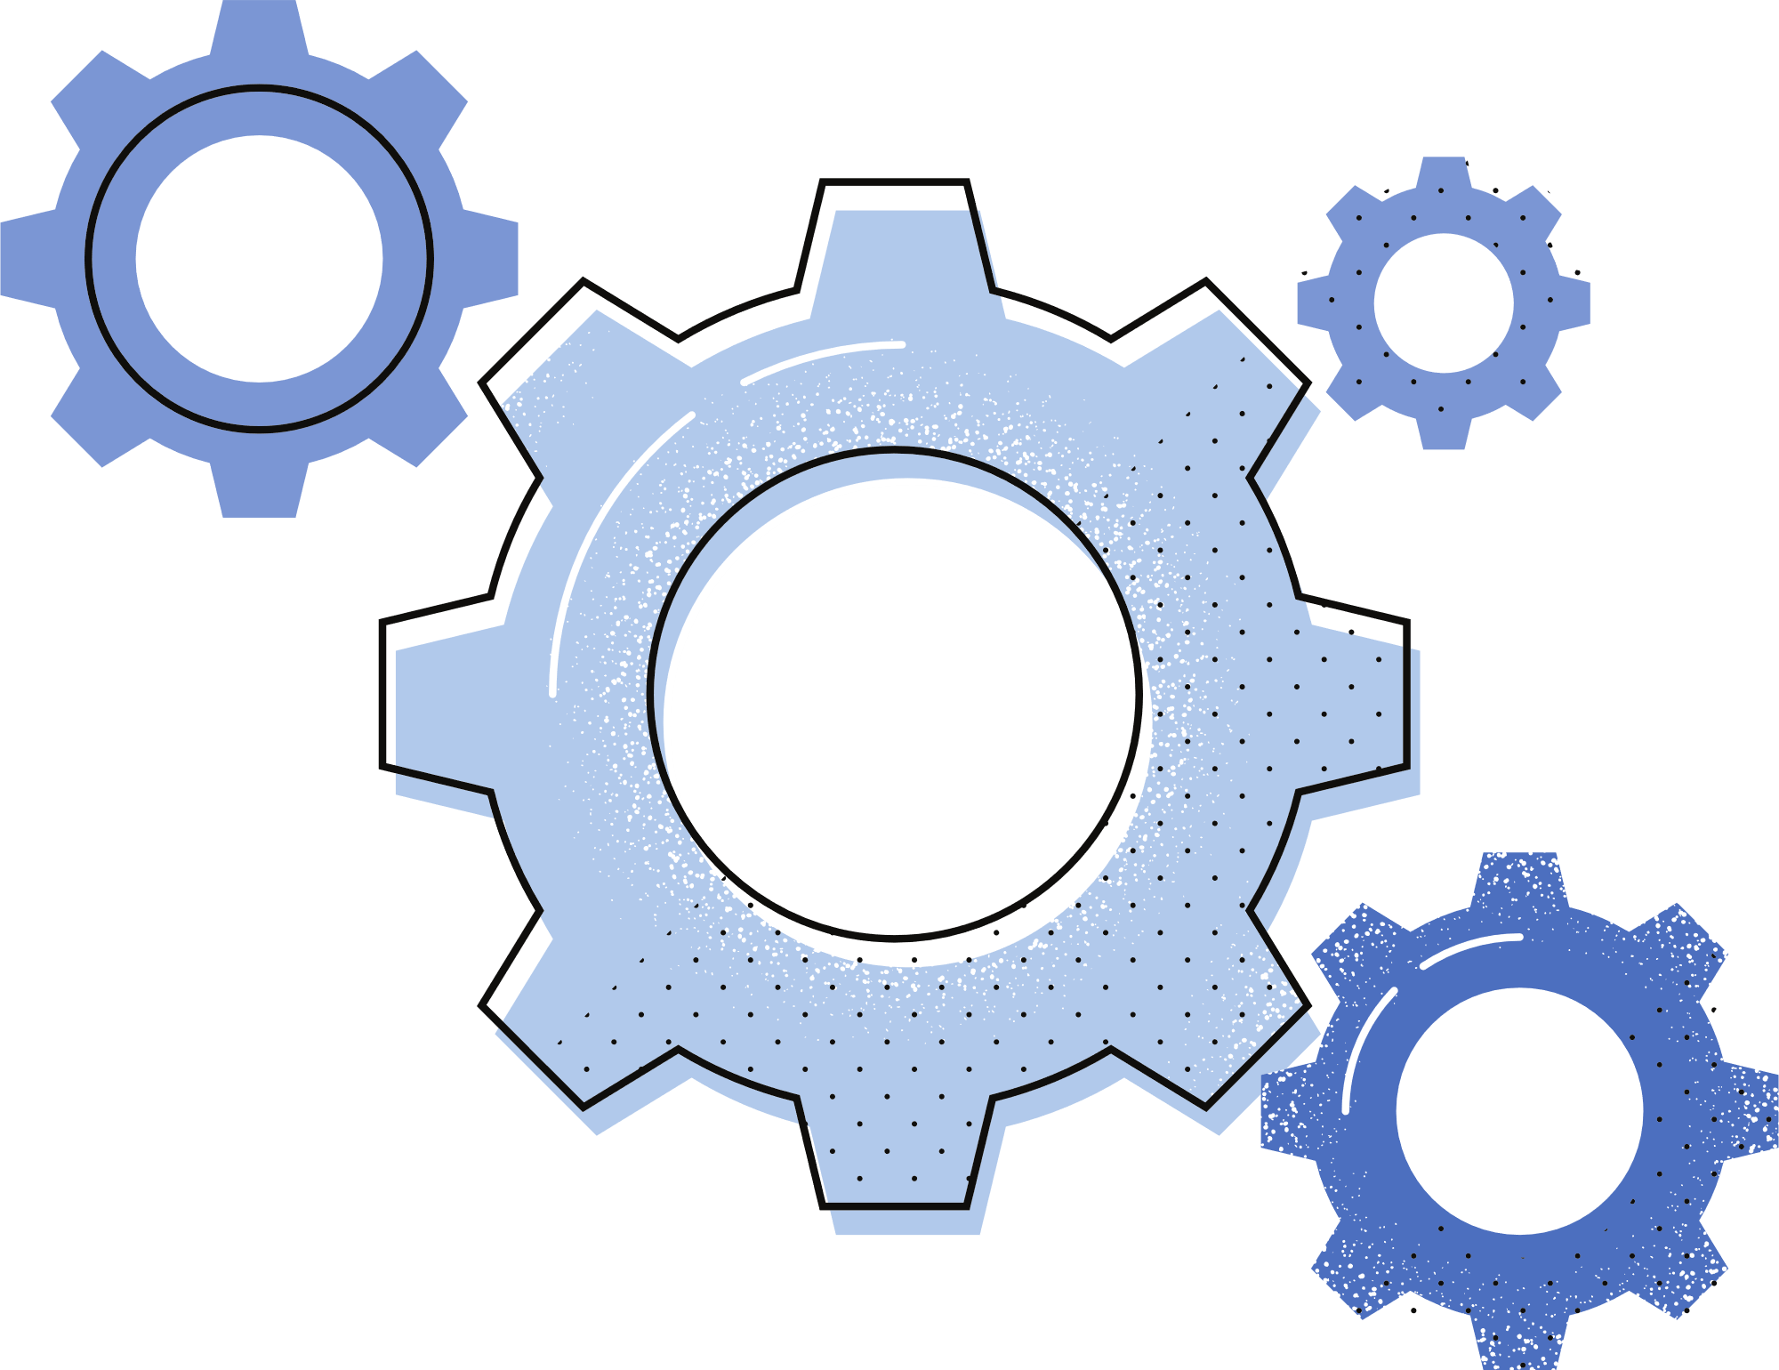
OBJECTIVES OF THE PROJECT
Disease prediction
Image-based report analysis
Text extraction from medical documents
User-generated content and feedback

Slide 9

EXPECTED OUTCOMES
Early detection and intervention
Cost-effective services
Higher user engagement
Smoother communication and care coordination

Slide 10

FRONTEND TECHNOLOGIES
The frontend of Healthify is built using:
HTML: Provides the structure and content of the web pages.
CSS: Styles the HTML elements, ensuring a visually appealing and consistent design (Tailwind CSS is used).
JavaScript: Enables interactivity and dynamic behavior on the client-side.
React: A JavaScript library for building user interfaces, used for creating a dynamic and responsive user experience.
These technologies were chosen for their ability to create a dynamic, responsive, and user-friendly interface.

Slide 11

BACKEND TECHNOLOGIES
The backend of Healthify is powered by:
Node.js: A JavaScript runtime environment for building scalable and efficient server-side applications.
Express: A Node.js web application framework that provides tools for building APIs and handling server-side logic.

Slide 12

DATABASE & TOOLS
The project utilizes:
Appwrite: A backend-as-a-service (BaaS) platform for storing and managing application data with built-in authentication, databases, and cloud functions.
GitHub: A version control system for collaborative code management and tracking changes.
VS Code: A code editor used for writing and editing the application's code.

Slide 13
AI & IMAGE/TEXT PROCESSING LIBRARIES
Tesseract.js
A JavaScript-based OCR (Optical Character Recognition) library.
Used to extract text from uploaded prescription images.
Gemini AI
Used for disease prediction based on symptom input.
Model processes user-provided symptoms and returns probable diseases using Gemini’s advanced language understanding.
Google Translate API
Automatically translates extracted text and predicted results into regional languages.
Helps non-English speakers understand prescriptions and diagnosis.
Supports over 100 languages for wide accessibility.
News API
For showing the latest news to the users.

Slide 14

SYSTEM ARCHITECTURE
The system architecture comprises the following layers:
Frontend: Handles user interface and user interactions.
Backend: Manages server-side logic, API endpoints, and data processing.
Database: Stores application data, including user information, medical records, and blog posts.
AI Models: Provides AI-powered functionalities, such as disease prediction and image analysis.
Data flows between these layers to enable the application's features.

Slide 15
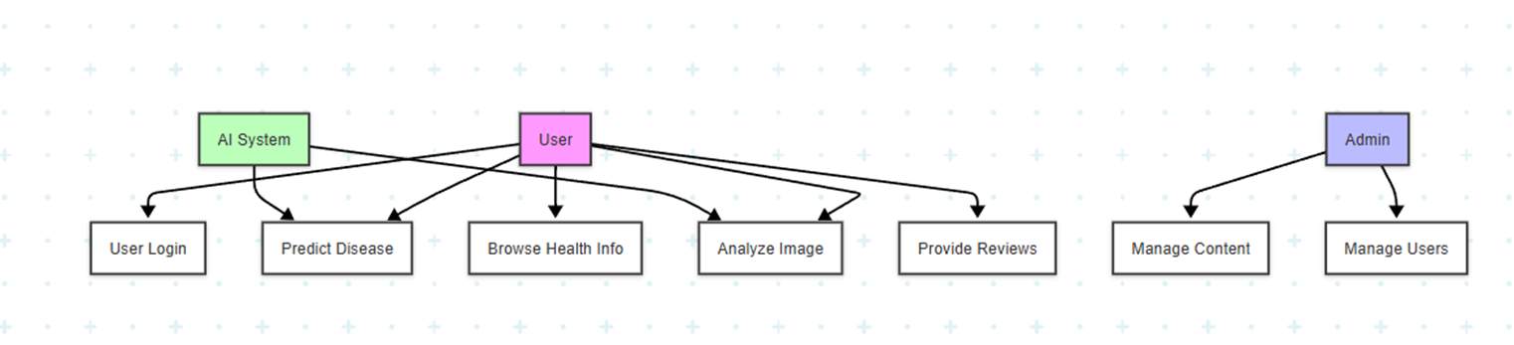
USE CASE DIAGRAM
THE USE CASE DIAGRAM ILLUSTRATES THE INTERACTIONS BETWEEN ACTORS AND THE SYSTEM:
USER: INTERACTS WITH THE SYSTEM FOR TASKS LIKE LOGIN, SIGNUP, VIEWING BLOG POSTS, PROVIDING REVIEWS, AND USING AI-POWERED TOOLS.
ADMIN: MANAGES USERS, CONTENT, AND SYSTEM SETTINGS.
AI SYSTEM: PROVIDES AUTOMATED ANALYSIS AND PREDICTIONS.
KEY USE CASES INCLUDE USER LOGIN, PREDICT DISEASE, ANALYZE IMAGE, MANAGE CONTENT, AND PROVIDE REVIEWS.

Slide 16
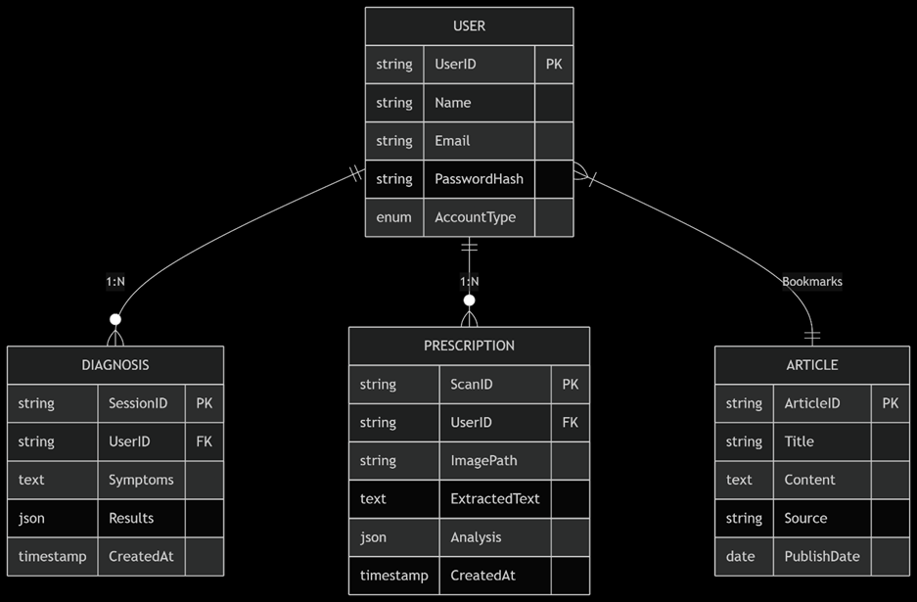
ENTITY RELATIONSHIP (ER) DIAGRAM

Slide 17
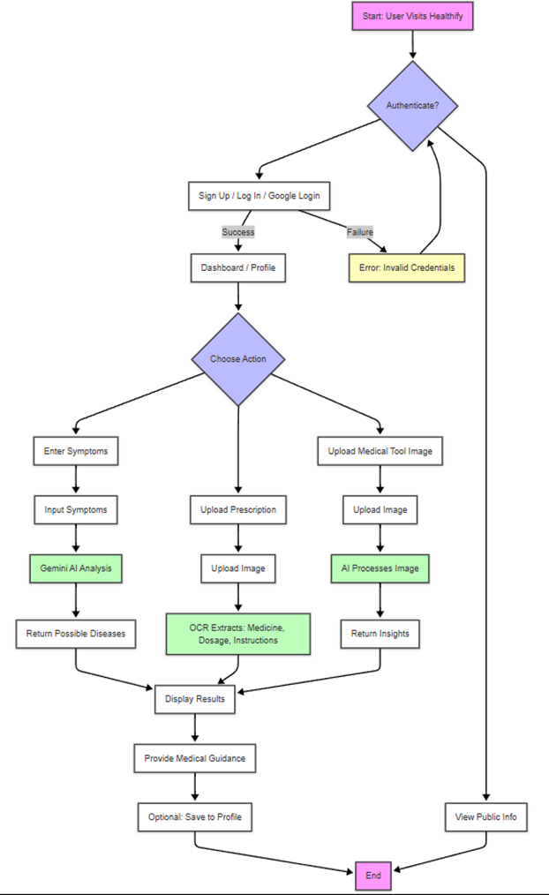
FLOWCHART
STEP 1: USER ENTRY
USER VISITS THE HEALTHIFY HOMEPAGE
PROMPTED TO SIGN UP, LOG IN, OR USE GOOGLE LOGIN
STEP 2: AUTHENTICATION
USER SIGNS UP OR LOGS IN SECURELY
ON SUCCESS, REDIRECTED TO DASHBOARD/PROFILE
STEP 3: CHOOSE AN ACTION
USER SELECTS ONE OF THE FOLLOWING FEATURES:
A. SYMPTOM-BASED DIAGNOSIS
ENTERS SYMPTOMS IN TEXT INPUT (PREDICTOR.HTML)
GEMINI AI PREDICTS POSSIBLE DISEASES

Slide 18
B. PRESCRIPTION SCAN
UPLOADS IMAGE OF PRESCRIPTION (EXTRACT-TEXT.HTML)
OCR EXTRACTS:
MEDICATION NAMES
DOSAGES
INSTRUCTIONS
C. IMAGE INFERENCE
UPLOADS MEDICAL TOOL/REPORT IMAGE (IMAGE-INFERENCE.HTML)
AI INTERPRETS THE IMAGE AND PROVIDES INSIGHTS
STEP 4: OUTPUT
RESULTS ARE DISPLAYED CLEARLY:
PREDICTED CONDITIONS
EXTRACTED PRESCRIPTION DETAILS
IMAGE ANALYSIS FEEDBACK
OPTIONALLY SHOWN IN USER PROFILE

Slide 19
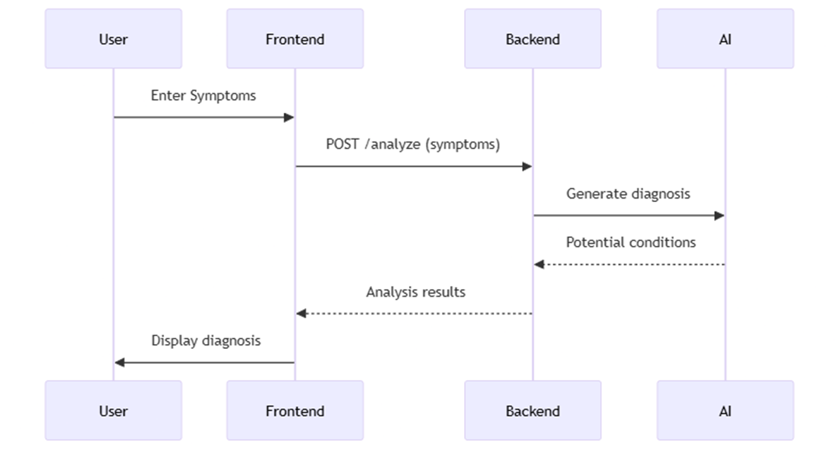
SEQUENCE DIAGRAM

Slide 20
MODULE OVERVIEW
HEALTHIFY IS ORGANIZED INTO SEVERAL KEY MODULES:
USER AUTHENTICATION MODULE: MANAGES USER ACCOUNTS, LOGIN, AND SIGNUP.
AI-POWERED PREDICTIVE ANALYSIS MODULE: PROVIDES AI-DRIVEN DISEASE PREDICTION.
IMAGE ANALYSIS & TEXT EXTRACTION MODULE: PROCESSES IMAGES AND EXTRACTS TEXT.
HEALTHCARE BLOG MODULE: ENABLES USERS TO POST AND VIEW HEALTH-RELATED CONTENT.
REVIEW AND RATING SYSTEM MODULE: ALLOWS USERS TO PROVIDE FEEDBACK.
ADMIN DASHBOARD MODULE: PROVIDES ADMINISTRATIVE CONTROL OVER THE SYSTEM.
EACH MODULE CONTRIBUTES TO THE OVERALL FUNCTIONALITY OF THE PLATFORM.

Slide 21
USER AUTHENTICATION
KEY FEATURES INCLUDE:
LOGIN AND SIGNUP: USERS CAN CREATE ACCOUNTS AND LOG IN SECURELY.
PROFILE MANAGEMENT: USERS CAN MANAGE THEIR PROFILES AND UPDATE THEIR INFORMATION.
USER DATA IS SECURELY STORED AND MANAGED USING APPWRITE, A BACKEND-AS-A-SERVICE.
THE INDEX.JS FILE HANDLES THE CLIENT-SIDE LOGIC FOR USER AUTHENTICATION, INTERACTING WITH THE APPWRITE API.

Slide 22
AI-POWERED PREDICTIVE ANALYSIS
THE SYSTEM USES AI, SPECIFICALLY TENSOR FLOW, TO MAKE PREDICTIONS ABOUT POTENTIAL HEALTH RISKS OR OUTCOMES.
THE TYPES OF PREDICTIONS OFFERED MAY INCLUDE:
DISEASE RISK ASSESSMENT BASED ON USER-PROVIDED DATA.
PREDICTION OF POTENTIAL HEALTH OUTCOMES BASED ON ANALYZED INFORMATION.
THE SPECIFIC AI MODELS AND ALGORITHMS USED ARE IMPLEMENTED USING LIBRARIES LIKE TENSOR FLOW.

Slide 23
IMAGE ANALYSIS & TEXT EXTRACTION
THE SYSTEM PROCESSES UPLOADED IMAGES, SUCH AS PRESCRIPTIONS OR MEDICAL REPORTS, TO EXTRACT RELEVANT INFORMATION.
THIS PROCESS INVOLVES:
SING OPENCV FOR IMAGE PROCESSING TASKS LIKE ENHANCING IMAGE QUALITY.
EMPLOYING TESSERACT FOR OPTICAL CHARACTER RECOGNITION (OCR) TO EXTRACT TEXT FROM THE IMAGES.
THE EXTRACTED TEXT CAN THEN BE USED FOR FURTHER ANALYSIS OR INTEGRATION INTO THE PATIENT'S DIGITAL RECORD.

Slide 24

HEALTHCARE BLOG
THE PLATFORM INCLUDES A HEALTHCARE BLOG WHERE USERS OR ADMINISTRATORS CAN POST HEALTH-RELATED CONTENT.
THIS MODULE ALLOWS FOR SHARING INFORMATION, NEWS, AND UPDATES RELATED TO HEALTHCARE.
THE BLOGS.HTML FILE PROVIDES THE STRUCTURE FOR THE BLOG SECTION.

Slide 25

REVIEW AND RATING SYSTEM
USERS CAN PROVIDE FEEDBACK ON SERVICES, BLOG POSTS, OR OTHER ASPECTS OF THE PLATFORM.
THE SYSTEM INCLUDES A RATING MECHANISM (E.G., STAR RATING) TO QUANTIFY USER FEEDBACK.
THIS FEATURE HELPS TO IMPROVE THE PLATFORM BY GATHERING USER OPINIONS AND IDENTIFYING AREAS FOR IMPROVEMENT.

Slide 26
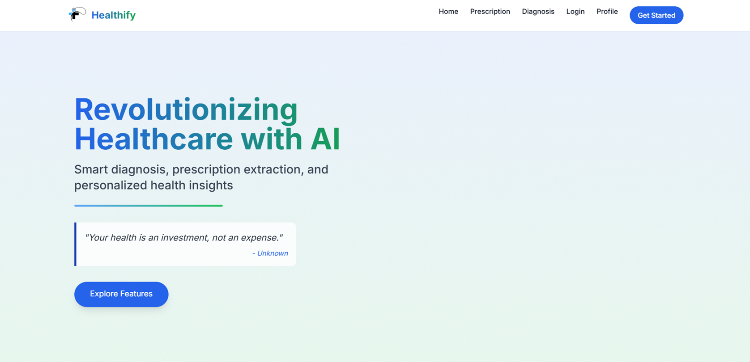
HOME PAGE

Slide 27
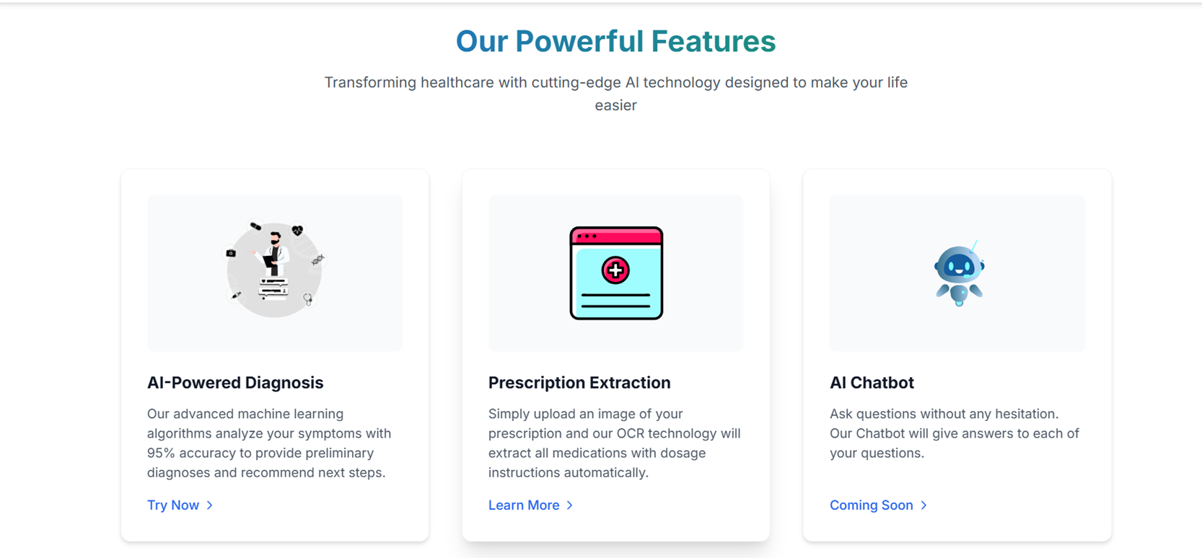
HOME PAGE

Slide 28
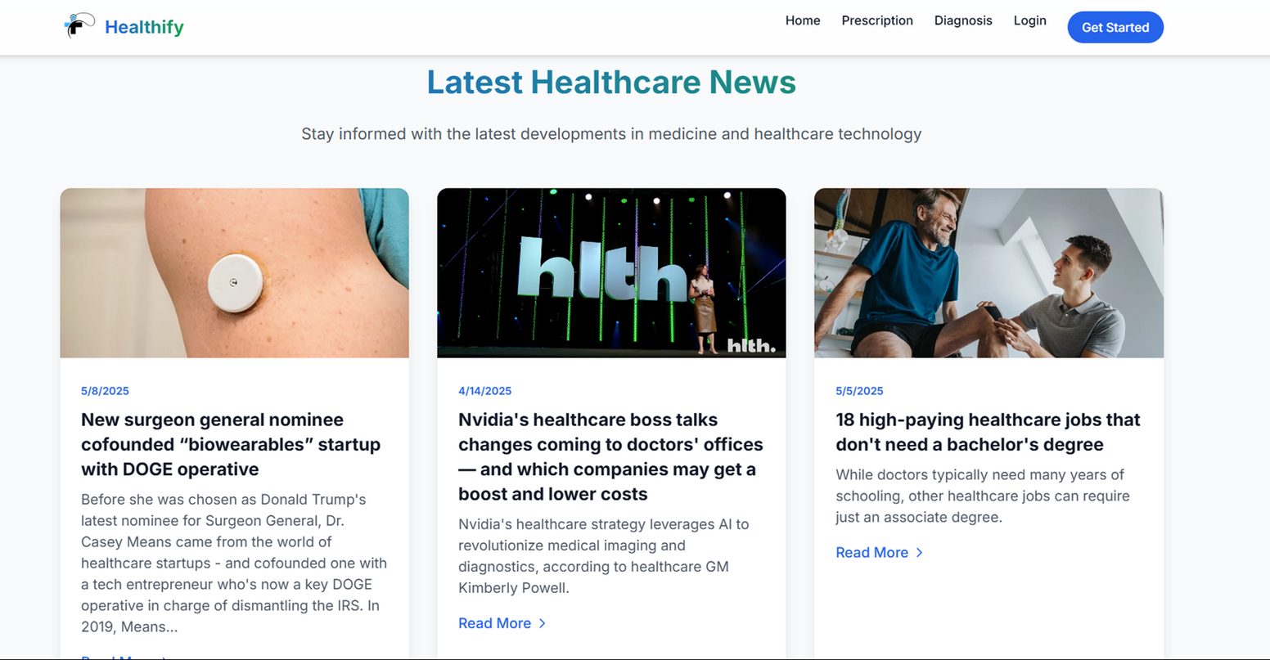
HOME PAGE

Slide 29
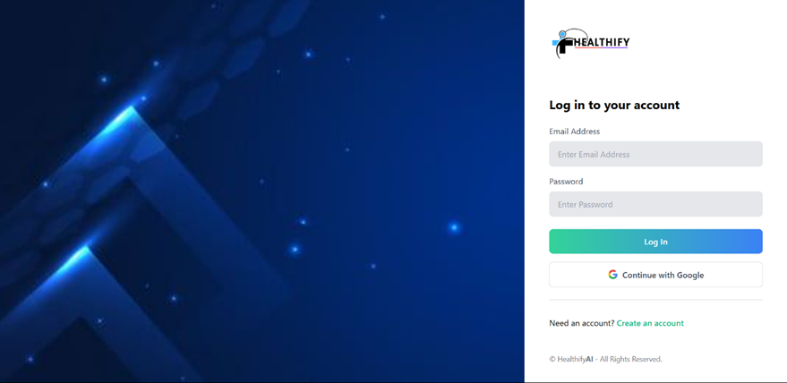

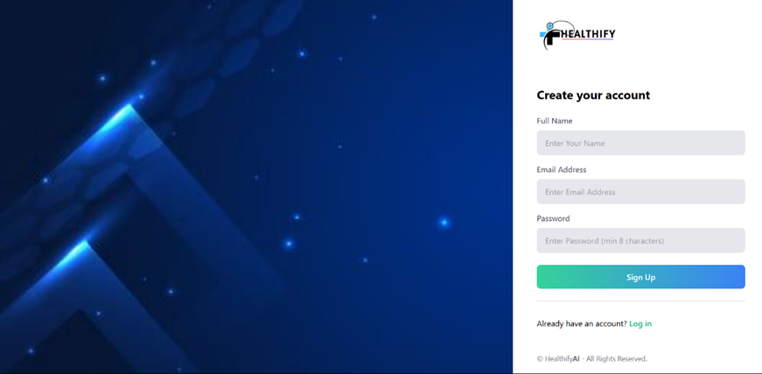
LOGIN AND SIGN IN
LOGIN PAGE
SIGNIN PAGE

Slide 30
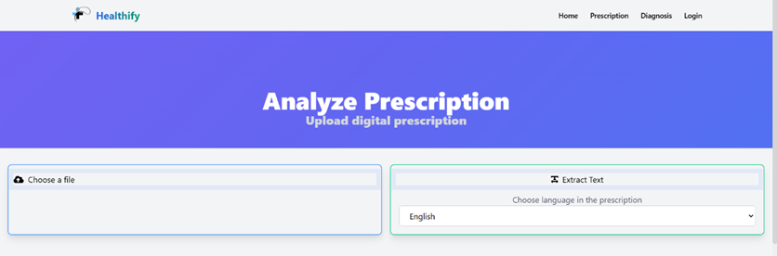
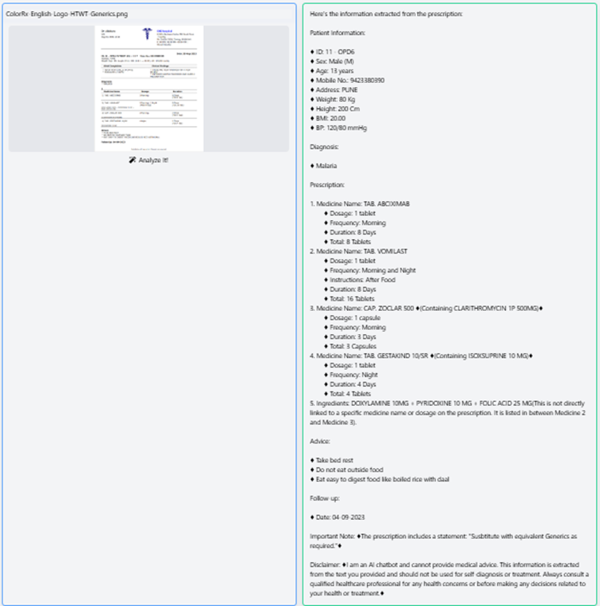
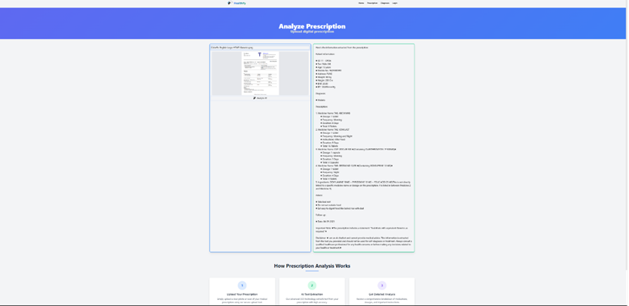

PRESCRIPTION PAGE

Slide 31
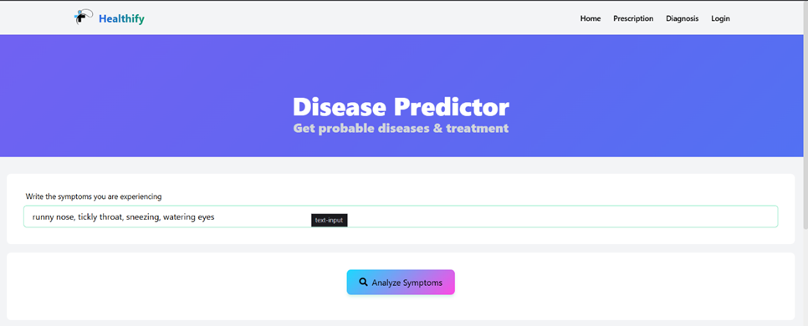
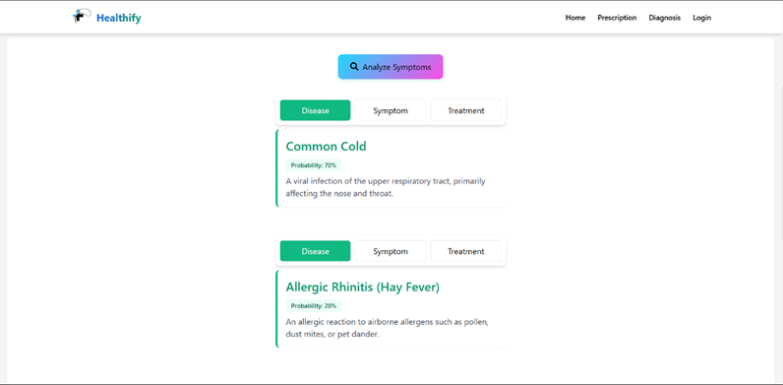
DISEASE PREDICTOR
DISEASE PREDICTOR
RESULTS

Slide 32
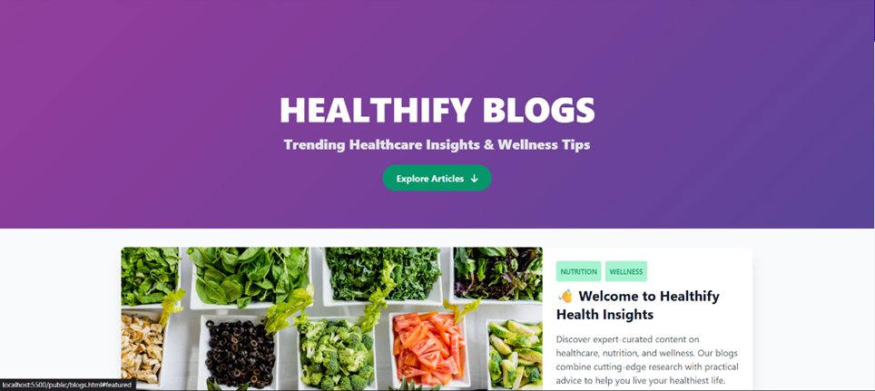
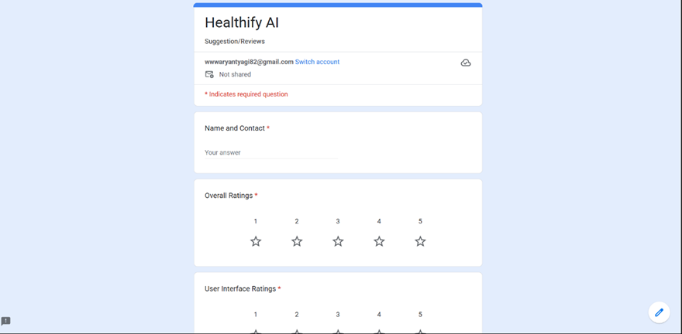
BLOG AND REVIEW SYSTEM SCREENSHOTS
BLOG PAGE
REVIEW PAGE

Slide 33
TESTING & VALIDATION
THE APPLICATION HAS UNDERGONE TESTING AND VALIDATION TO ENSURE ITS ACCURACY, RELIABILITY, AND SECURITY.
TESTING METHODS USED INCLUDE:
UNIT TESTING: TO VERIFY INDIVIDUAL COMPONENTS AND FUNCTIONS.
INTEGRATION TESTING: TO TEST THE INTERACTION BETWEEN DIFFERENT MODULES.
THE TESTING PROCESS ENSURES THAT THE APPLICATION MEETS THE REQUIRED STANDARDS AND PERFORMS AS EXPECTED.

Slide 34
SECURITY MEASURES & CHALLENGES
SECURITY IS A CRITICAL CONSIDERATION FOR A HEALTHCARE APPLICATION.
MEASURES IMPLEMENTED INCLUDE:
JWT (JSON WEB TOKEN) AUTHENTICATION FOR SECURE USER AUTHENTICATION AND AUTHORIZATION.
DATA VALIDATION TO PREVENT MALICIOUS INPUT AND ENSURE DATA INTEGRITY.
CHALLENGES FACED DURING DEVELOPMENT INCLUDE:
ENSURING THE SECURITY AND PRIVACY OF SENSITIVE PATIENT DATA.
SCALABILITY OF THE SYSTEM TO HANDLE A GROWING NUMBER OF USERS AND DATA.
INTEGRATING WITH EXISTING HEALTHCARE SYSTEMS AND ADHERING TO INDUSTRY STANDARDS.

Slide 35
CONCLUSION & FUTURE ENHANCEMENTS
HEALTHIFY PROVIDES AN AI-POWERED PLATFORM WITH THE POTENTIAL TO SIGNIFICANTLY IMPROVE HEALTHCARE ACCESS AND PERSONALIZATION.
KEY ACHIEVEMENTS INCLUDE THE DEVELOPMENT OF MODULES FOR USER AUTHENTICATION, AI-DRIVEN ANALYSIS, AND EFFICIENT DATA MANAGEMENT.
FUTURE ENHANCEMENTS MAY INCLUDE:
INTEGRATION WITH WEARABLE DEVICES FOR CONTINUOUS HEALTH MONITORING.
IMPLEMENTATION OF A CHATBOT FOR AUTOMATED PATIENT SUPPORT AND INTERACTION.
EXPANDING THE AI CAPABILITIES TO COVER A BROADER RANGE OF MEDICAL CONDITIONS.

Slide 36
THANK YOU

