Slide 1

Shri Ramswaroop Memorial University
Uttar Pradesh
PulseCam
Heart rate and pulse waveform from a webcam face video, live
Aryan Singh
Roll no. 202310101150038
Ruchi Singh
Roll no. 202310101150025
Ananya Dwivedi
Roll no. 202310101150039
B.Tech CS (DS + AI) | Group 71, 72
Research prototype. Not a medical device, never diagnostic.
Notes:
Introduce the project and say clearly that this is a research prototype, not a medical device.

Slide 2
Why measure heart rate from a face?
Today
Our goal
The gap
Finger clips, smartwatches and chest straps all need contact and a device on the body.
One normal webcam, 30 seconds, nothing worn. Heart rate and a pulse waveform on screen.
Public rPPG data has few darker skin tones, so we test fairness across Monk skin-tone bands (E4).
Notes:
Contact sensors versus a webcam. The fairness gap motivates the skin-tone experiment E4.

Slide 3
How rPPG works
1
Heartbeat
HR = 60 x f
Each beat pushes blood into the face skin.
2
Colour change
f is the peak frequency in Hz
Skin colour shifts by a tiny amount, mostly in green. Eyes cannot see it, a camera can.
1.8 Hz
3
Frequency
Filter 0.7 to 3.0 Hz, then take the strongest frequency with an FFT.
= 108 beats per minute
Notes:
Explain simply: heartbeat, tiny colour change, filter and FFT peak gives the heart rate.

Slide 4
The pipeline
Video
Face + skin
Model
Bandpass
FFT peak
30 fps webcam
MediaPipe box, crop 72x72
POS or TS-CAN
0.7 to 3.0 Hz
HR = 60 x f
Live demo
10 s rolling buffer (300 frames), a new estimate every second, the median of the last 5 is shown. A 'Hold still' warning appears on motion, darkness or a weak signal.
Notes:
Walk left to right. TS-CAN outputs the derivative of the pulse, so we integrate it before the filter.

Slide 5
Three kinds of model
Classical
TS-CAN
Fine-tuning
GREEN, ICA, CHROM, POS
Deep network
Tried on UBFC
Hand-made colour maths. No training needed. CHROM and POS are the strong ones.
Temporal-shift attention CNN from rPPG-Toolbox. We use its released PURE and SCAMPS weights.
Person-wise split, 30 train, 6 valid, 6 test. Result: 1.60 vs 1.58 BPM, no real gain, so the released model stays.
Notes:
Fine-tuning was person-wise so nobody appears in both train and test. We report that it gave no gain.

Slide 6
Data and experiments
Item | What | Status
E1 | Classical baselines vs deep model on UBFC-rPPG (42 people) | Done
E2 | PURE and SCAMPS weights tested on UBFC | Done
Fine-tune | UBFC person-wise split, released weights kept | Done, no gain
E3, E4 | Robustness per condition, skin-tone bands | Needs volunteers
E5 | Live demo vs a reference device | Needs hardware
Scored on 490 ten-second windows per method against the heart rate of the ground-truth pulse.
Notes:
Be upfront that E3 to E5 need people and hardware and were not done.

Slide 7
E1 and E2: error by method
1.80 vs 2.00
TS-CAN (PURE) vs CHROM, BPM per window
Tied per video
Median 0.72 BPM for both. The deep model only narrowly beats the best classical method.
Notes:
42 UBFC subjects, 490 windows per method. SCAMPS weights transfer poorly; we checked five ways and it is not a scoring bug.

Slide 8
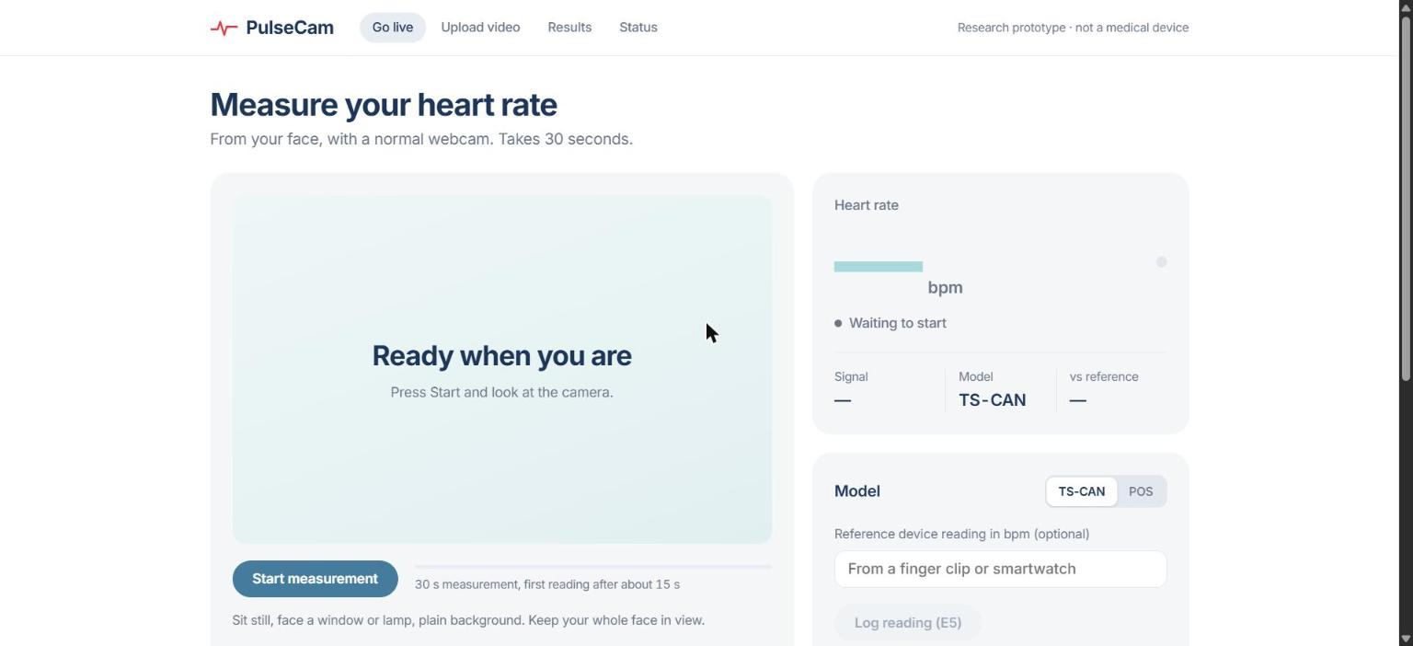
The live demo app
1
Go live
30 s webcam measurement
2
Upload video
Analyse a recorded clip
3
Results
E1 and E2 tables, Bland-Altman plots
4
Status
Project checklist
Python, Starlette and a browser page. Works offline, no cloud, nothing leaves the laptop.
Notes:
Screenshot of the running app on localhost. Live webcam run with a person is still untested.

Slide 9
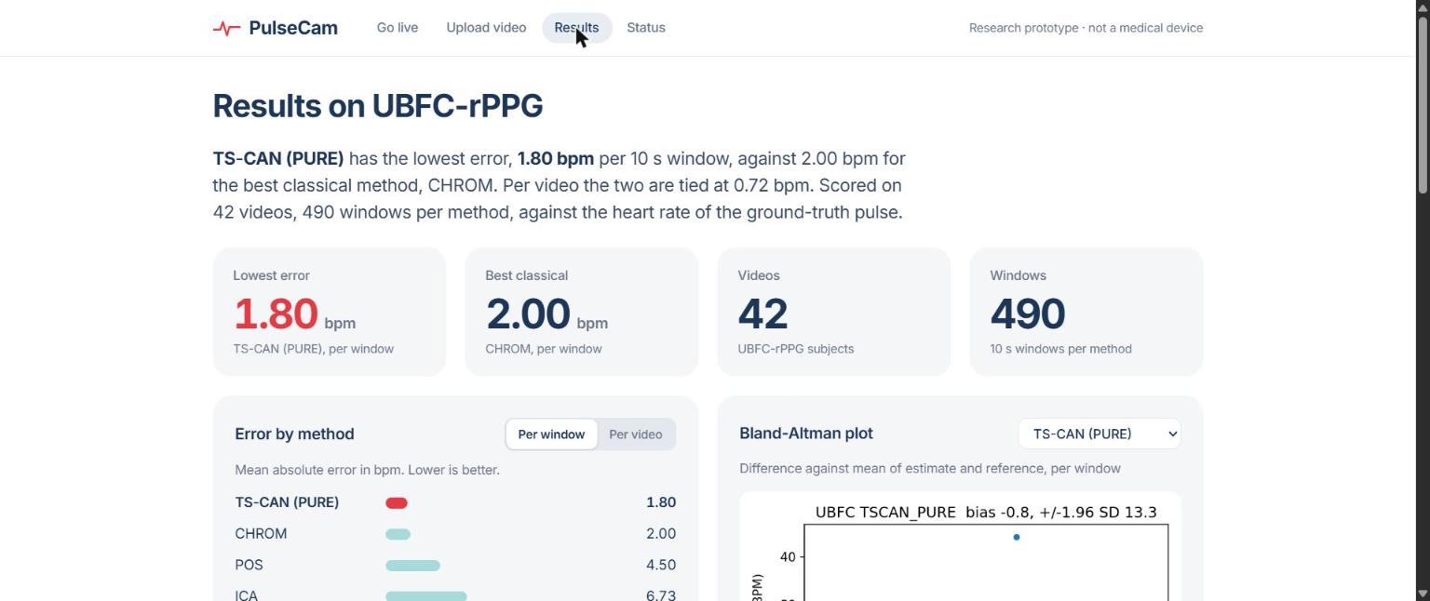
Results tab in the app
How to read it honestly
TS-CAN edges out CHROM, but by a small margin.
Per video the two are exactly tied.
UBFC fine-tuning gave no gain.
No result here says anything medical.
Headline numbers, error bars per method and a Bland-Altman plot for every model, read straight from the results tables.
Notes:
Screenshot of the Results tab. Stress that the margin over CHROM is small.

Slide 10
Limits and next steps
Not done yet
Next
No volunteer recordings or consent forms
No reference device, so no E3, E4 or E5
Live webcam test with a person pending
Record volunteers with signed consent
Score against a finger-clip or watch
Fine-tune on own recordings, person-wise
A research prototype, never a medical device. Faces and consent forms are never committed; people are P01, P02 and so on.
Notes:
Close with limitations and ethics, then thank the audience.

