Slide 1

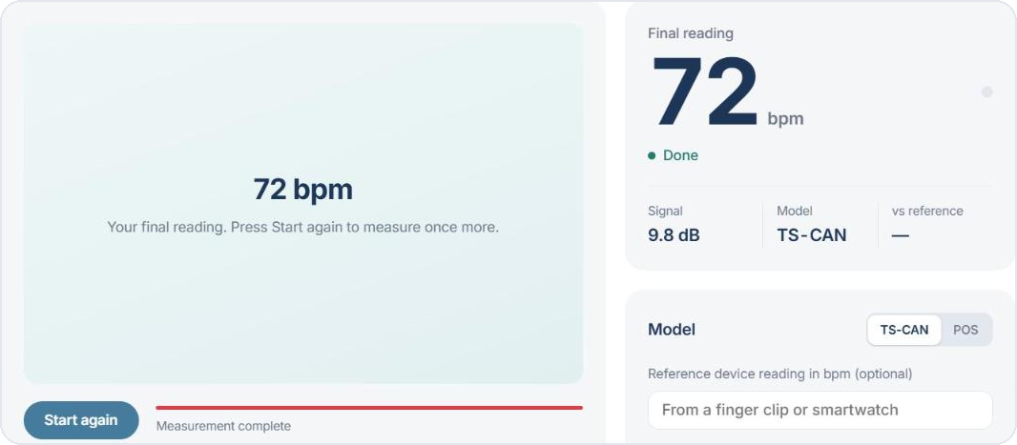
Shri Ramswaroop Memorial University
Uttar Pradesh
PulseCam
Measuring heart rate from a normal webcam: classical vs deep rPPG
The PulseCam web app after a 30-second measurement
Student research project · October 2026
Research prototype, not a medical device
Aryan Singh | Roll no. 202310101150038
Ruchi Singh | Roll no. 202310101150025
Ananya Dwivedi | Roll no. 202310101150039
B.Tech CS (DS + AI) | Group 71, 72
Notes:
Introduce the team and the guide. PulseCam estimates resting heart rate from ordinary face video, live from a webcam or from a recorded file. We compare classical signal-processing methods with a deep model on a public dataset, and we built a local web app for the demo. Say early and clearly: this is a research prototype, not a medical device.

Slide 2




Heart rate today needs contact
Finger-clip oximeter
Has to touch the finger; one person at a time
Chest strap or ECG
A webcam is everywhere
Worn on the body; not for a quick check
Remote photoplethysmography (rPPG) reads the pulse from ordinary face video. No contact, no extra hardware.
Smartwatch
Costs money; not everyone owns one
The gap
Public rPPG datasets are mostly lighter skin tones, so accuracy for Indian users is not well tested.
Notes:
Every common way to measure heart rate needs contact or a device. A webcam is already in every laptop and phone. rPPG uses it to read the pulse without touching the person. The open problem we care about: the public datasets mostly contain lighter skin, so nobody really knows how well this works for Indian users.

Slide 3




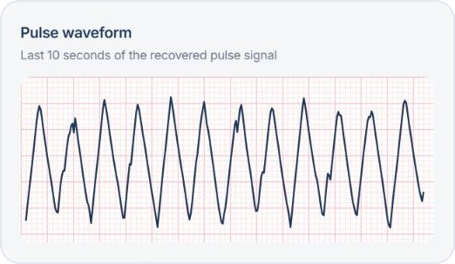
How a camera sees your pulse
Heart beats
Skin colour shifts
Camera records
Signal to rate
Blood volume in the skin rises and falls
A tiny change in absorbed light, invisible to the eye
30 frames per second capture the change
Find the strongest beat frequency
HR = 60 × f
A 1.2 Hz peak means 72 beats per minute
The FFT finds the strongest frequency between 0.7 and 3.0 Hz, which is 42 to 180 beats per minute.
Notes:
Each heartbeat pushes a little more blood into the face, which changes how much light the skin absorbs. The change is far too small to see, but a 30 fps camera records it. We turn the colour of the skin over time into a pulse signal, then use an FFT to find its strongest frequency f. Heart rate is 60 times f: a 1.2 Hz peak is 72 beats per minute. The waveform on the left is a real screenshot from our app.

Slide 4


Four research questions
Build a working video-to-BPM pipeline and live demo, and answer:
RQ1
RQ2
Do deep models beat classical methods on UBFC-rPPG?
How much accuracy is lost when training on a different dataset?
Answered by E1
Answered by E2
RQ3
RQ4
Is accuracy lower for Indian skin tones, and does fine-tuning help?
Which hurts most: movement, talking or dim light?
Open: needs volunteer recordings (E4)
Open: needs volunteer recordings (E3)
Notes:
These are the four research questions from the project specification. RQ1 and RQ2 are answered with the public UBFC-rPPG dataset. RQ3 and RQ4 need our own recordings of consenting volunteers with a reference heart-rate device. That data collection has not happened yet, so we say so openly.

Slide 5



From video to beats per minute
1. Video
2. Face & skin
3. Crop
4. Model
5. Band-pass
6. FFT peak
30 fps webcam or a recorded file
MediaPipe face box, forehead and cheeks
72 × 72 face crop, normalised
POS (classical) or TS-CAN (deep)
Keep 0.7 to 3.0 Hz
HR = 60 × f of the peak
In the live demo
10 s
5
15 s
3
rolling window of frames (300 at 30 fps)
latest estimates, median shown
to the first reading on a laptop CPU
warnings: hold still, too dark, weak signal
Notes:
This is the whole pipeline, the same code for the evaluation, the upload and the live demo. MediaPipe finds the face and the skin patches, we crop a 72 by 72 image, the model turns colour changes into a pulse signal, a band-pass filter keeps the plausible heart-rate band, and the FFT peak gives beats per minute. In the live demo we keep the last 10 seconds, show the median of the last five estimates, and warn when the person moves, the room is dark or the signal is weak.

Slide 6
What we compared, and how we scored it
Classical: signal processing, no training
GREEN
Green channel only, no motion handling
Evaluation on UBFC-rPPG
42
490
6
ICA
Separates pulse from noise statistically
videos
windows per method
methods
CHROM
Colour difference that cancels glare and motion
Each 10 s window (5 s step) is scored against the heart rate of a finger-clip pulse recording
Per video: median over its windows
Main metric MAE; also RMSE, MAPE, Pearson r, Bland-Altman
Targets: beat every classical method, MAE under 5 bpm
POS
Projection against skin tone, strong baseline
Deep: learned from data
TS-CAN
Neural network on 72 × 72 frames. Released rPPG-Toolbox weights trained on PURE (real video) and on SCAMPS (synthetic faces).
Notes:
Four classical methods need no training at all. TS-CAN is the deep model; we used the rPPG-Toolbox weights trained on two different datasets, PURE which is real video and SCAMPS which is synthetic. All six are scored the same way on all 42 UBFC videos: every 10-second window against the ground-truth pulse from a finger clip. Mean absolute error in beats per minute is the main number.

Slide 7
RQ1: deep edges out classical
1.80 bpm
TS-CAN (PURE), per window
2.00 bpm
CHROM, best classical method
0.72 = 0.72
Per video: an exact tie
A narrow lead: CHROM keeps a slightly higher correlation (0.94 vs 0.93). Both are well under the 5 bpm target.
Notes:
RQ1. On all 42 UBFC videos, TS-CAN trained on PURE has the lowest error, 1.80 beats per minute per window, but the best classical method, CHROM, is close at 2.00. When we take one reading per video, the two tie exactly at 0.72. So the deep model meets our target of beating every classical baseline, but only narrowly, and CHROM keeps a slightly better correlation. GREEN, the simplest method, is far behind.

Slide 8
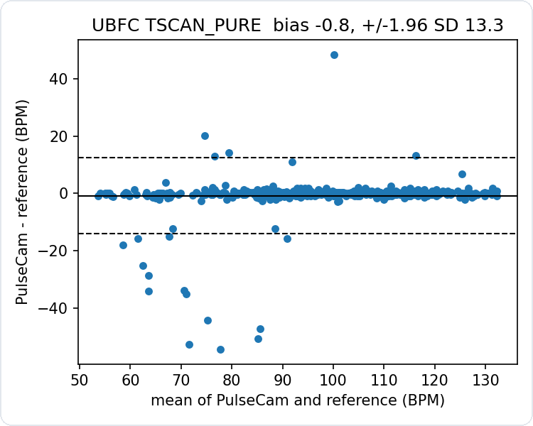
Most windows are right; a few miss badly
−0.8 bpm
Average bias: almost none
±13.3 bpm
95% limits, widened by a few outliers
6.80 vs 1.80
RMSE much larger than MAE: the error sits in a few windows
Typical failure: for one window the FFT locks onto the wrong frequency, like the dip to 76 bpm on subject 1 (slide 12).
Bland-Altman plot, TS-CAN (PURE), 490 windows
Notes:
The Bland-Altman plot shows each window: difference between our estimate and the reference against their mean. Almost all points sit on the zero line and the average bias is under one beat per minute. The limits are wide only because of a handful of windows where the method locks onto a wrong frequency. That is why RMSE is almost four times the MAE.

Slide 9
RQ2: real data transfers, synthetic does not
1.80
12.83
trained on real video
trained on synthetic
The gap stays under every scoring method, including the toolbox’s own, so it is not a scoring mistake.
Fine-tuning on UBFC
1.60 → 1.58 bpm
30 / 6 / 6 people, split by person. Within noise, so the released weights stay in use.
Notes:
RQ2 is about transfer between datasets. The same network trained on real video, PURE, works well on UBFC; trained on synthetic faces, SCAMPS, it is about seven times worse. Because that was surprising, we re-scored the same predictions five ways, including the toolbox’s own pipeline. The gap never closes, so it is a real property of the SCAMPS model. We also fine-tuned TS-CAN on UBFC with a person-wise split: 1.60 to 1.58 is within noise, so we kept the released weights.

Slide 10
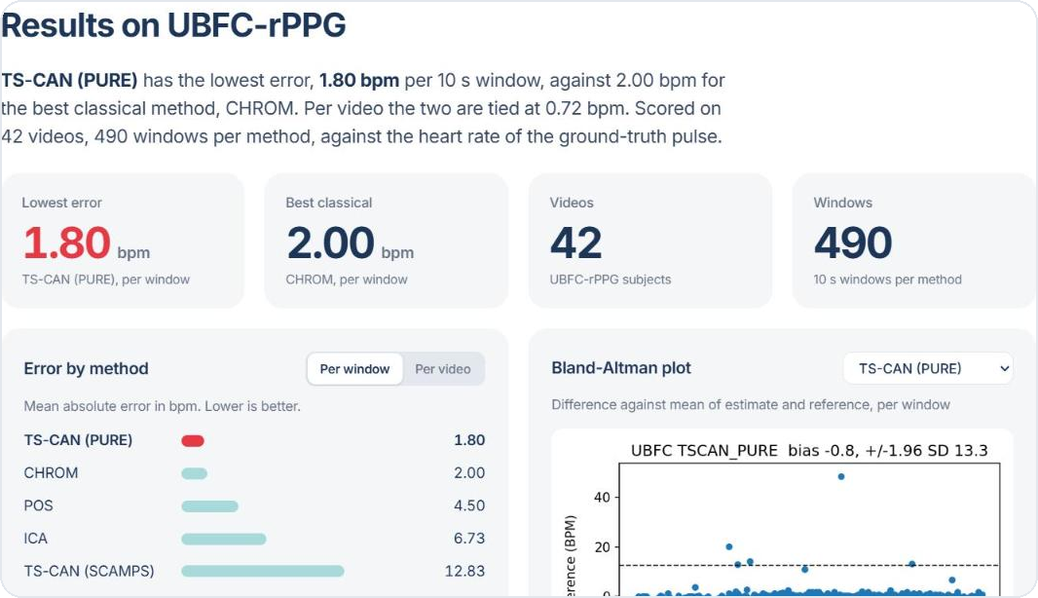



PulseCam: the web app
Go live
A 30-second measurement from the webcam
Upload video
Analyse a recorded clip; the file is deleted afterwards
Results
Evaluation numbers, charts and plots
Status
Project checklist and progress
Results tab: the E1 and E2 numbers, charts and Bland-Altman plots
Runs on the laptop: a small Python server plus a web page. No cloud, works offline, faces never leave the machine.
Notes:
The demo is a local web app we built: a small Python server and one web page. It has four tabs: a live measurement, an upload for recorded videos, the results of our evaluation and the project status. Nothing goes to the cloud; video is processed on the laptop and uploaded files are deleted straight after analysis.

Slide 11
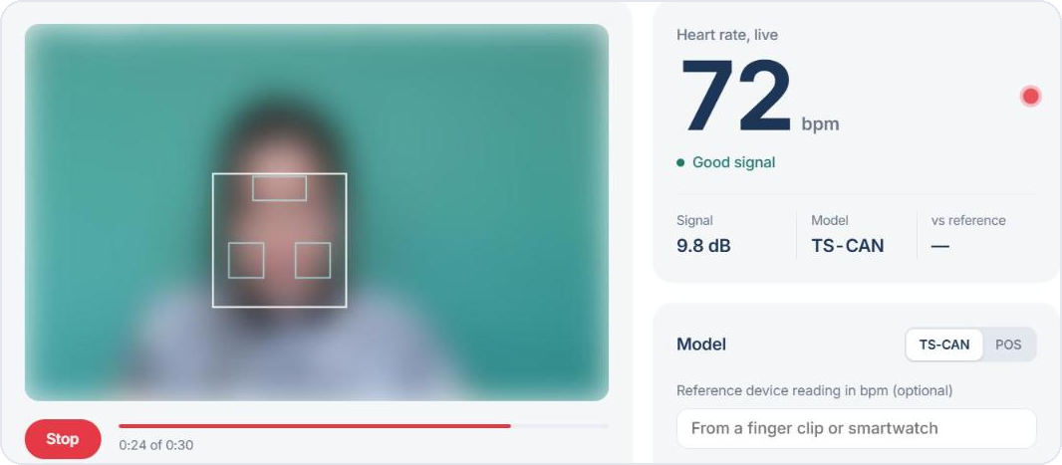
Go live: a 30-second measurement
1
Press Start and sit still
2
Reading after about 15 s
3
Final reading stays
The face box and three skin patches are tracked
10 s of signal plus the first TS-CAN estimate; updates every few seconds
After 30 s the result stays on screen for logging
Shown: a test run using a UBFC-rPPG video frame with a simulated 72 bpm pulse; face blurred for privacy. A live run with a volunteer and a reference device is still to be done.
Notes:
This is the live mode. You press Start and sit still; the white box is the face and the three small boxes are the forehead and cheeks we read colour from. After about 15 seconds the first reading appears and it updates every few seconds; after 30 seconds the final value stays on screen. Be honest here: these screenshots come from a test run with a dataset frame and a simulated 72 bpm pulse, and the app returned 72. A run with a real volunteer and a reference device is still on our to-do list.

Slide 12
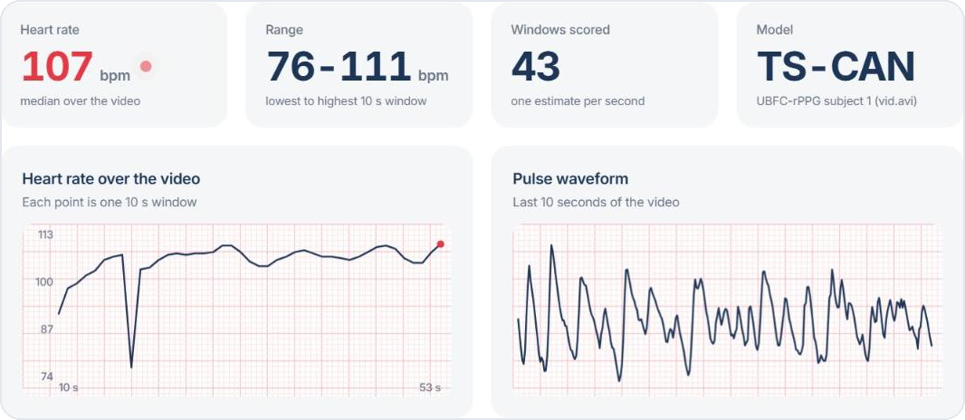
Upload: a real result on UBFC subject 1
107.2 bpm
measured by PulseCam (TS-CAN)
106.7 bpm
ground truth, finger-clip pulse
+0.5 bpm
error over the whole video
One window dips to 76 bpm, a wrong-frequency lock; the median over 43 windows is not affected.
Upload and the evaluation scripts share one function, checked to give identical results.
Notes:
Here we uploaded a real 53-second UBFC video. PulseCam reports 107.2 beats per minute; the finger-clip ground truth is 106.7. You can see one window where the estimate drops to 76: that is the wrong-frequency failure from the Bland-Altman slide, and the median ignores it. The upload uses exactly the same function as our evaluation scripts, so the demo and the reported numbers cannot drift apart.

Slide 13




Making it real-time on a laptop CPU
116 → 19 ms
per frame: switched off compression of 1.2 MB frames
Browser
Camera, page, charts
3.5 → 0.3 s
session start: face detector loaded once at start-up
raw frames
BPM, signal, face box
9.1 → 4.2 s
per TS-CAN estimate: 2 CPU threads instead of 4
Python server
Face → skin patches → model → FFT. TS‑CAN runs in a background thread so frames keep flowing.
5 → 20+ fps
capture rate while an estimate is running
Frames are never compressed: re-encoding a clip made POS read 62 instead of 107 bpm.
Notes:
Getting live readings on a normal laptop took real engineering, and every number here was measured. Compression of the video frames on the WebSocket cost about 116 ms per frame, so we turned it off. Loading the face detector once at start-up removed a 4-second gap. TS-CAN was faster on 2 threads than on 4, and running it in the background keeps the camera at 20+ frames per second. We send raw frames on purpose: compressing a video destroys the tiny colour change we measure.

Slide 14


Limits and responsibilities
Limitations
Ethics and privacy
No volunteer recordings yet, so RQ3, RQ4 and E5 are open
UBFC is easy: indoor, still, uncompressed video
Deep models are released checkpoints; our fine-tune gave no gain
A live run with a real person is still to be tested
Not validated for any clinical use
Written consent before any recording
Follows India’s DPDP Act 2023
IDs instead of names; videos stay private, never on GitHub
Faces shown only with permission (blurred in this deck)
The app says clearly: not a medical device
Notes:
Limitations first: the biggest is that we have no volunteer recordings yet, so the skin-tone and robustness questions are open. UBFC is an easy dataset, so real webcams will do worse. On ethics: nobody is recorded without written consent, we follow the DPDP Act, videos stay private and are identified by IDs only, and the face in this deck is blurred.

Slide 15



What we found
RQ1
TS-CAN 1.80 vs CHROM 2.00 bpm: deep edges out classical, tie per video
Next steps
RQ2
Record volunteers across Monk skin-tone bands (E3, E4)
Compare live readings with an oximeter (E5)
Fine-tune TS-CAN on our own recordings, split by person
Training on real video transfers (1.80); synthetic does not (12.83)
RQ3, RQ4
Need consenting volunteers across skin tones
App
Live and upload analysis work end to end, offline
Thank you. Questions?
Notes:
To sum up: on UBFC, the deep model narrowly beats the best classical method and ties it per video; training on real video transfers well while synthetic training does not; and the app works end to end on a laptop. The skin-tone and robustness questions need volunteer recordings, which is our next step. Thank you, we are happy to take questions.

