Slide 1

GINI&JONY x SCHBANG
CRO Audit · Phase 1
Mobile website review of giniandjony.com · October 2026
Notes:
CRO Audit, Phase 1. Evidence captured live on 6 Oct 2026 and fact-checked on 7 Oct 2026 at a 390px mobile viewport. No Gini & Jony analytics access yet, so revenue figures are models marked as such.

Slide 2

What we’ll cover
01
Where We Stand
What’s on the shelf, and whether the numbers can be trusted
02
What We Found
A parent’s journey from search to checkout, with evidence
03
What We Do Next
Fixes this week, the festive window, then tests
Gini & Jony · Schbang · CRO Audit, Phase 1
02
Notes:
Three sections, then the Phase 2 asks. Claim labels used in notes: MEASURED (captured live or from the public product feed), TO VALIDATE (needs Gini & Jony data), HYPOTHESIS (to be tested).

Slide 3

“The constraint is upstream of the page: what’s on the shelf, how sizes are described, and the missing link to the stores.”
THE ANSWER
— Live audit of giniandjony.com on mobile, 6–7 Oct 2026
Gini & Jony · Schbang · CRO Audit, Phase 1
03
Notes:
Lead with this. No landing-page test can fix an empty festive shelf or a 45% size run. Fix the hygiene items now, stock the shelf before Diwali (8 Nov 2026), then test.

Slide 4
Three numbers from the live store
AT A GLANCE
Each one sends a parent away before page design matters. All three are measured on giniandjony.com and its public product feed.
0
45%
0
festive or ethnic styles online
of size options in stock
stores listed on the Find a store page
33 days before Diwali · product feed, 7 Oct
2,706 of 5,987 · product feed, 7 Oct
Source: live page, 7 Oct 2026
Gini & Jony · Schbang · CRO Audit, Phase 1
04
Notes:
MEASURED. Festive check covered titles, product types, tags and descriptions. Size availability uses Shopify's 'available' flag per variant. Find a store has a heading and an empty body in the server HTML.

Slide 5

Where We Stand
SECTION 01
The shelf, and the numbers behind it
GINI & JONY
SCHBANG
Notes:
Pre-flight: two checks that can overturn any page-level diagnosis.

Slide 6
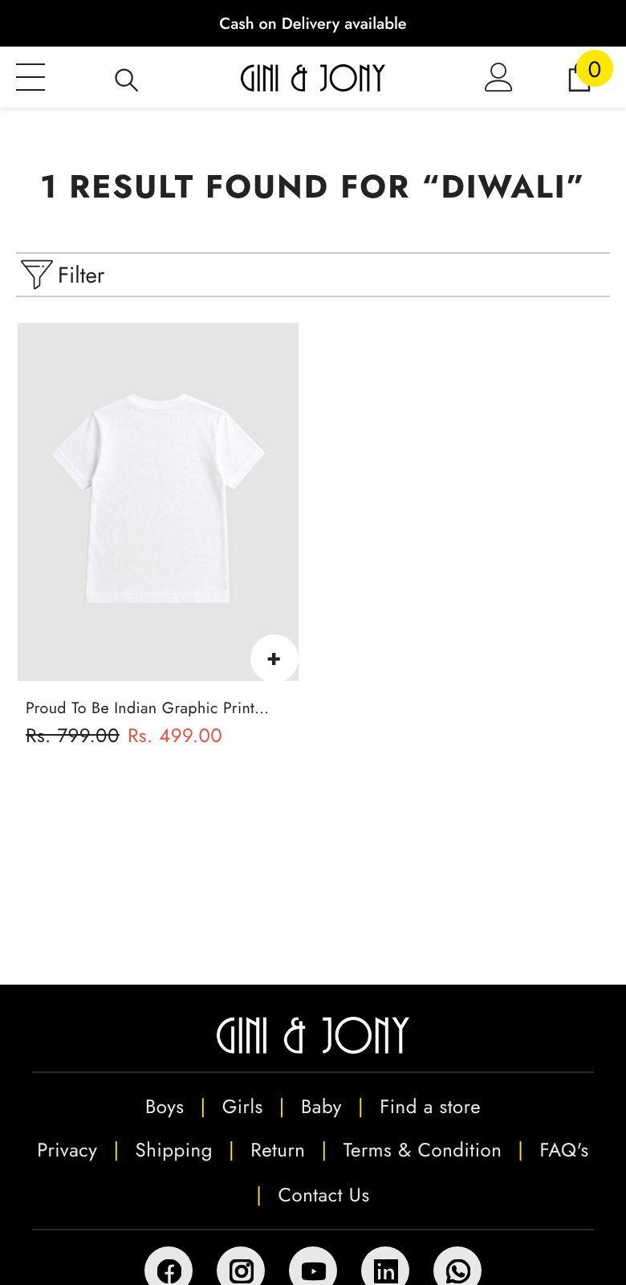
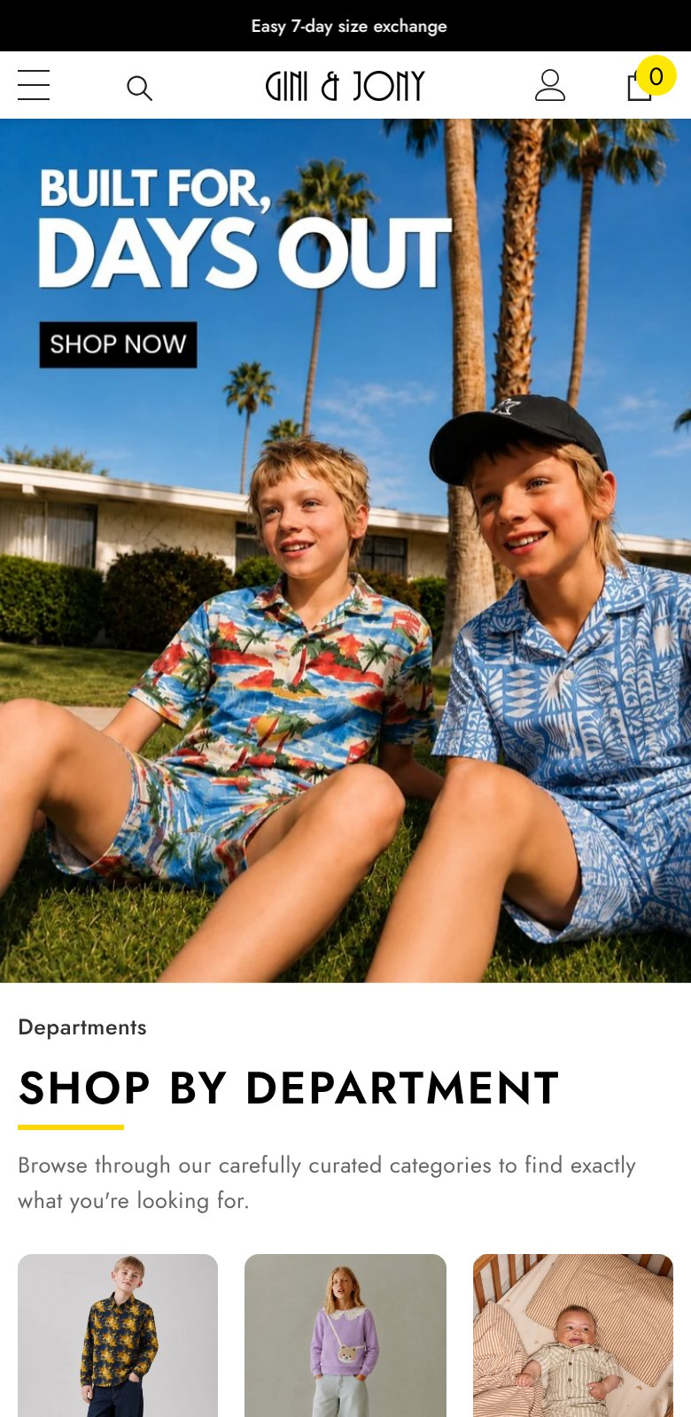
Five weeks before Diwali, there’s nothing festive to buy
PRE-FLIGHT · ASSORTMENT
No festive or ethnic styles, and no party wear (3 sequin tops). Searching “diwali” returns an Independence Day tee.
Only 2 products have been created since July. The homepage hero is still a summer “days out” shoot.
Search “diwali”
Homepage, 6 Oct
Gini & Jony · Schbang · CRO Audit, Phase 1
06
Notes:
MEASURED: 0 festive styles after checking titles, types, tags and descriptions; 672 of 674 products created May–Jul 2026, 2 in Aug, 0 since (Shopify created date). TO VALIDATE: does a festive or winter range exist in stores or the warehouse that never reached the site?

Slide 7
The shelf, measured
PRE-FLIGHT · ASSORTMENT
Check | Gini & Jony today | What it means
Products live | 674, of which 179 fully sold out | Sold-out styles still appear in collection listings (search hides them)
Size options in stock | 45% (2,706 of 5,987) | Only 140 products (21%) have a full size run; size 16 at 32%, waist 36 at 21%
New products | 2 in Aug · 0 in Sep · 0 in Oct | 672 of 674 were created May–Jul 2026
Festive / ethnic | 0 | Comps carry 18–799 festive kids’ styles
Winter | 50 styles, all with some sizes | Cherry Crumble has 253 kids’ winter styles in stock
Price | Median ₹824 · 84% within ₹500–1,800 | 95% of products start below the ₹1,499 free-shipping line
Discounting | 100% struck through · median 25% | When everything is on sale, “Sale” stops meaning anything
Photos | Median 3 per product | Comps show 6–10
Data hygiene | 3 vendor names · 17 types in two casings | Filters and feeds built on these fields split in two
Gini & Jony · Schbang · CRO Audit, Phase 1
07
Notes:
Source: giniandjony.com/products.json, all pages, re-pulled 7 Oct 2026. All rows MEASURED.

Slide 8
The tags fire, but the numbers can’t be trusted yet
PRE-FLIGHT · MEASUREMENT
01
02
03
No consent prompt
No behavioural data
Sales not reconciled
15 third-party domains, including GA4, Google Ads and Meta, load before any consent. DPDP consent duties start 13 May 2027.
No session recording, review app or search app. Cherry Crumble and Kidbea run Microsoft Clarity; all three comps run Judge.me reviews.
We couldn’t check whether GA4, Google Ads and Meta agree on purchases, or whether COD returns are netted out. That is deliverable one.
Gini & Jony · Schbang · CRO Audit, Phase 1
08
Notes:
MEASURED: third-party domains and missing consent prompt from a live homepage load. One unidentified tracker: tr.securification.ai. TO VALIDATE: purchase reconciliation needs GA4 and Shopify access.

Slide 9
What Gini & Jony already does well
PRE-FLIGHT · WHAT WORKS
01
02
03
Risk is answered
Age is the right idea
Price and checkout hold
Cash on delivery, 7-day size exchange and free shipping over ₹1,499 sit in the top bar and next to the buy button.
“Shop by age” on the homepage matches how parents shop. It needs correct data underneath.
One coherent price band, notify-me on sold-out styles, a sticky buy bar on scroll, and a checkout with UPI and COD that works.
Gini & Jony · Schbang · CRO Audit, Phase 1
09
Notes:
Credit before critique. These are strengths to keep through any redesign.

Slide 10
What We Found
SECTION 02
A parent’s journey, step by step
GINI & JONY
SCHBANG
Notes:
Audited by the question a parent arrives with, not by page template.

Slide 11
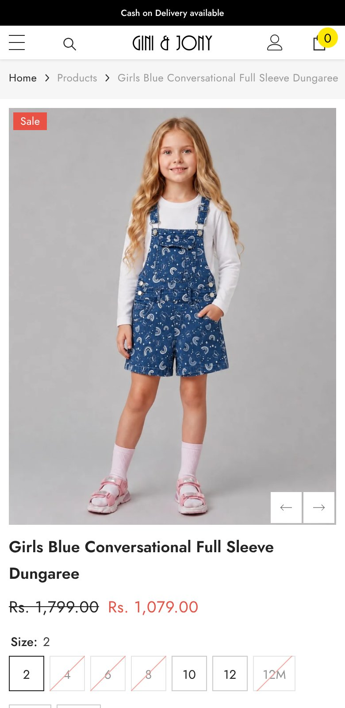
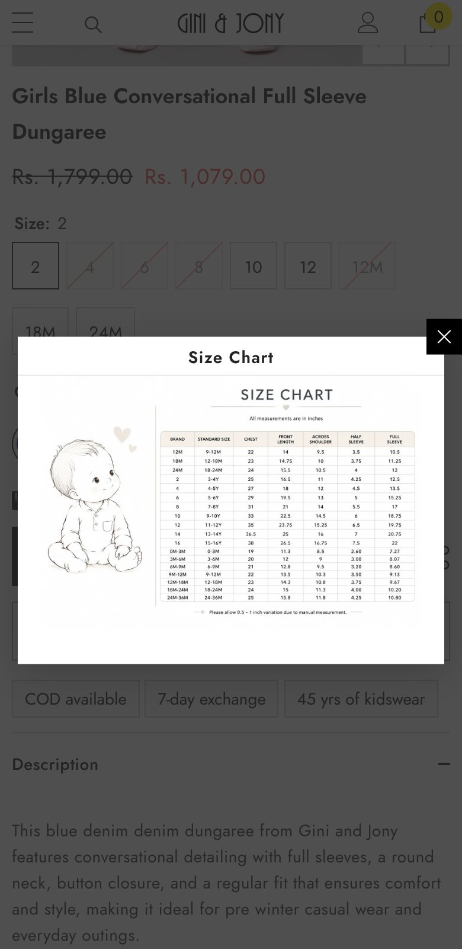
A size “2” fits a 3–4-year-old
FIT & SIZE
Sizes are bare numbers, and months are listed after the size-12 tween. The brand’s own chart maps 2 → 3–4Y and 8 → 7–8Y, but it’s an image behind a click.
Cherry Crumble, PS Peaches and Kidbea label every size by age.
Product page sizes
Size chart (an image)
Gini & Jony · Schbang · CRO Audit, Phase 1
11
Notes:
MEASURED from the live PDP and size chart. TO VALIDATE: share of exchanges citing size, from the exchange-reason report.

Slide 12
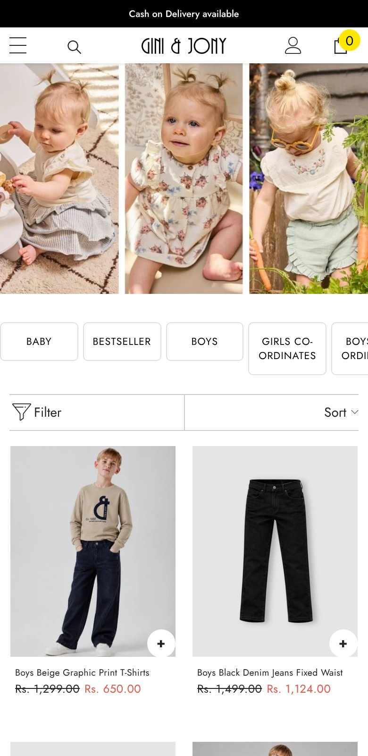
Nearly half of “0–2 Years” can’t fit a baby
FINDABILITY
257 of the 558 products in the 0–2 collection have no baby size. The second product shown is boys’ waist-size jeans.
Filters are availability and price only. There is no size filter, and the “trousers-leggings” menu link opens an empty page.
/collections/0-2-years
Gini & Jony · Schbang · CRO Audit, Phase 1
12
Notes:
MEASURED: age tags vs size options per product (7 Oct). 129 products tagged all three ages genuinely come in 12–24M; 257 don't. Availability filter shows In Stock 419 / Out of Stock 455.

Slide 13
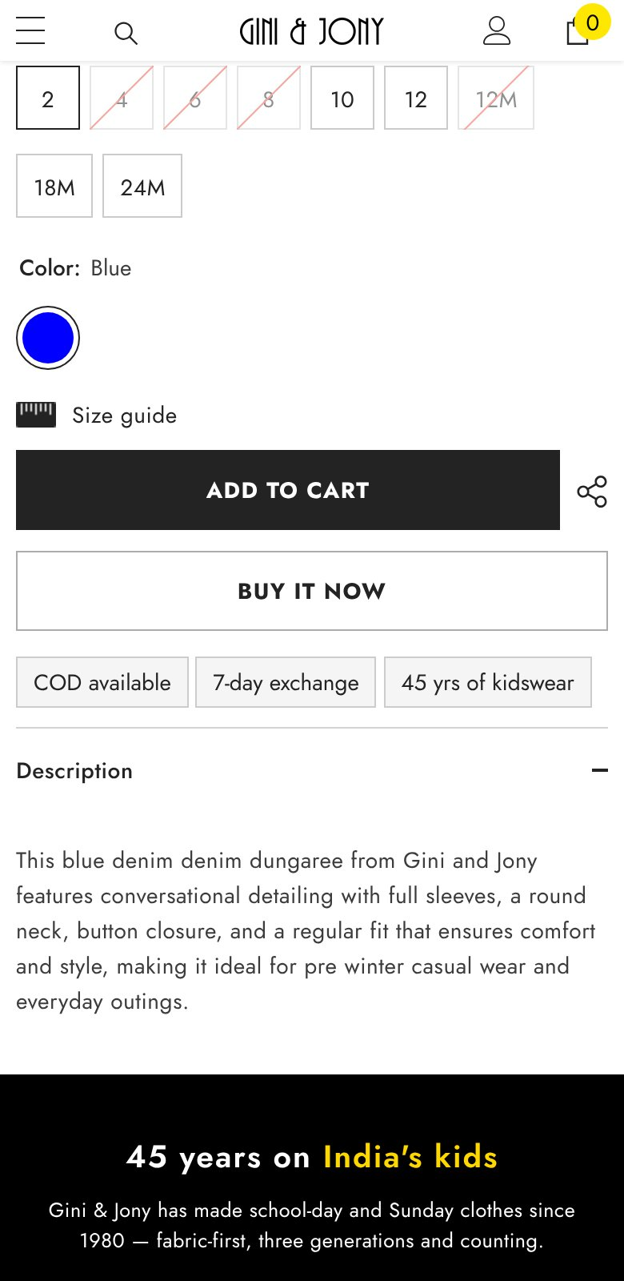
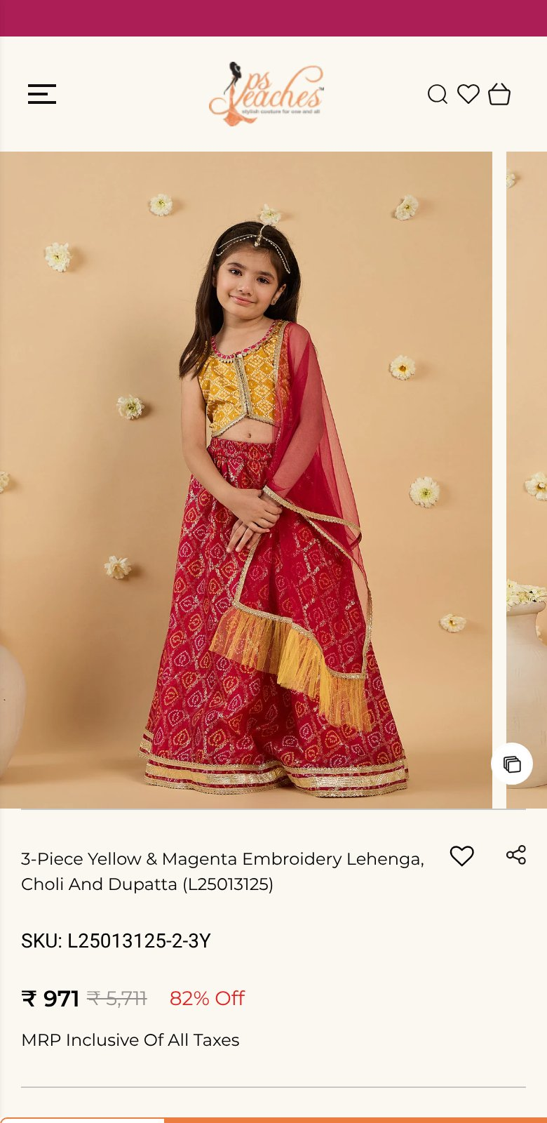
Add to cart isn’t on the first screen
PRODUCT PAGE
On a 390×844 phone, Add to cart starts at 981px; the sticky bar appears only after scrolling past it. PS Peaches shows its bar from the start.
No reviews, a median of 3 photos, no delivery date, and 74% of tap targets under 44px.
Gini & Jony, scrolled
PS Peaches, first screen
Gini & Jony · Schbang · CRO Audit, Phase 1
13
Notes:
MEASURED. Sale price in red is 3.67:1 contrast at 18px regular, below WCAG AA's 4.5:1.

Slide 14
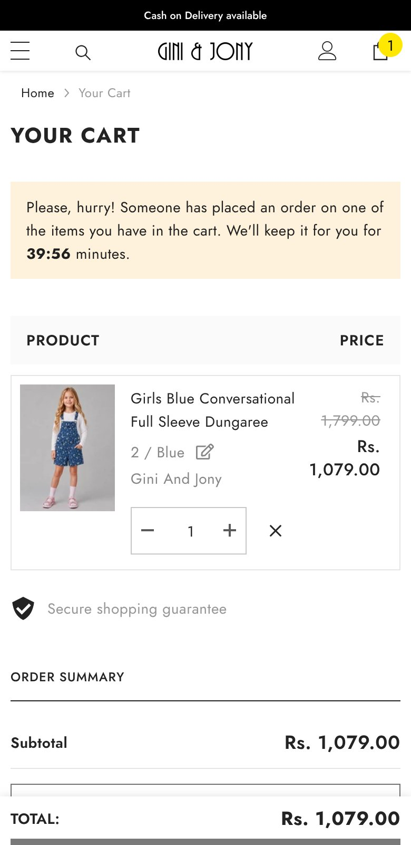
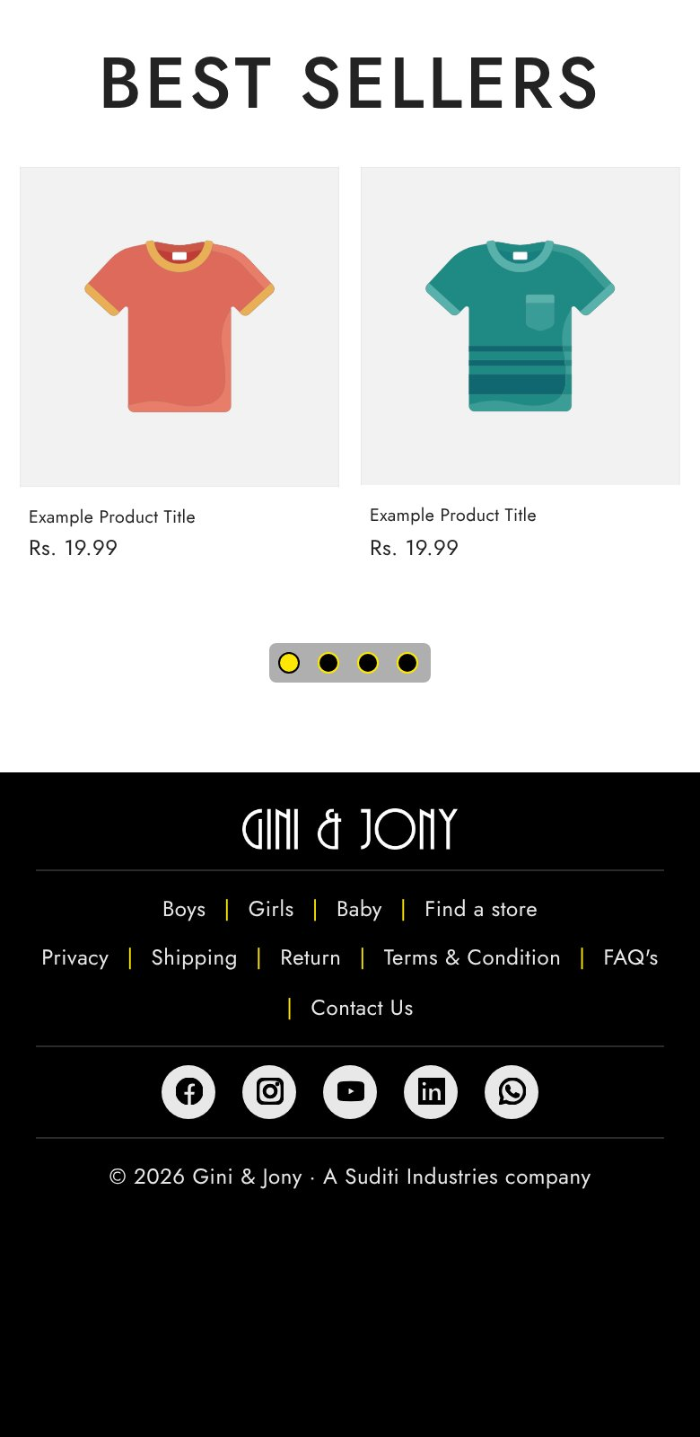
The cart invents urgency
CART
A fresh session with one item sees “Someone has placed an order… we’ll keep it for you for 39:56 minutes”. False urgency is a specified dark pattern under the CCPA’s 2023 guidelines.
Below it: 12 “Example Product Title · Rs. 19.99” tiles, and no nudge towards free shipping.
Cart, fresh session
Cart “Best sellers”
Gini & Jony · Schbang · CRO Audit, Phase 1
14
Notes:
MEASURED twice (6 and 7 Oct). The sticky checkout button is drawn at 60% opacity, so it looks disabled. Checkout itself works: Shopify native, Razorpay and COD, email first, 9 required fields.

Slide 15
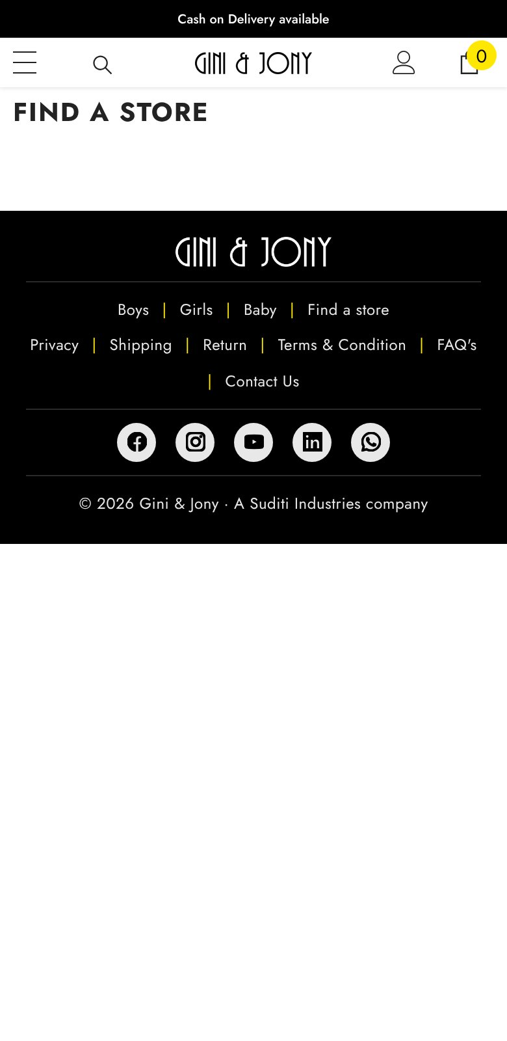
The store network is invisible online
STORES
Find a store has a heading and an empty body. At acquisition (Nov 2024) the brand reported 59 standalone stores, 70+ large-format outlets and ~600 dealers.
No page offers call, WhatsApp or directions, so no campaign can be credited with a walk-in.
/pages/find-a-store
Gini & Jony · Schbang · CRO Audit, Phase 1
15
Notes:
MEASURED: empty page. Store counts from Nov 2024 acquisition coverage (Indian Retailer); TO VALIDATE against today's store master after the Suditi transition.

Slide 16
Parents’ questions, scored where they land
INTENT AUDIT
Who · question | Where | What happens today | Verdict
Relative · “A gift for a 6-month-old” | Shop by age 0–2 | 46% of products have no baby size; no size filter | Answered wrongly
Parent · “Something festive for Diwali” | Search, home | No festive range; summer hero | Not answered
Parent · “Which size fits my 4-year-old?” | Product page | Bare numbers; chart is an image | Needs a click
Parent · “Jeans in size 12, in stock” | Listing | No size filter; size 12 is 39% in stock | Not answered
Parent · “Is it well made?” | Product page | No reviews, 3 photos, template copy | Not answered
Parent · “Can I pay cash and exchange?” | Product page | COD and 7-day exchange by the button | Answered
Parent · “Will it arrive by Saturday?” | Product page | No pincode check or delivery date | Not answered
Store shopper · “Is there one near me?” | Find a store | Empty page | Not answered
Gini & Jony · Schbang · CRO Audit, Phase 1
16
Notes:
Verdicts MEASURED live. Intents themselves are inferred: TO VALIDATE against site search, Search Console, WhatsApp/call-centre logs and store-staff questions.

Slide 17
Independent kidswear brands, same day, same phone
COMPETITION
Kids’ products only | Gini & Jony | Cherry Crumble | PS Peaches | Kidbea
Median price | ₹824 | ₹2,467 | ₹684 | ₹749
New styles created Aug–Oct | 2 | 61 | 84 | 346
Festive / ethnic styles | 0 | 18 | 799 | 40
Party / occasion styles | 3 | 99 | 109 | 83
Size options in stock | 45% | 62% | 33% | 66%
Sizes labelled by age | No | Yes | Yes | Yes
Median photos | 3 | 6 | 7 | 10
Discounted · median depth | 100% · 25% | 56% · 40% | 100% · 82% | 87% · 39%
Reviews app | None | Judge.me | Judge.me | Judge.me
Phone-first checkout | No | Not detected | GoKwik | GoKwik
Source: each brand’s public Shopify product feed, 7 Oct 2026; apps from homepage source. Ed-a-Mamma isn’t on Shopify, so it couldn’t be compared.
Gini & Jony · Schbang · CRO Audit, Phase 1
17
Notes:
MEASURED. 'New' uses Shopify's created date, which doesn't reset on republish. Gini & Jony doesn't lose on price or on trust basics; it loses on freshness, occasion and fit language, and it has a store network the comps don't.

Slide 18
What We Do Next
SECTION 03
Fix, stock the shelf, then test
GINI & JONY
SCHBANG
Notes:
Sequenced around Diwali on 8 Nov 2026.

Slide 19
Defects to fix this week, not test
FIX NOW
Fix | Why it isn’t a test | Effort
Remove the “someone has placed an order” countdown | False urgency: regulatory and trust risk | Hours
Replace the 12 placeholder tiles with real best-sellers in her size | Placeholder content at the highest-intent moment | Hours
Fill Find a store: address, hours, call, WhatsApp, directions per store | Empty page for a store brand | 1–3 days
Move the 257 non-baby products out of “0–2 Years” | The age filter returns wrong results | 1 day
Fix the empty menu link; merge the three special-price collections | Dead ends and duplicate routes | Hours
Hide or sink the 179 sold-out products in listings | Dead ends inside listings | Hours
Swap the summer hero; tidy vendor and product-type values | Season and data hygiene | Hours
Consent banner; reconcile GA4, Ads and Meta purchases; add Clarity | Without these, no test result can be trusted | 2–4 days
Gini & Jony · Schbang · CRO Audit, Phase 1
19
Notes:
Target: all shipped by 20 Oct 2026, before the festive freeze.

Slide 20
Phase 1 runs around Diwali
THE PLAN
PHASE 1
PHASE 2
PHASE 3
PHASE 4
By 20 Oct
By 25 Oct
25 Oct – 15 Nov
From 16 Nov
Fix
Stock the shelf
Festive freeze
Test
Fake timer, placeholders, store page, age tags, tracking
Festive and winter online, or a store bridge
Reversible changes only; free-shipping nudge as a holdout
Age-labelled sizes, size filter, buy button on first screen, phone checkout
Gini & Jony · Schbang · CRO Audit, Phase 1
20
Notes:
Run tests within paid traffic already being bought; never pause working media to create a control.

Slide 21
Tests in priority order, after the freeze
TEST BACKLOG
# | Change | Because | Primary metric · guardrail
1 | Label sizes by age (“3–4 Y”), chart as text | Parents shop by age; today they must translate | PDP→ATC · size exchanges
2 | Size filter; in-stock-first sorting | 38% of in-stock PDP visits hit a missing size | Sessions with ATC · listing exits
3 | Free-shipping progress bar + sized add-on | 95% of products start below ₹1,499 | AOV · checkout completion
4 | Buy button on the first screen | ATC starts at 981px on an 844px screen | PDP→ATC · accidental adds
5 | Phone-first checkout with COD scoring | Email-first, 9 required fields | Checkout→order · RTO %
6 | Reviews via WhatsApp + 5 photos per style | No reviews; median 3 photos | PDP→ATC by review band
7 | Store pages with call / WhatsApp / directions | No store action exists today | Store actions per 1,000 sessions
Gini & Jony · Schbang · CRO Audit, Phase 1
21
Notes:
Each test ships with a scale-or-stop threshold agreed before it runs, e.g. test 1 scales if ATC rises 3%+ relative at 90% confidence with no rise in size exchanges. Sample sizes once GA4 traffic is known.

Slide 22
The size-break leak, with assumptions visible
SIZING THE PRIZE
On an in-stock product, a parent finds her child’s size missing about 38% of the time (measured). What she does next decides the loss:
If she finds a substitute… | Visits lost | Per 100,000 product-page visits
70% of the time | 11% | ≈ 460 carts · ≈ ₹2.8 lakh
50% of the time | 19% | ≈ 760 carts · ≈ ₹4.6 lakh
30% of the time | 27% | ≈ 1,060 carts · ≈ ₹6.4 lakh
Placeholders until GA4 access: 4% add-to-cart, 55% checkout completion, ₹1,100 order value. Only the 38% is measured. The substitution rate is what the size filter and in-stock sorting are meant to move.
Gini & Jony · Schbang · CRO Audit, Phase 1
22
Notes:
Lost visits = 38% × (1 − substitution rate). Carts = 100,000 × 4% × lost share. Revenue = carts × 55% × ₹1,100. HYPOTHESIS until replaced with GA4 numbers.

Slide 23
Three things we’d hold off on
WHAT WE WOULD NOT DO
01
02
03
Deeper discounts
Hero tests first
Personalisation tools
Every product is already marked down. More depth erodes margin without fixing a missing size or an empty festive shelf.
They would optimise the route to a listing that can’t yet deliver the right size.
Not before the age data and tracking are right. Three simple rules with holdouts come first.
Gini & Jony · Schbang · CRO Audit, Phase 1
23
Notes:
Also not recommended: exit pop-ups or spin wheels, and scaling paid traffic to collection pages before the age filters are fixed.

Slide 24
Phase 2
SECTION 04
Turning estimates into measured numbers
GINI & JONY
SCHBANG
Notes:
What we need from Gini & Jony to move every TO VALIDATE to MEASURED.

Slide 25
What we need from Gini & Jony
PHASE 2
STEP 1
STEP 2
STEP 3
STEP 4
Week 1
Week 1
Week 2
Week 3
Data access
Merch answer
Intent inventory
Store list
GA4, Shopify orders with COD/RTO and exchange reasons, Ads and Meta settings
Is a festive or winter range in stores or the warehouse, ready to go online?
Site-search terms, Search Console, WhatsApp and store-staff questions
Current store master: ID, address, phone and hours, per store
Gini & Jony · Schbang · CRO Audit, Phase 1
25
Notes:
With these, Phase 2 replaces every placeholder in the sizing with real numbers and sets test sample sizes.

Slide 26

Thank you
Schbang CRO · CRO Audit, Phase 1 · October 2026
GINI & JONY
SCHBANG
Notes:
Close.

