Slide 1
Conversion Rate Optimisation
Building the journeys that turn organic traffic into leads
Manav Rachna Educational Institutions | MRIIRS · MRU
2,91,492
67.4%
90 days
5
Sessions analysed
From organic search
GA4 behavioural data
Distinct user journeys
Prepared by Schbang · September 2026
Notes:
Opening frame: the client asked for 100% organic lead growth. SEO drives the traffic multiplier; CRO drives the conversion multiplier. This deck covers the CRO half.

Slide 2
THE ANSWER, UP FRONT
The traffic is there. The next step isn’t — and neither is the lead event.
Where the constraint sits, what we would do first, and what the target means in numbers
01 WHERE THE CONSTRAINT IS
02 WHAT HAS TO HAPPEN FIRST
03 WHAT WE WOULD DO
MEASURED
TO VALIDATE
HYPOTHESIS
0.6%
0
2×
of sessions reach any page built to capture a lead
lead events configured in GA4 today
organic leads = 1.33 traffic × 1.50 conversion
Organic is 67.4% of sessions and they engage (68.4%). Course, fee, blog and proof templates take 43% of landings but fire 12% of form submits. Each answers its visitor’s question, then offers no next step: after 6,964 returns from the fee page, 6 users continue.
form_submit exceeds form_start on course pages (209 vs 64) and file_download fires on any file. Every conversion figure here is directional until generate_lead exists. Weeks 1–2: instrumentation, plus five verified defects such as the Fee Calculator redirecting home.
Put the next step where each question is answered: a fee summary on the course page, one fee card plus a call on the fee page, a programme link in every article. Illustratively, the CRO half needs ~590 more organic sessions a quarter to reach a capture point — under 1 in 100 of those already landing on these templates.
WHAT ALREADY WORKS The /mriirs and /mru hubs: 76.1% engagement, 3.33 views per session and 517 of 613 Apply-MRIIRS clicks. We protect this template and copy its pattern — self-segment in one step, route onward — onto the pages that leak.
Source: GA4 — MREI Regular Website, 11 Jun – 10 Sept 2026 (sessions, paths) · GA4 event export by page type (event counts) · Live site audit, 24 Sept 2026. Value maths on “Leads = sessions × reach × capture”.
Notes:
Open with the answer. Three things: where the constraint is (reach to a next step, not traffic), what has to happen first (measurement — there is no lead event), and what the target means in numbers. The credit line at the bottom matters: the institution hubs already work, and the plan protects them.

Slide 3
HOW THIS DECK IS BUILT
Data first. Behaviour second. Only then, problems and fixes.
Every recommendation traces back to a metric, a path, an event or a screenshot.
01
02
03
04
05
06
07
The opportunity
What users actually do
The five journeys
What breaks
What the site should do
Page & template fixes
Experimentation
Traffic, organic share, where conversion happens
Events + page paths: move, stop, loop, signal
Evidence + page path for each persona
Three gaps + sitewide template issues
Journey and interaction architecture
Course · Fees · Proof · Blog · Institution
Fix-first list + A/B test backlog
↑ THE HOOK: sections 01 and 02
CLAIM LABELS
MEASURED
seen in GA4 or on the site
TO VALIDATE
measured, dirty definition
HYPOTHESIS
our proposal, to test
THREE EVIDENCE SOURCES — LABELLED ON EVERY SLIDE, NEVER MIXED ON ONE METRIC
GA4 EXPLORATIONS
GA4 EVENT EXPORT
LIVE SITE AUDIT
Sessions, engagement, landing pages and Path Exploration, 13 Jun – 10 Sept 2026. The numbers already in this deck — unchanged.
Event counts by page type and persona (form_start, form_submit, Apply, phone, brochure, scroll). A separate pull: event counts, not sessions.
manavrachna.edu.in inspected 24 Sept 2026 at 390px mobile and 1440px desktop; official MREI pages for proof claims.
Notes:
Story spine. The two GA4 pulls are built differently: explorations report sessions and path movement; the event export counts events on the page type where they fired. We use both, label both, and never divide one by the other.
Claim labels: every content slide carries one in the top-right corner. MEASURED = observed in GA4 or on the live site. TO VALIDATE = measured, but the event behind it is not a clean definition (form_submit, file_download) or two cuts disagree. HYPOTHESIS = a proposal that a test or MREI confirmation has to prove.

Slide 4
01
The opportunity
Traffic is not the problem. Where it converts is.

Slide 5
MEASURED
What the data says today
Organic already dominates. The site holds attention. It does not convert it.
67.4%
1.96
3m 08s
43.6%
of sessions are organic search
average views per session
average session duration
site-wide bounce rate
1,96,542 sessions · 68.39% engagement
Site-wide · most users see one page and leave
Users are reading, not bouncing quickly
Against 23.9% on the pages that work
THE ENGAGEMENT IS REAL
THE CONVERSION IS NOT
Institution pages hold users for 5m 07s at 3.33 views per session
Fee and eligibility pages engage 73.4% of sessions at 26.6% bounce
Mobile engages at 65.4% against desktop at 47.7%
AI Assistant traffic is the deepest on the site at 2.43 views per session
Only 0.6% of sessions reach any page built to capture a lead
The highest-traffic course page produced 21 form starts in 90 days
Apply Now was clicked 5 times on that same page across 90 days
No lead event is configured in GA4, so nothing is being measured today
Source: GA4 — MREI Regular Website, 11 Jun – 8 Sept 2026 (traffic) and 13 Jun – 10 Sept 2026 (page and event data).
Notes:
The point of this slide: traffic is not the problem and engagement is not the problem. The conversion surface is missing.
RECONCILE BEFORE SENDING: this slide says B.Tech CSE produced 21 form starts and 5 Apply Now clicks in 90 days. The event slide shows 47 Apply Now clicks on the same page, and the appendix journey slide shows 3 + 20 = 23 form starts and 38 main-nav Apply clicks. These are probably different buttons / event definitions — name the one used here.

Slide 6
TO VALIDATE
THE OPPORTUNITY · EVENT DATA
Intent lands deep. Conversion happens shallow.
Share of landings vs share of intent events, by page type — the pages built for each persona barely convert
HOMEPAGE + INSTITUTION ROOT
48% → 87%
48% of landings, 87% of form_submit events and 96% of form_start events. The generic pages do almost all the converting.
THE FIVE PERSONA TEMPLATES
43% → 12%
Course, fee, blog and proof pages take 43% of landings but only 12% of form submits. So what: the pages that answer each persona’s question have no working capture point.
Source: GA4 event export by page type (event counts; separate pull, not directly comparable). Shares compare landings with events fired on that page type — a directional comparison, not a conversion rate.
Notes:
Hook 1. Read as: where people arrive vs where intent events fire. Events are counted on the page type where they fired, so a homepage form_submit may come from a user who landed elsewhere — this is why we call it a comparison of shares, not a conversion rate.

Slide 7
MEASURED
THE OPPORTUNITY · MEASUREMENT
What we count — and what we can’t count yet
The KPI hierarchy for this programme, with the honest status of each signal in GA4 today
Leads
No lead event is configured in GA4 (see “What the data says today”). form_submit fires 2,266 times, but exceeds form_start on course pages (209 vs 64) — it is not a clean lead signal.
NOT MEASURABLE YET
MACRO
Leads
Phone clicks · 658 events
Number_footer 620 · Number MRIIRS 26 · MRU 7 · MROnline 5. Mail clicks: 54.
TRACKED
Apply Now clicks · 3,028 events
Main 2,281 · MRIIRS 613 · MRU 134. form_start: 3,415.
TRACKED
Brochure · 2,746 + 971 events
Download_Brochure 2,746 (brochure page). file_download 971 fires on any file, not only brochures.
PARTLY
MICRO
Intent actions
Google / GMB clicks · Save to shortlist
Evidence not available in current dataset. GMB clicks live in Google Business Profile, not site GA4; no shortlist feature was found on audited pages.
MISSING
Progression
90% scroll: 35,150 events. Site search results: 99 (homepage only). Path movement: GA4 Path Exploration (section 02).
TRACKED
BEHAVIOUR
Progression
Fee search · Fee calculator
No event exists for either — usage of the fee page’s own tools is invisible today.
MISSING
Source: GA4 event export by page type (event counts; separate pull, not directly comparable); lead-event status as stated in this deck; Live site audit, 24 Sept 2026.
Notes:
Primary KPI hierarchy: 1) Leads, 2) meaningful micro-conversions, 3) progression. The macro KPI cannot be baselined until a lead event exists — this is why Phase 0 in section 07 is measurement.

Slide 8
THE OPPORTUNITY · FUNNEL ECONOMICS
Leads = sessions × reach × capture. The leak is the middle term.
Where a unit of CRO effort buys the most leads — with the assumptions on the slide, not in a footnote
ORGANIC SESSIONS
REACH A CAPTURE POINT
CAPTURE RATE
LEADS
1,96,542
×
0.6%
×
?
=
—
per 90 days · SEO’s term: +33% target
of sessions today · the leak
no lead event to measure it
not measurable today
MEASURED
MEASURED
TO VALIDATE
TO VALIDATE
LEVER
TODAY
REALISTIC MOVE
EFFORT
RANK · WHY
Reach a capture point
0.6% of sessions reach a lead page; 6 continue after the CSE–fee round-trip
Bring the next step onto course, fee and blog pages: 0.6% → 0.9%
Medium · template
1 · Leak and lever: 43% of landings meet no next step
Capture intent already shown
483 brochure downloads vs 47 Apply on CSE; 82 calls vs 31 submits on fee pages
Record who acts: optional WhatsApp send, callback beside the fee
Low · config
2 · Intent is already expressed — we just don’t know who
Capture rate on forms
Unknown — form_submit is not a clean lead
Set after Phase 0 gives a baseline
Low–medium
3 · Cannot be ranked until it is measured
Organic traffic
1,96,542 sessions / 90 days
+33% via the SEO programme
High · slow
Out of scope here — compounds with every CRO gain
HYPOTHESIS
Worked illustration: holding capture rate flat, +50% leads needs reach to rise from 0.6% to 0.9% of organic sessions — 1,179 → ~1,770 a quarter. That is ~590 more sessions, or 0.7% of the ~84,500 organic sessions that land on course, fee, blog and proof templates. Assumes the site-wide 0.6% and the export’s 43% landing share both hold for organic traffic.
Source: GA4 — MREI Regular Website, 11 Jun – 8 Sept 2026 (organic sessions) · GA4 event export by page type (landing shares, event counts) · lead-event status as stated in this deck.
Notes:
Funnel economics: Leads = organic sessions × share that reaches a capture point × capture rate. Traffic is SEO's term. Capture rate cannot be ranked until Phase 0 gives it a number. Reach is both the leak (0.6%) and the lever (43% of landings meet no next step). The worked illustration is a hypothesis — its assumptions are printed on the slide.

Slide 9
02
What users actually do
Where users move, stop, loop back — and where they signal intent.

Slide 10
TO VALIDATE
WHAT USERS ACTUALLY DO · EVENT MAP
Every page type signals intent differently
Page type → event → volume → persona. Cell shade = that page type’s share of the column total
Page type | Persona (export mapping) | Landings | Form start | Form submit | Apply | Phone | Brochure DL | File DL | 90% scroll
Homepage | Unassigned | 48,383 | 2,432 | 1,367 | 1,952 | 271 | 0 | 111 | 11,781
Institution root | Shortlister | 15,837 | 833 | 607 | 774 | 260 | 0 | 302 | 6,900
Course page | Course Researcher | 14,615 | 64 | 209 | 50 | 4 | 0 | 516 | 916
Programme-type hub | Course Researcher | 1,320 | 13 | 14 | 71 | 21 | 0 | 0 | 2,892
Cost & eligibility | Cost Checker | 8,995 | 31 | 31 | 112 | 82 | 0 | 39 | 5,899
Admissions info | Cost Checker | 307 | 8 | 4 | 13 | 9 | 2,746 | 0 | 1,016
Blog index | Early Explorer | 32,318 | 22 | 21 | 0 | 0 | 0 | 0 | 42
Blog article | Early Explorer | 26 | 0 | 0 | 0 | 0 | 0 | 0 | 6
Campus life & experience | Proof Seeker | 191 | 1 | 1 | 3 | 2 | 0 | 2 | 248
Student utility | Non-prospect | 11,610 | 11 | 12 | 53 | 9 | 0 | 1 | 5,340
Other / unclassified | Non-prospect | 51 | 0 | 0 | 0 | 0 | 0 | 0 | 110
Total |  | 133,653 | 3,415 | 2,266 | 3,028 | 658 | 2,746 | 971 | 35,150
COURSE PAGES DOWNLOAD
516 file downloads vs 50 Apply clicks and 4 phone clicks. The course moment wants a document.
FEE PAGES CALL
82 phone clicks vs 31 form submits — the only high-volume page type where calls beat submits.
HUBS APPLY
Institution roots carry 517 of 613 Apply-MRIIRS clicks and all 134 Apply-MRU clicks.
BLOG DOES NOTHING
32,318 blog-index landings → 0 Apply, 0 phone, 42 scroll events. Check traffic quality before optimising.
Source: GA4 event export by page type (event counts; separate pull, not directly comparable). Apply = Main + MRIIRS + MRU; Phone = Number_footer + MRIIRS + MRU + MROnline.
Notes:
Event counts are not users and not sessions. The first column (landings) is session_start by landing page type; every other column counts events on the page type where they fired.

Slide 11
MEASURED
Five questions, arriving at one site
Every landing page classified by the question the user came with — 1,52,694 prospect sessions
1
Course Researcher
"What is this course, and is it worth it?"
35%
53,812 sessions · 35%
66.2% engagement · 1.78 views/session
2
Proof Seeker
"Should I believe what they claim?"
18%
27,579 sessions · 18%
Faculty, placements, rankings, campus life
3
Cost Checker
"What does it cost, and can I get in?"
15%
23,219 sessions · 15%
73.4% engagement · 26.6% bounce — highest intent
4
Early Explorer
"What should I even study after 12th?"
15%
22,813 sessions · 15%
59.6% engagement · 1.20 views/session — lowest depth
5
University Shortlister
"Is this university right for me?"
12%
18,752 sessions · 12%
76.1% engagement · 3.33 views/session — best on site
Source: GA4 — Landing page + query string, 13 Jun – 10 Sept 2026. Excludes existing-student utility pages, news, research and pages under 20 sessions.
Notes:
Personas are derived from observed landing behaviour, not assumed demographics. Shortlister is highlighted because it is the one journey that already works.

Slide 12
MEASURED
WHAT USERS ACTUALLY DO · PAGE PATH EXPLORATION
Three movement patterns repeat across the site
Users rarely move forward. They round-trip, climb back up, or hop between the MREI, MRIIRS and MRU copies of a section
01
ROUND-TRIP
02
CLIMB-BACK
03
CROSS-BRAND HOP
B.Tech CSE
Fee structure
B.Tech CSE
B.Tech CSE
Listings · home
MRIIRS
MRU
84.3%
of onward movement from CSE goes to the fee page
491
next-step moves from CSE go up to UG listings (202 + 167), homepage (70), /mriirs (52)
494
users jump from the MRIIRS fee page to the MRU fee page
99.3%
of movement from the fee page comes straight back
1,236
fee-page moves go to the homepage — its #2 next step
166
move from /mru to /mriirs
6
users continue anywhere after that
673
moves from /mriirs go to the homepage
167
move from B.Tech to /academics/undergraduate (MREI copy)
SO WHAT
SO WHAT
SO WHAT
The answer to the course decision lives on a different page — users fetch it and return.
When a page doesn’t offer the next step, users go back up the tree to look for it.
Users are still choosing between institutions at the fee stage — the site makes them do it by hand.
Source: GA4 explorations, 13 Jun – 10 Sept 2026 (figures as used in this deck). Percentages are shares of onward event movement, not of sessions.
Notes:
Hook 2. Every figure on this slide is from the path explorations already in this deck (course, fee, institution and journey slides). Nothing new is computed here — the slide just puts the three patterns side by side.

Slide 13
03
The five journeys
For each persona: what we know, the page path, and the question the site fails to answer.

Slide 14
THE FIVE JOURNEYS · INTENT × JOURNEY MATRIX
MEASURED
Five questions, scored where they land
Does the page answer this visitor’s question at each point of the visit? The unanswered cells are the backlog
PERSONA · QUESTION
SESSIONS
LANDS ON
1 · FIRST FOLD
2 · THE ANSWER
3 · THE NEXT STEP
4 · A CAPTURE THAT FITS
RANK
Course Researcher
53,812
B.Tech CSE
BELOW THE FOLD
BELOW THE FOLD
NOT ANSWERED
ANSWERED WRONGLY
1
“Is this course worth it?”
Campaign block before any CSE content
Fee ~13 screens down, year 1 only
6 continue after the fee round-trip
Brochure is an anonymous PDF
Cost Checker
23,219
Fee structure
NEEDS A CLICK
ANSWERED WRONGLY
NOT ANSWERED
NOT ANSWERED
2
“What does it cost — can I get in?”
Search box; 15-column table
Search misreturns; total in column 15
Calculator → homepage; eligibility 7–201
Footer number only; 82 calls vs 31 submits
Proof Seeker
27,579
Awards
IN THE FOLD
NOT ANSWERED
NOT ANSWERED
ANSWERED WRONGLY
3
“Should I believe them?”
Real rankings and awards
NBA for CSE absent from the CSE page
~11% move on; 9 reach fees
Generic Apply / Enquire
Early Explorer
22,813
Blog article
IN THE FOLD
NEEDS A CLICK
ANSWERED WRONGLY
ANSWERED WRONGLY
4
“What should I study?”
Article answers the exam question
0–1 programme links per article
“Also Read” → more posts; home
Apply Now to an undecided reader
University Shortlister
18,752
/mriirs, /mru
IN THE FOLD
IN THE FOLD
IN THE FOLD
NOT ANSWERED
5
“Is this university right?”
Find a Program + NAAC up front
UG / PG / Doctoral hub
Hub routes onward: UG 2,452
No compare route; 673 loop home
How to read it Same template, different verdicts: the fee answer exists on the CSE page, but thirteen screens down it fails the Course Researcher. Rank 1–2 carry the first wave of fixes and tests; the Early Explorer waits for blog traffic to be validated; the Shortlister row is the pattern to copy — its only gap is people still comparing MRIIRS and MRU.
Source: Live site audit, 24 Sept 2026 (390px mobile) · GA4 explorations and landing pages, 13 Jun – 10 Sept 2026 (figures as used in this deck). Priority = sessions × intent value (closeness to a lead).
Notes:
Audit the question, not the template. Each row is a persona with the question it arrives with; each column is a point in the visit. Verdicts come from the live audit (24 Sept) and the GA4 paths already in this deck. Priority = sessions × how close the intent is to a lead — the Cost Checker ranks above the Proof Seeker despite fewer sessions because it is the highest-intent visitor (73.4% engagement, 82 phone clicks). The Shortlister ranks last because it already works: protect it.

Slide 15
Course Researcher
Notes:
Course Researcher — the largest persona. Evidence first, then the page path, then current state.

Slide 16
MEASURED
COURSE RESEARCHER · WHAT WE KNOW
The course page holds attention — but not the decision
“What is this course, and is it worth it?” — B.Tech CSE, the highest-traffic course page on the site
METRIC
WHAT USERS DO
SO WHAT THIS TELLS US
84.3%
Users read the course page, then leave for one missing piece — the fee — and 99.3% come straight back.
The fee question is being resolved outside the course context.
of onward movement from the CSE page goes to the fee structure page
GA4 PATH
516 vs 50
On course pages the download is the most-used action; Apply and form_start (64) trail far behind.
The brochure moment, not Apply, is where this persona is ready to act.
file downloads vs Apply Now clicks on course pages (event counts)
CSV
4
Course Researchers self-serve. They almost never call from a course page.
A call CTA is not this persona’s next step; a document or a fee answer is.
phone-click events on course pages — 0.6% of all phone clicks, from 10.9% of landings
CSV
~13 screens
The fee exists on the page — at 11,288px of a 16,456px mobile page. Specialisation fees and installments exist only on the fee table.
The gap is placement and completeness of the fee answer, not its absence.
down: where the CSE page already states “Course fee (first year) INR 3,05,800”
AUDIT
Source: GA4 explorations, 13 Jun – 10 Sept 2026 (figures as used in this deck) · GA4 event export by page type (event counts; separate pull, not directly comparable) · Live site audit, 24 Sept 2026.
Notes:
Unique to this persona: the round-trip to fees and the download-first behaviour. Sticky CTAs, chat and CTA duplication are covered in the sitewide section, not here.

Slide 17
MEASURED
COURSE RESEARCHER · PAGE PATH
Land → fetch the fee → come back → stop
Page path from /mriirs/academics/btech-computer-science-and-engineering
LAND
LEAVE
RETURN
CONTINUE
B.Tech CSE page
Fee structure page
Back to B.Tech CSE
Anywhere else
12,308
84.3%
99.3%
6
landings on the course page
of onward movement (7,010 events)
come straight back (6,964 events)
users go anywhere at all after that
GA4 PATH
AUDIT
SIDE LEAK · CLIMB BACK
ON THE PAGE TODAY
491 next-step moves from CSE go up, not forward: UG listings 202 + 167 · homepage 70 · /mriirs 52.
A “Fee Details” block exists (INR 3,05,800, first year) at ~69% page depth. The table adds installments (1,85,900 + 1,19,900) and specialisation variants (3,33,800).
INTERPRETATION
CRO QUESTION
OPPORTUNITY
The page holds attention but doesn’t finish the decision: users leave for the fee, find it, return — and the journey ends. Because the page already states a first-year fee, the round-trip points to where and how completely the fee is answered.
Why does a page that already states the fee still send most onward movement to the fee table?
A complete, programme-scoped fee summary — year 1, total, installments, specialisation variants — at decision height, with the next step beside it.
Source: GA4 explorations, 13 Jun – 10 Sept 2026 (figures as used in this deck) · Live site audit, 24 Sept 2026. Confirm whether the on-page fee block was live during the path period.
Notes:
Same path as the journey slides that follow; this slide adds the interpretation, the question and the opportunity. Audit caveat: the fee block was observed on 24 Sept; if it was added after 10 Sept the round-trip may partly predate it.

Slide 18
COURSE RESEARCHER · EVENT DATA
TO VALIDATE
The most-used action on the site hands us nothing.
Brochure downloads against every other action people take, counted as events.
ACROSS ALL PAGES IN THE EXPORT
ON THE B.TECH CSE PAGE ALONE
Brochure downloads
3,717
Brochure downloads
483
Apply Now clicks
Form submits
190
3,028
Form submits (not clean leads)
Apply Now clicks
47
2,266
Phone number clicks
1
Here, brochure downloads outnumber Apply Now clicks 10 to 1.
The strongest signal of interest on the site is the one we choose not to capture.
GA4 events export, MREI. Brochure total = Download_Brochure (admissions brochure page) + file_download (course pages). Event counts, not sessions. file_download fires on any file, so 3,717 is an upper bound.
Notes:
These are event counts, not sessions — so they compare cleanly against each other on the same page.
The brochure on a course page is a direct PDF link: no form, no name, no email. The dedicated brochure page carries 2,746 downloads and has no form on it either.
This is not an argument for gating information. Fee, eligibility and curriculum stay free. A marketing brochure is the one asset where a short, honest exchange is fair — and it is currently the most wanted thing on the site.

Slide 19
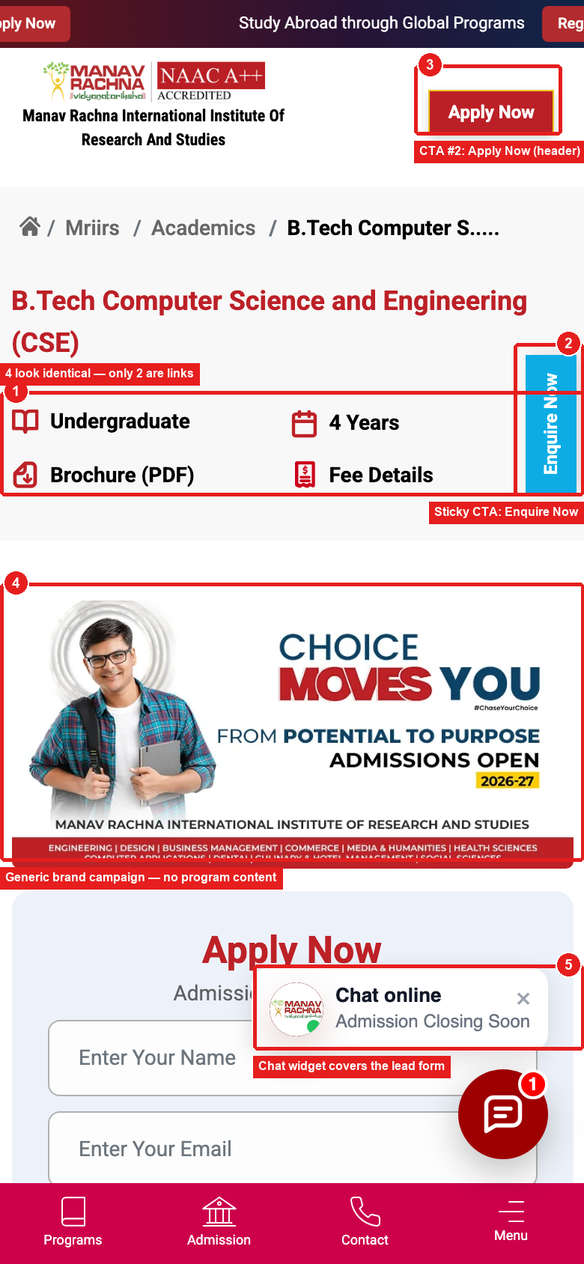
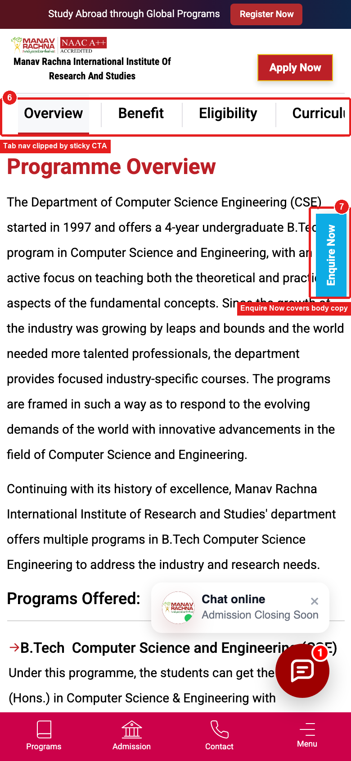
COURSE RESEARCHER · CURRENT STATE
MEASURED
Two phone-width folds, as visitors actually see them
FOLD 1
1
Four stat icons look identical — only “Brochure” and “Fee Details” are actual links.
2
A sticky “Enquire Now” tab sits beside the title, a 3rd CTA before any content.
3
A second “Apply Now” button repeats right next to the page title.
4
First visual block is a generic institute campaign — no CSE content yet.
5
A chat teaser and bubble sit directly over the lead-capture form.
FOLD 2
6
The in-page tab nav (Overview / Benefit / Eligibility…) is clipped by the sticky tab.
7
That same sticky tab covers live paragraph text as the page scrolls.
FOLD 1
FOLD 2

Slide 20

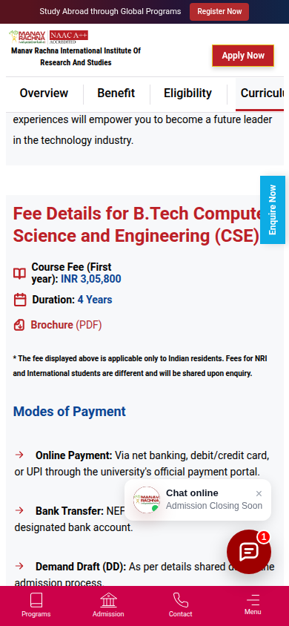
MEASURED
COURSE RESEARCHER · CURRENT STATE
The fee is already on the page — thirteen screens down
B.Tech CSE, 390px mobile. The fold-1 “Fee Details” link jumps to a block at 11,288px of 16,456px
1
“Fee Details” in fold 1 is an anchor jump, styled like the non-link “4 Years” label beside it.
2
DISCOVERABILITY
2
The same link sits in the in-page tab bar as “Fee” — two routes to one block, far below.
1
4
3
FINDABILITY
3
The block gives one number: first-year fee. Installments and specialisation variants (3,33,800) exist only in the fee table.
COMPLETENESS
4
The sticky “Enquire Now” tab clips the fee heading itself (“…Compute | Science”).
So what: move a complete fee answer to decision height — the content exists, the journey can’t reach it.
TEMPLATE ISSUE → SITEWIDE
FOLD 1
SCREEN ~14 · FEE BLOCK
Source: Live site audit, 24 Sept 2026 (CSE page and /mriirs/admissions/fee-structure table values).
Notes:
Measured with a headless browser: fee heading at y=11,288px on a 16,456px document at 390x844. That is ~13.4 viewport heights from the top.

Slide 21
COURSE RESEARCHER · EVENT DATA
TO VALIDATE
At the fee moment, people reach for the phone.
What people actually do on the fee structure page, compared with the course page.
FEE STRUCTURE PAGE
B.TECH CSE COURSE PAGE
Apply Now clicks
97
Brochure downloads
483
Phone number clicks
76
Form submits
190
Brochure downloads
35
Apply Now clicks
47
Form submits
30
Phone number clicks
1
There is no enquiry form on this page.
One phone click, against 76 on the fee page.
WHAT IT MEANS
People will happily read a course page on their own. The moment it turns into money, they want a person — and the fee page gives them a footer number and nothing else.
The fee page is where the conversation should start. Today it is where it ends.
GA4 events export, MREI. Phone = Number_footer plus institution number clicks. Event counts, not sessions.
Notes:
On the fee page, phone clicks outnumber form submits 76 to 30 — and this is the only prospect page in the export where that happens. On the course page the number is 1.
Read together with the previous slide: the course page moment wants a document, the fee page moment wants a person. Neither is served well today — one gives the document away anonymously, the other offers no way to start the conversation.
This is the evidence behind treating the fee page as a conversion surface rather than a reference page.

Slide 22
COST CHECKER
Notes:
Cost Checker — highest-intent visitor. Evidence, page path, current state, findability test.

Slide 23
MEASURED
COST CHECKER · WHAT WE KNOW
At the money moment, users work hard — then reach for the phone
“What does it cost, and can I get in?” — /mriirs and /mru fee-structure pages
METRIC
WHAT USERS DO
SO WHAT THIS TELLS US
70%
The fee page is mostly reached from one course page, and its #1 next step is back to that course (7,070).
The fee page is a downstream answer to a course-level question.
of MRIIRS fee-page entries arrive straight from the B.Tech CSE page
GA4 PATH
82 vs 31
The only high-volume page type where calls beat submits: 12.5% of all phone clicks from 6.7% of landings.
At the money moment, users want a person — the page offers a footer number.
phone clicks vs form submits on fee & eligibility pages (event counts)
CSV
1,236
Forward movement goes home, not to eligibility (7–201) or financial aid (4–71).
There is no forward route from the fee answer to the next decision.
fee-page moves go to the homepage — its #2 next step
GA4 PATH
301 → /
Two Fee Calculator buttons on each fee page (plus the menu and CSE page) send users to the homepage.
The one self-serve fee tool is a dead end. Whether it drives part of the 1,236 homepage moves needs a click event.
every “Fee Calculator” button redirects to the homepage
AUDIT
Source: GA4 explorations, 13 Jun – 10 Sept 2026 (figures as used in this deck) · GA4 event export by page type (event counts; separate pull, not directly comparable) · Live site audit, 24 Sept 2026.
Notes:
Unique to this persona: phone behaviour, the fee-to-homepage exit and the calculator dead end. The link between the calculator redirect and the homepage exits is a hypothesis until a fee_calculator_click event exists.

Slide 24
MEASURED
COST CHECKER · PAGE PATH
Arrive from a course, find the fee, go back — or go home
Page path around /mriirs/admissions/fee-structure
ENTER FROM
ON PAGE
NEXT STEP #1
NEXT STEP #2
B.Tech CSE page
MRIIRS fee structure
Back to B.Tech CSE
Homepage
70%
8,664
7,070
1,236
of MRIIRS fee-page entries
sessions in 90 days · 73.94% engagement
moves back to the course
moves to the homepage
GA4 PATH
GA4 PATH
CSV
CROSS-BRAND HOP
CONVERSION PAGES BARELY REGISTER
WHAT USERS DO ON THE PAGE
494 users jump to the MRU fee page — the institution decision is still open at the fee stage.
Eligibility 7–201 · financial aid 4–71 · admission process 48 as next steps.
82 phone clicks · 31 form submits · 112 Apply clicks · 5,899 90%-scroll events on fee & eligibility pages.
INTERPRETATION
CRO QUESTION
OPPORTUNITY
The page is visited to answer one course’s fee. Users scroll deep, then either return to the course or leave to the homepage. The action they choose is the phone — not the form, not eligibility.
Can a Cost Checker find the exact fee they came for without scanning a long generic table — and is there a next step when they do?
Programme selector → one fee card → a next step for that programme: call admissions, check eligibility, apply. Return link to the originating course.
Source: GA4 explorations, 13 Jun – 10 Sept 2026 (figures as used in this deck) · GA4 event export by page type (event counts; separate pull, not directly comparable).
Notes:
Figures from the fee-structure path exploration already in this deck (journey 02 notes) and the Cost Checker slides; event counts from the export are labelled separately.

Slide 25
WHO LANDS HERE
MEASURED
The Cost Checker, arriving with the highest intent on the site
“What does it cost, and can I get in?” — across both fee-structure templates
12,416
74.0%
~26%
70%
combined sessions across both fee pages in 90 days
average engagement rate — highest of any template on the site
bounce rate — far below the 43.6% site-wide average
of MRIIRS fee-page entries arrive straight from the B.Tech CSE page
MRIIRS — /mriirs/admissions/fee-structure
MRU — /mru/admissions/fee-structure
8,664 sessions · 73.94% engagement · 2.05 views/session · 26.06% bounce
3,752 sessions · 74.07% engagement · 2.11 views/session · 25.93% bounce
“70% of entries arrive from the B.Tech CSE page; strongest onward link points back.”
Same shape as MRIIRS: high engagement, high intent, same round-trip pattern.
WHAT THIS MEANS
This is the most qualified visitor on the entire site — already past research, actively pricing. The template is currently spending that intent on a table they can't read.
Source: GA4 Landing Page Data and Path Exploration, 13 Jun – 10 Sept 2026.

Slide 26
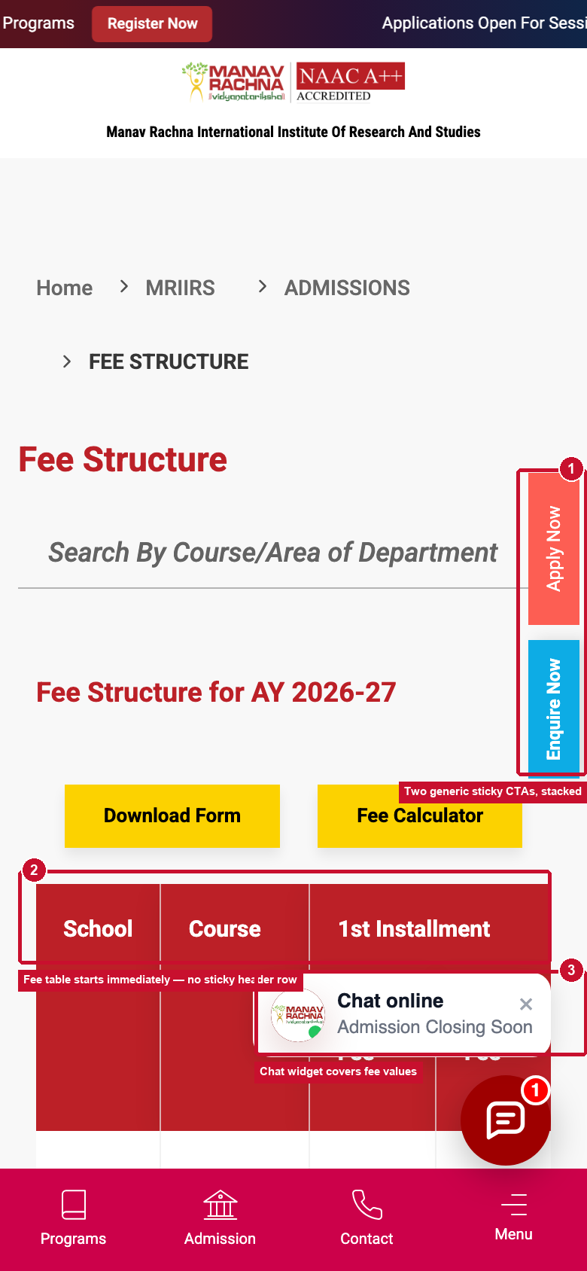
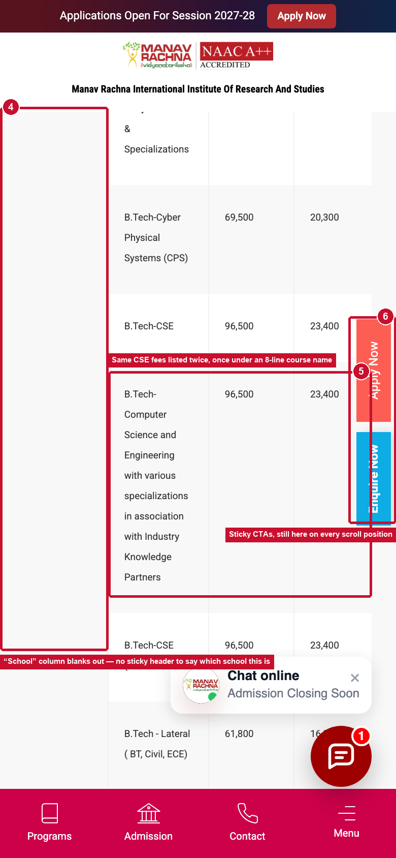
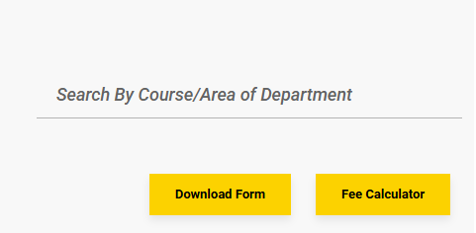
COST CHECKER — CURRENT STATE
MEASURED
MRIIRS Fee Structure Page
1
Two generic sticky CTAs (Apply Now + Enquire Now) stacked — same pattern as the course page.
8,664 sessions in 90 days · 70% arrive straight from the B.Tech CSE page
2
The fee table starts with no sticky header row — scroll two rows and the column labels are gone.
3
The chat teaser and bubble sit directly over live fee values.
4
The “School” grouping column blanks out; nothing tells you which school you're still reading.
5
The same CSE fees are listed twice — once under an 8-line course name.
FOLD 1
FOLD 2
Click redirects to homepage
Button results in dead click
Source: GA4 Landing Page Data, 13 Jun – 10 Sept 2026.

Slide 27
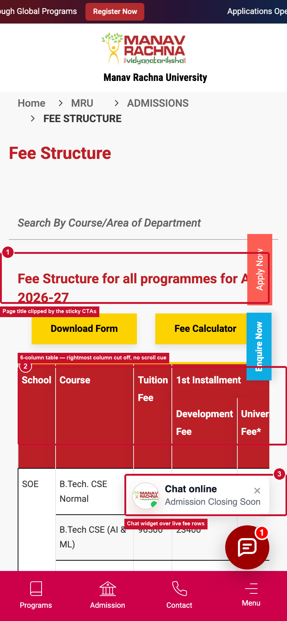
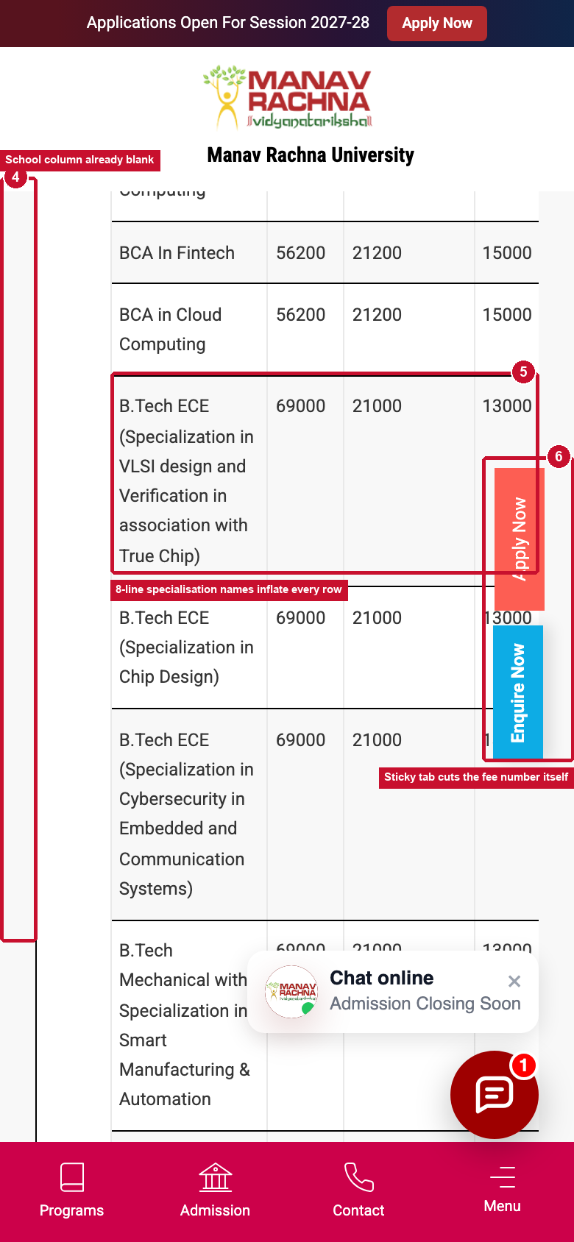
COST CHECKER — CURRENT STATE
MEASURED
/mru/admissions/fee-structure
3,752 sessions in 90 days · 74.07% engagement, 25.93% bounce — the same template, one school over
1
The page title itself is clipped by the sticky CTAs on load.
2
The table runs 6 columns wide — the rightmost “University Fee” is cut off, with no scroll indicator.
3
Chat widget covers live fee rows here too.
4
“School” blanks out even sooner than on the MRIIRS version.
5
8-line specialisation names inflate every row — and the sticky tab cuts a fee number mid-digit.
FOLD 1
FOLD 2
Source: GA4 Landing Page Data, 13 Jun – 10 Sept 2026. Live capture, 390px mobile viewport, 22 Sept 2026.

Slide 28
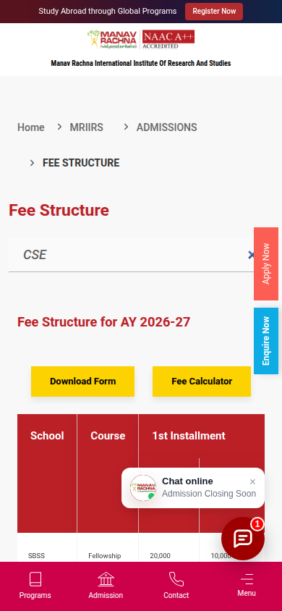
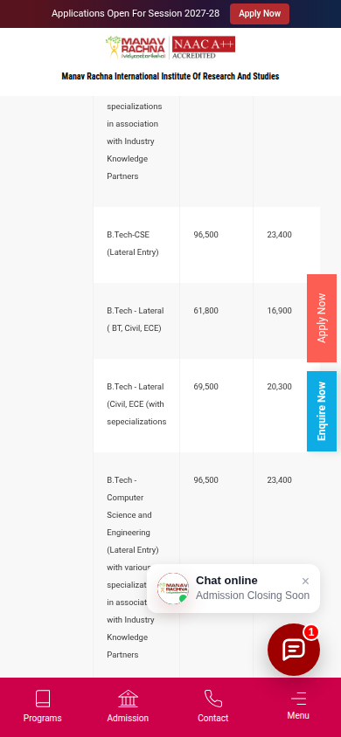
MEASURED
COST CHECKER · FINDABILITY TEST
We searched the fee page for “CSE”
The page has a search box — but it returns the wrong rows and hides the number users came for
1
Search exists (“Search By Course/Area of Department”) and filters live.
WORKS
4
2
“Fee Calculator” → 301 redirect to the homepage.
DEAD END
5
3
“CSE” returns 4 data rows: 2 unrelated (Clinical Psychology fellowship; B.Tech BT/Civil/ECE) kept by the grouped School column.
MISLEADING
1
“CSE” misses “B.Tech – Computer Science and Engineering with various specializations” (3,33,800); “Computer” misses “B.Tech-CSE”.
MISSES
2
4
15 columns; the total fee is the last. The table is 1,642px wide in a 342px container; headers are gone once scrolled.
HIDDEN ANSWER
5
Vertical Apply / Enquire tabs sit over the fee values.
SITEWIDE
3
SEARCH “CSE”
TABLE, SCROLLED
Source: Live site audit, 24 Sept 2026. Search behaviour reproduced on /mriirs and /mru (same component). No GA4 event exists for fee-search usage — evidence not available in current dataset.
Notes:
Marker 5 on the scrolled table: the vertical Apply/Enquire tabs sit over the fee values — covered in the sitewide section. The findability problems (1–4) are unique to this template.

Slide 29
PROOF SEEKER
Notes:
Proof Seeker — proof exists; the question is whether it reaches the programme decision.

Slide 30
MEASURED
PROOF SEEKER · WHAT WE KNOW
The proof exists — it just never reaches the programme
“Should I believe what they claim?” — awards, faculty, placements and rankings pages
METRIC
WHAT USERS DO
SO WHAT THIS TELLS US
67.13%
~11% move onward, mostly through navigation; only 9 reach the fee page.
Proof is consumed where it sits and rarely leads back to a programme decision.
bounce on /mriirs/about/awards-recognitions (1,500 sessions)
GA4
78.19%
A filterable directory of named faculty holds users far better than the certificate gallery.
Proof attached to people, and findable by department, works on this site already.
engagement on /mru/academics/teaching-faculty (926 sessions)
GA4
NBA
The most programme-relevant proof for the highest-traffic course sits on a page 67% of visitors bounce from.
Programme proof is not attached to the programme.
accreditation of B.Tech CSE — stated on the awards page, not in the CSE page text
AUDIT
191
Awards, faculty and placement pages are not mapped to Proof Seeker in the export.
Proof-page event behaviour: evidence not available in current dataset.
sessions mapped to this persona in the event export (campus-life pages only)
CSV
Source: GA4 explorations, 13 Jun – 10 Sept 2026 (figures as used in this deck) · Live site audit, 24 Sept 2026 · GA4 event export by page type (event counts; separate pull, not directly comparable).
Notes:
The export’s persona mapping differs from the deck’s landing-page classification — we keep the deck’s 27,579 sessions and treat the export as silent on proof pages.

Slide 31
MEASURED
PROOF SEEKER · PAGE PATH
Read the proof, then leave — rarely toward a programme
Page path from /mriirs/about/awards-recognitions, with the faculty directory as the contrast
LAND
BOUNCE
MOVE ON
REACH FEES
Awards & recognitions
No second page
Mostly via navigation
Fee structure page
1,500
67.13%
~11%
9
sessions in 90 days
bounce rate
move onward at all
visitors reach fees
GA4
AUDIT
CONTRAST · WHAT WORKS
THE MISSING LINK
/mru/academics/teaching-faculty: 926 sessions, 78.19% engagement, 21.81% bounce — filter by school, department or name.
Awards page: “B.Tech Programmes in CSE & Biotechnology and MBA … accredited by NBA.” CSE page text: no mention of its NBA accreditation.
INTERPRETATION
CRO QUESTION
OPPORTUNITY
Proof pages answer “is this institution credible?” but not “is my programme credible?”. The awards page is a destination, not a bridge; the faculty directory shows that findable, person-level proof holds attention.
Does proof ever connect back to the programme decision it is meant to support?
Attach verified, programme-specific proof to programme pages, and link every award or accreditation to the programmes it covers.
Source: GA4 explorations, 13 Jun – 10 Sept 2026 (figures as used in this deck) · Live site audit, 24 Sept 2026.
Notes:
All path figures are from the Proof Seeker slides already in this deck.

Slide 32
MEASURED
PROOF SEEKER · PROOF INVENTORY
What MREI can actually claim — and where it says it
Verified fact vs interpretation vs recommended presentation. Nothing here is inferred; every row is quoted from an official MREI page
Claim (quoted) | Where it appears | Status | Interpretation | Recommended presentation
NBA accreditation — B.Tech CSE, Biotechnology, MBA (MRIIRS) | Awards page | VERIFIED | Programme-level; high relevance | Badge on each accredited programme page, near the form
QS World University Rankings 2026 debut; QS Asia 2026: 741–750 band, 224th in Southern Asia | Awards page | VERIFIED | Institution-level | Quote the band exactly; institution pages only
“5000+ placements in last few years” · “500+ recruiters” · “QS 5 Star — rated for employability” | Placements overview | NO TIME FRAME | Institution-level | Add the period before reuse
Named offers: 40 LPA & 32 LPA (Headout), 22 LPA (Kazam EV), 19 LPA (Arcesium), 17.78 LPA (American Express) | Placements overview | VERIFIED · UNSCOPED | Programme & year not stated | Attach programme + year, then show on that programme
“60 LPA — Highest CTC Offered” | B.Tech CSE page | UNSCOPED | Higher than any named offer on the placements page (40 LPA) | Confirm source, year and scope before use
NIRF: “Ranked 96th · NIRF Rankings 2025” vs “Top 100 in NIRF Rankings 2026” | Homepage banner vs awards page | CONFLICTING | Different years shown side by side | Reconcile to the current year
NAAC A++ (MRIIRS header logo) vs “NAAC A+ Accredited” (MRU prospectus page) | Header vs brochure page | CONFIRM | May be correct per institution | State the grade per institution
“95% Placement Rate” | Brochure page only | NOT FOUND ELSEWHERE | No source on placement pages | Do not use until verified
“Ranked no. 1 for Research and Placement” | /mru | NO SOURCE NAMED | Ranking body not stated | Name the source or remove
Placement % and average package | Placement pages audited | NOT PUBLISHED | Evidence not available | Request from MREI placement cell
Source: Official MREI pages, read 24 Sept 2026 — /mriirs/about/awards-recognitions, /mriirs/placements/overview, /mru/placements/overview, /mru, B.Tech CSE page, /admissions/download-brochure, homepage.
Notes:
Verified = stated on an official MREI page as quoted. It does not mean independently audited. Rows marked unscoped / conflicting / not found must be confirmed by MREI before they appear in any recommendation or test variant.

Slide 33
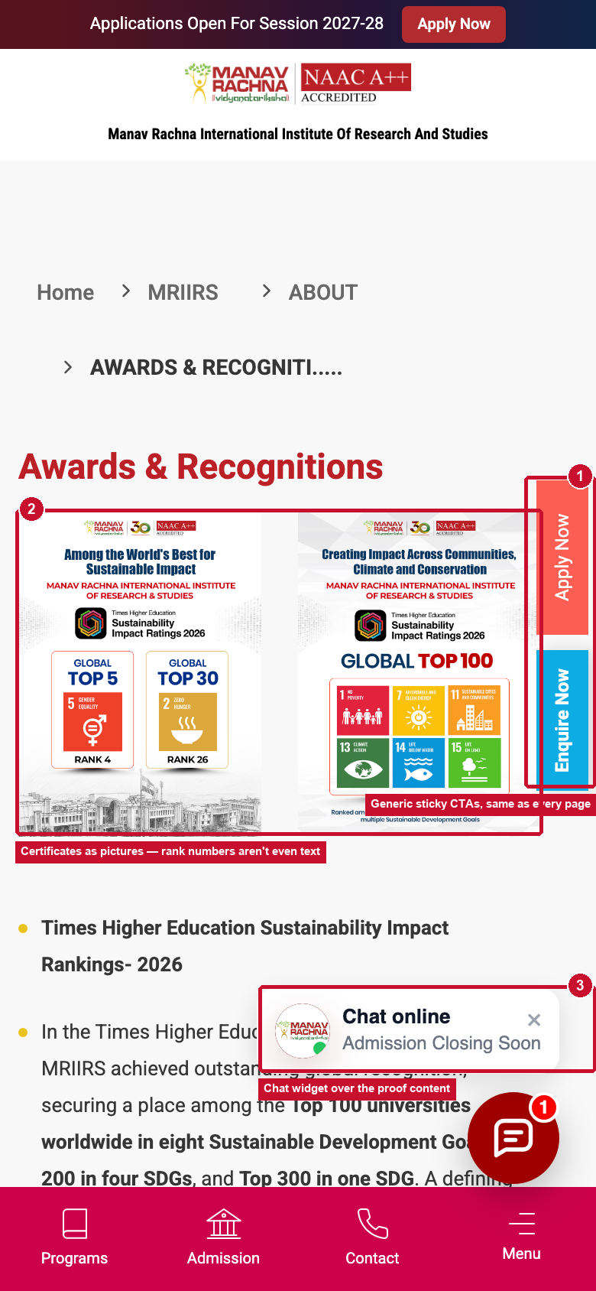
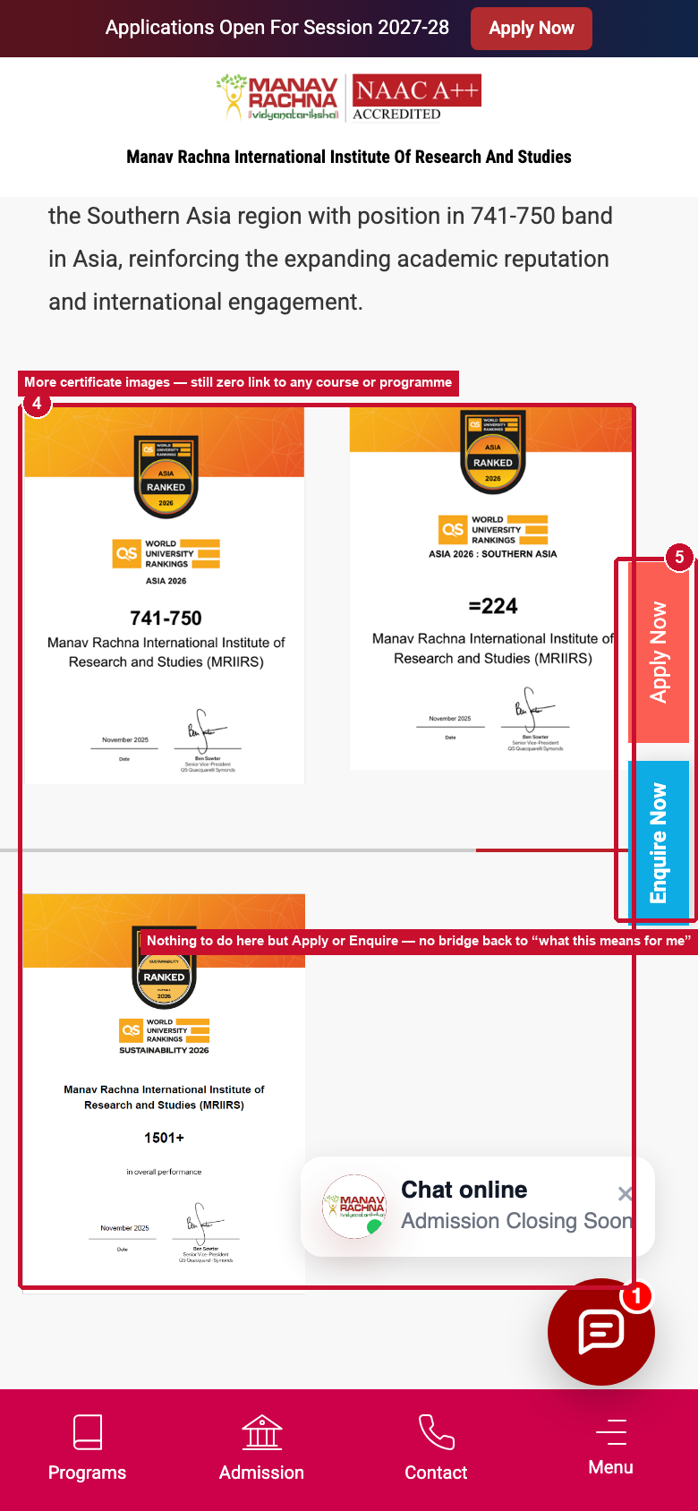
PROOF SEEKER — CURRENT STATE
MEASURED
/mriirs/about/awards-recognitions
1,500 sessions in 90 days · 67.13% bounce — the weakest Proof Seeker touchpoint on the site
1
Real, strong proof content — THE Sustainability Impact Rankings, QS Asia — but presented mainly as certificate images.
2
The rank and what it covers are not the headline — the certificate is.
3
Zero links from any award back to a course, school or department page.
4
Nothing to do here but Apply or Enquire — no bridge to “what this means for me.”
5
Same generic sticky CTAs and chat overlay as every other template.
FOLD 1
FOLD 2
Source: GA4 Landing Page Data, 13 Jun – 10 Sept 2026. Live capture, 390px mobile viewport, 22 Sept 2026.

Slide 34
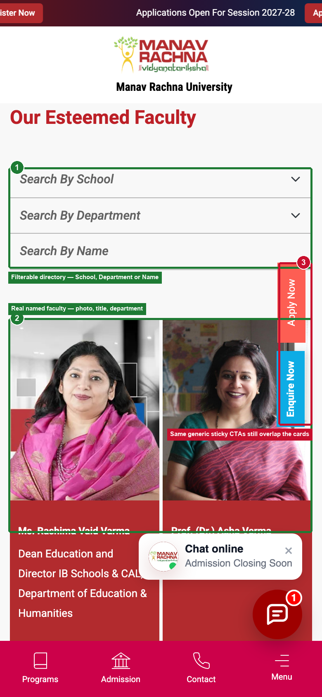
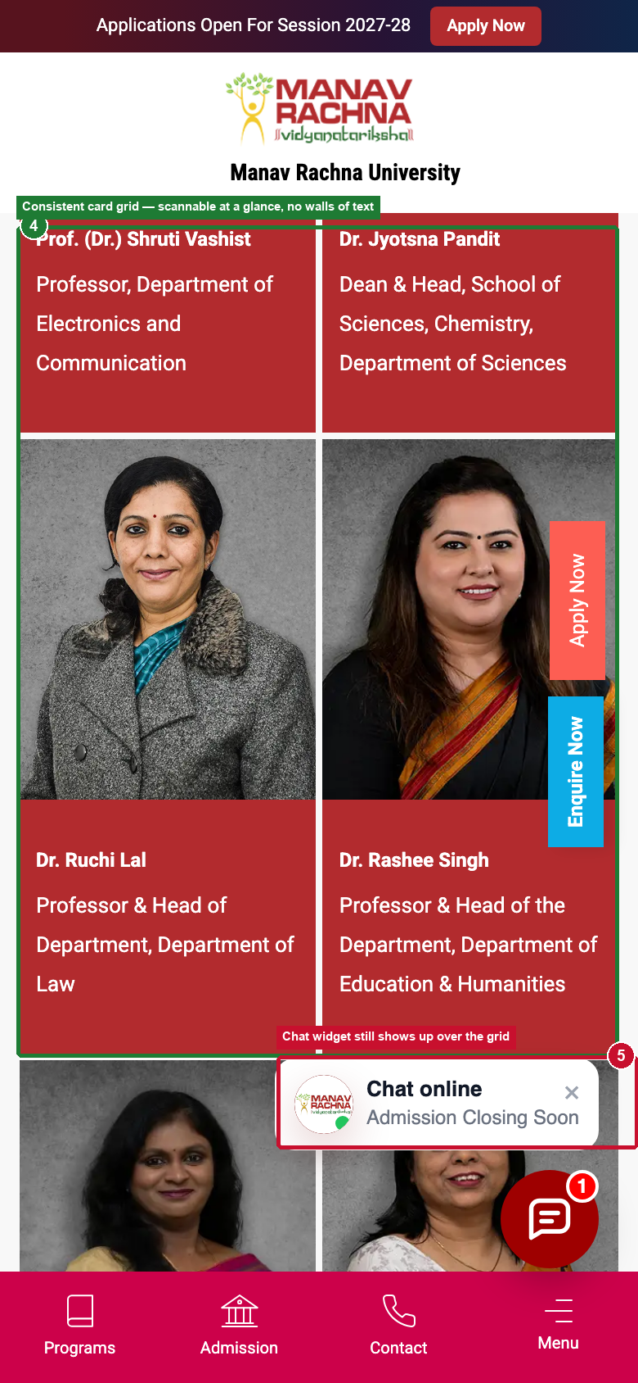
PROOF SEEKER — CURRENT STATE
MEASURED
/mru/academics/teaching-faculty
926 sessions · 78.19% engagement, 21.81% bounce — one of the best-performing pages on the whole site
1
Filterable directory — School, Department or Name — lets a visitor self-serve straight to their answer.
2
Real named faculty: photo, title, department — credibility attached to a person, not a certificate.
3
Consistent card grid stays scannable across every scroll — no walls of text.
4
Still carries the same generic sticky CTAs and chat overlay as the rest of the site.
FOLD 1
FOLD 2
Source: GA4 Landing Page Data, 13 Jun – 10 Sept 2026. Live capture, 390px mobile viewport, 22 Sept 2026.

Slide 35
WHO LANDS HERE
MEASURED
The Proof Seeker — well served in one place, abandoned in another
“Should I believe what they claim?” — faculty, placements, rankings, campus life
27,579
62.2%
sessions sitewide · 18% of all prospect traffic
average engagement rate across every Proof Seeker page
/mriirs/about/awards-recognitions
WEAK
/mru/academics/teaching-faculty
STRONG
1,500 sessions · 32.87% engagement · 67.13% bounce
926 sessions · 78.19% engagement · 21.81% bounce
“~11% move onward; destinations are navigation clicks, only 9 reach fees.”
Outperforms the Proof Seeker average by 16 points of engagement.
WHAT THIS MEANS
This persona isn't uniformly failing — it's inconsistent. The fix is half replication (do more of what /mru/teaching-faculty already does) and half repair (fix the awards page's dead end).
Source: GA4 Landing Page Data and Pivot — Persona (in scope), 13 Jun – 10 Sept 2026.

Slide 36

COMPETITIVE BENCHMARKING
MEASURED
Two ways competitors make proof feel earned, not printed
Observed live and via public faculty profiles
1
Accreditation as text, not a picture
2
Rankings fused to a named person
AMITY ONLINE · HOMEPAGE
BENNETT UNIVERSITY · FACULTY PROFILE
This professor's own bio leads with “World's Top 2% Scientists, Stanford (2023 & 2024)” — the institutional ranking becomes personal credibility for whoever might teach you.
MREI has both halves today (rankings + named faculty) on two different pages that never reference each other.
“UGC Entitled” and “Globally Recognized” sit as compact icon + text badges, readable in one glance and indexable by search — not a certificate scan a visitor has to zoom into.
Source: Amity Online homepage, live capture 22 Sept 2026. Bennett University faculty profile, public page, 22 Sept 2026.

Slide 37
EARLY EXPLORER
Notes:
Early Explorer — informational traffic; the question is progression to programmes.

Slide 38
MEASURED
EARLY EXPLORER · WHAT WE KNOW
Articles answer their own question — then send readers home
“What should I even study after 12th?” — 792 in-scope blog articles
METRIC
WHAT USERS DO
SO WHAT THIS TELLS US
35
~4% move onward at all; the top onward destination is the homepage (82).
Informational traffic has no bridge to the programme it describes.
of 4,195 readers of the NEET/BPT article reach the BPT course page
GA4 PATH
10 : 0–1
Articles link to other articles. The CLAT article links to no law programme.
The link graph keeps readers in the blog or sends them up to the homepage.
in-body blog links vs programme links, in each of 3 sampled articles
AUDIT
0 / 0
21 form submits and no other intent action on this page type.
This template produces no intent signal at all today.
Apply clicks / phone clicks on 32,318 blog-index landings
CSV
42
Implausibly low scroll for a content page — the deck already flags /blog as “Review”.
Validate traffic quality and tracking before optimising this template.
90%-scroll events on 32,318 blog-index landings
CSV
Source: GA4 explorations, 13 Jun – 10 Sept 2026 (figures as used in this deck) · Live site audit, 24 Sept 2026 (articles: best-mba-specialisations, clat-registration…, mat-exam-pattern…) · GA4 event export by page type (event counts; separate pull, not directly comparable).
Notes:
Unique to this persona: link graph and zero intent signal. The deck’s session figure for this persona (22,813) stays as is; the export groups the blog differently.

Slide 39
MEASURED
EARLY EXPLORER · PAGE PATH
Read the article, then go home — not to the programme
Page path from the blog article “Is NEET Compulsory for BPT Admission 2026?”
LAND
MOVE ON
TOP DESTINATION
PROGRAMME
NEET / BPT article
Any second page
Homepage
BPT course page
4,195
~4%
82
35
sessions
move onward at all
moves to the homepage
readers ever reach it
AUDIT
CSV
LINK GRAPH (3 ARTICLES SAMPLED)
BLOG TEMPLATE EVENTS
Each article: ~10 in-body links to other blog posts, 0–1 to a programme page. “Also Read” exists — it never points to a course.
32,318 blog-index landings → 0 Apply · 0 phone · 22 form_start · 21 form_submit · 42 scroll events.
INTERPRETATION
CRO QUESTION
OPPORTUNITY
The article does its job — it answers the exam question — and then offers only more articles. The readers who move on go to the homepage and start over.
Why does informational traffic rarely progress to the programme it describes?
A programme-link rule for every course or exam mention, and an end-of-article card for the matching MRIIRS / MRU programme.
Source: GA4 explorations, 13 Jun – 10 Sept 2026 (figures as used in this deck) · Live site audit, 24 Sept 2026 · GA4 event export by page type (event counts; separate pull, not directly comparable).
Notes:
Path figures are from the Early Explorer slides already in this deck.

Slide 40
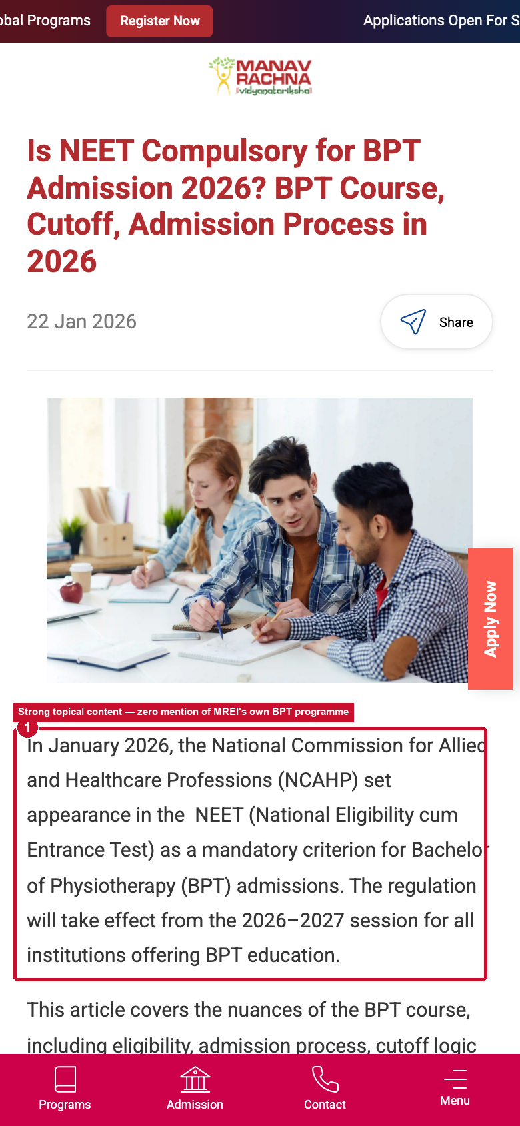
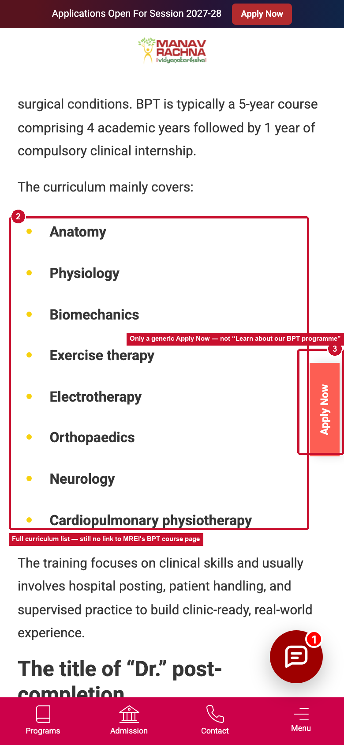
EARLY EXPLORER — CURRENT STATE
MEASURED
“Is NEET Compulsory for BPT Admission 2026?”
4,195 sessions · only 35 readers ever reach the BPT course page
1
1,300+ words on NEET rules and BPT curriculum — genuinely useful, well-researched content.
2
Not one mention of MREI's own BPT programme, anywhere in the article.
3
“~4% move onward; top destination is the homepage (82); only 35 of 4,195 reach the BPT course page.”
FOLD 1
FOLD 2
Source: GA4 Landing Page Data and Path Exploration, 13 Jun – 10 Sept 2026. Live capture, 22 Sept 2026.

Slide 41
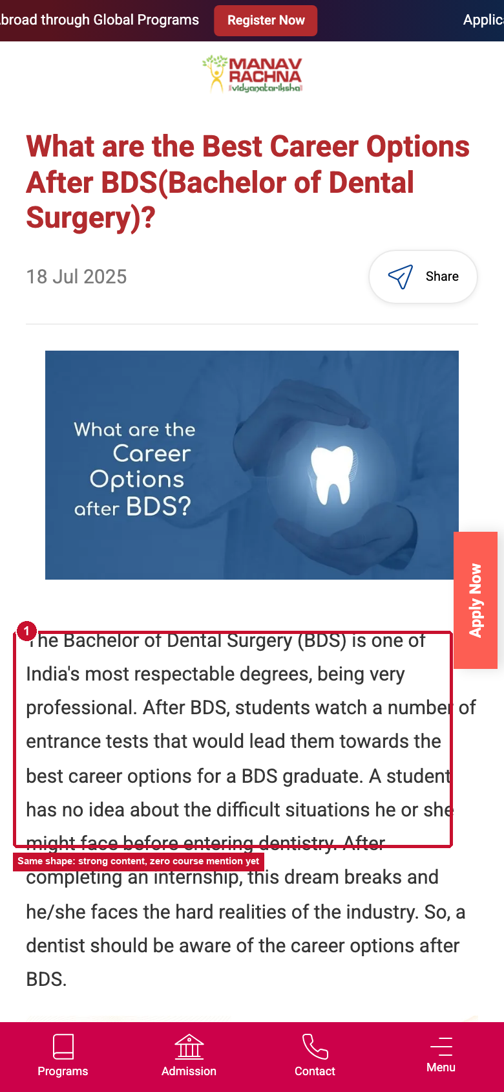
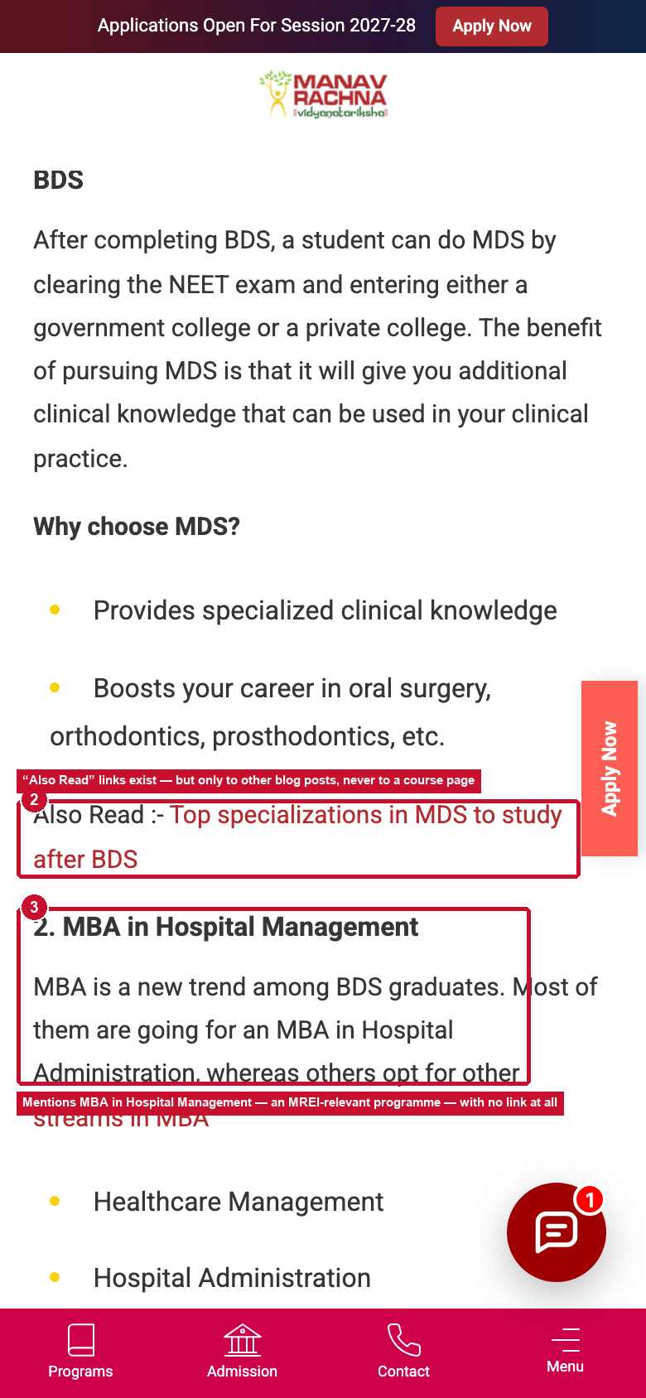
EARLY EXPLORER — CURRENT STATE
MEASURED
“Best Career Options After BDS?”
1,220 sessions · the site already builds in-content links — just not to a course
1
“Also Read” in-content links already exist here — but only point to other blog posts, never a course page.
2
Mentions “MBA in Hospital Management” — a real MRIIRS programme — with no link at all.
3
Scope note: BDS itself sits at MRDC, outside MRIIRS/MRU — the fix is a related MRIIRS programme link, not a direct BDS one.
FOLD 1
FOLD 2
Source: GA4 Landing Page Data, 13 Jun – 10 Sept 2026. Live capture, 390px mobile viewport, 22 Sept 2026.

Slide 42
WHO LANDS HERE
MEASURED
The Early Explorer — lowest depth of any persona on the site
“What should I even study after 12th?” — arrives with a question, leaves with only an answer to that question
22,813
59.6%
1.20
sessions across 792 in-scope articles · 15% of all sessions
engagement rate — lowest of any persona on the site
views per session — also the lowest on the site
/blog (index)
REVIEW
NEET/BPT article
DEAD END
BDS article
DEAD END
33,075 sessions · 68.26% engagement
4,195 sessions · 38.52% bounce
1,220 sessions · 35.16% bounce
Scope flagged “Review” — traffic source unexplained. Fix measurement before optimising further.
Only 35 readers ever reach the BPT course page.
Links to other posts exist — never to a course.
WHAT THIS MEANS
The content answers the question it was written for, then stops. Nothing here asks anything of the reader — which is exactly why depth is the lowest on the site.
Source: GA4 Landing Page Data and Pivot — Persona (in scope), 13 Jun – 10 Sept 2026.

Slide 43

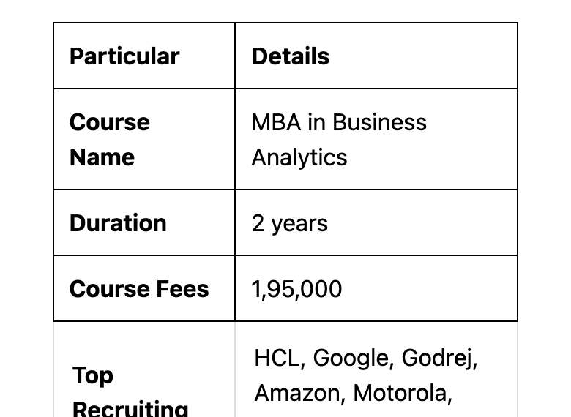
COMPETITIVE BENCHMARKING
MEASURED
Exploration content that still leads somewhere
Observed live on Amity Online's blog
1
Browse by interest, not by exam
2
The explainer article still ends in an answer
AMITY ONLINE · BLOG INDEX
AMITY ONLINE · “WHAT IS AN MBA IN BUSINESS ANALYTICS”
Every article carries a category ribbon (“MANAGEMENT”) instead of just an exam name. The sticky CTA on this template also swaps to “Call Us / 1-1 Counselling” — the right ask for someone still deciding, not “Apply Now.”
Same genre as MREI's NEET/BPT and BDS articles — but this one closes with Amity's own course name, duration, fee, and top recruiters. Curiosity content still resolves into a real answer.
Source: live capture, Amity Online blog, mobile viewport, 22 Sept 2026.

Slide 44
UNIVERSITY SHORTLISTER
Notes:
University Shortlister — the journey that already works; the benchmark for other templates.

Slide 45
MEASURED
UNIVERSITY SHORTLISTER · WHAT WE KNOW
The one journey that already works — the benchmark
“Is this university right for me?” — /mriirs and /mru institution roots
METRIC
WHAT USERS DO
SO WHAT THIS TELLS US
76.1%
Users self-segment in the hub: UG 2,452 · PG 587 · school hub 465 · search 318 · fees 287.
Self-segmentation + onward routing is the pattern other templates lack.
engagement · 3.33 views per session — the best of any persona
GA4
517 / 613
Institution roots also carry 607 form submits and 260 of 658 phone clicks.
Outside the homepage, this is the only persona template that converts at scale.
Apply-MRIIRS clicks that happen on institution roots (all 134 Apply-MRU too)
CSV
673
Users who don’t find their route in the hub loop back to the top.
Even the best template leaks when the user is still comparing.
moves from /mriirs go to the homepage
GA4 PATH
166
Users compare institutions by hopping between parallel copies of the same section.
Comparison between MRIIRS and MRU is unsupported.
moves from /mru to /mriirs (and 494 between the two fee pages)
GA4 PATH
Source: GA4 explorations, 13 Jun – 10 Sept 2026 (figures as used in this deck) · GA4 event export by page type (event counts; separate pull, not directly comparable).
Notes:
Unique to this persona: it works. The recommendation is protect and replicate, plus a comparison route.

Slide 46
MEASURED
UNIVERSITY SHORTLISTER · PAGE PATH
Land on the hub, pick a lane — the pattern to replicate
Onward distribution from /mriirs (11,597 sessions)
2,452 UG hub
GA4 PATH
LAND
LEAK · LOOP HOME
/mriirs
673 moves from /mriirs go to the homepage.
11,597
587 PG hub
sessions · 74.72% engagement · 3.32 views/session
465 School hub
GA4 PATH
318 Search
LEAK · BRAND HOP
166 moves from /mru to /mriirs; 494 between the fee pages.
287 Fees
INTERPRETATION
CRO QUESTION
OPPORTUNITY
Institution roots let users self-segment in one step and route them onward — and they carry 517 of 613 Apply-MRIIRS clicks. The leak is comparison: users who are still choosing loop home or hop brands.
What is working here that other templates should copy — and where do comparers lose the thread?
Protect the hub pattern and replicate it on school pages; add a “compare MRIIRS and MRU” / counsellor route for users still choosing.
Source: GA4 explorations, 13 Jun – 10 Sept 2026 (figures as used in this deck) · GA4 event export by page type (event counts; separate pull, not directly comparable).
Notes:
Distribution figures from the Shortlister slide already in this deck; loops from the journey slides. Apply-click counts from the event export.

Slide 47

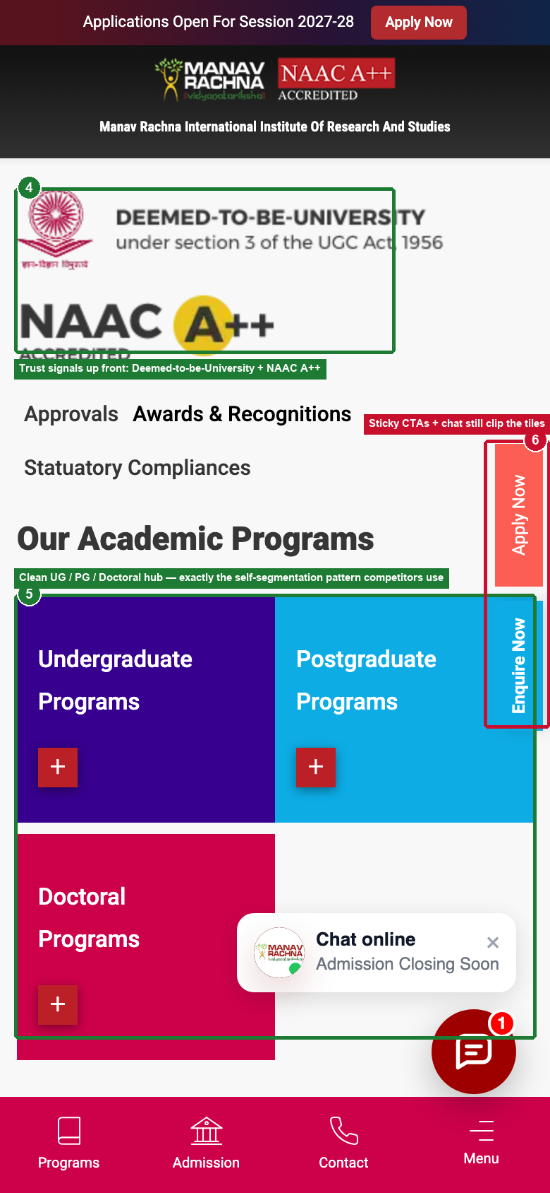
UNIVERSITY SHORTLISTER — CURRENT STATE
MEASURED
/mriirs — the institution root page
11,597 sessions · 74.72% engagement, 3.32 views/session — already one of the best templates on the site
1
“Find A Program” search sits right in the hero — self-segmentation from second one.
2
Trust signals up front: Deemed-to-be-University status + NAAC A++.
3
Clean UG / PG / Doctoral hub — exactly the picker pattern competitors use.
4
Same generic sticky CTAs and chat overlay clip the search bar and the hub tiles.
FOLD 1
FOLD 2
Source: GA4 Landing Page Data, 13 Jun – 10 Sept 2026. Live capture, 390px mobile viewport, 22 Sept 2026.

Slide 48
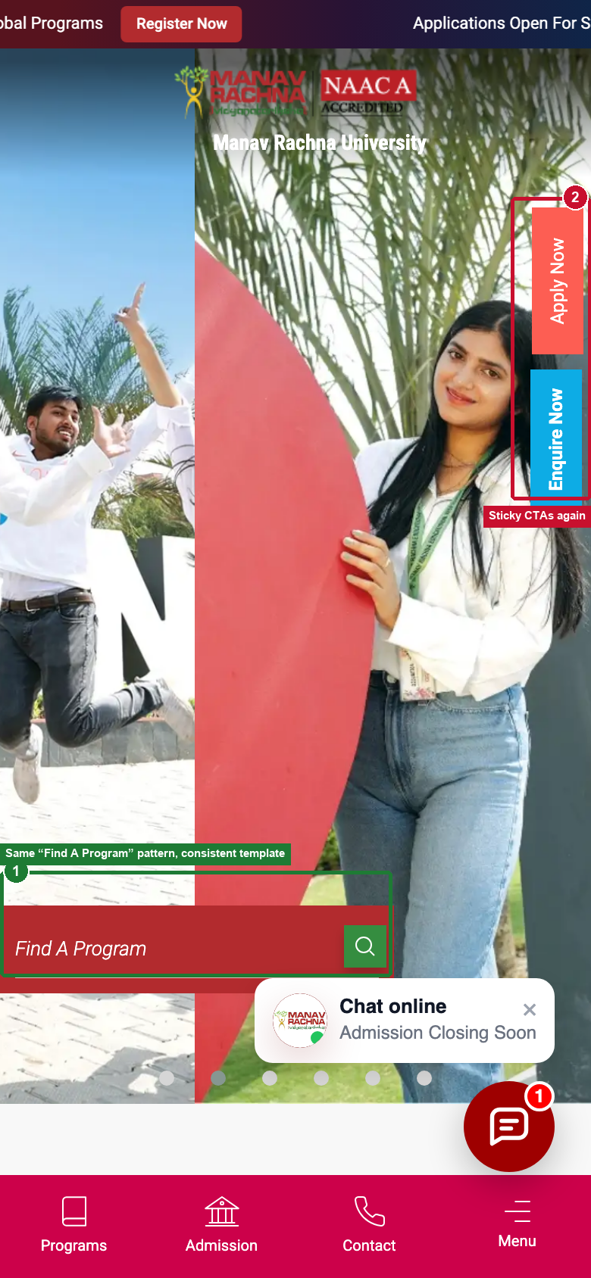
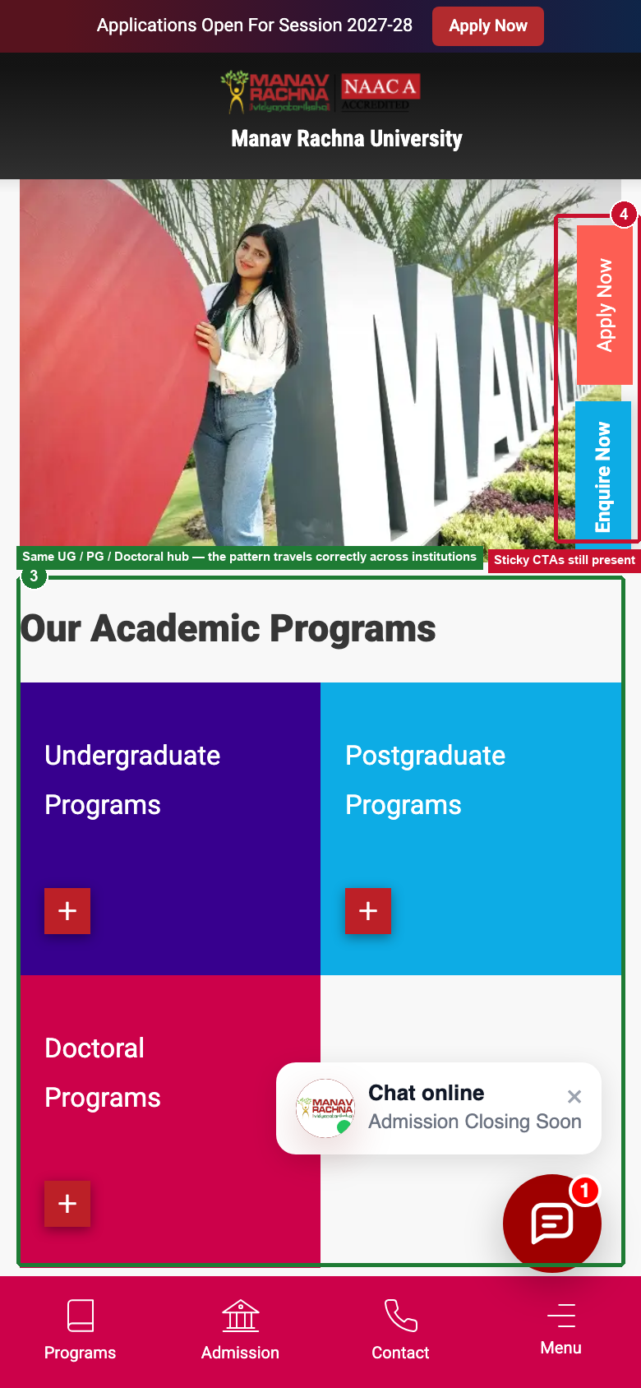
UNIVERSITY SHORTLISTER — CURRENT STATE
MEASURED
/mru — the same template, one institution over
3,877 sessions · 78.44% engagement, 21.56% bounce — the pattern travels correctly
1
Same “Find A Program” search and candid campus photography — consistent template.
2
Same UG / PG / Doctoral hub — MRU is actually 3.7 points higher on engagement than MRIIRS.
3
NAAC badge text gets clipped in the header on this sub-brand — a small polish miss.
4
Sticky CTAs still present, still generic, still undifferentiated by persona.
FOLD 1
FOLD 2
Source: GA4 Landing Page Data, 13 Jun – 10 Sept 2026. Live capture, 390px mobile viewport, 22 Sept 2026.

Slide 49
WHO LANDS HERE
MEASURED
The University Shortlister — the best-performing journey on the site
“Is this university right for me?” — comparing across institutions before committing to a course
18,752
76.1%
3.33
/mriirs, /mru
sessions · 12% of all sessions
engagement rate — best of any persona on the site
views per session — also the best on the site
distribute onward correctly: UG, PG, school hubs, search, fees
MRIIRS — /mriirs
MRU — /mru
11,597 sessions · 74.72% engagement · 3.32 views/session
3,877 sessions · 78.44% engagement · 3.44 views/session
“Distributes onward: UG hub 2,452 · PG 587 · school hub 465 · search 318 · fees 287.”
Even stronger than MRIIRS on every metric — the same template, performing consistently.
WHAT THIS MEANS
This is the template to protect and replicate, not redesign. The main deck already flagged it: “Already works — replicate its navigation pattern across institution and school pages.”
Source: GA4 Landing Page Data and Pivot — Persona (in scope), 13 Jun – 10 Sept 2026.

Slide 50
04
What breaks
Three gaps that repeat across journeys — and the template issues underneath them.

Slide 51
MEASURED
Three gaps, repeating everywhere
Different pages, different personas, identical shape
01
02
03
The answer is not on the page
The destination is not built for them
There is no next step
Users reach a course page, cannot complete their decision there, and leave to find the missing piece.
The page they leave to is built for everyone, so they work hard, find their answer, and come back rather than move forward.
Once the research is complete, nothing invites the user to act. The journey ends where the lead should begin.
EVIDENCE
EVIDENCE
EVIDENCE
84.3% of onward movement from the course page goes to fees
Only 4% of blog article readers move onward at all
11% move onward from credibility pages; 67% bounce
43.9% of fee-page sessions scroll past 90% of the page
99.3% then return to the page they came from
70% of all fee-page entries arrive from one course page
6 users continue anywhere after 6,964 return moves
Only 0.6% of site sessions reach a conversion page
35 of 4,195 blog readers reach the course they read about
Source: GA4 Path Exploration, Per-cent-scrolled and Landing page reports, 13 Jun – 10 Sept 2026.
Notes:
Three gaps, not three problems per page. This is what makes the fix scalable across templates rather than page by page.

Slide 52
MEASURED
WHAT BREAKS · SITEWIDE — FUNCTIONAL / UX
Six template issues that follow users onto every page
Moved out of the persona sections: these belong to the shared template, not to any one journey
1
1
Session-year conflict
HIGH
2
Top bar “Applications Open For Session 2027-28” vs CSE banner “Admissions Open 2026-27” vs fee table “AY 2026-27”.
→ Credibility; which fee applies
2
Same-intent CTAs
MED
3
3 × Apply + 1 × Enquire in CSE fold 1; the same pair on every template, whatever the page’s intent.
→ Dilutes the one next step
3
3
Vertical Apply / Enquire tabs over content
MED
Clip the CSE fee heading and sit over live fee rows.
→ Comprehension on fee & course pages
1
4
Chat teaser on every page
MED
“Chat online · Admission Closing Soon” + bubble over forms and fee rows.
→ Covers the content users came for
4
4
5
Fixed chrome ≈ 21–24% of the screen
MED
Header 103–130px + bottom nav 54–68px on an 844px screen, before tabs and chat.
5
→ Less room for the answer
6
Fee Calculator → homepage (301)
HIGH
B.TECH CSE · FOLD 1
MRIIRS FEE TABLE · SCROLLED
Menu, both fee pages and the CSE page link to a URL that redirects home.
→ Dead end at the cost decision
Source: Live site audit, 24 Sept 2026. All six reproduced on /, /mriirs, /mru, B.Tech CSE, both fee pages, awards, placements and blog templates unless stated. Issue 6 has no GA4 click event — its traffic impact is evidence not available.
Notes:
Earlier captures (22 Sept) on the persona current-state slides show further instances. Two earlier claims did not reproduce on 24 Sept and are not repeated here: the chat auto-opening a full panel over the form, and ranking numbers shown only as images on the awards page.

Slide 53
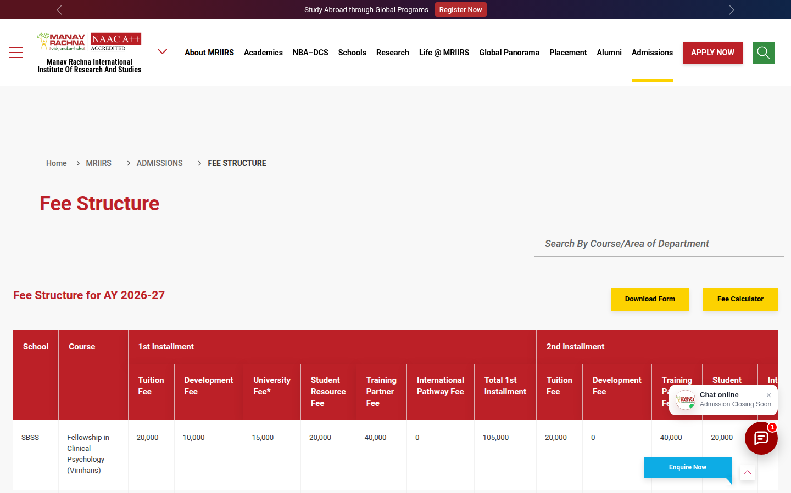
MEASURED
WHAT BREAKS · SITEWIDE — UI POLISH
Polish issues — kept separate, and only where they touch conversion
None of these is a CRO recommendation on its own; each is linked to the behaviour it could affect
1
Empty band above the breadcrumb
Linked to: Fee findability (desktop)
About 120px of blank space pushes the fee table below the fold on desktop.
1
School codes and blank group cells
Linked to: Fee comprehension
2
“SBSS”, “SET” are unexplained; the School cell blanks after each group’s first row.
4
3
Table overflows desktop too
Linked to: Fee findability
15 columns in 1,392px — the last columns (incl. total) scroll horizontally even at 1440px.
4
Search sits apart from the table
Linked to: Discoverability of a working tool
3
The search field is right-aligned above the heading; nothing labels it as a fee filter.
2
Fold-1 icons on course pages
Linked to: Discoverability (course)
“Brochure (PDF)” and “Fee Details” look identical to non-link labels (“Undergraduate”, “4 Years”).
MRIIRS FEE STRUCTURE · 1440px DESKTOP
Small tap targets
Linked to: Interaction friction (see appendix benchmark)
135 of 175 visible links/buttons on the mobile homepage are under 44px in at least one dimension.
Source: Live site audit, 24 Sept 2026. Tap-target count measured by script on the rendered page.
Notes:
Kept deliberately lower in the story: cosmetic issues are only raised where they plausibly affect discoverability, comprehension or interaction.

Slide 54
05
What the site should do differently
Every page opens the next step for the question the user arrived with.

Slide 55
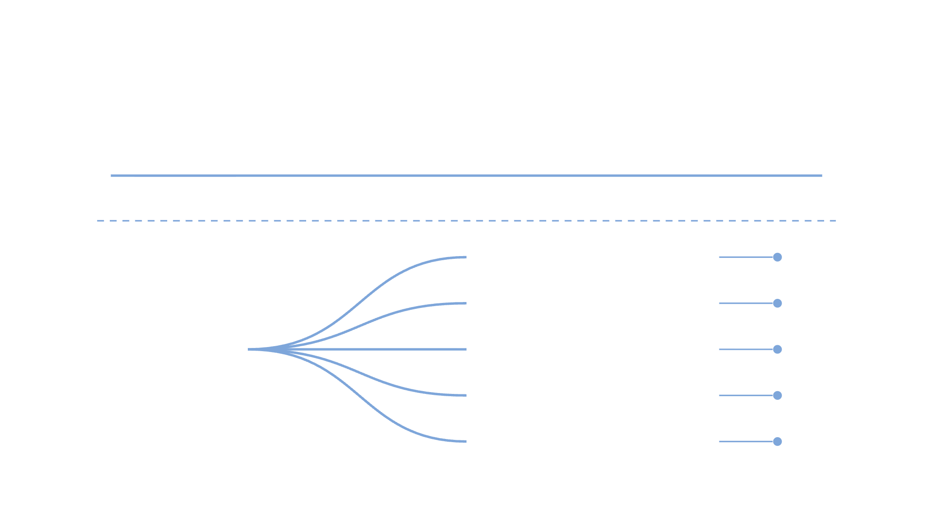


HYPOTHESIS
THE SOLUTION
Turn the site into a connected journey.
Today, no apply or enquiry page makes the top next steps in any of the 9 path explorations.
Land
Explore
Check
Compare
Apply
Continue
every page opens the next step
Fees for this program
Eligibility & process
Program
Scholarships & aid
…and onward
or fee page
Download brochure
Apply or enquire
No dead ends. No trips back to the homepage.
Notes:
Evidence: on almost every page explored, the homepage or a hub page is a top-two next step (e.g. fees → "/" 1,236; MRIIRS → "/" 673; MRU → "/" 373). Conversion pages barely register: admission-process 48, financial aid 4–71, eligibility 7–201, brochure 234 (homepage only). The fix: every program and fee page becomes a hub with its own forward routes.

Slide 56


HYPOTHESIS
THE GUIDING PRINCIPLE
Every visitor leaves with a next step.
ACT
DISCOVER
DECIDE
1
2
3
I took a step.
I found my answer.
I know which campus fits me.
Download · Enquire · Apply
Fees · Eligibility · Scholarships
MRIIRS · MRU · Rankings · Awards
No student should leave without taking a step, finding an answer, or knowing which Manav Rachna is right for them.
Notes:
The success test for every page: did the visitor act, discover, or decide? Today most sessions do none of the three and loop back to the homepage or /search (817 from the homepage, 292 from MRIIRS, 110 from MRU).

Slide 57





HYPOTHESIS
THE FRAMEWORK
One question. Three journeys.
01
I know the course I want
Course → Fees → Eligibility → Apply
What are you looking for?
02
I want to know what it costs
Student
Fees → Scholarships → Eligibility
03
I'm comparing MRIIRS and MRU
Profile → Shortlist → Counsellor
Instead of listings with no route onward, let the student self-select their intent.
Notes:
The three journeys map to the three loops in the path data: course pages climbing back to listings (01), fee pages sending users to the homepage (02), and users crossing between the MREI, MRIIRS and MRU copies of the same section (03).

Slide 58



JOURNEY 01 · THE COURSE RESEARCHER
HYPOTHESIS
01
Found a course — check, qualify, apply.
Course
1
next-step moves from B.Tech CSE climb back up — to UG listings, /mriirs or the homepage — instead of forward.
Program detail, specialisations, outcomes
491
Fees
2
This program's fee, right on the page
Eligibility
3
Criteria and entrance exams for this course
Your next step for B.Tech CSE
Scholarships
4
See the fees
Am I eligible?
Scholarships
What I'd actually pay, not the sticker fee
Apply
Apply now
5
Start the application or book a counsellor
The page answers the next question before the student goes looking for it.
Course page → see the fee → check eligibility → apply
Notes:
B.Tech CSE path exploration: apart from fees, every next page is a parent page — UG listings 202 + 167, homepage 70, /mriirs 52 (491 in total). The fee page round-trips back to CSE. Journey 01 puts fees, eligibility, scholarships and apply on the course page itself.

Slide 59

JOURNEY 02 · THE COST CHECKER
HYPOTHESIS
02
Saw the fee? Answer what comes next.
I know the fee
I know what I'd pay
I know I qualify
I'm ready to apply
What is the fee for my program?
−
Every answer leads forward.
The fee for this program, year by year, beside the course — no detour to a group-wide fee table.
Today the fee page's #2 next step is the homepage (1,236), and 494 users jump across to a second, MRU fee page.
Are there scholarships for me?
+
What financial aid can I get?
+
Here, each question opens the next one — a route to applying, not a dead end.
Am I eligible for this course?
+
Check scholarships
What is the admission process?
+
I know the fee → I know what I'd pay → I qualify → I'm ready to apply
Notes:
Fee structure path exploration: B.Tech CSE is #1 next step (7,070), the homepage is #2 (1,236), and 494 cross to the MRU fee page. Financial aid (4–71) and eligibility (7–201) barely register. Journey 02 turns the fee page into a question-led route: fee → scholarships/aid → eligibility → process → apply.

Slide 60




HYPOTHESIS
JOURNEY 03 · THE SHORTLISTER · DATA + CAPTURE
03
Turn a browser into a known applicant.
?
Anonymous
Find your Manav Rachna fit
Then — a relevant shortlist
Course
Course you're interested in
The right program at the right campus, with fees and eligibility attached.
known applicant profile
MRIIRS · MRU · Not sure yet
Institution
Today users bounce between three copies of the same section — MRU → /mriirs 166, B.Tech → /academics/undergraduate 167.
Name
Name
Mobile number
Compare my options
Ask once. Show one answer.
Mobile
Course → Institution → Contact · one short, mobile-first step.
Notes:
MREI (/academics/undergraduate), MRIIRS and MRU each carry their own copy of the same section, and users cross between them: B.Tech → /academics/undergraduate 167, fees → MRU fees 494, MRU → /mriirs 166. Journey 03 captures intent once and returns a single shortlist — a lead with context, not a cold form fill.

Slide 61
WHAT THE SITE SHOULD DO · PERSONALISATION
HYPOTHESIS
Three rules, not thirty — each ships with a holdout
No login needed: signals the session already carries. A rule stays only if it beats the default
SIGNAL
INFERRED INTENT
WHAT THE PAGE SHOWS
HOLDOUT · MEASURE
WHY WE THINK SO
R1
Fee page entered from a course page (referrer)
“What does this programme cost?”
Opens on that programme’s fee card — total, installments, variants — with “Back to B.Tech CSE”
10% see the generic page · leads on fee page · guard: fee→home exits
70% of MRIIRS fee entries come from CSE; 7,070 go back
R2
Viewed an MRIIRS and an MRU page in one session
“Which Manav Rachna is right for me?”
“Compare MRIIRS & MRU” and a counsellor option on the next page, instead of a second Apply
10% holdout · leads · guard: Apply-MRIIRS clicks
494 fee-page hops; 166 /mru → /mriirs
R3
Landed on a blog article mapped to a programme
“What should I study?” — not ready to apply
The matching programme card and “Talk to a course guide” replace the sticky Apply Now
10% holdout · article → programme · guard: engagement
35 of 4,195 NEET/BPT readers reach BPT
THE LOOP signal → one session profile → rule → surface → result feeds the profile. All three need Phase 0 events to be read. R1 is a URL parameter, so it can ship with test T4. Rules using city or campaign wait until consent handling is in place.
Source: GA4 explorations, 13 Jun – 10 Sept 2026 (figures as used in this deck). Holdout share and metrics are proposals, to agree with MREI.
Notes:
Personalisation, kept small: three rules, each fed by a first-party session signal, each with a 10% holdout. If a rule does not beat the default, it comes off. City or campaign signals wait until consent handling is in place. R1 is the cheapest — it is a URL parameter and overlaps with test T4.

Slide 62
06
Page & template opportunities
Problem → evidence → recommendation → expected behaviour → KPI.

Slide 63
HYPOTHESIS
What CRO will do about it
One onward path and one capture point for every journey
PERSONA
JOURNEY FIX
MICRO-CONVERSION
MEASURED BY
Course Researcher
Bring course-specific fees, eligibility and outcomes onto the course page itself
Download the course brochure
Course page → capture rate
53,812 sessions
Cost Checker
Make the fee page answer one course at a time — filtered, anchored, comparable
Check my eligibility
Fee page → forward exit rate
23,219 sessions
Early Explorer
Link every article to the course it describes, in context and mid-article
Get the career guide
Article → course page rate
22,813 sessions
Proof Seeker
Surface placements and faculty proof inside the course journey, not five levels down
Book a campus visit
Proof page → course page rate
27,579 sessions
University Shortlister
Already works — replicate its navigation pattern across institution and school pages
Talk to a counsellor
Hub → course page rate
18,752 sessions
Micro-conversions are lead-generating events placed at the point research completes, not at the top of the page. Session volumes from GA4, 13 Jun – 10 Sept 2026.
Notes:
Every intervention is a CRO change: placement, structure and capture. None of it requires new content strategy or SEO work.

Slide 64
HYPOTHESIS
PAGE OPPORTUNITIES · COURSE TEMPLATE
Course pages: finish the decision on the page
Applies to every programme page — B.Tech CSE first
PROBLEM
EVIDENCE
RECOMMENDATION
EXPECTED BEHAVIOUR CHANGE
KPI
Users leave the course page to fetch the fee, then stop. The fee answer on the page is buried and incomplete.
84.3% of onward movement goes to fees; 99.3% return; 6 continue [GA4]. Fee block at ~13 screens down [audit]. 516 file downloads vs 50 Apply clicks on course pages [CSV].
Fee summary at decision height: year 1, total, installments, specialisation variants — “Fee Details” expands in place. Pre-filtered link to the fee table. Brochure with an optional “send to WhatsApp”.
Fewer CSE → fee round-trips; more actions taken on the course page itself (brochure request, form start).
Primary: leads on course pages. Secondary: fee-page exit share, brochure requests, form_start. Guardrail: engagement. Tests T4, T5, T6.
Source: GA4 explorations, 13 Jun – 10 Sept 2026 (figures as used in this deck) · GA4 event export by page type (event counts; separate pull, not directly comparable) · Live site audit, 24 Sept 2026.
Notes:
Detailed orchestration and fix list follow on the next two slides (from the earlier deck).

Slide 65
COURSE RESEARCHER — JOURNEY ORCHESTRATION
HYPOTHESIS
The next step is a choice, not a forced page
Applied to the B.Tech CSE course page
STAY
ON THE PAGE
Fee, eligibility and placement snippets expand inline — the 84.3% round-trip to the fee page has nowhere left to go.
Answer stays on the page
Visitor still has a question
VISITOR LANDS ON
Course Page (e.g. B.Tech CSE)
What does the visitor need right now?
ACT
OPTION 1
Apply Now
Opens a short lead form — name, phone, course pre-filled
OPTION 2
Download Brochure
Direct PDF, no gate — optional “send to WhatsApp” captures the number
Pick one clear next step
Visitor is ready to move
The course page doesn't need to send readers to the fee page — it needs one clear place to act.

Slide 66
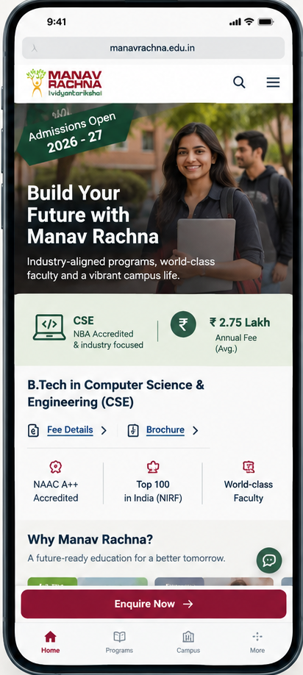
COURSE TEMPLATE · FIXES
Six fixes, ranked by effort vs. what breaks today
# | Fix | Why it matters here | Effort
1 | Restyle “Fee Details” & “Brochure” as real links underline, colour, chevron | Matches appearance to function; the exact ambiguity flagged on this page | Quick
2 | Fix the sticky “Enquire Now” tab position so it never overlaps the tab bar or body copy | It clips real content at multiple scroll positions, on mobile and desktop | Quick
3 | Cap same-intent CTAs to two per fold; keep the chat teaser clear of the lead form | Four CTAs sit above the fold today, all pointing at one action | Quick
4 | Pull one CSE-specific proof point + the fee figure into fold 1 as a stat strip | Proof Seeker and Cost Checker get no answer until they scroll | Medium
5 | Fix the ribbon rotation and the 2026‑27 vs 2027‑28 date mismatch | A direct hit to credibility in the first three seconds | Medium
6 | Define one type scale and one colour system for the template | 17 type sizes / 13 colours today — this template repeats on every program page | Template-wide
This is a shared template — fixes 1–3 alone would apply across every program page on the site.

Slide 67
HYPOTHESIS
PAGE OPPORTUNITIES · FEE TEMPLATE
Objective: increase fee findability and decision efficiency
Can a Cost Checker find the exact fee they came for without scanning a long generic table?
WHY THIS OBJECTIVE
WHAT EACH ELEMENT ANSWERS
Fee finder · AY 2026-27
Not “improve fee page UX”. The page already has content and a search box; users can’t reach the one number they need.
Evidence. 70% of entries come from CSE; 1,236 moves to the homepage; 494 hop to MRU fees [GA4]. 82 phone clicks vs 31 submits [CSV]. Search misreturns; total fee in column 15; calculator → homepage [audit].
Investigate. Institution → school → programme → specialisation selectors; sticky headers; a fee summary card; mobile-first cards instead of a 15-column table; compare two programmes; return to the originating course; contextual next steps.
Selectors, not free-text search
Institution: MRIIRS
▾
Search misses “Computer Science…” when typing “CSE” and returns unrelated grouped rows.
Programme: B.Tech CSE
▾
One fee card, total first
Specialisation: Core (no industry partner)
The total is column 15 of a 1,642px table on mobile.
▾
Installments + variant in the card
TOTAL FEE · AY 2026-27
The course page shows only the year-1 fee — a likely (untested) reason users leave it.
₹3,05,800
1st installment ₹1,85,900
2nd installment ₹1,19,900
With industry-partner specialisation: ₹3,33,800
Call as the primary action
82 phone clicks vs 31 form submits on these pages.
Call admissions
Eligibility + apply for this programme
Eligibility (7–201) barely registers as a next step today.
Check eligibility for B.Tech CSE
Apply for B.Tech CSE
Return to the course
7,070 moves already go back to CSE — make it one tap, with context.
← Back to B.Tech CSE
CONCEPT FOR TESTING (T1 + T2) — fee values from the live table
KPI: leads on fee pages · phone clicks, fee→course return, fee→home exits · guardrail: engagement. Sources: GA4 explorations, 13 Jun – 10 Sept 2026 (figures as used in this deck) · GA4 event export by page type (event counts; separate pull, not directly comparable) · Live site audit, 24 Sept 2026.
Notes:
Fee values in the concept are the live MRIIRS table values for B.Tech-CSE (185,900 + 119,900 = 305,800) and the industry-partner specialisation row (333,800). The Fee Calculator redirect must be fixed regardless of the test.

Slide 68
COST CHECKER — JOURNEY ORCHESTRATION
HYPOTHESIS
A parent checking fees needs a button, not another page
Applied to the fee-structure pages (/mriirs, /mru)
STAY
ON THE PAGE
Tiered fee cards answer the number in place — no horizontal-scroll table required to read it.
Answer stays on the page
Visitor still has a question
VISITOR LANDS ON
Fee Structure Page
What does the visitor need right now?
ACT
OPTION 1
Apply
Routes straight to a Contact-Us lead form, course and fee carried over
OPTION 2
Check Eligibility
2-field inline form, answered on the spot
Pick one clear next step
Visitor is ready to move
On the fee page, ‘Apply’ shouldn't lead to more content — it should open the form and capture the lead.

Slide 69
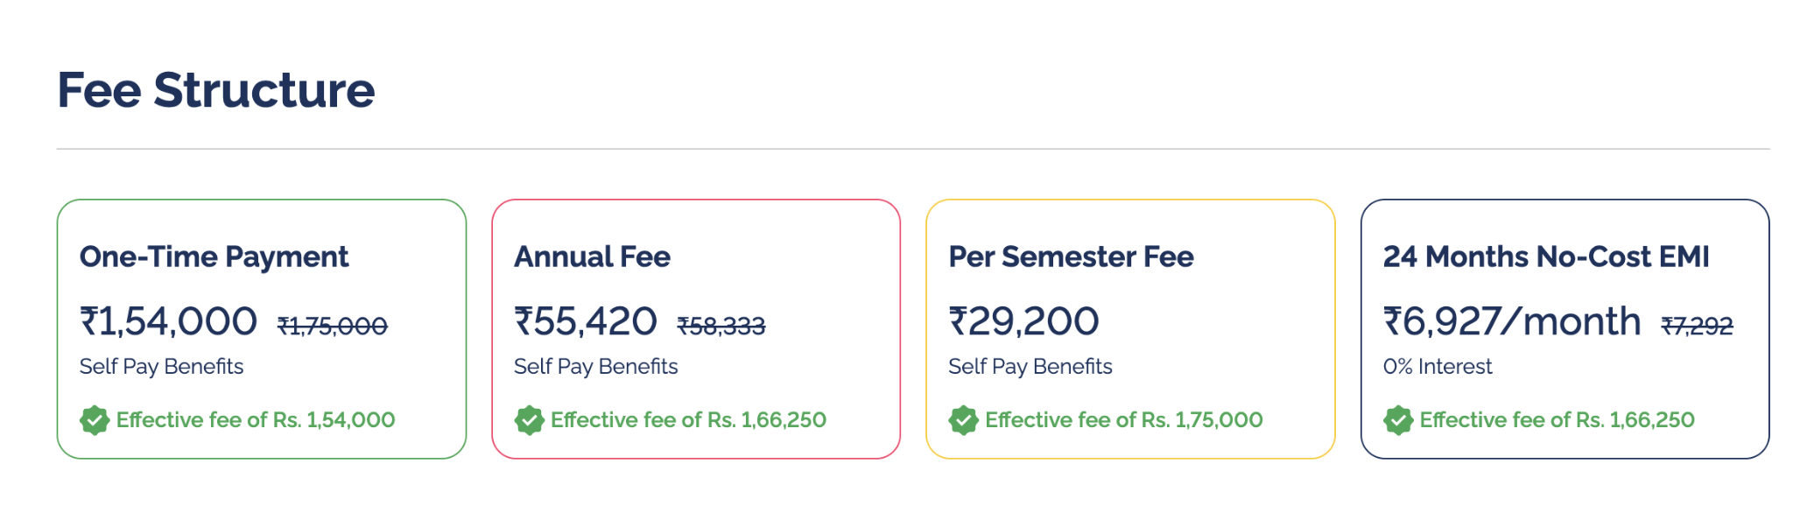
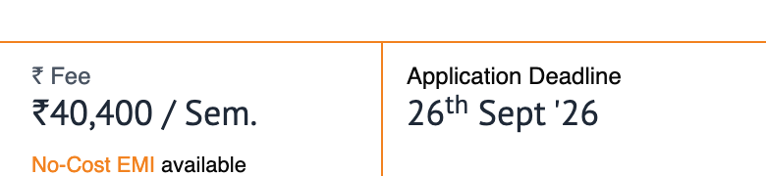
COMPETITIVE BENCHMARKING
MEASURED
Two ways competitors answer “what does it cost” without a table
Observed live on the equivalent program-fee pages
1
Tiered fee cards
2
At-a-glance fee strip
AMITY ONLINE · MBA PROGRAMME PAGE
LPU ONLINE · MBA PROGRAMME PAGE
One line answers the question — ₹40,400/Sem, No-Cost EMI available — placed right after the program description, before the lead form. The application deadline sits next to it, same glance.
Neither competitor makes a Cost Checker scroll a wide table sideways to find a number.
Four payment options as cards — one-time, annual, per-semester, no-cost EMI — each with the discount struck through and the effective price called out. No table, no scrolling.
Source: live capture of competitor programme-fee pages, mobile viewport, 22 Sept 2026.

Slide 70
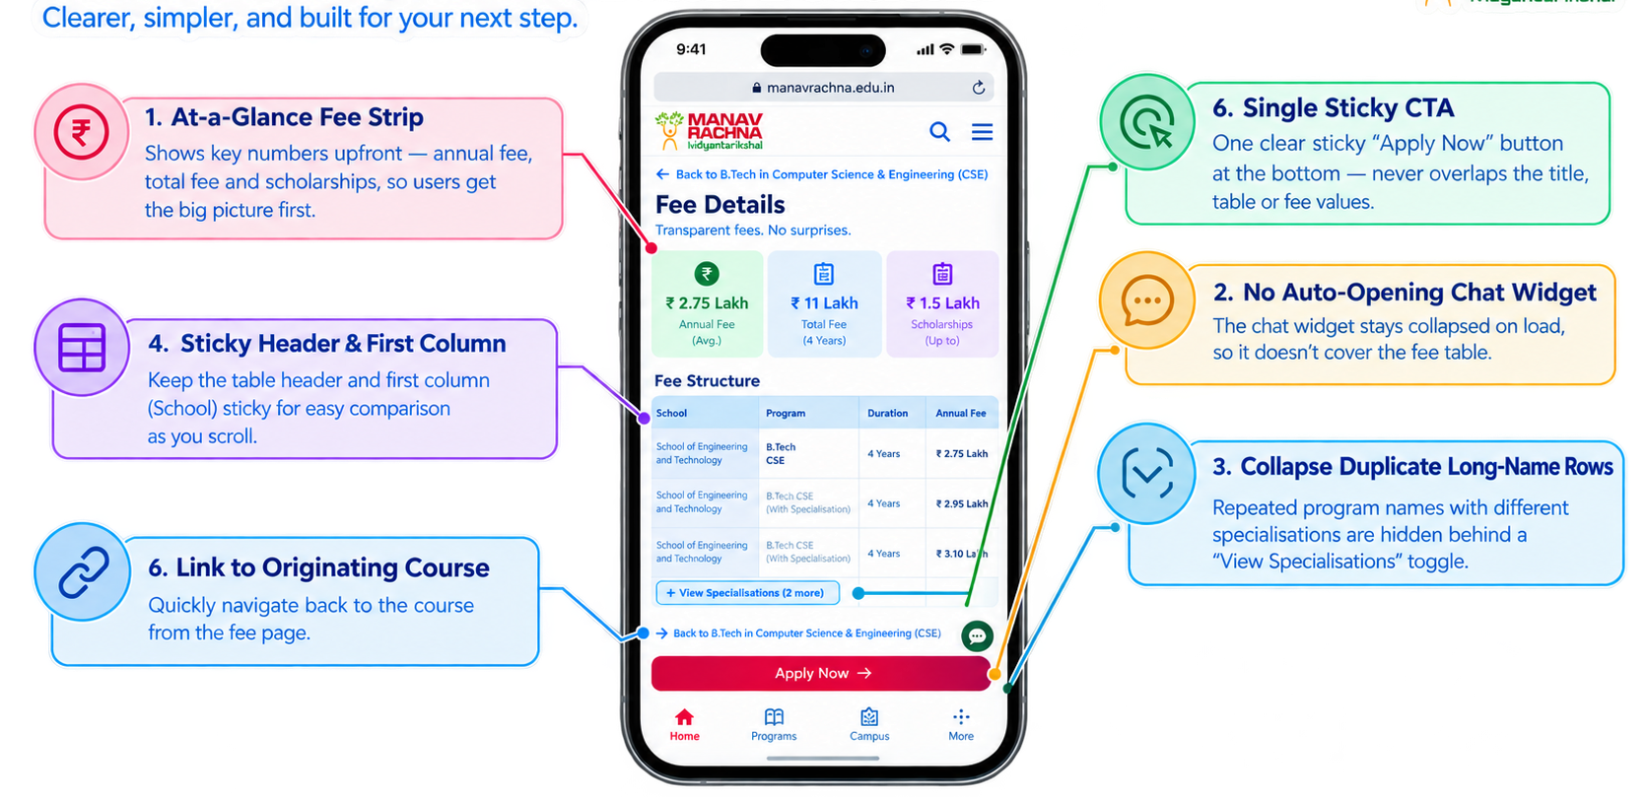
FIXES
Six fixes for the fee-structure template
Ranked by effort — applies once to both /mriirs and /mru, since it's one shared template
# | Fix | Effort
1 | Cap sticky CTAs to one; never let it overlap the title, table or fee values | Quick
2 | Move the chat teaser and bubble off the fee table | Quick
3 | Collapse duplicate long-name rows behind a “view specialisations” toggle | Quick
4 | Add a sticky header row and sticky first (“School”) column to the table | Medium
5 | Lead with an at-a-glance fee strip or tiered cards, table optional below | Medium
6 | Link back to the originating course inline on the fee page | Medium
One template, two URLs — every fix here ships once and fixes both /mriirs and /mru at the same time.

Slide 71
HYPOTHESIS
PAGE OPPORTUNITIES · PROOF
Proof: verify it, then attach it to the programme
Awards, placements and programme pages
PROBLEM
EVIDENCE
RECOMMENDATION
EXPECTED BEHAVIOUR CHANGE
KPI
Proof sits on standalone pages that rarely lead to a programme, and several claims conflict or have no stated source.
Awards: 67.13% bounce, 9 reach fees [GA4]. NBA accreditation of B.Tech CSE not stated on the CSE page; NIRF 2025 vs 2026; “95%” and “60 LPA” unscoped [MREI pages].
Reconcile claims with MREI first. Then a programme proof strip (NBA badge, dated named offers) beside the form; every award links to the programmes it covers; faculty filter pattern reused.
Proof pages lead to programmes; programme pages carry their own credibility, so fewer users leave to look for it.
Primary: awards → programme progression; course-page form_start. Secondary: leads. Guardrail: bounce. Tests T8, T9.
Source: GA4 explorations, 13 Jun – 10 Sept 2026 (figures as used in this deck) · Official MREI pages, read 24 Sept 2026.
Notes:
No proof claim goes into a test variant until MREI confirms it (see proof inventory).

Slide 72
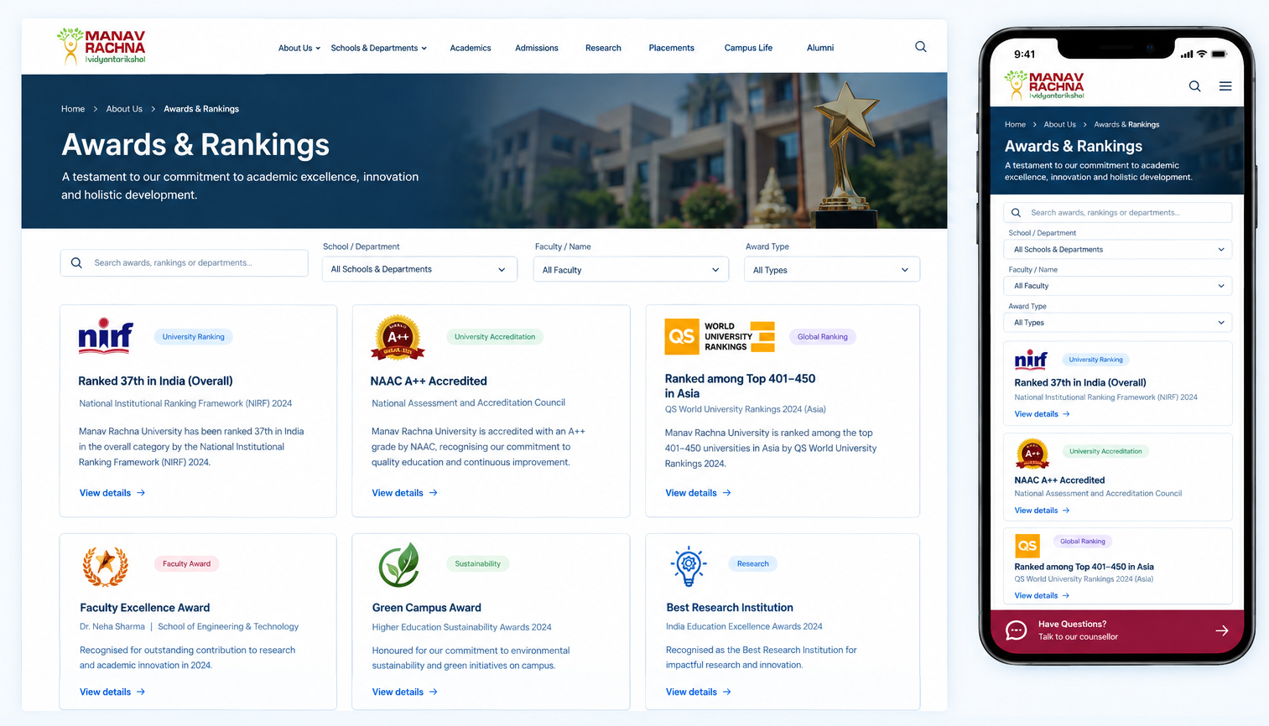
FIXES
Six fixes for the Proof Seeker's two templates
Half repair, half replication — ranked by effort
# | Fix | Applies to | Effort
1 | Turn certificate images into scannable text + icon badges | Awards page | Quick
2 | Cap sticky CTAs to one; keep the chat teaser off content | Both pages | Quick
3 | Link every award/ranking to the relevant school or course page | Awards page | Medium
4 | Attach top rankings to named faculty or department pages, not a standalone gallery | Awards page | Medium
5 | Add the faculty page's School/Department/Name filter to the awards page | Awards page | Medium
6 | Roll the faculty directory's search + card pattern out to every other proof template | Sitewide | Template-wide
The fastest win here isn't new content — it's connecting proof that already exists to the people and courses it's proof for.

Slide 73
PROOF SEEKER — JOURNEY ORCHESTRATION
HYPOTHESIS
Proof should end in a conversation, not a dead end
Applied to the awards & faculty pages
STAY
ON THE PAGE
Rankings and named faculty appear together on one page, instead of two that never reference each other.
Answer stays on the page
Visitor still has a question
VISITOR LANDS ON
Awards & Recognitions / Faculty Page
What does the visitor need right now?
ACT
OPTION 1
Talk to Faculty
Chat or callback request — a real conversation, not a form into silence
OPTION 2
Book a Campus Visit
Scheduling form, routed to the admissions team
Pick one clear next step
Visitor is ready to move
A certificate gallery with nowhere to go wastes the strongest proof on the site.

Slide 74
HYPOTHESIS
PAGE OPPORTUNITIES · DISCOVERY (BLOG)
Blog: link every answer to a programme
792 articles on one template — one linking rule compounds across all of them
PROBLEM
EVIDENCE
RECOMMENDATION
EXPECTED BEHAVIOUR CHANGE
KPI
Articles link to articles; readers who move on go to the homepage, not to the programme described.
35 of 4,195 NEET/BPT readers reach BPT; top onward page is the homepage (82) [GA4]. ~10 blog vs 0–1 programme links per article [audit]. 0 Apply / 0 phone on 32,318 blog-index landings [CSV].
Validate blog traffic and scroll tracking first. Then: programme link for every course/exam mention, an end-of-article programme card, and an exploratory CTA (“help me choose”) instead of Apply.
Readers move article → programme instead of article → homepage; the blog starts producing intent events.
Primary: article → programme progression. Secondary: form_start, leads. Guardrail: engagement. Tests T10, T11.
Source: GA4 explorations, 13 Jun – 10 Sept 2026 (figures as used in this deck) · Live site audit, 24 Sept 2026 · GA4 event export by page type (event counts; separate pull, not directly comparable).
Notes:
Blog data-quality check is a precondition, not a test.

Slide 75
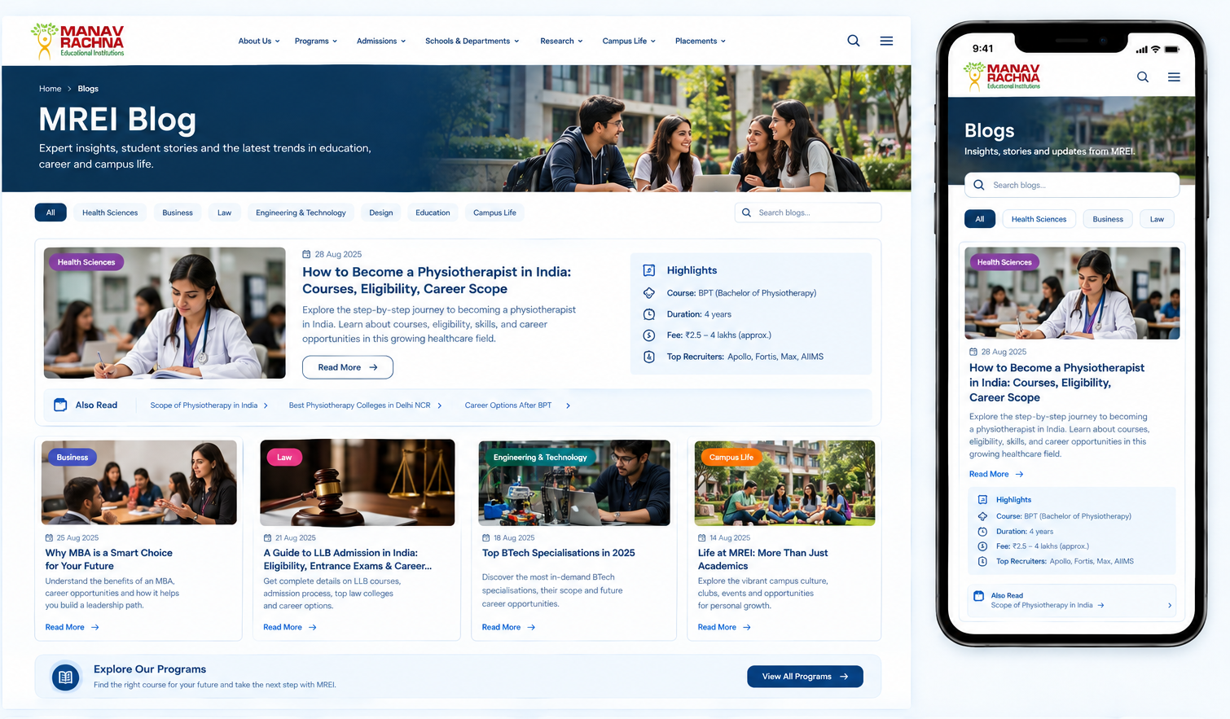
FIXES
Six fixes for the blog template
Content edits first, no development needed for most of these
# | Fix | Why | Effort
1 | Link every course/exam mention to the matching MREI programme page | Zero in-article course links today, on either article checked | Quick
2 | Point “Also Read” links at the matching course too, not only other posts | The link pattern already exists — it just never points at a course | Quick
3 | Add a “Highlights” box (course, duration, fee, recruiters) to explainer articles | Amity's pattern — turns curiosity content into a real answer | Medium
4 | Tag every article with a topic category (Health Sciences, Business, Law…) | Feed is exam names only — nothing to browse by interest | Medium
5 | Swap the blog template's sticky CTA to something exploratory, not “Apply Now” | Amity uses “1-1 Counselling” on this exact template type | Quick
6 | Confirm /blog's traffic source before optimising it further | 33,075 sessions are flagged “Review” — unexplained in GA4 today | Quick
This is 792 articles on one template — a content and linking rule here compounds across the whole blog, no redesign required.

Slide 76
EARLY EXPLORER — JOURNEY ORCHESTRATION
HYPOTHESIS
Someone unsure what to study shouldn't see ‘Apply Now’
Applied to blog articles (e.g. career options after BDS)
STAY
ON THE PAGE
A Highlights box answers course, fee and outcomes right inside the article — no click required.
Answer stays on the page
Visitor still has a question
VISITOR LANDS ON
Blog Article
What does the visitor need right now?
ACT
OPTION 1
Get Career Guidance
Short interest quiz — captures intent, not an application
OPTION 2
Explore This Programme
Routes to the one matching MRIIRS/MRU course page
Pick one clear next step
Visitor is ready to move
The right next step for someone still exploring is a guide, not a generic Apply button.

Slide 77
HYPOTHESIS
PAGE OPPORTUNITIES · INSTITUTION ROOT
Institution roots: protect the benchmark, close the comparison leak
/mriirs and /mru — and the school pages that should copy them
PROBLEM
EVIDENCE
RECOMMENDATION
EXPECTED BEHAVIOUR CHANGE
KPI
The best template loses users who are still comparing institutions — they loop home or hop brands.
76.1% engagement, 3.33 views/session [GA4]. 517 of 613 Apply-MRIIRS clicks happen here [CSV]. /mriirs → homepage 673; /mru → /mriirs 166; 494 hop fee pages [GA4].
Keep the hub unchanged. Add a “Compare MRIIRS & MRU” route and a counsellor option for comparers; replicate the hub pattern on school pages.
Fewer homepage loops and brand hops; comparers stay in a guided route to a programme.
Primary: leads. Secondary: cross-brand hops, hub progression. Guardrail: Apply-MRIIRS clicks must not fall. Test T12.
Source: GA4 explorations, 13 Jun – 10 Sept 2026 (figures as used in this deck) · GA4 event export by page type (event counts; separate pull, not directly comparable).
Notes:
Lowest-risk change first: add, don’t redesign.

Slide 78
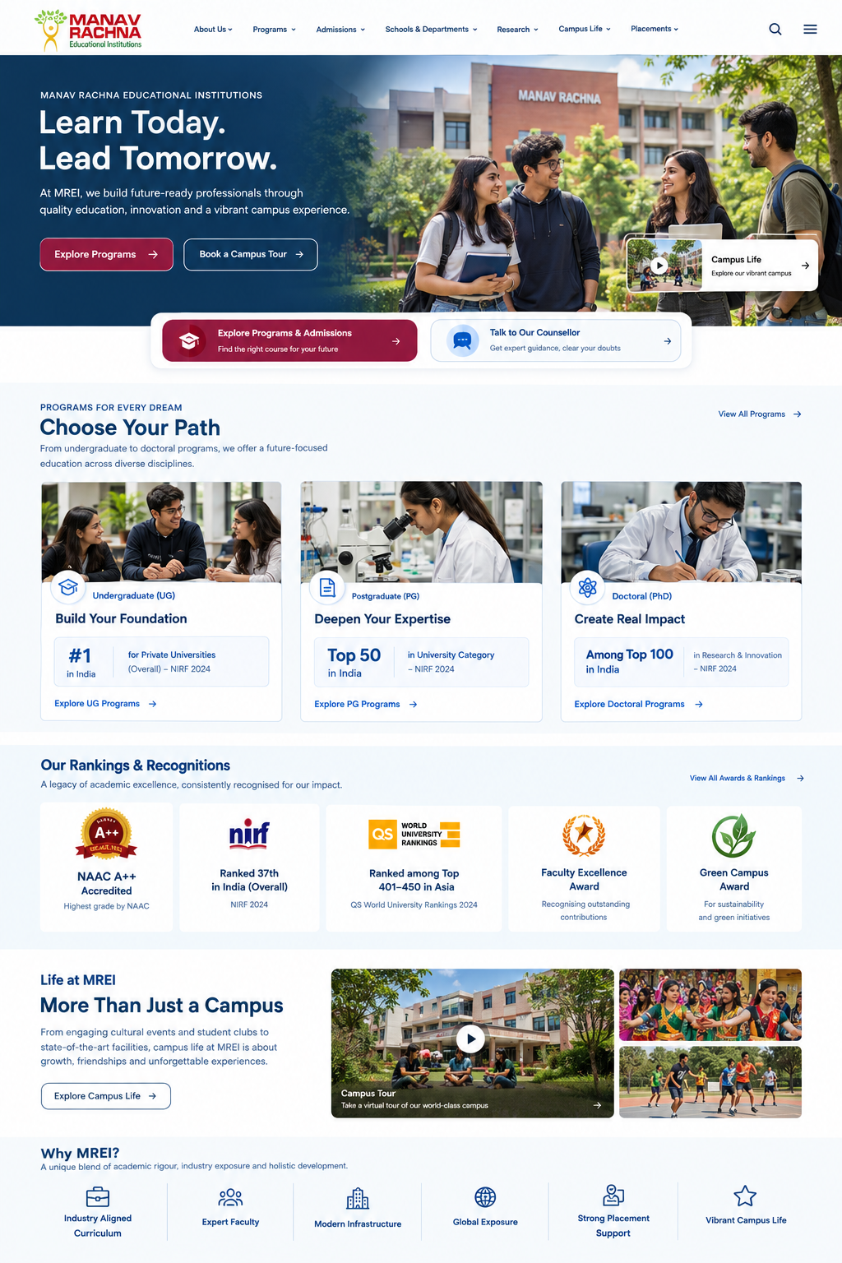
FIXES
Six fixes for the institution-root template
Mostly protect and extend — this is the strongest template on the site
# | Fix | Why | Effort
1 | Differentiate the two sticky tabs by intent, not just Apply / Enquire | Same generic-CTA problem, even on the best template | Quick
2 | Fix the clipped NAAC badge text on the /mru header | Small polish miss on an otherwise strong page | Quick
3 | Add a one-line positioning statement to the hero (“Why MREI”, not just “what MREI is”) | Chandigarh University answers this in its H1; MREI doesn't | Medium
4 | Fuse a rankings or outcome stat onto the UG / PG / Doctoral tiles themselves | Proof and segmentation exist but never touch each other | Medium
5 | Add a short campus-life visual or tour alongside the existing candid photography | Galgotias answers “what's it like here” viscerally; MREI relies on generic photos | Medium
6 | Protect this template and roll it out to /mrdc and school-level pages unchanged | It already outperforms every other template on engagement and views/session | Template-wide
The risk here isn't inaction — it's a redesign that throws away the one template already proven to work.

Slide 79
UNIVERSITY SHORTLISTER — JOURNEY ORCHESTRATION
HYPOTHESIS
The hub already works — it just needs a second action
Applied to the institution-root pages (/mriirs, /mru)
STAY
ON THE PAGE
The UG / PG / Doctoral hub already lets a visitor self-segment in place — protect this pattern.
Answer stays on the page
Visitor still has a question
VISITOR LANDS ON
Institution Root Page
What does the visitor need right now?
ACT
OPTION 1
Apply
Programme-specific lead form, once a choice is made
OPTION 2
Talk to a Counsellor
1-1 booking, for a visitor still comparing universities
Pick one clear next step
Visitor is ready to move
Someone still comparing universities needs a counsellor, not the same ‘Apply Now’ as everyone else.

Slide 80
COMPETITIVE BENCHMARKING — HOMEPAGE TEMPLATE
MEASURED
No competitor does everything — but each does one thing worth grabbing
Feature coverage across all six named competitors' homepages, observed live
Site | Positioning statement | Segmentation picker | Search / AI assist | Named proof | Campus life visual | Differentiated sticky CTAs
MREI | — | ✓ | ✓ | — | ✓ | —
LPU Online | — | ✓ | — | — | — | —
Chandigarh University | ✓ | — | ✓ | — | — | —
Galgotias | — | — | — | ✓ | ✓ | ✓
Amity Online | — | ✓ | ✓ | — | — | —
Sharda | — | — | ✓ | ✓ | — | ✓
Bennett | — | ✓ | — | ✓ | — | ✓
MREI already leads on two of six — segmentation and search. Positioning, named proof and differentiated CTAs are open ground.

Slide 81

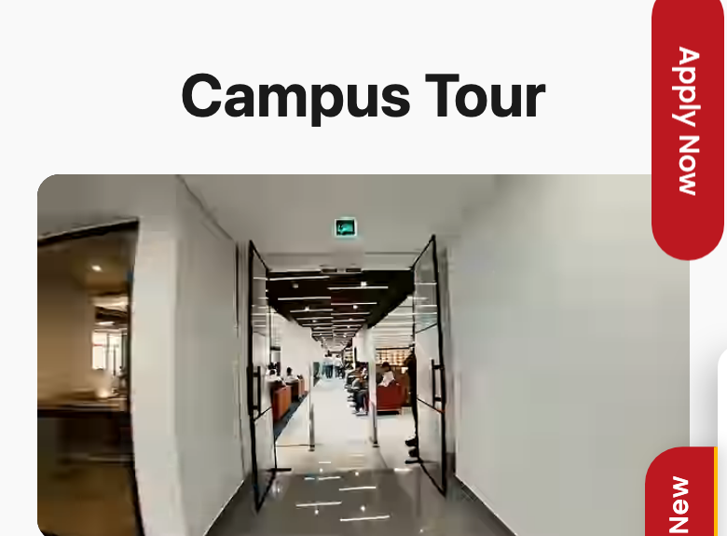

COMPETITIVE BENCHMARKING — HOMEPAGE TEMPLATE
MEASURED
Three patterns worth taking a closer look at
Observed live on competitor homepages, 21–22 Sept 2026
1
Answer the question in the headline
2
Campus life as an interactive tour
3
Proof tied to a name and an employer
CHANDIGARH UNIVERSITY
GALGOTIAS UNIVERSITY
SHARDA UNIVERSITY
“Best Private University in Punjab (India)” — the H1 answers the shortlister's exact question before any photo or CTA. MREI's institution roots lead with a generic tagline instead.
A named “Campus Tour” section sits in fold two, with real interior photography — answering “what's it like here” viscerally, not with stock photography.
“Star Alumni” cards pair a real graduate's name with the company logo they now work at (NVIDIA, Microsoft, Amazon) — outcome proof in one glance, no rankings PDF required.

Slide 82
07
Experimentation
Fix what is broken, measure what matters, then test.

Slide 83
HYPOTHESIS
How we will know it worked
Measurement has to be built before the target can be tracked — no lead event exists in GA4 today
PHASE 0
PHASE 1
PHASE 2
Weeks 1–2
Weeks 3–6
Ongoing
Measurement foundation
Journey fixes
Capture and iterate
Define and configure lead events in GA4
Implement form start, submit and CTA tracking
Establish the true organic conversion baseline
Exclude bot traffic so the baseline is honest
Course page: fees, eligibility and outcomes in place
Fee page: course-level filtering and a forward exit
Blog: in-context links to the matching course
Micro-conversion on every persona journey
Monthly funnel reporting by persona
A/B testing on the highest-volume templates
THE TARGET
SEO’s +33% traffic and CRO’s +50% conversion rate compound: 1.33 × 1.50 = 2.0, i.e. 100% more leads. The CRO half can only be read once Phase 0 sets a lead baseline.
Source: GA4 — MREI Regular Website, 13 Jun – 10 Sep 2026.
Notes:
Close on measurement. The absence of lead events is the single biggest blocker to proving the 100% target either way. The target is multiplicative: 1.33 × 1.50 = 2.0. A 50% conversion lift alone is +50% leads, not the same as +33% traffic.

Slide 84
MEASURED
EXPERIMENTATION · PHASE 0
Fix before testing: verified defects and missing measurement
These are not hypotheses. Testing on top of them would measure the defects, not the ideas
VERIFIED DEFECTS — FIX, DON’T TEST
MEASUREMENT TO ADD — SO THE KPIs EXIST
Fee Calculator → homepage
generate_lead
Restore the calculator or remove the four links.
On confirmed form success (NoPaperForms widget), not on any form submit.
phone_click (unified)
Fee search returns unrelated rows
One event with page_type + number, replacing four Number_* events.
Filter per row, not per school group; add synonyms (“CSE” should also match “Computer Science”).
fee_search · fee_calculator_click
Session-year conflict
Make the fee page’s own tools visible.
One admissions year per page context: top bar, banners, fee table.
brochure_request vs file_download
Separate brochure intent from any file download.
Enquire tab clips content
Reposition so it never covers headings, tab bars or fee values.
GMB clicks · shortlist
GMB from Google Business Profile Insights; shortlist only if the feature is built.
Proof claims
Reconcile NIRF year, NAAC grade per institution, 60 LPA scope, 95% rate.
Persona dimension
From landing page type; fix blog-article classification (26 sessions today).
Source: Live site audit, 24 Sept 2026 · GA4 event export by page type (event counts; separate pull, not directly comparable).
Notes:
Phase 0 is the detail behind the first column of the roadmap on the previous slide: until generate_lead exists, the macro KPI in every test that follows cannot be read.

Slide 85
HYPOTHESIS
EXPERIMENTATION · A/B TEST BACKLOG (1/3)
Every test starts from a behaviour we observed
Primary KPI hierarchy: 1) leads 2) meaningful micro-conversion 3) progression. Tests run after Phase 0.
# | Test | Persona | URL / template | Evidence | Hypothesis | Control | Variant | Primary KPI | Secondary KPI | Guardrail | Effort
T1 | Fee selector → fee card | Cost Checker | /mriirs & /mru fee-structure | Search misreturns; total in col 15 [audit]; 82 phone vs 31 submits [CSV] | One fee card cuts effort and lifts contact | Table + search | School → programme → specialisation selector → card | Leads (fee page) | Phone clicks; fee→course return | Engagement; fee→home exits | M
T2 | Next step under the fee | Cost Checker | Fee-structure | Eligibility 7–201, aid 4–71 as next steps [GA4] | A “for this programme” block converts leaking intent | Generic sticky Apply / Enquire | Call · check eligibility · apply for this programme | Leads | Eligibility progression; phone | Total contact actions | S
T3 | Callback card | Cost Checker | Fee-structure (mobile) | 12.5% of phone clicks from 6.7% of landings [CSV] | An explicit phone route + callback raises contact | Footer number only | Tap-to-call + callback request beside the fee | Leads (callback) | Phone clicks | Form submits | S
T4 | Pre-filtered fee link | Course Researcher | CSE → fee-structure | 70% of fee entries from CSE; 99.3% return [GA4] | Landing on the CSE row cuts round-trip effort | Generic fee link | ?programme=btech-cse pre-filtered | Leads (CSE + fee) | Round-trip count | Fee-page engagement | M
T5 | Fee summary at decision height | Course Researcher | Course template | 84.3% onward to fees; fee block ~13 screens down [GA4 + audit] | A complete fee summary high up reduces round-trips | “Fee Details” anchors to bottom block | Inline summary in fold 2 (total, installments, variants) | Leads (course page) | Fee-page exit share | Scroll / engagement | M
Evidence tags: [GA4] = explorations used in this deck, 13 Jun – 10 Sept 2026 · [CSV] = GA4 event export by page type · [audit] = live site, 24 Sept 2026. Effort: S = content/config, M = template change.
Notes:
Generic tests (button colours etc.) are deliberately excluded. Each row names the observed behaviour it responds to.

Slide 86
HYPOTHESIS
EXPERIMENTATION · A/B TEST BACKLOG (2/3)
Every test starts from a behaviour we observed
Primary KPI hierarchy: 1) leads 2) meaningful micro-conversion 3) progression. Tests run after Phase 0.
# | Test | Persona | URL / template | Evidence | Hypothesis | Control | Variant | Primary KPI | Secondary KPI | Guardrail | Effort
T6 | Brochure + WhatsApp option | Course Researcher | Course template | 516 file downloads vs 64 form starts on course pages [CSV] | An optional send captures downloaders without gating | Direct PDF | Direct PDF + optional “send to WhatsApp” | Leads | Brochure clicks | Brochure clicks must not drop | S
T7 | Programme prospectus | Cost Checker (export mapping) | /admissions/download-brochure | 2,746 Download_Brochure vs 4 form submits on page type [CSV] | A tailored PDF + optional contact captures intent | Free download + Enquire form | Programme picker → tailored PDF + optional contact | Leads | Download_Brochure | Download volume | S
T8 | Programme proof strip | Proof Seeker, Course Researcher | B.Tech CSE page | NBA CSE only on awards page [audit]; awards 67.13% bounce [GA4] | Verified programme proof beside the form lifts form starts | Generic stat block | NBA badge + dated named offers (MREI-confirmed) | Leads | form_start | Engagement | M
T9 | Award → programme links | Proof Seeker | Awards & recognitions | ~11% onward; 9 reach fees [GA4] | Linking each accreditation to its programmes creates progression | No programme links | “Applies to: B.Tech CSE, Biotech, MBA →” | Awards → programme | Leads | Bounce | S
T10 | In-article programme card | Early Explorer | Blog article template | 35 of 4,195 reach BPT [GA4]; 10 : 0–1 link ratio [audit] | A matching-programme card moves readers onward | “Also read” blog links | Programme card mid + end of article | Article → programme | Leads; form_start | Engagement | S
Evidence tags: [GA4] = explorations used in this deck, 13 Jun – 10 Sept 2026 · [CSV] = GA4 event export by page type · [audit] = live site, 24 Sept 2026. Effort: S = content/config, M = template change.
Notes:
Generic tests (button colours etc.) are deliberately excluded. Each row names the observed behaviour it responds to.

Slide 87
HYPOTHESIS
EXPERIMENTATION · A/B TEST BACKLOG (3/3)
Every test starts from a behaviour we observed
Primary KPI hierarchy: 1) leads 2) meaningful micro-conversion 3) progression. Tests run after Phase 0.
# | Test | Persona | URL / template | Evidence | Hypothesis | Control | Variant | Primary KPI | Secondary KPI | Guardrail | Effort
T11 | Exploratory CTA | Early Explorer | Blog template | 0 Apply, 0 phone on 32,318 blog landings [CSV] | “Help me choose” fits intent better than Apply | Sticky Apply / Enquire | “Talk to a counsellor / course guide” | form_start | Leads | CTA click-through | S
T12 | Compare MRIIRS & MRU | Shortlister | /mriirs, /mru | /mru → /mriirs 166; 494 fee-page hops [GA4] | A side-by-side route keeps comparers in the journey | Current hub | Hub + “Compare MRIIRS & MRU” module | Leads | Cross-brand hops | Apply-MRIIRS clicks (517) | M
T13 | One contextual mobile sticky | All (sitewide) | All templates, mobile | Fixed chrome 21–24% of screen; tabs clip content [audit] | One template-specific action beats two generic tabs | Apply + Enquire tabs + chat teaser | Single bottom CTA by template: fee = call, course = brochure, hub = apply | Leads | form_start; phone | Total CTA clicks | M
T14 | Homepage intent router | Unassigned → all | Homepage | 36% of landings, 60% of form submits, persona unknown [CSV] | A 3-way router routes faster and makes persona measurable | “Find a Program” search | “I know my course / checking fees / comparing campuses” + search | Leads | Router-path progression | Homepage form_submit | M
Evidence tags: [GA4] = explorations used in this deck, 13 Jun – 10 Sept 2026 · [CSV] = GA4 event export by page type · [audit] = live site, 24 Sept 2026. Effort: S = content/config, M = template change.
Notes:
Generic tests (button colours etc.) are deliberately excluded. Each row names the observed behaviour it responds to.

Slide 88
EXPERIMENTATION · HOW THE PROGRAMME RUNS
HYPOTHESIS
Six live at most, one per template, decided by rules agreed up front
The fourteen tests are a backlog, not a launch plan — this is the order and the rules
WAVE 1 — AFTER PHASE 0 SETS THE BASELINE
DECISION RULES — AGREED BEFORE LAUNCH
Fee structure
T1
Fee selector → one fee card
Highest-intent visitor; defect-level findability
One primary metric, one guardrail and a minimum detectable effect per test, sized from the Phase 0 baseline.
Run at least two full weeks and to the pre-set sample — no peeking.
Scale if the primary metric wins at 95% confidence and the guardrail holds within −5%.
Stop early only on a guardrail breach. A loss is written up as carefully as a win.
Course template
T5
Fee summary at decision height
Largest persona; 84.3% leave for the fee
Brochure page
T7
Programme prospectus
2,746 downloads, 4 form submits
Awards
T9
Award → programme links
S effort; 67% bounce today
Institution root
T12
Compare MRIIRS & MRU
Adds to the benchmark, doesn’t replace it
Homepage
T14
Three-way intent router
36% of landings, persona unknown
THE ADMISSIONS CALENDAR
TO VALIDATE
WAVE 2 — AS WAVE 1 DECIDES
Agree a freeze window with MREI admissions around results and counselling weeks: reversible changes only.
Never pause campaigns to create a control; split the traffic already arriving.
Every result feeds a pattern library: observe → hypothesise → prioritise → run → decide.
T2, T3 fee page, after T1 · T4, T6 course page, after T5
T8 only once MREI confirms the proof claims
T10, T11 only once blog traffic and scroll tracking are validated
T13 sitewide sticky — runs alone, because it touches every template
Source: A/B test backlog (T1–T14) in this deck. Thresholds, holdouts and freeze dates are proposals, to agree with MREI before the first launch.
Notes:
How the test programme runs. One live test per template so tests don't contaminate each other, six live at most. Decision rules are agreed before a test starts, not after the result. The freeze window must be agreed with MREI admissions: the dates are theirs, not ours. Never switch off media to create a control — split traffic already arriving.

Slide 89
BEFORE WE START · WHAT WE WOULD NOT DO
Six things we would deliberately not do
Each one protects something that works, or stops the programme measuring noise
✕
✕
✕
Gate fees, eligibility or curriculum
Redesign /mriirs or /mru
Start A/B tests before the lead event exists
Information stays free. Only the brochure gets an optional, honest exchange — T6 keeps the direct PDF.
The benchmark: 76.1% engagement and 517 of 613 Apply-MRIIRS clicks. Add to it; don’t replace it.
form_submit exceeds form_start on course pages (209 vs 64). We would be measuring noise.
✕
✕
✕
Optimise the blog before checking its traffic
Use unverified claims in any variant
Add CTAs or run generic tests
32,318 blog-index landings produced 42 90%-scroll events. Validate the source and the tracking first.
“95% placement”, “60 LPA”, the NIRF year and the NAAC grade wait for MREI to confirm them.
Four same-intent CTAs already sit in fold 1. No button-colour tests: every test traces to a behaviour.
Source: GA4 explorations, 13 Jun – 10 Sept 2026 · GA4 event export by page type · Live site audit and official MREI pages, 24 Sept 2026.
Notes:
What we would not recommend, and why. This slide is part of the answer: it protects the parts of the site that already work and stops the programme measuring noise.

Slide 90
APPENDIX
Supporting material
Benchmarks and slides retained from earlier versions of this deck.

Slide 91
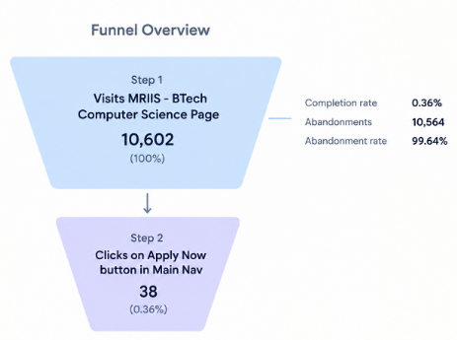
TO VALIDATE
Source: GA4 Path Exploration and Event Count, page path and screen class, 13 Jun – 10 Sept 2026.
Course Researcher · the journey on B.Tech CSE
B.Tech Computer Science — the highest-traffic course page on the site
67.9%
32.1%
2m 54s
1.68
Engagement rate
Bounce rate
Avg. session duration
Views per session
vs 66.1% across scope
vs 33.9% across scope
vs 3m 22s across scope
vs 2.07 across scope
AND AT THE END OF THAT JOURNEY
3
form starts, in 90 days for Desktop
The ‘Apply Now’ button at the top of the page has highest visibility, yet has a very low click through rate
5.90%
Users scrolling till 90% of the page
20
form starts, in 90 days for Mobile
Notes:
This is the core slide. Users research thoroughly, complete a fee round-trip, and the journey simply ends. Device split on this path is 3.9K desktop / 3.0K mobile, so this is not a mobile-specific issue.
APPENDIX — retained from an earlier cut. Figures differ from the page-path slide in section 03 (83.0% / 99.6% / 22 of 6,097 here vs 84.3% / 99.3% / 6 of 6,964 there; 3 + 20 form starts vs 21). Likely a different date range or filter — reconcile before using externally.

Slide 92
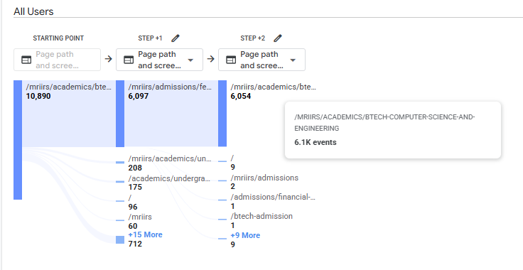
TO VALIDATE
Course Researcher · the journey on B.Tech CSE
12,308
84.3%
99.3%
6
LAND
→
LEAVE
→
RETURN
→
CONTINUE
on the course page
of all onward movement goes to the fee structure page
come straight back to the course page
users go anywhere at all after that
7,010 events
6,964 events
of 6,964
BUT THE ANSWER IS SOMEWHERE ELSE
83.0%
of all onward movement leaves for the fee structure page
99.6%
of movement from that page comes straight back here
22
users out of 6,097 go anywhere else at all
The page holds attention. It does not complete the decision.
Source: GA4 — Landing page + query string and Path Exploration (page path and screen class), 13 Jun – 10 Sept 2026. Percentages are shares of onward event movement, not of sessions.
Notes:
Read order: metrics first, then the path. The page does everything right except give the user the last piece of information they need, so they leave to find it and the journey ends on the return trip.
APPENDIX — retained from an earlier cut. Figures differ from the page-path slide in section 03 (83.0% / 99.6% / 22 of 6,097 here vs 84.3% / 99.3% / 6 of 6,964 there; 3 + 20 form starts vs 21). Likely a different date range or filter — reconcile before using externally.

Slide 93
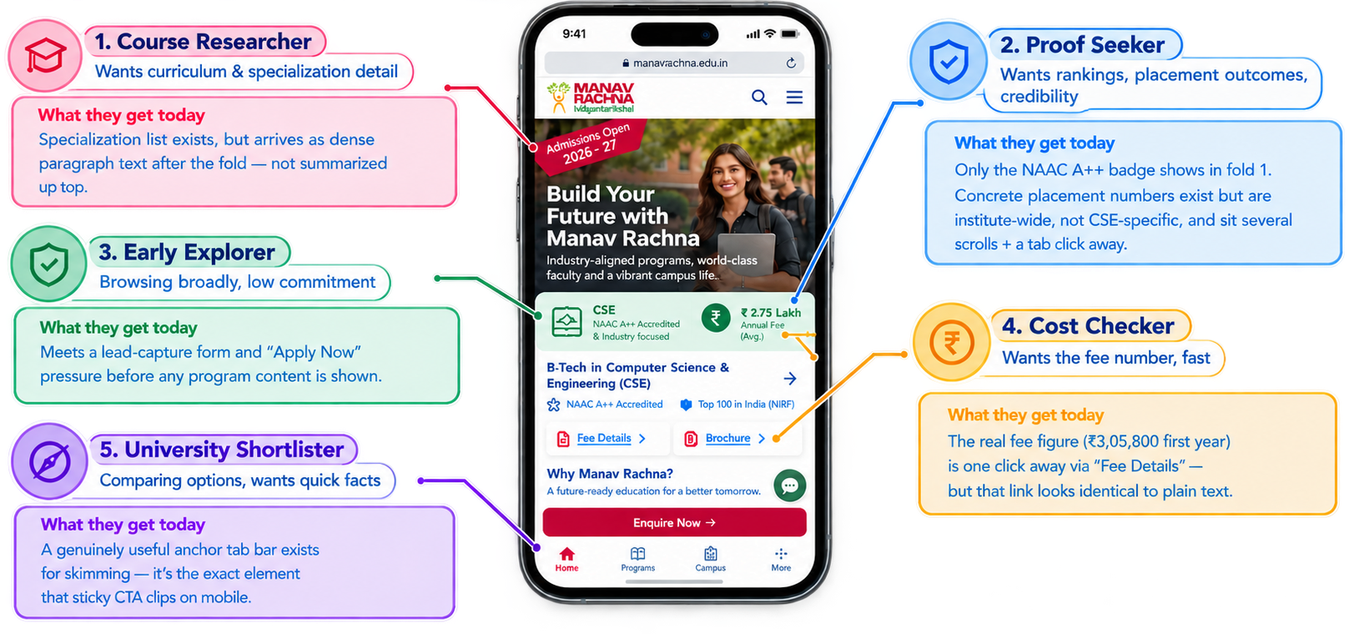
APPENDIX · PERSONA VERDICTS, FOLD 1–2
What each persona actually gets, in fold 1–2
Persona | Verdict
Course Researcher Wants curriculum & specialization detail | Partial
Proof Seeker Wants rankings, placement outcomes, credibility | Weak
Early Explorer Browsing broadly, low commitment | Weak
Cost Checker Wants the fee number, fast | Partial
University Shortlister Comparing options, wants quick facts | Partial
CTA inventory: up to 4 same-intent “apply / enquire” prompts live above the fold (ribbon, nav, form, sticky tab) — none differentiated by the persona reading them.

Slide 94
MEASURED
COMPETITIVE BENCHMARKING — HOMEPAGE TEMPLATE
This is the homepage — so the bar is all six competitors, measured
Same instrument, same viewport, run live across every named competitor's homepage
Site | Tap targets <44px | Type sizes | Text colours | Contrast fails
MREI (manavrachna.edu.in) | 76% | 15 | 7 | 24%
Sharda | 77% | 12 | 8 | 16%
Chandigarh University | 75% | 13 | 12 | 44%
LPU Online | 67% | 10 | 9 | 18%
Bennett | 62% | 16 | 11 | 2%
Amity Online | 54% | 22 | 19 | 2%
Galgotias | 53% | 20 | 14 | 9%
WHY THIS MATTERS HERE
The institution root is the closest thing MREI has to a homepage — it's the page a shortlister compares across universities. These fundamentals are visible in that comparison.
MREI ties for worst on tap-target ergonomics despite running a leaner page than most competitors here — there's no complexity excuse.
Source: live capture, 390px mobile viewport, 21–22 Sept 2026.

