Slide 1


SMART INDIA HACKATHON 2026
• Problem Statement ID –
• Problem Statement Title -
• Theme -
• PS Category - Software/Hardware
• Team ID -
• Team Name (Registered on portal)

Slide 2

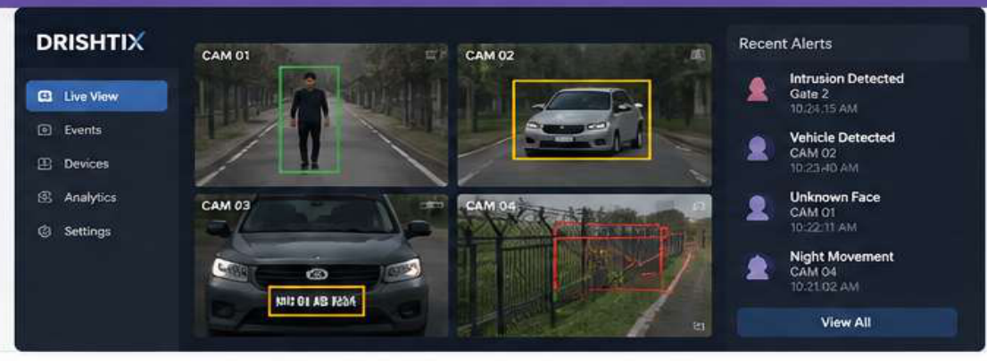
DRISHTIX – INTELLIGENT BORDER SURVEILLANCE PLATFORM
Turning Existing CCTV infrastructure into intelligent Actionable intelligence
💡 1. OUR IDEA
🧩 2. THE PROBLEM
🎯 3. OUR SOLUTION (DRISHTIX)
🛡 4. KEY BENEFITS
⚙ 5. TECHNOLOGIES USED
Create a software-defined AI platform that converts existing CCTV cameras into an intelligent surveillance network without requiring expensive hardware.
• Existing CCTV is passive and requires constant manual monitoring.
• High false alarms with conventional motion detection.
• Advanced features like FRS, ANPR, intrusion detection require costly hardware.
• Difficult & expensive to deploy at large scale, especially in remote border areas.
AI-Powered Video Analytics Platform
• Human Detection & Tracking
• Vehicle Detection & Classification
• Face Detection
• ANPR (Plate Recognition)
• Virtual Fence Intrusion Detection
• Suspicious Activity Detection
• Night-Time Movement Detection
• Real-Time Alerts & Event Logging
• Works with existing CCTV infrastructure
• Eliminates dependency on expensive hardware
• Real-time alerts for quick response
• Improved situational awareness for border security
• Scalable, cost-effective for remote locations
• Seamless integration with Command & Control systems
• Python, FastAPI
• OpenCV
• YOLOv8
• Deep Learning (Autoencoders, LSTM)
• OCR / ANPR
• PostgreSQL / SQLite
• React Dashboard
6. SOLUTION PROTOTYPE – WORKFLOW
📺 7. PROTOTYPE SCREEN (DEMO VIEW)
INPUT
PREPROCESSING
AI ANALYTICS
OUTPUT
DASHBOARD
Existing CCTV
(IP / RTSP Feeds)
Frame Extraction
Resize • Noise Reduc.
Normalization
Detection & Track
Feature Extraction
Anomaly Detection
Rule & Event Anal.
Real-time Alerts
Event Logging
Snapshots / Clips
Risk Score
Live Monitoring
Event Tagging
Search & Filter
Reports & Analytics
▶
▶
▶
▶
@SIH Idea submission- Template
2

Slide 3
TECHNICAL APPROACH
</> 1. PROGRAMMING
2. COMPUTER VISION
3. AI / MACHINE LEARNING
4. ANPR & ANALYTICS
5. PLATFORM & STORAGE
Python
• Core development
• AI/ML pipeline
• Automation
• Alert handling
• Integration & APIs
OpenCV
• Video processing
• Frame extraction
• Image preprocessing
• Object / Face detection
• Tracking & contouring
Deep Learning
• YOLO-based detection
• Autoencoders for anomaly
• LSTM for temporal seq
• Behavior analytics
OCR / ANPR
• Number plate detection
• Character recognition
• Vehicle identification
• Event classification
• Confidence scoring
FastAPI + Database
• FastAPI for backend APIs
• Event logging
• PostgreSQL / SQLite
• Data storage & retrieval
• Web dashboard
INPUT: Existing CCTV / RTSP Feeds
→
AI PROCESSING: Computer Vision & Deep Learning
→
INTELLIGENCE: Detection, Tracking & Analysis
→
ALERT: Real-Time Alerts & Notifications
→
RESPONSE: Action by Security Forces
2. METHODOLOGY & IMPLEMENTATION — DRISHTIX : From Video to Actionable Intelligence
WORKING PROTOTYPE (DEMO FLOW)
1. VIDEO INPUT
2. PREPROCESSING
3. AI ANALYTICS
4. EVENT ANALYSIS
5. ALERT ENGINE
6. DASHBOARD & LOGS
📹 Camera Feed (Live Video)
↓
🧠 AI Detection (Objects/Faces)
↓
⚠️ Event Identified (Anomaly)
↓
🔔 Alert Generated (Real-Time)
↓
💾 Evidence Stored (Clip + Log)
⚠️ EXAMPLE ALERT
VIRTUAL FENCE INTRUSION
Camera: CAM-04
Time: 22:14:08
Date: 20-05-2026
Risk Level: HIGH 🔴
✔ Evidence Saved (Clip+Snap)
• Capture video from existing CCTV cameras
• (IP / RTSP Feeds)
• Frame extraction, resize,
• normalization, noise reduction,
• enhancement
• Human / Vehicle Detection
• Face Detection, ANPR
• Tracking (DeepSORT)
• Feature Extraction
• Virtual Fence Intrusion
• Suspicious Activity
• Night-Time Movement
• Rule Engine & Risk Scoring
• Real-Time Alerts
• Risk Class (Low/Med/High)
• Notifications: Email, SMS,
• WhatsApp & Dashboard
• Live View (Multi-Camera)
• Event Log & Snapshots
• Search, Filter & Reports
• Export & Integration APIs
@SIH Idea submission- Template
3

Slide 4
FEASIBILITY AND VIABILITY
✅ FEASIBILITY OF THE IDEA
⚠️ POTENTIAL CHALLENGES & RISKS
🛡️ STRATEGIES TO OVERCOME
✔ Uses existing IP CCTV infrastructure (RTSP/ONVIF).
✔ Software-based solution – no need for new hardware.
✔ Proven AI technologies: YOLO/SSD, OCR, Face Recognition, OpenCV.
✔ Public datasets (COCO, WIDER FACE, PETS, CUHK Square) for training & evaluation.
✔ Edge-ready – works on laptops, GPUs or edge devices.
✔ Modular architecture for incremental feature addition.
⚠ Poor quality / night-time video (low visibility)
⚠ Multiple CCTV streams processing load
⚠ False positives / false negatives in edge cases
⚠ Existing legacy camera integration variance
⚠ Face & number plate recognition at distance/angles
⚠ Large feature scope management in Phase 1
🔧 Data: Denoising, enhancement, CLAHE & day/night augmentation.
🔧 Performance: Model pruning, FP16 quantization, TensorRT/GPU edge acceleration.
🔧 Accuracy: Threshold tuning + DeepSORT tracking + confidence verification.
🔧 Integration: Standard RTSP/ONVIF connectors with modular microservices.
🔧 Privacy & Security: Role-based access, encrypted video storage.
🔧 Scope: Prioritize core MVP → Detection → Tracking → Intrusion → Alerts.
📊 TECHNICALLY FEASIBLE, SCALABLE & COST-EFFECTIVE
💡 BOTTOM LINE: Technically feasible, scalable and cost-effective —
with risks manageable through modular microservice design, edge optimization and phased MVP deployment.
@SIH Idea submission- Template
4

Slide 5
IMPACT AND BENEFITS
• IMPACT ON TARGET AUDIENCE •
BORDER SECURITY FORCES
SECURITY OPERATORS
COMMAND & CONTROL CENTRES
GOVERNMENT & AGENCIES
REMOTE BORDER POSTS
Faster detection of suspicious activities and intrusions.
Improved situational awareness.
Automated detection of humans, vehicles and events.
Reduced workload and prioritized alerts.
Centralized alerts, event logs, video snippets and metadata.
Faster decision-making and response.
Scalable solution using existing infrastructure.
No need for dedicated FRS/ANPR smart hardware.
AI-assisted monitoring even in resource-limited and remote perimeter locations.
• KEY BENEFITS •
SOCIAL BENEFITS
ECONOMIC BENEFITS
OPERATIONAL BENEFITS
ENVIRONMENTAL / RESOURCE
• Improved border safety
• Faster response to incidents
• Reduced operator workload
• Better situational awareness
• Reuses existing CCTV infrastructure
• Lower hardware cost & capex
• Open-source core technology
• Scalable multi-site deployment
• Real-time human & vehicle detection
• Face & license plate recognition
• Virtual-fence intrusion detection
• Automated alerts & evidence logging
• Extends operational life of existing cameras
• Reduces unnecessary e-waste & replacement
• Edge processing minimizes cloud bandwidth
• Energy-efficient compute architecture
🎯 OVERALL IMPACT: EXISTING CCTV + AI INTELLIGENCE + REAL-TIME ALERTS
= A SMARTER, FASTER & MORE PROACTIVE BORDER-SECURITY NETWORK
@SIH Idea submission- Template
5

Slide 6
RESEARCH AND REFERENCES
1. PROBLEM STATEMENT
2. TECHNOLOGIES USED
3. DATASETS
4. EVALUATION METRICS
5. DEPLOYMENT & TOOLS
Smart India Hackathon 2026
SIH26187
AI-Based Intelligent Video Analytics Platform for Border Surveillance using Existing CCTV Infrastructure
Ministry of Home Affairs
Smart Automation
sih2026.vuce.in/en/ps/SIH26187
• OpenCV
(Image & Video Processing)
• YOLO / SSD
(Object Detection)
• PyTorch
(Deep Learning Framework)
• OCR
(License Plate Recognition)
• Face Recognition
(Identity Matching)
• COCO
(Object Detection)
• WIDER FACE
(Face Detection)
• PETS / CUHK Square
(Surveillance Videos)
• OpenALPR
(License Plate Recognition)
• mAP (Mean Average Precision)
• Accuracy & Precision
• Recall & F1 Score
• AUC-ROC Curve
• False Alarm Rate (FAR)
• Processing Latency (ms)
• Frames Per Second (FPS)
• FastAPI
(Backend APIs)
• PostgreSQL / SQLite
(Data Storage)
• NVIDIA TensorRT
(Inference Optimization)
• Edge / GPU Deployment
(Real-Time Processing)
RESEARCH → DEVELOPMENT PIPELINE
Step 1
Step 2
Step 3
Step 4
Step 5
Step 6
Research Papers
& Datasets
→
AI Models
(Train & Test)
→
Computer Vision
& Analytics
→
ANPR / Face
Recognition
→
Testing & Eval
(Metrics)
→
Real-Time
Deployment
@SIH Idea submission- Template
6

