Slide 1

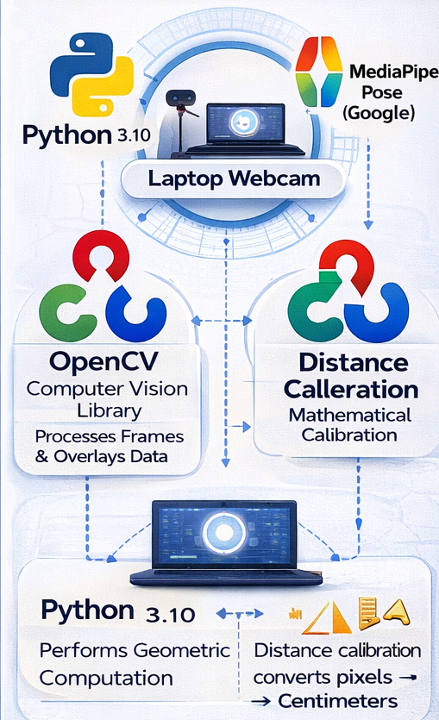
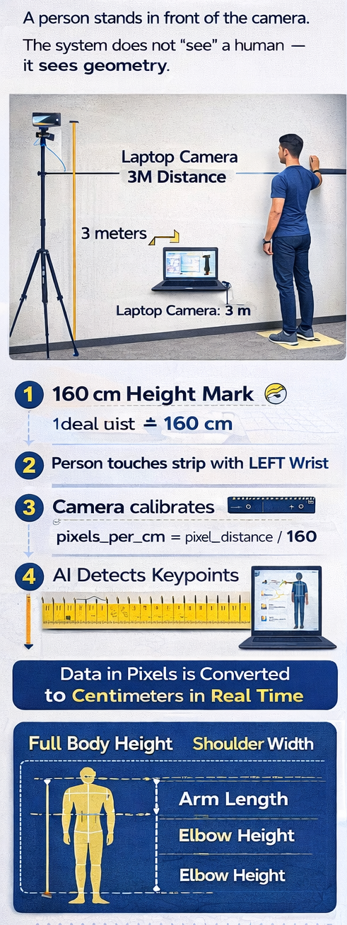
Stable and repeatable energy generation observed during every descent cycle
Output increased with mass up to an optimum value
Best performance obtained at m ≈ 1 kg
Peak values achieved:
Imax⁡≈0.72 A,Pmax⁡≈0.74 W,ηmax⁡≈17.9%I_{\max} \approx 0.72\ \text{A}, \quad P_{\max} \approx 0.74\ \text{W}, \quad \eta_{\max} \approx 17.9\%Imax​≈0.72 A,Pmax​≈0.74 W,ηmax​≈17.9%
Beyond the optimum mass, performance reduced due to frictional and mechanical losses
Real-time sensing using Arduino + INA219 validated system behavior
RV College of Engineering, Bengaluru – 560059
IIISemester Odd2025-2026|WorkSystems Design | IM233AI
Dr. Vikram N Bahadurdesai|Prof.Shruthi M N | Dr. Rajeswara Rao K V S
Go, change the world
Title: AI-Based Ergonomic Measurement of Human Body
Aryan Lodha | Harsh Jain
1RV24IM064 | 1RV24IM013
Introduction
Tools used
Body measurement is required in e-commerce, medicine, tailoring, and ergonomics. Yet we still depend on slow and uncomfortable manual tools.
This project transforms a normal camera into a measuring instrument using AI. It enables contactless, real-time body measurement in centimeters using only a laptop webcam.
The goal is simple: Replace the measuring tape with a camera.
Problem Definition
Accurate body measurement is essential in ergonomics, healthcare, tailoring, and online shopping. However, current methods rely on manual tools such as measuring tapes and stadiometers.
These methods are:
-Time-consuming -Contact-based and uncomfortable
-Prone to human error -Not scalable for large populations
-Impractical for digital platforms like e-commerce
There is no simple, low-cost, camera-based system that can measure human body dimensions automatically in real-world units.
This project addresses this gap by creating an AI-driven, contactless body measurement system using only a webcam.
Objectives
Eliminate manual body measurement
Enable camera-based dimension capture
Convert pixels to real-world centimeters
Provide live ergonomic measurements
Make body measurement fast and digital
Results and Discussions
The system successfully measures human body dimensions in real time using only a laptop camera. All measurements are displayed directly in centimeters with an accuracy of about ±1–2 cm.
The model adapts to different body types and heights without any hardware change. It eliminates physical contact and reduces human error in manual measurement.
The results prove that computer vision and AI can replace traditional ergonomic tools, making body measurement faster, safer, and digitally scalable for real-world applications such as e-commerce, healthcare, and tailoring.
Methodology
Conclusions
This project demonstrates that a simple camera can be transformed into a precise ergonomic instrument using AI. By combining pose estimation with real-world calibration, manual measuring tools become unnecessary.
The system enables fast, contactless, and low-cost body measurement for any user. It opens the path for smart sizing systems in online shopping, automated clinical assessment, and digital ergonomics.
The future of human measurement is no longer manual—it is intelligent, visual, and accessible.
References
Lugaresi, C. et al., MediaPipe: A Framework for Building Perception Pipelines, Google Research, 2019.
Google, MediaPipe Pose Documentation.
Bradski, G., The OpenCV Library, Dr. Dobb’s Journal, 2000.
ISO 7250-1:2017, Basic Human Body Measurements for Technological Design.
Pheasant, S. & Haslegrave, C., Bodyspace: Anthropometry and Ergonomics, 2006.
Cao, Z. et al., Realtime 2D Pose Estimation, IEEE CVPR, 2017.
Shotton, J. et al., Real-Time Human Pose Recognition, IEEE, 2011.
Zhang, Z., A Flexible New Technique for Camera Calibration, IEEE TPAMI, 2000.
Chen, Y. et al., Vision-Based Human Body Measurement, Elsevier, 2018.
The methodology image shows how the system converts a live camera feed into measurable data. It highlights fixed camera positioning, user alignment, and the use of a known height reference to calibrate pixels into real-world units. AI detects key body landmarks and forms a skeletal model, from which all dimensions are computed. Once calibrated, every frame becomes a measurable space, enabling continuous and contactless ergonomic assessment without physical tools.

