Slide 1

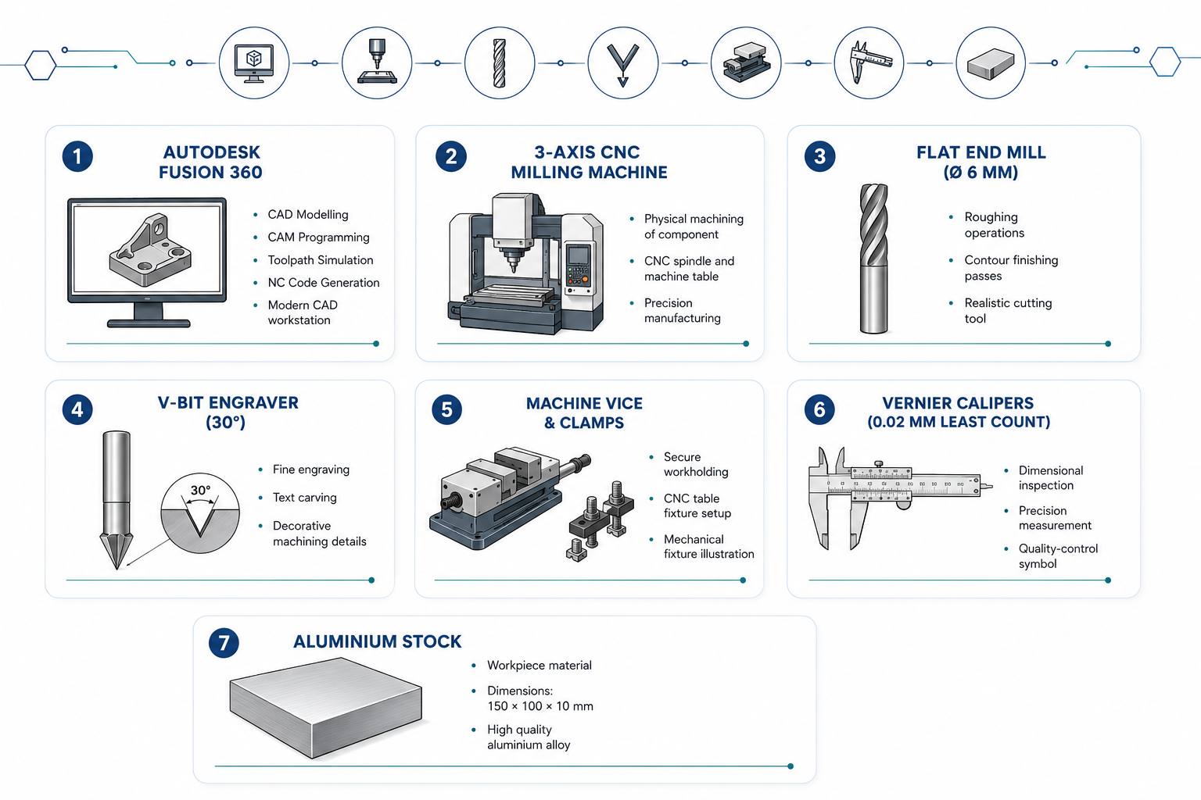
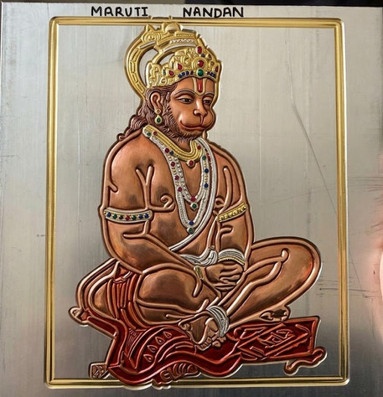
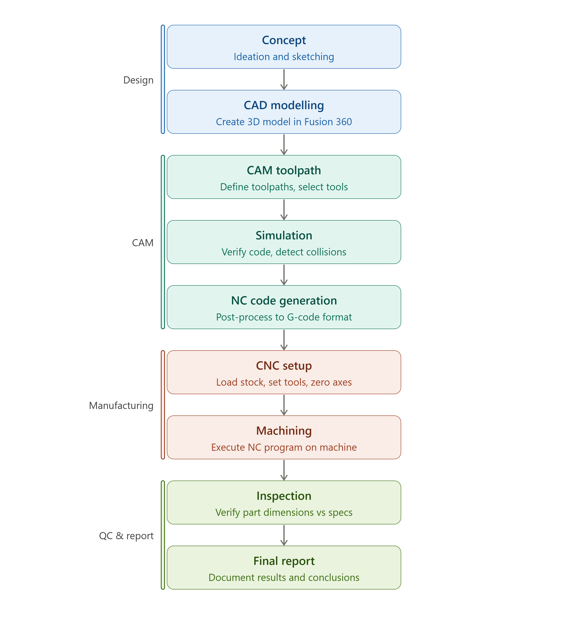
RV College of Engineering, Bengaluru – 560059.
Go, change the world
Title: Design and Machining of Maruti Nandan
Aryan Lodha | Roshan Kumar
1RV24IM064 | 1RV24IM039
CAD/CAM & ROBOTICS PBL
Introduction
Tools used
This project demonstrates a complete CAD-to-CNC manufacturing workflow through the design and machining of "Maruti Nandan" — a decorative engraved aluminium plaque. Using Autodesk Fusion 360 for 3D modelling and CAM programming, the design was physically manufactured on a 3-axis CNC milling machine, bridging the gap between classroom theory and real-world manufacturing practice.
As part of the EL programme, the team also visited 3 manufacturing industries in Peenya, Bengaluru — gaining first-hand exposure to industrial CAD/CAM, CNC technology, and shop-floor management.
Problem Definition
Engineering students learn CAD and CAM as separate, theoretical subjects — with no hands-on experience connecting a digital design to an actual machined part.
The core question this project answers: How do you take a design from a screen and turn it into a real, accurate, physical component using CNC machining?
▶ No practical exposure to G-code, toolpath planning, or WCS setup ▶ Gap between simulation and actual machine operation ▶ Industries in automotive, aerospace & defence depend on this exact workflow daily — students need to experience it, not just read about it
Results and Discussions
The "Maruti Nandan" engraved plaque was successfully machined — text sharp, legible, and dimensionally accurate to ±0.2 mm vs. the CAD model. Total machining time: ~55 min across 3 operations (Roughing → Contouring → Engraving).
Objectives
Iterations made: ▶ Tool collision caught in simulation →
clearance height corrected before machining ▶ Chatter on first engraving run → feed rate reduced 600 to 500 mm/min ▶ Z-depth error → WCS re-zeroed after rough pass ▶ Feature too small for V-bit → enlarged in CAD and re-run
Industry visits — key takeaways: ▶ Sands Precision — 45% utilisation, CMM inspection, builds CNC machines ▶ United Concord — 85% utilisation, lean manufacturing, 250+ staff ▶ Sree Ranga Engineering — CNC laser cutting, SolidWorks/AutoCAD; same CAD/CAM pipeline as our project
Primary ▶ Model "Maruti Nandan" in Fusion 360 using parametric CAD ▶ Generate and simulate CNC toolpaths (Pocket → Contour → Engrave) ▶ Machine the design on a CNC mill to ±0.2 mm accuracy ▶ Inspect and validate finished part against the CAD model
Secondary ▶ Learn G-code structure and NC post-processing ▶ Observe industrial CAD/CAM through 3 factory visits ▶ Build skills in process planning, teamwork, and documentation
Methodology
Conclusions
The project successfully demonstrated an end-to-end CAD → CAM → CNC manufacturing workflow using Autodesk Fusion 360 and a 3-axis CNC milling machine.
▶ All primary and secondary objectives achieved within the 6-week timeline ▶ Toolpath simulation proved essential — prevented tool collision before physical machining ▶ Accurate WCS setup was the key determinant of dimensional conformance ▶ Industry visits validated that the same CAD/CAM principles operate across all manufacturing scales
Outcome of the work
Deliverables: ▶ CNC-machined "Maruti Nandan" aluminium plaque — 150×100×10 mm, ±0.2 mm accuracy ▶ Fusion 360 CAD file (.f3d) and verified NC G-code (.nc) ▶ Industry visit documentation — Peenya, Bengaluru
Future Scope: 4-axis CNC machining | Steel/SS materials | Mould & die applications | Additive manufacturing integration
References
Autodesk Inc. (2024). Fusion 360 Documentation. autodesk.com
Groover, M.P. (2020). Fundamentals of Modern Manufacturing, 6th Ed. Wiley.
Kalpakjian & Schmid (2022). Manufacturing Engineering & Technology, 8th Ed. Pearson.
Smid, P. (2010). CNC Programming Handbook, 3rd Ed. Industrial Press. Industry Visits — Sands Precision Pvt. Ltd. (Guide: Mr. Dinesh Karanth), United Concord Industries, Sree Ranga Engineering Works, Peenya, Bengaluru. May 2025.
RVCE (2025). CAD/CAM EL Guidelines. Dept. of IEM, Bengaluru.

