Slide 1

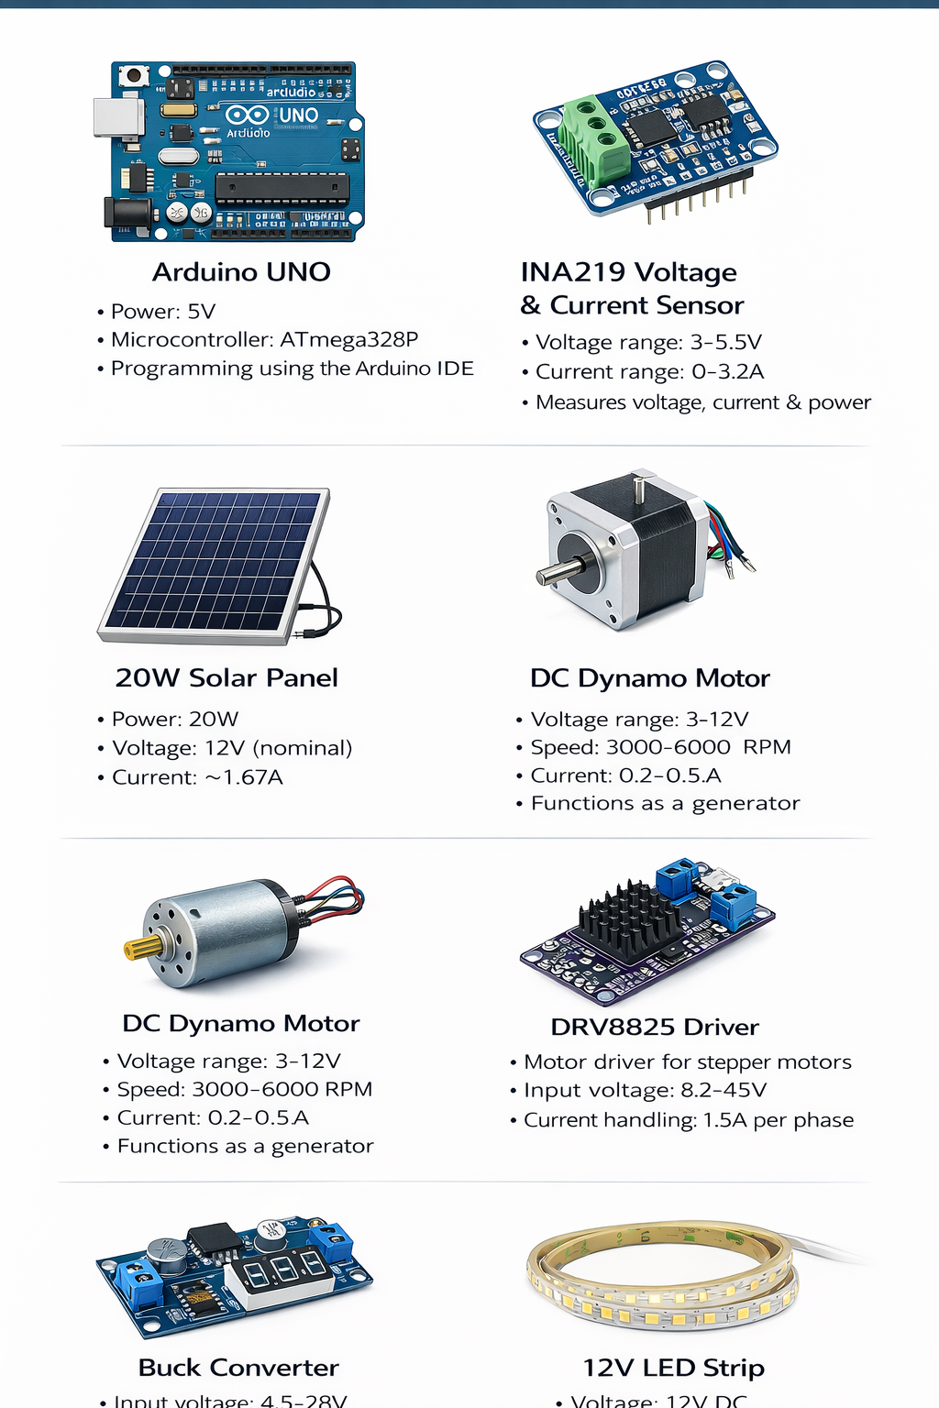
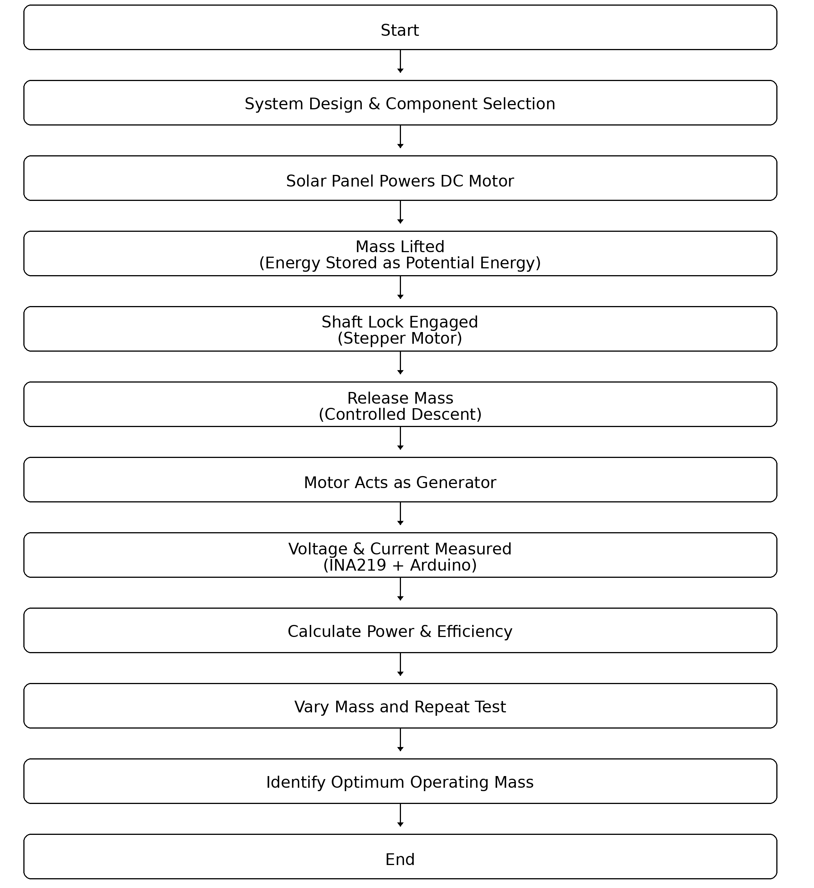


Stable and repeatable energy generation observed during every descent cycle
Output increased with mass up to an optimum value
Best performance obtained at m ≈ 1 kg
Peak values achieved:
Imax⁡≈0.72 A,Pmax⁡≈0.74 W,ηmax⁡≈17.9%I_{\max} \approx 0.72\ \text{A}, \quad P_{\max} \approx 0.74\ \text{W}, \quad \eta_{\max} \approx 17.9\%Imax​≈0.72 A,Pmax​≈0.74 W,ηmax​≈17.9%
Beyond the optimum mass, performance reduced due to frictional and mechanical losses
Real-time sensing using Arduino + INA219 validated system behavior
RV College of Engineering, Bengaluru – 560059.
Go, change the world
Title: Gravity-Driven Mechanical Energy Storage for Renewable Integration
Vijay S Halagi | Aryan Lodha | Amith B | Shashank Joga
1RV24CH041 | 1RV24IM064 | 1RV24CV005 | 1RV24CV049
Theme: Environmental Engineering and Sustainability
Introduction
Tools used
The rapid growth of renewable energy is limited by the lack of efficient and long-duration storage. Conventional batteries provide only short-term storage and degrade over time. Gravitational energy storage offers a mechanical, safe, and eco-friendly alternative by storing energy in the form of lifted mass and releasing it during descent. The working principle is based on gravitational potential energy,
$$E=mgh$$
where energy is stored when a mass is raised and converted into electrical energy during controlled lowering. This project demonstrates a compact gravity-based energy storage prototype for sustainable renewable integration.
Problem Definition
Renewable sources like solar and wind are:
-Unpredictable -Intermittent -Mismatched with demand patterns
Due to insufficient storage:
70% of global renewable curtailment occurs
Coal plants still operate 24×7 for grid stability
Problem Statement: How can we develop a low-cost, safe, and long-life energy storage system to support renewable energy integration?
Objectives
Design and Build a gravity-based mechanical energy storage prototype
Study the effect of mass on current, power, efficiency
Identify optimum operating mass
Measure real-time voltage & current using Arduino
Analyze energy losses
Validate gravity storage as a sustainable alternative
Results and Discussions
Working gravity energy storage prototype developed
Electrical energy generated during controlled descent
Optimum operating mass ≈ 1.0 kg
Peak values obtained:
Current ≈ 0.72 A
Power ≈ 0.74 W
Efficiency ≈ 17.9%
Clear trends observed between mass, power & efficiency
Losses due to friction, heat, and mechanical limits
Methodology
Conclusions
Gravity-based storage is technically viable
System performance strongly depends on mass
At small scale, losses dominate efficiency
At larger scale, efficiency will improve significantly
Mechanical storage offers:
Long life
Low maintenance
Environmental safety
Gravity storage is a promising solution for 24/7 renewable grids
References
The process starts with system design and component selection to ensure mechanical stability and electrical compatibility. A solar panel supplies power to a DC motor, which lifts a mass vertically and stores energy in the form of gravitational potential energy.
Once the mass reaches the top position, a shaft-locking mechanism operated by a stepper motor holds it securely, preventing energy loss. During the discharge phase, the lock is released and the mass descends in a controlled manner.
During descent, the same motor acts as a generator, converting mechanical energy into electrical energy. The generated voltage and current are measured in real time using an INA219 sensor interfaced with an Arduino.
Power and efficiency are calculated from the measured values. The experiment is repeated by varying the mass, and performance trends are analyzed. From these trials, the optimum operating mass that delivers maximum power and efficiency is identified.
International Energy Agency (IEA), World Energy Outlook 2023, Paris, France.
International Renewable Energy Agency (IRENA), World Energy Transitions Outlook 2023.
Tong et al., “Solid Gravity Energy Storage: A Review,” Energy Reports, 2022.
Hunt et al., “Underground Gravity Energy Storage,” Energies, 2023.
United Nations, Sustainable Development Goal 7 – Affordable and Clean Energy
QR Code of the Demonstration Video

