Slide 1
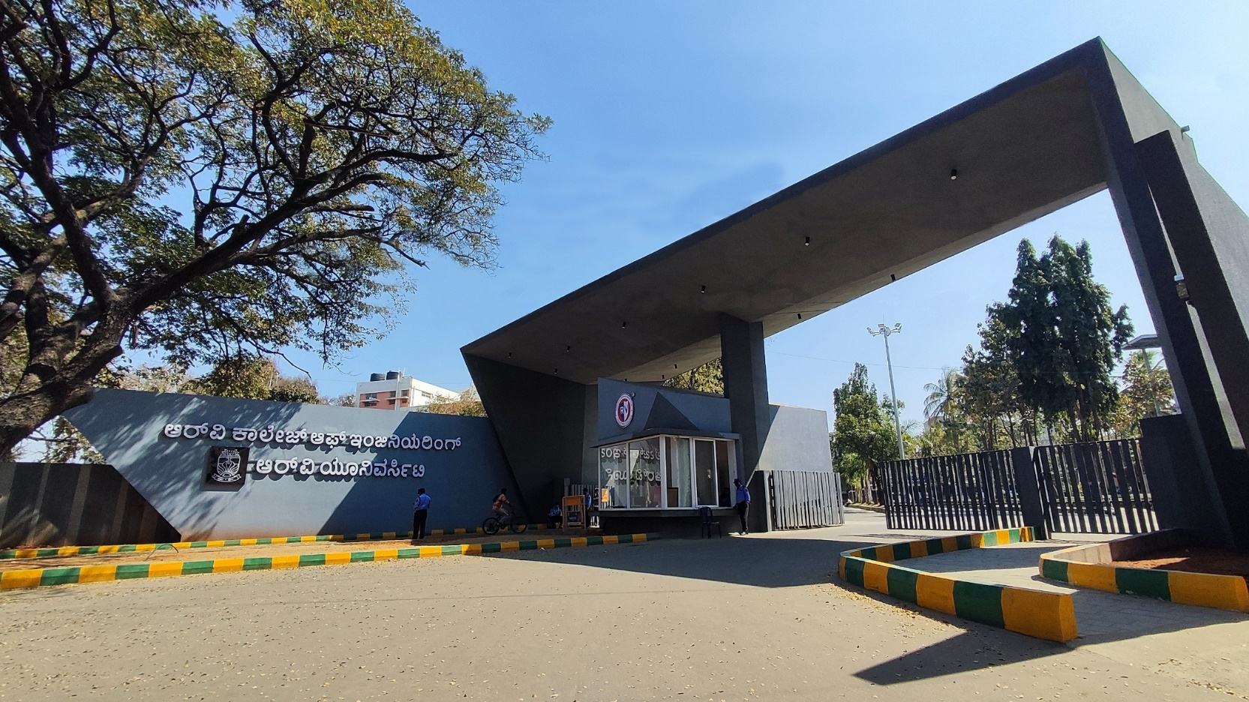
Gravity-Driven Mechanical Energy Storage for Renewable Integration
Civil Cluster

Slide 2


TEAM GRAVITECH
Team Members :-
1.Vijay S Halagi - 1RV24CH041
2. Aryan Lodha - 1RV24IM064
3. Amith B - 1RV24CV005
4. Shashank Joga - 1RV24CV049
Dr. Praveen Kumar Gupta
Assistant Professor,
Biotechnology Dept.

Slide 3
EL Phase-II
Presentation Outline
Introduction
Literature Review
Problem Definition
Objectives
Methodology
Proposed Outcomes
Timeline of the project
Conclusion
References

Slide 4
Introduction
Gravitational Battery – Overview
Gravitational batteries are large-scale energy-storage systems that store electricity by lifting heavy masses and release energy by lowering them back down.
The principle is simple: Energy = Mass × Gravity × Height.
This technology uses solid materials (concrete blocks, steel weights, or excavated rock) instead of water or chemical reactions.
It offers long operational life, high efficiency, and minimal environmental impact.
Gravitational batteries provide:
Long-duration storage for solar and wind power
Fast response for grid stability
Very low degradation over decades
Safety, with no chemical or fire risks

Slide 5
Introduction
Importance of the topic:
The world will require 8–10 times more storage by 2040 compared to today (IEA).
Lithium-ion batteries provide only 2–4 hours of affordable storage and degrade over time.
70% of global renewable curtailment (wasted solar/wind energy) occurs because grids lack storage capacity.
This is where gravitational batteries become important.
They offer:
High efficiency (80–90%)
Minimal degradation over decades
No chemical waste, no fire risk
Ability to scale from tens to hundreds of megawatt-hours
Use of simple, abundant materials like concrete, steel, or rock

Slide 6
Problem Definition
The Biggest huddles for renewable transition are:
Unpredictable and uncertainty around renewable energy ( solar and wind).
A huge gap between energy demand vs energy consumption patterns.
Economics of coal power plants ( in order to reduce cost power plants have to run 24x7 )

Slide 7
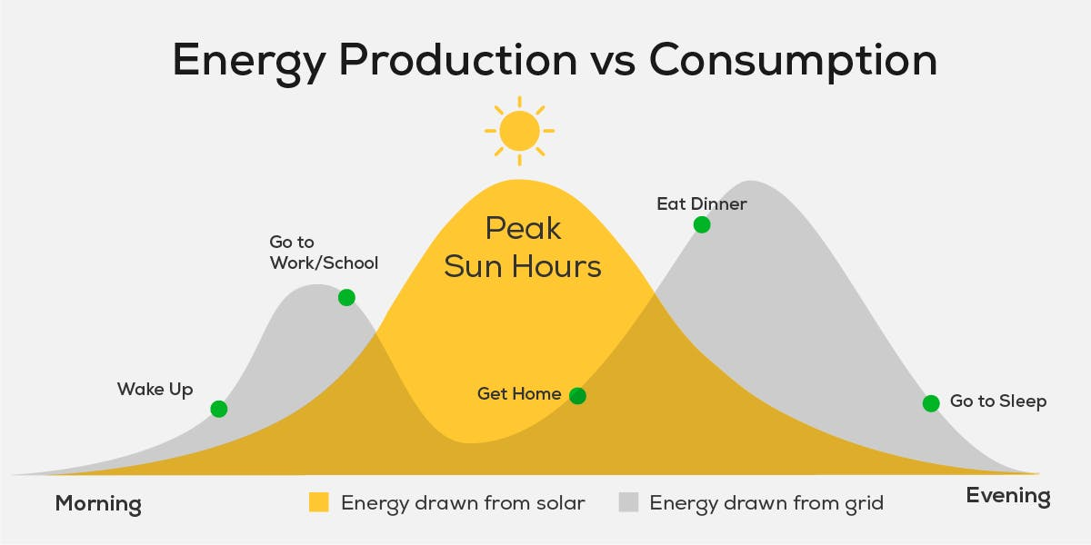
Problem Definition
Problem Statement:
70% of the globe renewal curtailments occur because grid lacks storage capacity

Slide 8
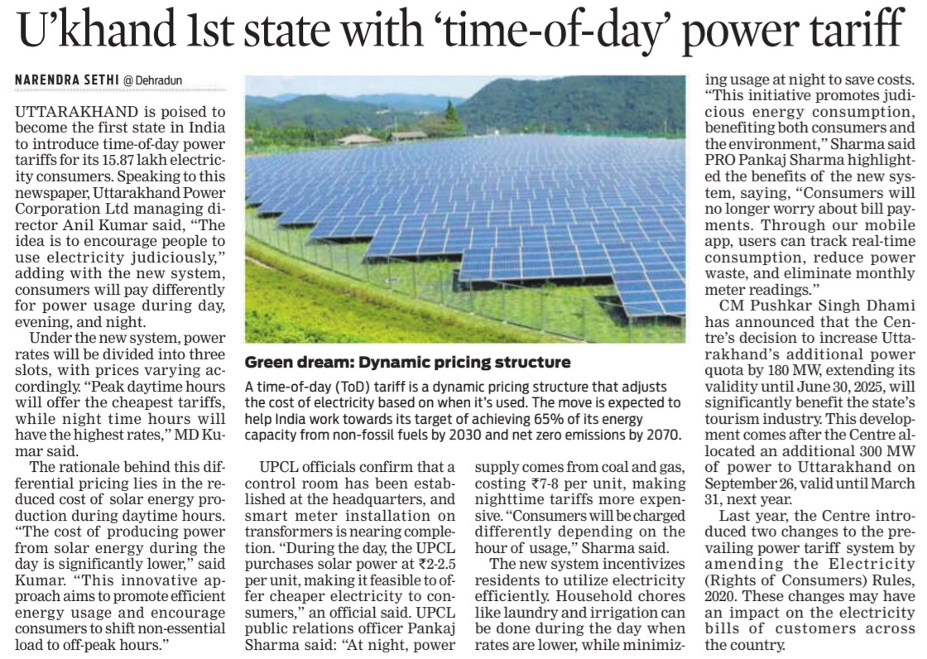
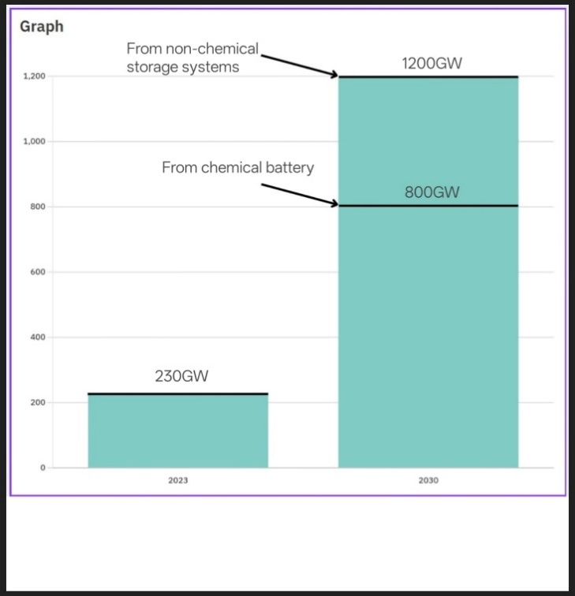
Problem Definition
Problem Statement:
The chart highlights the rapid growth in global energy storage capacity from 230 GW in 2023 to a projected 1,200 GW by 2030.
Reference: INDIAN EXPRESS [October 4th, 2024]

Slide 9
Literature Review
Key studies and Findings:
Energy Vault (2020): | Energy Vault demonstrated a large-scale gravity battery using crane-like structures to stack heavy blocks for energy storage.
Gravitricity Ltd (2021): | Developed a 250kW prototype using free-falling weights in mine shafts to generate electricity.
Pumped Hydro Storage (IEA, 2019): | Highlighted gravitational storage as the most efficient large-scale energy storage system with up to 90% efficiency.
Mechanical Energy Storage Systems (Khalilpour & Vassallo, 2022): | Discussed the advantages of mechanical (gravity-based) storage systems over chemical batteries for long-term sustainability.
Sand Battery Concepts (MIT Energy Initiative, 2023): | Showed innovative use of inexpensive materials like sand for gravity-driven thermal and mechanical energy storage.

Slide 10
Literature Review
Key studies and Findings:
Solid Gravity Energy Storage: A Review (2022) | Provides a full overview of solid-mass gravity storage systems, their efficiency, structure, and performance limits.
A Review of Gravity Energy Storage (2025) | Summarizes the latest advancements and compares SGES with pumped hydro and other mechanical storage options.
Parametric Optimisation for the Design of Gravity Energy Storage System Using Taguchi Method (2022) | Identifies the best design parameters (mass, height, timing) for maximizing energy output.
Can Solid Gravity Close the Energy Storage Gap? Emerging GES Technologies and Cost-Potential (2025) | Evaluates cost potential and global scalability of emerging gravity energy technologies.
Gravity Energy Storage and Its Feasibility with Mine Shafts (2025) | Assesses feasibility and benefits of converting abandoned mine shafts into gravity energy systems.

Slide 11
Literature Review
Key studies and Findings:
Grid Connection Method of Gravity Energy Storage Generator (2024) | Examines how gravity generators can safely connect and synchronize with electrical grids.
The Innovative Gravity Energy Storage Solution (2024) | Proposes next-generation design concepts and integration pathways for gravity batteries.
Design and Fabrication of Gravity-Based Energy Storage System (2023) | Presents a small-scale prototype demonstrating practical construction and testing.
Mountain Gravity Energy Storage for Isolated Micro-Grids (2020) | Explores using mountain elevations for gravity storage in remote microgrid areas.
Gravity Energy Storage Feasibility for Residential Homes (2024) | Studies the feasibility and constraints of using gravity batteries in home-scale applications.

Slide 12
Literature Review
Key studies and Findings:
Critical Review of Energy Storage Systems (2025) | Compares gravity storage with chemical and thermal systems on cost, lifespan, and sustainability.
Gravity-Based Storage for Renewable Integration: Challenges & Opportunities (2024) | Discusses the main challenges and future opportunities for SGES in renewable-heavy grids.
Media Taxonomy, Efficiency and Potential of Gravity Energy Storage (2025) | Classifies gravity storage types and compares efficiency ranges across solid, granular, and fluid media.

Slide 13
Literature Review
Trends in Literature:
Shift towards mechanical storage to overcome chemical battery limitations.
Focus on cost reduction, efficiency, and eco-friendly storage solutions.
Rising interest in decentralized, modular gravity battery systems for rural electrification.
Emerging hybrid models combining gravity with other storage technologies.

Slide 14
Literature Review
Theoretical Framework:
Principle: Conservation of Energy — Potential Energy (mgh) converted into Electrical Energy.
→ Mechanism:
Mass lifted during energy surplus → stored as potential energy.
Mass lowered during demand → generates electricity via generators.
Relevance: Forms the core working principle of the gravity battery prototype.

Slide 15
Literature Review
Relevance to current research:
Supports the shift from chemical to mechanical energy storage.
Validates the feasibility of low-cost, long-lifespan energy storage prototypes.
Aligns with global efforts to enable 24/7 renewable energy grids.
Our project contributes by prototyping a compact, scalable gravity battery model for practical applications.

Slide 16
Objectives
To design and develop a working gravity-based mechanical energy storage prototype.
To experimentally study the effect of mass on current, power, and efficiency of the system.
To identify the optimum operating mass that gives maximum power output and efficiency.
To measure real-time electrical parameters (voltage and current) using sensors and Arduino UNO.
To analyze energy conversion losses due to friction, heat, and mechanical limitations.
To validate the feasibility of gravity-driven storage as a low-maintenance alternative for renewable energy integration.

Slide 17
Methodology
1. System Design and Planning
The overall system was designed to store energy by lifting a mass using solar power and generate electricity during controlled descent.
A 0.6 m vertical structure was designed using PVC pipes and cardboard for mechanical stability and insulation.
Component selection was finalized based on availability, power rating, and compatibility with Arduino-based control.
2. Energy Input and Storage Mechanism
A 20 W solar panel was used as the primary renewable energy source.
The solar output was regulated using a DC–DC buck converter to obtain a stable 12 V supply.
This regulated power was supplied to a DC dynamo motor, which lifted a 1.0 kg mass vertically, storing energy in the form of gravitational potential energy.

Slide 18
Methodology
3. Mechanical Locking and Safety Control
A shaft-locking mechanism was implemented to hold the mass securely at the top position.
A NEMA17 stepper motor driven by a DRV8825 driver provided precise angular control for lock engagement and disengagement.
A potentiometer was used to monitor the shaft position and confirm locking status.
In case of stepper failure, a manual DPDT switch and BO motor were used as a backup control system.

Slide 19
Methodology
4. Energy Generation During Descent
When the mass was released, the lifting motor acted as a generator, converting mechanical energy into electrical energy.
The generated power was supplied to a 12 V LED array, serving as the output load and visual indication of energy generation.
5. Data Acquisition and Monitoring
An INA219 current and voltage sensor was used to measure real-time electrical output.
Sensor data was collected and processed using an Arduino UNO.
Parameters such as voltage, current, power, descent time, and efficiency were recorded during multiple trials.

Slide 20
Methodology
6. Experimental Testing and Optimization
The system was tested with multiple descent cycles to verify repeatability.
Mass values were varied (up to system limit) to identify optimum operating conditions.
Efficiency was calculated by comparing electrical output energy with input potential energy.
Observed losses due to friction, heat, and structural flexibility were noted.
7. Validation of Working Model
Successful energy generation was confirmed through LED illumination during descent.
The system demonstrated stable operation up to 1.0 kg, validating the feasibility of gravity-based energy storage at small scale.

Slide 21
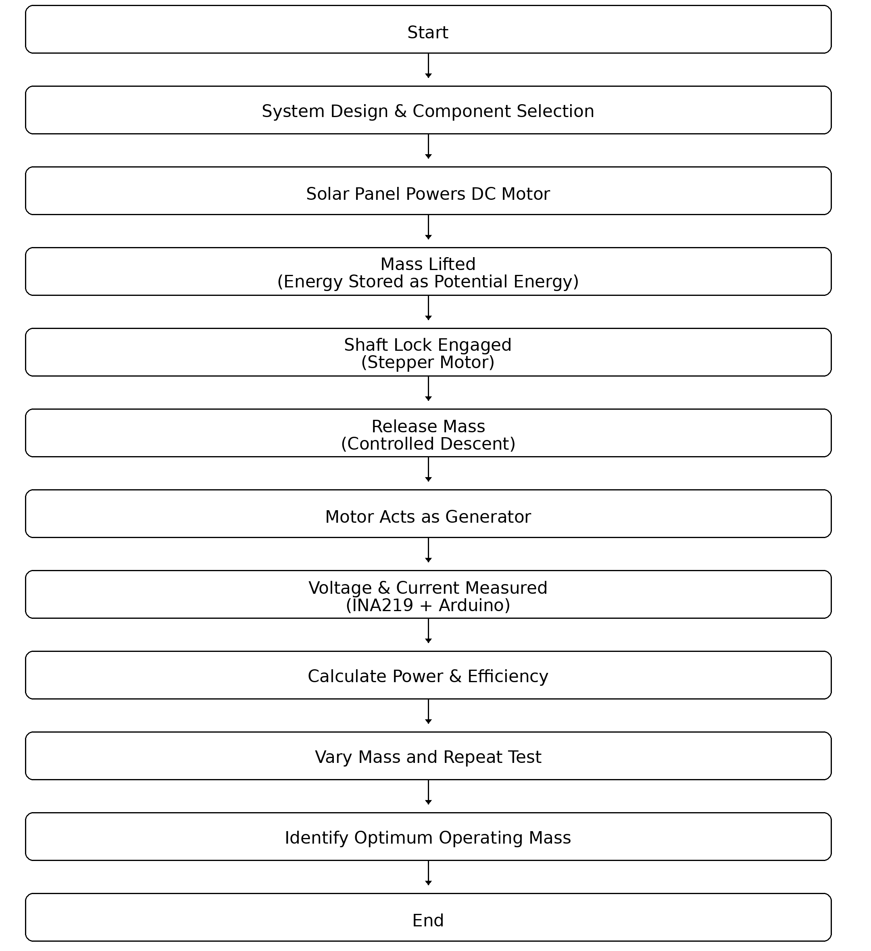
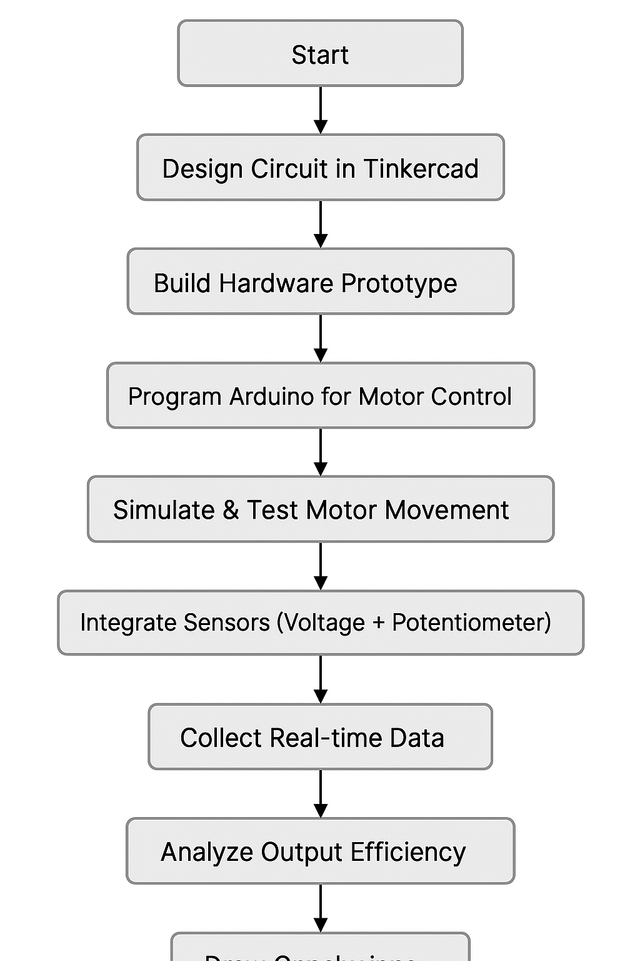
Methodology
Flowchart: Flow of Work

Slide 22

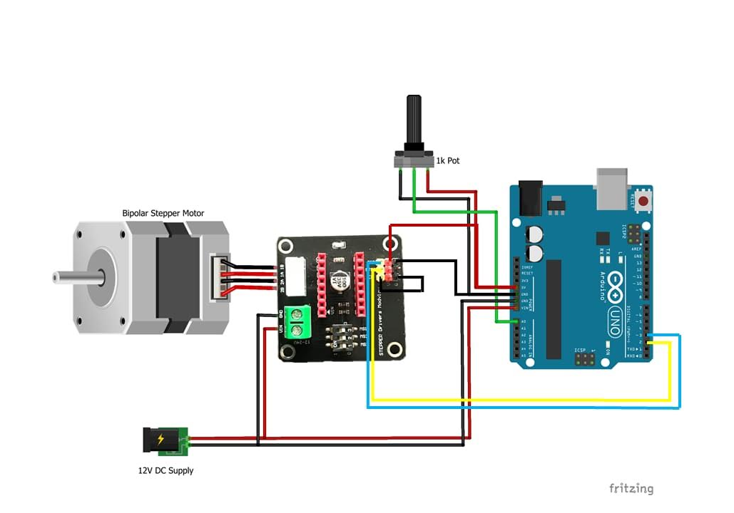
Methodology
Circuit Diagram: Stepper Motor
Circuit Diagram: Main Motor, using TINKERCAD

Slide 23
Outcomes
Successfully developed a working gravity-based energy storage prototype.
Demonstrated electrical energy generation during controlled mass descent.
Identified the optimum operating mass (≈ 1.0 kg) for maximum current, power, and efficiency.
Achieved peak efficiency of ~17.9%, validating effective mechanical-to-electrical energy conversion.
Established clear performance trends between mass, current, power, and efficiency.
Validated real-time monitoring of voltage and current using Arduino and INA219 sensor.
Identified key system losses due to friction, heat, and mechanical limitations.
Confirmed feasibility of gravity-driven storage as a low-maintenance, sustainable alternative for renewable energy integration.

Slide 24
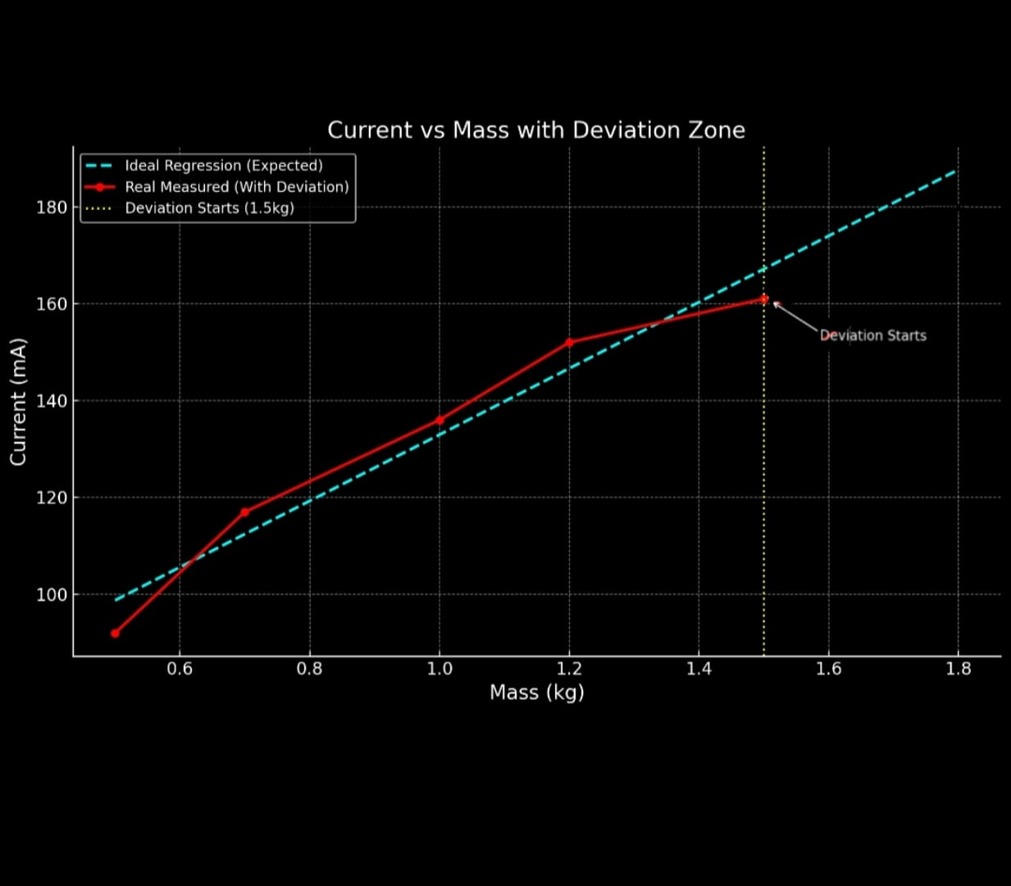
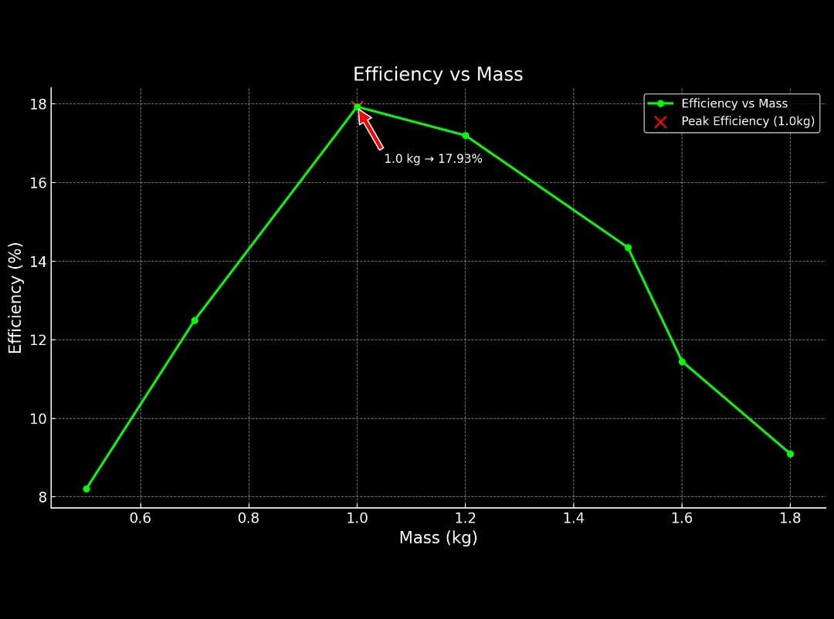
Outcomes

Slide 25
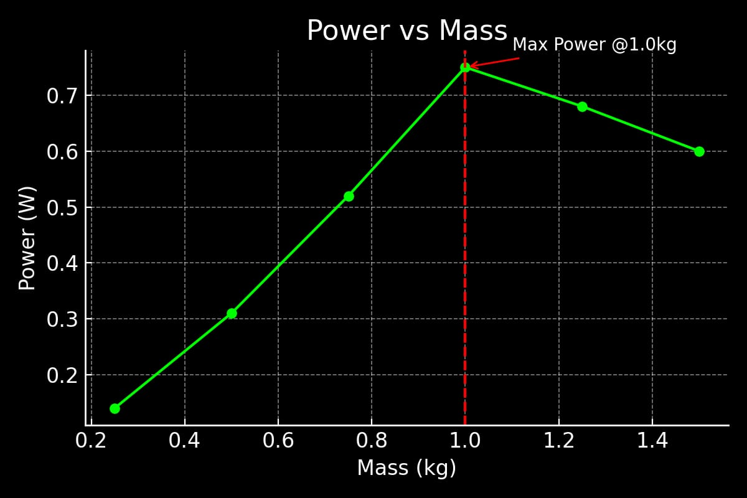
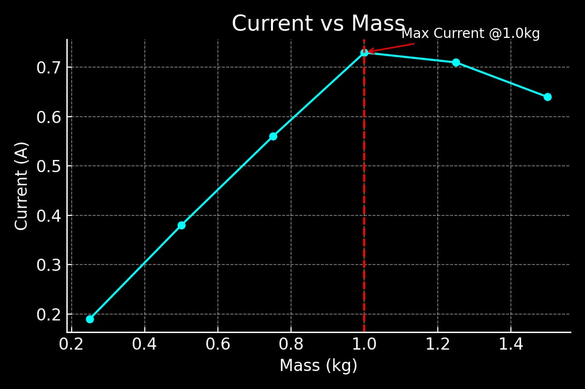
Outcomes

Slide 26
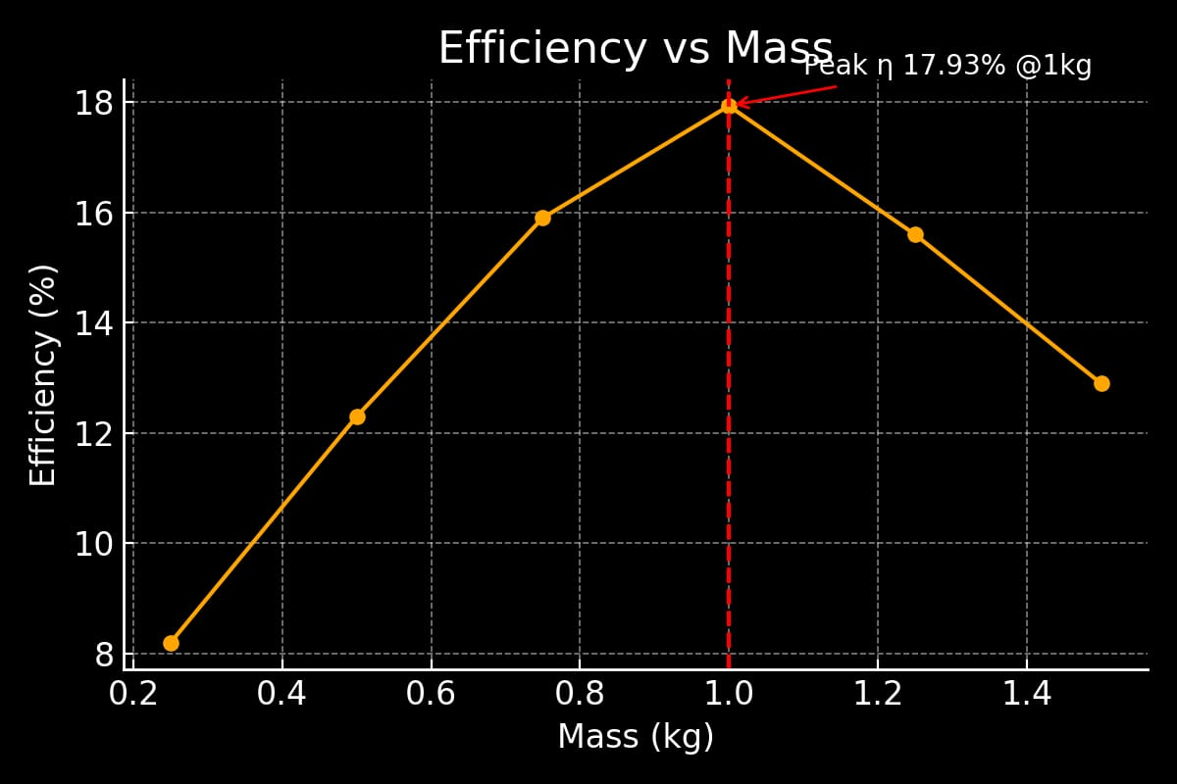
Outcomes

Slide 27
Conclusion
Technical Findings -
A gravity-driven mechanical energy storage system was successfully demonstrated using a solar-powered lifting mechanism.
Electrical energy generation during controlled mass descent confirmed the feasibility of gravitational energy conversion.
System performance showed a strong dependence on mass, with an optimal operating point at ~1.0 kg.
Peak performance achieved:
Maximum current ≈ 0.72 A
Maximum power ≈ 0.74 W
Peak efficiency ≈ 17.93%
Beyond the optimal mass, performance decreased due to mechanical and electrical limitations.

Slide 28
Conclusion
Performance Interpretation –
The efficiency trend indicates that fixed mechanical and electrical losses dominate at small scale.
Losses arise mainly from friction, generator inefficiency, structural flexibility, and control mechanisms.
Measurement accuracy is affected by current sensor saturation, leading to possible underestimation of actual output.
Despite low absolute efficiency, results clearly demonstrate repeatable and predictable system behavior.
Findings validate the importance of mass optimization and controlled descent in gravity-based storage systems.

Slide 29
Conclusion
Broader Implications -
The study confirms that gravity-based energy storage is technically viable for renewable energy applications.
At larger scale, increased height and mass would significantly improve efficiency by reducing the relative impact of losses.
Mechanical storage systems offer advantages of long life, low maintenance, and environmental safety over chemical batteries.
Gravity-driven storage shows strong potential as a long-duration energy storage solution supporting renewable energy integration.

Slide 30
References
List of References:
Global Energy Storage & Renewable Data
1. IEA (International Energy Agency). World Energy Outlook 2023.
2. IEA. Electricity Market Report 2024.
3. IRENA. World Energy Transitions Outlook 2023.
Gravitational Energy Storage
4. Tong et al. “Solid Gravity Energy Storage: A Review,” Energy Reports, 2022.
5. Hunt et al. “Underground Gravity Energy Storage,” Energies, 2023.
6. Elsayed et al. “Parametric Optimization for Gravity Energy Storage,” Scientific Reports, 2022.
7. Cai et al. “Techno-Economic Assessment of Gravity Storage,” WIREs Energy & Environment, 2024.
8. Wang et al. “Review of Gravity Energy Storage,” Energies, 2025.
Sustainability & SDG
9. United Nations. SDG 7 – Affordable and Clean Energy.
Lithium-Ion, Sodium-Ion & Flow Batteries
10. NREL. Grid Energy Storage Technology Cost and Performance (2022).
11. BloombergNEF. Battery Price Survey 2023.

Slide 31


