Slide 1
SchemaShift
A SQL to MongoDB migration compiler
that tells you what the migration changes, and proves it
Team members
Aryan Verma 24BCT0223
Sara Choudhary 24BCT0219

Slide 2
Problem statement
Moving from PostgreSQL to MongoDB silently changes what the database guarantees
• Migration tools copy data. They do not say what stops being true afterwards.
• A relational schema enforces: foreign keys and ON DELETE CASCADE, UNIQUE, NOT NULL, CHECK, types, atomic multi-table writes.
• MongoDB enforces only what is written into validators, indexes and application code.
• Queries change meaning too: NULL handling in joins and comparisons, ordering, aggregates over empty sets.
• Embed or reference? Each relationship needs a design decision, usually made by guesswork.
• Nobody learns what broke until production data is wrong.
ON DELETE CASCADE
MongoDB has no cascade across collections: deleting an account leaves its transactions orphaned (BROKEN).
NUMERIC(10,2)
MongoDB decimals have no precision: a value PostgreSQL rejects is accepted (CHANGED).
CHECK (LENGTH(s) >= 2 OR s IS NULL)
Our first generated validator rejected rows with s missing. SQL accepts them. A bug our own tests found.
SchemaShift | Aryan Verma 24BCT0223 | Sara Choudhary 24BCT0219
2

Slide 3
Aim and goals
A compiler for the migration, not a copy script
Aim: take a PostgreSQL schema and its queries, report exactly which guarantees MongoDB keeps, changes or loses, generate the MongoDB side, and back every claim with evidence.
1. Report per guarantee
2. Generate MongoDB
3. Decide embed vs reference
SAFE, CHANGED or BROKEN, with an evidence level (PROVEN, CONDITIONAL, TESTED, UNVERIFIED).
Validators, indexes, translated queries, a data migration script and enforcement helpers.
With an explanation, a sensitivity analysis and a what-if simulator.
4. Verify on real databases
5. Support change over time
6. Measure honestly
Run the SQL on PostgreSQL and the generated code on MongoDB, diff the results, race the writers.
Schema diffs, reversible incremental migrations, safe resumable runs, CI checks.
One command reproduces every number; self-labeled and independent results are never merged.
SchemaShift | Aryan Verma 24BCT0223 | Sara Choudhary 24BCT0219
3

Slide 4
How we achieve it
Five ideas that the whole system is built on
Guarantees become data
Rules are declarative
Evidence, not opinion
Every promise SQL makes (key, constraint, join, NULL, ordering) becomes a node of an intermediate representation.
A registry of rules maps each node and the placement plan to a verdict. Adding a rule means adding data, a test and a generated doc.
PROVEN by an argument or an SMT proof, CONDITIONAL on stated conditions, TESTED by real runs, otherwise UNVERIFIED.
Test against the real thing
AI only advises
Pure compiler stages
PostgreSQL 16 and MongoDB 7 are the oracles: differential and metamorphic fuzzing, concurrency races, Z3 answers replayed.
An LLM may give a second opinion on embed vs reference from schema structure. It never decides and never sees data.
Parser, semantic analysis, IR, rules, optimizer and code generation are pure functions over frozen models. Only verification, AI and the API do I/O.
SchemaShift | Aryan Verma 24BCT0223 | Sara Choudhary 24BCT0219
4

Slide 5
Workflow and process
From a SQL schema to verified MongoDB code
1 Parse
2 Analyze
3 IR
4 Rules
sqlglot, typed schema and queries
FK graph, junctions, cycles
one node per guarantee
SAFE / CHANGED / BROKEN + evidence
5 Optimize
6 Prove
7 Generate
8 Verify
embed vs reference, workload, sensitivity
Z3 on validators
validators, indexes, pipelines, migration
PostgreSQL vs MongoDB
Around the pipeline
• Evolve: two schema versions or ALTER scripts become an ordered, reversible migration plan and a guarantee diff.
• Safe migration: dry run, batch checkpoints, resume after a crash, quarantine of invalid records, consistency checks.
• Risk score, simulator, CI check with SARIF, benchmark lab, reproducible evaluation.
SchemaShift | Aryan Verma 24BCT0223 | Sara Choudhary 24BCT0219
5

Slide 6
System architecture
Frontend
React, TypeScript, Vite, Tailwind
Compile, Verdicts, Relationships + simulator, Generated Code, Verification, Compare versions, Benchmarks, About
API
FastAPI, SQLAlchemy, Alembic
/compile /runs (queued, cancel) /diff /simulate /samples /metrics
Security headers, body limit, CORS allow list, Redis-shared rate limits
Compiler core (pure)
parser, semantic, IR, equivalence + SMT, optimizer, codegen, evolve, risk, simulate
I/O side
verification, fuzz, bench, migrate, ai, worker (arq)
PostgreSQL 16 (app + sandbox) | MongoDB 7 replica set | Redis | Docker, GitHub Actions | Render, Vercel, Neon, Atlas configs
SchemaShift | Aryan Verma 24BCT0223 | Sara Choudhary 24BCT0219
6

Slide 7
Tools and technologies
Area | Tools
Language and models | Python 3.12/3.13, pydantic v2 (frozen models), type hints checked with mypy --strict
SQL and analysis | sqlglot (PostgreSQL dialect), networkx (FK graph), Z3 (SMT solver)
Backend | FastAPI, SQLAlchemy, Alembic, structlog, arq job queue, Redis
Databases | PostgreSQL 16 and MongoDB 7 replica set (psycopg 3, pymongo), Docker, testcontainers
Frontend | React 18, TypeScript, Vite, Tailwind, Monaco editor, react-flow, TanStack Query
Testing | pytest, hypothesis (fuzzing, soundness), mutmut, Vitest, Playwright + axe accessibility
Quality gates | ruff, mypy --strict, ESLint, coverage floor 85% on core packages, GitHub Actions CI
Delivery | Docker images, render.yaml, Vercel config, smoke-test script, SARIF + GitHub Action, LSP server
SchemaShift | Aryan Verma 24BCT0223 | Sara Choudhary 24BCT0219
7

Slide 8
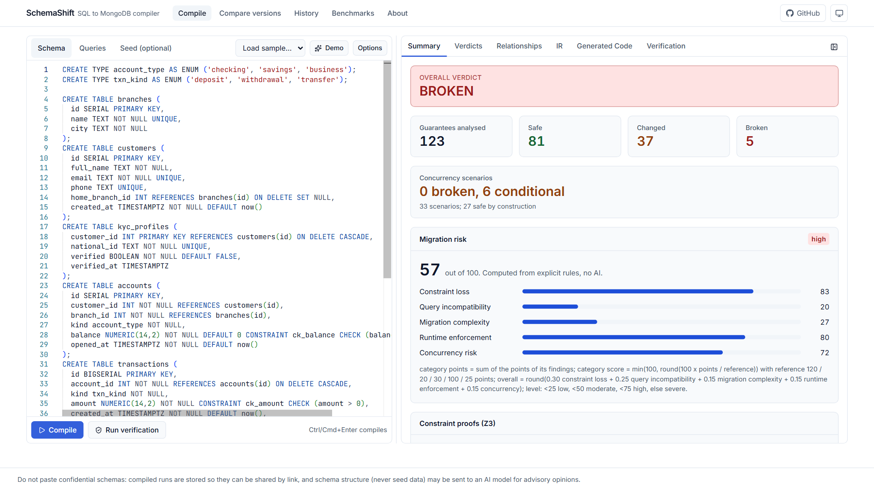
Feature: compile and see what changes
Banking sample: 123 guarantees analysed in one pass
• Overall verdict and counts: 81 SAFE, 37 CHANGED, 5 BROKEN.
• Concurrency scenarios judged separately: 33 scenarios.
• Migration risk 57 of 100, from explicit rules in five categories. No AI number.
• Z3 proof card per table below it.
• Source highlighting: click a verdict to see its SQL.
SchemaShift | Aryan Verma 24BCT0223 | Sara Choudhary 24BCT0219
8

Slide 9
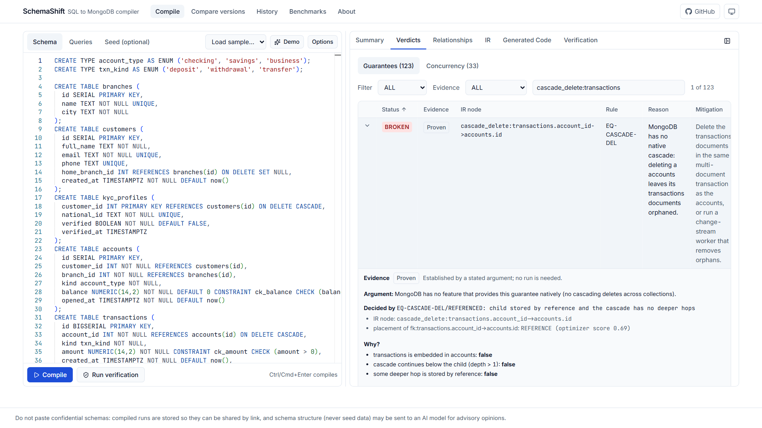
Feature: evidence on every verdict
How we know, not just what we think
• Level per verdict: PROVEN, CONDITIONAL, TESTED, UNVERIFIED.
• The sound argument, or the conditions it depends on.
• The rule outcome that decided it and every input it consulted.
• Minimal counterexample with a replay button against real databases.
• Filter by status, evidence level or text.
SchemaShift | Aryan Verma 24BCT0223 | Sara Choudhary 24BCT0219
9

Slide 10
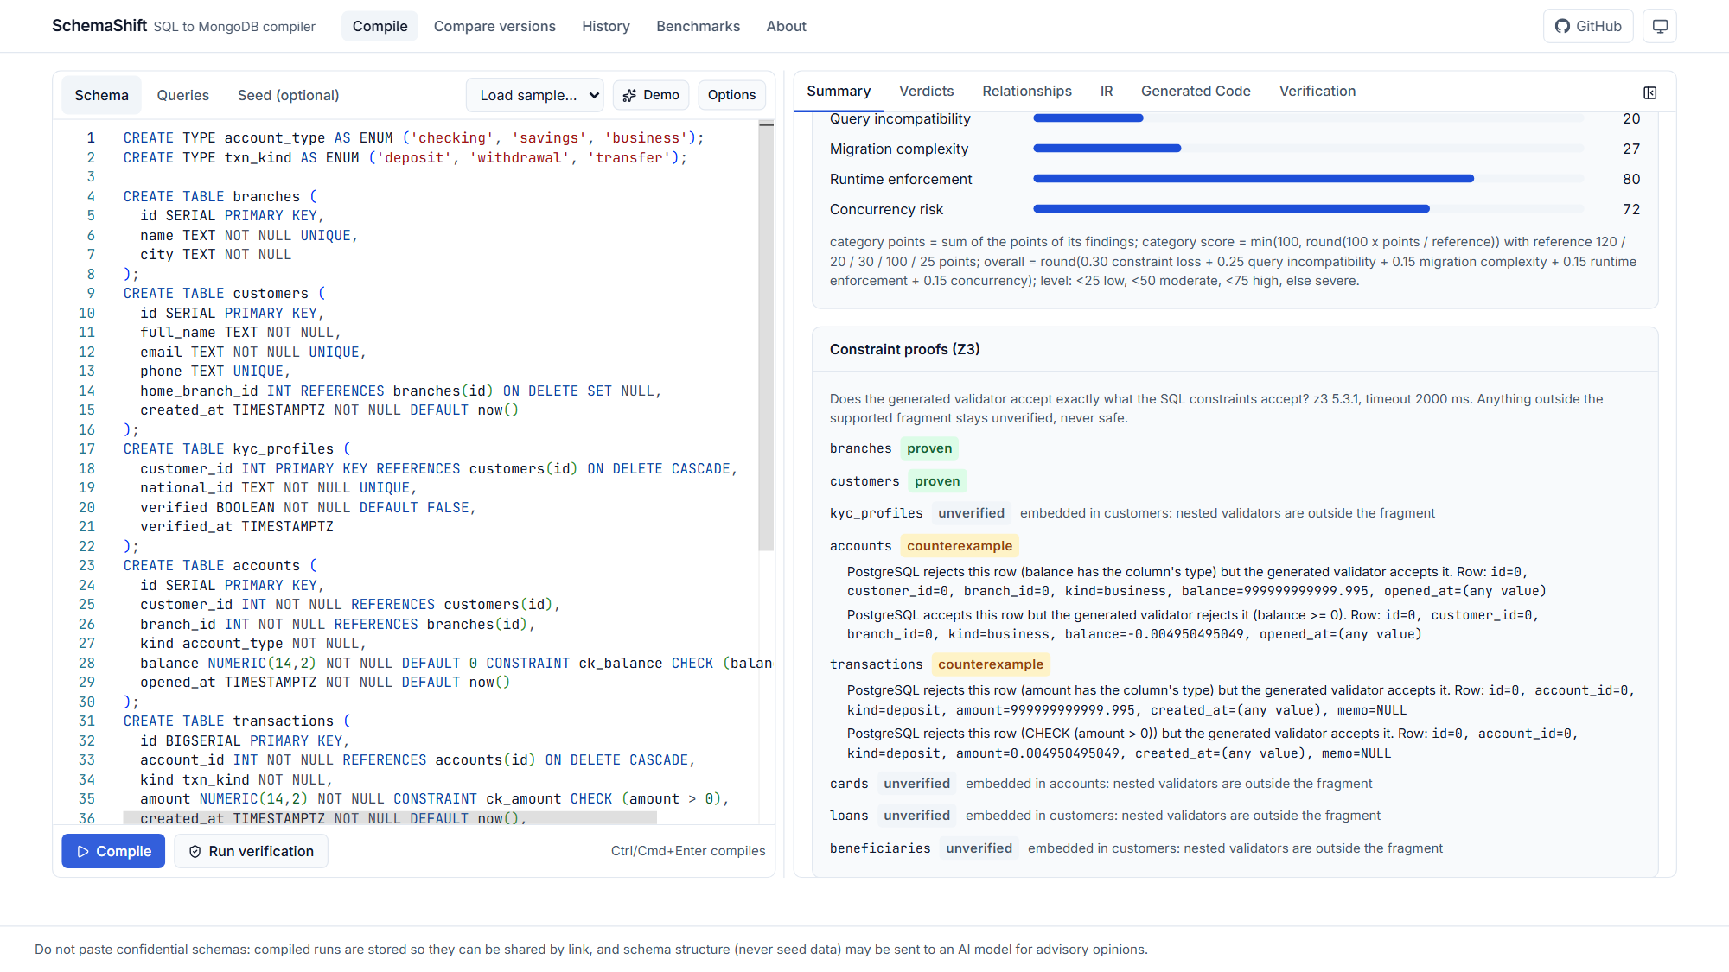
Feature: Z3 proofs of validator equivalence
Do the generated validators accept exactly what the SQL constraints accept?
• Per table: EQUIVALENT (proven), COUNTEREXAMPLE (a concrete row), UNSUPPORTED (UNVERIFIED, never SAFE).
• Models SQL three-valued logic, NUMERIC rounding and precision, integer overflow, BSON null ordering and expressions that raise.
• Soundness test on real databases: 1,000 random schemas, 863 counterexamples confirmed, 565 proofs, 33,900 random rows agreeing, 0 contradictions.
• It found 2 bugs in the generated validators.
SchemaShift | Aryan Verma 24BCT0223 | Sara Choudhary 24BCT0219
10

Slide 11
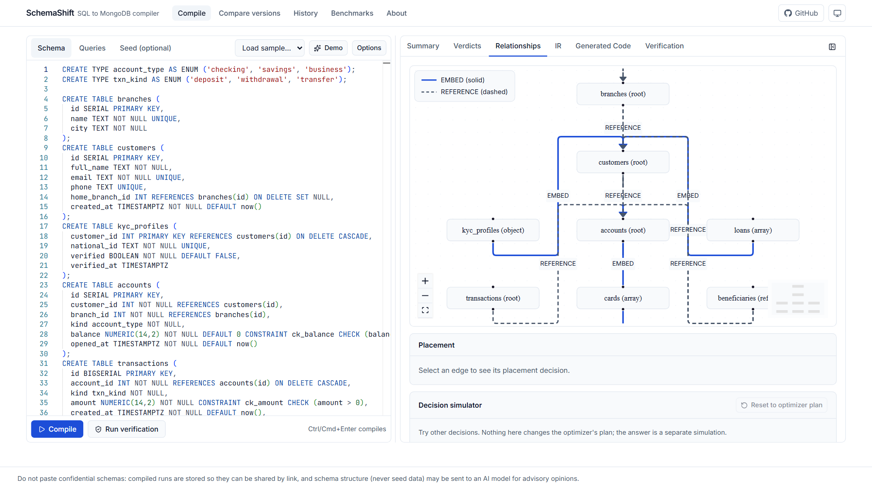
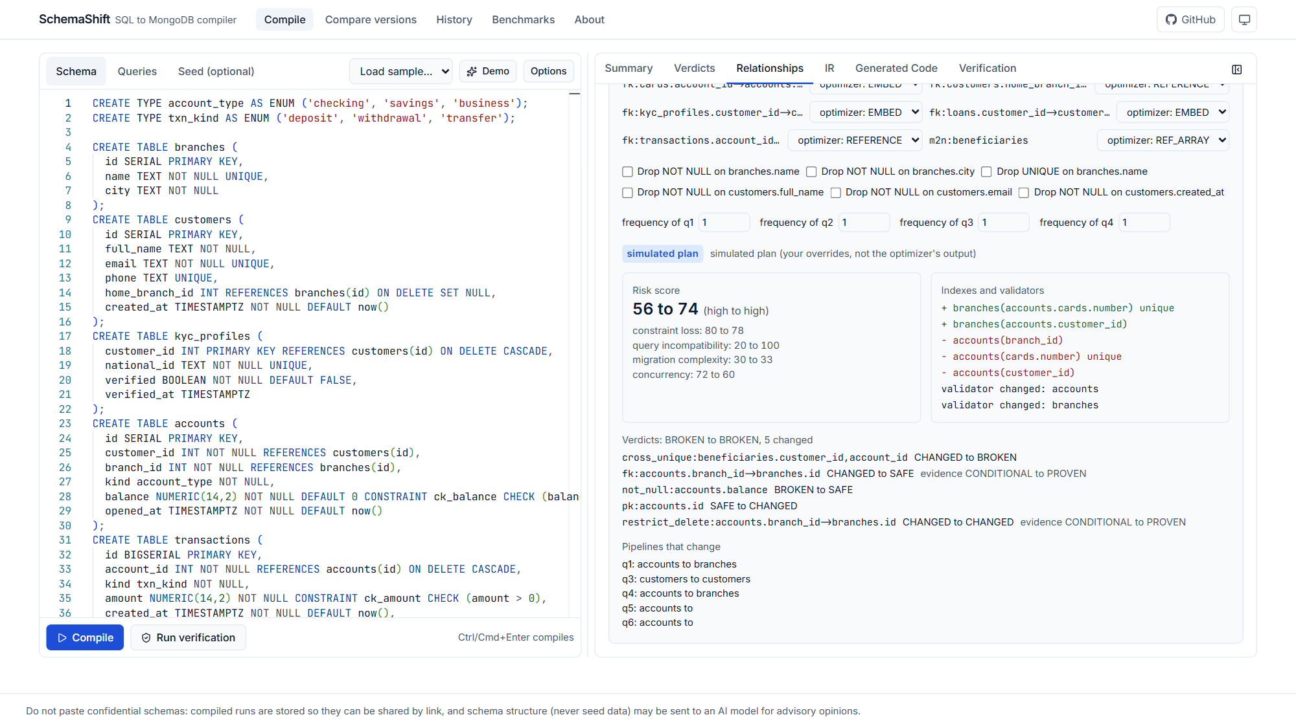
Feature: embed or reference, with a what-if simulator
Decisions come with reasons, fragility and a risk delta
Placement graph: EMBED solid, REFERENCE dashed
Simulator: flip a relationship, see verdicts, indexes, pipelines and risk
Workload frequencies and measured fan-out feed the score; every weight is moved by 10% and 20% to mark decisions fragile or stable. The optimizer's own plan is never modified by the simulator.
SchemaShift | Aryan Verma 24BCT0223 | Sara Choudhary 24BCT0219
11

Slide 12
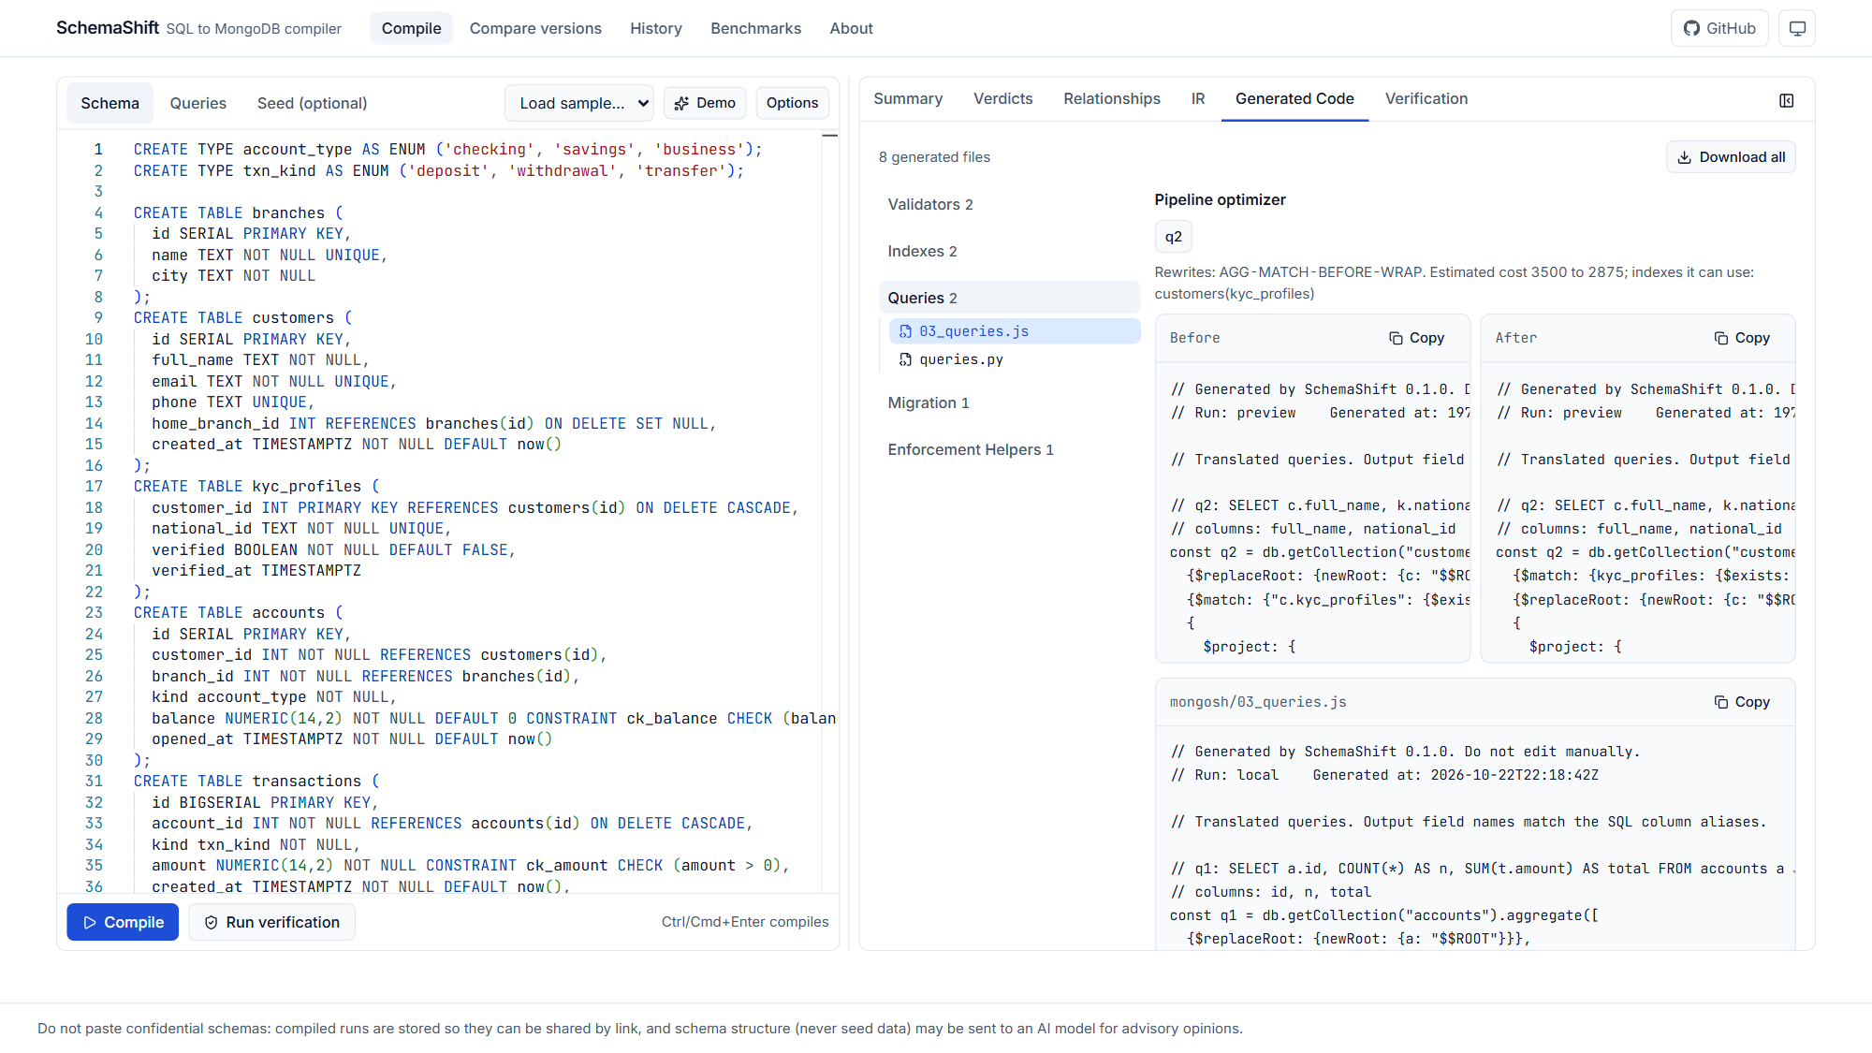
Feature: generated MongoDB code and a pipeline optimizer
Validators, indexes, queries, migration script, helpers (mongosh and PyMongo)
• Rewrite rules with stated preconditions: move filters earlier, drop unused lookups, merge matches, top-k.
• Bounded search picks the cheapest candidate by an estimated cost.
• Estimates checked against explain("executionStats"): pooled Spearman rho 0.81 over 20 candidate pipelines.
• Before and after shown side by side.
SchemaShift | Aryan Verma 24BCT0223 | Sara Choudhary 24BCT0219
12

Slide 13
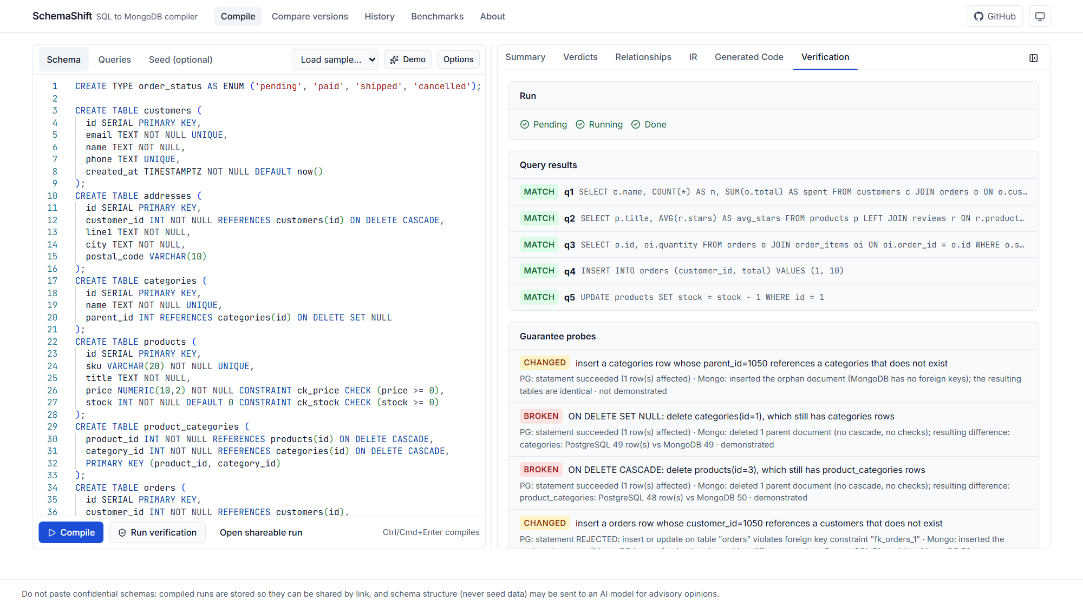
Feature: verification against real PostgreSQL and MongoDB
The same data, the SQL on one side and the generated queries on the other
• Per query MATCH or MISMATCH with a diff and a hypothesis.
• Samples: 21 of 21 queries match PostgreSQL.
• Probes demonstrate every BROKEN or CHANGED verdict.
• Concurrency probes race writers: generated helpers 0 violations, unguarded code 372 on the four samples.
• SQL is never executed as text: the sandbox runs re-emitted ASTs with bound parameters.
SchemaShift | Aryan Verma 24BCT0223 | Sara Choudhary 24BCT0219
13

Slide 14
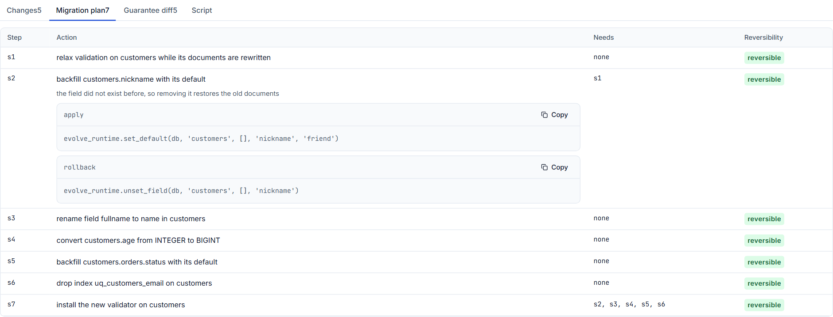
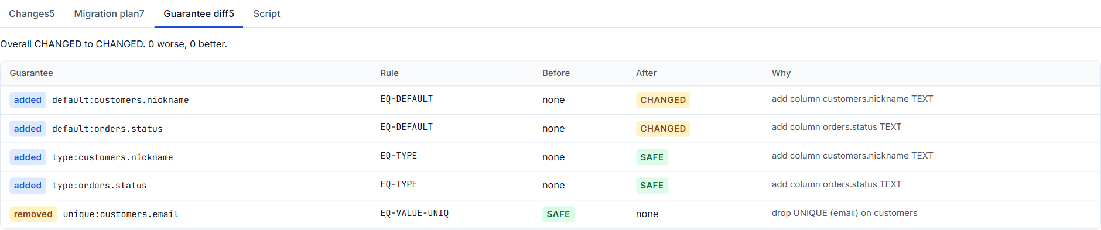
Feature: compare versions and migrate incrementally
Two schema versions or an ALTER script become a reversible plan
Guarantee diff: what got better, worse, added or removed
Ordered steps, each classified for reversibility
• Typed changes (add, drop, rename, retype, keys, constraints, indexes). A rename is only a candidate until confirmed: otherwise it is a drop plus an add and loses data.
• Ordered steps with dependencies, each REVERSIBLE, REVERSIBLE_WITH_SAVED_DATA (backup or archive) or IRREVERSIBLE (manual, with a recovery strategy). Nothing is ever deleted.
• Guarantee diff: which verdicts got worse or better, and the schema change that explains it.
• Acceptance on real databases: migrate v1, apply the incremental script, and the result equals a fresh v2 migration. Rollback restores v1.
SchemaShift | Aryan Verma 24BCT0223 | Sara Choudhary 24BCT0219
14

Slide 15
Feature: safe migration mode
A migration you would trust on real data
Dry run
Run
Crash
Resume
Verify
counts, time, storage, records that would fail. Writes nothing.
keyset-paged batches, upsert by _id, atomic manifest after each batch.
process killed at any instruction.
continue from the persisted cursor. No duplicates.
counts, keys, references, embedded rows, sampled deep comparison.
• Invalid records are quarantined whole with the reason down to the nested field (orders[3].price), never dropped silently.
• Tested with a real kill: the CLI calls os._exit(137) after N batches; the resumed run completes with no missing or duplicate records.
• Irreversible steps need --i-understand-this-is-lossy and take a snapshot first. Manual steps are never run automatically.
• CLI: schemashift migrate plan | dry-run | run | resume | verify | status | apply | rollback.
SchemaShift | Aryan Verma 24BCT0223 | Sara Choudhary 24BCT0219
15

Slide 16
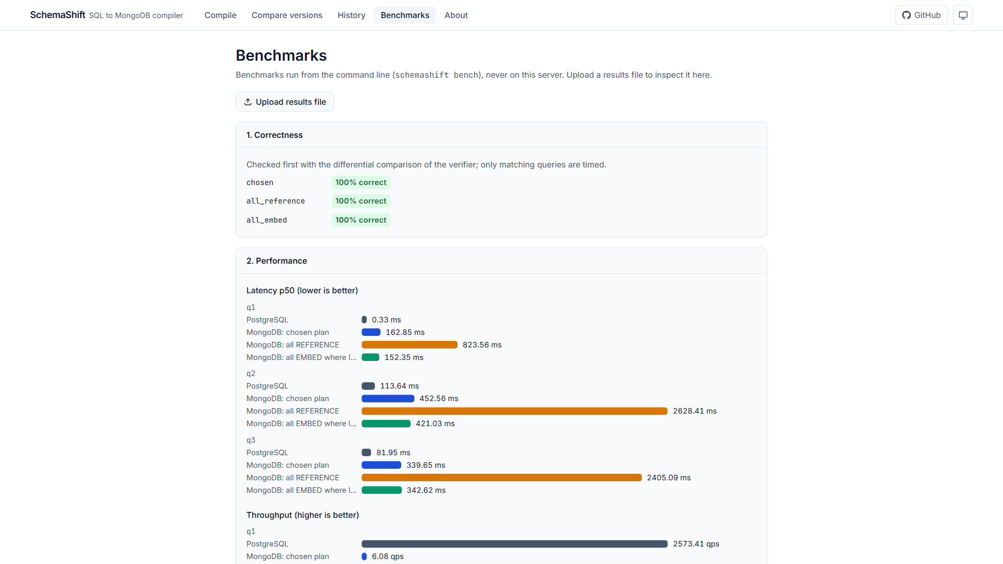
Feature: fuzzing, concurrency probes and a benchmark lab
Finding the problems before users do
• Differential fuzzing: random schemas and queries, PostgreSQL vs generated MongoDB, shrunk to a minimal reproducer. 14 bugs found and fixed to date.
• Metamorphic relations (partitioning, tautology, commutativity) catch NULL and missing-field bugs.
• Benchmark lab (CLI only): chosen plan vs all-REFERENCE vs all-EMBED, correctness first, then p50/p95/p99, storage, index use.
• Honest result: at 1,000 rows the chosen plan was fastest on 1 of 6 queries, and PostgreSQL was faster than MongoDB on every query measured, also at 100,000 rows (screenshot). The report shows the cases where we lose.
SchemaShift | Aryan Verma 24BCT0223 | Sara Choudhary 24BCT0219
16

Slide 17
Feature: developer tooling and deployment
CI check
Editor support
schemashift check --baseline-ref origin/main
Policy file: unacceptable regressions. Output: text, JSON, SARIF 2.1.0, Markdown PR comment.
GitHub Action uploads SARIF and fails the check per policy.
Language server (pygls) shows SEM diagnostics and verdict hints on .sql files, tested over real stdio JSON-RPC.
Small VS Code client launches it.
Production infrastructure
Checked locally
Redis-shared rate limits, arq job queue with retries, timeouts and cancel, run status in PostgreSQL.
Configs for Render, Vercel, Neon, Atlas; docs/DEPLOY.md.
docker-compose.prod.yml runs the same images: smoke test passed, a verified run through the worker matched PostgreSQL on every query, cancel and shared limits worked.
Live deployment is left for the owner to run.
SchemaShift | Aryan Verma 24BCT0223 | Sara Choudhary 24BCT0219
17

Slide 18
Results
Every number below is reproduced by: schemashift evaluate --all
Measure | Result | How to read it
Checker vs labels (32 schemas, 883 guarantees) | 100% detection, 0% false positives | self-labeled by the rule author; independent labels pending
Result-set correctness (21 sample queries) | 21 of 21 match PostgreSQL | label-free, hand-written workloads, synthetic data
Differential + metamorphic fuzzing | 0 failures in 100 cases (seed 52) | 14 bugs found and fixed to date
Z3 soundness on real databases | 0 contradictions in 33,900 rows | 863 counterexamples confirmed, 565 proofs
Evidence levels over 41 schemas | PROVEN 864 to 1384 | after the Z3 step; UNVERIFIED stays 93
Crash and resume test | no missing or duplicate records | real process kill, 40-customer migration
Pipeline cost model vs explain | Spearman rho 0.81 | 20 candidates: small sample
Chosen placement fastest | 1 of 6 timed queries | the optimizer does not optimize latency
Mutation score | 89.1% | recorded before Phase 18: stale
Tests at the end: 1,250 unit tests, integration suite against real PostgreSQL and MongoDB, 60 frontend tests, 14 Playwright end-to-end checks including accessibility (axe, light and dark).
SchemaShift | Aryan Verma 24BCT0223 | Sara Choudhary 24BCT0219
18

Slide 19
What the tooling found in our own code
Testing against the real databases paid for itself
Found by | Defect | Where
Z3 soundness test | Two IN checks with an empty intersection produced enum: [], which MongoDB refuses | code generator (fixed)
Z3 soundness test | A LENGTH check guard raised on missing fields, so valid rows were rejected | code generator (fixed)
Z3 soundness test | Integer overflow, NUMERIC rounding and IS NOT NULL were modelled wrongly | the encoder (fixed)
Fuzzing | A NUMERIC column compared with a decimal literal sent a double that never matches | code generator (fixed)
Fuzzing and metamorphic tests | 14 semantic mismatches in joins, NULL, ordering and division | code generator (fixed, regression store)
Benchmarks | The optimizer's choice was not the fastest in most queries | documented, not hidden
Verification on Chinook | Seed rows were inserted in declaration order, violating foreign keys | verification (fixed)
SchemaShift | Aryan Verma 24BCT0223 | Sara Choudhary 24BCT0219
19

Slide 20
Honest limitations
• Accuracy figures are consistency with the author's own rules. The independent (blind, second labeler) corpus is empty.
• Embed vs reference is decided by risk and a heuristic cost, not measured latency.
• Z3 covers row-local constraints on root tables inside a documented fragment. Everything else is UNVERIFIED.
• Incremental restructuring is automatic only for simple cases; the rest is a manual step with a recovery plan.
• Benchmarks: one laptop, both databases in Docker, small repetition counts.
• Mutation score is stale (before Phase 18); re-run needs Docker.
• The GitHub Action, the Render/Vercel/Neon/Atlas deployment and the VS Code client were not run on the real services from here; configs, local stack and tests are.
• PostgreSQL 16 and MongoDB 7 only.
SchemaShift | Aryan Verma 24BCT0223 | Sara Choudhary 24BCT0219
20

Slide 21
Future work
• Independent evaluation: a second person labels the corpus blind (a template command is ready).
• A latency-aware optimizer trained on the benchmark lab's measurements.
• Run the deployment on Vercel, Render, Neon and Atlas and publish the status badge.
• Extend the Z3 fragment: UNIQUE across fields, embedded arrays, dates, and collation-aware string order.
• Automatic restructuring for nested and composite-key layouts; online migration with change streams.
• More dialects and versions beyond PostgreSQL 16 and MongoDB 7.
SchemaShift | Aryan Verma 24BCT0223 | Sara Choudhary 24BCT0219
21

Slide 22
Thank you
SchemaShift tells you what a migration changes,
generates the MongoDB side, and shows the evidence.
Team members
Aryan Verma 24BCT0223
Sara Choudhary 24BCT0219
github.com/aryannn229/SchemaShift

