Slide 1
C# Presentation
ARYAN BHAGAT – SL5310
VENKATA SAI KRISHNA ADITYA VATTURI– BY4412
CS_311 – PROGRAMMING LANGUAGE CONCEPTS

Slide 2
Introduction
C#, pronounced “C Sharp,” is one of the new languages in the .NET framework being implemented by Microsoft. All .NET languages compile to a common byte code (MSIL) making their integration into programs written in different languages easier.
C# was designed from scratch with the .net framework in mind
C# combines the power of C and C++ with the productivity of Visual Basic
With its familiar syntax the transition for Java and C++ programmers will be an easy one
C# PRESENTATION, GROUP 4

Slide 3
Let’s start with “HELLO WORLD”
using System;
class Hello {
static void Main( ) {
Console.WriteLine("Hello world");
Console.ReadLine();
}
}
Explanation:
using System; : Imports the System namespace.class
Program: Defines a class named Program.
static void Main(): Main method, the entry point of the program.
Console.WriteLine("Hello, World!");: Prints the message to the console.
C# PRESENTATION, GROUP 4

Slide 4
Variables-Binding and Allocation
Value types
  Primitives (int, float, bool, char, double, decimal)
  Enums (enum State { Off, On })
  Structs (struct Point {int x,y;})
Reference types
  Root: object
  String: string
  Classes: class Foo: Bar, IFoo {...}
  Interfaces: interface IFoo: {...}
  Array: string[] a = new string[10];
  Delegates: delegate void Empty();
Example:
int x = 10;
string name = "C#";
Allocation:
Memory is allocated based on the data type.
Value types (e.g., int, float) are stored on the stack.
Reference types (e.g., string, object) are stored on the heap.
C# PRESENTATION, GROUP 4

Slide 5
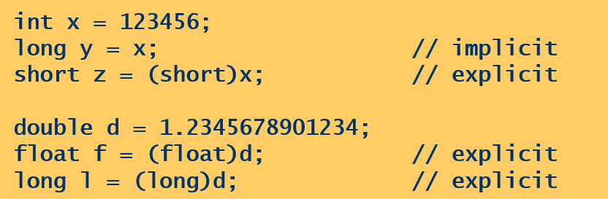
Type Conversion:
Implicit conversions
  Occur automatically
  Guaranteed to succeed
  No information loss
Explicit conversions
Require a cast
May not succeed
Information might be lost
Example:
C# PRESENTATION, GROUP 4

Slide 6
Arithmetic Expression Evaluation
Supports standard operators: +, -, *, /, %.
Follows operator precedence (PEMDAS/BODMAS).
Example
int result = (10 + 5) * 2; // Output: 30
Type safety ensures operands are compatible.
C# PRESENTATION, GROUP 4

Slide 7
Selection Statements
Conditional logic to control program flow.
if-else:
if (x > 0) {
Console.WriteLine("Positive");
}
else{
Console.WriteLine("Negative");
}
switch:
switch (day) {
case 1: Console.WriteLine("Monday"); break;
case 2: Console.WriteLine("Tuesday"); break;
}
C# PRESENTATION, GROUP 4

Slide 8
Loops in C# (for, while, foreach)
for Loop
Definition: Executes a block of code for a fixed number of iterations.
Use Case: Iterating when the number of iterations is known.
while Loop
Definition: Repeats a block of code as long as a condition is true.
Use Case:Iterating until a condition changes.
foreach Loop
Definition: Iterates over collection of elements
Use Case: Traversing collections effortlessly.
Example:
for (int i = 0; i < 3; i++) { Console.WriteLine($"Iteration: {i}");}
Example:
int i=0;
while (i<3) { Console.WriteLine($“Iteration: {i}");
i++;}
Example:
int[] num={1,2,3};
foreach(int i in nums) { Console.WriteLine(i);}
C# PRESENTATION, GROUP 4

Slide 9
Subprograms
Definition:
Reusable code blocks (methods) defined using void or a return type.
Key Features:
Parameters for input.
Return values for output.
Method overloading supported.
Example:
int add(int a,int b){ return a+b; }
C# PRESENTATION, GROUP 4

Slide 10
Encapsulation and Inheritance
Encapsulation
Wrapping data and methods into a single unit (class).
Inheritance
Reusing code from a base class in derived classes
Example
class Person { private string name; public void SetName(string name) { this.name = name; } public string GetName() { return name; }}
Example
class Animal {
public void Speak() { Console.WriteLine("Animal speaks");
} }
class Dog : Animal {
public void Bark() { Console.WriteLine("Dog barks");
} }
C# PRESENTATION, GROUP 4

Slide 11
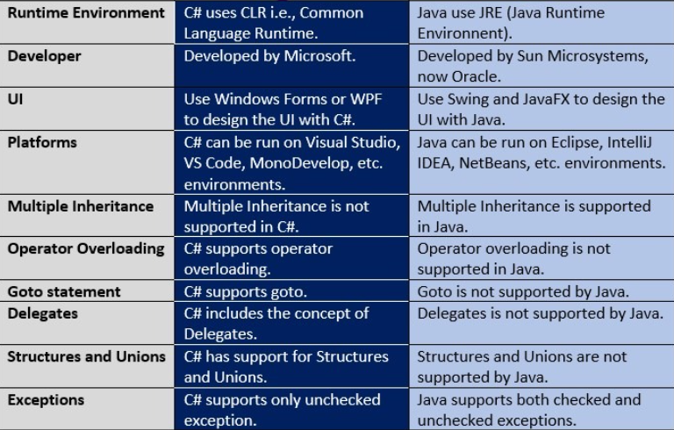
Comparing C# and Java
C# PRESENTATION, GROUP 4

