Slide 1
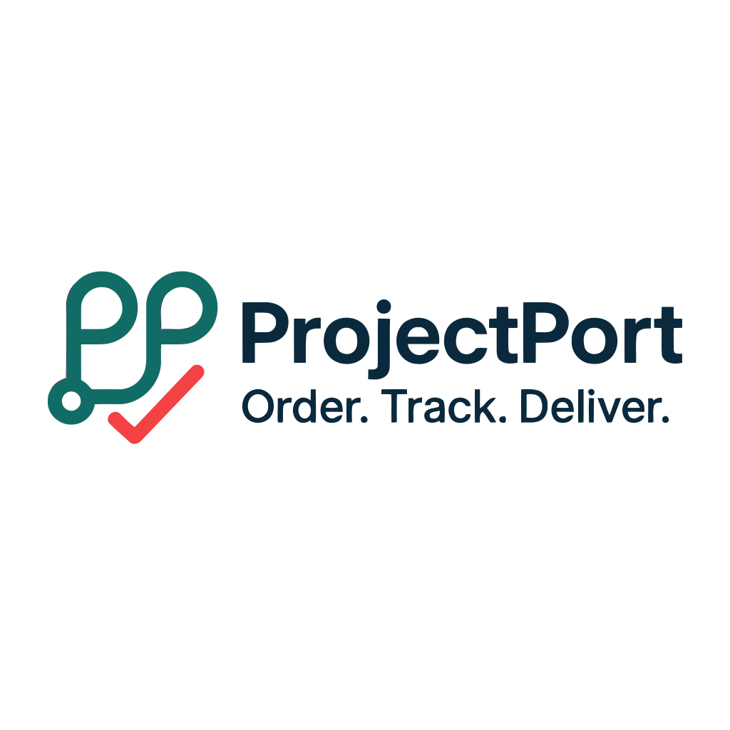
Project Title
ProjectPort – Project Management Platform
Team Name
IBM PBEL (Web Dev)
Team Members
Aryan Gupta
A full-stack platform for managing client
projects, automated quotations & seamless
project delivery.
Course
Full Stack Web Development
Guide / Mentor
Prof. Naina Ma’am
Institution
IBM PBEL
Date
February 2026
🚀 projectsport.vercel.app
ProjectPort | Full Stack Project Management Platform

Slide 2
Introduction
02
📌 Background
💡 Why This Topic?
ProjectPort is an intelligent, full-stack project management and client interaction platform. Designed specifically for development agencies, freelancers, and project-based businesses, it streamlines the entire project lifecycle — from the first client inquiry all the way to final delivery.
Built with React 18 on the frontend and Node.js/Express on the backend, with a MySQL database, ProjectPort automates quotations, manages leads, and enables real-time collaboration between clients, admins, and developers.
Rising demand for remote & freelance project work
No all-in-one platform for inquiry → delivery workflow
Manual quotation processes waste time & cause errors
Clients lack visibility into project progress & payments
🌐 Problem Domain
Development agencies lose leads due to slow quote turnarounds and fragmented communication channels.
ProjectPort | Introduction

Slide 3
03
Problem Statement
Development agencies and freelancers lack a unified digital platform that handles the full project lifecycle — from capturing client inquiries and generating accurate quotations to managing milestones, payments, and delivery tracking — leading to revenue loss and poor client experience.
⚡ Fragmented Workflow
💰 Manual Quotation Errors
🔍 Zero Visibility
Client inquiries, pricing, project tracking, and payments managed across disconnected tools — email, spreadsheets, WhatsApp.
Manually calculating project prices is slow, inconsistent, and error-prone, leading to underpricing or client disputes.
Clients have no real-time view of project status, milestone progress, or payment schedules after signing up.
✅ Solving this saves hours per lead, prevents revenue loss, and delivers a professional client experience.
ProjectPort | Problem Statement

Slide 4
Objectives
04
🎯 Main Goal
Build an intelligent, automated full-stack project management platform that unifies client inquiry, quotation, delivery and payment tracking in one seamless product.
01
Dynamic Project Wizard
02
Automated Quotation Engine
03
Complete Lead Management
Multi-step intelligent form with real-time price calculation for web, mobile, e-commerce & custom projects.
Excel-driven pricing rules → JSON config for instant, accurate cost estimation with detailed breakdowns.
Capture, review & convert leads to active projects with one-click automated client account creation.
04
Comprehensive Dashboards
05
Milestone & Payment System
06
JWT Security & RBAC
Client & Admin dashboards with real-time project status, payment tracking and business analytics.
Milestone tracking, payment schedules, invoice management, document sharing and activity logs.
Role-based access control for Clients, Admins & Developers with bcrypt password hashing.
ProjectPort | Objectives

Slide 5
05
Literature Review / Existing Systems
Platform
What It Offers
Key Limitation
Upwork
Large talent marketplace
20% fee; poor fit for agency-client workflows; no project wizard
Fiverr
Gig-based service marketplace
Gig model not suited for complex custom projects; no inquiry tracking
Freelancer.com
Competitive bidding platform
Overcrowded; spam bids; no automated pricing; no milestone control
Jira / ClickUp
Internal project management
No client-facing portal; no lead capture; no quotation engine
Custom Emails
Used by most small agencies
Zero automation; manual pricing; no tracking; unprofessional experience
📄 Research References:
Statista (2024): Freelance Platform Market Report • IEEE (2022): Microservice Architecture Patterns • Sommerville, I. (2016): Software Engineering, 10th Ed.
ProjectPort | Literature Review

Slide 6
Proposed System – ProjectPort
06
ProjectPort replaces fragmented tools with a single unified platform covering the complete journey: Inquiry → Quotation → Lead Management → Project Execution → Milestone Tracking → Payment → Delivery.
👥 CLIENT
⚙️ ADMIN
👨‍💻 DEVELOPER
▸ Submit project inquiries via wizard
▸ View & qualify all incoming leads
▸ Access assigned project tasks
▸ Receive instant automated quotations
▸ One-click convert lead → project
▸ Update milestone progress
▸ Track project progress in real-time
▸ Assign teams, set milestones
▸ Team collaboration tools
▸ Manage payments & view invoices
▸ Monitor analytics & pipeline
▸ (Coming Soon — full feature set)
🚀 KEY IMPROVEMENT: Single platform replaces 5+ disconnected tools — saving time, reducing errors and boosting client trust.
ProjectPort | Proposed System

Slide 7
System Architecture / Design
07
🖥️ CLIENT LAYER — React 18 + Vite | Tailwind CSS | React Router v6 | Context API
▼
🔌 API GATEWAY — Express.js 4.x | REST API | CORS | JWT Auth Middleware | Helmet Security
▼
Auth Service
JWT + bcrypt
Lead Service
Inquiry capture
Project Service
Milestones
Notification
Service
▼
🗄️ DATA LAYER — MySQL 8.0 | mysql2 driver | Parameterized queries | Connection Pooling
Data Flow:
Client Browser → React Router → Page Component → Fetch API → Express Route → Auth Middleware → MySQL → JSON Response → State Update → UI Render
MODULES: User Management | Lead Pipeline | Project Management | Milestone Tracker | Payment Engine | Notifications | SEO/PWA
ProjectPort | System Architecture

Slide 8
Technologies Used
08
🖥️ Frontend
⚙️ Backend
🗄️ Database & DevOps
React 18.2
UI Framework
Node.js 20.x
Runtime
MySQL 8.0
Primary DB
Vite
Build Tool
Express.js 4.x
Framework
mysql2
DB Driver
Tailwind CSS 3.x
Styling
JWT
Auth
Git & GitHub
Version Control
React Router v6
Routing
bcrypt.js
Password Hashing
Vercel
Frontend Hosting
React Helmet Async
SEO
dotenv
Config
Render
Backend Hosting
Lucide React
Icons
CORS / Helmet
Security
npm
Package Manager
ProjectPort | Technologies Used

Slide 9
Implementation
09
01
Planning & Setup
ERD design, DB schema (schema.sql), API blueprint, folder architecture, Git repo setup
02
Authentication Layer
JWT login/register endpoints, bcrypt hashing, role-based middleware (Client / Admin)
03
Lead & Quotation System
Project wizard (multi-step form), real-time SidebarPricing, Quotation Engine (JSON config)
04
Project Management
Lead → Project conversion, milestone CRUD, payment schedules, Admin & Client dashboards
05
Notifications & SEO
Real-time in-app notifications, React Helmet SEO, sitemap.xml generator, PWA manifest
🔥 Key Features Built
ProjectPort | Implementation

Slide 10
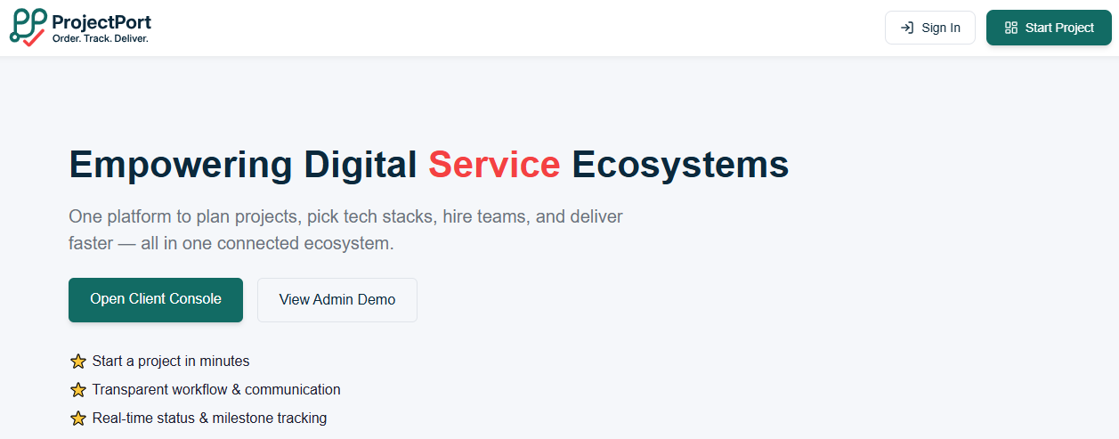
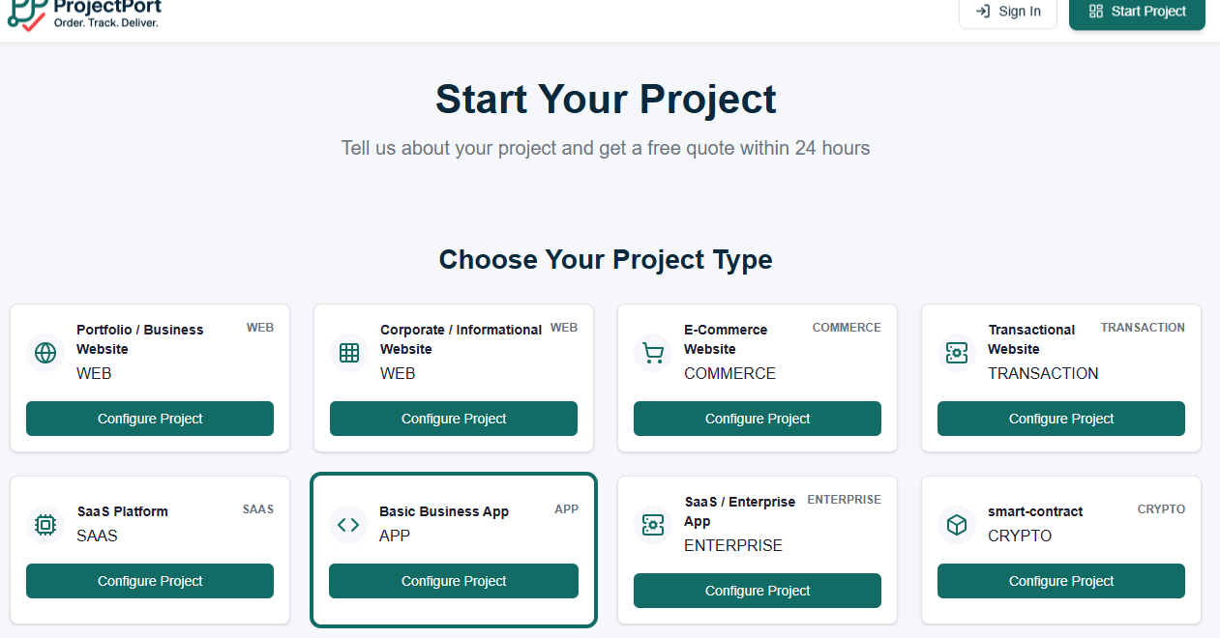
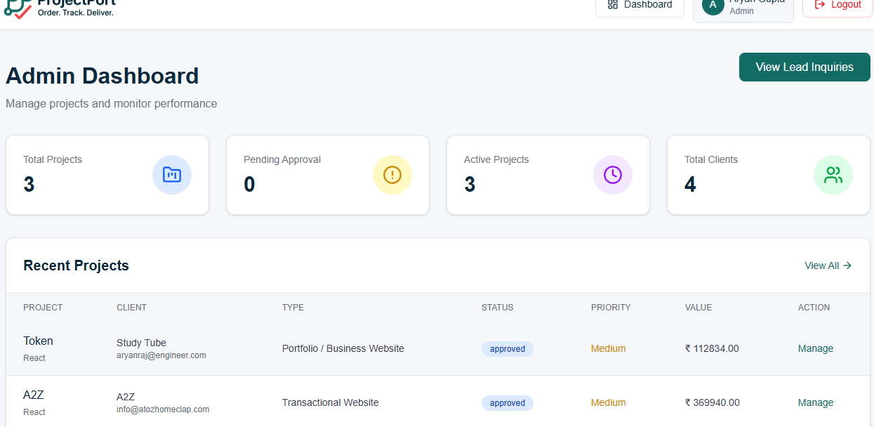
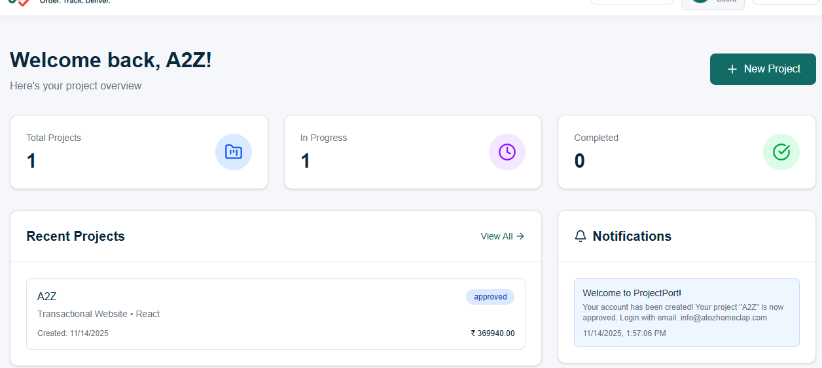
Results & Output
10
100%
< 2s
95+
3
Test Pass Rate
Avg Page Load Time
Lighthouse Score
User Roles Supported
Landing / Home Page
Client Project Wizard
[ Screenshot Placeholder ]
[ Screenshot Placeholder ]
Hero section, Project Wizard entry point, CTA buttons
Multi-step form with real-time price calculation sidebar
Admin Leads Dashboard
Client Dashboard
[ Screenshot Placeholder ]
[ Screenshot Placeholder ]
Leads table, convert to project button, status badges
Project status, milestones, payment tracker, notifications
ProjectPort | Results & Output

Slide 11
Challenges Faced
11
⚙️ Technical Challenges
🤝 Team & Project Challenges
⚠ Automated Quotation Engine
⚠ Parallel Development
Converting complex Excel pricing rules into a reliable real-time JSON-driven pricing system.
Coordinating frontend and backend work simultaneously without blocking each other on API contracts.
⚠ Role-Based Access Control
⚠ Git Merge Conflicts
Seamlessly handling 3 user roles (Client/Admin/Dev) across frontend routes and backend middleware.
Integration conflicts during feature branch merges required a clear branching and PR review strategy.
⚠ MySQL Relational Schema
⚠ Consistent UI/UX
Designing a normalized database that cleanly represents leads → projects → milestones → payments.
Ensuring design coherence across pages built by different team members using a shared component library.
⚠ JWT Security in Production
⚠ Scope Management
Managing token expiry, refresh flows and httpOnly cookie options securely across environments.
Keeping the feature set realistic for the timeline while planning the developer module for future sprints.
✅ Solution Strategy: Agile sprints + feature branching + weekly syncs + shared API contract documentation resolved coordination issues.
ProjectPort | Challenges Faced

Slide 12
Future Scope & Roadmap
12
📧 Email Notifications
Planned
📎 File Upload & Docs
Planned
💳 Payment Gateway
Planned
SMTP integration for critical event alerts — project updates, payment reminders, milestone completions.
Attach briefs, designs and deliverables directly to projects using cloud storage (AWS S3).
Razorpay / Stripe integration for in-platform payments, automated receipts and GST invoices.
📱 Mobile App
Roadmap
🤖 AI Quotation Engine
Roadmap
📊 Advanced Analytics
Roadmap
React Native apps for iOS & Android enabling on-the-go project management and push notifications.
ML-based intelligent pricing using historical project data — smarter, more accurate estimates.
Revenue dashboards, lead conversion funnels, team performance metrics and exportable PDF/Excel reports.
ProjectPort | Future Scope

Slide 13
13
🏆 Key Achievements
CONCLUSION
✓ Built a complete Lead → Quotation → Project → Payment workflow
ProjectPort successfully demonstrates how a focused student team can design and implement an enterprise-grade, full-stack SaaS product using modern open-source technologies.
✓ Automated quotation engine with Excel-driven JSON pricing config
✓ Role-based access: Client, Admin & Developer portals
The platform is live at
projectsport.vercel.app
✓ JWT authentication with bcrypt + parameterized SQL queries
✓ SEO optimized with React Helmet, sitemap & PWA manifest
👨‍ Aryan Gupta
📧 aryan@engineer.com
📱 +91-6205650368
🔗 github.com/aryanony
ℹn linkedin.com/in/aryanony
✓ Deployed live on Vercel with CI/CD via GitHub
✓ Responsive mobile-first design with Tailwind CSS
Thank you for your attention! | Questions welcome 🙏

Slide 14
References
14
📚 Books
Sommerville, I. (2016). Software Engineering (10th ed.). Pearson Education.
Flanagan, D. (2020). JavaScript: The Definitive Guide (7th ed.). O'Reilly Media.
Martin, R. C. (2017). Clean Architecture. Prentice Hall.
🌐 Official Documentation & Websites
React.js Documentation – https://react.dev
Node.js Official Site – https://nodejs.org | Express.js – https://expressjs.com
MySQL 8.0 Reference Manual – https://dev.mysql.com/doc
Tailwind CSS Docs – https://tailwindcss.com/docs | Vite – https://vitejs.dev
Vercel Deployment Docs – https://vercel.com/docs
📄 Research Papers
🙏 ProjectPort — Built with React, Node.js, Express & MySQL | github.com/aryanony/ProjectPort
Statista (2024). Global Freelance Platforms Market Size & Growth Report.
ProjectPort | References
IEEE (2022). Microservice Architecture Patterns for Scalable Web Applications. IEEE Transactions on Software Engineering, 28(1).
Ghosh, R. et al. (2021). The Gig Economy and Digital Platforms. Journal of Digital Labor, 12(3), 45–67.

