Slide 1
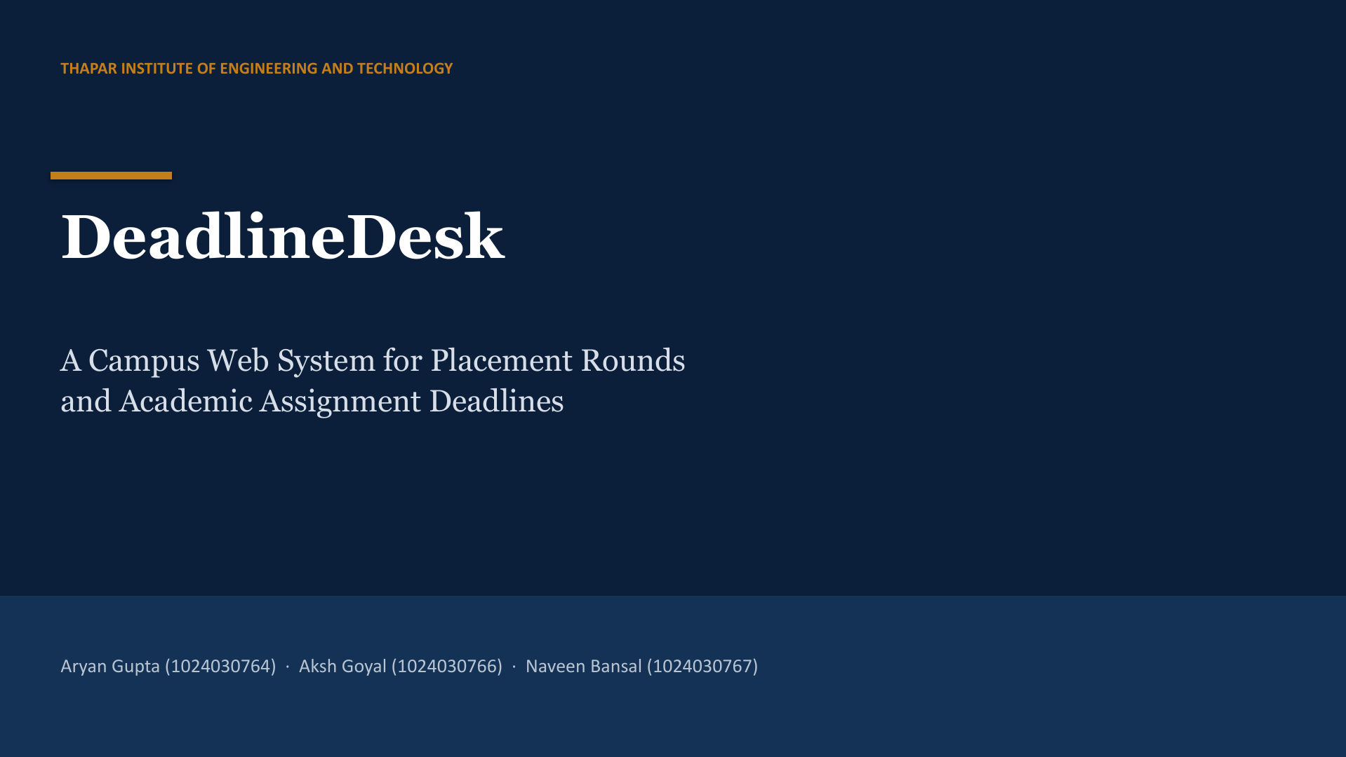
WEEK 7 PROTOTYPE PRESENTATION

Slide 2
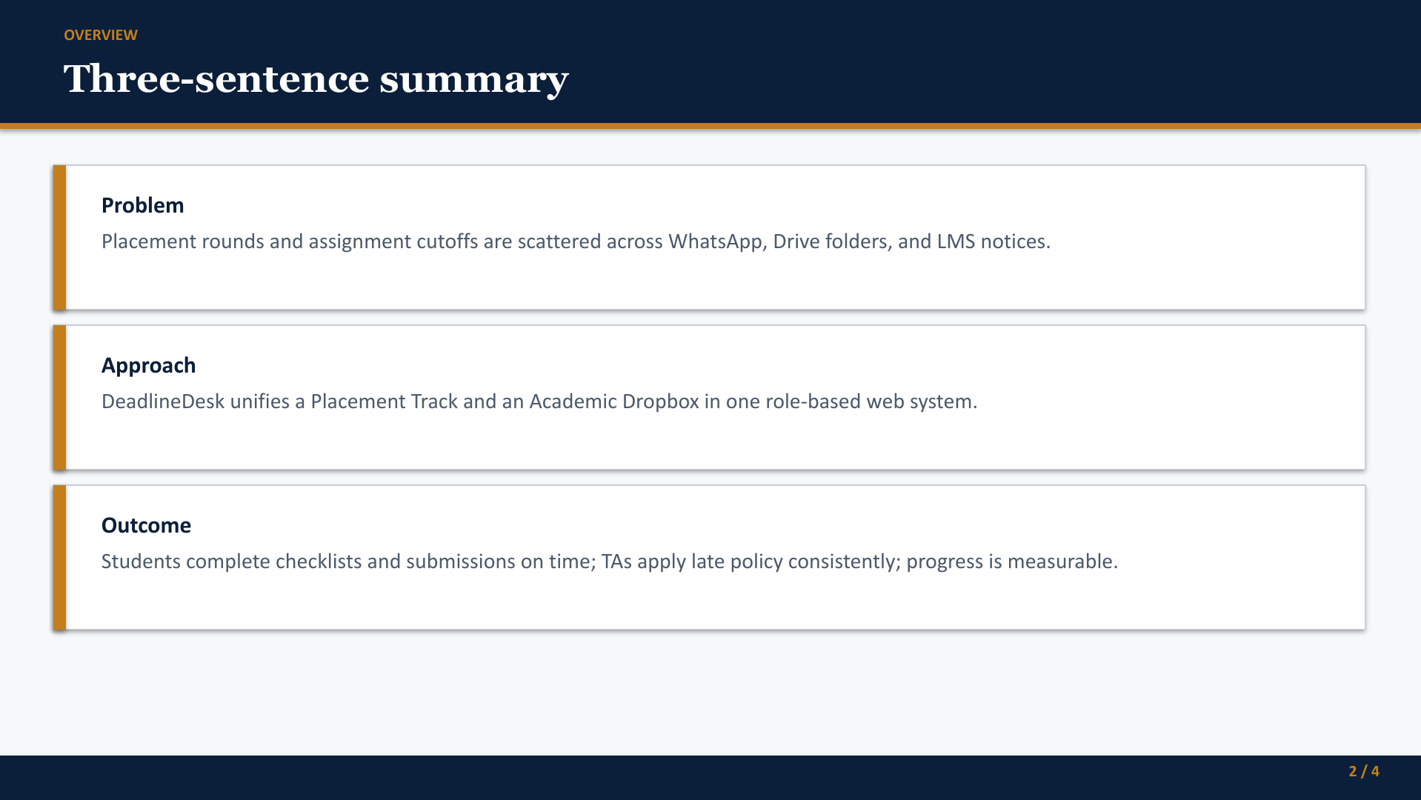
2 / 13

Slide 3
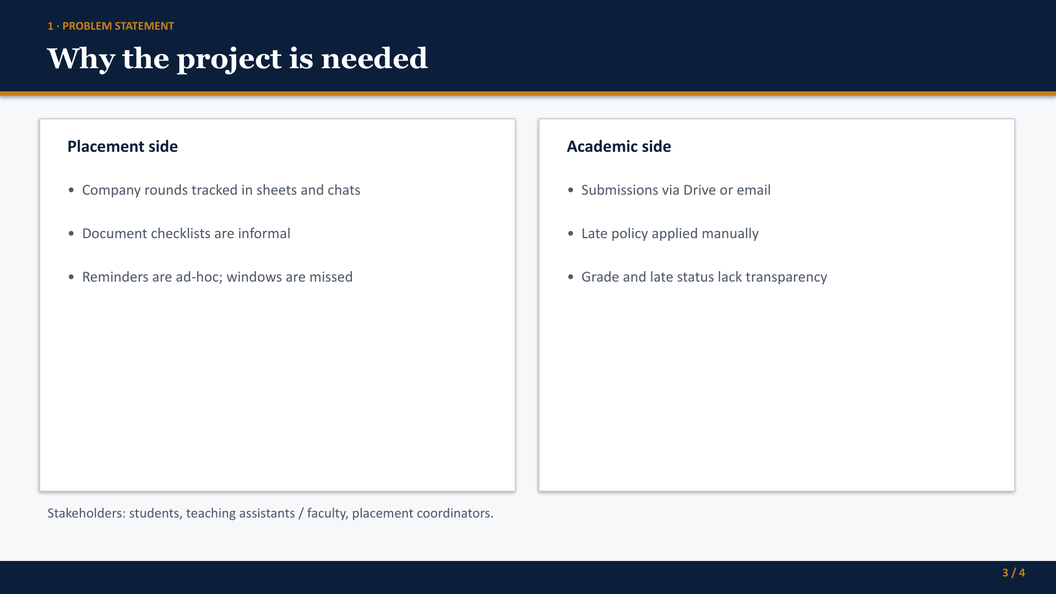
3 / 13

Slide 4
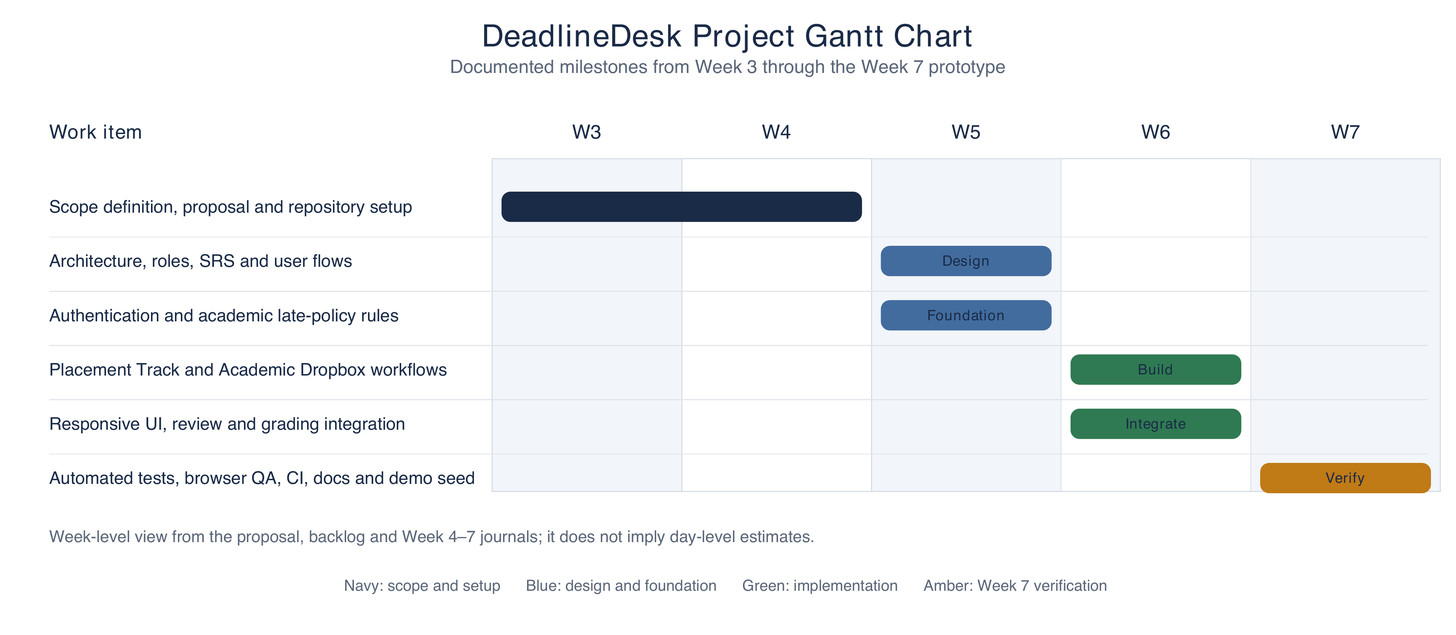
DELIVERY PLAN
Project schedule through Week 7
4 / 13
Notes:
The Gantt chart summarizes the documented weekly milestones from the proposal, backlog, and Week 4–7 journals. The source records weekly scope, not day-level task durations.

Slide 5
SYSTEM ARCHITECTURE
Frontend, backend and data
DeadlineDesk is one Python/Django web application with server-rendered pages.
PRESENTATION
Django templates, HTML and CSS render role-specific pages and forms.
WEB / BACKEND
Python views and URL routes handle requests, sessions and role guards.
DOMAIN
Forms and services validate uploads, apply late policies and calculate the similarity stub.
DATA
Django ORM stores users, rounds, checklists, assignments, submissions, grades and audit events in SQLite.
No separate React frontend or REST backend is part of the Week 7 prototype.
5 / 13
Notes:
Explain that the project uses Django templates and CSS for the frontend. The same Django application routes requests through views, forms, services, and the ORM. SQLite is the prototype database. This is a layered monolith, not a separate React client talking to a Django API.

Slide 6
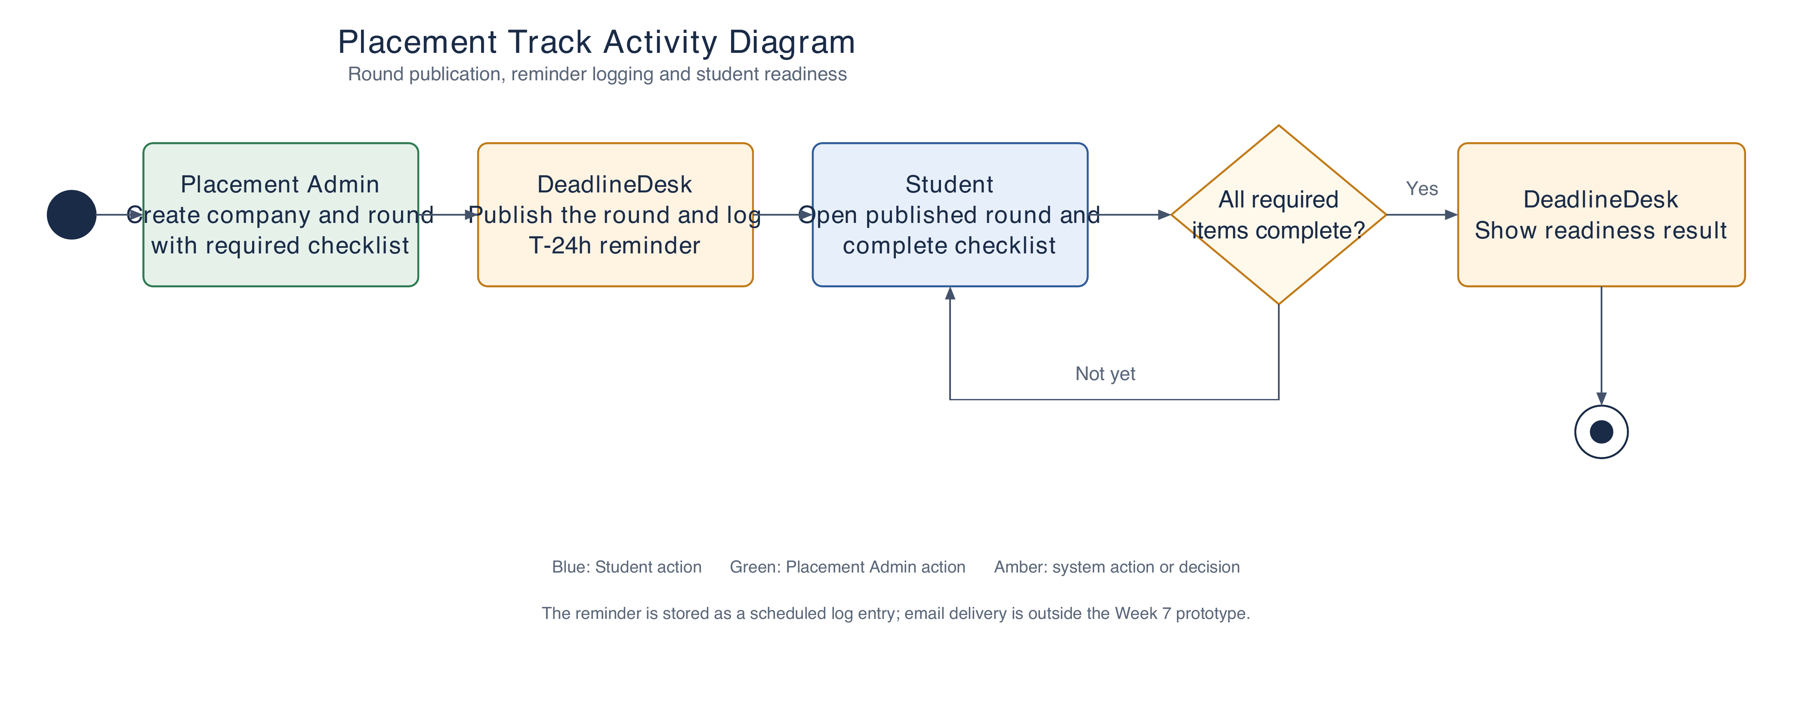
ACTIVITY DIAGRAM
Placement readiness workflow
6 / 13
Notes:
Walk through the placement activity: an administrator sets up and publishes the round, the system writes a scheduled reminder record, and the student completes the checklist. The readiness result is calculated from required items. There is no email sender in this prototype.

Slide 7
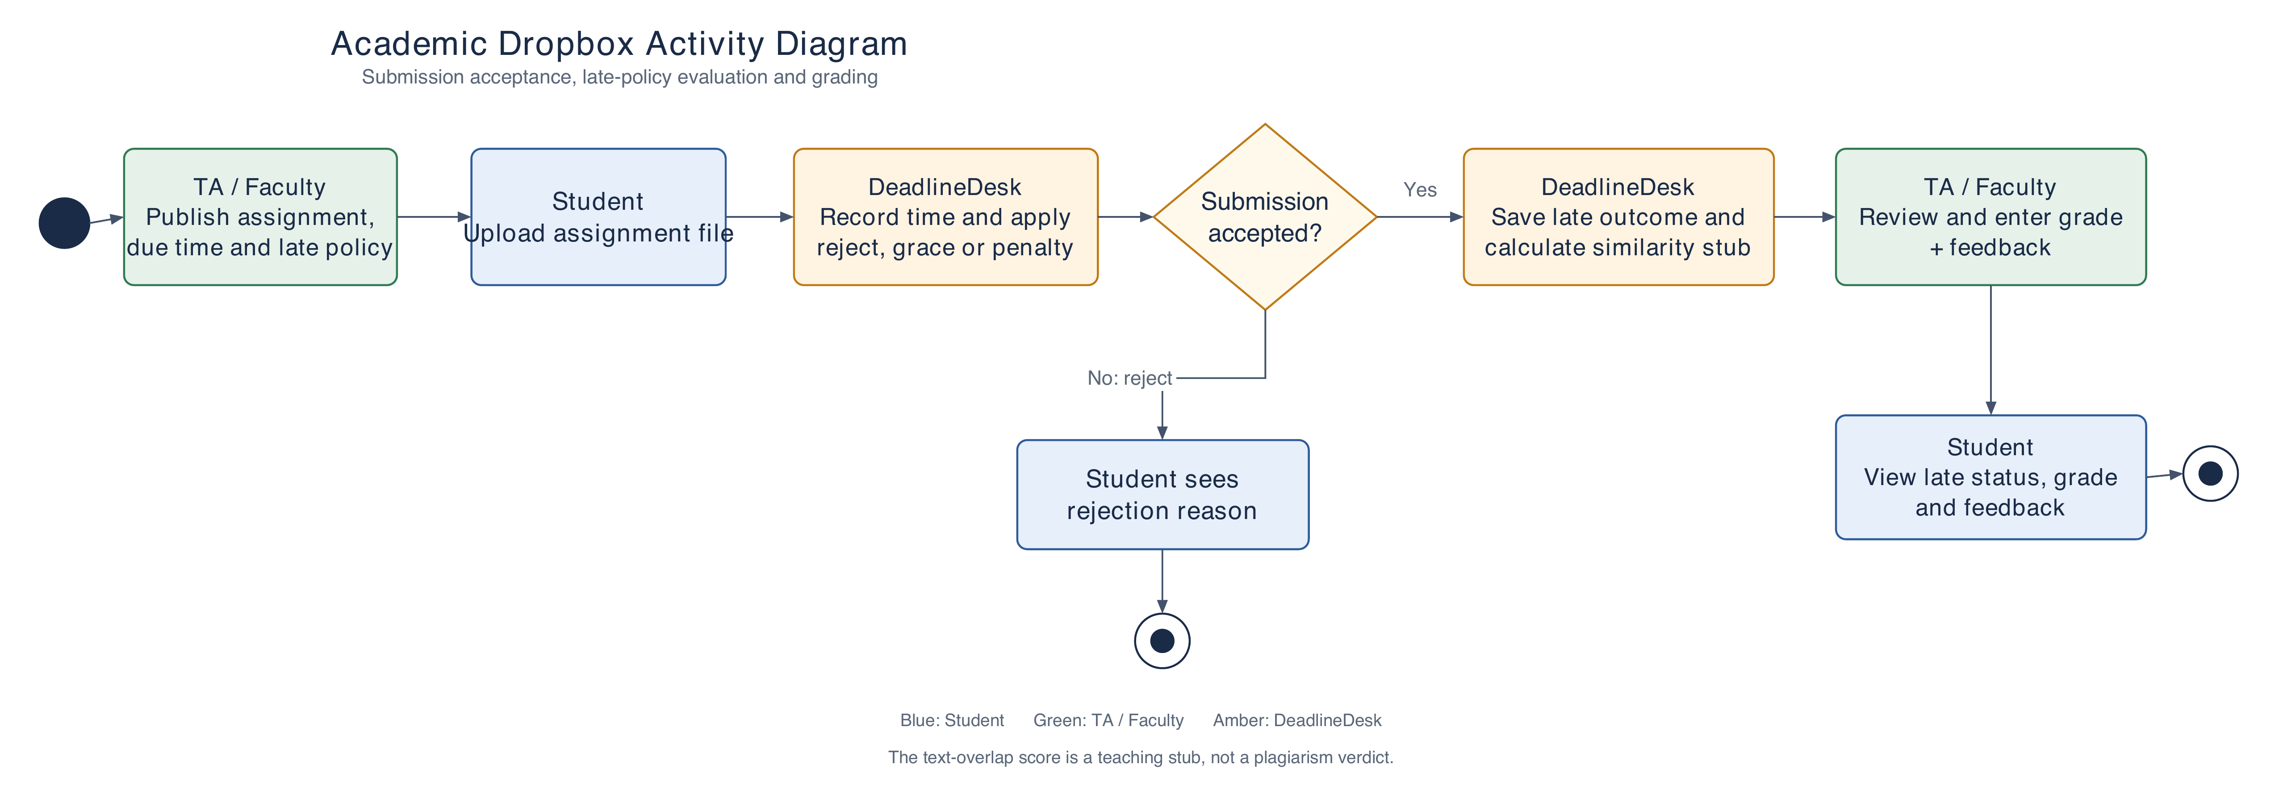
ACTIVITY DIAGRAM
Academic submission and grading
7 / 13
Notes:
Explain the decision branches. On-time submissions are accepted. Late submissions follow the assignment's configured reject, penalty, or grace policy. Accepted submissions can be reviewed and graded by TA/Faculty. The similarity score compares normalized text tokens and must not be presented as plagiarism detection.

Slide 8
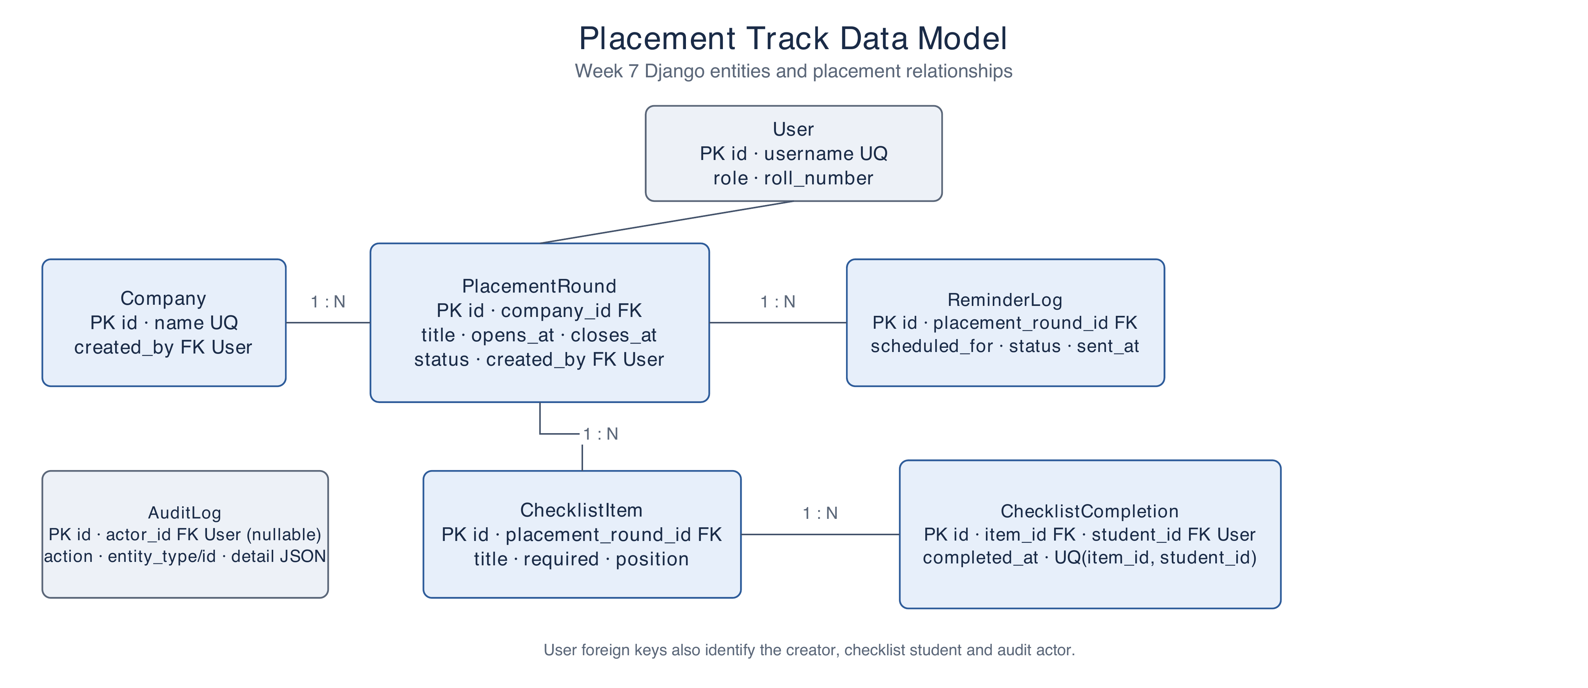
ENTITY-RELATIONSHIP DIAGRAM
Placement data model
8 / 13
Notes:
This is the placement half of the combined ER diagram, enlarged for presentation. The complete editable combined ER diagram is in project-proposal/figures/er-diagram.drawio and the proposal. PlacementRound belongs to Company and owns checklist items and reminder logs. ChecklistCompletion is unique per checklist item and student. User foreign keys record who created and completed the relevant records.

Slide 9
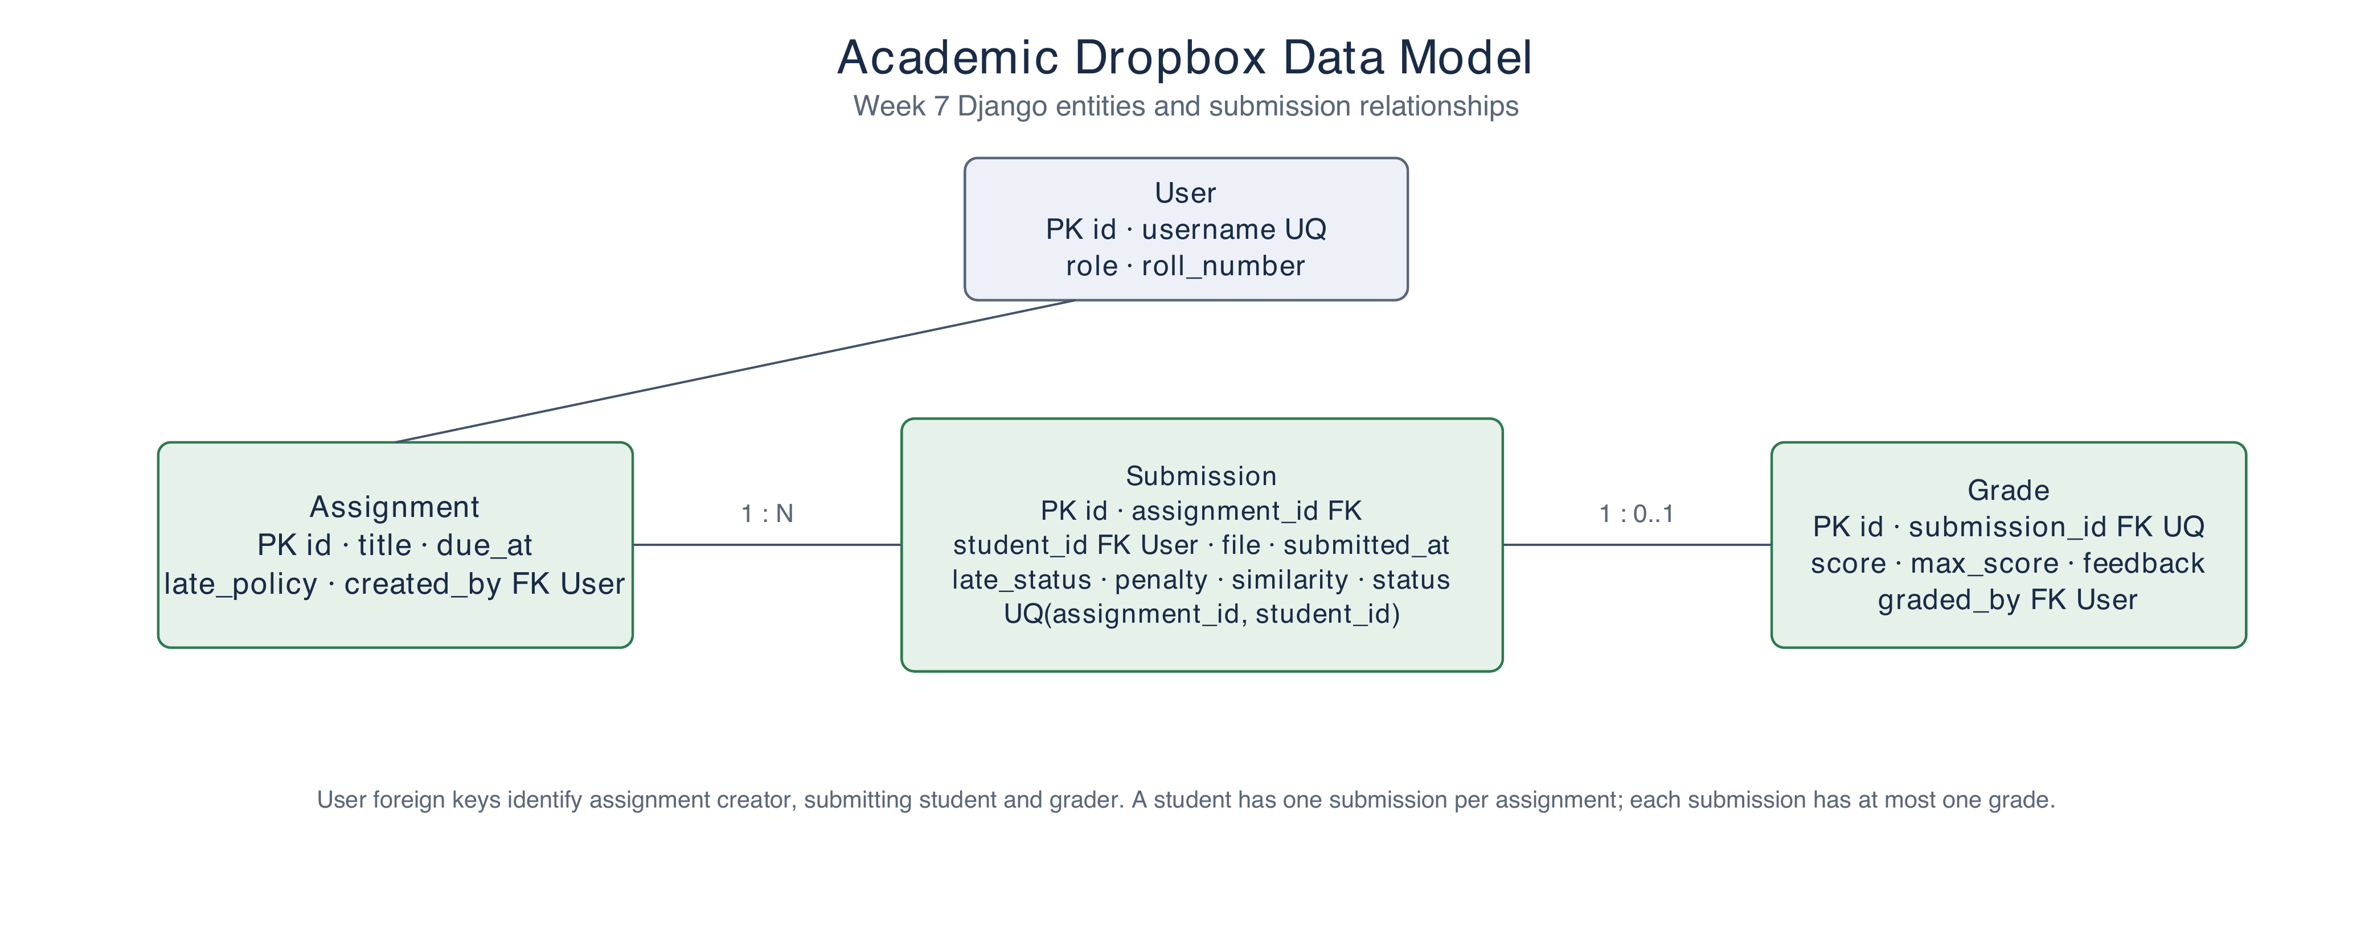
ENTITY-RELATIONSHIP DIAGRAM
Academic data model
9 / 13
Notes:
This is the academic half of the combined ER diagram. Assignment owns student submissions, with a unique constraint for each assignment/student pair. Grade is a one-to-one optional child of Submission. User foreign keys record the assignment author, student and grader. The complete combined model is available as an editable Draw.io file in the repository.

Slide 10
IMPLEMENTATION
Weeks 5 and 6 delivery
WEEK 5
WEEK 6
Foundation
Both workflows
SRS and role model
Session authentication and route guards
Academic late-policy rules
Architecture and user flows
Placement rounds, checklists and reminder logs
Academic uploads and automatic late outcomes
TA review, grading and feedback
Responsive role-specific pages
10 / 13
Notes:
Use the week split to explain implementation progress. Week 5 established requirements, architecture, authentication, the role model, policies, and user flows. Week 6 integrated the placement and academic thin paths and made the role-specific UI responsive.

Slide 11
PROTOTYPE EVIDENCE
Week 7 verification
12
6
3
automated tests
late-policy boundary cases
authenticated roles
Browser and CI checks
Placement checklist moved from in progress to ready, with a reminder record.
Student upload passed through late evaluation, TA review, grading and feedback.
Role violations returned 403. Responsive pages were checked at 390 × 844.
CI covers migrations, Django checks, tests and the documentation build.
11 / 13
Notes:
The repository records 12 automated tests, including six late-policy boundaries. Browser QA exercised both end-to-end workflows, role denial cases and a 390 by 844 viewport. GitHub Actions runs migrations, Django checks and tests; the documentation site has its own build/deployment pipeline.

Slide 12
PROJECT BOUNDARY
Week 7 scope and follow-on work
IN THE WEEK 7 PROTOTYPE
AFTER WEEK 7
Working thin paths
Planned improvements
Role-based login and protected actions
Placement readiness and reminder logging
Assignment upload, late decision, review and grading
SQLite and local media for demonstration
Real reminder worker and email delivery
PostgreSQL and managed file storage
Additional authorization, malware and concurrency checks
The similarity score remains a simple text-overlap stub
12 / 13
Notes:
Be clear about the prototype boundary. Week 7 stores reminders as log rows and uses SQLite/local media. It does not send email. The similarity feature is a deterministic token-overlap stub rather than plagiarism detection. Production hardening and PostgreSQL remain future work.

Slide 13


