Slide 1
Key Questions
Why is process selection important?
  Fit with competitive priorities
How do you select processes
  Pre-selection decision
  Product-process fit
  Fit with competitive priorities
How do you arrange processes?
  Layout
  Type of layout
  Layout selection

Slide 2
Process Selection
Process selection is important because it affects
  Cost
  Flexibility
  Volume
  Variety
  All of which are competitive factors.

Slide 3
Before selecting a process …
Decide
  Make or buy?
  How much capital intensity
  How much process flexibility

Slide 4
Make or Buy?
  Available capacity
  Expertise
  Quality Consideration
  The nature of demand
  Cost

Slide 5
Whether or not to automate?
Automation: Machinery that has sensing and control devices that enables it to operate
Two questions: (a) whether or not to automate and (b) how much
Advantages: low variability (high consistency), higher speed both leading to lower variable cost
Disadvantages: less flexible, higher investment, effect of employment

Slide 6
Types of Automation
Fixed – dedicated automation that can only process a very limited set of products albeit at a very high efficiency
Programmable – increased flexibility compared to the fixed type: NC machines, robots, etc.
Flexible – provides even higher flexibility than programmable type but at a lower cost: cellular manufacturing, flexible manufacturing system

Slide 7
Process Types
Job Shops
  Small runs
Batch Processing
Repetitive/Assembly
  Semicontinuous
Continuous Processing
Projects
  Nonroutine jobs

Slide 8
Important factors in
selecting a process
Variety
  How much
Flexibility
  What type and degree
Volume
  Expected output

Slide 9
Product-Process Matrix
Few
Major
Products,
Higher
Volume
High
Volume,
High
Standard-
ization
Low
Volume
One of a
Kind
Multiple
Products,
Low
Volume
Flexibility-
Quality
Job
Shop
Commercial
Printer
Batch
Classroom
lecture
Assembly
Line
Automobile
Assembly
Continuous
Flow
Sugar
Refinery
Dependability
Cost
Flexibility-Quality
Dependability-Cost

Slide 10
Layout
Layout: the configuration of departments, work centers, and equipment, with particular emphasis on movement of work (customers or materials) through the system

Slide 11
Layout Decisions are Important
Requires substantial investments of money and effort
Involves long-term commitments
Has significant impact on cost and efficiency of short-term operations
Each layout type has its advantages & disadvantages – what are they?

Slide 12
Basic Layout Types
Product Layout
  Layout that uses standardized processing operations to achieve smooth, rapid, high-volume flow
Process Layout
  Layout that can handle varied processing requirements
Fixed Position Layout
  Layout in which the product or project remains stationary, and workers, materials, and equipment are moved as needed

Slide 13
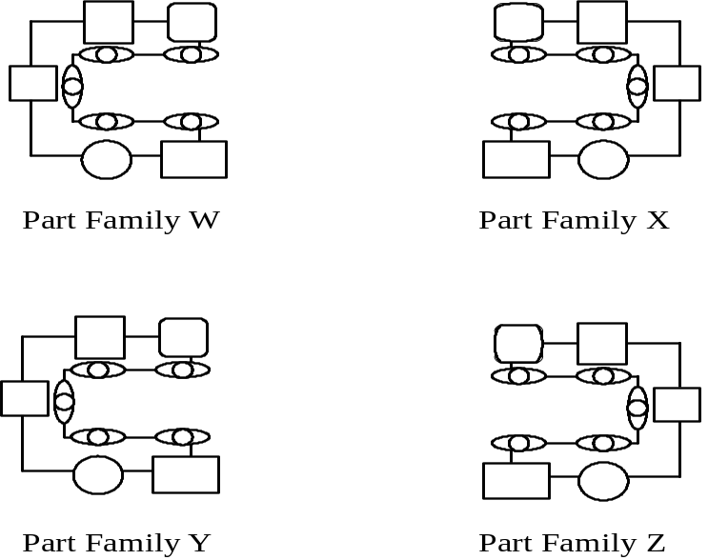

Basic Layout Formats
Cellular Layout
  (aka Just-in-Time Layouts)
  May be assembly-line or
  Group Technology formats
Fixed Position Layout
  e.g. Shipbuilding

Slide 14
A Flow Line for Production or Service
Flow Shop or Assembly Line Work Flow
Raw materials
or customer
Station
1
Station
2
Station
3
Station
4
Finished item
Material
and/or labor
Material
and/or labor
Material
and/or labor
Material
and/or labor

Slide 15
A U-Shaped Production Line
In
1
2
3
4
5
Workers
6
Out
10
9
8
7

Slide 16
Process Layout
Milling
Assembly
& Test
Grinding
Drilling
Plating
Process Layout - work travels
to dedicated process centers

Slide 17
Functional Layout
222
222
222
Mill
111
Drill
Grind
444
22222
3333
444
1111
2222
Assembly
111
333
333333333
44444
333333
111
111
Heat
treat
Gear
cutting
Lathes
111
333
444

Slide 18
Cellular Manufacturing Layout
Heat
treat
Gear
cut
-1111
Lathe
Mill
Drill
-1111
Heat
treat
2222
Mill
Drill
Grind
- 2222
Assembly
3333
Heat
treat
- 3333
Lathe
Mill
Grind
Mill
Drill
Gear
cut
- 4444
4444

Slide 19
Summary
Process choice affects capabilities and, hence, competitive position
Key issues are efficiency & flexibility
Process layout has long-term consequences
Layout must be chosen carefully to be consistent with competitive needs

Slide 20


Slide 21
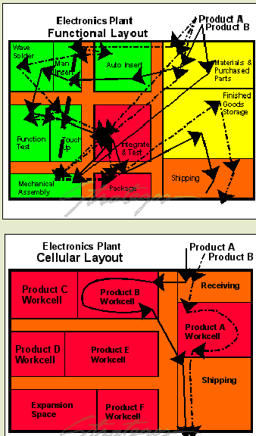
Functional vs. Cellular layout
Notes:
Figures at right contrast functional layouts, and cellular operations. The example is from an electronics plant. In the functional configuration, departmental organization is by function (or process). Since each board requires all (or most) processes, it travels to every department. In each department, it sits in queue waiting for processing. Ten process steps require ten queues and ten waits. Travel distances are long, communication is difficult and coordination is messy.

Slide 22
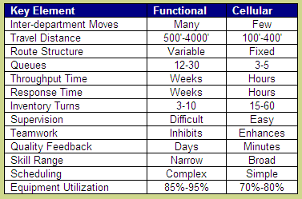
Notes:
The table compares cellular and functional layouts along thirteen key dimensions. It is typical of the improvements possible with this approach. Cells negate many of the tradeoffs of conventional manufacturing approaches.
http://www.strategosinc.com/cellular_manufacturing.htm

