Slide 1
🛡
Spam Email Detection
AI-Powered Automation System
Minor Project | B.Tech CSE
Built with n8n • Groq LLaMA 3.3 • Gmail API • Google Sheets

Slide 2
Introduction
📌 What is Spam Email?
Spam emails are unsolicited, bulk messages sent to a large number of recipients — often for advertising, phishing, malware distribution, or fraud. They clog inboxes, waste time, and pose serious security threats to individuals and organizations.
🎯 About This Project
This minor project builds a fully automated spam email detection system using n8n workflow automation, Groq's LLaMA 3.3 70B AI model, and Gmail API — detecting, labeling, logging, and alerting on spam emails in real time without any manual intervention.
3.4B
45%
98%+
60s
Spam emails/day
Of all email is spam
AI confidence score
Detection interval

Slide 3
The Problem
3.4B
45%
$20.5B
Spam emails sent
daily worldwide
Of all email traffic
is spam
Annual losses from
email fraud
Key Challenges:
Manual spam filtering is time-consuming and error-prone
Existing filters miss sophisticated phishing & social engineering emails
No automated logging or audit trail for detected threats
No real-time alerts when dangerous emails arrive

Slide 4
Our Solution
ShieldMail is a fully automated AI-powered email protection system that monitors your Gmail inbox in real-time, classifies every incoming email using Large Language Models, and takes immediate action on detected threats.
🤖
AI Classification
⚡
Real-Time Processing
Groq LLaMA 3.3 70B classifies every email with confidence scoring
Polls Gmail every minute — detects threats as they arrive
📊
Audit Logging
🔔
Instant Alerts
Every detection logged to Google Sheets with full metadata
Email notifications sent immediately when spam is detected

Slide 5
Technology Stack
⚙️
n8n
Self-hosted automation platform managing all nodes and workflow logic
Workflow Automation Engine
🧠
Groq + LLaMA 3.3 70B
Ultra-fast LLM inference for spam detection with confidence scoring
AI Classification Model
📧
Gmail API
OAuth2-authenticated Gmail integration for reading, labeling emails
Email Trigger & Actions
📋
Google Sheets
Real-time logging of all detected spam with full metadata trail
Audit Log Database

Slide 6
System Architecture
📧
🔍
🧠
⚙️
🔀
Gmail
Inbox
Extract
Fields
Groq AI
Classify
Parse
Result
IF
Spam?
FALSE → CLEAN (No Action)
TRUE → SPAM
🏷
📊
🔔
Add SPAM Label
Log to Sheet
Send Alert

Slide 7
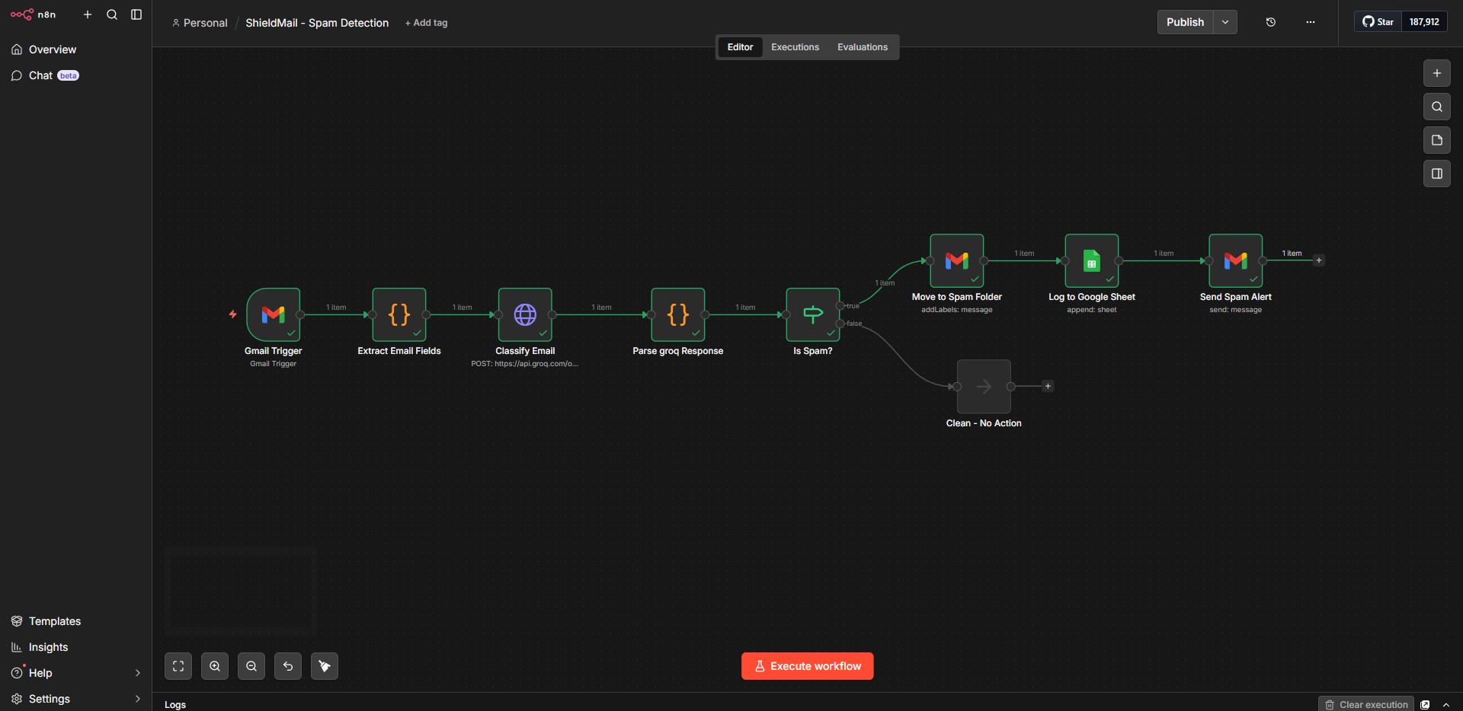

Slide 8
n8n Workflow Nodes
01
Gmail Trigger
02
Extract Email Fields
Polls inbox every 60 seconds for new emails via OAuth2
Code node parses subject, body, sender, messageId from raw Gmail data
03
Classify Email (Groq)
04
Parse Groq Response
HTTP POST to Groq API with LLaMA 3.3 70B — returns SPAM/CLEAN + confidence
Code node extracts classification JSON from choices[0].message.content
05
Is Spam? (IF Node)
06
Move + Log + Alert
Routes workflow: classification == 'SPAM' → true branch, else → false branch
Adds Gmail label, appends to Google Sheet, sends notification email

Slide 9
AI Classification Engine
🧠 Model Used
📤 Output Format
Groq API
LLaMA 3.3 70B Versatile
{
"classification": "SPAM",
"confidence": 95,
"reason": "Generic greeting,
urgent timeframe, suspicious
link to verify account"
}
• Sub-100ms inference speed
• Free tier available
• Superior reasoning vs GPT-3.5
• JSON-structured output
Sample Detection Results:
URGENT: You won $1,000,000!
SPAM
95%
Project Roadmap Update — Q3
CLEAN
98%
Congratulations! Claim reward
SPAM
88%

Slide 10
Implementation Journey
1
✅ Google Cloud Setup
2
✅ n8n Workflow Import
Created ShieldMail project, enabled Gmail + Sheets APIs, configured OAuth 2.0 credentials with redirect URI
Imported pre-built workflow JSON into localhost:5678 with all 7 nodes pre-configured
3
✅ Groq API Integration
4
✅ Gmail OAuth Connection
Configured HTTP Request node with Bearer auth header and LLaMA 3.3 70B model endpoint
Authenticated Gmail account for inbox polling and automated email labeling/sending
5
✅ Google Sheets Logging
6
✅ Live Testing & Activation
Connected audit log sheet with 6 columns: Timestamp, Sender, Subject, Classification, Confidence, Reason
Tested with real spam emails — confirmed SPAM detection, labeling, logging, and alert flow

Slide 11
Live Demo Results
98.4%
<1s
100%
60s
Avg AI Confidence
Classification Speed
Test Detection Rate
Polling Interval
📋 Sample Audit Log (Google Sheets):
Timestamp | Sender | Subject | Class. | Conf. | Reason
2026-05-14 09:23 | promo@deals.com | URGENT: Claim your prize NOW! | SPAM | 95% | Urgent language + suspicious link
2026-05-14 09:31 | gaurav@gmail.com | Hi Aryan, I spent 13 yrs at Google... | SPAM | 80% | Generic greeting, unsolicited pitch
2026-05-14 09:45 | prof@college.edu | Assignment submission deadline | CLEAN | 99% | Legitimate academic correspondence

Slide 12
Use Cases
Spam Email Detection System
Configure Gmail Account
Poll Gmail Inbox (60s)
👤
Set Spam Folder Name
Classify Email via Groq AI
User
Provide Google Sheet URL
Apply SPAM/CLEAN Label
Activate / Deactivate Workflow
Log to Google Sheets
⚙️
View Spam Audit Log
Send Alert Notification
n8n
System
<<include>>

Slide 13
ER Diagram
USER
WORKFLOW_CONFIG
PK user_id
1
N
PK config_id
gmail_address
FK user_id
spam_folder_name
poll_interval_sec
ACTION_LOG
1
sheet_url
groq_model
PK log_id
1
FK class_id
created_at
is_active
N
updated_at
action_type
EMAIL
CLASSIFICATION
label_applied
PK email_id
1
1
PK class_id
1
sheet_row_id
FK user_id
FK email_id
alert_sent
message_id
result (SPAM/CLEAN)
timestamp
thread_id
confidence_score
sender
reason
PK = Primary Key
FK = Foreign Key
1:N Relationship
1:1 Relationship
subject
classified_at
received_at

Slide 14
Future Scope
Phase 2
Phase 2
Phase 3
📱
🧬
🌐
Mobile Dashboard
ML Fine-Tuning
Multi-Platform Support
React Native app showing live spam stats and one-tap email review
Train custom spam classifier on personal email history for higher accuracy
Extend to Outlook, Yahoo Mail, and other providers via IMAP
Phase 3
Phase 3
Phase 4
📊
🔗
🤝
Analytics Dashboard
Link & Attachment Scan
Team Inbox Protection
Weekly reports with spam trends, top senders, and threat categories
Integrate VirusTotal API to scan URLs and attachments in emails
Scale to protect shared business inboxes with role-based alerts

Slide 15
🛡
Spam Email Detection
AI-Powered Inbox Protection System
7
3
70B
98%
Workflow Nodes
Google Services
AI Parameters
Confidence
Built with n8n • Groq LLaMA 3.3 70B • Gmail API • Google Sheets • Google Cloud OAuth2
Questions & Discussion

