Slide 1
7-Segment traffic light system

Slide 2



hello!
Team Members:
Aryan Pandey
Ananya B
Sakshi Agnihotri

Slide 3
What is that one problem that we face living in high tech metropolitan cities?

Slide 4


TRAFFIC!!!!!!

Slide 5
ABSTRACT
Traffic problems on roads in the modern cities are increasing day by day as the number of vehicles on the
road is increasing. Traffic lights control systems are used as the signaling devices for managing challenging
traffic in cities. Over the years there is a drastic change in technology which is implemented to improve work
efficiency, to reduce time losses. But irritating, poor traffic systems are available which in turn causes accidents. In order to reduce inconvenience, the system which we will propose in our course will have continuous down count display of waiting time. This system is also capable to modify the timings of traffic signals according to a requirement of the signals as the density of the vehicles vary from place to place.

Slide 6
INTRODUCTION
The project provides the basic model of traffic light control system which has an additional feature of displaying a countdown timer on a 7-segment display.
This project makes use of LED lights for indication purpose and a microcontroller is used for auto changing of signal at specified range of time interval. LED lights gets automatically turns on and off by making corresponding port pin of the microcontroller “HIGH”.
The project provides the basic model of traffic light control system which has an additional feature of displaying a countdown timer on a 7-segment display.

Slide 7
WHY NEED THIS SYSTEM?
Traffic lights
Signalling devices
Traffic control
Improve safety
Minimize travel time

Slide 8
What microcontroller?
ATMEL MEGA- 328P
ARDUINO UNO
R3 SMD COMPATIBLE BOARD

Slide 9
WHY THIS MICROCONTROLLER?
ATmega328 is an 8-bit, 28-Pin AVR Microcontroller, manufactured by Microchip, follows RISC Architecture and has a flash-type program memory of 32KB.
Atmega328 is the microcontroller, used in basic Arduino boards i.e Arduino UNO, Arduino Pro Mini and Arduino Nano.
It has an EEPROM memory of 1KB and its SRAM memory is 2KB.
It has 8 Pins for ADC operations, which all combine to form PortA ( PA0 – PA7 ).
It also has 3 built-in Timers, two of them are 8 Bit timers while the third one is 16-Bit Timer.
You must have heard of Arduino UNO, UNO is based on atmega328 Microcontroller. It’s UNO’s heart. 🙂
It operates ranging from 3.3V to 5.5V but normally we use 5V as a standard.
Its excellent features include cost-efficiency, low power dissipation, programming lock for security purposes, real timer counter with separate oscillator.

Slide 10
SPECIFICATIONS:
IC type: AVR microcontroller
Core size: 8-bit
Speed: up to 20MHz
Number of I/O: 23
Program memory size: 32Kb (16K x 16)
Program memory type: Flash
3
8
EEPROM size: 1K x 8
RAM size: 2K x 8
Package: DIP-28 (0.1" x 0.3" pin spacing)
Supply voltage: 1.8 V - 5.5 V
Lead-free (RoHS compliant): Yes
Manufacturer: Atmel
Manufacturer part number: ATmega328P-PU
2
p

Slide 11
COMPONENTS REQUIRED
LED YELLOW
BREAD BOARD
USB CABLE
GROUND WIRES
BCD TO 7 SEGMENT LATCH DECODER
LED RED
1
2
3
4
5
6
7
8
9
10
11
MICROCONTROLLER
LED GREEN
13 - JUMPER WIRES
5 V BATTERY
GENERAL PURPOSE TRANSISTOR
330 OHM RESISTORS

Slide 12
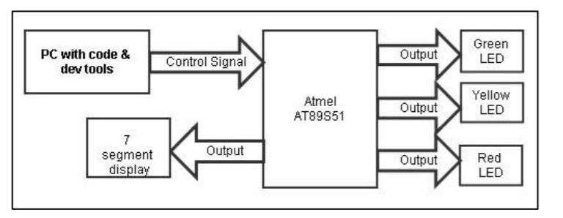
BLOCK DIAGRAM
ATmega382P

Slide 13
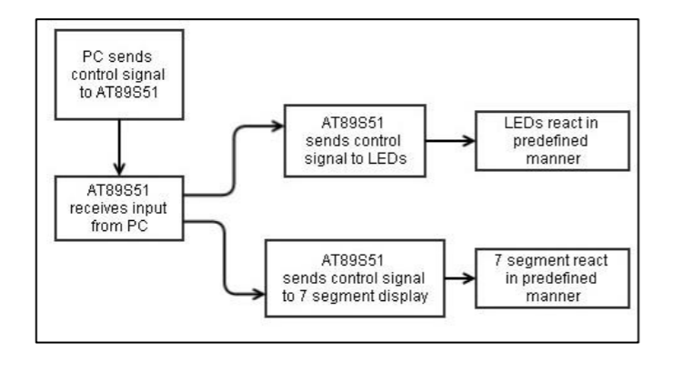
BLOCK DIAGRAM
AT Mega 382P
AT Mega 382P
AT Mega 382P
AT Mega 382P

Slide 14
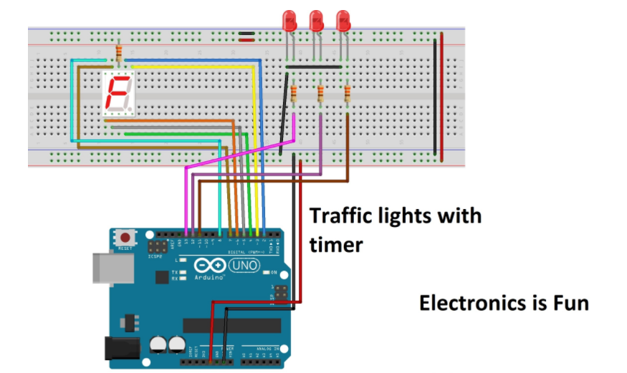
CIRCUIT DIAGRAM

Slide 15
Working
7 –segment display is used as a counter display and three led s are used for traffic lights.
Microcontroller is used to initiate the traffic signal at the intersection of the road.
Crystal oscillator is used for generation frequency clock pulses.
Led s interfaced with port zero are powered to 5V power supply.
7-segment is connected to port one with common anode configuration

Slide 16
WORKING
The LEDs get automatically switched on and off by making the corresponding port pins of the microcontroller high, based on the microcontroller and its programming done by using KEIL software. At a particular period of time, only the green light holds ON and the other lights remains OFF, and after sometime, the changeover traffic light control from green to red takes place by making the succeeding change for glowing of yellow LED. This process continues as a cycle and the timing for changing the LEDs can be displayed with the use of a seven-segment LED display in this project.
This traffic light control system can be further enhanced in such a way to control the traffic signals automatically based on the traffic density on roads with the help of IR sensor modules with automatic turnoff if there are no vehicles on either side of the road which leads to power consumption.

Slide 17
CONCLUSION
1.Seven segments are widely used in digital clocks to display the time.
2.These are used in electronic meters for displaying the numerical information.
3.Used in Instrument panels and used in digital readout displays.
4. The complexity is increased to display large information.
5.It is not possible to display the symbols on seven segment.

Slide 18

THANK YOUUU !!!!

