Slide 1


JavaScript
www.Shyamsir.com
78 74 39 11 91

Slide 2
Web Application
Jquery
React
Angular
Vue
Node

Slide 3
Desktop Application
Electron

Slide 4
Mobile Application
Angular
React
Vue
Node

Slide 5
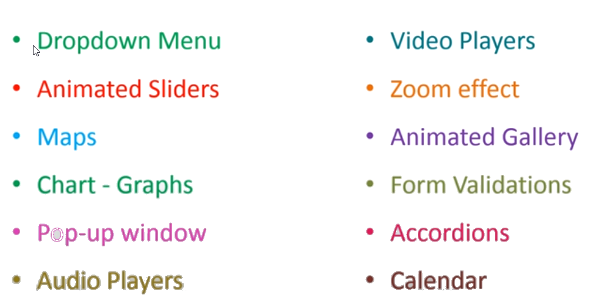
Application

Slide 6
Where to write
Internal/Inpage
External
Inline

Slide 7
Add HTML Tag
document.write(“<h1>Hi hello</h1>”);

Slide 8
Comment
//
/* */

Slide 9
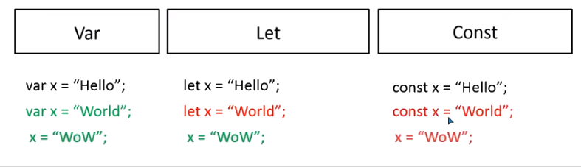
Variable

Slide 10
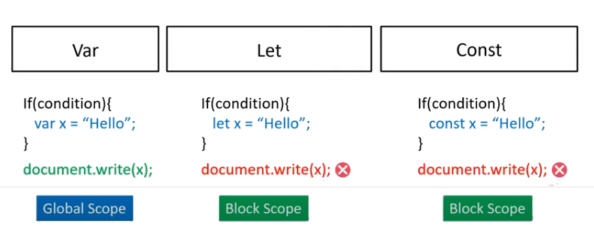
Variable

Slide 11
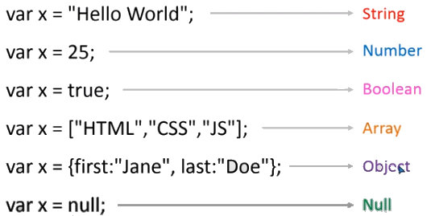
Data Types

Slide 12
Comparison Operator
Operator | Description
== | equal to
=== | equal value and equal type
!= | not equal
!== | not equal value or not equal type
> | greater than
< | less than
>= | greater than or equal to
<= | less than or equal to
? | ternary operator

Slide 13
Arithmetic Operators
Operator | Description
+ | Addition
- | Subtraction
* | Multiplication
** | Exponentiation (ES2016)
/ | Division
% | Modulus (Division Remainder)
++ | Increment
-- | Decrement

Slide 14
Assignment Operators
Operator | Example | Same As
= | x = y | x = y
+= | x += y | x = x + y
-= | x -= y | x = x - y
*= | x *= y | x = x * y
/= | x /= y | x = x / y
%= | x %= y | x = x % y
**= | x **= y | x = x ** y

Slide 15
Console
console.log(22+2);
console.log([22,33,44]);
console.table([22,33,44]);
console.error("In error");
console.warn("In warn");
console.clear();

Slide 16
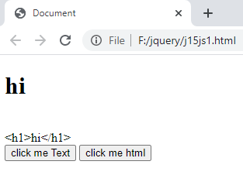
innerText vs innerHTML

Slide 17
innerText vs innerHTML
<script>
const hi1=()=>{
let data=document.getElementById("divdata").innerHTML;
divAns.innerText=data;
}
const hi2=()=>{
let data=document.getElementById("divdata").innerText;
divAns.innerText=data;
}
</script>

Slide 18
innerText vs innerHTML
<div id="divdata">
<h1>hi</h1>
</div>
<div id="divAns">
</div>
<input type="button" name="btnAns1" value="click me Text" onclick="hi1();"/>
<input type="button" name="btnAns2" value="click me html" onclick="hi2();"/>

Slide 19
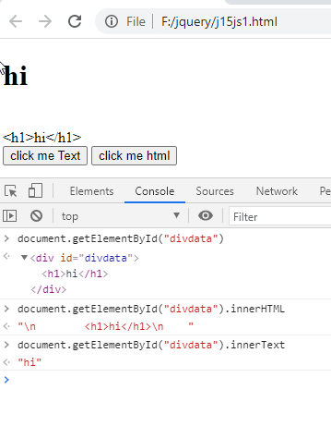
innerText vs innerHTML

Slide 20
Comparison Operator
== | equal to
=== | equal value and equal type
!= | not equal
!== | not equal value or not equal type
> | greater than
< | less than
>= | greater than or equal to
<= | less than or equal to
? | ternary operator

Slide 21
If..else , Switch , Loops , Logical Opertor , Ternary
Operator | Description
&& | logical and
|| | logical or
! | logical not

Slide 22
Alert(), Prompt(), Confirm()

Slide 23
Function()
const hi2=()=>{
}
function add(a,b){
}
function add(a,b){
return a+b;
}
function add(){
}

Slide 24
Global and Local Variable
let a=5;
function add()
{
let b=20;
document.writeln(a+b);
}
document.writeln(a+b);

Slide 25
Event
Click
Double Click
Right Click
Mouse Hover
Mouse Out
Mouse Up
Key Press , Key Down , Key Up
Load
Unload
Resize

Slide 26
Array

Slide 27
var emp=["Sonoo","Vimal","Ratan"]; var emp = new Array(); emp[0] = "Arun"; emp[1] = "Varun"; emp[2] = "John"; var emp=new Array("Jai","Vijay","Smith");
Array

Slide 28
Print Record
var myfriends=["rahul","anjali","simran","anurag","diya","niva","aditya"]; console.log(myfriends[0]); console.log(myfriends);
for (i=0;i<emp.length;i++){
console.log(emp[i]);
}
var myfriends=["rahul","anjali","simran","anurag","diya","niva","aditya"];
for(let element in myfriends)
{
console.log(element);
}

Slide 29
let fruits = ["Apple", "Orange", "Plum"]; // iterates
for (let fruit of fruits)
{
console.log( fruit );
}

Slide 30
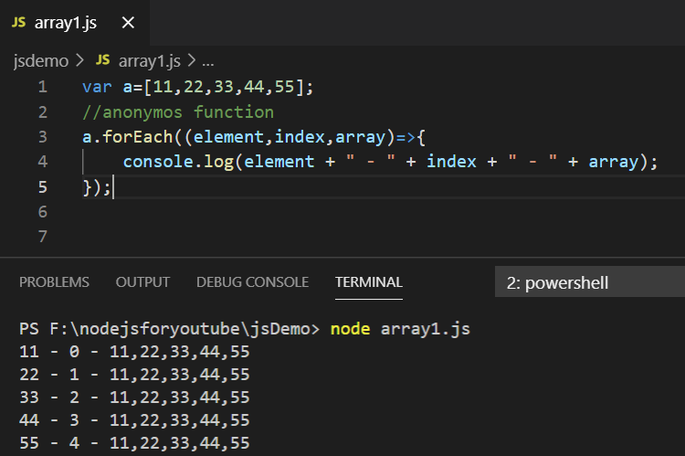

Slide 31
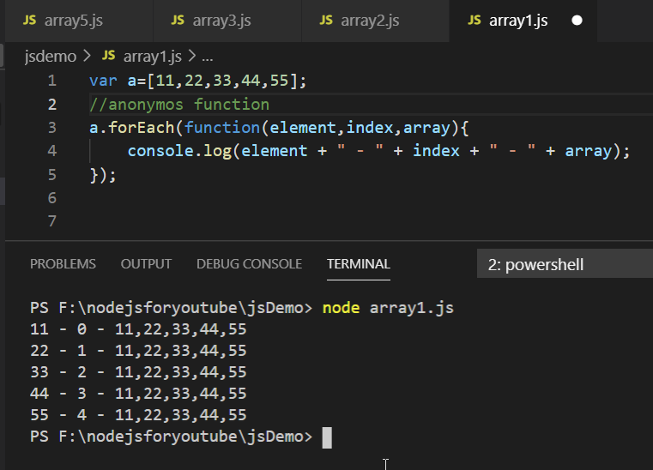

Slide 32
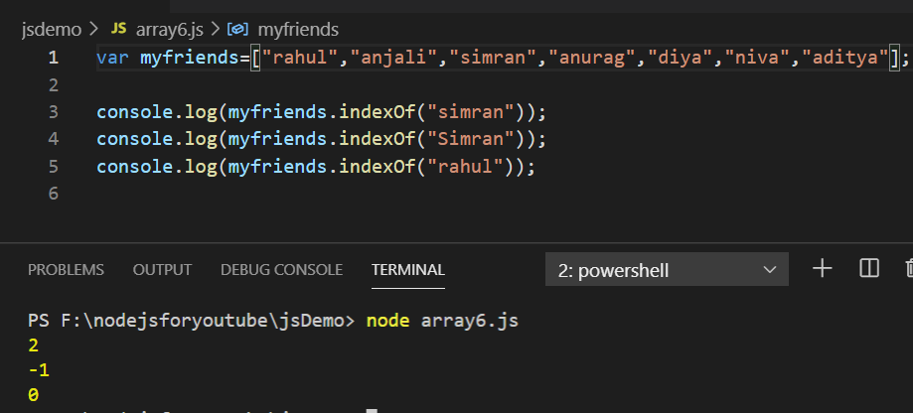
indexOf()

Slide 33
Modify
var myfriends=["rahul","anjali","simran","anurag","diya","niva","aditya"];
myfriends[0]="ram";
for (x in myfriends)
{
console.log(myfriends[x]);
}

Slide 34
Insert – push()
let animals =['dog','cat','cow','donkey’]
animals.push('chick’)
animals.push(‘zebra’)
animals.push(‘lion’)
Console.log(animals)

Slide 35
Insert – unshift()
let animals =['dog','cat','cow','donkey’]
animals.unshift('chick’)
animals.unshift(‘zebra’)
animals.unshift(‘lion’)
Console.log(animals)

Slide 36
let animals =['dog','cat','cow','donkey’]
animals.push('chick’)
for (x in animals)
{
console.log(animals[x]);
}
const cnt=animals.push('monkey','tiger','lion')
console.log(cnt)
console.log(animals)

Slide 37
animals.unshift('11')
const cntnew=animals.unshift('22','33','44')
console.log(animals);
console.log(cntnew);
Unshift vs push

Slide 38
let animals =['dog','cat','cow','donkey’]
animals.push('chick’)
for (x in animals)
{
console.log(animals[x]);
}
const cnt=animals.push('monkey','tiger','lion')
console.log(cnt)
console.log(animals)

Slide 39
Delete– pop() vs shift()
const animals =['dog','cat','cow','donkey'];
console.log(animals);
console.log(animals.pop());
console.log(animals);
console.log(animals.shift());
console.log(animals);

Slide 40
Slice()
const months =['jan','feb','april','aug','nov'];
const newMonth1= months.splice(1,1,"Feb");
console.log(months);
console.log(newMonth1);
const months =['jan','feb','april','aug','nov'];
const newMonth1= months.splice(1,2,"woooo");
console.log(months);
console.log(newMonth1);

Slide 41
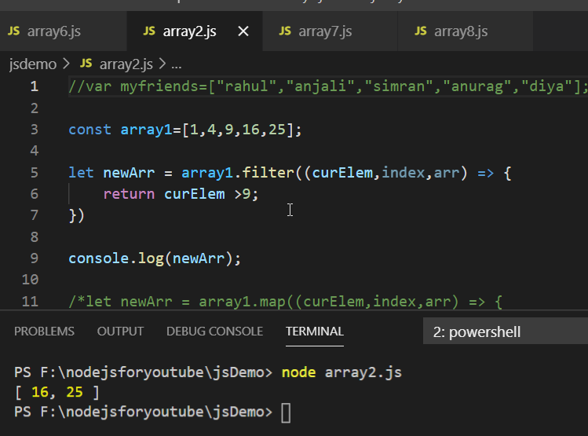
filter()

Slide 42
const words = ['spray', 'limit', 'elite', 'exuberant', 'destruction', 'present'];
const result = words.filter(word => word.length > 6);
console.log(result);

Slide 43
var fruits = ["Banana", "Orange", "Apple", "Mango"];
fruits.sort();
var fruits = ["Banana", "Orange", "Apple", "Mango"];
fruits.reverse();
const cities = ['srinagar','abad','mum','udaipur'];
const ispresent = cities.includes('abad');
console.log(ispresent);

Slide 44
Exercise 1:
let fruits = ["Apples", "Pear", "Orange"];
let shoppingCart = fruits;
shoppingCart.push("Banana“);
alert( fruits.length ); // ?

Slide 45
Exercise 2:
Let’s try 5 array operations.
Create an array styles with items “Jazz” and “Blues”.
Append “Rock-n-Roll” to the end.
Replace the value in the middle by “Classics”. Your code for finding the middle value should work for any arrays with odd length.
Strip off the first value of the array and show it.
Prepend Rap and Reggae to the array.

Slide 46
Exercise 2:
let styles = ["Jazz", "Blues"];
styles.push("Rock-n-Roll");
styles[1] = "Classics";
console.log(styles);
console.log(styles[0]);
styles.shift();
styles.unshift("Rap", "Reggae");
console.log(styles);

Slide 47
Object

Slide 48
Object
let a=[11,22,33,44]; // 0,1,2,3 indexes
let data={
firstname :"shyam",
lastname :"chawda",
contactno:"7874391191",
age:39
}; //instead of 0,1,2,3 keys are indexes

Slide 49
Object
An object can be created with figure brackets {…} with an optional list of properties.
A property is a “key: value” pair, where key is a string (also called a “property name”), and value can be anything.
Object Literal is simply a key:value pair data structure.
Storing variable and functions together in one container, we can refer this as an objects.

Slide 50
Object There are two ways
let user = new Object();
// "object constructor"
2. let user = {};
// "object literal" syntax ,First example

Slide 51
Object There are two ways
let o = new Object();
o.foo = 42
console.log(o)

Slide 52
Object There are two ways
let user = {
name: “Vraj",
sizes: {
height: 182,
width: 50
}
};
alert( user.sizes.height );

Slide 53
Object
let biodata = {
myname :{
firstname: "shyam",
lastname: "chawda"
},
myage:39,
city:"Ahmedabad",
contactno:7874391191,
"likes birds": true,
}

Slide 54
Object
let fname=biodata.myname.firstname;
let lastname=biodata.myname.lastname;
let myage=biodata.myage;
let birds=biodata["like birds"];
let merge=fname +"<br>" + lastname +"<br>" + myage +"<br>" + birds;
document.getElementById("spandata").innerHTML=merge;
alert( biodata["myage"] );

Slide 55
let key = prompt("What do you want to know about the user?", "name");
alert(biodata[key]);
// access by variable
</script>

Slide 56
To Access Any property
The dot notation: obj.property.
Square brackets notation obj["property"].
Square brackets allow to take the key from a variable, like obj[varWithKey].

Slide 57
Computed Properties
<script>
let fruit = prompt("Which fruit to buy?", "apple");
let biscuit = prompt("Which Biscuit to buy?", "parleg");
let biscuitPrice = prompt("Which Biscuit Price to buy?", "10");
let bag = {
[fruit]: 5,
[biscuit]:biscuitPrice,
};
alert(bag[fruit] +" - " + fruit);
alert(bag[biscuit] + " - " + biscuit);
</script>

Slide 58
<script>
let user ={name: "John",age: 30,gender:"male"};
alert( "age" in user );
alert( "blabla" in user );
let key = "gender";
alert( key in user );
</script>

Slide 59
<script>
let obj = {
test: undefined
};
alert( obj.test );
alert( "test" in obj );
</script>

Slide 60
Print all
<script>
let user = { name: "John", age: 30,gender:"male" };
for (let key in user) {
alert(key+ " ---- " + user[key] );
}
</script>

Slide 61
Print all
let user = {
name: “Aslam",
surname: “rakshi"
};
user.age = 25; // add one more
for (let prop in user) {
alert( prop ); //name, surname, age
}

Slide 62
Arrays of Objects
let data=[
{Name:"Ram",Std:5,Div:"A"},
{Name:"Anjali",Std:4,Div:"B"},
{Name:"Rahul",Std:5,Div:"A"},
{Name:"Simran",Std:3,Div:"B"},
];
document.writeln(data);

Slide 63
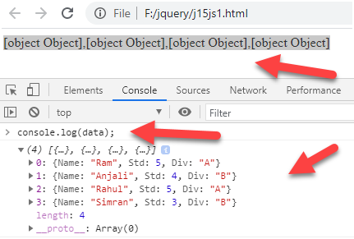
Arrays of Objects

Slide 64
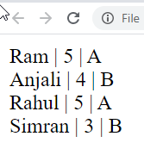
Arrays of Objects
let data=[
{Name:"Ram",Std:5,Div:"A"},
{Name:"Anjali",Std:4,Div:"B"},
{Name:"Rahul",Std:5,Div:"A"},
{Name:"Simran",Std:3,Div:"B"},
];
for(i=0;i<data.length;i++)
{
document.writeln(data[i].Name + " | " + data[i].Std + " | " + data[i].Div +"<br>");
}

Slide 65
Const with Array and Object
const a=[11,22,33];
//a=[10,20,30];
document.writeln(a +"<br>");
a[0]=55;
document.writeln(a +"<br>");

Slide 66
Const with Array and Object
const data={
name:"Ram",
age:25
};
data.name="Devdas";
data.age=39;
document.writeln(data.name + " -- " + data.age);

Slide 67
Function

Slide 68
Function
<h1>Demo: JavaScript Object</h1>
<p id="p1"></p>
<p id="p2"></p>
<p id="p3"></p>
<p id="p4"></p>
<p id="p5"></p>

Slide 69
Function - this
<script>
var person = {
firstName: "James",
lastName: "Bond",
age: 25,
getFullName: function () {
return this.firstName + ' ' + this.lastName
}
};

Slide 70
Function
document.getElementById("p1").innerHTML = person.firstName;
document.getElementById("p2").innerHTML = person.lastName;
document.getElementById("p3").innerHTML = person["firstName"];
document.getElementById("p4").innerHTML = person["lastName"];
document.getElementById("p5").innerHTML = person.getFullName();
</script>

Slide 71
Function
let user = {
name: "John",
age: 30,
sayHi() {
alert(this.name);
}
};
user.sayHi(); // John
let user = {
name: "John",
age: 30,
sayHi() {
alert(user.name);
}
};
user.sayHi(); // John

Slide 72
Function
let data={
firstname :"shyam",
lastname :"chawda",
contactno:"7874391191",
age:39,
fullname:function()
{
return this.firstname+" - " + this.lastname;
},
yourage:function()
{
return "Age = " + this.age;
}
};
document.writeln(data.fullname());
document.writeln(data.yourage());
document.writeln(data.contactno);

Slide 73
Object Constructor
const school = new Object();
school.name = 'Vivekanada school';
school.location = 'Delhi';
school.established = 1971;
school.displayInfo = function(){
console.log(`${school.name} was established
in ${school.established} at ${school.location}`);
}

Slide 74
Another approach of Constructor
function Vehicle(name, maker) {
this.name = name;
this.maker = maker;
}
let car1 = new Vehicle('Fiesta', 'Ford');
let car2 = new Vehicle('Santa Fe', 'Hyundai')
console.log(car1.name); // Output: Fiesta
console.log(car2.name); // Output: Santa Fe

Slide 75
Another approach of Constructor
function User(name) {
this.name = name;
this.isAdmin = false;
}
let user = new User("Jack");
alert(user.name); // Jack
alert(user.isAdmin); // false

Slide 76
Project kind of
<script>
let user={
name:'shyam',
age:39,
email:'shyam.rajput@gmail.com',
blog:'MAC vs Windows',
login()
{
console.log("the user logeed in and username " + user.name);
},

Slide 77
Project kind of
logout()
{
console.log("the user logout and username "+ user.name);
},
logblogs()
{
console.log('the user has written the following blogs');
console.log(user.blog);
},
}

Slide 78
Project kind of
user.login();
user.logblogs();
user.logout();
</script>
</body>
</html>

Slide 79
Exercise
Create an empty object user.
Add the property name with the value John.
Add the property surname with the value Smith.
Change the value of the name to Pete.
Remove the property name from the object.

Slide 80
Exercise
let salaries = {
John: 100,
Ann: 160,
Pete: 130
}
Sum of all the values

Slide 81
Object Reference
let user = { name: 'John' };
let admin = user;
admin.name = 'Pete’;
alert(user.name);

Slide 82
Object Reference - Compare
let a = {};
let b = a;
alert( a == b );
alert( a === b );
let a = {};
let b = {};
alert( a == b );
alert( a === b );

Slide 83
Object Reference
let user = {
name: "John",
age: 30
};
let clone = {};
for (let key in user) {
clone[key] = user[key];
}
clone.name = "Pete";
alert( user.name );

Slide 84
Object Assign
const target = { a: 1, b: 2 };
const source = { b: 4, c: 5 };
const returnedTarget = Object.assign(target, source);
console.log(target);
console.log(returnedTarget);

Slide 85
Map Function – It is like loop
let a=[11,22,33,44];
let b=a.map(test);
document.write(b);
function test(x){
return x*10;
}

Slide 86
Map Function
let data=[
{Name:"Ram",Std:5,Div:"A"},
{Name:"Anjali",Std:4,Div:"B"},
{Name:"Rahul",Std:5,Div:"A"},
{Name:"Simran",Std:3,Div:"B"},
];
var b=data.map(test);
document.write(b);
function test(x){
return x.Name;
}

Slide 87
Map Function
let data=[
{Name:"Ram",Std:5,Div:"A"},
{Name:"Anjali",Std:4,Div:"B"},
{Name:"Rahul",Std:5,Div:"A"},
{Name:"Simran",Std:3,Div:"B"},
];
var b=data.map(test);
document.write(b);
function test(x){
return x.Name +" " + x.Std + " " + x.Div ;
}

Slide 88
Map Function
let data=[
{Name:"Ram",Std:5,Div:"A"},
{Name:"Anjali",Std:4,Div:"B"},
{Name:"Rahul",Std:5,Div:"A"},
{Name:"Simran",Std:3,Div:"B"},
];
var b=data.map(test);
document.write(b);
function test(x){
return x.Name;
}

Slide 89
String function

Slide 90
Math function

Slide 91
Date function

Slide 92
The Browser Object Model (BOM)

Slide 93
The Browser Object Model (BOM)
There are no official standards for the Browser Object Model (BOM).
The Browser Object Model (BOM) is used to interact with the browser.
The default object of browser is window means you can call all the functions of window by specifying window or directly.

Slide 94
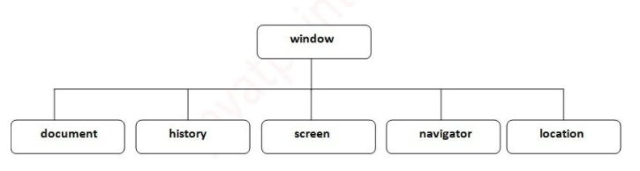
The Browser Object Model (BOM)

Slide 95
The Browser Object Model (BOM)
Global variables are properties of the window object.
Global functions are methods of the window object.
Even the document object (of the HTML DOM) is a property of the window object:
window.document.getElementById("header");

Slide 96
The Browser Object Model (BOM)
<body onmousemove="hadd();" onresize="hadd();">
<script>
const hadd=()=>
{
let w=window.innerWidth;
let h=window.innerHeight;
document.getElementById("spananswer").innerHTML="Width = " + w + " Height = " +h;
}
</script>

Slide 97
The Browser Object Model (BOM)
<div class="container w-25 p3">
<form name="frm1">
<div class="form-row">
<div class="col">
<button type="button" value="Add" class="btn btn-warning" id="btnans" onclick="hadd();">Click me </button>
</div>
</div>
<br/>

Slide 98
The Browser Object Model (BOM)
<div class="form-row">
<div class="col">
Ans <span id="spananswer"></span>
</div>
</div>
</form>
</div>

Slide 99
Methods of Window
Methods | Description
Alert () | It displays the popup messages with the ok button.
Confirm () | It displays the message on the alert box with the OK and cancel button.
Prompt () | It gets input from the user to display a text message in the dialog box.
Open () | Opens the current window.
Close () | Closes the current window.
moveTO () | Moves the current window.
resizeTo () | Resizes the current window.
setTimeout () | It performs an action after a specified time, like calling a function, evaluating expressions, etc.

Slide 100
Methods of Window Open
<body>
<script>
const hadd=()=>
{
window.open("http://www.shyamsir.com");
}
const hadd2=()=>
{
window.open("trycatch1.html");
}
</script>

Slide 101
Methods of Window
<div class="container w-25 p3">
<input type="button" value="Click_to_Next" onclick="hadd();"/>
<input type="button" value="Open" onclick="hadd2();"/>
</div>

Slide 102
Methods of Window
<style>
.hide
{
visibility: hidden;
}
</style>
<script>
let con=setInterval("hadd()",1000);
let idno=1;
const hadd=()=>
{
if(idno==1)
{
document.getElementById("main").style.visibility = "visible";
idno=0;
}
else
{
document.getElementById("main").style.visibility = "hidden";
idno=1;
}
}
</script>

Slide 103
<div class="container w-25 p3">
<div class="row">
<div class="col">
<img src="img/img1.jpg" height="200px" width="200px" name="main" id="main" class="hide"/>
</div>
</div>
</div>
</body>
</html>

Slide 104
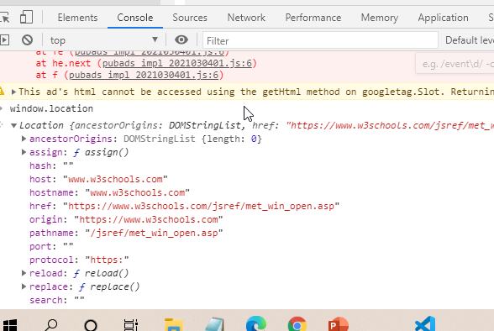

Slide 105
Questions
setTimeOut vs setTimeInterval
window.print();
How to clear history?

Slide 106
DOM

Slide 107
DOM
JavaScript can access all the elements in a webpage making use of Document Object Model (DOM).
One of the most unique and useful abilities of JavaScript is its ability to manipulate the DOM.
The DOM (or Document Object Model) is a tree-like representation of the contents of a webpage - a tree of “nodes” with different relationships depending on how they’re arranged in the HTML document.

Slide 108
DOM
In the DOM, all parts of the document, such as elements, attributes, text, etc. are organized in a hierarchical tree-like structure; similar to a family tree in real life that consists of parents and children.
JavaScript can be used to dynamically add a page's DOM to add, delete, and modify elements. The DOM represents a document as a tree structure.

Slide 109
HTML can be viewed as a tree. Every tag is parsed by the browser, and a DOM object is created. Tags that are inside this tag are considered to be this DOM Object's child elements.
In the end you get a hierarchy of objects that have parents and children. In Computer Science such hierarchies are called Trees.

Slide 110
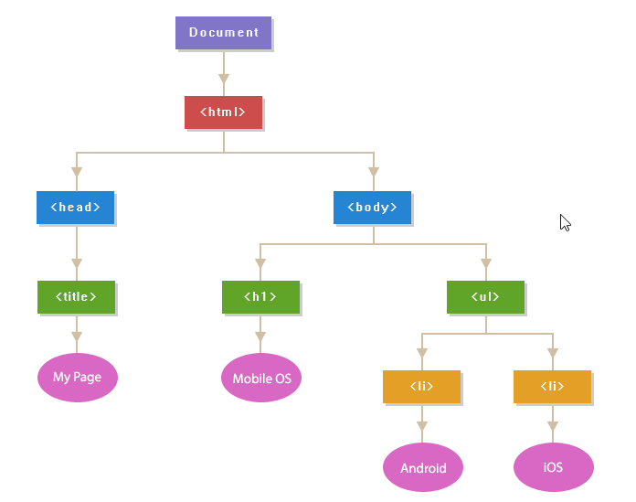
DOM
<!DOCTYPE html>
<html>
<head>
<title>My Page</title>
</head>
<body>
<h1>Mobile OS</h1>
<ul>
<li>Android</li>
<li>iOS</li>
</ul>
</body>
</html>

Slide 111
The way a document content is accessed and modified is called the Document Object Model, or DOM.
The Objects are organized in a hierarchy. This hierarchical structure applies to the organization of objects in a Web document.

Slide 112
Window object − Top of the hierarchy. It is the outmost element of the object hierarchy.
Document object − Each HTML document that gets loaded into a window becomes a document object. The document contains the contents of the page.
Form object − Everything enclosed in the <form>...</form> tags sets the form object.
Form control elements − The form object contains all the elements defined for that object such as text fields, buttons, radio buttons, and checkboxes.

Slide 113
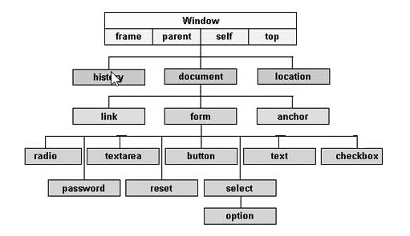

Slide 114
The DOM allows us to do anything with elements and their contents, but first we need to reach the corresponding DOM object.
All operations on the DOM start with the document object. That’s the main “entry point” to DOM. From it we can access any node.

Slide 115
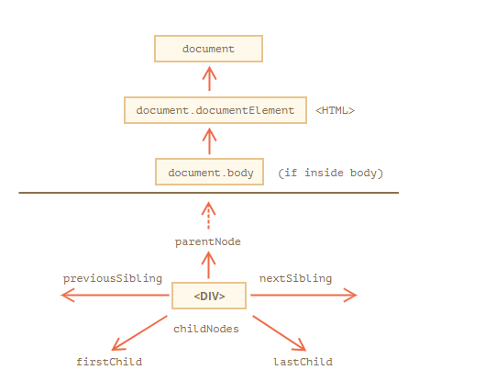

Slide 116
JavaScript DOM Selectors

Slide 117
Methods
Action that Perform on Html elements
getElementByID()
getElementsByName()
getElement ByTagName()
getElementsByClassName()
getQuerySelector()
getQuerySelectorAll()

Slide 118
DOM Manipulation
getAttribute() – get new attribute
setAttribute() – set the new attribute
removeChild() – remove elements
createElement() – Create New element
createTextNode() – Text write in a element
appendChild() – join the object
replaceChild() – replace the tag
ChildElementCount() – inside the division tag count the tag

Slide 119
Example # 1
<!DOCTYPE html>
<html lang="en">
<head>
<meta charset="UTF-8">
<meta http-equiv="X-UA-Compatible" content="IE=edge">
<meta name="viewport" content="width=device-width, initial-scale=1.0">
<title>Document</title>
</head>

Slide 120
Example # 1
<script>
// Display lang attribute value of html element
alert(document.documentElement.getAttribute("lang")); // Outputs: en
// Display tag name of the head element's first child
alert(document.head.firstElementChild.nodeName); // Outputs: meta
</script>
<body>
</body>
</html>

Slide 121
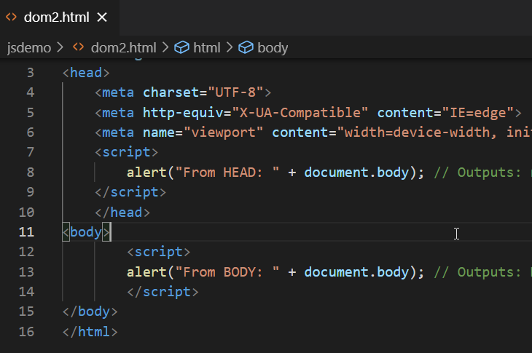

Slide 122
Example#2
<!DOCTYPE html>
<html lang="en">
<head>
<meta charset="UTF-8">
<meta http-equiv="X-UA-Compatible" content="IE=edge">
<meta name="viewport" content="width=device-width, initial-scale=1.0">
<title>Document</title>
</head>

Slide 123
Example#2
<script>
alert("From HEAD: " + document.body); // Outputs: null (since <body> is not parsed yet)
</script>
</head>
<body>
<script>
alert("From BODY: " + document.body); // Outputs: HTMLBodyElement
</script>
</body>
</html>

Slide 124
TOP MOST
The topmost tree nodes are available directly as document properties:
<html> = document.documentElement
The topmost document node is document.documentElement. That’s the DOM node of the <html> tag.

Slide 125
TOP MOST
<body> = document.body
Another widely used DOM node is the <body> element – document.body.
<head> = document.head
The <head> tag is available as document.head.

Slide 126
Travels
ParentNode
ParentElement
FirstChild
Children
ChildNode
FirstElementChild

Slide 127
Travels
lastChild
lastElementChild
previousElementSibling
nextElementSibling
nextSibling
PreviousSibling

Slide 128
<h1>Hello</h1>
<p>
This is first Para Graph
</p>
<ul>
<li>Ahmedabad</li>
<li>Mumbai</li>
</ul>
<h3>Developed by </h3>
<script>

Slide 129
alert( "From BODY: " + document.body );
alert( "From document Element: " + document.documentElement);
alert( "From Head: " + document.head);
let nodename1=document.body.nodeName;
alert(nodename1);
let nodename2=document.body.firstElementChild.nodeName;
alert(nodename2);
let nodename3=document.body.lastElementChild.nodeName;
alert(nodename3);

Slide 130
let nodename4=document.body.firstElementChild.nextElementSibling
.nodeName;
alert(nodename4);
let lang= document.documentElement.getAttribute("lang");
let nodename=document.head.firstElementChild.nodeName;
alert(lang);
alert(nodename);

Slide 131
Example 2
<ul>
<li>Mumbai</li>
<li>Delhi</li>
<li>Pune</li>
</ul>
<script>
let nodename2=document.body.firstElementChild.nodeName;
alert(nodename2);
let cnt = document.body.firstElementChild.childElementCount;
alert(cnt);
</script>

Slide 132
Example 3
<ul><li>Mumbai</li><li>Delhi</li><li>Pune</li></ul>

Slide 133
Example 3
<script>
let nodename2=document.body.firstElementChild.nodeName;
alert(nodename2);
let cnt = document.body.firstElementChild.childElementCount;
alert(cnt);

Slide 134
Example 3
var ulnode =document.body.firstElementChild;
alert(ulnode.childElementCount);
for (var i = 0; i < ulnode.childElementCount; i++) {
alert(ulnode.childNodes[i].nodeName);
}

Slide 135
Example 3
for (var i = 0; i < ulnode.childElementCount; i++) {
alert(ulnode.childNodes[i].innerHTML);
}
</script>

Slide 136
Display All
<h1>Hello</h1>
<p>
This is first Para Graph
</p>
<ul>
<li>Ahmedabad</li>
<li>Mumbai</li>
</ul>
<h3>Developed by </h3>

Slide 137
Display All
<script>
for (let node of document.body.childNodes)
{
alert(node);
}
</script>

Slide 138
Display all 2
<body>
<h1>Hello</h1>
<p>
This is first Para Graph
</p>
<ul>
<li>Ahmedabad</li>
<li>Mumbai</li>
</ul>
<h3>Developed by </h3>

Slide 139
Display all 2
<script>
for (let elem of document.body.children) {
alert(elem); }
</script>
</body>

Slide 140
Display all 2
<script>
for (let elem of document.body.children) {
alert(elem.innerHTML);
}
</script>

Slide 141
Example of Table
<table id="table">
<tr>
<td>Ahmedabad</td><td>Baroda</td><td>Surat</td>
</tr>
<tr>
<td>Mumbai</td><td>Pune</td>
</tr>
</table>

Slide 142
Example of Table
<script>
let td = table.rows[0].cells[1];
td.style.backgroundColor = "red"; // highlight it
let data=td.innerHTML;
alert(data);
td.innerHTML="Delhi";
</script>

Slide 143
Methods
Action that Perform on Html elements
getElementByID()
getElementsByName()
getElement ByTagName()
getElementsByClassName()
querySelector()
querySelectorAll()

Slide 144
getElementById()
<p id="mark">This is a paragraph of text.</p>
<p>This is another paragraph of text.</p>
<script>
var match = document.getElementById("mark");
match.style.background = "yellow";
</script>

Slide 145
var elem = document.getElementById("intro");
// Appling styles on element
elem.style.color = "blue";
elem.style.fontSize = "18px";
elem.style.fontWeight = "bold";

Slide 146
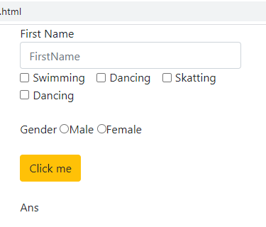
getElementsByName()

Slide 147
getElementsByName()
var x = document.getElementsByName("inlineCheckbox");
var i;
for (i = 0; i < x.length; i++) {
if (x[i].type == "checkbox") {
x[i].checked = true;
alert(x[i].value);
}
}

Slide 148
getElementsByName()
var y = document.getElementsByName("txtFirstName");
alert(y.length);
alert(y[0].type);
alert(y[0].value);

Slide 149
getElementsByName()
var gender = document.getElementsByName("gender");
alert(gender.length);
alert(gender[0].type);
alert(gender[0].value);
alert(gender[1].type);
alert(gender[1].value);
alert(gender[0].checked + " - " + gender[1].checked);

Slide 150
getElement ByTagName()
<body>
<p>Accessed by Tag1</p>
<p>Accessed by Tag2</p>
<script>
getByTag = document.getElementsByTagName("p");
alert(getByTag);
for (i = 0; i <getByTag.length; i++) {
var str=getByTag[i].innerHTML;
alert(str);
}
</script>
</body>

Slide 151
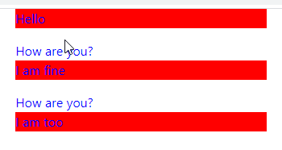
getElement ByTagName()

Slide 152
getElement ByTagName()
var x = document.getElementsByTagName("P");
var i;
for (i = 0; i < x.length; i++) {
x[i].style.backgroundColor = "red";
var str=x[i].innerHTML;
alert(str);
}

Slide 153
getElement ByTagName()
var x = document.getElementsByTagName("div");
var i;
for (i = 0; i < x.length; i++) {
x[i].style.color = "blue";
var str=x[i].innerHTML;
}

Slide 154
getElement ByTagName()
<div class="container w-25 p3">
<form name="frm1">
<p>Hello</p>
<div>How are you?</div>
<p>I am fine</p>
<div>How are you?</div>
<p>I am too</p>
</form>
</div>

Slide 155
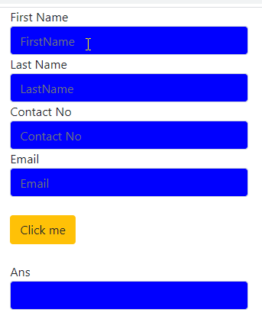
getElementsByClassName()

Slide 156
getElementsByClassName()
var x= document.getElementsByClassName("form-control");
var i;
for (i = 0; i < x.length; i++) {
x[i].style.backgroundColor = "blue";
}

Slide 157
getElementsByClassName()
<div class="container w-25 p3">
<form name="frm1">
<div class="form-row">
<div class="col">
First Name <input type="text" name="txtFirstName" id="txtFirstName" class="form-control" placeholder="FirstName"/>
Last Name <input type="text" name="txtLastName" id="txtLastName" class="form-control" placeholder="LastName"/>
</div>
</div>
<div class="form-row">
<div class="col">
Contact No <input type="text" name="txtContactNo" id="txtContactNo" name="txtContactNo" class="form-control" placeholder="Contact No"/>
Email <input type="text" id="txtEmail" name="txtEmail" name="txtEmail" class="form-control" placeholder="Email"/>
</div>
</div>
<br/>
<div class="form-row">
<div class="col">
<button type="button" value="Add" class="btn btn-warning" name="btnans" id="btnans" onclick="hdemo();">Click me </button>
</div>
</div>

Slide 158
getElementsByClassName()
<br/>
<div class="form-row">
<div class="col">
Ans <span class="form-control" id="divanswer"></span>
</div>
</div>
</form>
</div>

Slide 159
querySelector()
The querySelector() is a method of the Element interface. The querySelector() allows you to find the first element that matches one or more CSS selectors.

Slide 160
querySelectorAll()
The querySelectorAll() method returns a static NodeList of elements that match the CSS selector. If no element found, it returns an empty NodeList.

Slide 161
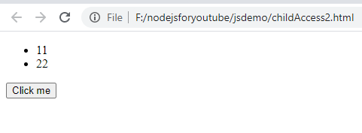
querySelectorAll()

Slide 162
querySelectorAll()
<body>
<script>
const hdemo=()=>{
let a=document.querySelectorAll("li")[0].innerHTML;
let b=document.querySelectorAll("li")[1].innerHTML;
document.writeln(a);
document.writeln(b);
document.writeln(parseInt(a) + parseInt(b));
}
</script>

Slide 163
querySelectorAll()
<ul id="menu">
<li>11</li>
<li>22</li>
</ul>
<button type="button" value="Add" class="btn btn-warning" name="btnans" id="btnans" onclick="hdemo();">Click me </button>
</body>

Slide 164
Self study

Slide 165
Setting and Getting Styles

Slide 166
var elem = document.getElementById("intro");
// Appling styles on element
elem.style.color = "blue";
elem.style.fontSize = "18px";
elem.style.fontWeight = "bold";

Slide 167
Setting and Getting Styles
<style>
.highlight {
background: yellow;
}
</style>
</head>

Slide 168
Setting and Getting Styles
<body>
<div id="info" class="disabled">Something very important!</div>
<script>
// Selecting element
var elem = document.getElementById("info");
elem.className = " highlight"; // Add a new class highlight
</script>
</body>

Slide 169
Setting and Getting Styles Example
var elem = document.getElementById("info");
elem.classList.add("hide"); elem.classList.add("note", "highlight"); elem.classList.remove("hide"); elem.classList.remove("disabled", "note"); elem.classList.toggle("visible");
if(elem.classList.contains("highlight")) { alert("The specified class exists on the element."); }

Slide 170
getAttributes() , setAttributes(), removeAttribute() , has Attribute()

Slide 171
Working with Attributes
getAttribute() – get new attribute
setAttribute() – set the new attribute
removeAttribute() – removes the attribute
hasAttribute() – check if an element has a specified attribute or not.

Slide 172
List of Attributes
<table id="tblid" border="2" cellspacing="2" cellpadding="2">
<tr>
<td>Hello</td>
</tr>
</table>

Slide 173
List of Attributes
<button id="btnDemo" onclick="hihello();">Click me</button>
<script>
const hihello=()=>{
let tbl = document.getElementById("tblid");
for(let attr of tbl.attributes) {
document.writeln("<br>" + attr.name +" - "+ attr.value);
}
}
</script>

Slide 174
<body>
<a href="https://www.google.com/" target="_blank" id="myLink">Google</a>
<script>
// Selecting the element by ID attribute
var link = document.getElementById("myLink");
// Getting the attributes values
var href = link.getAttribute("href");
alert(href); // Outputs: https://www.google.com/
var target = link.getAttribute("target");
alert(target); // Outputs: _blank
</script>
</body>

Slide 175
<button type="button" id="myBtn">Click Me</button>
<script>
// Selecting the element
var btn = document.getElementById("myBtn");
// Setting new attributes
btn.setAttribute("class", "click-btn");
btn.setAttribute("disabled", "");
</script>

Slide 176
<a href="#" id="myLink">Shyam sir</a>
<script>
// Selecting the element
var link = document.getElementById("myLink");
// Changing the href attribute value
link.setAttribute("href", "https://www.shyamsir.com");
link.setAttribute(“class”,”abc”);
document.getElementById("divData").attributes[1].value="1";
</script>

Slide 177
<a href="https://www.google.com/" id="myLink">Google</a>
<script>
// Selecting the element
var link = document.getElementById("myLink");
// Removing the href attribute
link.removeAttribute("href");
</script>

Slide 178
Traversing elements
Get the parent element – get the parent node of an element.
Get child elements – get children of an element.
Get siblings of an element – get siblings of an element.

Slide 179
Get the parent element
<div id="main">
<p class="note">This is a note!</p>
</div>
<script>
let note = document.querySelector('.note');
document.writeln(note.parentNode);
document.writeln("<br>") ;
document.writeln(note.parentNode.getAttribute("id"));
</script>

Slide 180
Example#2 Get the parent element
<ul id="menu">
<li class="first">Home</li>
<li>Products</li>
<li class="current">Customer Support</li>
<li>Careers</li>
<li>Investors</li>
<li>News</li>
<li class="last" id="lastIddd">About Us</li>
</ul>
<button type="button" value="Add" class="btn btn-warning" name="btnans" id="btnans" onclick="hdemo();">Click me </button>

Slide 181
Get the parent element
<script>
const hdemo=()=>{
let content = document.getElementById('menu');
let firstChild = content.firstChild.nodeName;
//let lastChild = content.lastElementChild;
let lastChild = content.lastElementChild.nodeName;
let lastChildId = content.lastElementChild.getAttribute("id");
let lastChildText = content.lastElementChild.innerHTML;

Slide 182
Get the parent element
//console.log(firstChild);
document.writeln(firstChild);
document.writeln(lastChild);
document.writeln(lastChildId);
document.writeln(lastChildId);
document.writeln(lastChildText);
}
</script>

Slide 183
Get First and Second Element

Slide 184
Get First and Second Element
createElement() – create a new element.
appendChild() – append a node to a list of child nodes of a specified parent node.
textContent – get and set the text content of a node.
innerHTML – get and set the HTML content of an element.
innerHTML vs. createElement – explain the differences beetween innerHTML and createElement when it comes to creating new elements.

Slide 185
appendChild()
<div id="divTemp">
</div>
<ul id="myList">
<li>Coffee</li>
<li>Tea</li>
</ul>
<button onclick="myFunction3()">Try it List</button>
<button onclick="myFunction2()">Try it Div Tag</button>
<button onclick="myFunction4()">Try it Div Tag2</button>
<button onclick="myFunction5()">Try it Div Tag3</button>

Slide 186
appendChild()
<script>
function myFunction2() {
let div = document.createElement('div');
div.id = 'content';
div.innerHTML = '<p>CreateElement example</p>';
document.body.appendChild(div);
}

Slide 187
appendChild()
function myFunction4() {
let div2 = document.createElement('div2');
div2.id = 'contentInside';
div2.innerHTML = '<p>I am inner one tag</p>';
document.getElementById("divTemp").appendChild(div2);
}

Slide 188
appendChild()
function myFunction3() {
var node = document.createElement("LI");
var value=prompt("Enter value =>");
var textnode = document.createTextNode(value);
node.appendChild(textnode);
document.getElementById("myList").appendChild(node);
}

Slide 189
appendChild()
function myFunction5()
{
let div = document.createElement('div');
div.id = 'contentnew';
let h2 = document.createElement('h2');
h2.textContent = 'Add h2 element to the div';
div.appendChild(h2);
document.body.appendChild(div);
}
</script>

Slide 190

Assign Events Using the HTML DOM

Slide 191
Let’s create two file 1.html and 1.js
style>
.a {color:red;}
</style>
<body>
<div id="header" class="a">
<h1>Header here</h1>
</div>
</body>
<script src="j16header1.js"></script>

Slide 192
Let’s create two file 1.html and 1.js
document.getElementById("header").onclick=changeCss;
function changeCss()
{
document.getElementById("header").style.color="green";
}

Slide 193
Event listener
Don’t write Onclick , just write “click”

Slide 194
Event listener – we can write like this way also
document.getElementById("header").addEventListener("click",function(){
document.getElementById("header").style.border="solid 10px red";
});

Slide 195
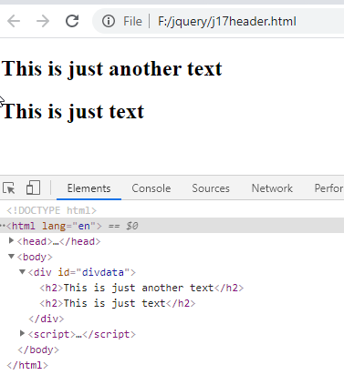
createElement createTextNode
<div id="divdata">
</div>

Slide 196
createElement createTextNode
<script>
let newElement = document.createElement("h2");
let newText=document.createTextNode("This is just text");
newElement.appendChild(newText);
document.getElementById("divdata").appendChild(newElement);
let newElement2 = document.createElement("h2");
let newText2=document.createTextNode("This is just another text");
newElement2.appendChild(newText2);
let target= document.getElementById("divdata")
document.getElementById("divdata").insertBefore(newElement2,target.childNodes[0]);
</script>

Slide 197
Location Object
console.log(location.hostname);
console.log(location.href);
console.log(location.search);

Slide 198
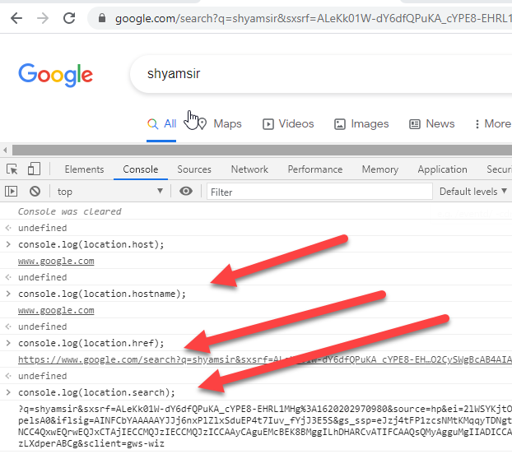
Location Object

Slide 199
History Object
history.length how many pages u accessed?
history.back();
history.forward();
history.go(2);

Slide 200
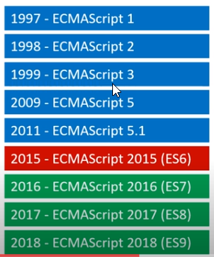
New Versions

Slide 201
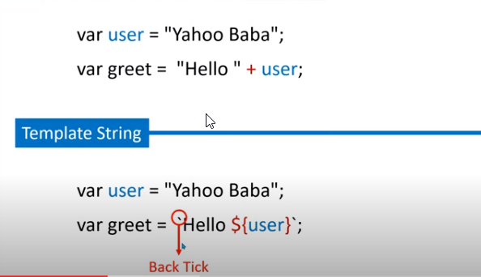
Template String or Template Literals

Slide 202
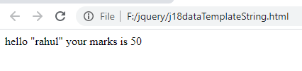
Template String or Template Literals
<script>
let studentname="rahul";
let marks=50;
let mix=`hello "${studentname}" your marks is ${marks}`;
document.write(mix);
</script>

Slide 203
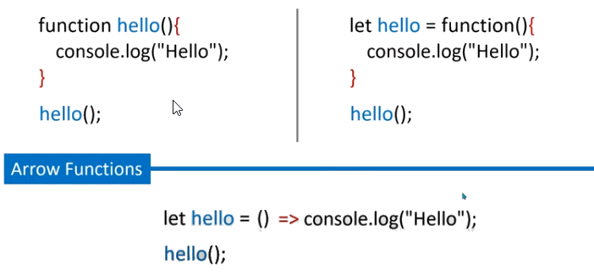
Arrow Function

Slide 204
Arrow Function
<script>
let welcome=(firstName,lastName)=>{
document.writeln(`categoryName: ${firstName}\ncategoryElements: ${lastName} `)
}
welcome('Ram','Shah’);
</script>

Slide 205
Arrow Function
<script>
let welcome=(firstName,lastName)=>`Welcome categoryName: ${firstName}\ncategoryElements: ${lastName} `;
document.writeln(welcome('Ram','Shah'));
</script>

Slide 206
Functions with Multiple Arguments
<script>
function sum()
{
let total=0;
for (let x in arguments)
{
total+=arguments[x];
}
document.writeln(total +"<br>");
}
sum(11,22,33);
sum(1,2,3,4,5);
</script>

Slide 207
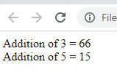
Functions with Multiple Arguments
<script>
function sum(name,...args)
{
let total=0;
for (let x in args)
{
total+=args[x];
}
document.writeln(name + " = " + total +"<br>");
}
sum("Addition of 3 " ,11,22,33);
sum("Addition of 5 " ,1,2,3,4,5);
</script>

Slide 208

Functions with Multiple Arguments
<script>
function sum(name,course,...args)
{
let total=0;
for (let x in args)
{
total+=args[x];
}
document.writeln(name + " is doing " + course+ " and total is " + total +"<br>");
}
sum("Ram","CE",11,22,33);
sum("Maurya","IT",1,2,3);
</script>

Slide 209

Object Literal
<script>
let name="Krish";
let subject="Js";
var obj={
name:name,
subject:subject,
};
document.writeln(obj.name+" " + obj.subject);
</script>

Slide 210
Object Literal
<script>
let name="Krish";
let subject="Js";
var obj={
name,
subject,
};
document.writeln(obj.name+" " + obj.subject);
</script>

Slide 211
Object Literal
<script>
let n="name";
var obj={
[n]:"shyam",
["last"+n]:"shah",
course:"BE",
};
document.writeln(obj.name+" " + obj.lastname + " " + obj.course);
</script>

Slide 212
Destructuring Array
<script>
let student=["Akash",22,"Mumbai",["Male",26000]];
let [name,age,city,[gender,salary]]=student;
document.writeln(name);
document.writeln(age);
document.writeln(city);
document.writeln(gender);
document.writeln(salary);
</script>

Slide 213
Destructuring Array
<script>
let user=["Kunal",22,"Mumbai"];
let [name,...args]=user;
document.write(name +"<Br>");
document.write(args);
</script>

Slide 214
Destructuring Object
let student={
name:"Kunal",
age:25,
city:"mumbai"
}
let {name,age,city}=student
document.writeln(name);
document.writeln(age);
document.writeln(city);

Slide 215
Destructuring Object
<script>
let student={
name:"Kunal",
age:25,
city:"mumbai"
}
let {name:n,age:a,city:c}=student
document.writeln(n);
document.writeln(a);
document.writeln(c);
</script>

Slide 216
Object Oriented Concepts

Slide 217
Object Oriented Concepts
<script>
class student{
constructor(name,age){
this.name=name;
this.age=age;
}
printdata(){
document.writeln(`hello ${this.name} your marks is ${this.age}`);
}
}
let s1=new student("ram",32);
s1.printdata();
</script>

Slide 218
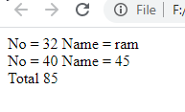
Inheritance
<script>
class student{
constructor(name,no){
this.name=name;
this.no=no;
}
printstudent(){
document.writeln(`No = ${this.no} Name = ${this.name} <br>`);
}
}

Slide 219
Inheritance
class marks extends student{
constructor(name,no,english,hindi){
super(name,no)
this.english=english;
this.hindi=hindi;
}
printmarks(){
document.writeln(`No = ${this.english} Name = ${this.hindi} <br>`);
}
}

Slide 220
Inheritance
class result extends marks{
constructor(name,no,english,hindi){
super(name,no,english,hindi)
this.result=0;
}
printresult(){
this.total=this.hindi+ this.english;
document.writeln(`Total = ${this.total} <br>`);
}
}

Slide 221
Inheritance
let r1=new result("ram",32,40,45);
r1.printstudent();
r1.printmarks();
r1.printresult();
</script>

Slide 222
Getter Setter
class Car { constructor(brand) { this._carname = brand; } get carname() { return this._carname; } set carname(x) { this._carname = x; } } let myCar = new Car("Ford"); myCar.carname = "Volvo"; document.getElementById("demo").innerHTML = myCar.carname;

Slide 223
Live Server and Module

Slide 224
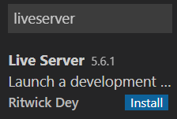
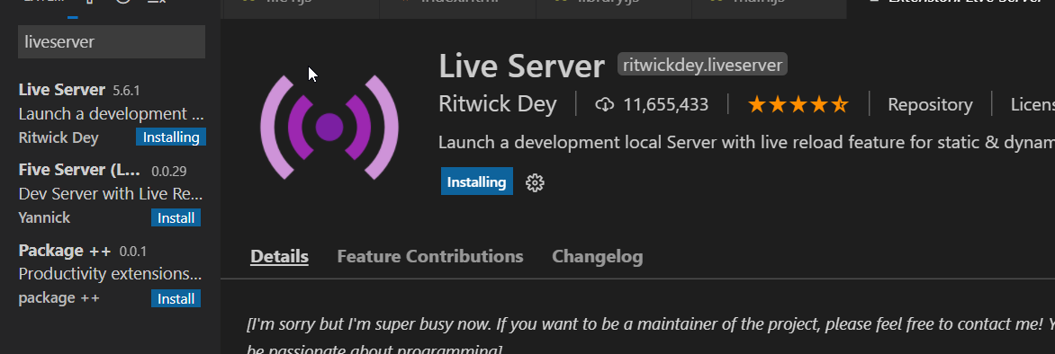
Modules Live Server
Install and restart

Slide 225
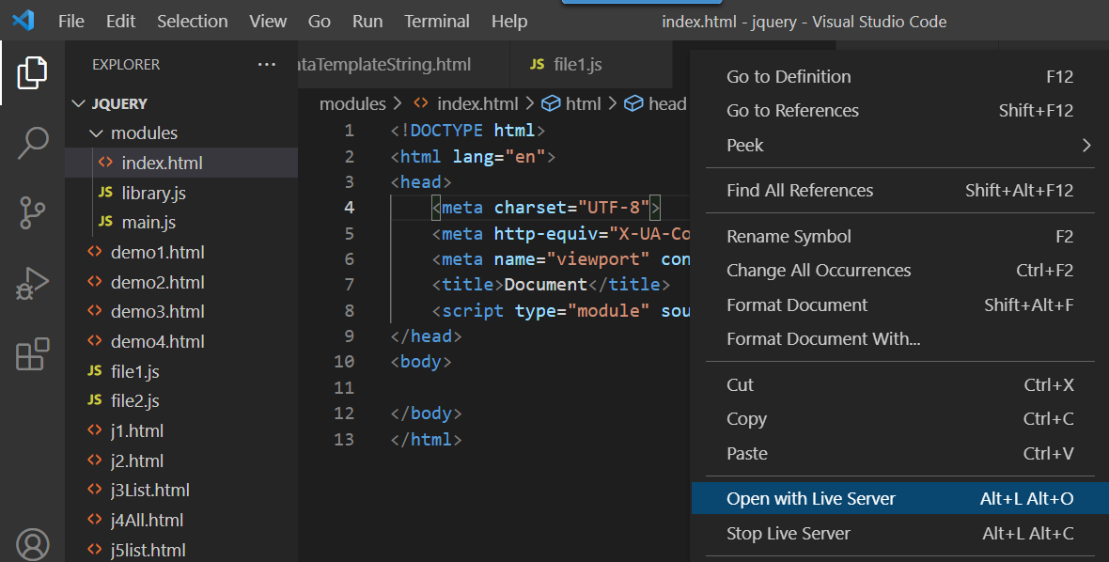

Slide 226
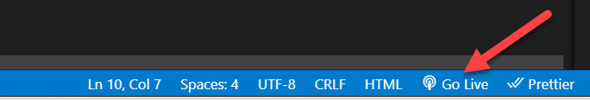

Slide 227
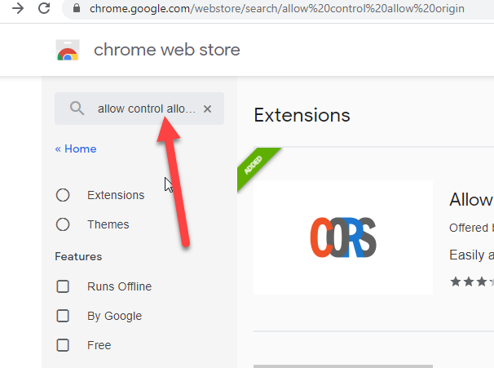
Modules Live Server

Slide 228
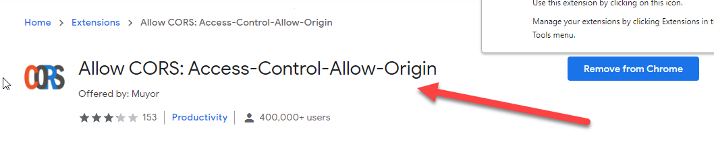
Modules Live Server

Slide 229
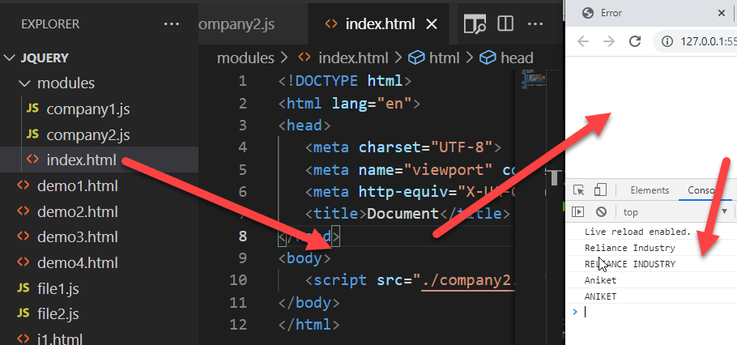
Modules Live Server

Slide 230
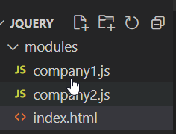
Modules – Create one modules folder and then 3 files (2).js and (1).html

Slide 231
Company1.js
let company = "Reliance Industry"
let getCompany = function(){
return company.toUpperCase()
}
let setCompany = function(newValue){
company = newValue
}
export {company,getCompany,setCompany}

Slide 232
Company2.js
import {company,getCompany,setCompany} from './company1.js'
console.log(company)
console.log(getCompany())
setCompany("Aniket")
console.log(company)
console.log(getCompany())

Slide 233
Index.html
<!DOCTYPE html>
<html lang="en">
<head>
<meta charset="UTF-8">
<meta name="viewport" content="width=device-width, initial-scale=1.0">
<meta http-equiv="X-UA-Compatible" content="ie=edge">
<title>Document</title>
</head>
<body>
<script src="./company2.js" type="module"></script>
</body>
</html>

Slide 234
Promise

Slide 235
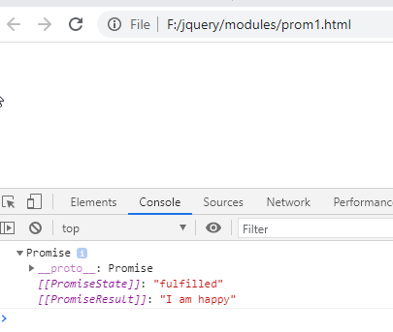
Promise

Slide 236
Promise
<script>
let complete=true;
let prom=new Promise(function(resolve,reject)
{
if(complete){
resolve("I am happy");
}
else
{
reject("I am failed");
}
});
console.log(prom);
</script>

Slide 237
Promise
If we achieve to get the information from the server, the Promise will be resolved successfully.
But if we don’t get the information, then the Promise will be in the rejected state.
Additionally, if there are multiple requests, then after the first Promise is resolved (or rejected), a new process will start to which we can attach it directly by a method called chaining.

Slide 238
Try Catch Throw

Slide 239
Try catch finally
try {
Block of code to try
}
catch(err) {
Block of code to handle errors
}
finally {
Block of code to be executed regardless of the try / catch result
}

Slide 240
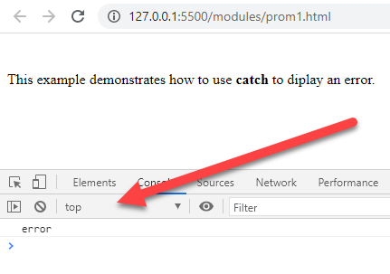
Try Catch

Slide 241
Try Catch
<body>
<p>This example demonstrates how to use <b>catch</b> to diplay an error.</p>
<script>
try {
adddlert("Welcome guest!");
}
catch {
console.log("error");
}
</script>
</body>

Slide 242
The throw Statement
<body>
<p>Please input a number between 5 and 10:</p>
<input id="demo" type="text">
<button type="button" onclick="myFunction()">Test Input</button>
<p id="p01"></p>
<script>
function myFunction() {
var message, x;
message = document.getElementById("p01");
message.innerHTML = "";
x = document.getElementById("demo").value;

Slide 243
The throw Statement
try {
if(x == "") throw "empty";
if(isNaN(x)) throw "not a number";
x = Number(x);
if(x < 5) throw "too low";
if(x > 10) throw "too high";
}
catch(err) {
message.innerHTML = "Input is " + err;
}
} </script></body>

Slide 244
The Error Object
Property | Description
name | Sets or returns an error name
message | Sets or returns an error message (a string)

Slide 245
Error Name Values
Error Name | Description
EvalError | An error has occurred in the eval() function
RangeError | A number "out of range" has occurred
ReferenceError | An illegal reference has occurred
SyntaxError | A syntax error has occurred
TypeError | A type error has occurred
URIError | An error in encodeURI() has occurred

Slide 246
Reference
var x; try { x = y + 1; // y cannot be referenced (used) } catch(err) { document.getElementById("demo").innerHTML = err.name; }

Slide 247
Type
var num = 1; try { num.toUpperCase(); // You cannot convert a number to upper case } catch(err) { document.getElementById("demo").innerHTML = err.name; }

Slide 248
Ajax

Slide 249
Definition
Asynchronous JavaScript and XML
AJAX is the most viable Rich Internet Application (RIA) technology so far.

Slide 250
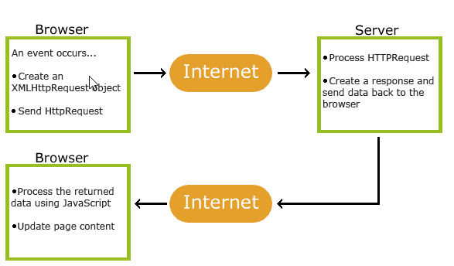
Ajax

Slide 251
Where to use?
JavaScript with AJAX you can able to make background server calls for fetching addition data, Updating some portion in web page without refreshing the whole page.
A good example of this is data validation on save actions.
Drop down list-box based on other inputs, such as state and college list boxes. When the user selects a state, the college list box will repopulate with only colleges and universities in that state.

Slide 252
Definition
“the method of exchanging data with a server, and updating parts of a web page – without reloading the entire page.”
Facebook Like Button

Slide 253
Ajax itself is mostly a generic term for various JavaScript techniques used to connect to a web server dynamically without necessarily loading multiple pages.
In a more narrowly-defined sense, it refers to the use of XmlHttpRequest objects to interact with a web server dynamically via JavaScript.

Slide 254
Call back
Ajax is used to perform a callback, making a quick round trip to and from the server to retrieve and/or save data without posting the entire page back to the server.
By not performing a full postback and sending all form data to the server, network utilization is minimized and quicker operations occur.

Slide 255
Making Asynchronous Calls
Ajax allows you to make asynchronous calls to a web server.
This allows the client browser to avoid waiting for all data to arrive before allowing the user to act once more.

Slide 256
Increased Speed
The main purpose of Ajax is to improve the speed, performance and usability of a web application.
A great example of Ajax is the movie rating feature on Netflix. The user rates a movie and their personal rating for that movie will be saved to their database without waiting for the page to refresh or reload. These movie ratings are being saved to their database without posting the entire page back to the server.

Slide 257
Types
Asynchronized
Asynchronous ajax call allow the next line of code to execute. Shop keeper “Dhyan rakhe badhanu”
Synchronized
Synchronous call stop JavaScript execution until the response from the server. Shop keeper “Turn by turn”

Slide 258
Technologies
AJAX cannot work independently. It is used in combination with other technologies to create interactive webpages.
JavaScript
JavaScript function is called when an event occurs in a page.
DOM
API for accessing and manipulating structured documents.
CSS
Allows for a clear separation of the presentation style from the content and may be changed programmatically by JavaScript
XMLHttpRequest
JavaScript object that performs asynchronous interaction with the server.

Slide 259
Ajax readyState values
0 Request not initialized
1 server connection established
4 request finished and response is ready
2 request received
3 processing request

Slide 260
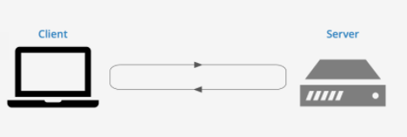
Ajax – Request and Response
Status
200:”OK”
403:”Forbidden”
404:”Not Found”
responseText
or
responseXML

Slide 261
Ajax – HTTPStatus code , other codes are also there
200 – Request , server response proper
403: Server is not responding
404: Not found , Your requested file is missing
4: request finished and response is ready

Slide 262
Ajax - XMLHttpRequest
The XMLHttpRequest object can be used to exchange data with a web server behind the scenes.
This means that it is possible to update parts of a web page, without reloading the whole page.

Slide 263
Ajax - XMLHttpRequest
open(method, url, async)
Specifies the request
method: the request type GET or POST
url: the file location "filename.text"
async: true (asynchronous) or false (synchronous)
send()Sends the request to the server
onreadystatechange
Defines a function to be called when the readyState property changes

Slide 264
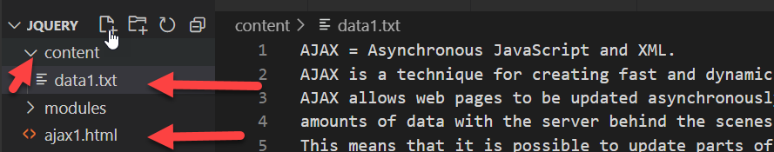
Ajax – Create one Text file in content folder

Slide 265
Ajax – Ajax1.html
<body>
<p id="demo">Here we load data</p>
<button onclick="loadData()">Click</button>
<script>
function loadData(){
var xhttp= new XMLHttpRequest();
xhttp.onreadystatechange= function()
{
if(this.readyState==4 && this.status==200)
{
document.getElementById("demo").innerHTML = this.responseText;
}

Slide 266
Ajax – Ajax1.html
else if(this.readyState==4 && this.status==404)
{
document.getElementById("demo").innerHTML = "Error";
}
};
xhttp.open("GET","content/data1.txt",true);
xhttp.send();
}
</script>
</body>

Slide 267
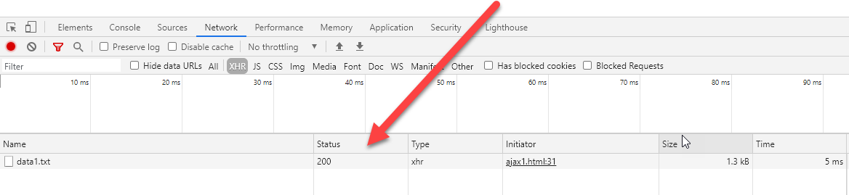
Ajax – Ajax1.html

Slide 268
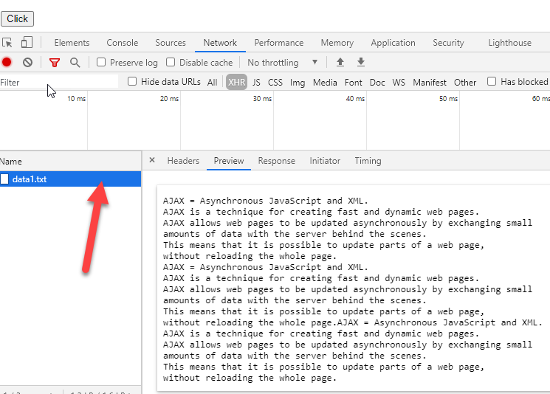
Ajax – Ajax1.html

Slide 269
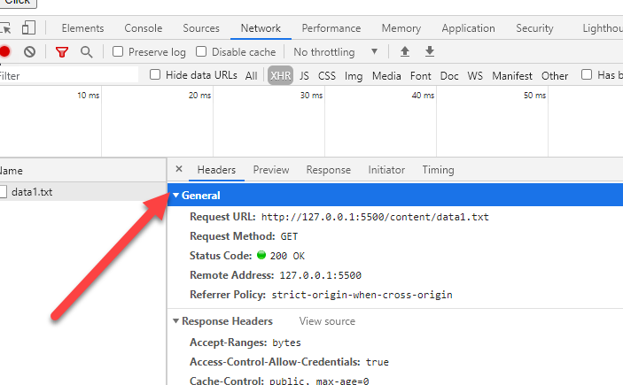
Ajax – Ajax1.html

Slide 270
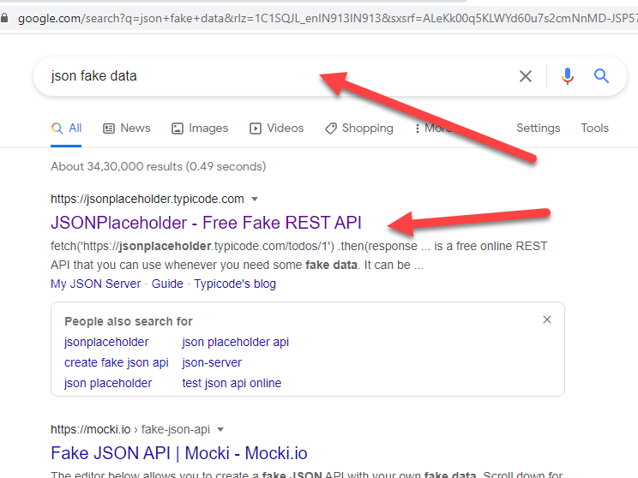
Ajax – Let’s see Json Fake data

Slide 271
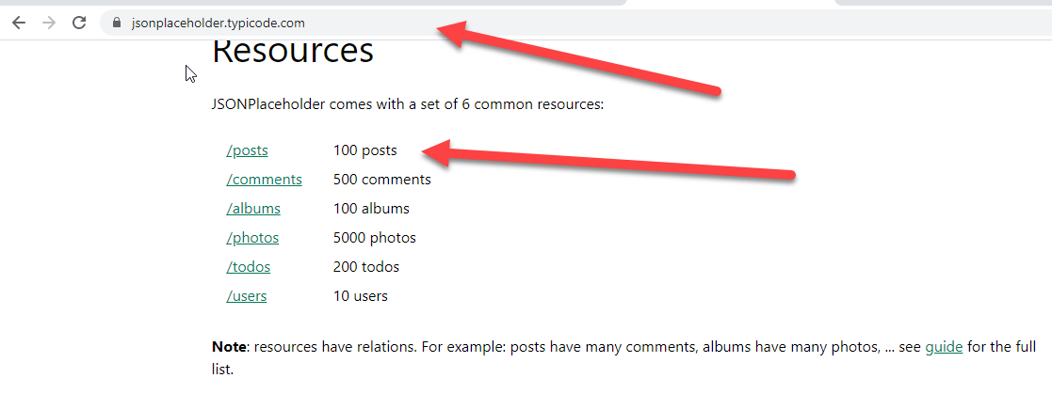
Ajax – Scroll Down

Slide 272
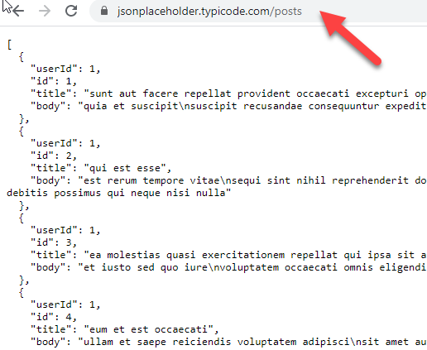
Ajax – See data

Slide 273
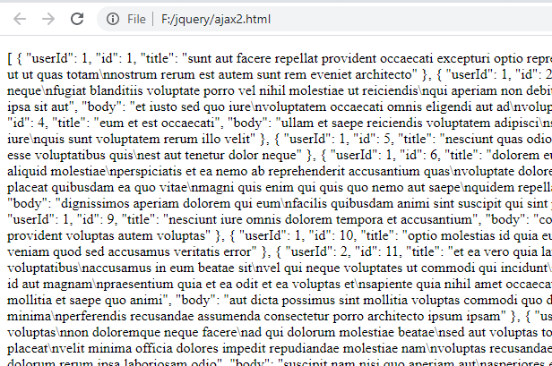
Ajax – See data

Slide 274
Ajax – Just change file path in previous code
xhttp.open("GET","https://jsonplaceholder.typicode.com/posts",true);
xhttp.send();

Slide 275
Ajax – Old Approach
jquery
$.ajax();
$.get();
$.post();
JavaScript
XMLHttpRequest

Slide 276
Ajax – Fetch()
jquery
$.ajax();
$.get();
$.post();
JavaScript
XMLHttpRequest
Old Approached

Slide 277
Ajax – Fetch()
ES6 introduced Fast and Less code
Fetch()
Insert
Update
Read
Delete

Slide 278
Ajax – Fetch()
Fetch();
Fetch(file/URL); promise function
Fetch(file/URL).then(); promise function
Fetch(file/URL).then(function(response

Slide 279
Ajax – Fetch()
Promise Success/Fail / Live server
fetch(file/URL).then(function(response){
return response.data;
}).then(function(result){
console.log(result);
}).catch(function(error){
console.log(error);
});

Slide 280

Ajax – Fetch()
<script>
fetch("content/data1.txt")
.then((response)=>{
console.log(response);
});
</script>

Slide 281

Ajax – Fetch()
<script>
fetch("content/data1.txt")
.then((response)=>{
console.log(response.text());
});
</script>

Slide 282

Ajax – Fetch()

Slide 283
Ajax – Fetch()
<script>
fetch("content/data1.txt")
.then((response)=>{
return response.text();
})
.then((data)=>{
document.write(data);
});
</script>

Slide 284
Ajax – Fetch()
<script>
fetch("content/data1.txt")
.then(response=>response.text())
.then(data=>document.write(data));
</script>

Slide 285


API Application Programming Interface

Slide 286

API Requests in Python

Slide 287

Ajax – Again fake data

Slide 288

Ajax – Again fake data

Slide 289
Ajax – Again fake data
<script>
fetch("https://jsonplaceholder.typicode.com/users")
.then(response=>response.json())
.then(data=>document.write(data));
</script>

Slide 290

Ajax – Again fake data

Slide 291

Ajax – Again fake data , showing error

Slide 292

Ajax – Again fake data

Slide 293
Ajax – Again fake data – data[x].address.city
<script>
fetch("https://jsonplaceholder.typicode.com/users")
.then(response=>response.json())
.then((data)=>{
for(var x in data)
{
document.write(`${data[x].name} - ${data[x].username} <br>`);
}
})
.catch((error) => console.log(error));
</script>

Slide 294

Ajax – Our file student.json

Slide 295

Ajax – Our file student.json

Slide 296
Ajax – Our file student.json
<script>
fetch("content/student.json")
.then(response=>response.json())
.then((data)=>{
for(var x in data)
{
let a=(`${data[x].Rollno} - ${data[x].name} - ${data[x].std} - ${data[x].gender} - ${data[x].Fees} <br>`);
document.write(a);
}
})
.catch((error) => console.log(error));
</script>

Slide 297
Ajax – Covid cases
<script>
fetch('https://api.covid19api.com/summary').then((apidata)=>{
console.log(apidata);
return apidata.json();
}).then((actualdata) =>{
console.log(actualdata);
}).catch((error) =>{
console.log(error);
});
</script>

Slide 298

Ajax – Covid cases

Slide 299
Ajax – Covid cases
<script>
fetch('https://api.covid19api.com/summary').then((apidata)=>{
console.log(apidata);
return apidata.json();
}).then((actualdata) =>{
console.log(actualdata.Countries[76]);
}).catch((error) =>{
console.log(error);
});
</script>

Slide 300

Ajax – Covid cases

Slide 301

Ajax – Covid cases

Slide 302
Ajax – Covid cases
<p>
Country : <span id="data"></span> <br/>
NewConfirmed : <span id="dataNewConfirmed"></span> <br/>
NewDeaths : <span id="dataNewDeaths"></span> <br/>
TotalConfirmed : <span id="dataTotalConfirmed"></span> <br/>
TotalDeaths : <span id="dataTotalDeaths"></span> <br/>
TotalRecovered : <span id="dataTotalRecovered"></span> <br/>
</p>

Slide 303
Ajax – Covid cases
<script>
fetch('https://api.covid19api.com/summary').then((apidata)=>{
console.log(apidata);
return apidata.json();
}).then((actualdata) =>{

Slide 304
Ajax – Covid cases
document.getElementById("data").innerHTML="<b>" + actualdata.Countries[76].Country +"</b>" ;
document.getElementById("dataNewConfirmed").innerHTML="<b>" + actualdata.Countries[76].NewConfirmed +"</b>" ;
document.getElementById("dataNewDeaths").innerHTML="<b>" + actualdata.Countries[76].NewDeaths +"</b>" ;
document.getElementById("dataTotalConfirmed").innerHTML="<b>" + actualdata.Countries[76].TotalConfirmed +"</b>" ;
document.getElementById("dataTotalDeaths").innerHTML="<b>" + actualdata.Countries[76].TotalDeaths +"</b>" ;
document.getElementById("dataTotalRecovered").innerHTML="<b>" + actualdata.Countries[76].TotalRecovered +"</b>" ;
}).catch((error) =>{
console.log(error);
});
</script>

Slide 305
Some API
https://cat-fact.herokuapp.com/facts
https://www.boredapi.com/api/activity
https://official-joke-api.appspot.com/random_joke
https://freegeoip.app/json/
https://mixedanalytics.com/blog/list-actually-free-open-no-auth-needed-apis/

Slide 306

Ajax – Gold Price

Slide 307
Ajax – Gold Price
<script>
var myHeaders = new Headers();
myHeaders.append("x-access-token", "goldapi-1fl7ukoscgezd-io");
myHeaders.append("Content-Type", "application/json");
var requestOptions = {
method: 'GET',
headers: myHeaders,
redirect: 'follow'
};
fetch("https://www.goldapi.io/api/XAU/INR", requestOptions)
.then(response => response.text())
.then(result => console.log(result))
.catch(error => console.log('error', error));
</script>

Slide 308

Ajax – List of Cities

Slide 309
Ajax – List of Cities
<script>
fetch('https://countriesnow.space/api/v0.1/countries/population/cities').then((apidata)=>{
console.log(apidata);
return apidata.json();
}).then((actualdata) =>{
console.log(actualdata);
}).catch((error) =>{
console.log(error);
});
</script>

Slide 310

Ajax – Fetch() Insert , Update , Delete

Slide 311

Ajax – List out Countries

Slide 312
Ajax – List out Countries
<script>
var headers = new Headers();
headers.append("X-CSCAPI-KEY", "cjN3WTNJUjJob0VpUVlvazk1WEg5MFZrNzZGODE4SWI4emp1ekZVVg==");
var requestOptions = {
method: 'GET',
headers: headers,
redirect: 'follow'
};
fetch("https://api.countrystatecity.in/v1/countries", requestOptions)
.then(response => response.text())
.then(result => console.log(result))
.catch(error => console.log('error', error));
</script>

Slide 313

Ajax – Fetch() Insert , Update , Delete

Slide 314

Ajax – Record insert update delete scroll

Slide 315

Ajax – Record insert update delete scroll

Slide 316
Any Question?
www.Shyamsir.com
78 74 39 11 91

