Slide 1


jQuery
www.Shyamsir.com
78 74 39 11 91

Slide 2
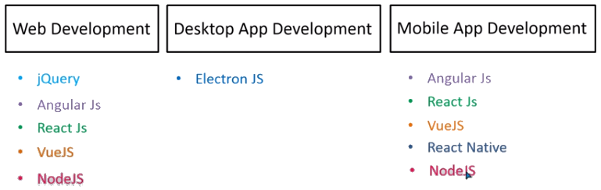

Slide 3
https://jquery.com/
jQuery is a fast, small, and feature-rich JavaScript library.

Slide 4
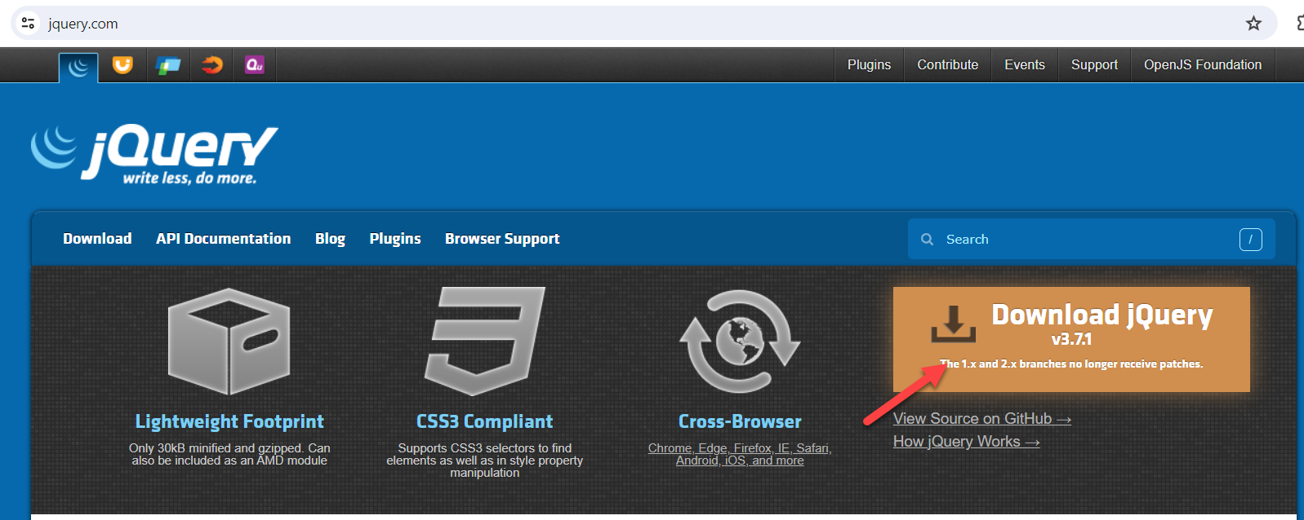

Slide 5
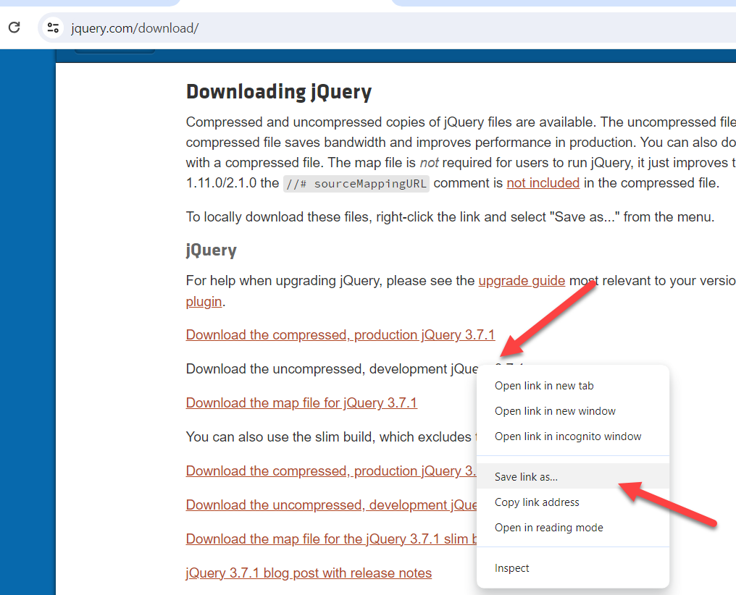

Slide 6
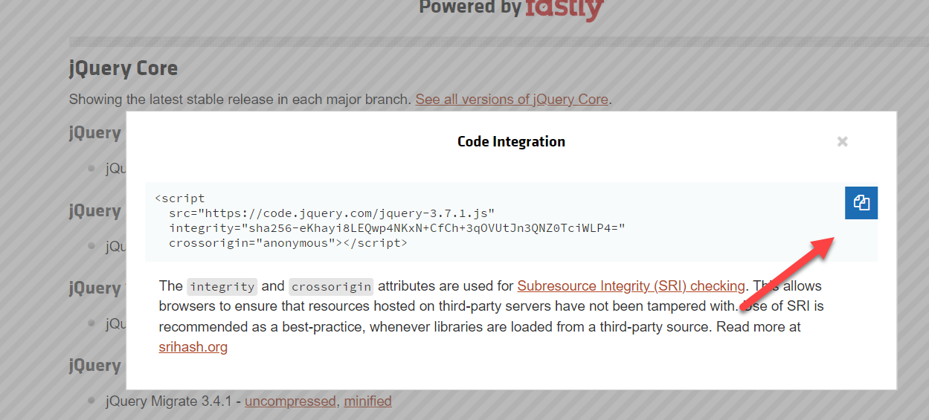

Slide 7
jQuery
$(selector).action()
$(“#test”).hide()
$ sign to define/access jQuery
Selector means html elements
Action() to be performed

Slide 8
<!DOCTYPE html>
<html lang="en">
<head>
<meta charset="UTF-8">
<meta name="viewport" content="width=device-width, initial-scale=1.0">
<title>Document</title>
<script src="https://code.jquery.com/jquery-3.7.1.js" integrity="sha256-eKhayi8LEQwp4NKxN+CfCh+3qOVUtJn3QNZ0TciWLP4=" crossorigin="anonymous"></script>
</head>

Slide 9
<body>
<div id="divdata">
Hello how are u
</div>
<input type="button" id="btnans" value="Click me"/>
</body>
<scirpt>
<script>
$(document).ready(function(){
$("#btnans").click(function(){
let a =$("#divdata").html();
alert(a);
});
});
</script>
</scirpt>
</html>

Slide 10
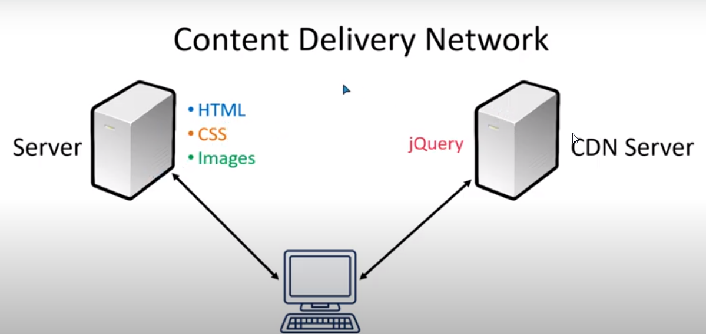

Slide 11
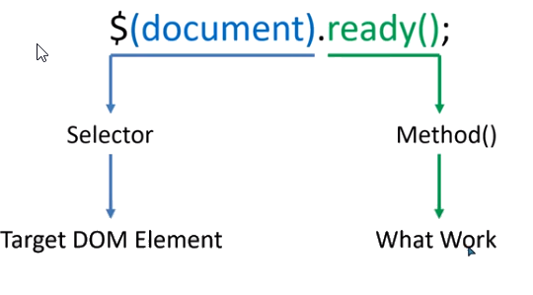
Basic Syntax

Slide 12
Basic Syntax
$(document).ready(function(){
});
$(function(){
));

Slide 13
Click Event
<div id="test">
</div>
<button id="btnAns">Click me</button>
<script>
$(document).ready(function(){
here the logic
});
</script>

Slide 14
Click Event
<div id="test">
Hello How are you?
</div>
<div id="copytest">
</div>
<button id="btnAns">Click me</button>

Slide 15
Click Event
<script>
$(document).ready(function(){
$("#btnAns").click(function(){
let a =$("#test").html();
alert(a);
$("#copytest").text(a);
});
});
</script>

Slide 16
How to Access our Elements?
Class
$('.classname’)
Id
$("#idname")
Tag
$("tagname")

Slide 17
How to Access our Elements?
$("*") - All tags
$("ul li") - All <li> inside <ul>
$(".abc,.xyz") - Class
$("h1,div,p") - Specific
$("p:first") - first
$("p:last") - last
$("li:even") - even
$("li:odd") - odd

Slide 18
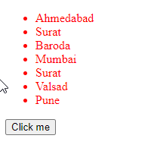
Using tag name
<ul>
<li>Ahmedabad</li>
<li>Surat</li>
<li>Baroda</li>
<li>Mumbai</li>
<li>Surat</li>
<li>Valsad</li>
<li>Pune</li>
</ul>

Slide 19
Using tag name
<button id="btnAns">Click me</button>
<script>
$(document).ready(function(){
$("#btnAns").click(function(){
$("ul").css("color","red");
});
});
</script>

Slide 20
Using odd/even
<button id="btnAns">Click me</button>
<script>
$(document).ready(function(){
$("#btnAns").click(function(){
$("li:even").css("color","red");
$("li:odd").css("color","green");
});
});
</script>

Slide 21
Using p:first/p:last
<p>
First Paragraph
</p>
<p>
Second Paragraph
</p>
<p>
Third Paragraph
</p>

Slide 22
Using p:first/p:last
<button id="btnAns">Click me</button>
<script>
$(document).ready(function(){
$("#btnAns").click(function(){
$("p:first").css("border","2px solid red"); $("p:last").css("border","3px dotted blue");
});
});
</script>

Slide 23
Using li:eq(2)
<script>
$(document).ready(function(){
$("#btnAns").click(function(){
$("ul li:eq(2)").css("color","red");
});
});
</script>

Slide 24
Using li:gt(3) , li:lt(3)
$("ul li:gt(3)").css("color","red");
$("ul li:lt(3)").css("color","red");

Slide 25
Click/Dblclick Event
<div id="box">
<h1>Test box</h1>
<p>
hi hello how are you?
</p>
</div>

Slide 26
Click/Dblclick/contextmenu Event
<script>
$(document).ready(function(){
$("#box").dblclick(function(){
$("#box").css("background-color","orange");
});
$("#box").click(function(){
$("#box").css("background-color","red");
});

Slide 27
Click/Dblclick/contextmenu Event
$("#box").contextmenu(function(){
$("#box").css("background-color","blue");
});
</script>

Slide 28
Mouseleave/Mouseenter Event
<script>
$(document).ready(function(){
$("#box").mouseleave(function(){
$("#box").css("background-color","red");
});
$("#box").mouseenter(function(){
$("#box").css("background-color","blue");
});
});
</script>

Slide 29
Keyboard Event
Keypress keyup keydown

Slide 30
Form Event
focus()
blur()
change()
select()
submit()

Slide 31
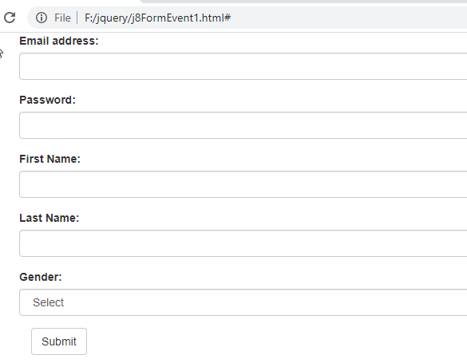

Slide 32
Form Event
$(".form-control").focus(function(){
$(this).css("background-color","lime");
});
$(".form-control").blur(function(){
$(this).css("background-color","white");
});
$("#Gender").change(function(){
let a=$(this).val();
$("#Genderdisplay").html(a);
});

Slide 33
Form Event
$("#firstname,#lastname").select(function(){
$(this).css("background-color","yellow");
});

Slide 34
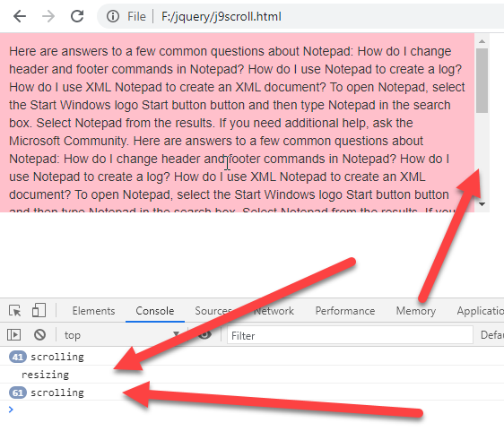
Scrolling Resizing

Slide 35
Scrolling Resizing
<style>
#box{
width:40%;
height:200px;
background:pink;
padding:10px;
border:1 px solid #000;
overflow:auto;
}
</style>
<div id="box">
Here are answers to a few common questions about Notepad:
How do I change header and footer commands in Notepad?.....
</div>

Slide 36
Scrolling Resizing
<script>
$(document).ready(function(){
$("#box").scroll(function(){
console.log("scrolling");
});
$(window).resize(function(){
console.log("resizing");
});
});
</script>

Slide 37
Get Methods()
text()
html()
attr()
val()

Slide 38
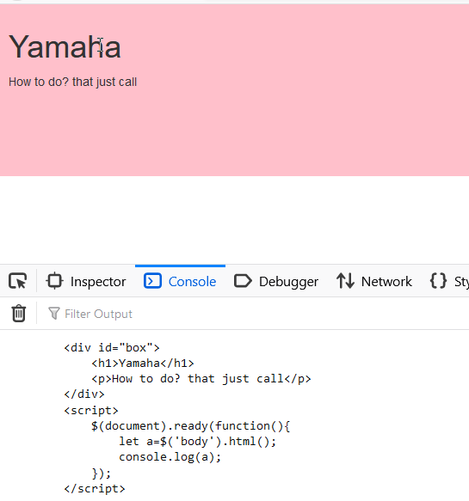
Get Methods() html()

Slide 39
Get Methods() html()
<body>
<div id="box">
<h1>Yamaha</h1>
<p>How to do? that just call</p>
</div>
<script>
$(document).ready(function(){
let a=$('body').html();
console.log(a);
});
</script>
</body>
<style>
#box{
width:40%;
height:200px;
background:pink;
padding:10px;
border:1 px solid #000;
}
</style>

Slide 40
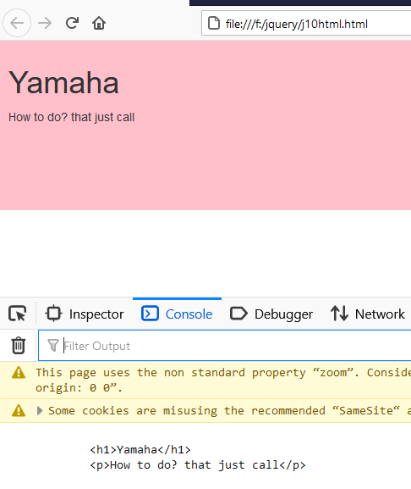
Get Methods() html()

Slide 41
Get Methods() html()
<body>
<div id="box">
<h1>Yamaha</h1>
<p>How to do? that just call</p>
</div>
<script>
$(document).ready(function(){
let a=$(‘#box').html();
console.log(a);
});
</script>
</body>
<style>
#box{
width:40%;
height:200px;
background:pink;
padding:10px;
border:1 px solid #000;
}
</style>

Slide 42
Get Methods() html()
<body>
<div id="box">
<h1>Yamaha</h1>
<p>How to do? that just call</p>
</div>
<script>
$(document).ready(function(){
let a=$(‘#box p').html();
console.log(a);
});
</script>
</body>

Slide 43
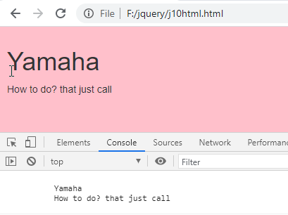
Get Methods() text()

Slide 44
Get Methods() text()
<div id="box">
<h1>Yamaha</h1>
<p>How to do? that just call</p>
</div>
<script>
$(document).ready(function(){
let a=$('#box').text();
console.log(a);
});
</script>

Slide 45
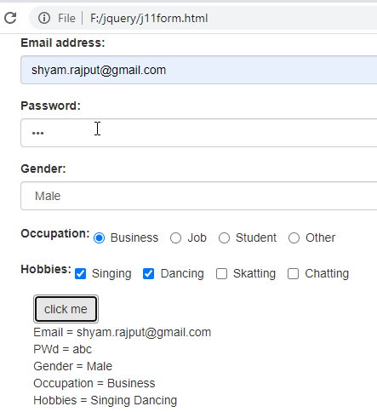
Controls of form

Slide 46
Controls of form
<div class="container">
<form name="frm1" class="form-horizontal" method="post">
<div class="form-group">
<label for="email">Email address:</label>
<input type="email" class="form-control" id="email">
</div>
<div class="form-group">
<label for="pwd">Password:</label>
<input type="password" class="form-control" id="pwd">
</div>

Slide 47
Controls of form
<div class="form-group">
<label for="gender">Gender:</label>
<select class="form-control" id="Gender">
<option>Select</option>
<option>Male</option>
<option>Female</option>
</select>
</div>

Slide 48
Controls of form
<div class="form-group">
<label for="Occupation">Occupation:</label>
<label class="radio-inline"><input type="radio" name="occupation" id="occupation" value="Business"> Business</label>
<label class="radio-inline"><input type="radio" name="occupation" id="occupation" value="Job"> Job</label>
<label class="radio-inline"><input type="radio" name="occupation" id="occupation" value="Student"> Student</label>
<label class="radio-inline"><input type="radio" name="occupation" id="occupation" value="Other"> Other</label>
</div>

Slide 49
Controls of form
<div class="form-group">
<label for="Hobbies">Hobbies:</label>
<label class="checkbox-inline"><input type="checkbox" name="hobbies" value="Singing"> Singing</label>
<label class="checkbox-inline"><input type="checkbox" name="hobbies" value="Dancing"> Dancing </label>
<label class="checkbox-inline"><input type="checkbox" name="hobbies" value="Skatting"> Skatting</label>
<label class="checkbox-inline"><input type="checkbox" name="hobbies" value="Chatting"> Chatting</label>
</div>

Slide 50
Controls of form
<input type="button" class="btn btn-default" id="btnAns" value="click me">
<div id="Selecteddisplay">
</div>
</form>

Slide 51
<script>
$(document).ready(function(){
$("#btnAns").click(function(){
alert("hi");
let str="";
let email=$('#email').val();
let pwd=$('#pwd').val();
let gender=$('#Gender').val();
let occupation=$("#occupation").val();
str = "Email = " + email +"<br>";
str += "PWd = " + pwd +"<br>";
str += "Gender = " + gender +"<br>";
str += "Occupation = " + occupation +"<br>";

Slide 52
strhobbies="";
$('input:checkbox[name=hobbies]').each(function()
{
if($(this).is(':checked'))
{
strhobbies+=($(this).val()) +" ";
}
});
str+="Hobbies = " + strhobbies;
$('#Selecteddisplay').html(str);
});
});
</script>

Slide 53
Controls of form
Set val()
$(“#txtname”).val(“ram”);

Slide 54
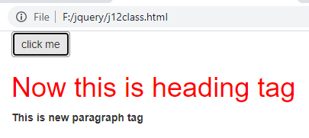
Controls of form

Slide 55
Controls of form
<body>
<div class="container">
<input type="button" class="btn btn-default" id="btnAns" value="click me">
<div id="box">
<h1>Heading tag</h1>
<p>This is paragraph tag</p>
</div>
</div>
<style>
.red
{
color:red;
}
</style>

Slide 56
Controls of form
<script>
$(document).ready(function(){
$("#btnAns").click(function(){
$("#box h1").text("Now this is heading tag");
$("#box h1").attr("class","red");
$("#box p").html("<b>This is new paragraph tag</b>");
});
});
</script>

Slide 57
Add/Remove Classes
<div class="container">
<input type="button" class="btn btn-default" id="btnAdd" value="Add Class">
<input type="button" class="btn btn-default" id="btnRemove" value="Remove Class">
<div id="box">
<h1>Heading tag</h1>
<p>This is paragraph tag</p>
</div>
</div>
<style>
.red
{
color:red;
}
</style>

Slide 58
Add/Remove Classes
<script>
$(document).ready(function(){
$("#btnAdd").click(function(){
$("#box,h1").addClass("red");
});
$("#btnRemove").click(function(){
$("#box,h1").removeClass("red");
});
});
</script>

Slide 59
Toggle Classes
$("#box,h1").toggleClass("red”)

Slide 60
Toggle Classes
Console.log($("#box").hasClass("red”));

Slide 61
css
$("#box,h1").css({“background”:”red”,”color”:”green”,”border”:”5px dotted green”});

Slide 62
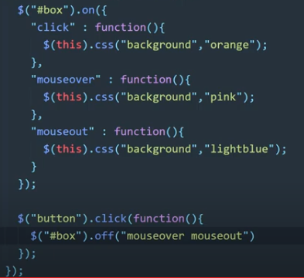
On/Off

Slide 63
Prepend/Append
<div class="container">
<ul>
<li>USA</li>
<li>Canada</li>
</ul>
<input type="button" class="btn btn-default" id="btnAdd" value="AddNewItem">
</div>

Slide 64
Prepend/Append
<script>
$(document).ready(function(){
$("#btnAdd").click(function(){
$("ul").prepend("<li>New Item</li>");
});
});
</script>

Slide 65
Before/After
<script>
$(document).ready(function(){
$("#btnAdd").click(function(){
$("ul").before("<p>New Item</p>");
});
});
</script>

Slide 66
Before/After
<script>
$(document).ready(function(){
$("#btnAdd").click(function(){
$("ul").before("<p>New Item</p>");
});
});
</script>

Slide 67
appendTo / prependTo
<script>
$(document).ready(function(){
$("#btnAdd").click(function(){
$("<p>New Item</p>").appendTo(“#box”);
});
});
</script>

Slide 68
Clone()
<script>
$(document).ready(function(){
$("#btnAdd").click(function(){
$("#box h2").clone().prependTo("#box2");
});
});
</script>

Slide 69
ReplaceWith & ReplaceAll
$("#box p:first").replaceWith("<h3>Wooooooooooo</h3>");
Difference is ReplaceWith can replace text or tag
ReplaceAll only for Tags

Slide 70
Height() Width() innerHeight() innerWidth()
Console.log($("#box").height())

Slide 71
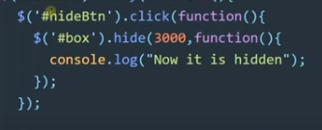
jQuery Effects – click Here

Slide 72
Hide(),show(),toggle()

Slide 73
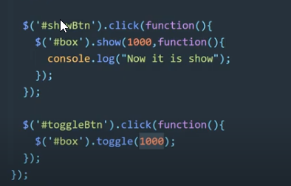
Hide(),show(),toggle()

Slide 74
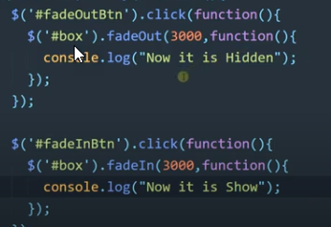
fadeIn / fadeOut / fadeToggle

Slide 75
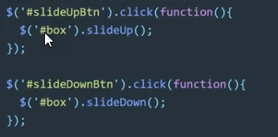
slideUp / slideDown / slideToggle
slideUp()
slideUp(fast) slow
slideUp(3000)

Slide 76
Any Question?
www.Shyamsir.com
78 74 39 11 91

