Slide 1
FleetFlow COMMAND CENTER
FleetFlow
Command Center
An intelligent, real-time fleet management platform
for vehicles · drivers · trips · maintenance · fuel · analytics
9 Modules
6 Vehicles
5 Drivers
Platform Screens
Fleet Registered
Active Profiles
Presented: Saturday, 21 February 2026 · Built for modern logistics fleet operations

Slide 2
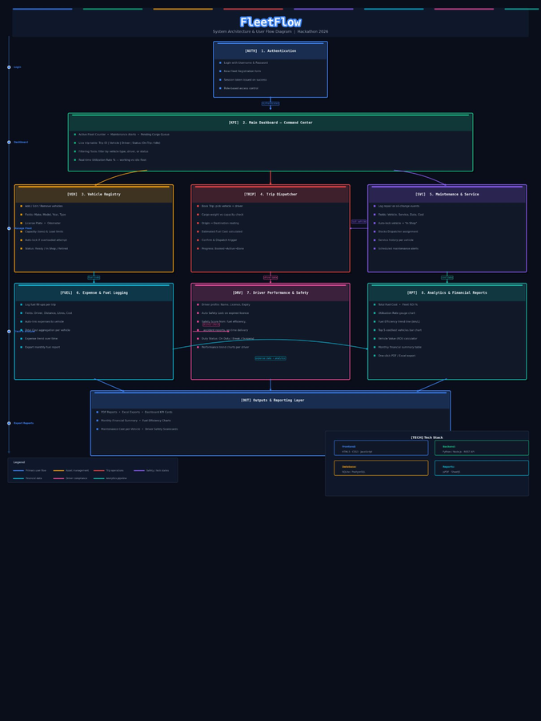
10
🏗 System Architecture Diagram
FleetFlow
FleetFlow — System Architecture & User Flow | Hackathon 2026
COMMAND CENTER
Architecture · FleetFlow Command Center

Slide 3
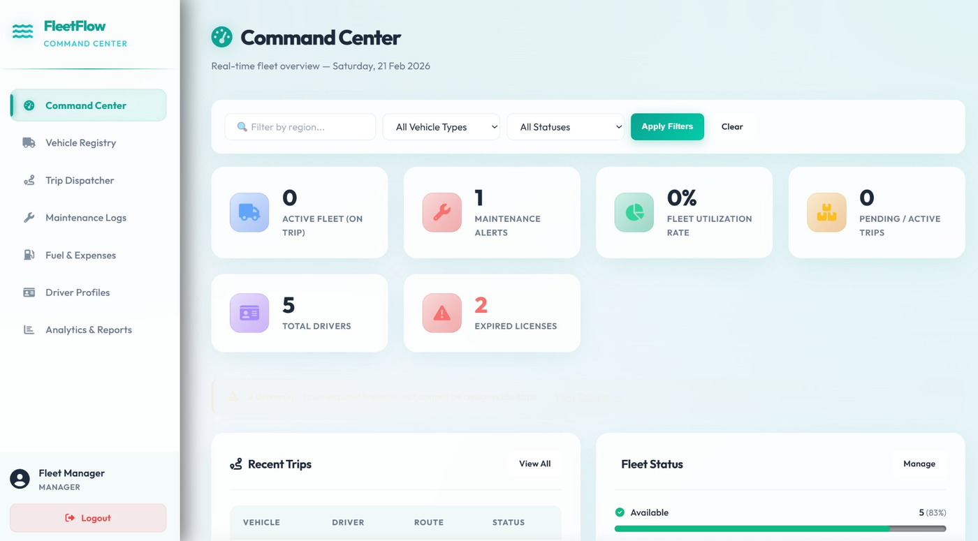
01
🎯 Command Center
FleetFlow
Dashboard — Real-time fleet overview
COMMAND CENTER
📌 Key Points
1
This dashboard provides a real-time overview of fleet operations.
2
It shows active vehicles, maintenance alerts, and fleet utilization.
3
Managers can filter data by region, vehicle type, and status.
4
It helps in quick decision-making by displaying key performance indicators at a glance.
01 / 09 · FleetFlow Command Center

Slide 4
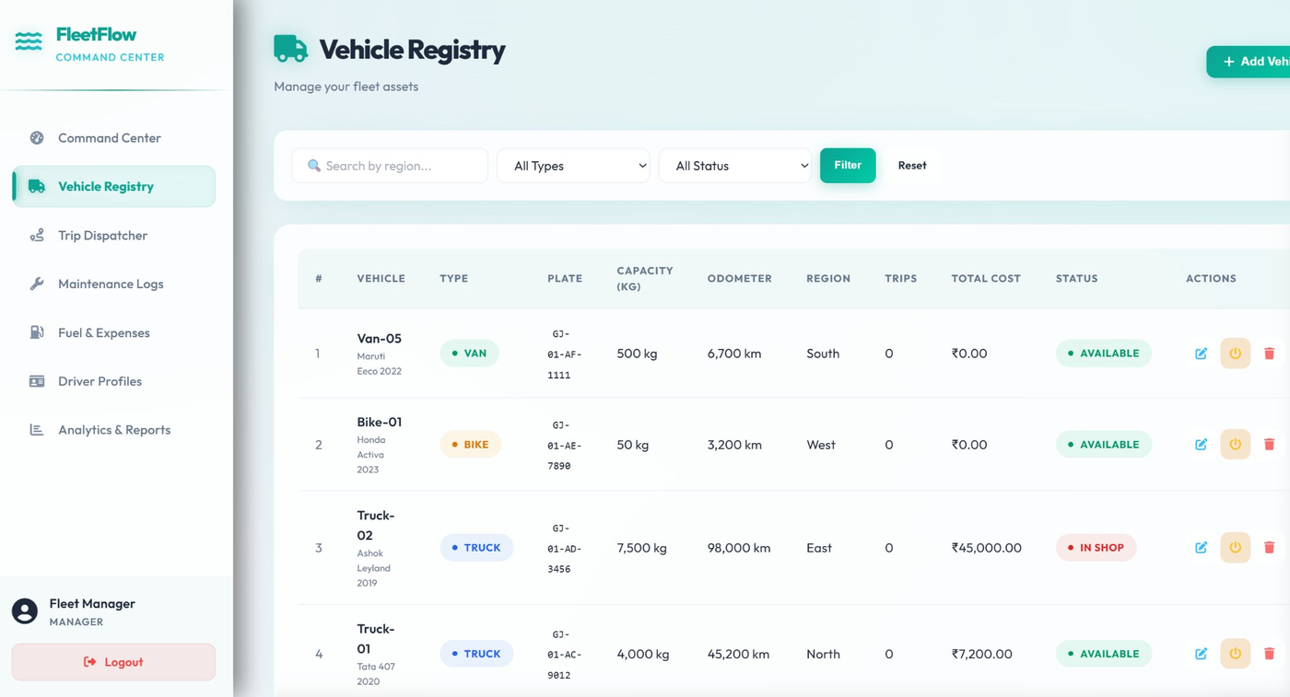
02
🚛 Vehicle Registry
FleetFlow
Manage your fleet assets
COMMAND CENTER
📌 Key Points
1
This section stores complete details of all fleet vehicles.
2
Users can add, edit, or delete vehicle records.
3
Vehicle status (Available / In Shop) is updated here.
4
Total operational cost and usage data are tracked for each vehicle.
02 / 09 · FleetFlow Command Center

Slide 5
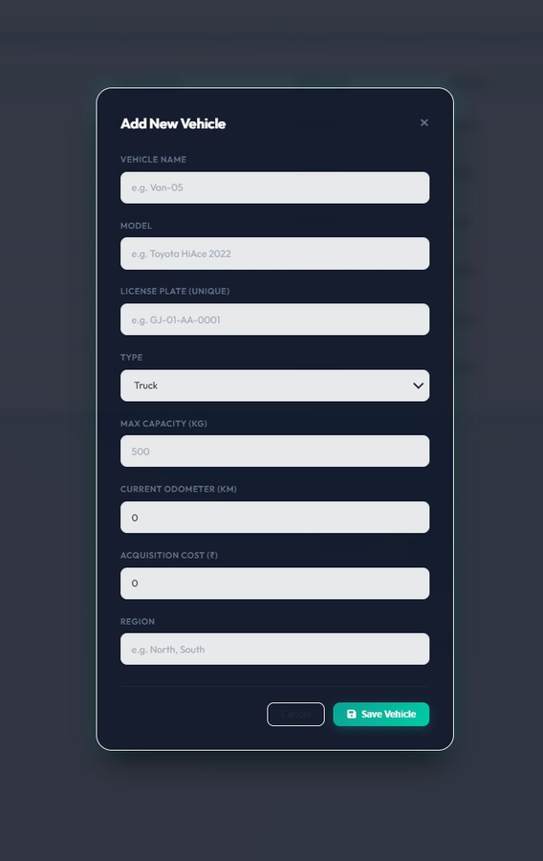
03
➕ Add New Vehicle Form
FleetFlow
Register a new vehicle in the system
COMMAND CENTER
📌 Key Points
1
This form is used to register a new vehicle in the system.
2
Unique license plate ensures proper vehicle identification.
3
Capacity and region help in trip planning and filtering.
4
Saved vehicles become immediately available for dispatch.
03 / 09 · FleetFlow Command Center

Slide 6
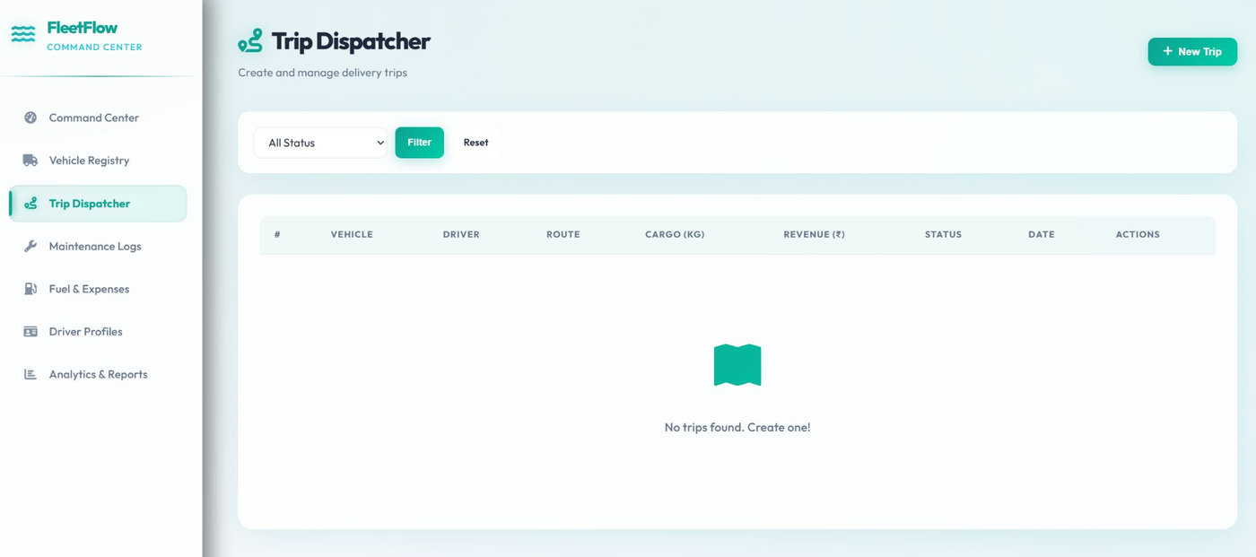
04
🚀 Trip Dispatcher
FleetFlow
Create and manage delivery trips
COMMAND CENTER
📌 Key Points
1
This module is used to create and manage delivery trips.
2
Trips can be tracked based on status: Draft, Active, or Completed.
3
Each trip includes vehicle, driver, route, cargo, and revenue details.
4
It ensures efficient trip planning and monitoring.
04 / 09 · FleetFlow Command Center

Slide 7
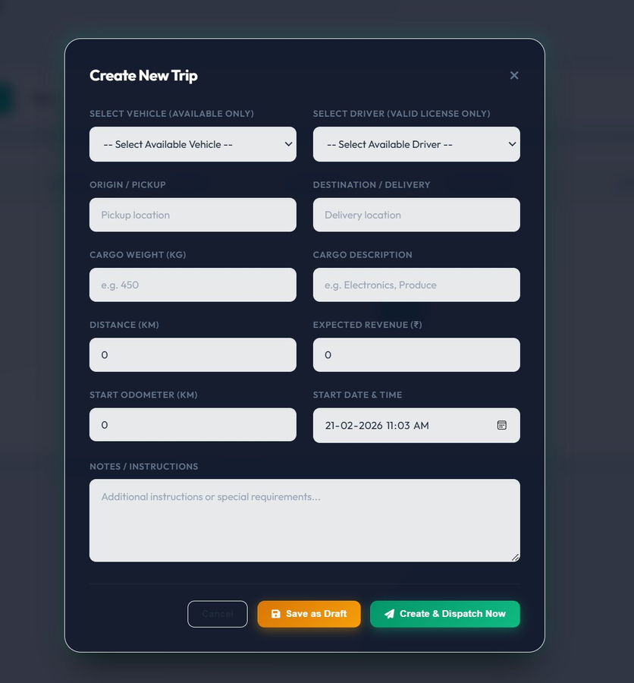
05
📋 Create Trip Form
FleetFlow
Plan and dispatch a delivery trip
COMMAND CENTER
📌 Key Points
1
Only available vehicles and valid drivers can be selected.
2
Cargo weight is validated against vehicle capacity.
3
Revenue and distance are recorded for performance analysis.
4
Trips can be saved as draft or dispatched instantly.
05 / 09 · FleetFlow Command Center

Slide 8
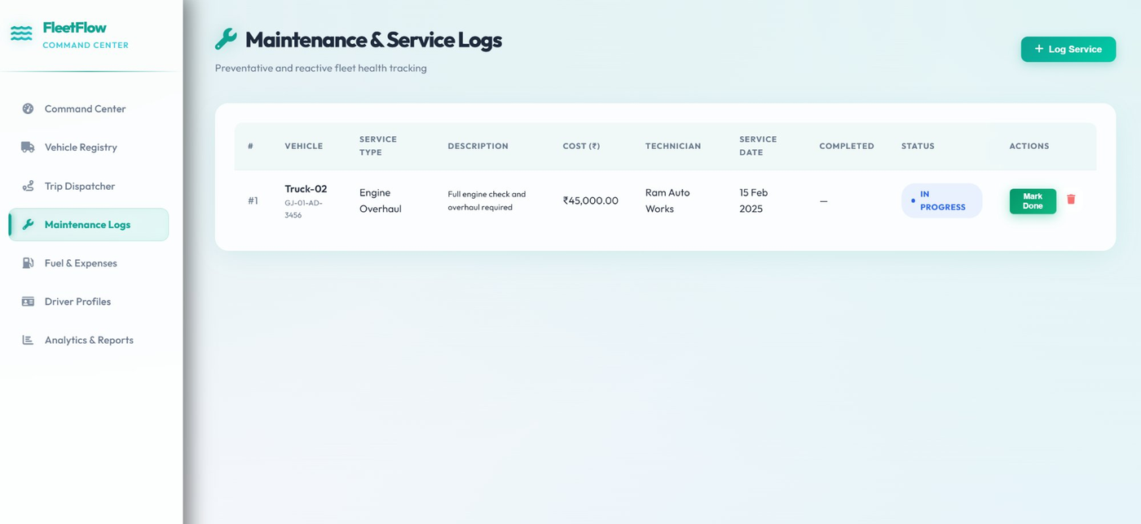
06
🔧 Maintenance Logs
FleetFlow
Preventative and reactive fleet health tracking
COMMAND CENTER
📌 Key Points
1
This section tracks vehicle service and repair history.
2
Managers can log maintenance type, cost, and technician details.
3
Service status can be updated when work is completed.
4
Helps in preventive maintenance and cost control.
06 / 09 · FleetFlow Command Center

Slide 9
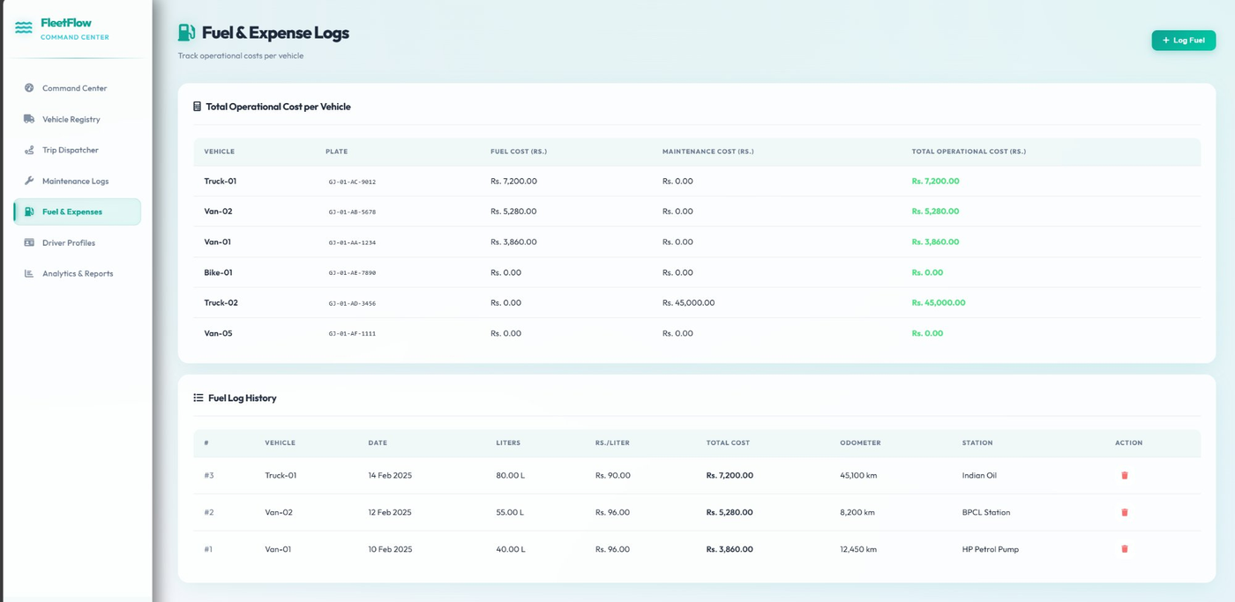
07
⛽ Fuel & Expenses
FleetFlow
Track operational costs per vehicle
COMMAND CENTER
📌 Key Points
1
This module records fuel usage and operational expenses.
2
Cost per vehicle is calculated automatically.
3
Fuel history includes date, liters, price, and station.
4
Provides total fleet operational cost for analysis.
07 / 09 · FleetFlow Command Center

Slide 10
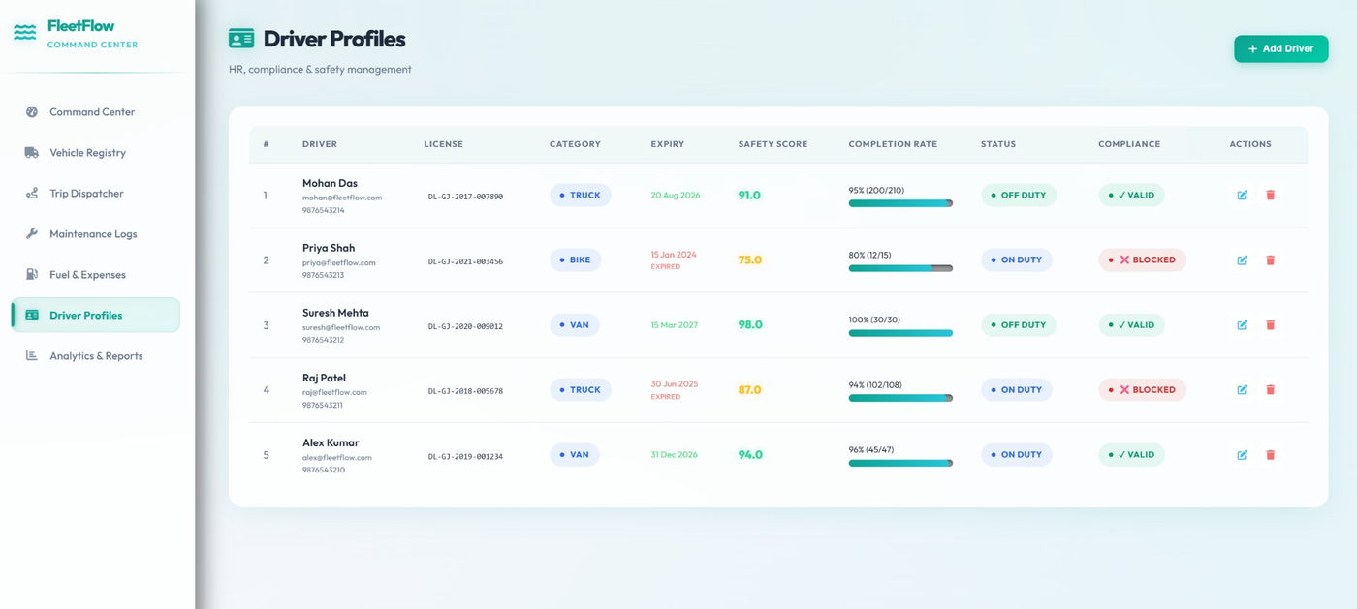
08
👤 Driver Profiles
FleetFlow
HR, compliance & safety management
COMMAND CENTER
📌 Key Points
1
Stores driver information, license details, and contact data.
2
License expiry is monitored for compliance.
3
Drivers with expired licenses are automatically blocked.
4
Safety score and trip completion rate are tracked.
08 / 09 · FleetFlow Command Center

Slide 11
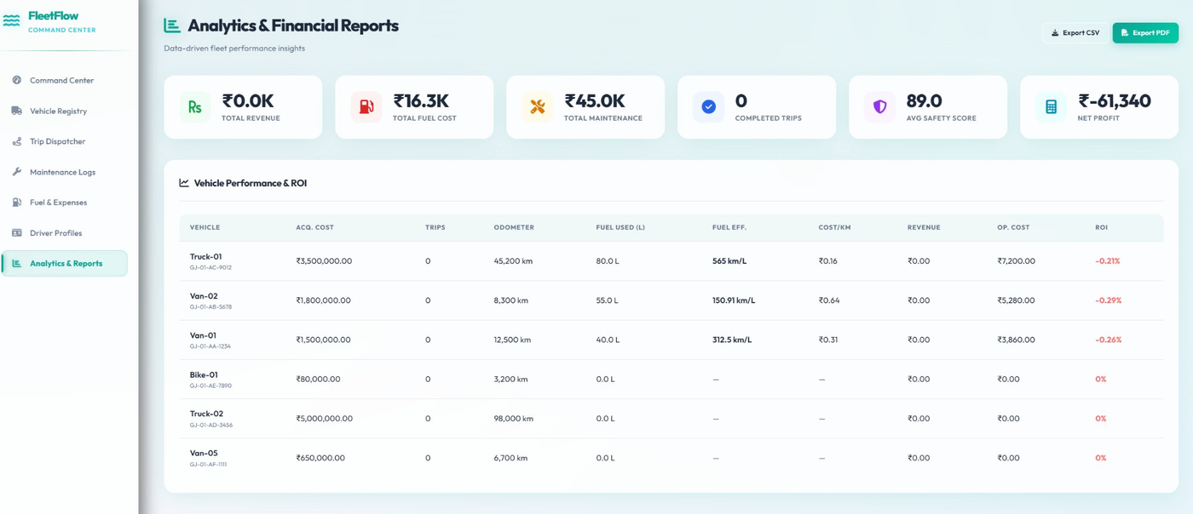
09
📊 Analytics & Reports
FleetFlow
Data-driven fleet performance insights
COMMAND CENTER
📌 Key Points
1
Provides financial and performance insights of the fleet.
2
Shows revenue, fuel cost, maintenance, and net profit.
3
Vehicle ROI and fuel efficiency are calculated.
4
Reports can be exported as CSV or PDF for offline use.
09 / 09 · FleetFlow Command Center

