Slide 1
SUMMER INTERNSHIP PRESENTATION
at Societe Generale, Global Solutions Centre

Slide 2
Agenda
1
2
3
4
Projects
Learnings
Discuss the tasks completed
Discuss the Learnings
Challenges
Room for QnA
Discuss the challenges faced
For questions regarding the work

Slide 3
TRADE REGULATORY TEAM
Replay
CBR
METH
Testing Software
Production

Slide 4



ROLE OF THE REG TEAM
Real-time Data
Regulators
Maintain Consistency and generate KPIs
ECB
AMF
SEBI
Europe
France
India
REG-SocGen

Slide 5
INTERNSHIP TIMELINE
2
4
Mitadru
Supreet
Testing Software
Production
1
3
Amit
METH
Testing Software

Slide 6
04
METH

Slide 7



Project Details
1
2
3
What is METH?
Elements
What does METH comprise of?
Idea of METH
Technical
Learning
Formatting Excel via Python

Slide 8
04
PRODUCTION
Mentor - Mr. Supreet

Slide 9

Project Details
1
2
3
4
Handling Database
Macros
MySQL
Python
Output Format
GUI
Formatting Excel via Python
Using TKinter

Slide 10
LEARNINGS
Technical
Co-operation
Proficiency in languages
With fellow interns and employees
Behavioural
Workflow
Patience, patience and patience
Inter-team workflow, how things happen

Slide 11
CHALLENGES
Mental
Technical
Requirements
Confidence in Proficiency
Version mismatches, scalability
Constantly changing requirements

Slide 12

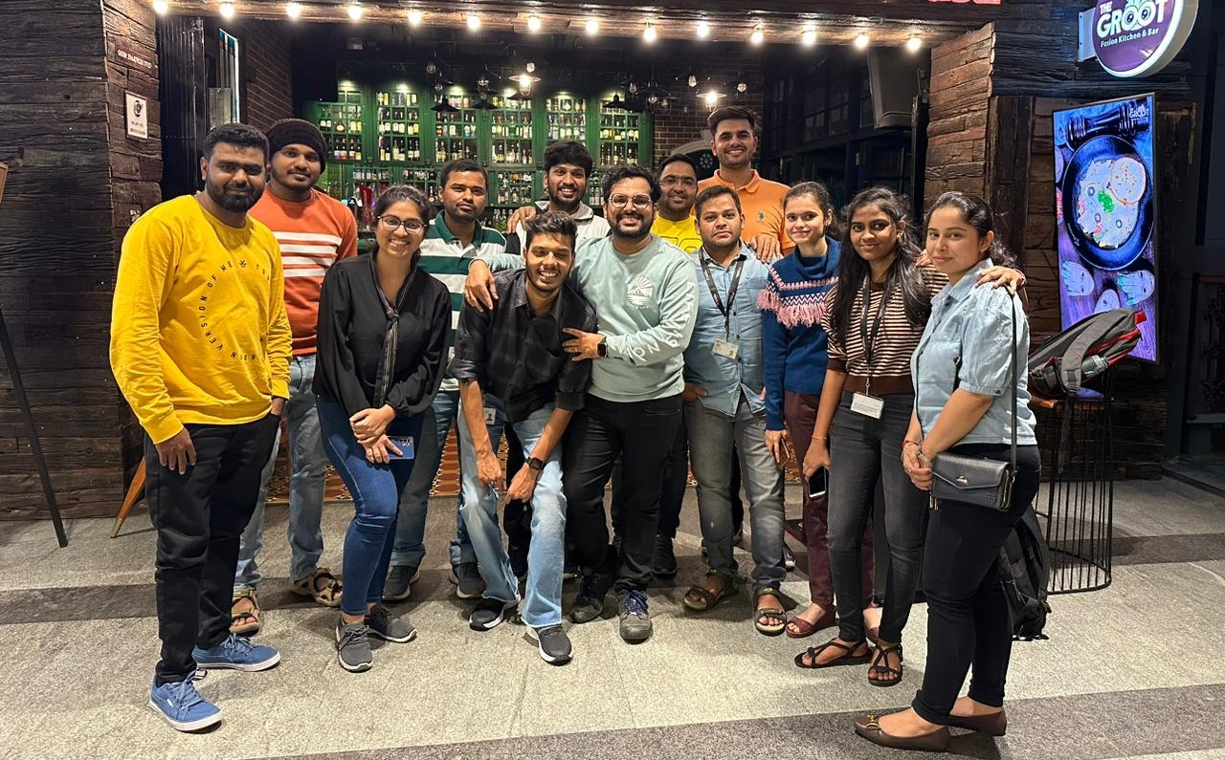
A Picture Speaks a Thousand Words

Slide 13
Thanks!
Do you have any questions?
BY
AYUSHA NAYAK ARYAN PUWAR

