Slide 1







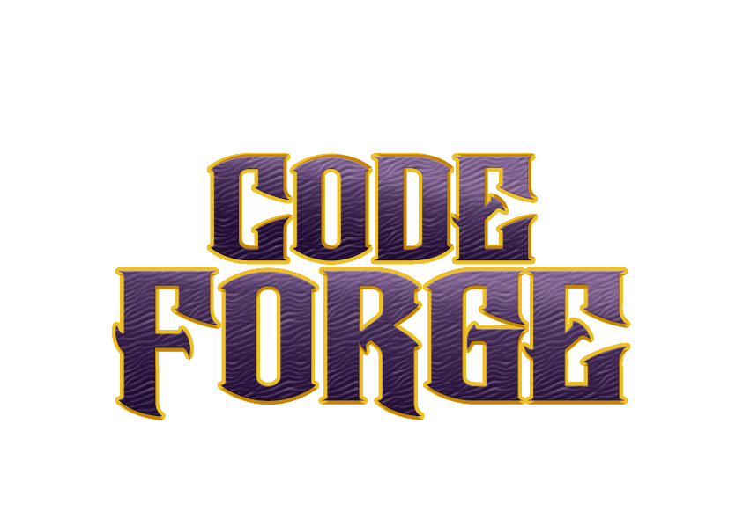

Developing innovative solution for DYSLEXIA
.

Slide 2


Team details
Team Lead: Name: Harsh Kumar
Contact: 9153805398
Email:harsh.ec22@bmsce.ac.in
Team Member 2: Name: Aryan Raj
Contact: 8454982691 Email:aryan.ec22@bmsce.ac.in
Team Member 3: Name: Pratyush Kumar Thakur Contact:9019742928 Email:pratyush.ec22@bmsce.ac.in

Slide 3


Our solution
Dyslexia Learning Enhancement Through Interactive Tasks :
1.Pronunciation Assistance:
ML detects mispronunciations while reading a paragraph.
Generates new paragraphs to reinforce correct pronunciation until mastery.
2.Math Learning with Visual Aid:
Displays basic math problems (e.g., 7-4) with corresponding images.
Helps users understand operations by counting visual objects.
3.Vocabulary Learning:
Provides a letter and guides the user to associate it with the correct word.
Offers feedback and correction for mistakes.

Slide 4

TECHNICAL APPROACH
Technical Approach for Dyslexia Learning Enhancement
1.Pronunciation Assistance:
Uses speech recognition to detect mispronunciations.
Adapts content based on user struggles for improvement.
2.Math Learning with Visual Aid:
Links math problems to visual images for better understanding.
3.Vocabulary Learning:
Associates letters with words and provides feedback for corrections.

Slide 5
Workflow/pipeline
Create the detailed Workflow/Pipeline outlining the end-to-end system architecture
For reference google “ML Pipeline”

Slide 6
Feasibility & FUTURE SCOPE
Future Scope:
AI Personalization
Wider Accessibility
Classroom Integration
Data Insights
VR Learning
Pros:
Engaging & Fun
Personalized Learning
Memory Boost
Focus Enhancement
Multisensory Approach
Instant Feedback
Cons:
Tech Dependency
Accessibility Issues
Limited Scope
Varied Effectiveness
Potential Distractions

