Slide 1
Status Report: GPU-Accelerated KMP
Feiran Wang(feiranw2) • Xingjian Ye(xye16) • Aryan Raja(aryankr2)

Slide 2
Problem Background
The KMP algorithm consists of two main components:
Preprocessing the pattern:
builds a prefix function to indicate shift for a mismatch
Time Complexity: O(m); m - pattern length
Searching the text:
Does character-by-character scan and uses the prefix function to calculate the next index to start scan in pattern
Time Complexity: O(n); n - text length
Total Complexity:
Time - O(n + m)
Space - O(m); for prefix function, represented as array

Slide 3
Motivation
Large-scale data processing:
Faster results by dividing workload across GPU cores
Useful for genomic sequences, web logs, textual data
Real-time applications:
Helps meet strict latency requirements
Applicable to intrusion detection systems, live stream text analysis

Slide 4
Motivation
Scalability:
GPU-based parallelization is highly scalable
Benefits from continued growth in GPU processing power
Multiple pattern matching:
Significantly speeds up the process
Different GPU cores search for different patterns simultaneously

Slide 5
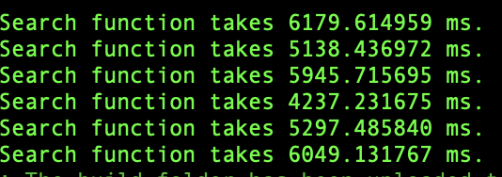
Baseline KMP-CPU
Text Data Size: 1GB
Pattern Length: 13
Queue: rai_amd64_exclusive
Six run average: 5474.6028 ms
Rai output:

Slide 6
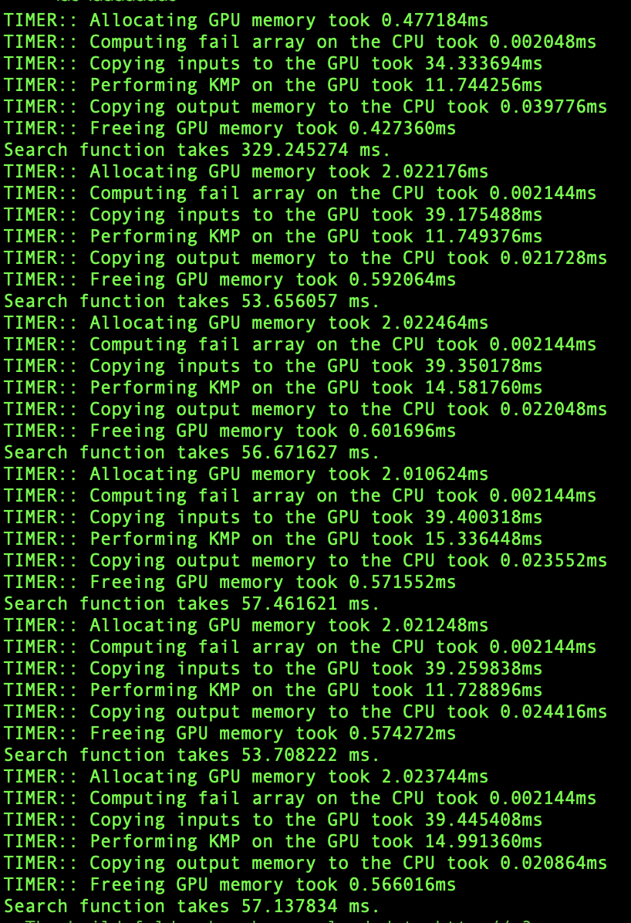
Baseline KMP-GPU
Text Data Size: 1GB
Pattern Length: 13
Queue: rai_amd64_exclusive
5 run average: 55.727 ms

Slide 7
Parallelization
Splitting input text across threads
Each thread scans 20,000 characters
Block size = 64
Pattern and fail array are stored in global/constant memory

Slide 8
Dataset (Input)
Dataset Overview:
Source: NCBI Human Genomic Data Sequences
Six Chromosome type sequences( Type 1-6)
Dataset size ~ 1.5 GB
Text Data generation:
Reads six chromosome file
Generate a txt file with text of required length
Loops over existing files if required length > total file characters
Pattern Generation:
CPP function generates random pattern of given length
Output: Occurrences count and indexes

Slide 9
Current State
Single Pattern Matching kernel:
Tested parameters, found block size = 64 and text input length per thread = 20,000 to perform best
Implemented shared memory to store input text
Implemented constant memory to store pattern and fail array
State machine Single Pattern - CPU:
Run time: ~1.5 secs
Next steps: Implementing multiple pattern matching kernel

Slide 10
Implementation Comparison
We have tested 3 kernel implementations:
Basic KMP Kernel
Shared memory kernel
Constant memory kernel

Slide 11
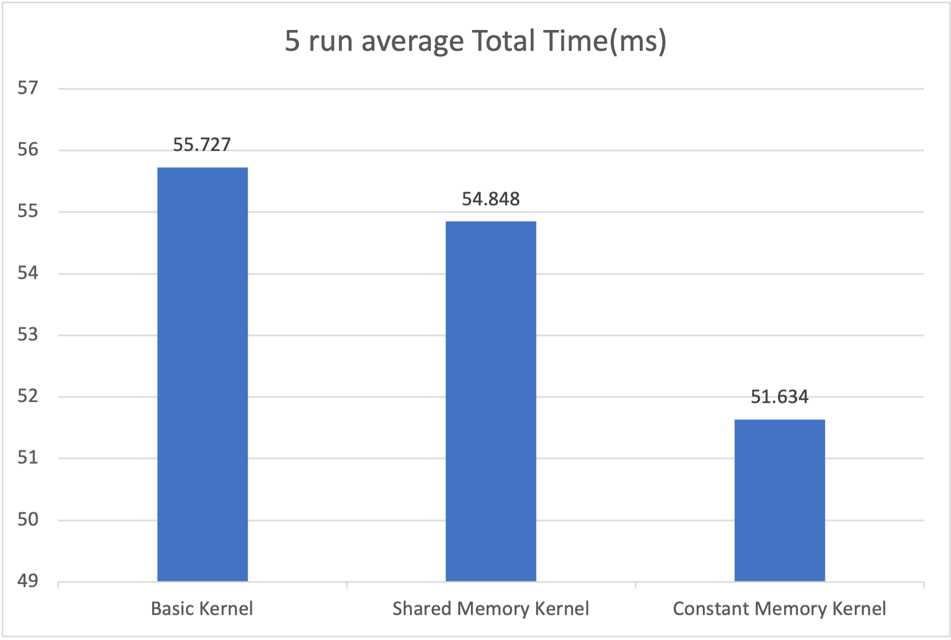
Implementation Comparison

Slide 12
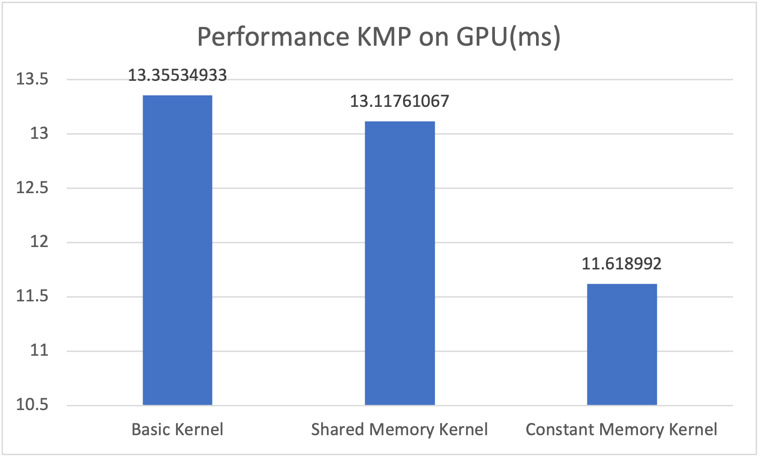
Implementation Comparison

Slide 13
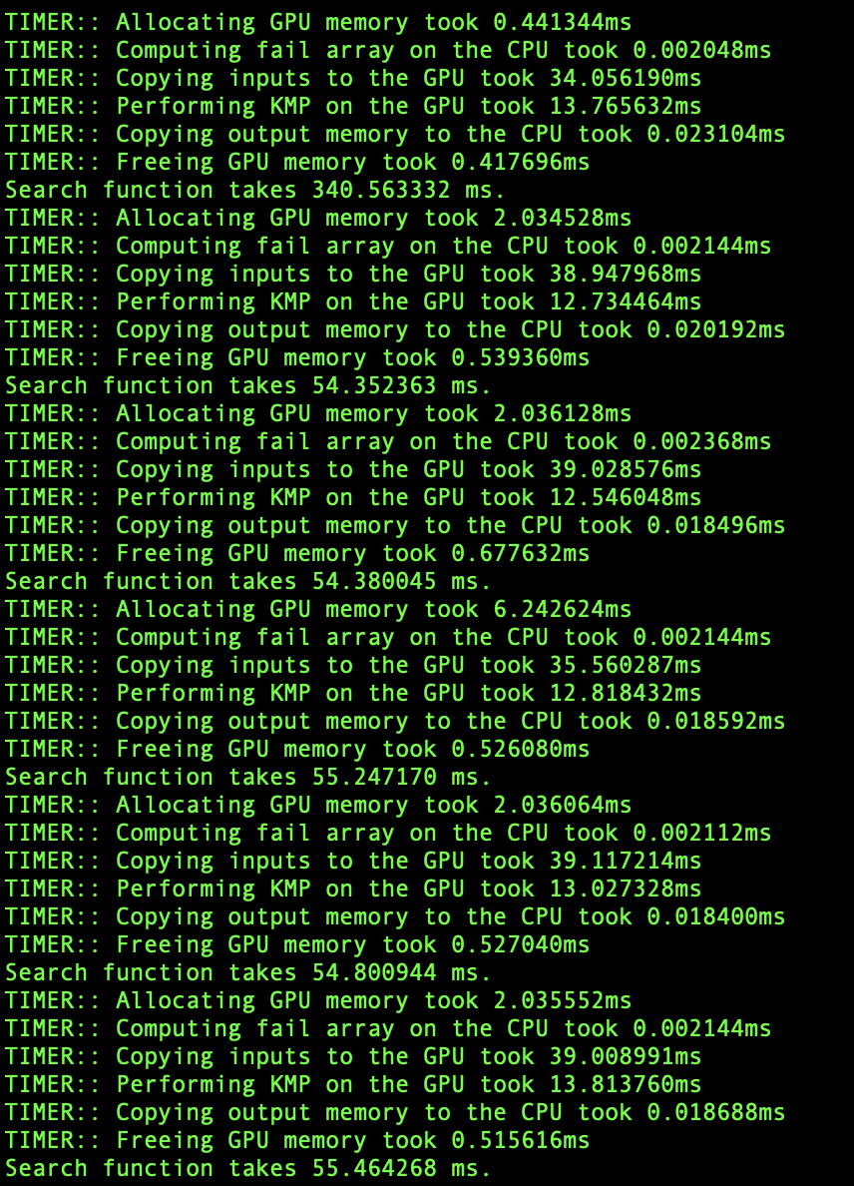
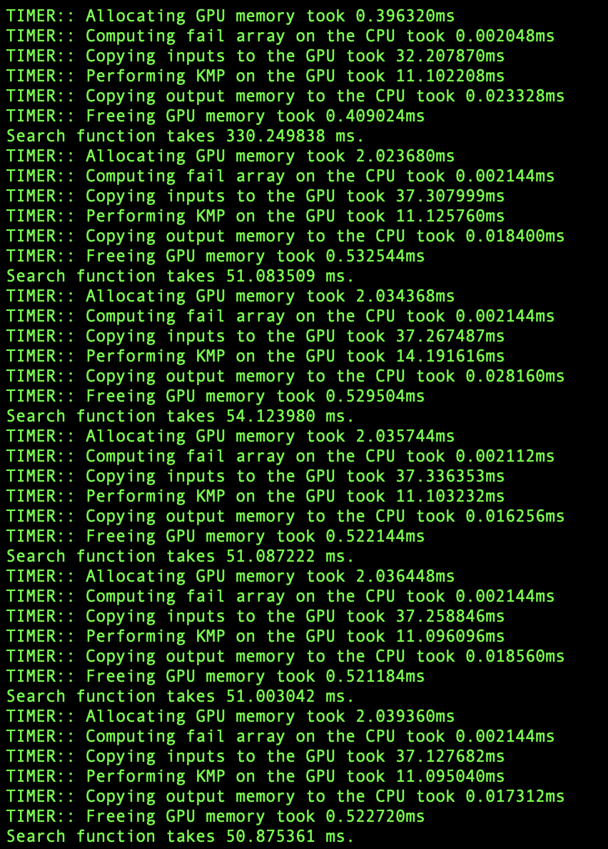
Comparison Samples
Basic Kernel
Shared Memory Kernel
Constant Memory Kernel

Slide 14
Future Optimizations
Implementing state machine
Utilizing streams
Thread coarsening
Using constant memory in shared memory implementation for pattern and fail array

Slide 15
Questions?

