Slide 1
PROBLEM DEFINITION & OBJECTIVES
Why do patients wait for a scan, and can we trust the data we use to explain it?
130,431
imaging exams in the workbook
4 sites · 89 features
Imaging departments log every step of a patient's visit: booked, arrived, scanned. That log is what hospitals use to plan staff and scanners. But the data is messier than it looks:
the four sites in our file even define “wait” differently, and thousands of values that look like zeros actually mean “not defined”.
queue state, schedule, timing
~3 years
of arrival, slot and start timestamps (dates as published)
1
Understand the data
2
Make it trustworthy
3
Medical image work
4
Show the evidence
What is one record, where does it come from, how do the sites differ? (T1)
Standardise, clean, remove redundancy, deal with missing values. (T2, T3)
Enhance, restore, segment, compress, analyse and visualise CT-style images. (T4–T6)
Every step reports what it found and what it changed, in a working web app.
Operational & Hospital Workflow Analytics
1
Notes:
Start with the motivation: hospitals plan scanners and staff from timestamp logs, so if the logs are misleading the plans are too. Our workbook has 130,431 exams from four facilities. The catch we found early is that the published Wait column means something different at F4 than at the other three sites. The project has four objectives: understand the data, make it trustworthy, work with medical images, and keep evidence for every step. The workbook contains no images, which is why T4 to T6 use a generated CT-style phantom; I will say that clearly again later.

Slide 2
METHODOLOGY / TECHNICAL IMPLEMENTATION
One pipeline, two data sources, one offline web app
WaitData.xlsx
Python pipeline
Results as data
Static web app
→
→
→
4 sheets, 130k rows
54 MB, read once and cached
pandas · scikit-learn
scikit-image · PyTorch
JSON + PNG files
every number the UI shows
no framework, no server
SVG charts + canvas viewer
↑
Synthetic CT phantom feeds T4–T6
T1–T3 on the real workbook
T4–T6 on the generated phantom
Timestamps re-derived so “wait” means the same thing at every site
Four-stage column pruning, checked on a time-based hold-out
Rule search for zeros that really mean “undefined”
Imputers benchmarked by hiding values we already know
Hounsfield-unit chest slices with nodules of known size and density
Every method scored against exact ground truth (PSNR, Dice, error in mm)
SIFT + RANSAC for registration, a 6k-parameter CNN for nodules
Interactive viewer written directly on the canvas
Operational & Hospital Workflow Analytics
2
Notes:
The whole thing rebuilds with one command, python -m pipeline.build. The pipeline reads the workbook once and caches it, writes cleaned files and every number the interface shows into small JavaScript data files, and the front end is plain HTML, CSS and JavaScript with no framework, so it opens straight from disk. For the imaging topics there is no real image data in the workbook, so I generated a chest-CT style phantom in Hounsfield units. The advantage is that we know exactly where every nodule is, so every method can be scored against the truth instead of eyeballed.

Slide 3
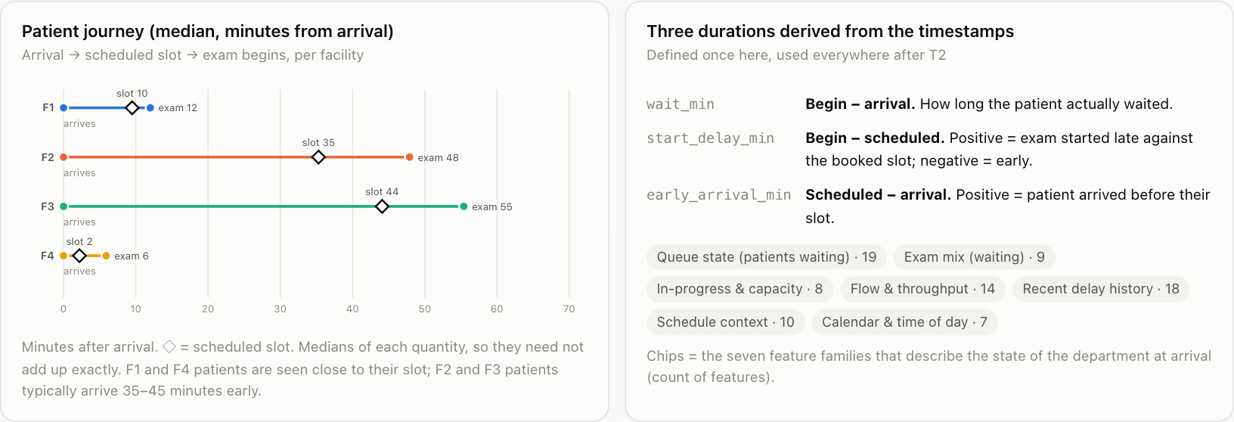
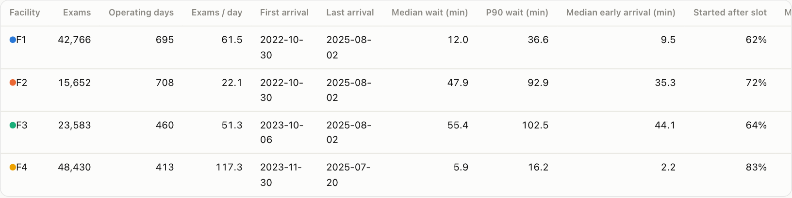
T1 · UNDERSTANDING EHR DATA
One row per exam, four different hospitals
Before cleaning anything we asked what a record actually is. Each row is one imaging exam with three timestamps (arrival, scheduled slot, exam start) plus a snapshot of what the department looked like when the patient walked in.
6–55 min
Median patient journey per facility
median wait, from F4 (lowest) to F3 (highest)
89 → 61
features documented, and how many exist at all four sites
No diagnoses, no patient IDs: it is an operational extract, not a clinical record.
The facilities differ in volume, scanners and scheduling style
Operational & Hospital Workflow Analytics
3
Notes:
T1 is about understanding, not fixing. Each row is one exam. The interesting part is that the four sites are not interchangeable: median wait runs from about 6 minutes at F4 to 55 at F3, but part of that is a definition difference which we untangle in T2. There are 89 features in total and 61 exist at every site. This is an operational extract only, so no diagnoses and no patient identifiers.

Slide 4
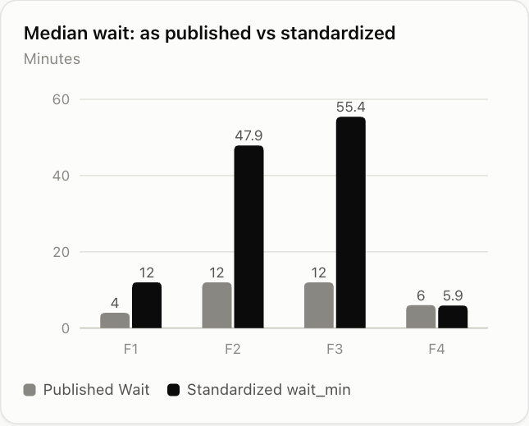
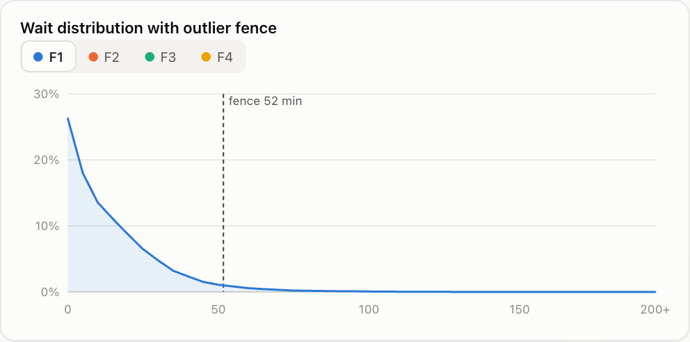
T2 · PREPROCESSING: STANDARDISATION AND CLEANING
“Wait” did not mean the same thing at every site
What we found and fixed
F4 publishes begin minus arrival; F1–F3 publish begin minus scheduled. We recomputed one definition from the timestamps for every site.
Timestamps are date-shifted by a constant amount. Source calendar columns only agree 100% after that shift, so we kept durations and time of day and did not invent real dates.
Day of week used Sunday = 1; converted to ISO. 96 blank calendar cells were derived from the timestamp, and 32 contradicting is_first flags were recomputed.
Long waits are flagged, never deleted: they are real events. 50 numeric features were z-scored using only each site's first 70% of time.
The distribution is right-skewed, so the fence marks the tail rather than errors.
Published Wait vs the standardised wait_min
Operational & Hospital Workflow Analytics
4
Notes:
This is the finding that changes how you read T1. The published Wait column at F4 is begin minus arrival, but at the other three sites it is begin minus scheduled. Comparing them directly would have made F4 look far faster than it is relative to the others. We recompute wait from the timestamps so every site uses the same definition. We were careful not to reconstruct calendar dates because the timestamps are shifted, and we flag outliers rather than delete them.

Slide 5
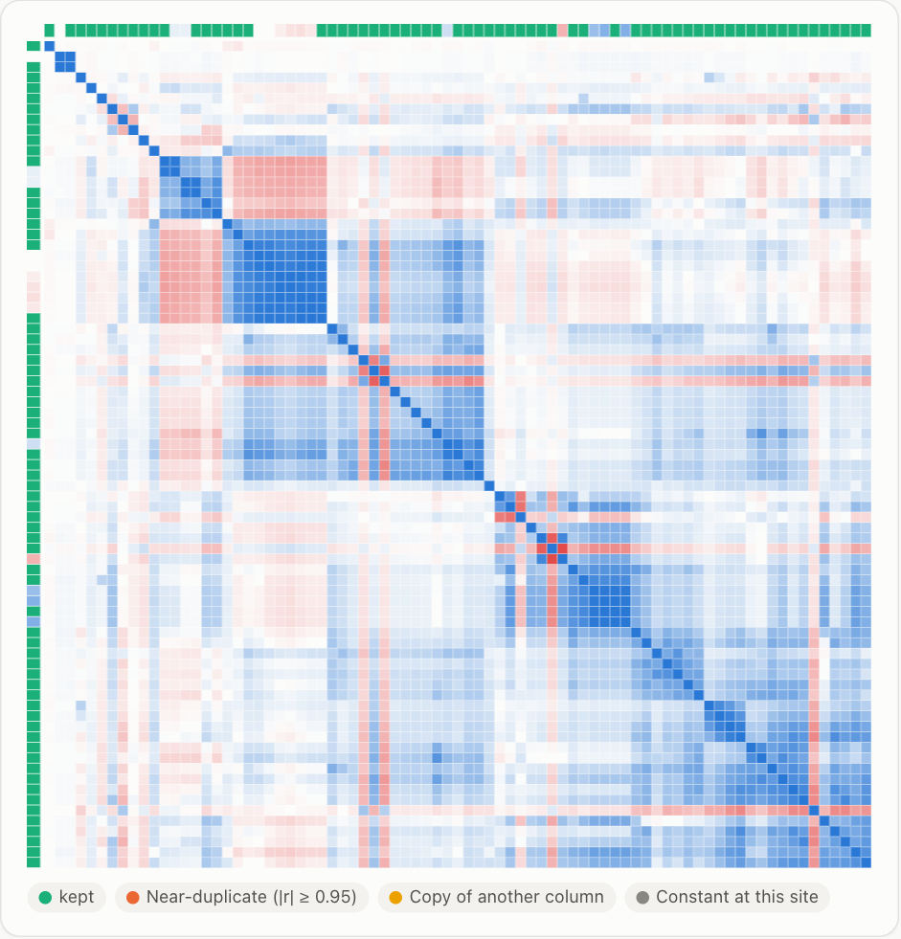
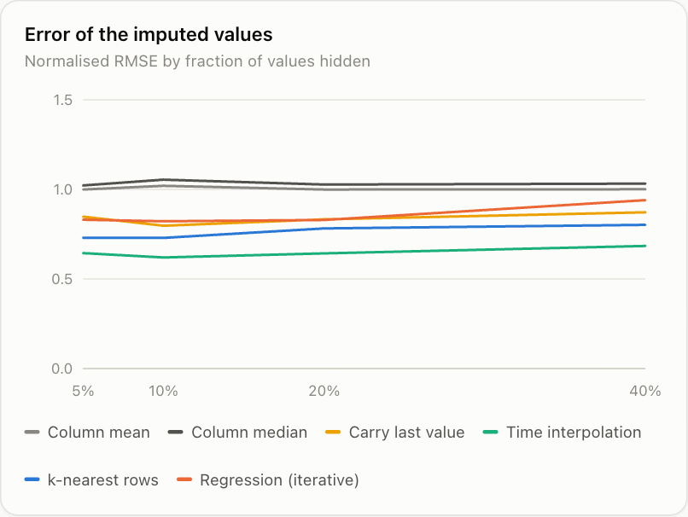
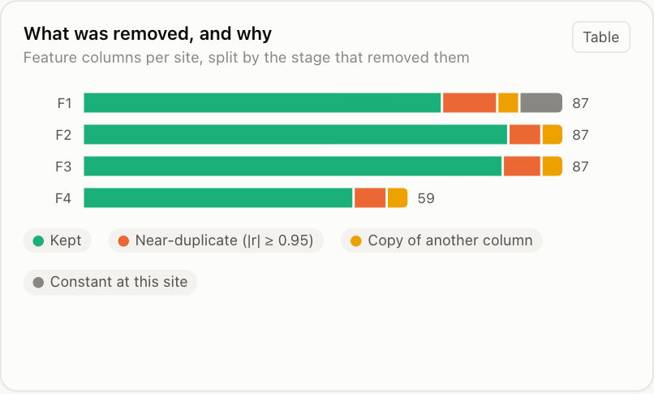
T3 · REDUNDANT DATA REMOVAL AND MISSING DATA
Less data, same accuracy; and zeros that were really blanks
Columns removed: 87 → 65 at F1
Correlation structure
Choosing an imputer
Constant columns, copies (start_hour squared, cubed...) and clusters with |r| ≥ 0.95. Accuracy on a time-based hold-out moved by under 0.3 min.
Blocks of near-identical features. One representative is kept per block, and every decision is written to a CSV.
We hid known values, imputed them and measured the error. Interpolation wins, but it peeks at the next row, so it is offline only.
196,967 hidden gaps. The file has only 96 blank cells, but averages of an empty queue are stored as 0 (average age of waiting patients is exactly 0 whenever nobody is waiting). A rule search found them and they are now blank.
Operational & Hospital Workflow Analytics
5
Notes:
Three results. First, no rows were removed: no exact duplicates, and rows that share an arrival second always have different waits so they are separate exams. Second, columns were pruned in four stages and the wait-time model error barely changed on a chronological hold-out, so the removed columns carried little extra. Third and most interesting: the real missing data is hidden. Statistics of an empty set, like the average age of people waiting, are stored as zero. We found about 197 thousand such cells by searching for a count that is zero exactly when the statistic is zero. These rules are inferred from the data and should be confirmed with the system owner.

Slide 6
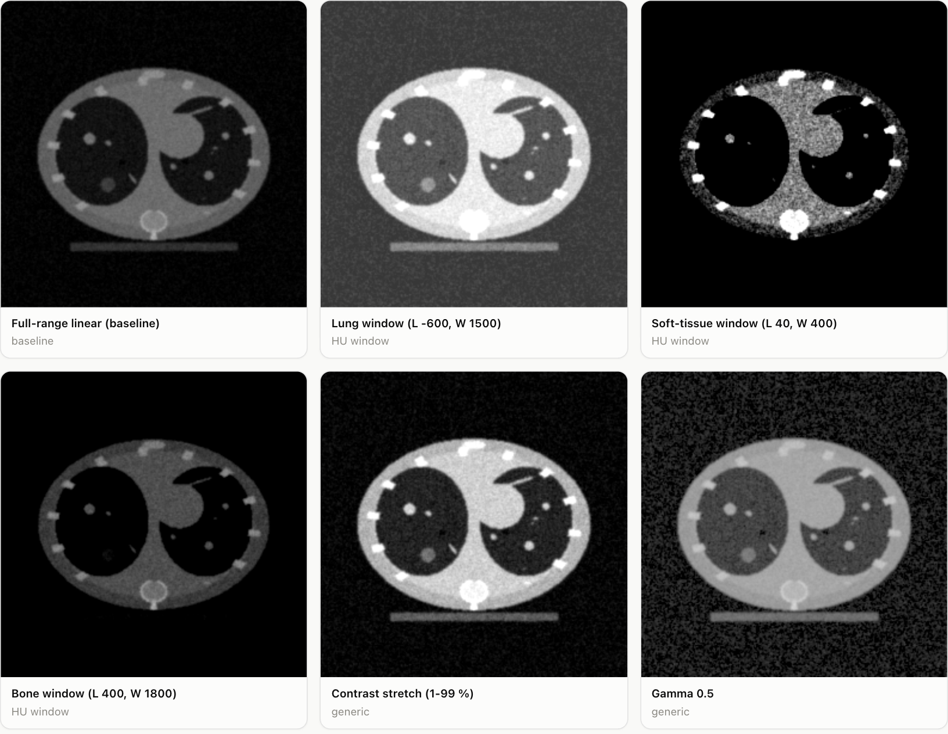
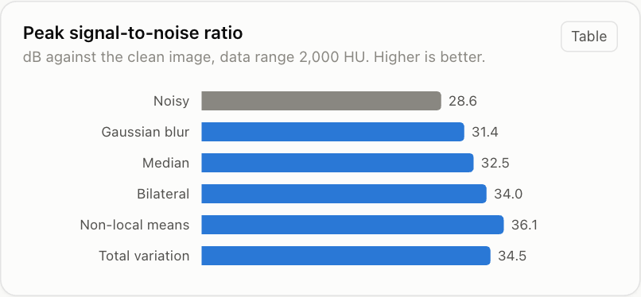
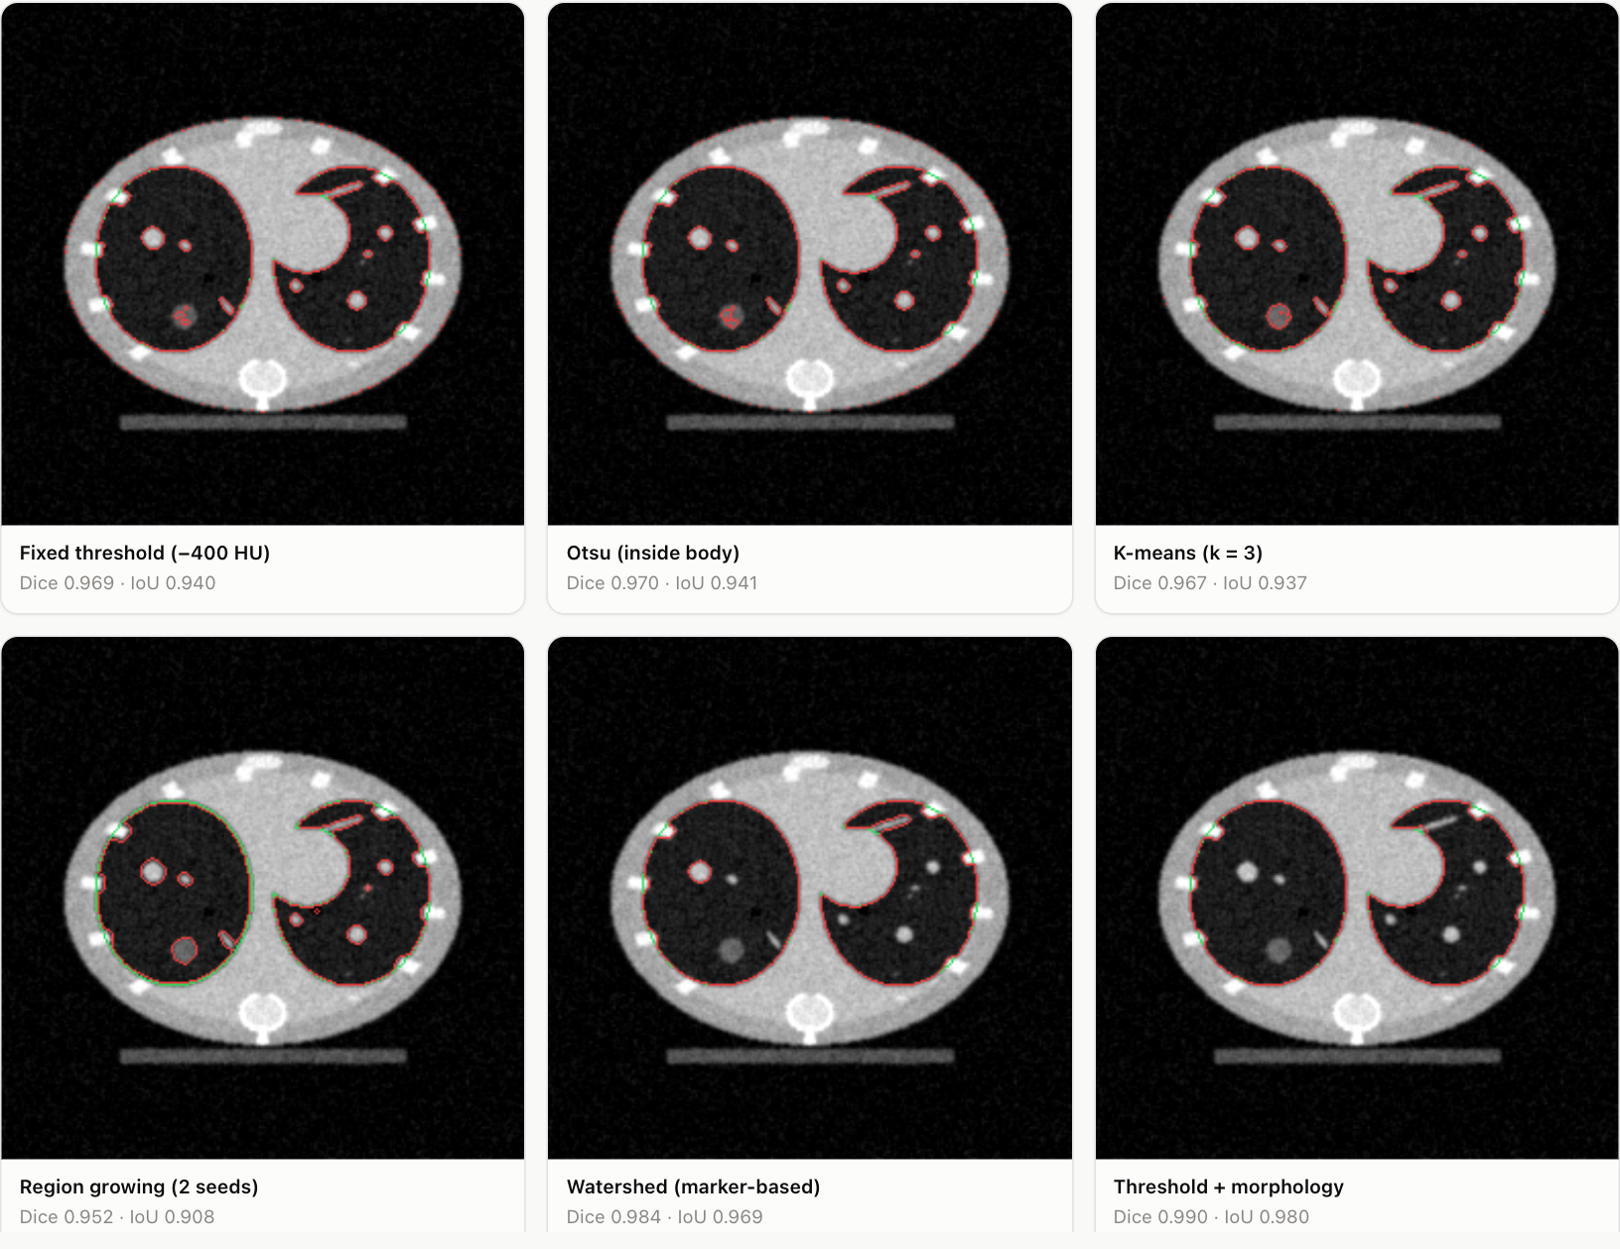
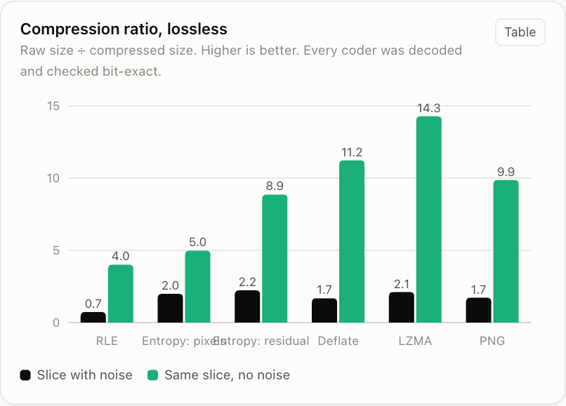
T4 · BIOMEDICAL IMAGE PROCESSING
Four jobs, each scored against ground truth
The workbook has no images, so we generated a chest-CT phantom whose nodules and lungs are known exactly. Every method below is scored, not judged by eye.
1
Enhance. CT windows raise contrast for the tissue you care about; equalisation and CLAHE mostly amplify noise.
2
Restore. Non-local means lifted PSNR from 28.6 to 36.1 dB; plain Gaussian blur only reached 31.4.
Enhancement variants
Denoising quality (PSNR)
3
Segment. Lung outline Dice 0.99 with threshold + morphology, but vessels fool a brightness rule.
4
Compress. Lossless gets ~2x on noisy slices vs ~14x without noise; JPEG blocks, JPEG 2000 blurs.
Lung segmentation methods
Lossless compression: noisy vs noise-free
Operational & Hospital Workflow Analytics
6
Notes:
Four kinds of image processing. Enhancement: CT windowing uses the known meaning of Hounsfield units, while histogram equalisation and CLAHE raise entropy but also amplify the noise. Restoration: non-local means was clearly the best denoiser here, and I should say the parameters were tuned on the same image they are scored on, so read the ranking rather than the absolute numbers. Segmentation: threshold plus morphology gave a lung Dice of 0.99, but finding nodules by brightness also picks up vessels. Compression: noise is essentially incompressible, so the same slice compresses about seven times better without noise.

Slide 7
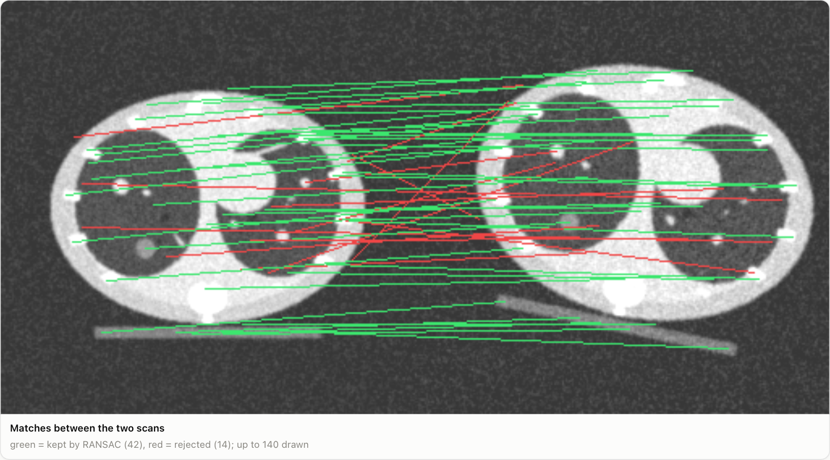
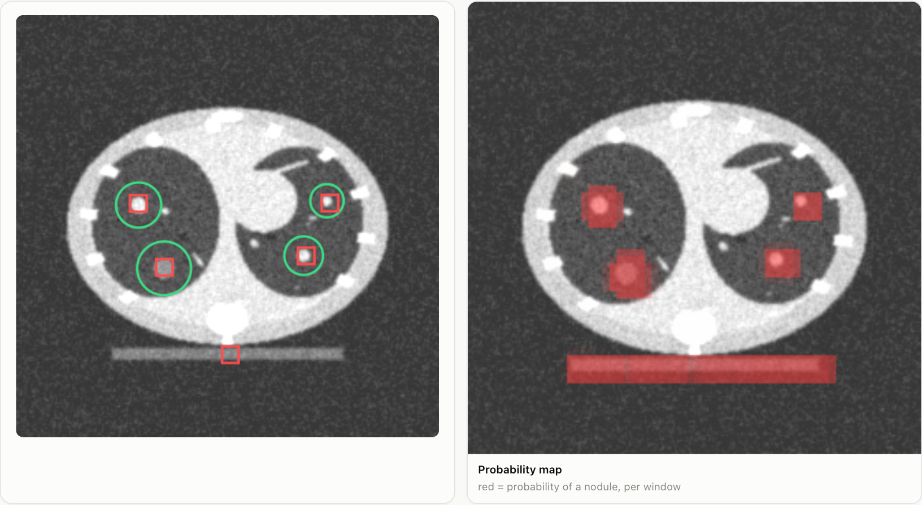
T5 · BIOMEDICAL IMAGE ANALYSIS: SIFT, RANSAC, CNN
Aligning two scans, then finding the nodules
SIFT matches: green kept by RANSAC, red rejected
CNN on an unseen slice: green = true nodules, red = detections
1.1 mm vs 29 mm
0.999 vs 0.952
4 of 4
Error at the nodules after registering a re-scan (RANSAC vs plain least squares on the same matches)
CNN test AUC vs logistic regression on pixels; all 3 training seeds agree
nodules found on a whole slice, with one false alarm on the CT couch
Operational & Hospital Workflow Analytics
7
Notes:
Two halves. First, registration: we made a second scan with a known 12 degree rotation, 1.08 scale and shift. SIFT found matches, about 30 percent of them wrong, and RANSAC fitted the transform while ignoring them, recovering it to about a millimetre at the nodules. Ordinary least squares on the same matches was off by nearly 3 centimetres. Second, a small CNN with about six thousand parameters classifies nodule patches. Early on one training seed got stuck and adding batch normalisation fixed it. Caveat: training and test patients come from the same generator, so the 0.999 is in-distribution and would be lower on real scans. The false alarm on the couch is an object the network never saw as a negative.

Slide 8
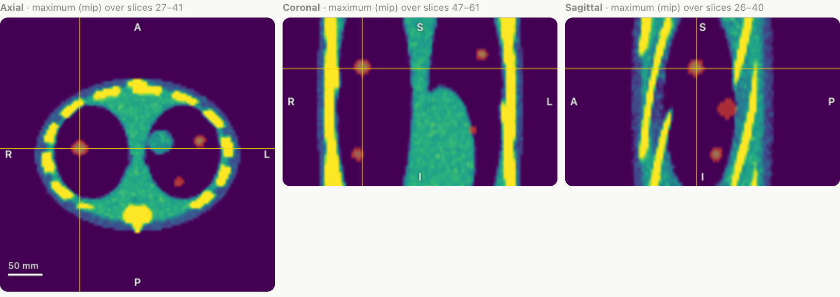
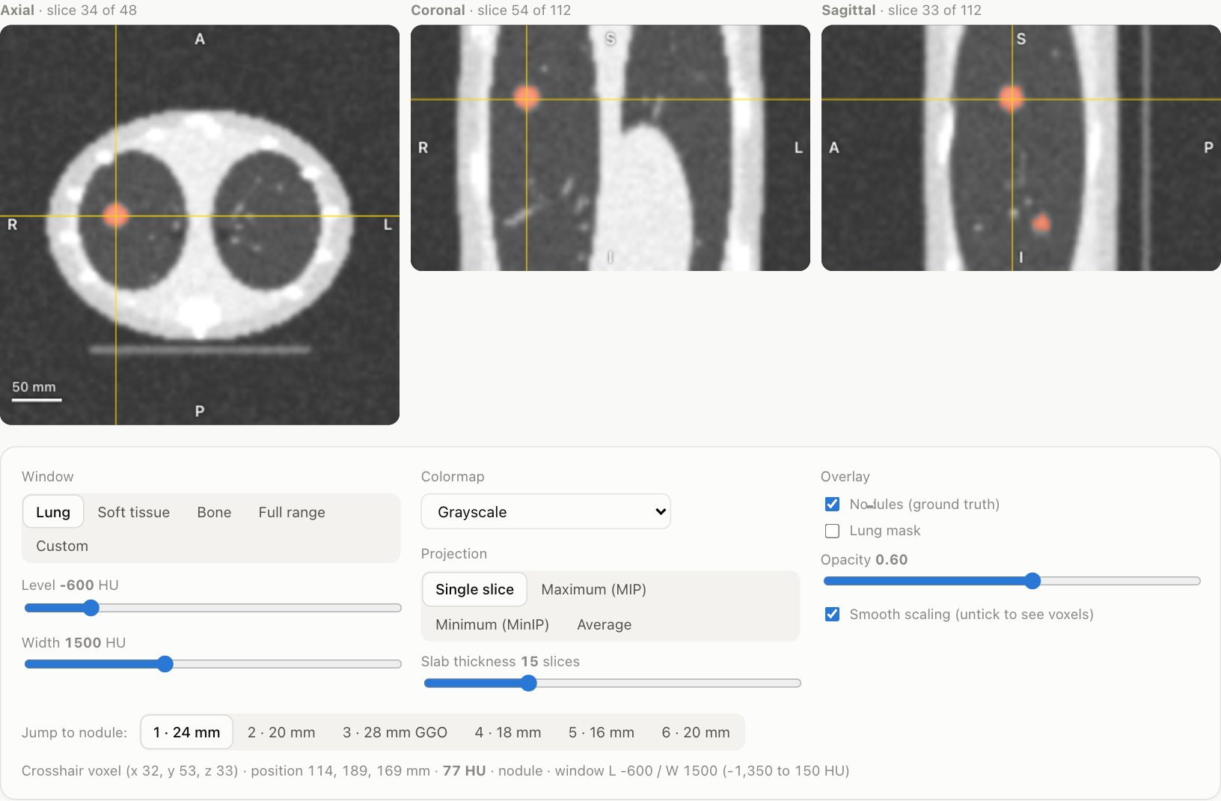
T6 · BIOMEDICAL IMAGE VISUALISATION
An interactive viewer instead of static pictures
Same volume: soft-tissue window, MIP slab, viridis colormap
Axial, coronal and sagittal views with a linked crosshair
Window presets, live level and width, five colormaps
MIP, MinIP and average slabs; ground-truth nodule overlay
Rainbow (jet) reverses lightness three times, so it fakes edges. Viridis rises steadily.
Operational & Hospital Workflow Analytics
8
Notes:
T6 is the part you can actually play with. The viewer runs on a small 48 by 112 by 112 volume and everything is drawn on a canvas in the browser. Change the window and the lungs, soft tissue or bone appear; switch to a maximum intensity projection and the nodules stand out. We also measured colormaps rather than just asserting that rainbow is bad: the lightness of jet goes up and down three times, which creates bands that look like boundaries. Diagnostic viewing needs calibrated displays, so this is an illustration only.

Slide 9
QUALITY OF PROJECT WORK / INNOVATION
What we did beyond following the textbook
1
Found the definition mismatch
2
Looked past the null count
3
Every claim has a test
Wait meant different things at different sites. We caught it by testing which formula reproduced each site's published column.
The real missing data was 196,967 zeros that meant “undefined”, found by an automatic rule search, not by counting blanks.
Pruned columns are checked on a time-based hold-out; imputers on values we hid; image methods against exact ground truth.
4
Honest baselines
5
Measured, not asserted
6
Easy to rerun and extend
The CNN is compared with logistic regression, and we report the seed that failed before we fixed it.
Colormaps are ranked by CIELAB lightness; compression by PSNR, SSIM and nodule contrast kept.
One command rebuilds everything. A new topic is one Python file and one JS file. The app opens offline.
Operational & Hospital Workflow Analytics
9
Notes:
What I would highlight is the habit of checking. Two examples: the wait definition mismatch was found by testing which formula reproduced each site's column, and the hidden missing values were found by searching for counts that are zero exactly when a statistic is zero. Baselines matter too: the CNN is only interesting because it beats logistic regression, and we report that one early training run failed. And everything is reproducible with one command.

Slide 10
RESULTS & DISCUSSION
What worked, and what to be careful about
0 rows, 22 columns
removed at F1 (87 → 65) with hold-out error within 0.3 min
Limits we would state up front
T4–T6 use a synthetic phantom: rankings carry over, absolute numbers do not.
The CNN's train and test patients share one generator, so its score is in-distribution.
Restoration parameters were tuned on the scored image.
The “undefined zero” rules are inferred from data and need the system owner's confirmation.
Nothing here is clinical advice or a diagnostic viewer.
+7.5 dB
PSNR from the best denoiser (non-local means)
1.1 mm
registration error at the nodules with SIFT + RANSAC
AUC 0.999
CNN vs 0.952 for logistic regression (synthetic test set)
Next: run T4–T5 on real DICOM studies, and turn the cleaned features into a wait-time predictor with a live-safe imputer.
Operational & Hospital Workflow Analytics
10
Notes:
To close: the numbers on the left are the headline results, but read them with the limits on the right. The imaging results are on a generated phantom, so the ranking of methods is meaningful and the absolute numbers are not clinical. The next step that would matter most is repeating T4 and T5 on real DICOM data and using the cleaned workbook features for an actual wait-time prediction model.

