Slide 1
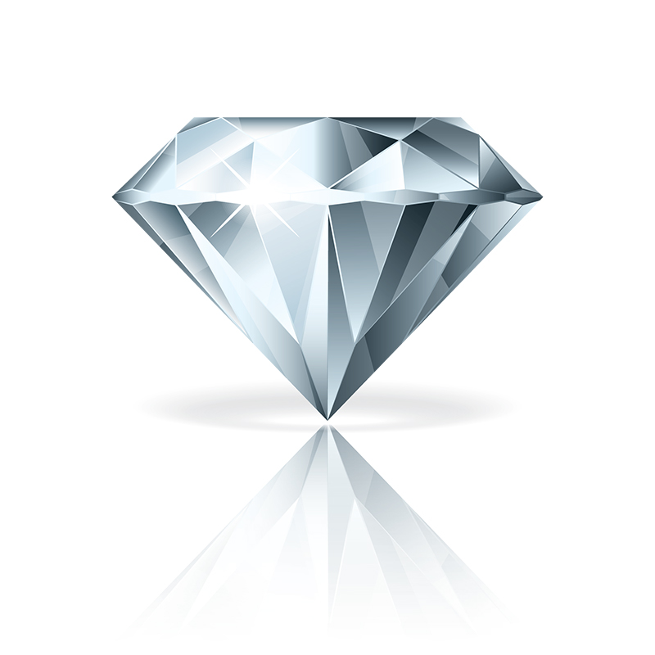
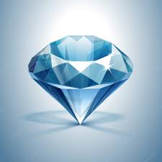
DIAMOND ANALYSIS
BY- Maithilee bahirat & aryan rao

Slide 2
diamondS
What is a diamond?
Diamonds known as the hardest materials on earth and diamond only can be scratched by the other diamonds
How are diamonds formed?
By combination of high heat and pressure, diamonds are formed within 100 miles away from the surface of Earth.
Why are diamonds so expensive?
Due to the complicated process of digging and finding it, that what make it so unique and expensive.

Slide 3
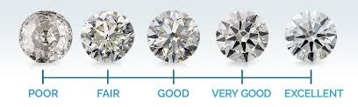

Slide 4
dataset
What make a diamond so expensive?
Depth: Height of the diamond from culet to the table
Carat: Weight of the diamond
Cutting: Cut quality of diamond
Benefits
This dataset will benefit a buyer and a seller before they conduct a deal.
It will benefit all the buyers to know what kind of diamonds they want.

Slide 5
Dataset features
Our dataset is from Kaggle.
Our dataset is a pre-made dataset.
Our dataset consist of 53137 diamonds.
Cleaning
Drop duplicates.
Drop unwanted column.
No existing NaN-numbers.

Slide 6
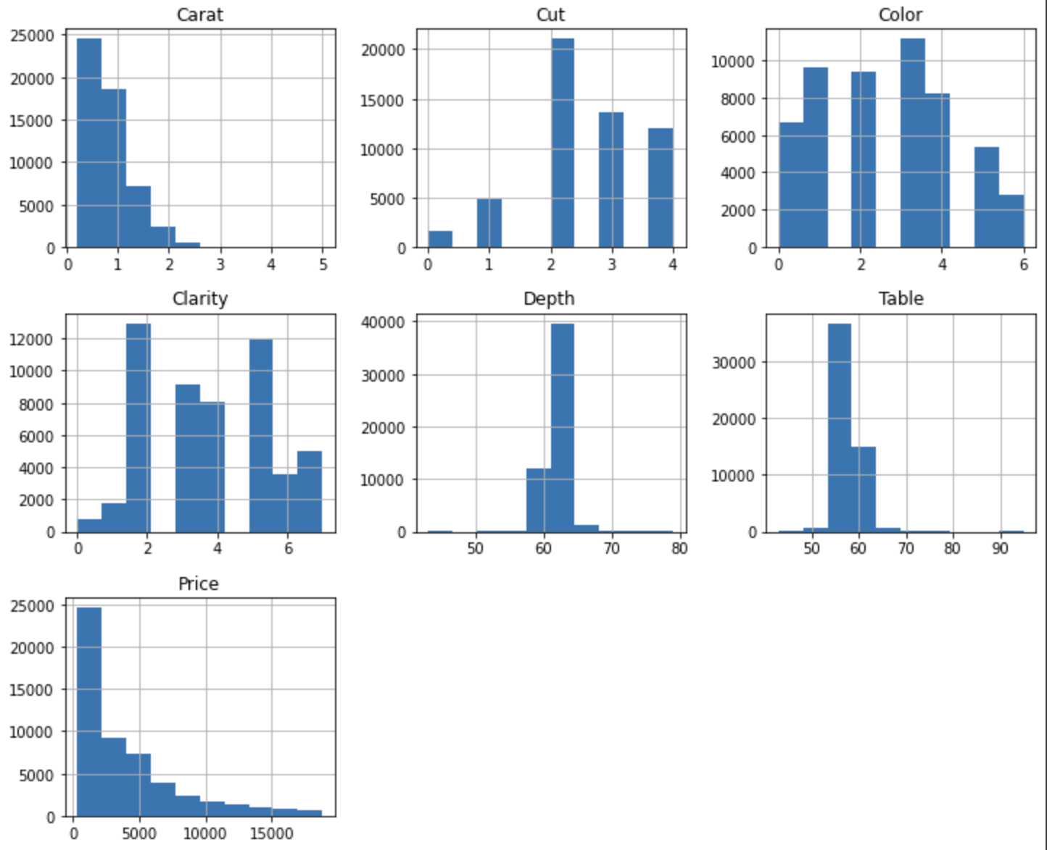
histogram

Slide 7
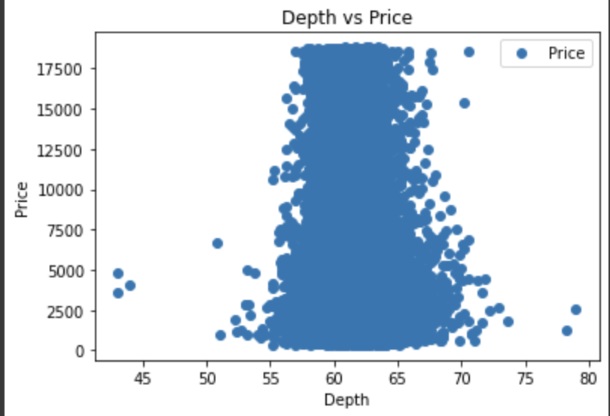
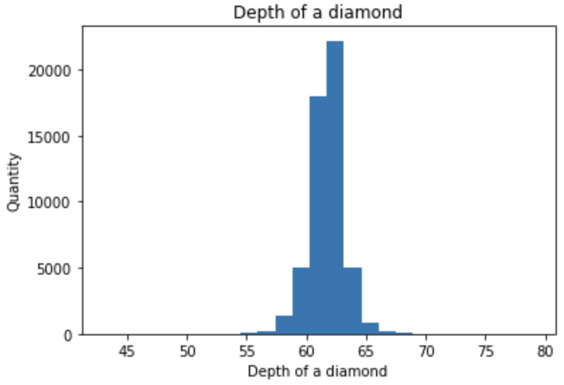
Depth of diamonds The quantity of diamonds purchase increase, when depth reaches between 60mm to 65mm.

Slide 8
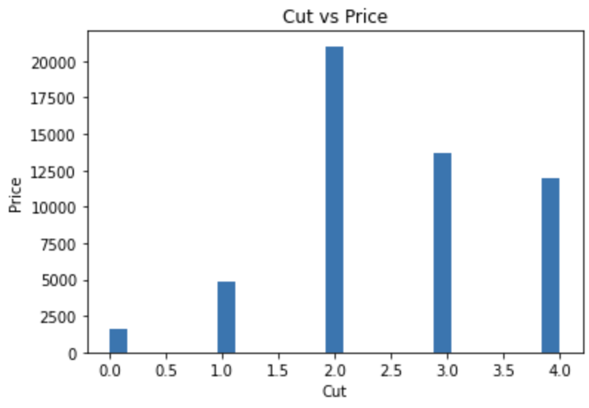
Cut of a diamond
Cut:
Ideal: 2.0
Premium: 3.0
Very Good: 4.0
Good: 1.0
Fair: 5.0

Slide 9
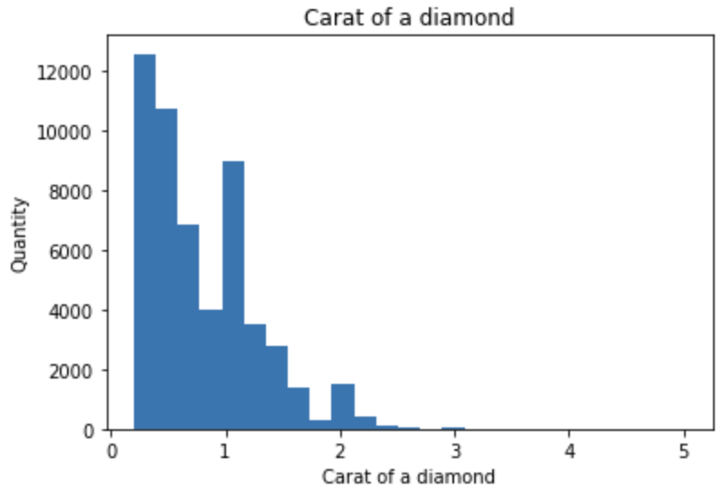
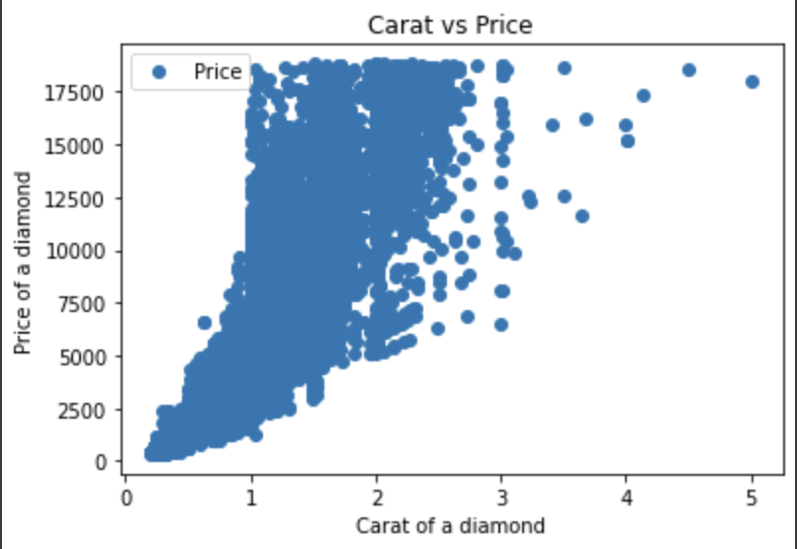
carat Price of a diamond can be affected not just by carat, it also will be affected by cutting, color, depth and clarity

Slide 10
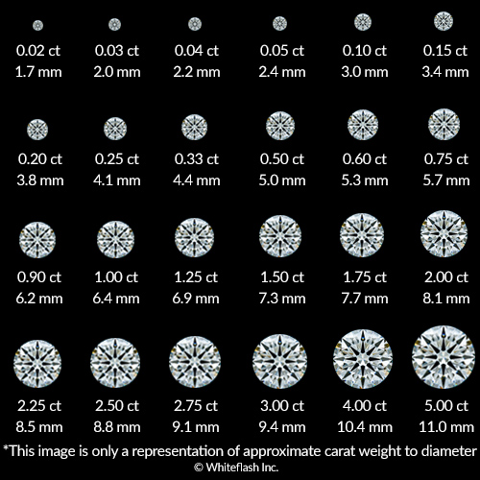

Slide 11
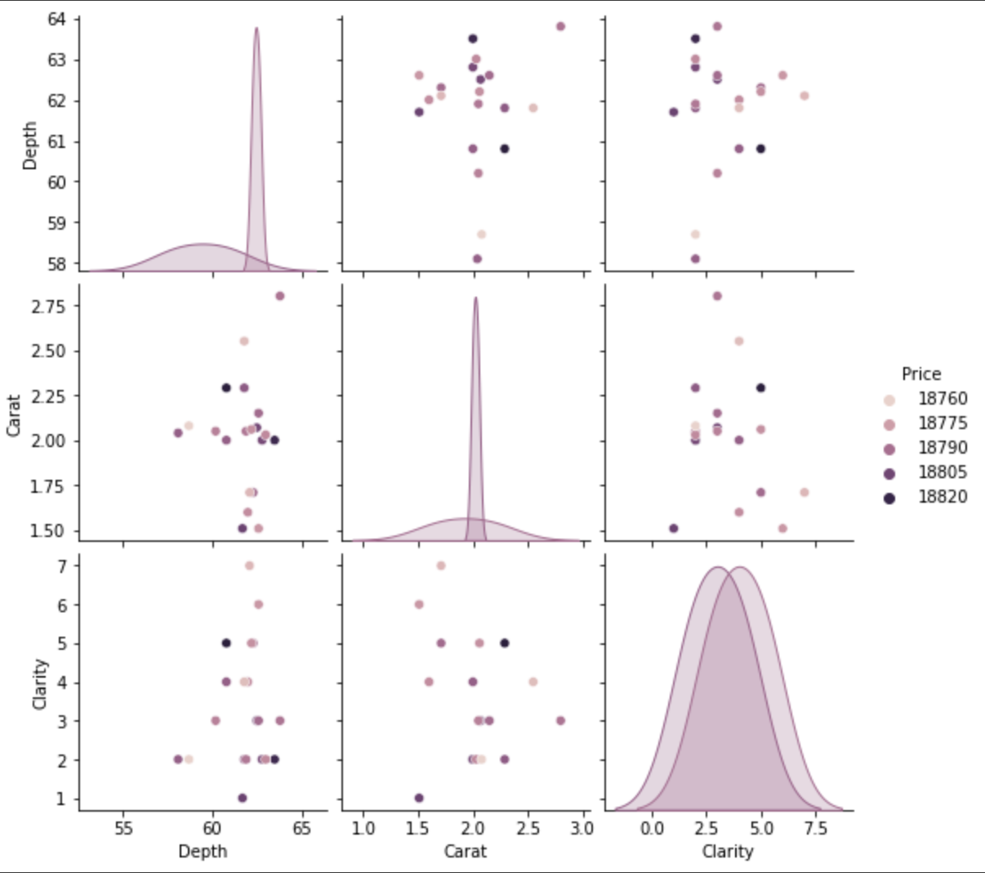
pairplot
Top price points of diamonds

Slide 12
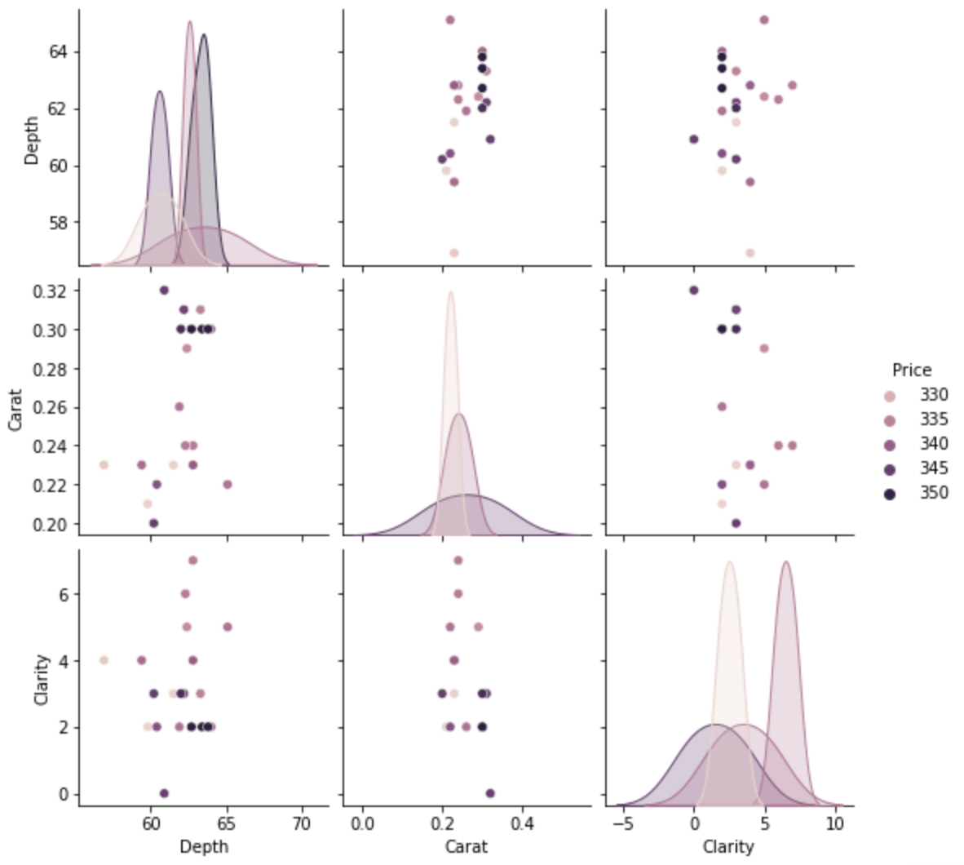
pairplot
Lowest price points of diamonds

Slide 13



Training methods
Decision Tree Method
Linear Regression
KNN

Slide 14
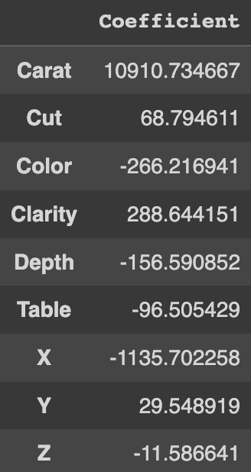
coefficient

Slide 15
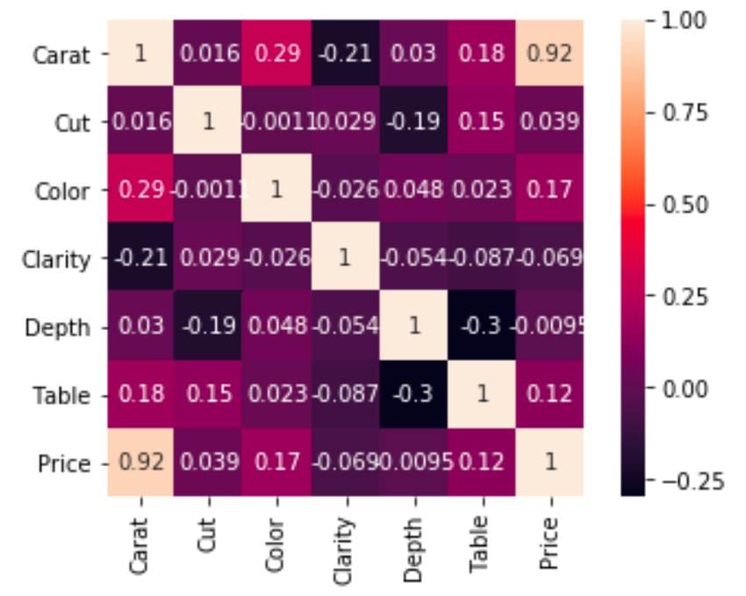
Correlation map

Slide 16
conclusion
Depth is inversely related to Price.
This is because if a 2 Diamond’s depth percentage is too large or small the Diamond will become 'Dark' in appearance because it will no longer return an attractive amount of light.
The Price of the Diamond is highly correlated to Carat, and its Dimensions.
The Carat (Weight) of a diamond has the most significant impact on its Price.
Since, the larger a stone is, the rarer it is, one 2 carat diamond will be more 'Expensive' than the total cost of two 1 Carat Diamonds of the same Quality.

Slide 17
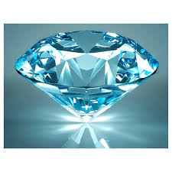
Thank you!
Maithilee & aryan

