Slide 1
S.A.D Analysis
Presented by:
Ayush Saxena (IIB2022032)
Aryan Rasiwasia (IIT2022024)
Ravindra Choudhary (IIT2022030)
Nomula Suveeksha Reddy (IIT2022102)
Shrinjoy Sarkar (IIT2022105)
Under the guidance of
Prof. Pritish Varadwaj

Slide 2
INTRODUCTION
Mental health issues like stress, anxiety, and depression often go undetected due to stigma and lack of tailored tools. Our model addresses this by:
Ensuring computational efficiency for fast assessments
Capturing personality-driven emotional patterns for accurate SAD prediction
Using LLMs to refine results and provide empathetic, personalized feedback

Slide 3
OBJECTIVE
To address mental health assessment challenges, we propose an automated system that:
Ensures computational efficiency using a lightweight logistic regression model
Captures personality-emotion relationships through structured questionnaire analysis
Enhances user engagement and personalized feedback using Large Language Models (LLMs)

Slide 4
LITERATURE REVIEW
Ref | Objectives | Methodologies | Achievements | Limitations
[1] | Use ML to predict stress, anxiety, and depression from survey data. | Applied SVM, Random Forest, and Logistic Regression on DASS-42 datasets. | Achieved >90% accuracy for depression, solid baseline for SAD classification. | Models depend on structured input and lack personalization.
[2] | Explore personality traits as predictors of mental health. | Analyzed Big Five traits from questionnaires and their link to SAD levels. | Found strong correlation between neuroticism and higher SAD levels. | Generalization is limited across different demographics.

Slide 5
LITERATURE REVIEW
Ref | Objectives | Methodologies | Achievements | Limitations
[3] | Integrate LLMs in mental health support. | Used LLMs for empathetic chat and revalidation of assessment. | Enabled personalized and engaging user interaction with actionable advice. | LLMs need context tuning and carry privacy concerns.
[4] | Combine datasets for SAD prediction. | Created a hybrid dataset (~1000 entries) using self-collected + public data. | Built a logistic regression model for real-time SAD classification. | Dataset size still limits deep learning application and diversity.

Slide 6
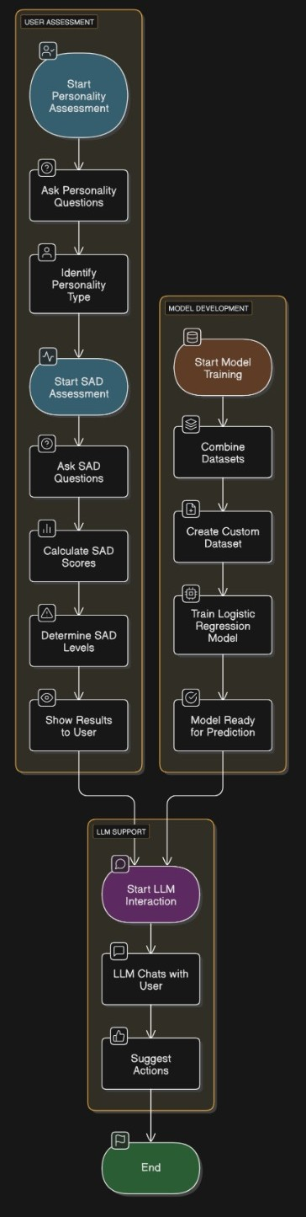
PROPOSED MODEL ARCHITECTURE

Slide 7
Model Used
We trained three separate Logistic Regression models for predicting:
Stress, Anxiety, and Depression levels
Input: 31 features from personality traits and questionnaire responses
Preprocessing: Data normalized using StandardScaler
Training setup:
penalty='l2', class_weight='balanced', solver='lbfgs’
GridSearchCV used for tuning C (regularization strength)
Output: Severity levels (Normal to Extremely Severe)

Slide 8
Why this Model?
Ideal for our classification task (severity levels as categories)
Handles imbalanced data well with class_weight='balanced’
Fast training & prediction, perfect for real-time apps
Scikit-learn’s multiclass support (one-vs-rest) fits our multi-label setup
A strong, interpretable baseline before exploring complex models

Slide 9
DATASET
Custom dataset with ~1000 entries, compiled from:
Public datasets
Original survey responses
Each entry includes 39 features, covering:
Big Five Personality Traits (10 questions)
Stress, Anxiety, Depression questions (21 total)
Demographics & Mood indicators
All responses are on a Likert scale (1–10)
No missing values; class labels are categorical severity levels

Slide 10
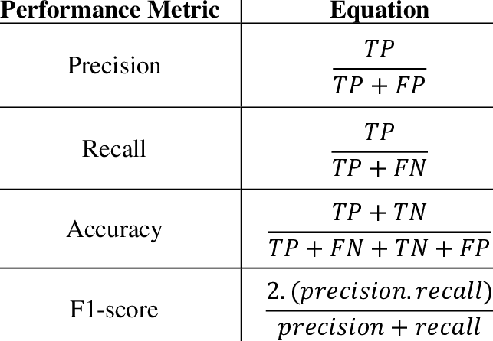
EVALUATION METRIC

Slide 11
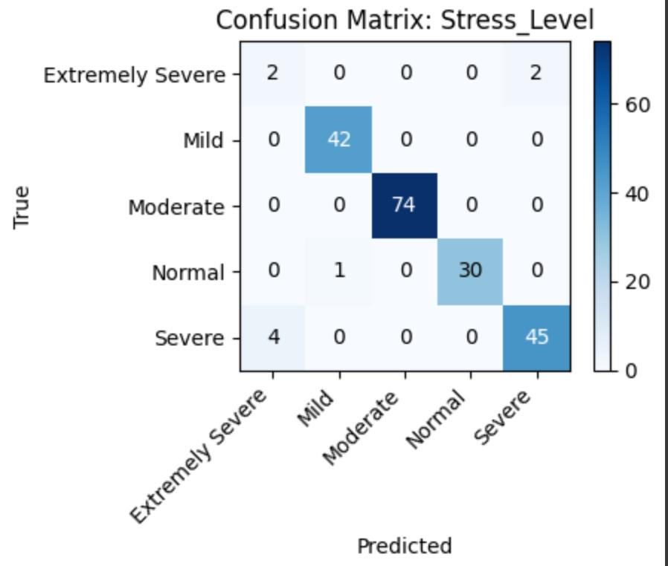
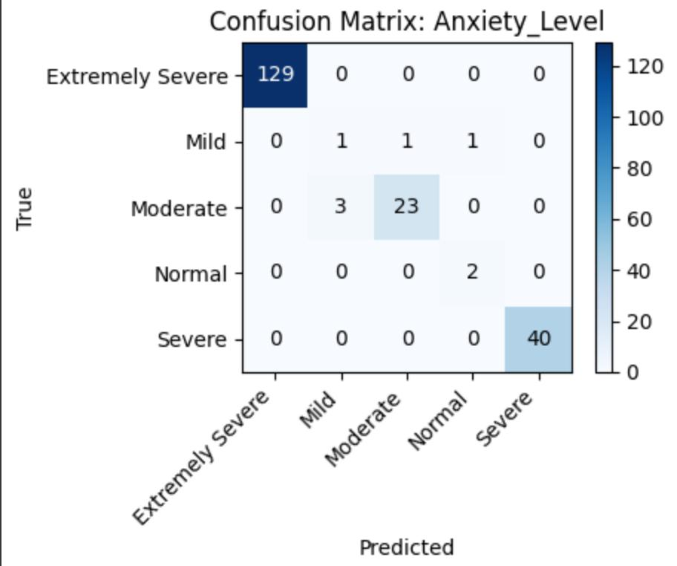
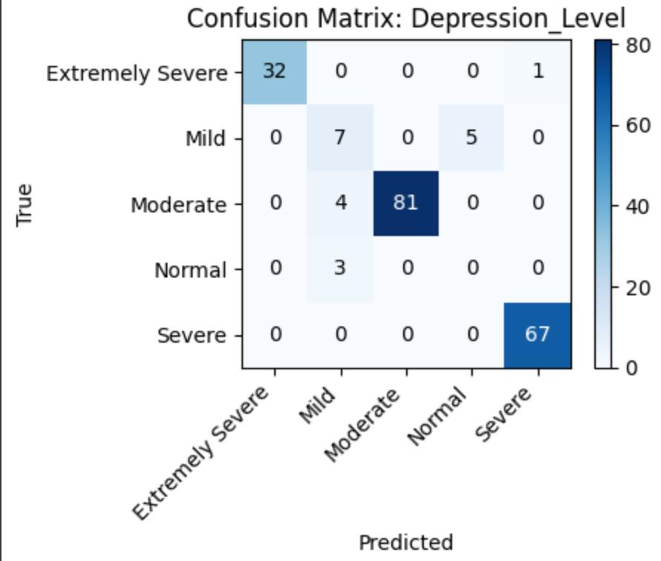
Confusion Matrices for S.A.D levels

Slide 12
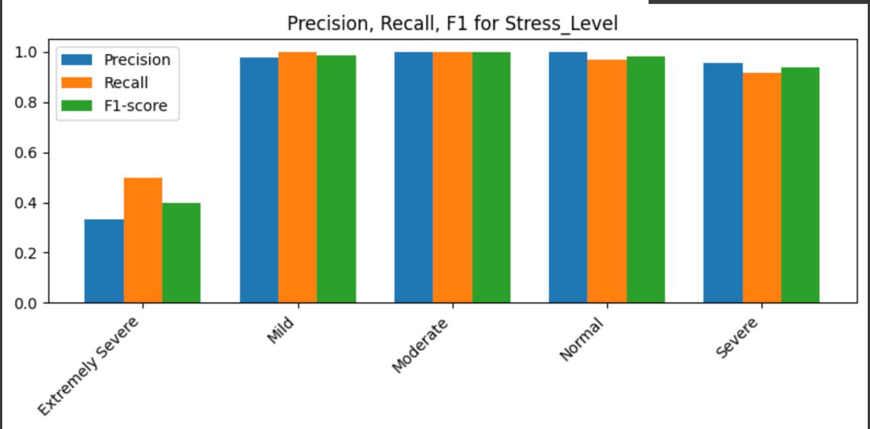
RESULTS

Slide 13
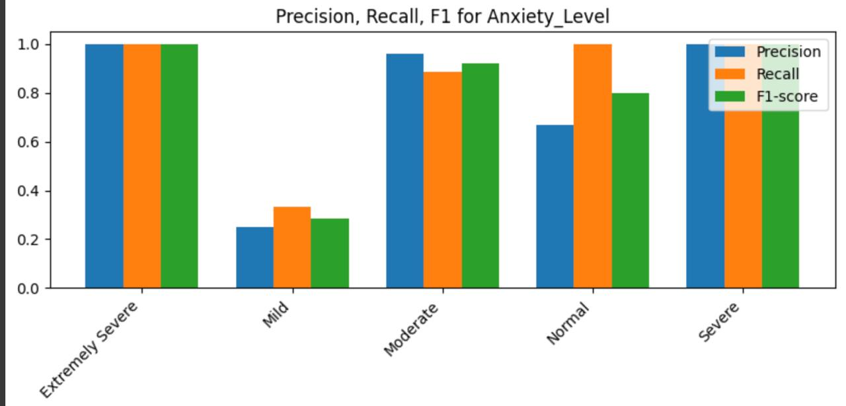

Slide 14
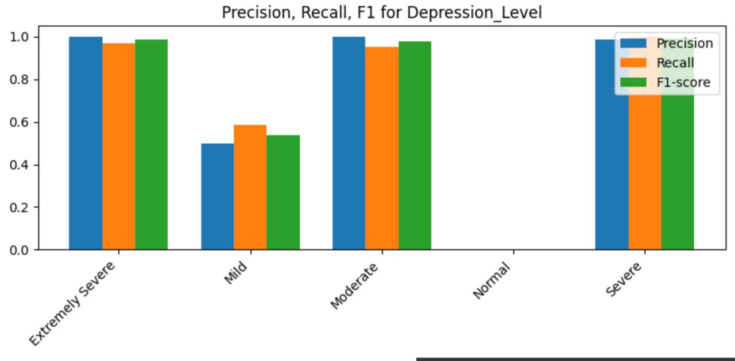

Slide 15
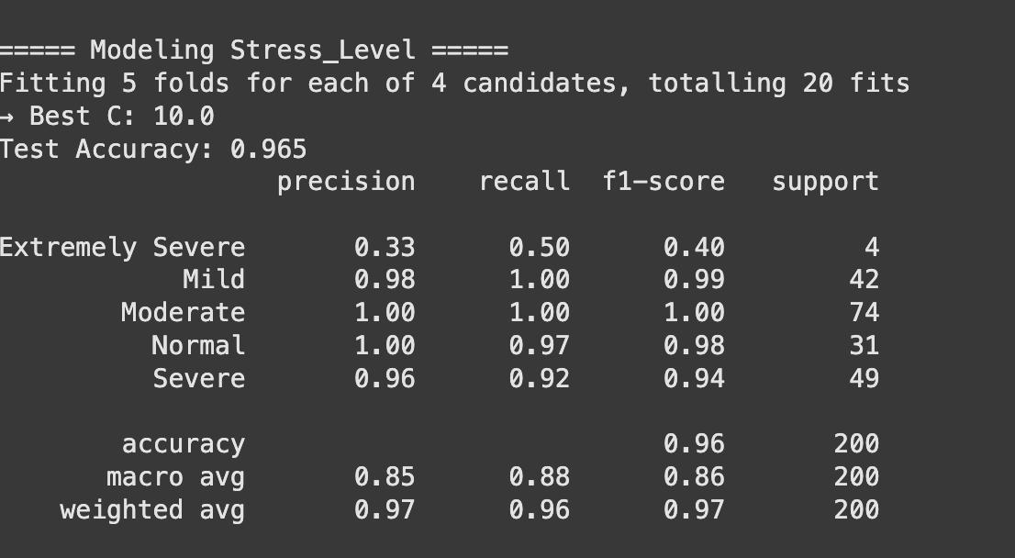
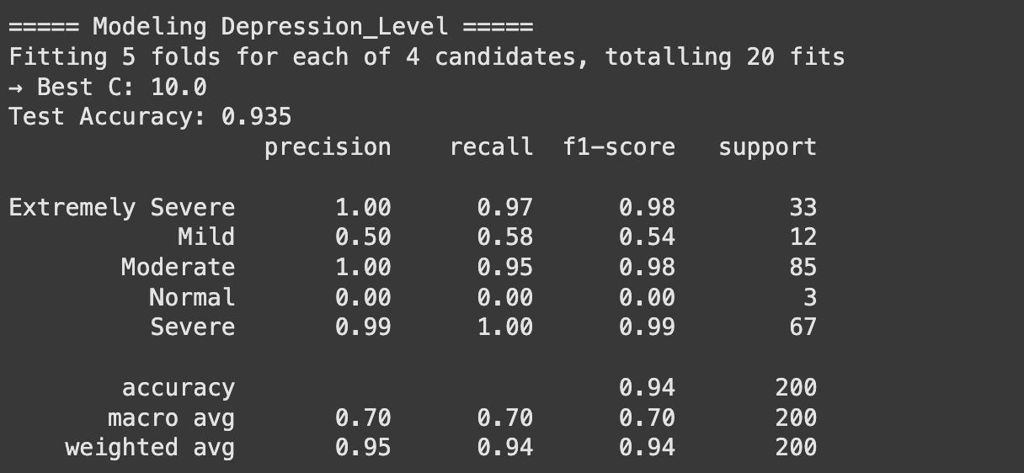
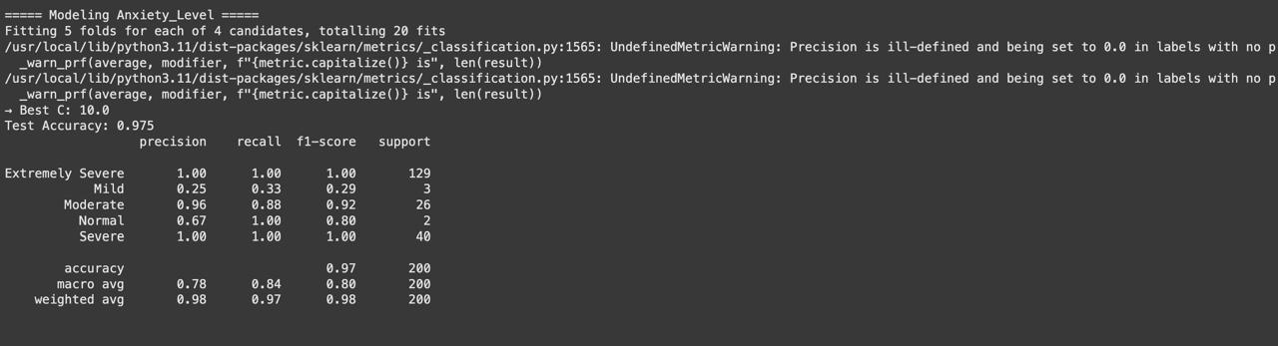

Slide 16
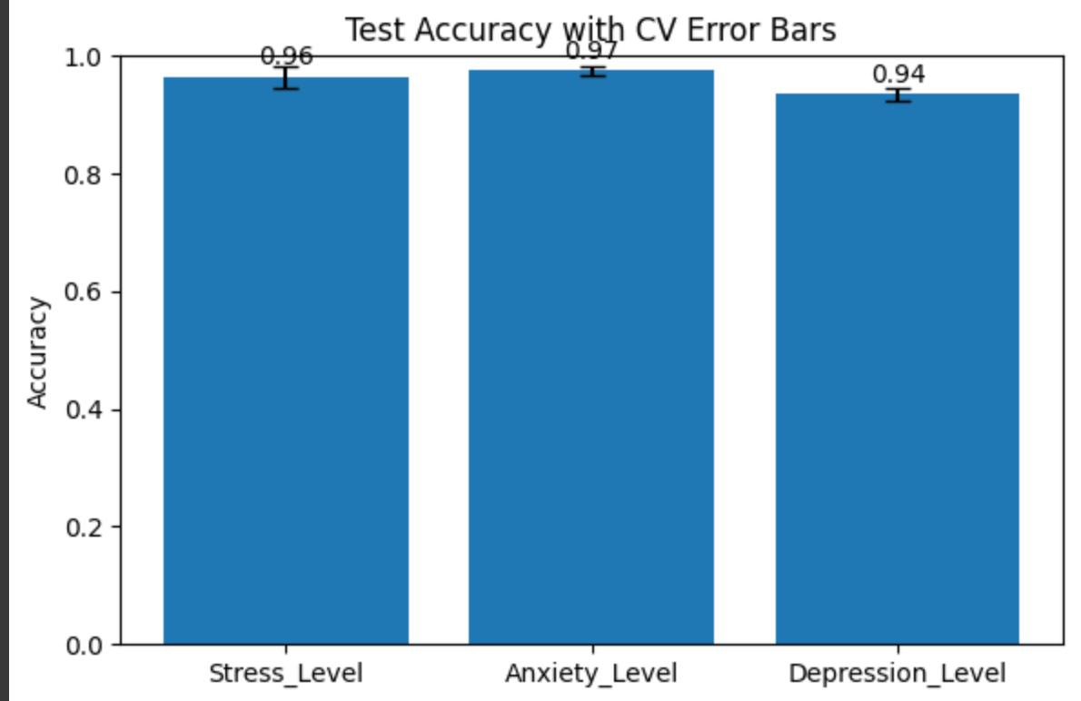

Slide 17
Future Scope
Deep Learning Integration: Expand to deep learning-based approaches for improved performance.
Larger Dataset Creation:Continue collecting more diverse and comprehensive data to improve the model's robustness and generalization across different populations.
Accuracy Improvement:Leverage a larger dataset to retrain and fine-tune models for better predictive accuracy and reliability.

Slide 18
REFERENCES
[1] Kumar, M., Murthy, P. R., Singh, S. (2020). Predicting Anxiety, Depression, and Stress in Modern Life using Machine Learning Algorithms. International Journal of Advanced Computer Science and Applications (IJACSA), 11(4), 1-10.
[2] Sharma, V., Gupta, R., Jha, R. (2020). Assessment of Anxiety, Depression, and Stress using Machine Learning Models. Journal of Medical Informatics and Decision Making, 2(1), 56-68.
[3] Bishop, C. M. (2016). Pattern Recognition and Machine Learning. Springer.
[4] Brown, T. et al. (2020). Language Models are Few-Shot Learners. Advances in Neural Information Processing Systems (NeurIPS), 33, 1877-1901.
[5] Lopez, R., Kim, J., Hassan, A. (2024). Analysis of depression, anxiety, and stress chaos among children and adolescents using machine learning algorithms. Child and Adolescent Mental Health Journal, 11(2), 133-157.

Slide 19
REFERENCES
[6] Taylor, C., Roberts, J. (2024). A machine learning approach for anxiety and depression prediction using PROMIS questionnaires. Healthcare AI Journal, 19(3), 89-110.
[7] Parker, L., Nguyen, T. (2024). Machine learning algorithms for predicting depression, anxiety, and stress in modern life. Journal of Psychological AI, 16(3), 201-223.
[8] Davis, H., Lee, C. (2024). An analysis of machine learning for detecting depression, anxiety, and stress of recovered COVID-19 patients. AI in Healthcare Research, 20(2), 78-99.

Slide 20
Thank You!

