Slide 1
Device-free Location-oriented Activity Identification Using Fine-grained WiFi Signatures
Aryan Sharma
UIN - 326006767

Slide 2
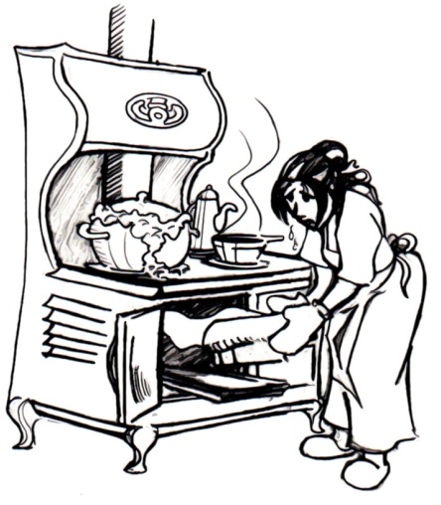



Motivation and Goals

Slide 3
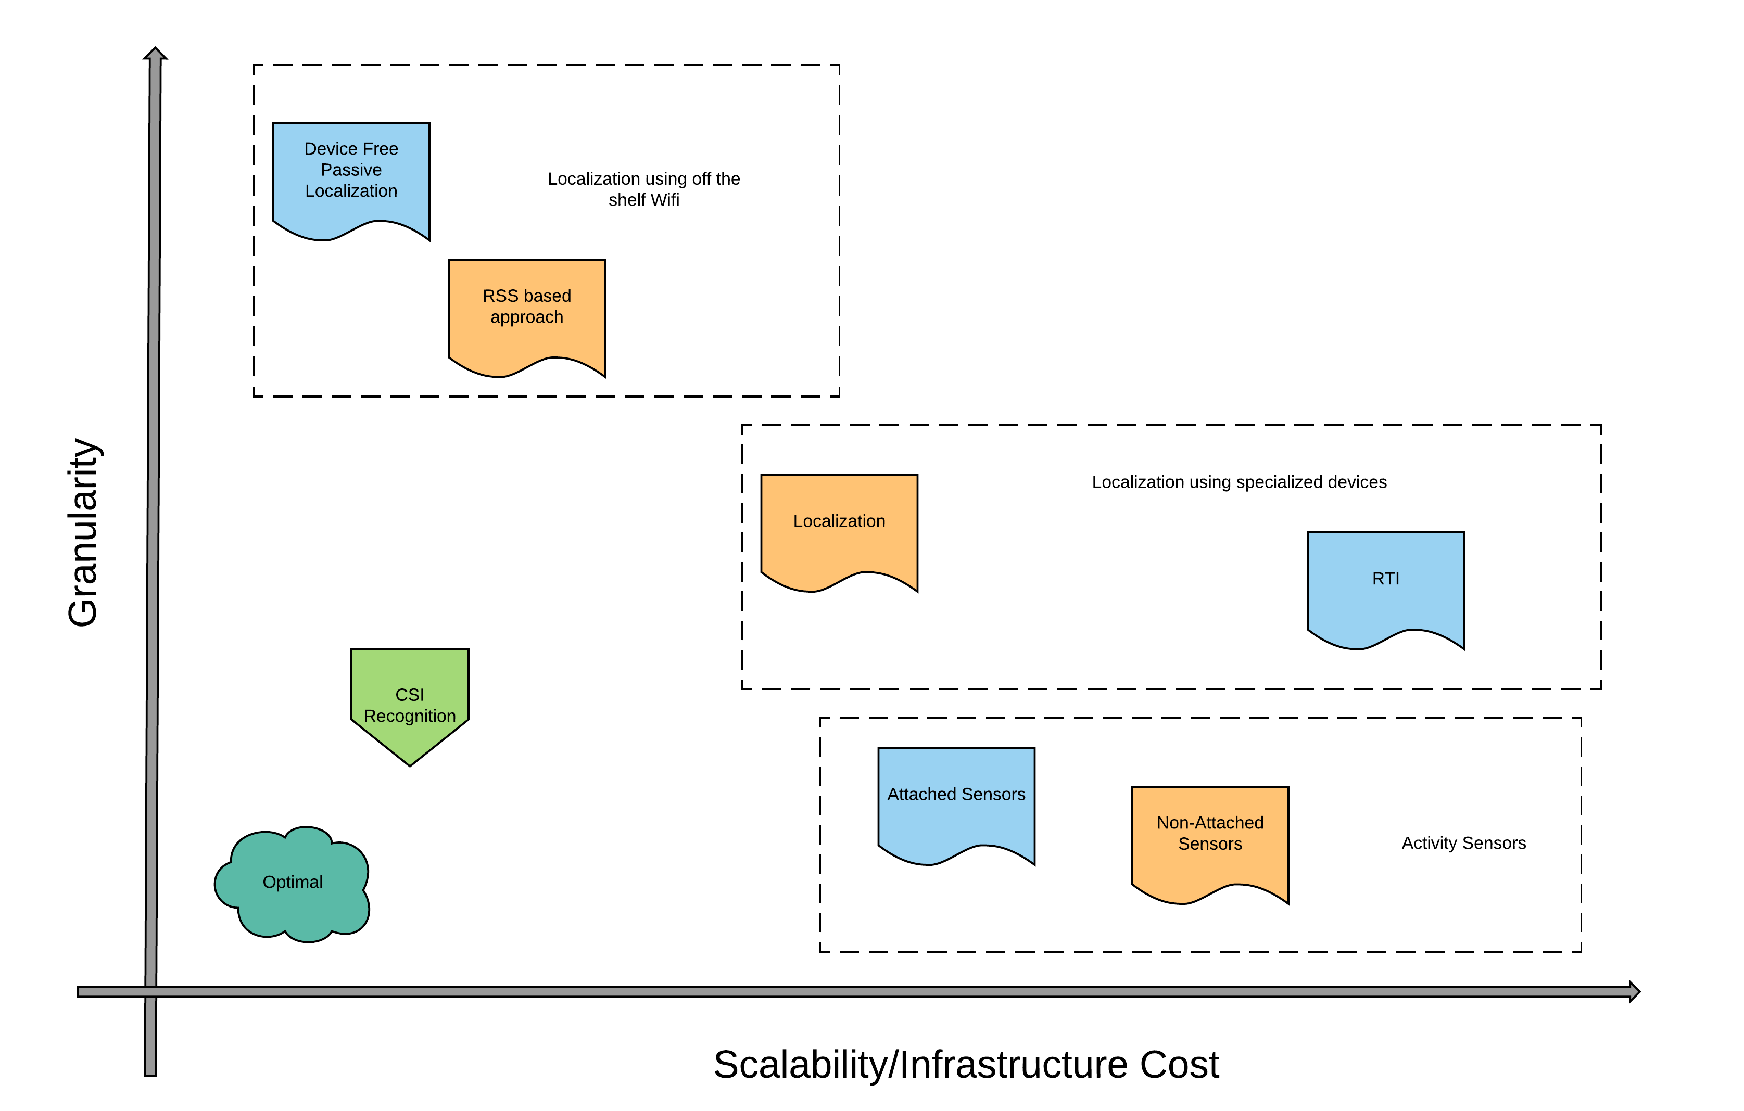
Goal: Low Cost Fine Grained Activity Identification

Slide 4
Intuition and basic Ideas
Increasing availability of WiFi signals in home environments
WiFi provides fine-grained channel state information (CSI)
Use CSI to capture changes of multipath environment

Slide 5


Uniqueness of Channel State Information

Slide 6
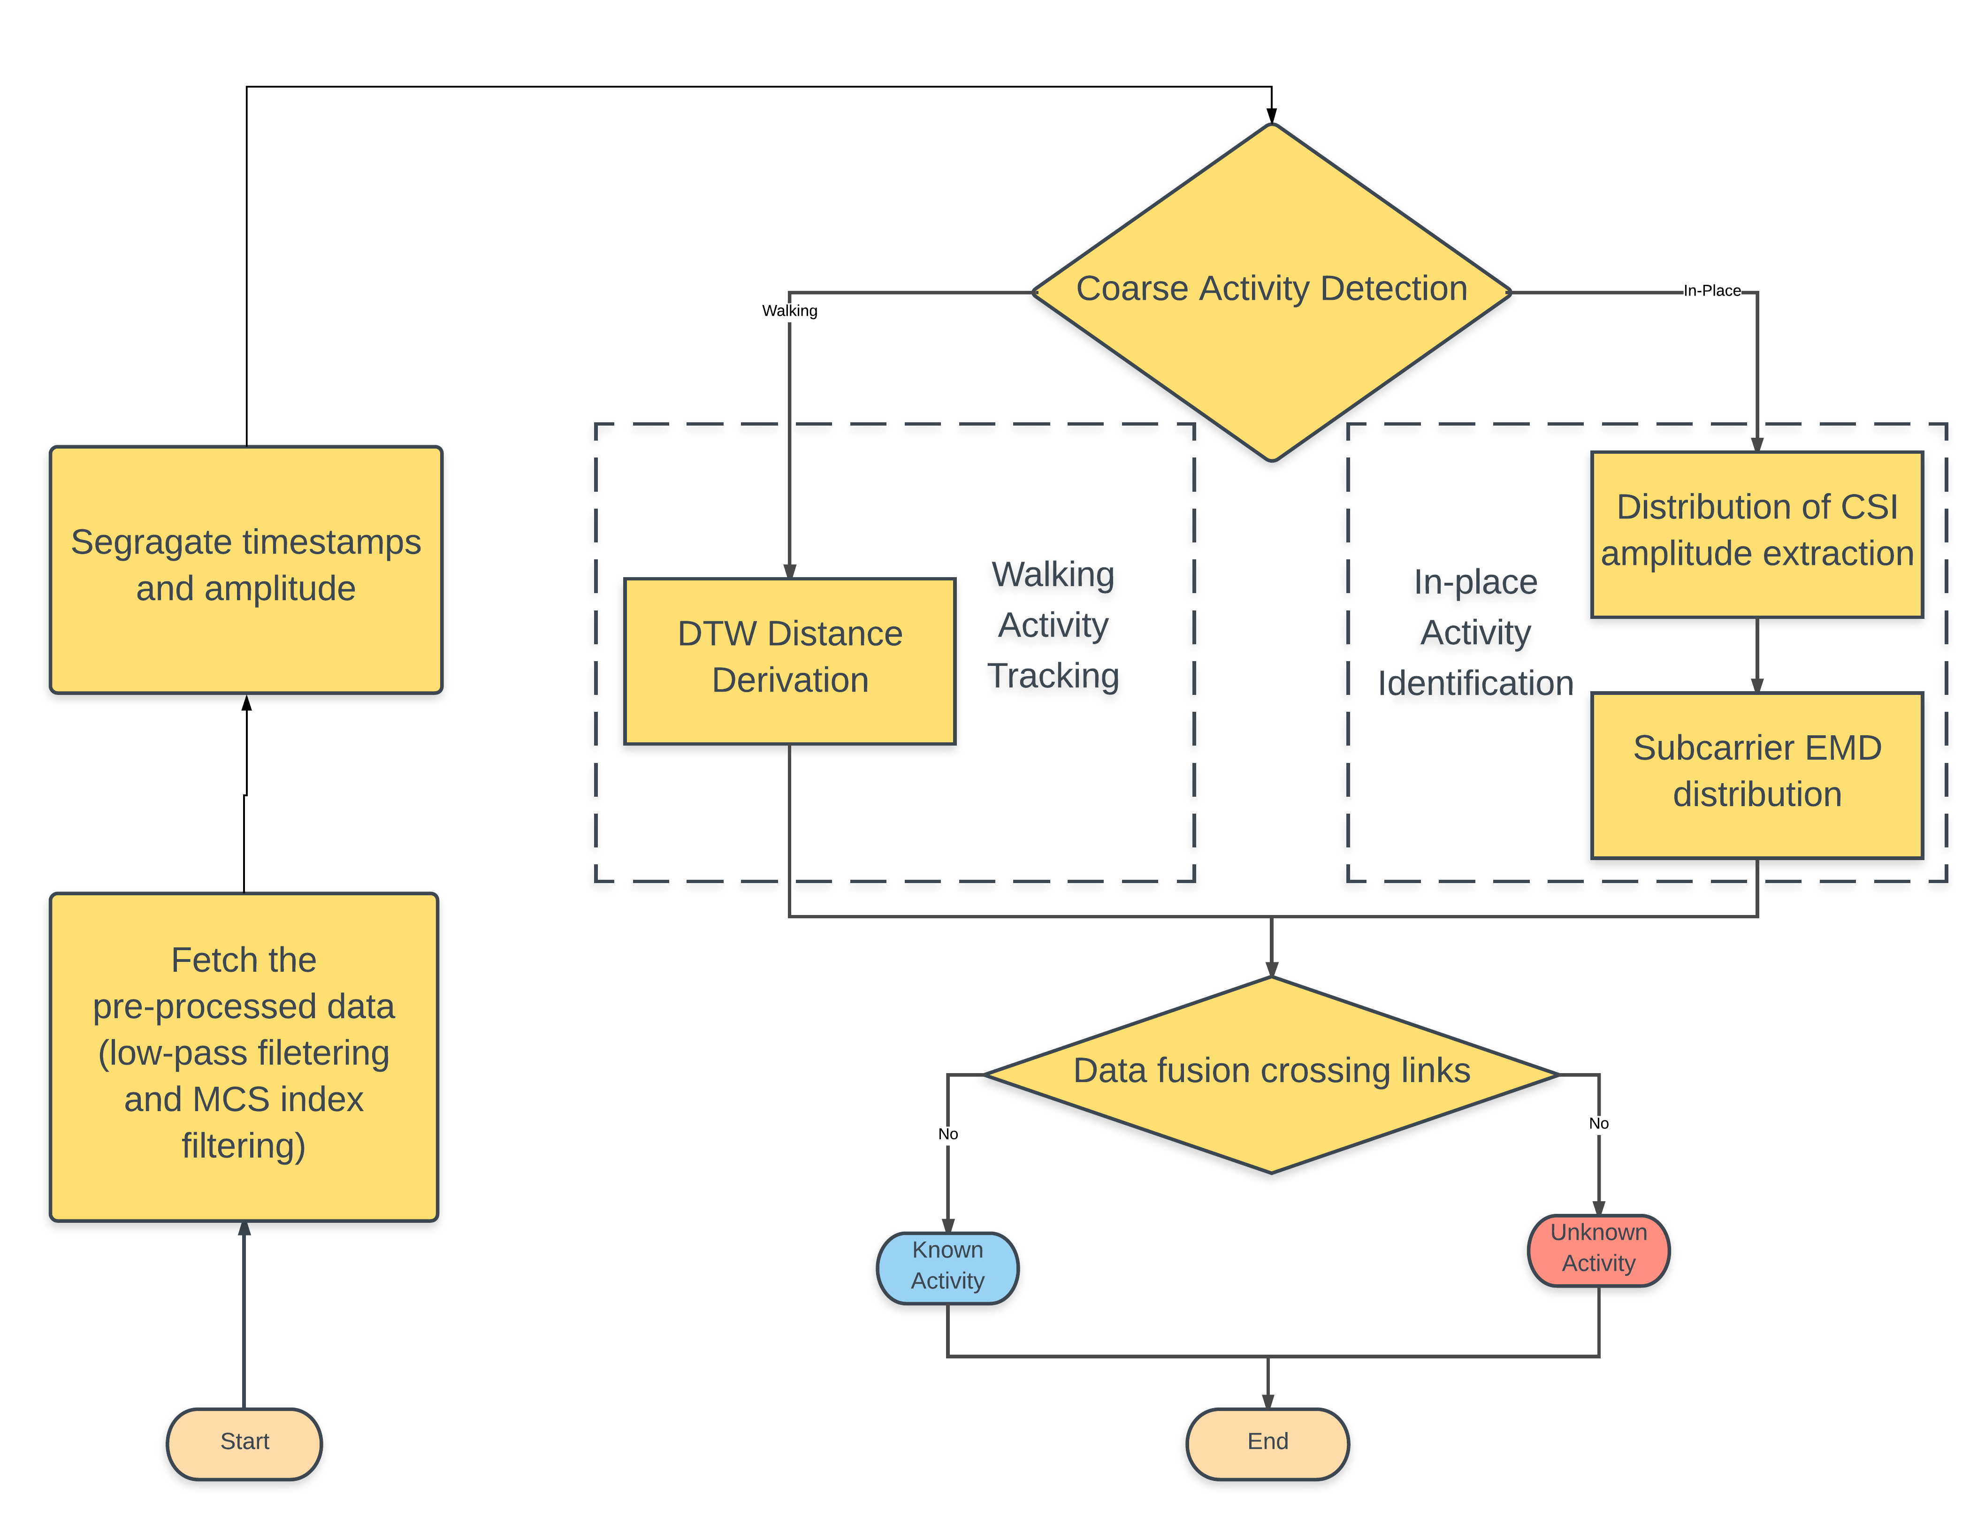
System overview

Slide 7
14.938 | 19.834 | 18.924 | 20.413
14.939 | 19.465 | 18.591 | 20.069
14.94 | 19.033 | 17.894 | 19.537
14.941 | 19.389 | 18.564 | 19.471
14.942 | 19.056 | 17.867 | 19.056
14.943 | 20.243 | 18.315 | 20.898
14.944 | 18.389 | 17.945 | 18.42
14.945 | 19.221 | 18.006 | 19.195

Slide 9
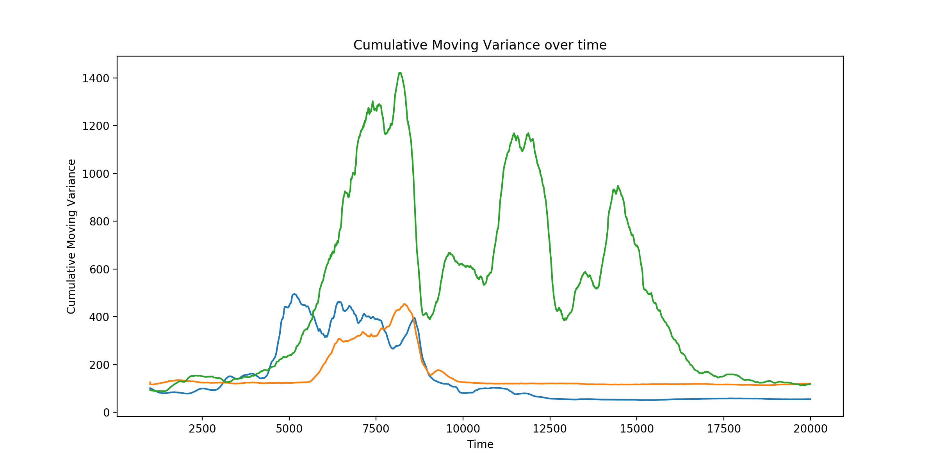
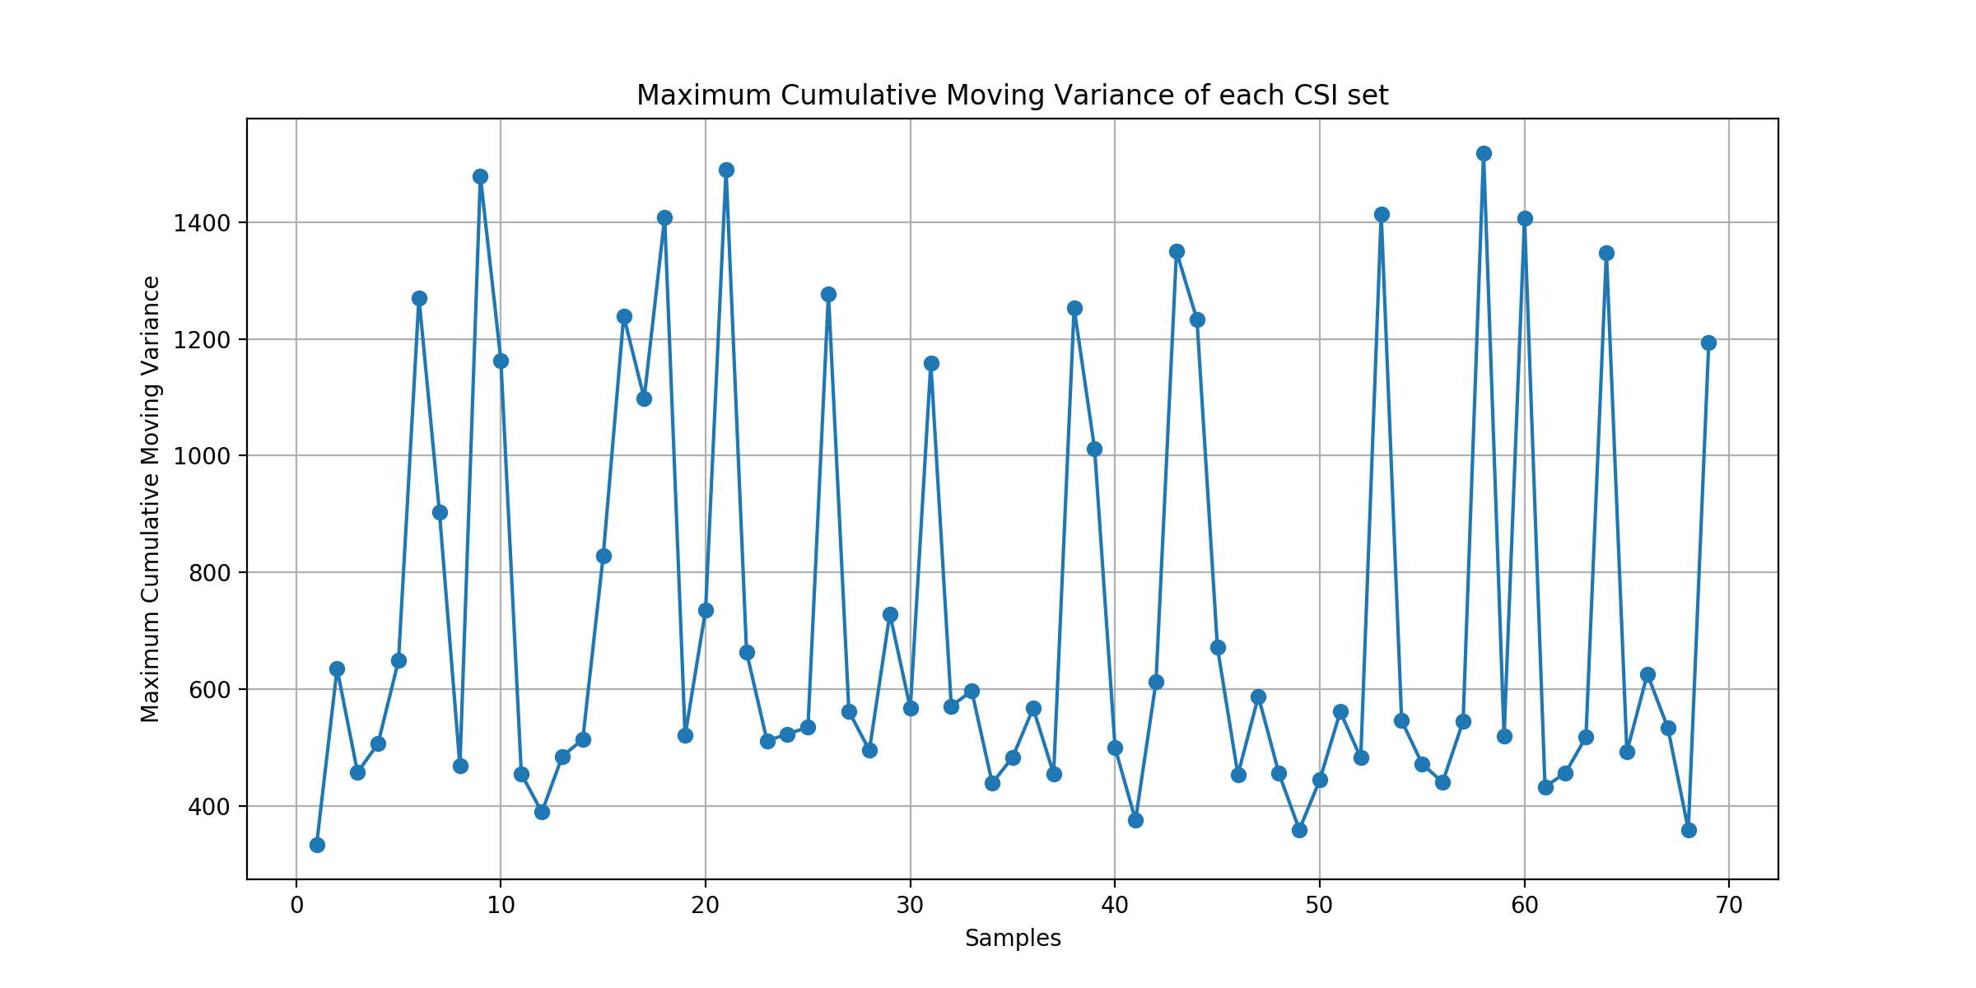
Coarse Activity Detection
Various activities causes different degrees of signal changes.
A large moving variance indicates the presence of a walking activity whereas a small moving variance represents the presence of an in-place activity or no activity at all

Slide 12


In-Place Activity
CSI amplitude distributions are similar for the same activity at different rounds, but distinctive for different activities.
Earth mover’s distance (EMD) technique is employed for evaluating the similarity between two probability distributions

Slide 15
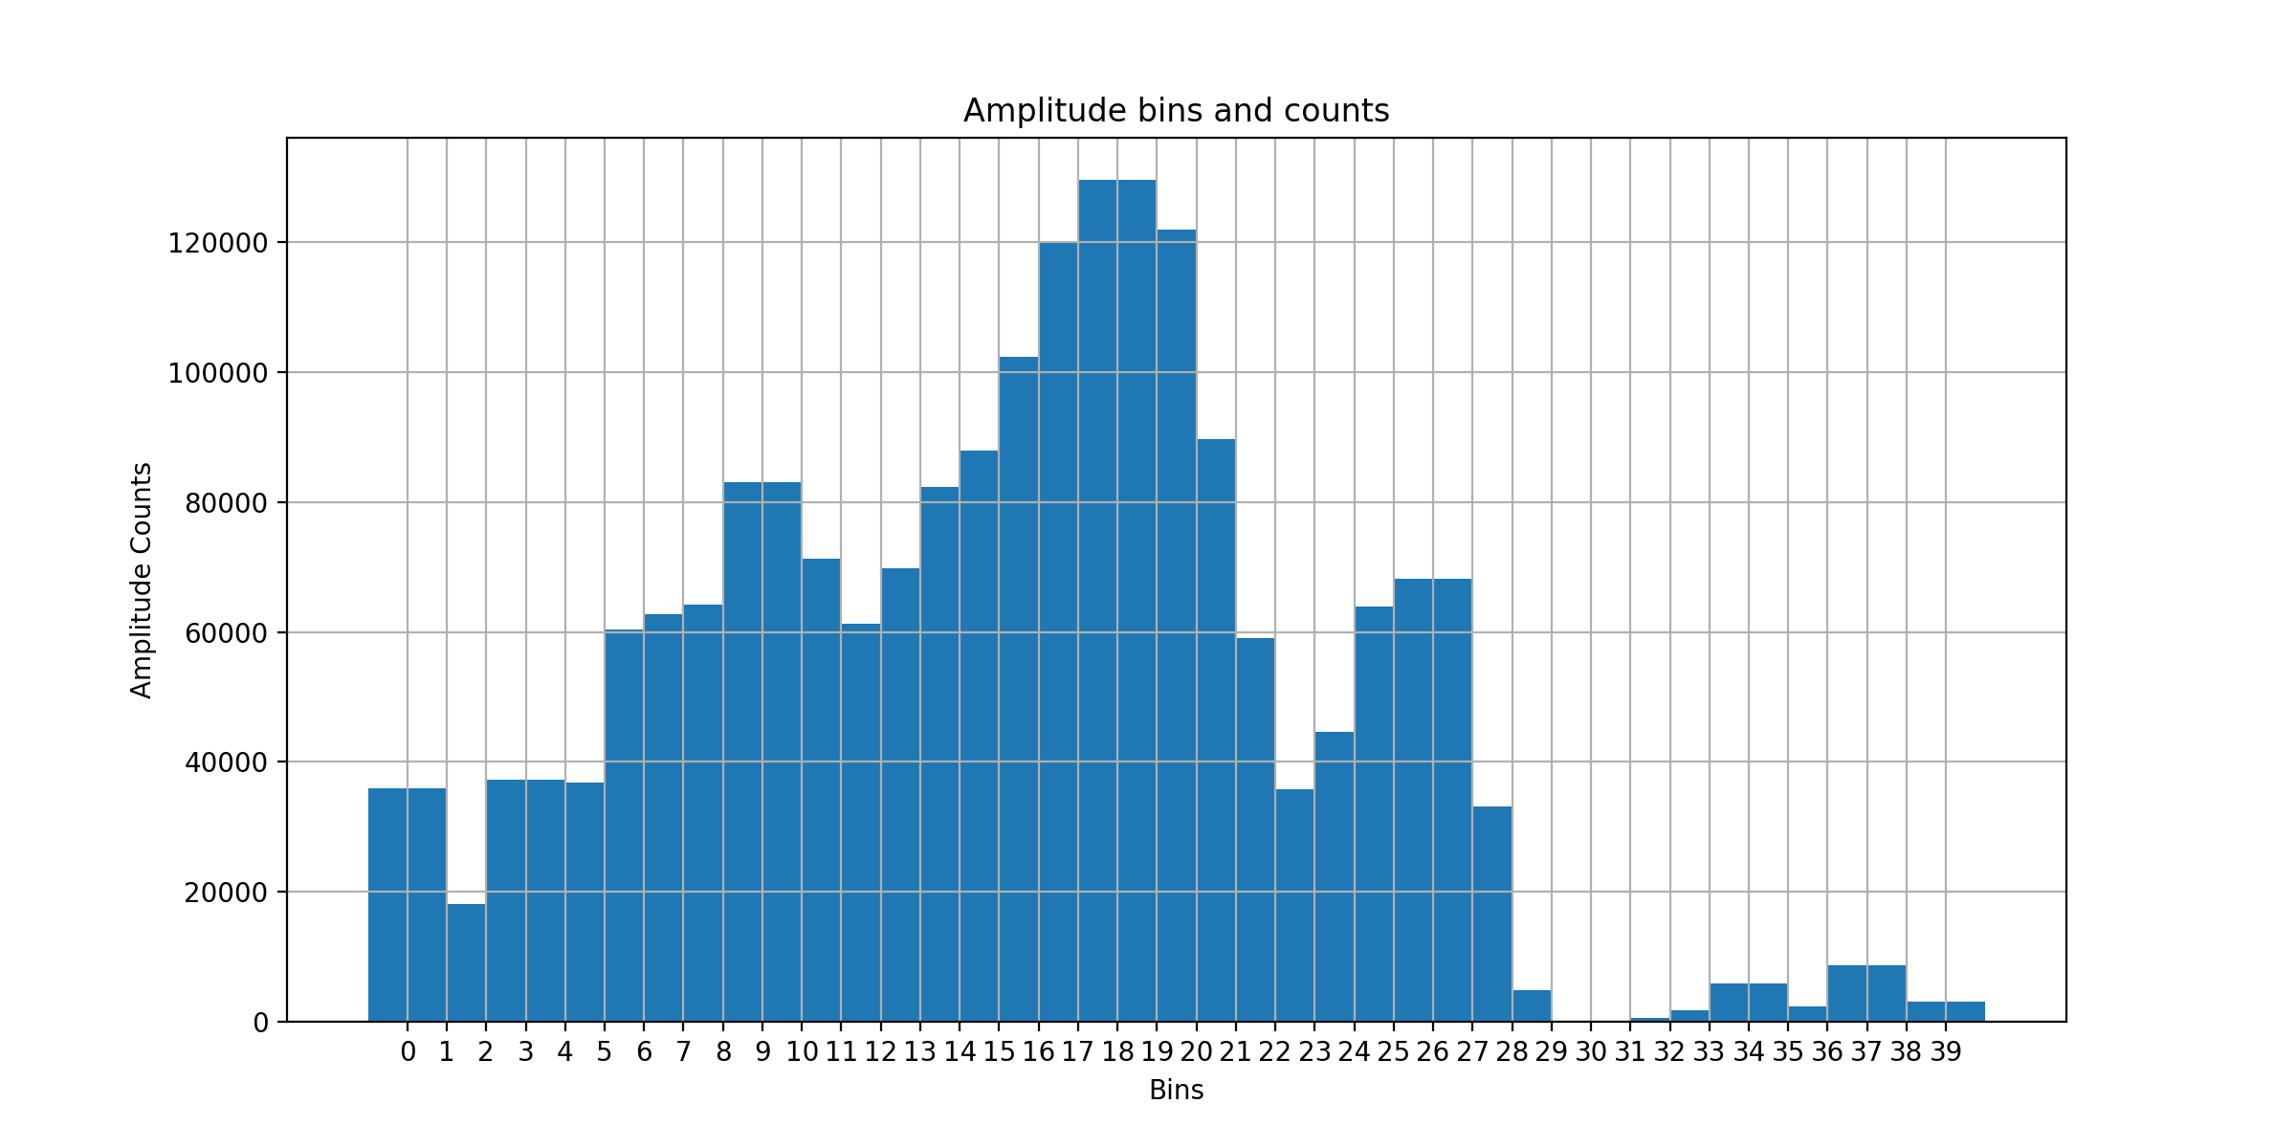
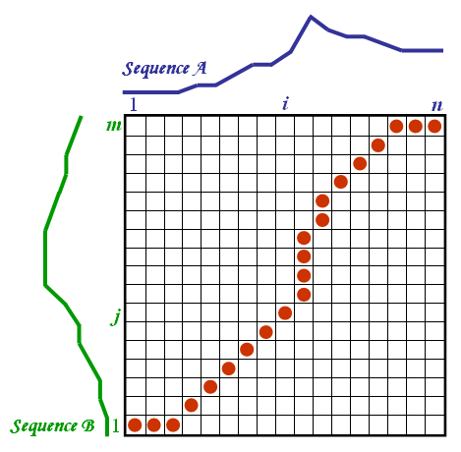
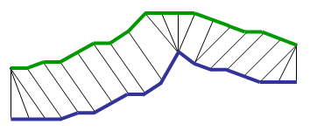
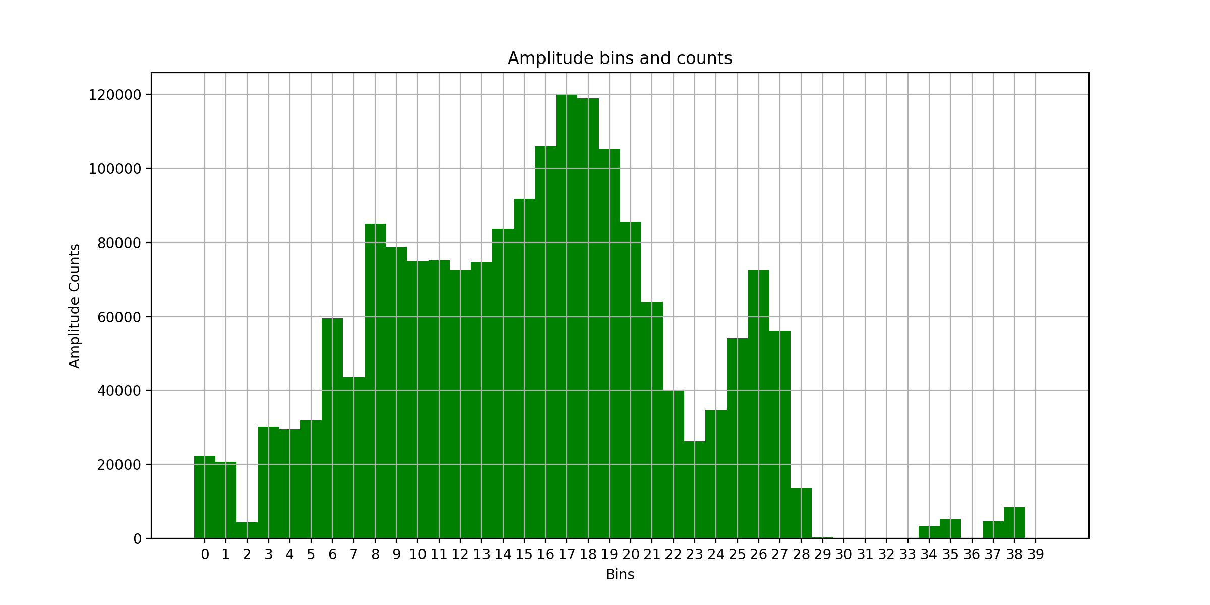
Walking Activity Tracking
The CSI measurements exhibit similar patterns for the same trajectory in different rounds.
To do the Walking Path Discrimination Multi-Dimension Dynamic Time Warping (DTW) is used.
DTW is to align the testing CSI measurements to those of known activities in the profile.

Slide 18
Data Fusion
Can use multiple access points to improve the activity recognition accuracy based on the basic schemes.
The final activity recognition result is that profile which minimizes the weighted summation of the similarities between the collected CSI measurements and the profiles on each WiFi device
This project assumes that there is no movement or replacement of wireless devices

Slide 19
Conclusion and Things learnt
Show that the channel state information (CSI) from off-the-shelf 802.11n devices can be utilized to identify and distinguish in-place activities inside a home
Develop a monitoring framework that can run on a single WiFi AP and use the associated profile matching algorithms to compare amplitude profiles against those from known activities
Learnt to compare two data distributions under various cicumstances using EMD, DTW.
Learnt to design experiment test bed and collect and process data.

