Slide 1
Smart Waste Classification System
By- Aryan Saamal(1000208)
Dibyajyoti Swain

Slide 2
Project Overview
This project focuses on building an AI system that classifies waste into categories like paper, plastic, metal, and biological waste using image recognition.
It recommends the correct bin color (Green, Blue, or Red) based on the waste type, reducing human error and improving recycling efficiency.
All images resized to 224x224 pixels for uniform input.
Augmentation applied using rotation, flipping, brightness adjustment, and zooming.
Enhances dataset variety and model accuracy.
User-friendly web app built using Streamlit.
Allows users to upload waste images.
Displays predicted waste type, confidence score, and suggested bin color.
Designed to be clean, responsive, and easy to use.

Slide 3
Model Used
• YOLOv8-L classification model (Large version).
• Trained on custom dataset to recognize waste categories.
• 'best.pt' weights file saved after training for highest accuracy.
• Fast, efficient, and ideal for real-time object classification.
100 images from each folder was selected for training and it took more than 12 hours to train the model. (Total of 1000 images were trained)

Slide 4
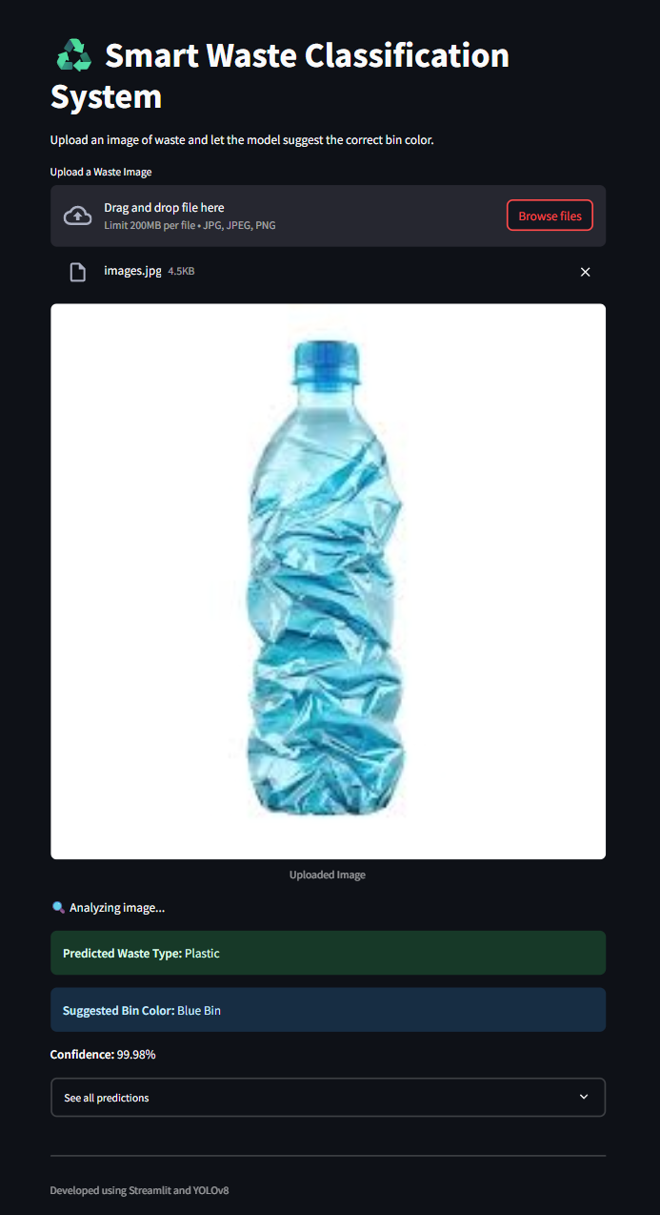
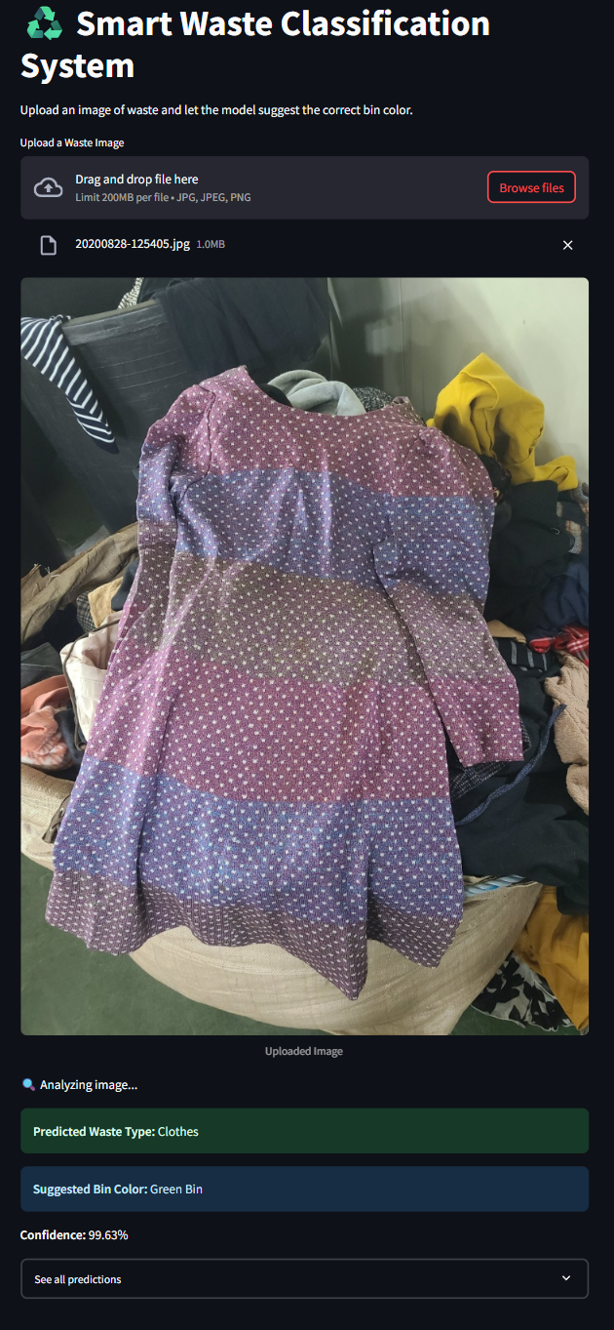
Output

Slide 5
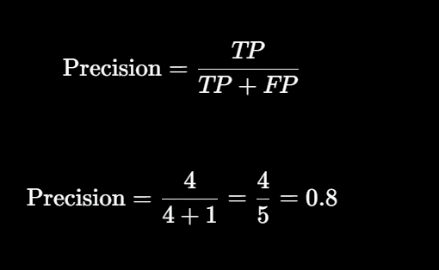
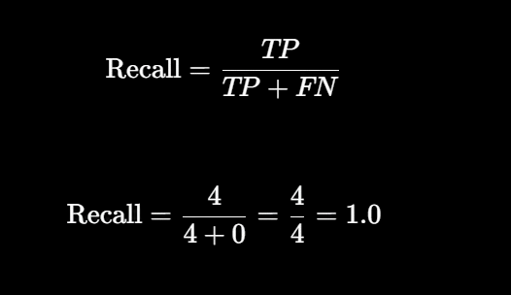
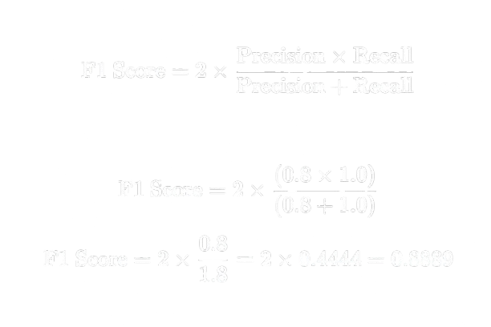
Evaluation matrix
An F1 score of 0.88 indicates strong model performance with high accuracy and balanced precision and recall.

Slide 6


