Slide 1
"People rarely succeed unless they have fun in what they are doing."
Dale Carnegie

Slide 2


Inc^{(Ognito)}AGE
AGE
^{(COGNITO)}
^{(OGNITO)}
INC
"To the Sageins, for the Sageins, by the Sageins"

Slide 3


Visionaries:
Vision:
Our Aim is to create a fun android application for the youth of today, we aim to create a new chatting experience, in which people can enter chat room according to their location.
The user can choose any chat room available in their locality and can chat & gossip with people anonymously.
Aayush Khare
20BTE3CSE10001
Aryan Sahu
20BTE3CSE10008

Slide 4
Incage is an web based social media application, which enables a new way of interacting with people on social media.
In this application you are not required to enter your personal information.
You can connect to people who are physically 'near you' as our application create chat rooms according to localities.
It is a 'truly secure' social platform as your sensitive and personal information will not be leaked, even to the admin.
AGE
INC
^{(COGNITO)}

Slide 5

RoadMap
Identification
Learning & mastering the tools
Testing
Designing the Web Pages
Coupling the web pages & the sockets
Packaging and delivering

Slide 6





Technology used
HTML
CSS
JAVASCRIPT
NODE JS
SOCKET IO

Slide 7
HTML
JS
CSS
WORKING
The three main languages for making a web application are HTML, JS, CSS . These three are the most important and essential language for web development .
HTML can be seen as the BUILDER
CSS can be seen as the ARTIST
JS can be seen as the WIZARD

Slide 8

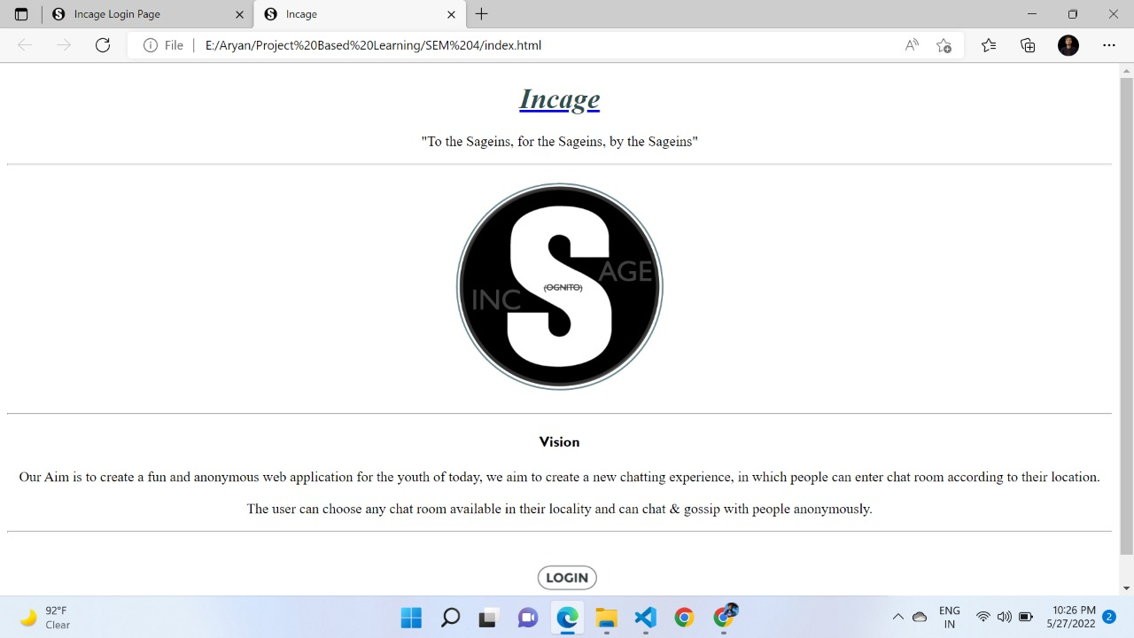
HTML WORKING
THE BUILDER , it is used for creating detailed instructions concerning style, type, format, structure and the makeup of a web page before it gets printed
It gives author the means to publish online documents with heading, text, tables, lists, phones, etc. HTML code ensures the proper formatting of text and images for your internet browser .
It helps you to understand how to make things more accessible .

Slide 9
SOCKET.io
Socket.IO is an evet-driven JavaScript library for real-time web applications . It enables real-time, bi-directional communication between web clients and servers. It has two parts: a client-side library that runs in the browser, and a s server-side library for Node.js.
Socket.IO primarily uses the Web Server protocol with polling as a fallback option, while providing the same interface. Although it can be used as simply a wrapper for WebSockets, it provides many more features, including broadcasting to multiple sockets, storing data associated with each client, and asynchronous I/O.

Slide 10
ThankYOu :)
Good afternoon
Open to questions!

