Slide 1
SECURE
A desktop application
Presentation by :-
Aayush khare
Aryan sahu
Piyush shashtri
Guided by :-
Prof. Nikhil Chourasiya

Slide 2
SECURE
What is secure ?

Slide 3
Secure is a desktop application which can be used for various tasks and can be installed on various devices, it is specially designed for maintaining the record of the users.
Secure is a application which Is launched as soon as the desktop booted up and the user can only use the system after logging in it , after logging in it the details of user is stored in its data server .
It will maintain the record of the user for:-
For how much time the user has used the pc
Attendance of the user
Whether user has shut down the system properly or not
For security purposes
Secure is programmed with the help of two languages which are JAVA and Apache derby

Slide 4
Problem identification
How we came up with this idea

Slide 5
Its a time consuming process to take attendance of multiple students , so SECURE desktop application is a time saving application with its own benefits, it will not only take attendance but it will also allow the teacher to know which student was sitting at that system for how much time and whether student has shut down the system properly or not . So it’s a transparent wall between the user the teacher.
STUDENT
SECURE
TEACHER

Slide 6
Roadmap
Downloading jdk.
Ddesigning the application.
Appling JDBC(to connect your application to the database created.)
1
3
5
2
4
6
Downloading NETBEANS and installing it .
Downloading Apache derby
Running and finding the errors o make it better for future.

Slide 7
TECHNOLOGY

Slide 8
Uses of languages
JAVA
It is a general purpose and object oriented programming.
Java is well known for building GUI based desktop application .
There are numbers of java frame works available for making GUI desktop application. For ex. AWT, JavaFX, Griffon, and many more.
Apache derby
It is a open source relational database management system .
Its been used for linking our desktop application to the data server where all the information will get stored.

Slide 9
HARDWARE

Slide 10
You can also split your content
FOR USER
FOR SERVER
CPU:- intel core i3
Ram :- 4gb
Memory :- 8 gb or more
Os :- windows 7 or higher

Slide 11
FINAL OUTPUT & METHODOLOGY

Slide 12
METHODOLOGY
Step by step

Slide 13
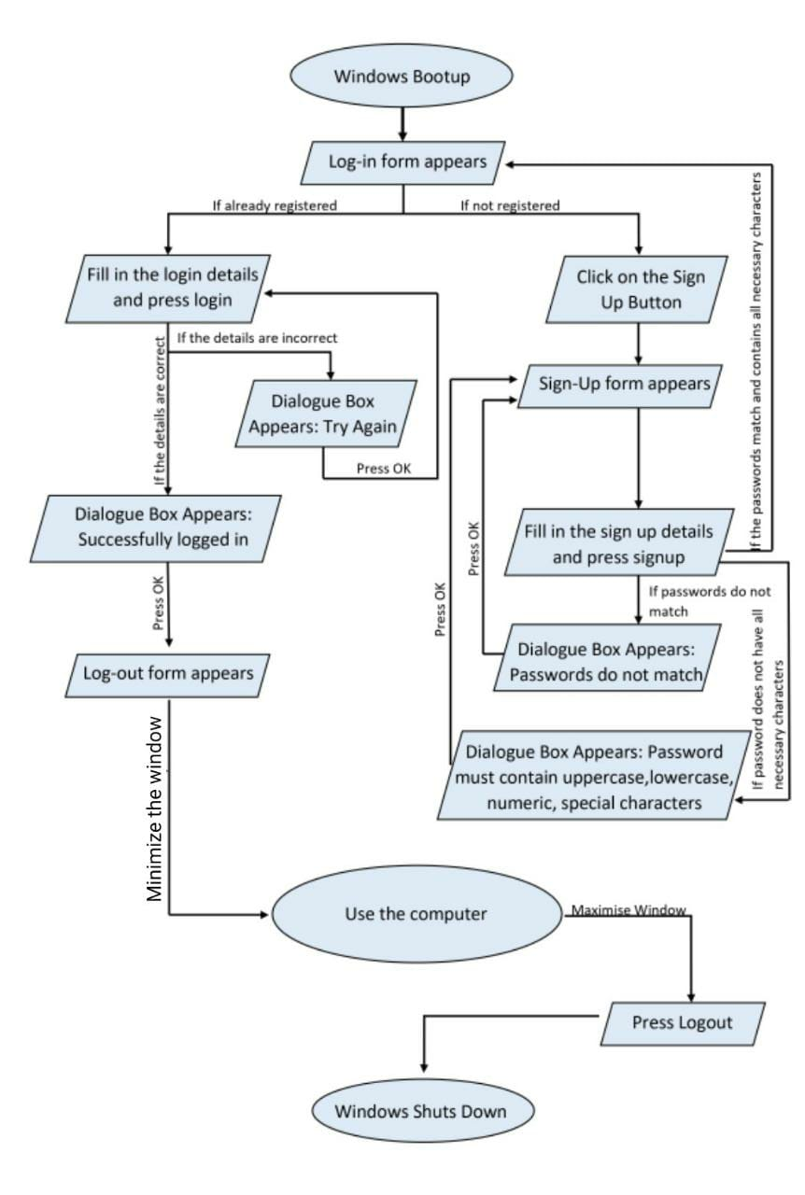

Slide 14
LOGIN PAGE
Login page .
If student is not registered or entered the login details wrong.
Successfully login.

Slide 15
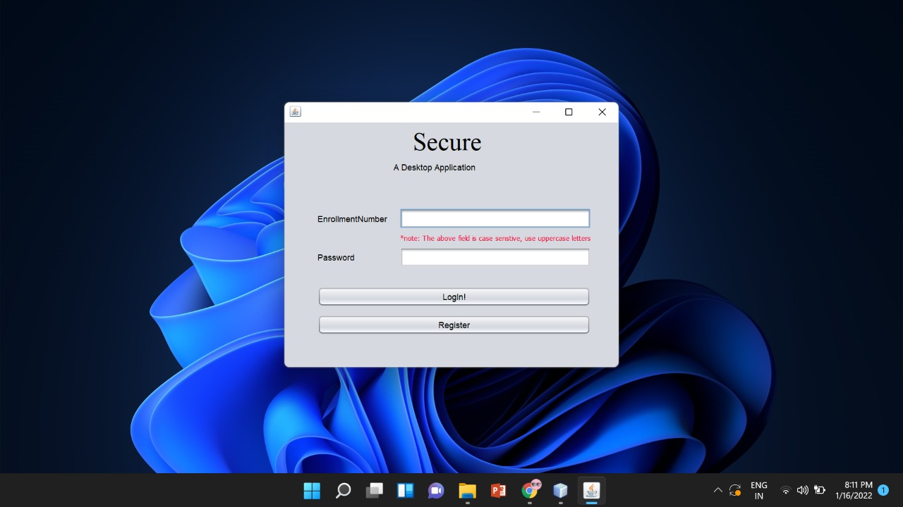
1. Login page

Slide 16
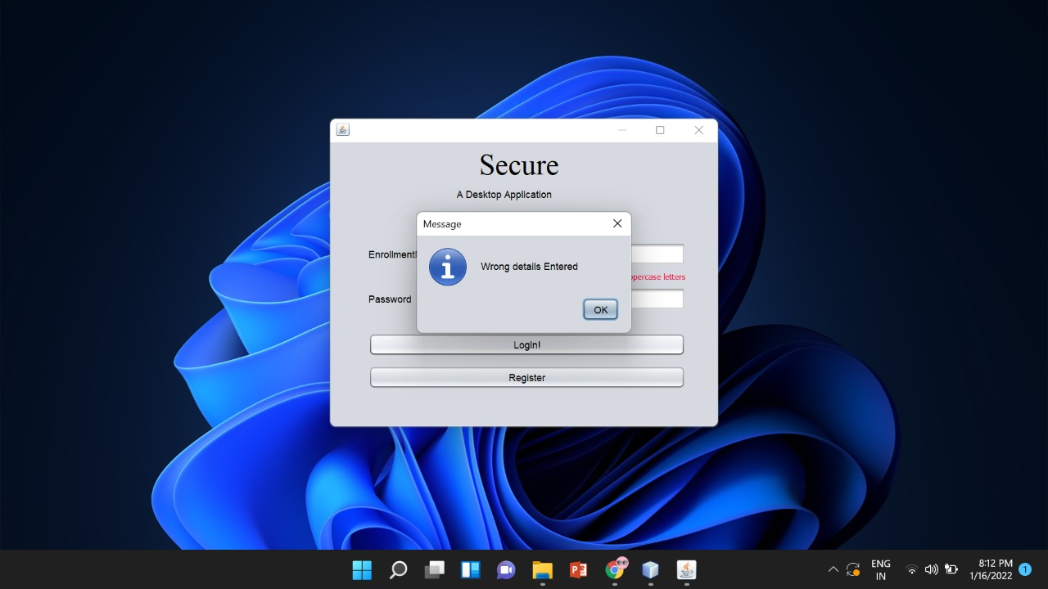
2. If student is not registered or entered the login details wrong.

Slide 17

3. Successfully login .

Slide 18
REGISTRATION FORM.
Filling registration form.
Password does not match.
Password should be in uppercase.
Registered successfully.

Slide 19
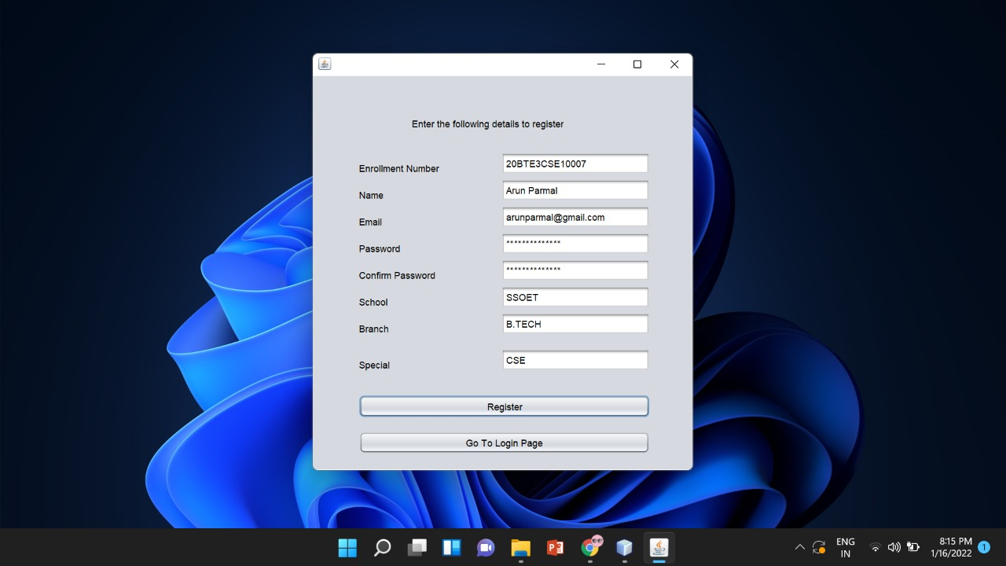
1. REGISTRATION FORM.

Slide 20
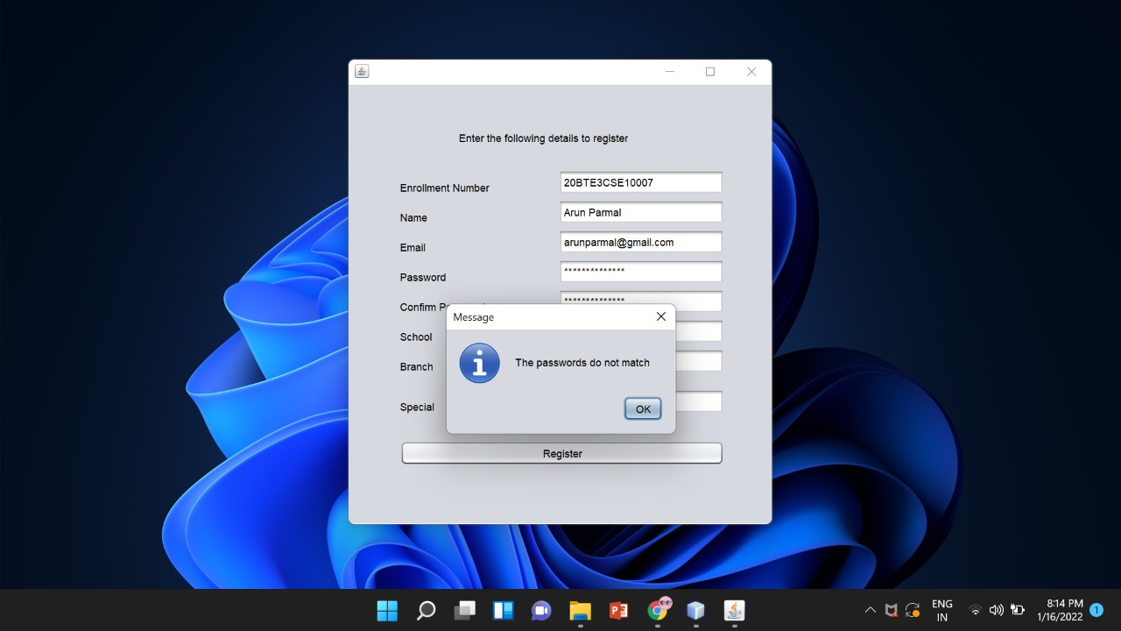
2. Password does not match

Slide 21
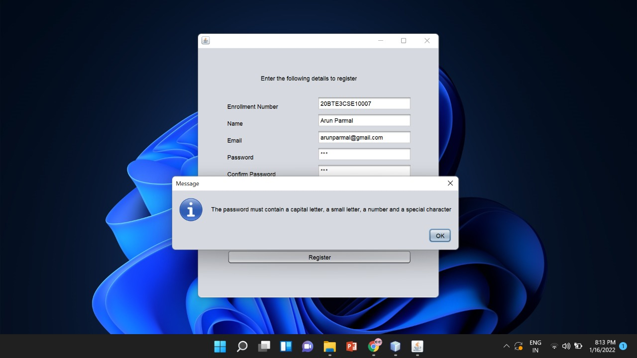
3. Password should be in uppercase

Slide 22
4. Registration successfully

Slide 23
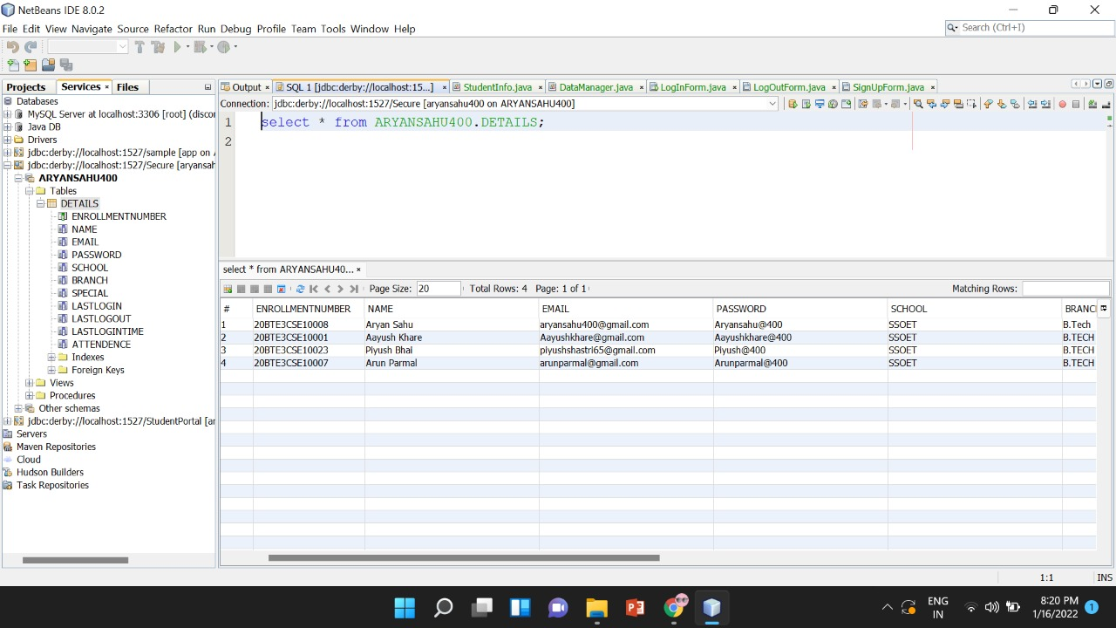
DATA BASE

Slide 24
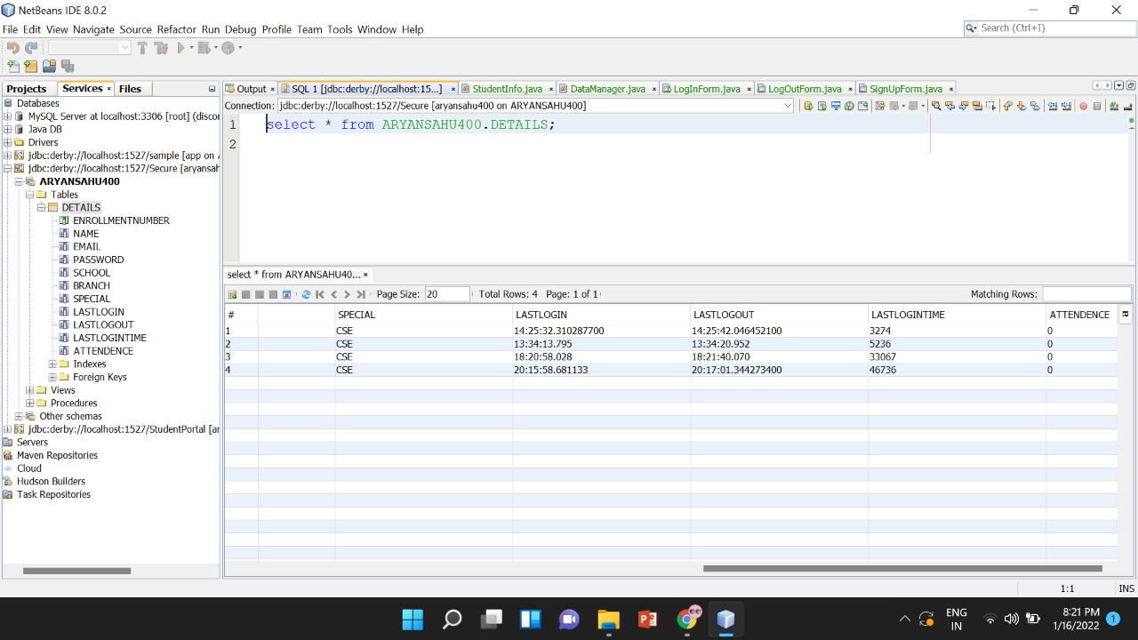
DATE BASE

Slide 25
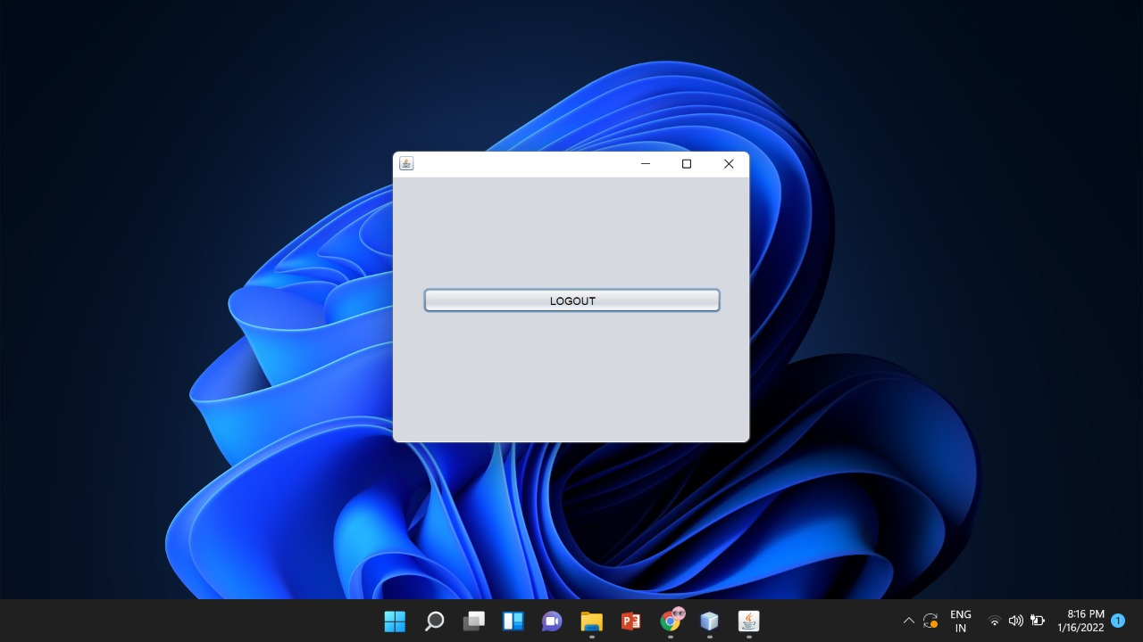
LOG OUT

Slide 26

LOG OUT

Slide 27
Thanks!
Any questions?

