Slide 1
rapecaseanalysis
File created on: 27-12-2022 00:33:26

Slide 2
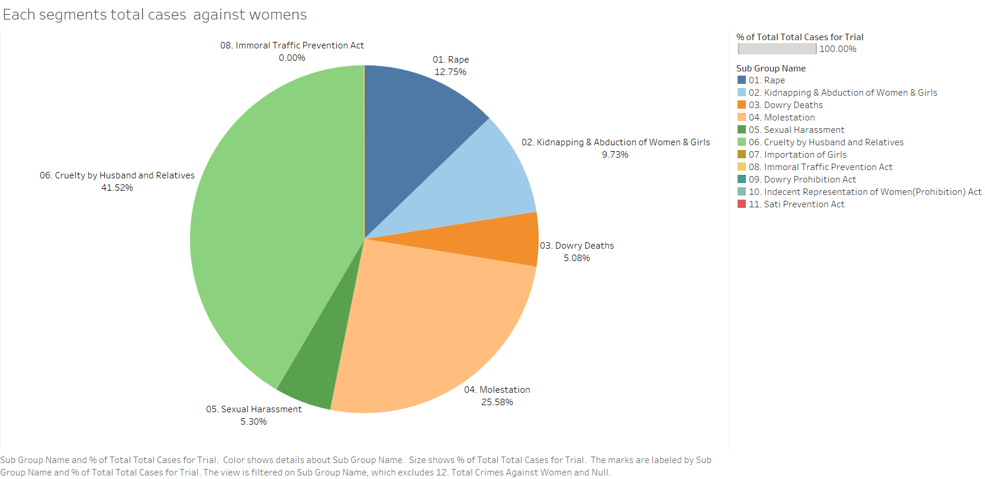

Slide 3
