Slide 1
StatewisePropertystolenandrecovered
File created on: 27-12-2022 00:36:59

Slide 2
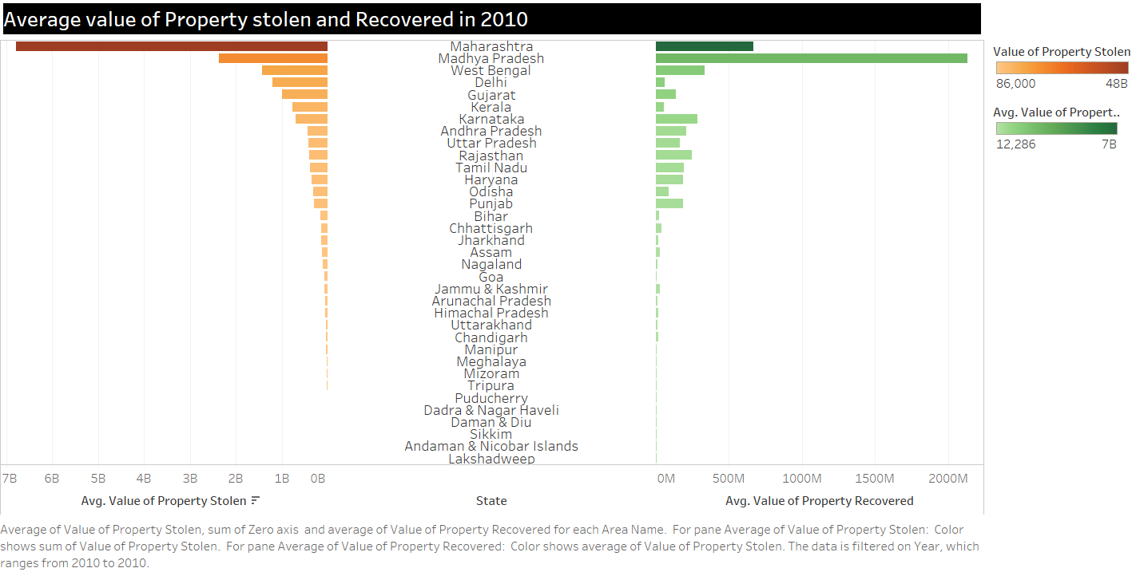

Slide 3


