Slide 1
Analysis of Food and Beverage Industry
Aryan Kumar Sao Batch- MIP-DA-13

Slide 2
Power BI
►Power BI is an interactive data visualization software product.
► Developed by Microsoft with a primary focus on business intelligence. It is part of the Microsoft Power Platform.
► It is a Business Intelligence tool which will help you to Analyse your data to Clean your data and Convert your data into visual format.
▶ Power Bl is a collection of components.
Example:- Power Query, Power Pivot, Power View, Power BI Desktop, Power BI Gateway, Power BI Mobile Apps and Power BI Service.

Slide 3
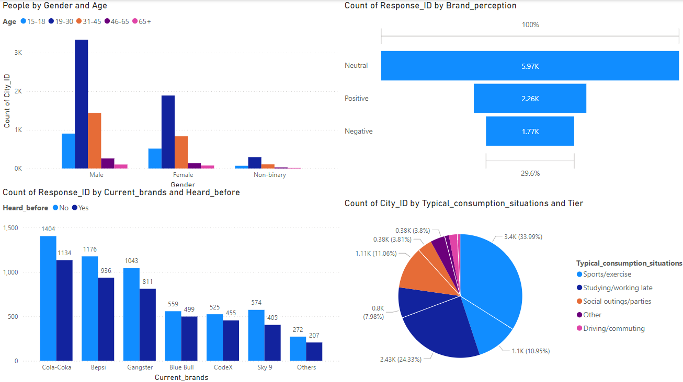

Slide 4
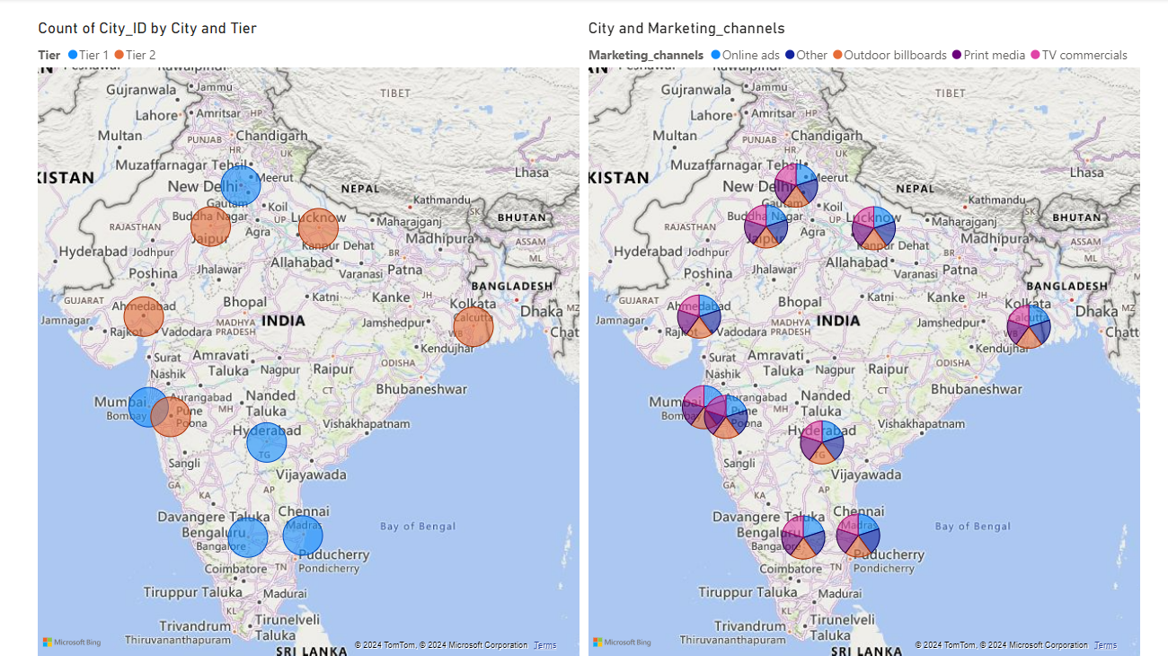

Slide 5
Thank you
Aryan Kumar Sao
Batch-MIP-DA-13

