Slide 1

IoT Sensor Data Fault Detection
DS5110: Introduction to Data Management and Processing
Team Members:
Aryan Rakeshbhai Shah
Atir Shakhrelia
Jwal Pranavkumar Shah

Slide 2

Agenda
Introduction to IoT and Data Management
Abstract of the Report
Significance of IoT Fault Detection
Literature Review Highlights
Data Collection Techniques
Data Preprocessing Steps
Analytical Techniques Overview
Fault Detection Using CNNs
Training Process and Model Compilation
Autoencoder Model for Anomaly Detection
Experimental Setup and Tools
Evaluation Metrics and Results
Model Performance Analysis
Conclusion of the Study
Future Research Directions

Slide 3
Introduction to IoT and Data Management
Overview
Understanding IoT
Significance in Data Management
The Internet of Things (IoT) is a network of interconnected smart devices that gather, share, and analyze data.
IoT enables real-time data collection and transmission across various industries including healthcare, agriculture, and smart cities.
It is projected that by 2025, billions of objects will be connected to the Internet, marking IoT as the third major wave of the global information industry.
IoT systems rely on intelligent sensors to collect data on environmental conditions and machinery performance.
Maintaining data accuracy and reliability is crucial to avoid inefficiencies and safety issues arising from sensor errors.
Effective data management in IoT is essential for informed decision-making and enhancing operational efficiency.

Slide 4

Introduction
IoT enables real-time data collection, transmission, and analysis across industries like automation, agriculture, smart cities, and healthcare
Challenge: Maintaining data accuracy and reliability in adverse conditions (e.g., harsh weather, hardware failures, network outages).
Inaccurate sensor data risks inefficiencies, safety issues, and system failures.
Focus: Advanced methods (e.g., deep learning and machine learning) for detecting and addressing sensor failures to enhance decision-making and system performance.
Abstract

Slide 5

Methodology
Significance of IoT Fault Detection
Alignment with Industry Trends
Development of Interdisciplinary Expertise
Real-World Relevance and Impact
Understanding IoT device integration and data analysis has become crucial due to the exponential growth of IoT devices. This project meets the demand for optimizing IoT systems.
This effort connects theoretical computer science with real-world applications in data science, machine learning, and deep learning, enhancing our multidisciplinary skill set.
Machine learning techniques for fault identification could revolutionize operations across various industries, yielding significant efficiency and safety improvements.

Slide 6

Literature Review
Literature Review Highlights
Survey on Sensor Fault Diagnosis
Anomaly Detection Techniques
AI and Deep Learning Applications
Challenges in Fault Detection
A notable survey discussed the causes of sensor failures, such as equipment problems and human error, highlighting the need for fault diagnostic techniques to ensure accurate data.
Another extensive survey focused on anomaly and fault detection techniques in IoT, identifying unmet research needs and clarifying the current methodologies being used.
Research highlighted the role of AI, deep learning, and statistical models in fault diagnosis, emphasizing continuous improvements in detection technologies.
A survey examined the challenges of anomaly detection in practical deployments, particularly the importance of understanding security needs in distributed systems.

Slide 7

Methodology
The data for this project came from two distinct sources, each with unique purposes and challenges: a private institute and an internally generated synthetic dataset.
The first dataset was provided by a private institute, where access to the raw dataset was restricted due to confidentiality requirements. The institute uploaded the data to a private Kaggle notebook for secure collaboration, limiting the usage to a two-day window.
The second dataset was synthetically generated using Python, allowing for flexibility in testing different preprocessing methods and understanding the data structure without risking confidentiality breaches.
Data Collection Techniques

Slide 8


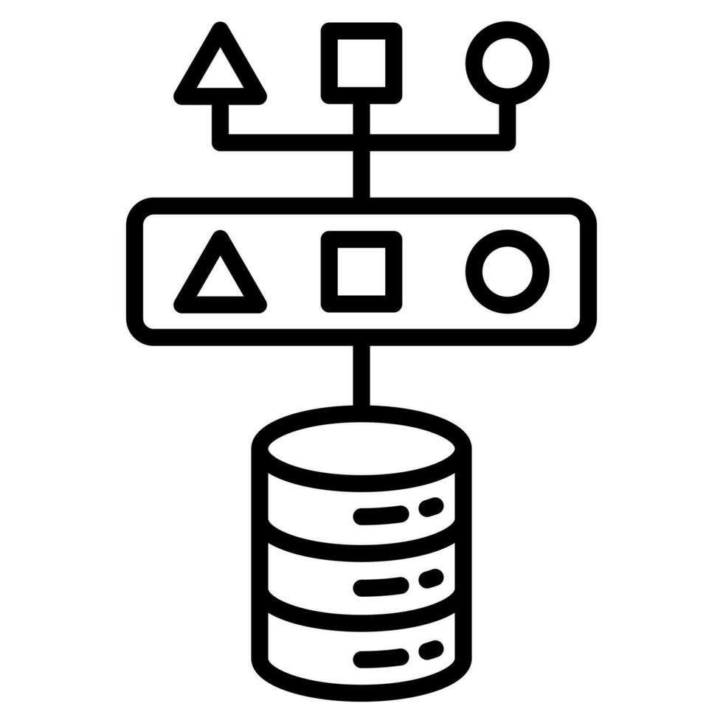


Methodology
Data Loading
The Python modules pandas and numpy were used to effectively load the sensor data into memory, ensuring data integrity and computational performance.
Data Preprocessing Steps
Normalization
Feature scaling was used to normalize the range of sensor data values. Min-max normalization was applied to ensure values fell within the range [0, 1].
Data Augmentation
Data augmentation techniques were used to increase model generalization and resilience, including rotations, flips, and brightness modifications.
Data Splitting
The dataset was divided into three subsets: training, validation, and testing using an 80-10-10 split ratio to ensure balanced distribution.

Slide 9

Methodology
Deep Learning Techniques for Fault Detection
Convolutional Neural Networks (CNNs) are employed for fault classification by capturing spatial features in sensor data.
Autoencoders are used for reconstruction-based anomaly detection, identifying deviations from expected patterns.
Both techniques leverage hierarchical feature extraction and unsupervised learning for accurate fault detection.
Analytical Techniques Overview
Applications in IoT Sensor Data
CNNs are effective in classifying sensor data into distinct fault categories, enhancing decision-making processes.
Autoencoders reconstruct normal operational data, flagging anomalies to ensure data integrity during transmission.
Integrating these techniques improves the overall reliability and efficiency of IoT systems.

Slide 10
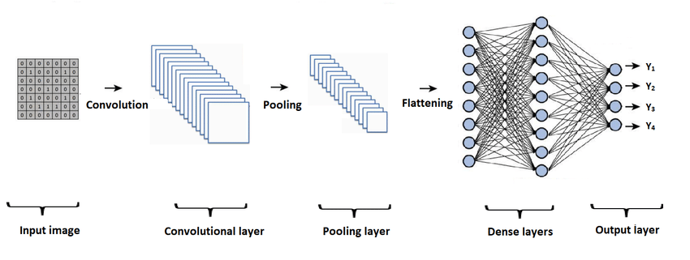
Methodology
Fault Detection Using CNNs
01
02
03
Model Architecture
Pooling & Dropout Layers
Fully Connected Layers
The CNN model was designed to extract spatial and temporal features from preprocessed sensor data. It includes: Input Layer: Shape (200 × 10), representing 200 time steps and 10 features. Convolutional Layers: Two layers with (3 × 3) kernels and ReLU activation to capture local patterns.
Max-pooling layers with a (2 × 2) pool size reduce spatial dimensions, decreasing complexity while retaining features. Dropout regularization at 0.25 rate reduces overfitting by randomly dropping neurons during training.
A dense layer with 128 neurons and ReLU activation integrates extracted features. An output layer with softmax activation produces probabilities for each fault category, enabling multi-class classification.

Slide 11

Methodology
Training Process and Model Compilation
Training Process
Optimizer Selection
Loss Function
Model Compilation
The CNN model was trained for a maximum of 50 epochs with a batch size of 32. Early stopping was used to halt training if validation loss did not improve for 5 epochs.
The Adam optimizer with a learning rate of 0.001 was selected for its ability to adaptively adjust learning rates, ensuring faster convergence.
Categorical Crossentropy was used as the loss function, quantifying the difference between predicted and actual probabilities, critical for model adjustments.
The CNN was compiled with accuracy as the primary evaluation metric to monitor performance during training and validation, ensuring effective learning.
Training accuracy
Validation accuracy
Training time
Testing time
Optimized model parameters
Learning rates
Convergence speed
Loss values
Model adjustments
Compiled model
Evaluation metrics
Training history

Slide 12

Autoencoder Model for Anomaly Detection
Methodology
Autoencoder Overview
Autoencoders are unsupervised neural networks designed to compress input data into a latent representation before reconstructing it.
The architecture consists of an encoder that compresses data and a decoder that reconstructs it.
Reconstruction error, the difference between the original input and its reconstructed output, is used to identify anomalies.
Anomaly Detection Process
The model is trained using normal operational data to effectively reconstruct non-anomalous patterns.
During inference, data points with reconstruction errors exceeding a predefined threshold are flagged as anomalies.
A high reconstruction error indicates that the input data does not conform to learned patterns, signaling potential faults.

Slide 13


Methodology
Experimental Setup and Tools
Programming Language and Frameworks
Hardware Configuration
The project was implemented using Python 3.8, leveraging frameworks such as TensorFlow for building and training models and scikit-learn for data preprocessing tasks. TensorFlow's high-level API, Keras, facilitated easy prototyping and model customization.
Models were trained and evaluated on Kaggle kernels equipped with GPU acceleration, significantly reducing training time for computationally intensive tasks like CNN and Autoencoder training.

Slide 14
Evaluation
Evaluation Metrics and Results
0.85
Training Accuracy
0.84
Validation Accuracy
0.75
Precision
0.80
Recall

Slide 15
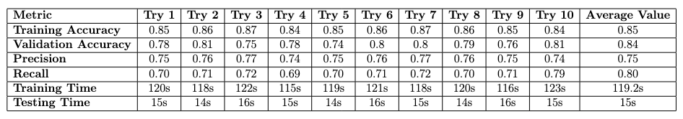
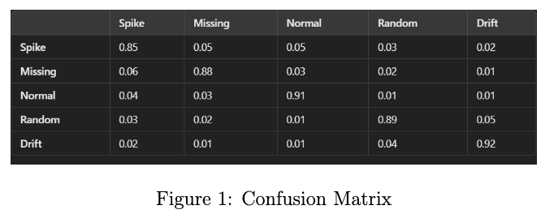
Evaluation
Evaluation Metrics and Results

Slide 16
Evaluation Metrics
The model demonstrated consistent performance across all trials, with an average training accuracy of 0.85 and a validation accuracy of 0.84, indicating its robustness in generalizing to unseen data.
The precision averaged 0.75, while recall averaged 0.80, which reflects a balanced performance in identifying true positives and minimizing false positives. The F1 score averaged 0.82, showcasing the model's effectiveness in fault detection tasks.
Despite these positive results, there are still "potential areas for improvement, particularly in the validation accuracy and recall metrics," suggesting that further tuning and enhancements could lead to even better model performance in real-world applications.
Model Performance Analysis

Slide 17

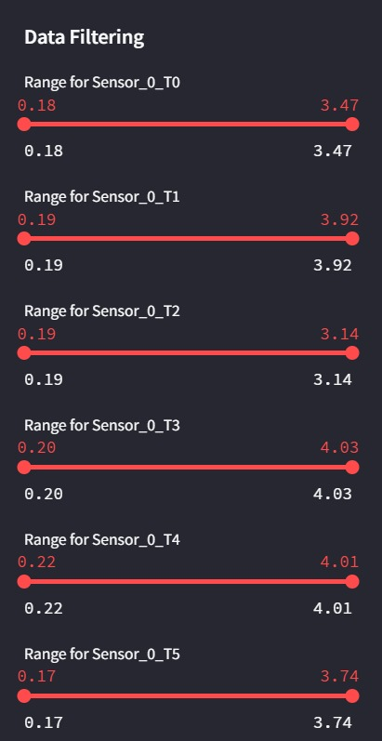
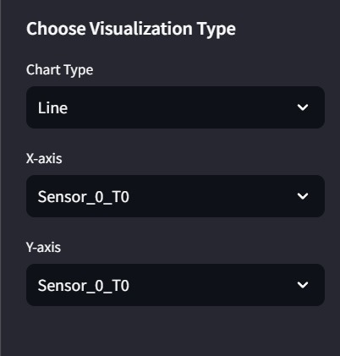
Dashboard Visualization

Slide 18
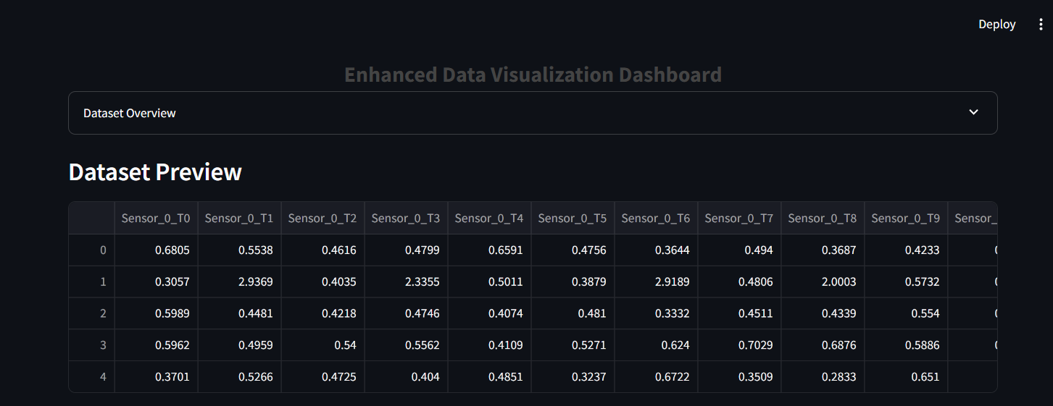
Dashboard Visualization

Slide 19
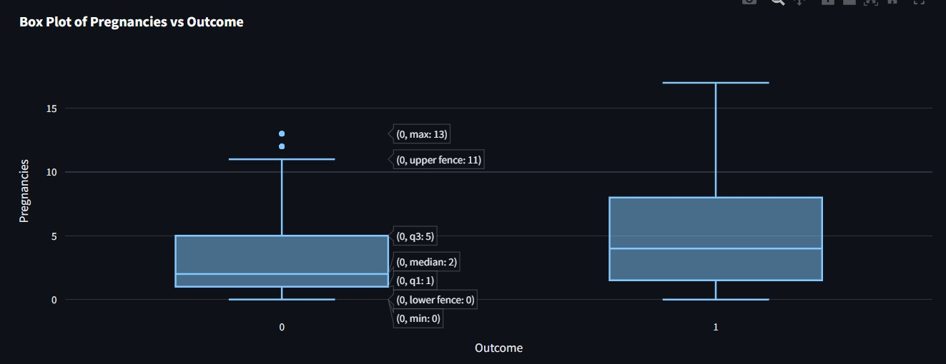
Dashboard Visualization

Slide 20

The CNN model demonstrated strong and consistent performance for IoT sensor fault detection across ten trials. It achieved an average training accuracy of 85%, validation accuracy of 84%, and test accuracy of 80%, indicating robust generalization to real-world scenarios.
With an average F1 score of 0.82, the model balanced precision (0.75) and recall (0.80), minimizing false positives and negatives.
Its computational efficiency, with an average training time of 119.2 seconds and testing time of 15 seconds, highlights suitability for real-time applications. These results validate the CNN’s potential as a reliable and efficient solution for fault detection in IoT systems.
Conclusion
Conclusion of the Study

Slide 21

Future Research Directions
Conclusion
Exploration of advanced machine learning algorithms to improve the reliability of fault detection systems in IoT environments.
Investigation into the integration of federated learning techniques for decentralized fault detection, addressing privacy concerns and enhancing model performance across distributed IoT devices.
Development of hybrid models combining statistical methods with deep learning approaches to improve anomaly detection accuracy and reduce false positives.
Research on real-time data processing frameworks that can handle large volumes of IoT sensor data and provide immediate fault detection capabilities.
Study of resilience strategies for IoT sensor networks under adverse conditions, ensuring continued functionality and data integrity during hardware failures or network outages.

