Slide 1

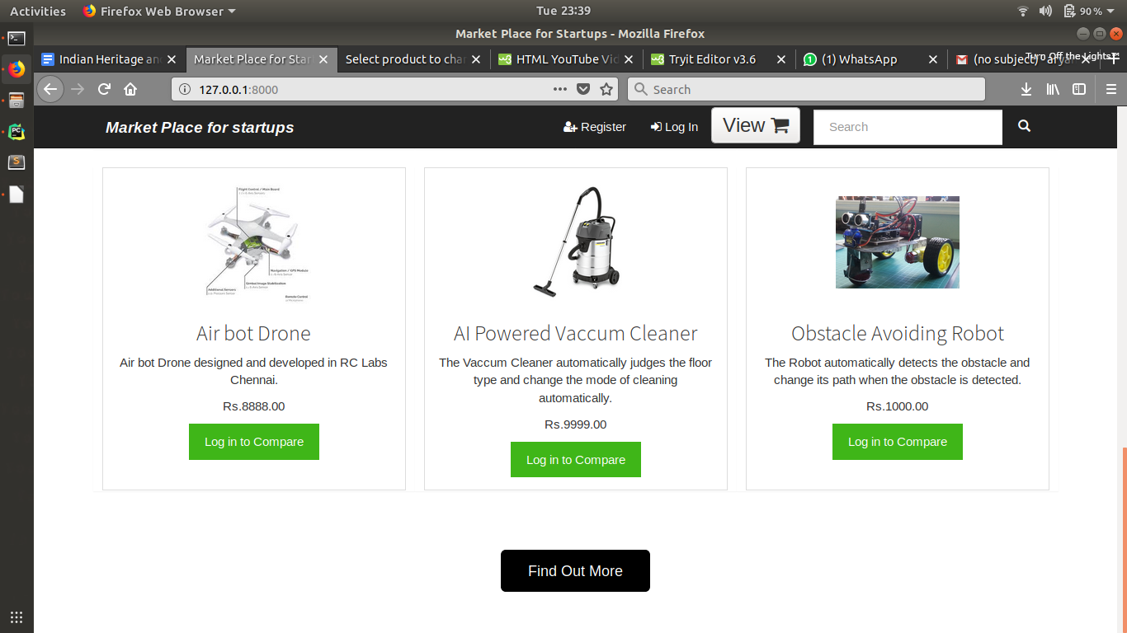
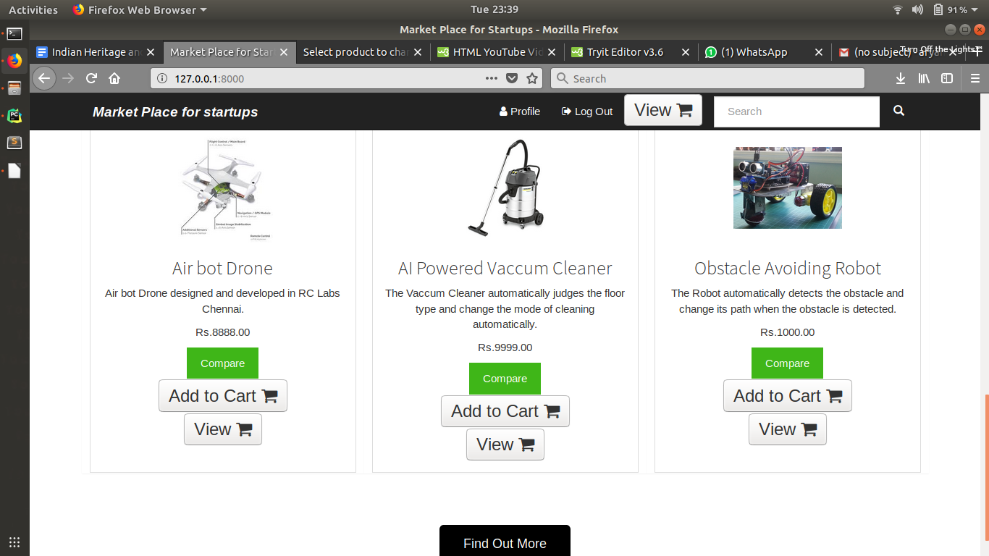
CSE3999 Tech Answer for Real World Problems
Market Place for Startups
Social Relevance
Many startups that remain unrecognized will get a platform to showcase their potential.Real World problems will be solved more effectively and efficiently.
Creative and deterministic people will get a chance to showcase their talent.
Methodology
We have used searching to render the products accroding to the needs of the customer.We have authenticated and validated the users and startups at various levels.
The user can compare similar products so that he can choose the best suited product according to his needs.The user can add the required products to cart so that they can be viewed or buyed later.The user have to Log-in the portal before comparing the products or performing any transaction.
Prototype
Team Members
16BCE1081
16BCE1281
16BCE1345
Faculty Coordinator:
Dr.JAGADEESH KANNAN R
Objectives
Developing a platform where startups can market and sell their products

