Slide 1
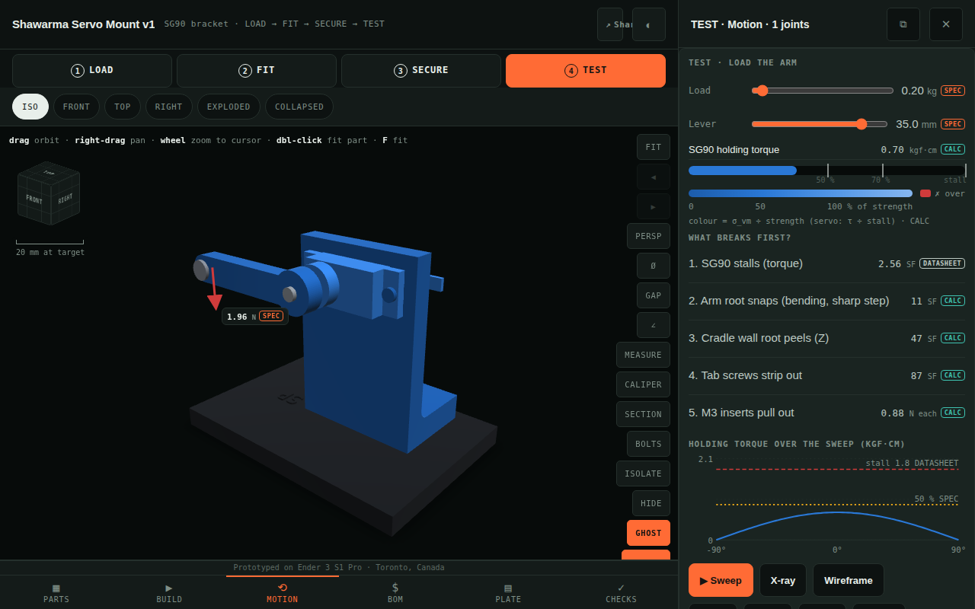
AV v8
See if it fits, bolts up and holds — before you print it
Shawarma Servo Mount v1 · LOAD → FIT → SECURE → TEST · one link, every number with its source
TEST phase: 2.0 kg on the arm — the SG90 stalls first (red), the arm root carries the stress.
Notes:
v8 adds a guided four-phase mode on top of everything v7 did. The point: every number on screen says where it came from, and the load test is a real hand calculation, cross-checked by PyBullet.

Slide 2
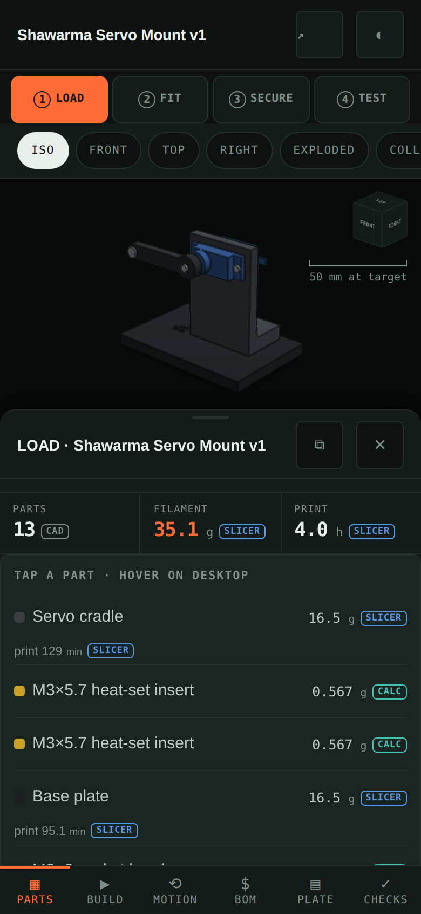
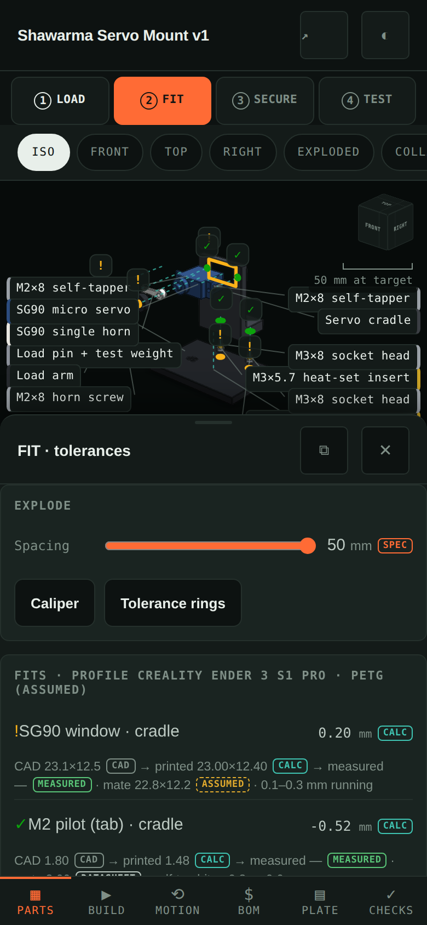
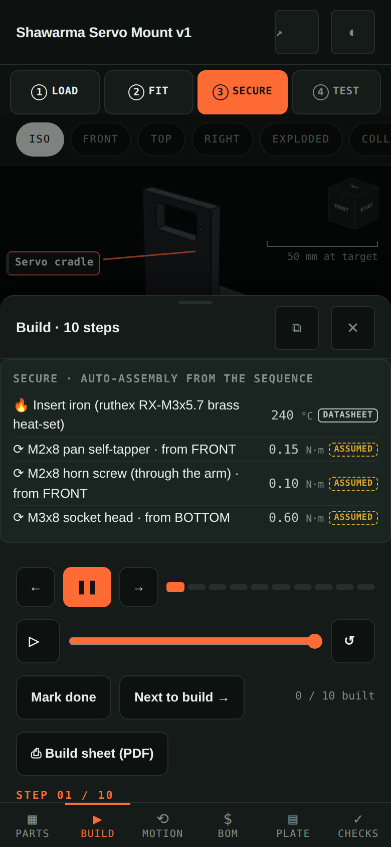
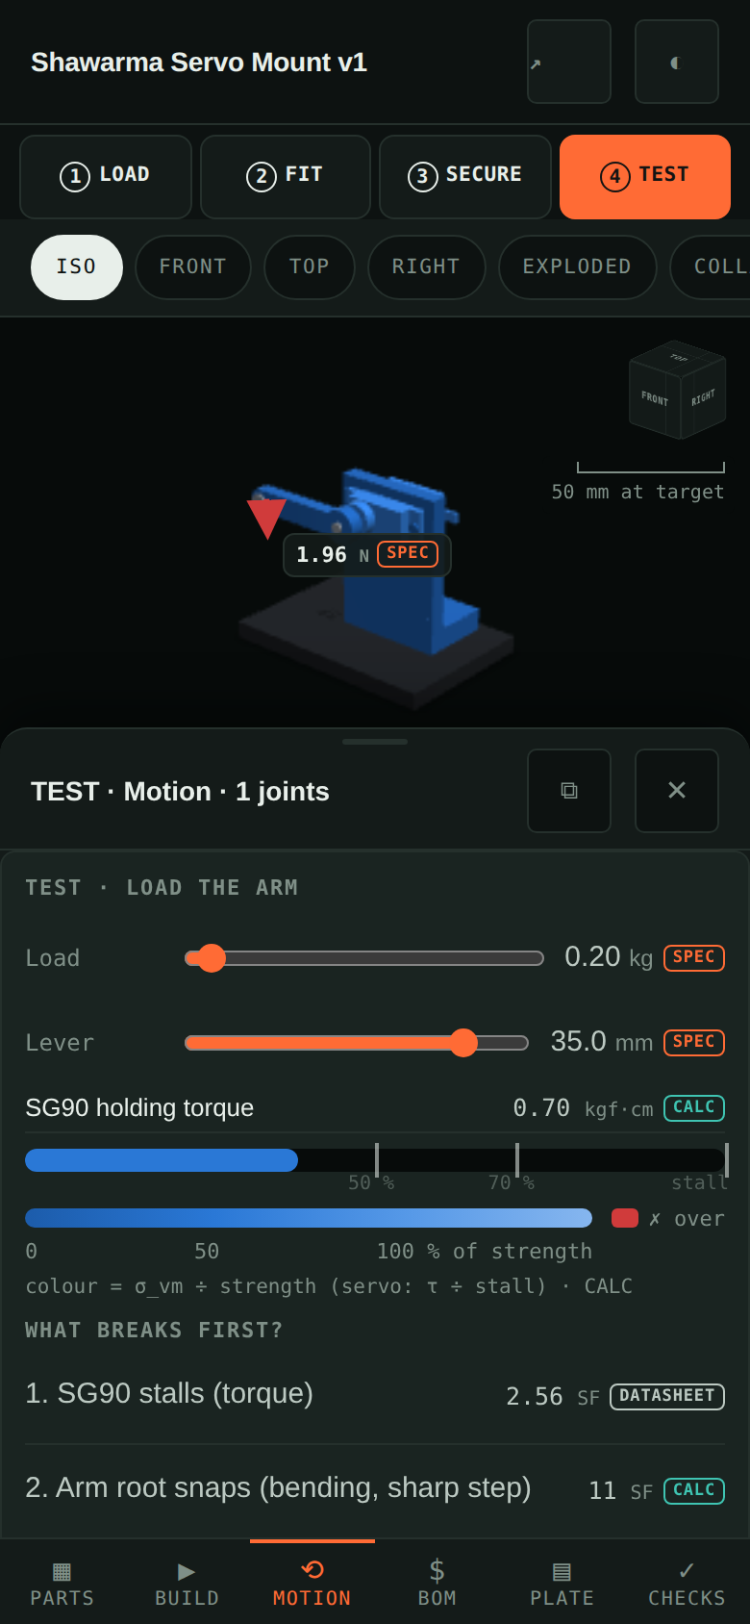
Four taps tell the whole story
1 LOAD
2 FIT
3 SECURE
4 TEST
mass + print time, from G-code
holes coloured by how YOUR printer prints
auto-build: 240 °C inserts, screws from their side
drag the load, see what breaks first
Notes:
Each phase is a URL: the hash carries the phase, camera, explode, section cut and load, so a client opens exactly what you saw.

Slide 3
The servo is the fuse
0.51 kg
2.24 kg
4.05 kg
0.10 %
SG90 stalls
arm root snaps, sharp step
with a 2 mm fillet
PyBullet vs hand calc
1.8 kgf·cm DATASHEET ÷ 35 mm lever
Kt 2.43 (Peterson) · CALC
Kt 1.34 · CALC
inverse-dynamics torque
The cheap part gives up first, safely — the bracket outlives the servo by 4.4× (arm SF at stall).
Notes:
Torque = force × distance. 5 kg at 35 mm is 17.5 kgf·cm, almost ten times the SG90's stall, so the servo stalls long before the printed arm breaks. The fillet is margin.

Slide 4
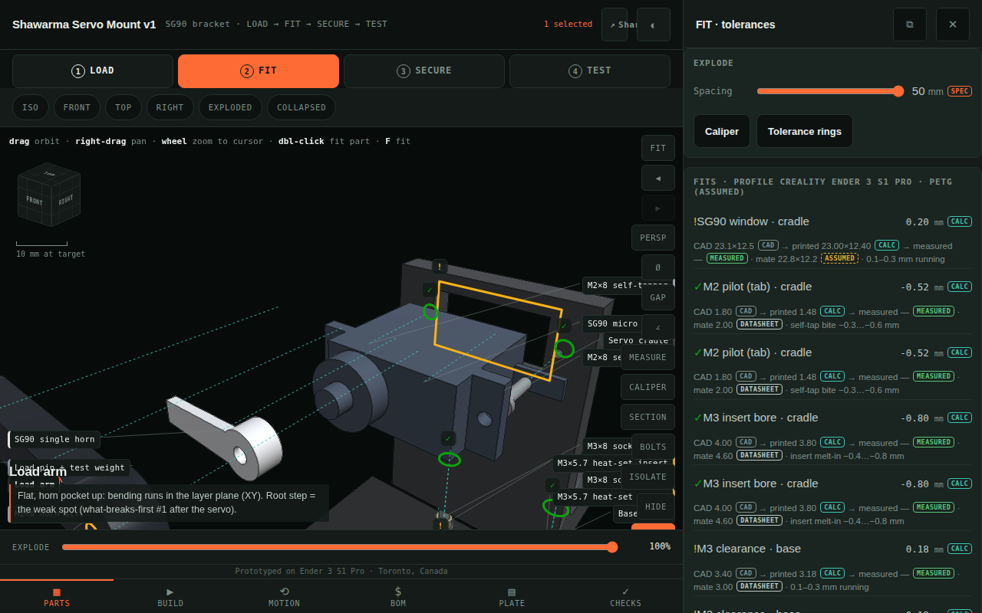
Caught before a gram was printed
Tips over
CoG 8.0 mm outside the base with 200 g → base under the load: 12.1 mm inside
Pilot too tight
Ø1.5 prints Ø1.13 (split risk) → Ø1.8 CAD prints Ø1.48: a clean M2 bite
SG90 may not fit
FIT: rings coloured from the printer's tolerance profile (green snug · yellow running · red sloppy/tight).
datasheets disagree by 0.8 mm → worst-case window −0.10 mm: calipers first
Notes:
Two of these were fixed in CAD. The third needs real calipers on a real SG90: until then the tile honestly reads FAIL on ASSUMED inputs.

Slide 5
Measure three things, then sell it
Caliper the SG90: body, tab span, hole pitch
Print + measure the hole coupon (9 holes, 46 min)
Weigh the parts; read the spool's datasheet
AV for your build
$450 — LOAD + FIT + SECURE
$1,200 — + TEST, checks, MEASURE_ME
First one free for a testimonial
12 UNVERIFIED tiles turn PASS or FAIL — both are useful.
Notes:
Agency 3D microsites run $3,000–8,000; basic viewers from ~$400. SP's edge is the engineering proof, not the turntable.

