Slide 1
Leveraging multi-modal longitudinal data from the Adolescent Brain Cognitive Development Study to refine obsessive-compulsive disorder phenotype for genetic analyses.
Franjo Ivankovic, Aryan Singh, Shashank Kumar, Richa Gupta

Slide 2
Introduction
Obsessive-compulsive disorder (OCD) affects about 2.3% of individuals in the US at some point in their lives.
OCD is highly heritable, however genetic architecture is very complex and little is known about exact causative factors and pathways.
Collaborative approaches have led to aggregation of large datasets, or summary statistics of smaller datasets, which have been combined by meta-analyses to increase power and drive discoveries.
ABCD study features phenotype and genetic data which could be used for GWAS of OCD. However, prevalence of OCD in this population sample is too high indicating high rates of phenotype misclassification.
Substantial rates of phenotype misclassification may cause inflation or deflation of GWAS p-values and affect downstream analyses.
Our aim is to use machine learning approaches to refine phenotype classification and reduce misclassification rates.

Slide 3
Project Data
ABCD Study is a longitudinal population study of 11,876 US adolescents and features phenotype, genetic, and neuroimaging data.
Data were accessed through National Institute of Mental Health (NIMH) Data Archives (NDA).
Genetic data for participants were derived from blood and saliva samples and genotyped on Affymetrix National Institute for Drugs and Addiction Smokescreen array featuring 646,247 loci.
Neuroimaging data for the participants in form of tabulated summaries of post-processed magnetic resonance imaging (MRI) and functional magnetic resonance imaging (fMRI) were made available by the ABCD Study.
Phenotype data: in form of tabulated questionnaire and phenotype data featuring over 100 unique questionnaires and batteries were made available by the ABCD Study.

Slide 4
Methods
Genetic Data: Preprocessed genetic data were further processed to remove problematics IDs and probes, followed by phasing and imputation, and final filtering based on previous OCD meta-analysis (p ≤ 10⁻²) resulting in 26,555 features and 8713 individuals.
Neuroimaging data: All imaging data were processed and tabulated by ABCD study and available for 11,841 individuals. We split them into 4 kernels based on types of imaging experiment:
Structural MRI (sMRI): 2,703 features.
Diffusion MRI (dMRI): 7,474 features.
Resting State fMRI (rsfMRI): 776 features.
Task-based fMRI (tsfMRI): 22,339 features.
Phenotype data: Phenotype data excluding OCD diagnostic measures were pulled for all psychiatric, cognitive, and behavioral tests and measures from 60 datasets. Final dataset was composed of 1317 features for 11,876 individuals.
Additional processing: All imaging and phenotype data were filtered to remove features with over 10% missing values, mean imputed, normalized to range [0,1], and filtered to remove features with low variance (< 0.001).

Slide 5
Methods
P-value simulations: We simulated associations based on differential general population and case minor allele frequencies and calculated p-values using Fisher’s exact test.
Learning model: All kernels (phenotype, genotype, sMRI, dMRI, rsfMRI and tsfMRI) were individually trained over multiple epochs by under-sampling to remove affects of label imbalance. Mean of the parameters from all batches were used to get parameters of the final kernel model. Each kernel used logistic regression model with elastic net penalty, saga solver, and L1 ratio of 0.9.
Kernel combination: We have tested various metrics to derive metric-weighted additive model: AUC, accuracy, specificity, Cohen’s kappa, and precision. Additionally, we conducted a leave-1-out analysis to determine influence of individual kernels on final combined model.
Support methods: We compared final combined model’s Cohen’s kappa to Cohen’s kappa scores reported in psychiatric and psychiatric epidemiology literature (CK = 0.41).

Slide 6
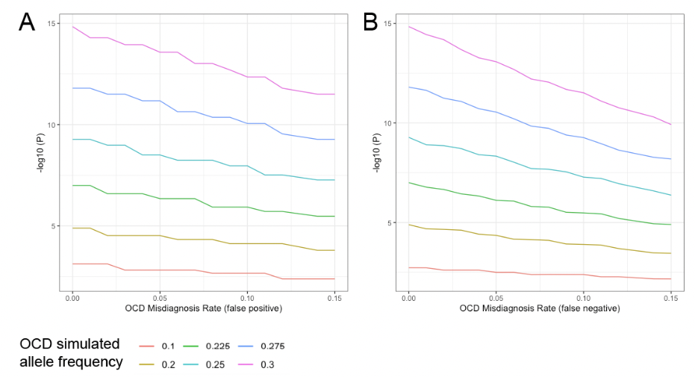
Figure 1
GWAS p-value simulation P-value deterioration curves per minor-allele frequency bins (0.1, 0.2, 0.225, 0.25, 0.275, 0.3), plotted against rates of phenotype misclassifications. A: P-value deterioration as a function of misclassified case status. B: P-value deterioration as a function of misclassified control status.

Slide 7
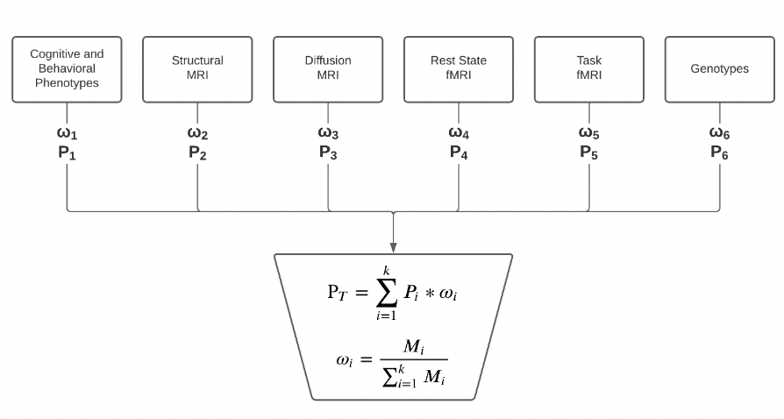
Figure 2
Machine learning model: A diagram showing how data are kernelized and processed, and class probabilities combined into a final class estimation.

Slide 8
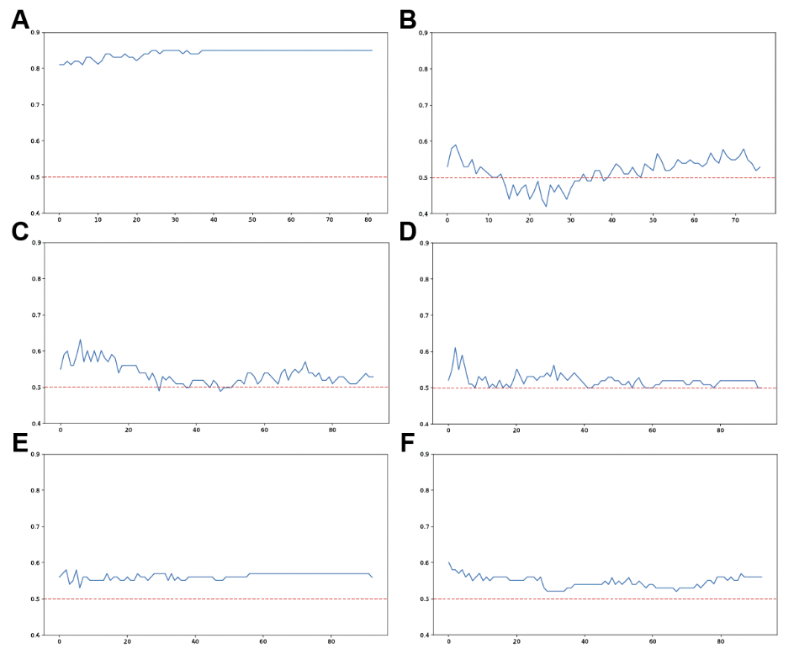
Figure 3
Kernel performance over epochs. Figure shows performance in terms of accuracy over epochs for each of the six kernels: phenotype (A), genotype (B), structural MRI (C), diffusion MRI (D), resting state fMRI (E), and task fMRI (F). Red line at 0.5 accuracy is associated with random case-control allocation.

Slide 9
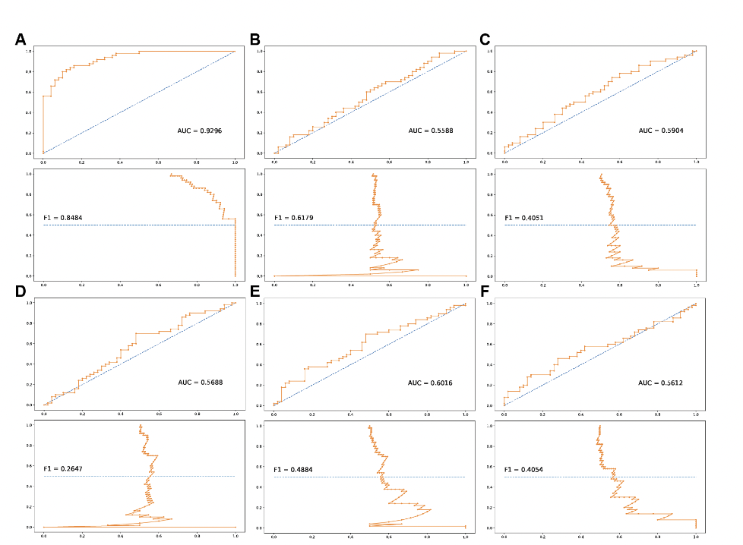
Figure 4A-B
Receiver operating and precision-recall curves. Kernel-wise ROC curve and precision-recall curve for each of the six kernels: phenotype (A), genotype (B), structural MRI (C), diffusion MRI (D), resting state fMRI (E), and task fMRI (F). Each ROC curve includes area under the curve calculation, each precision-recall curve includes F1 score.

Slide 10
Figure 4C-D
Receiver operating and precision-recall curves. Kernel-wise ROC curve and precision-recall curve for each of the six kernels: phenotype (A), genotype (B), structural MRI (C), diffusion MRI (D), resting state fMRI (E), and task fMRI (F). Each ROC curve includes area under the curve calculation, each precision-recall curve includes F1 score.

Slide 11
Figure 4E-F
Receiver operating and precision-recall curves. Kernel-wise ROC curve and precision-recall curve for each of the six kernels: phenotype (A), genotype (B), structural MRI (C), diffusion MRI (D), resting state fMRI (E), and task fMRI (F). Each ROC curve includes area under the curve calculation, each precision-recall curve includes F1 score.

Slide 12
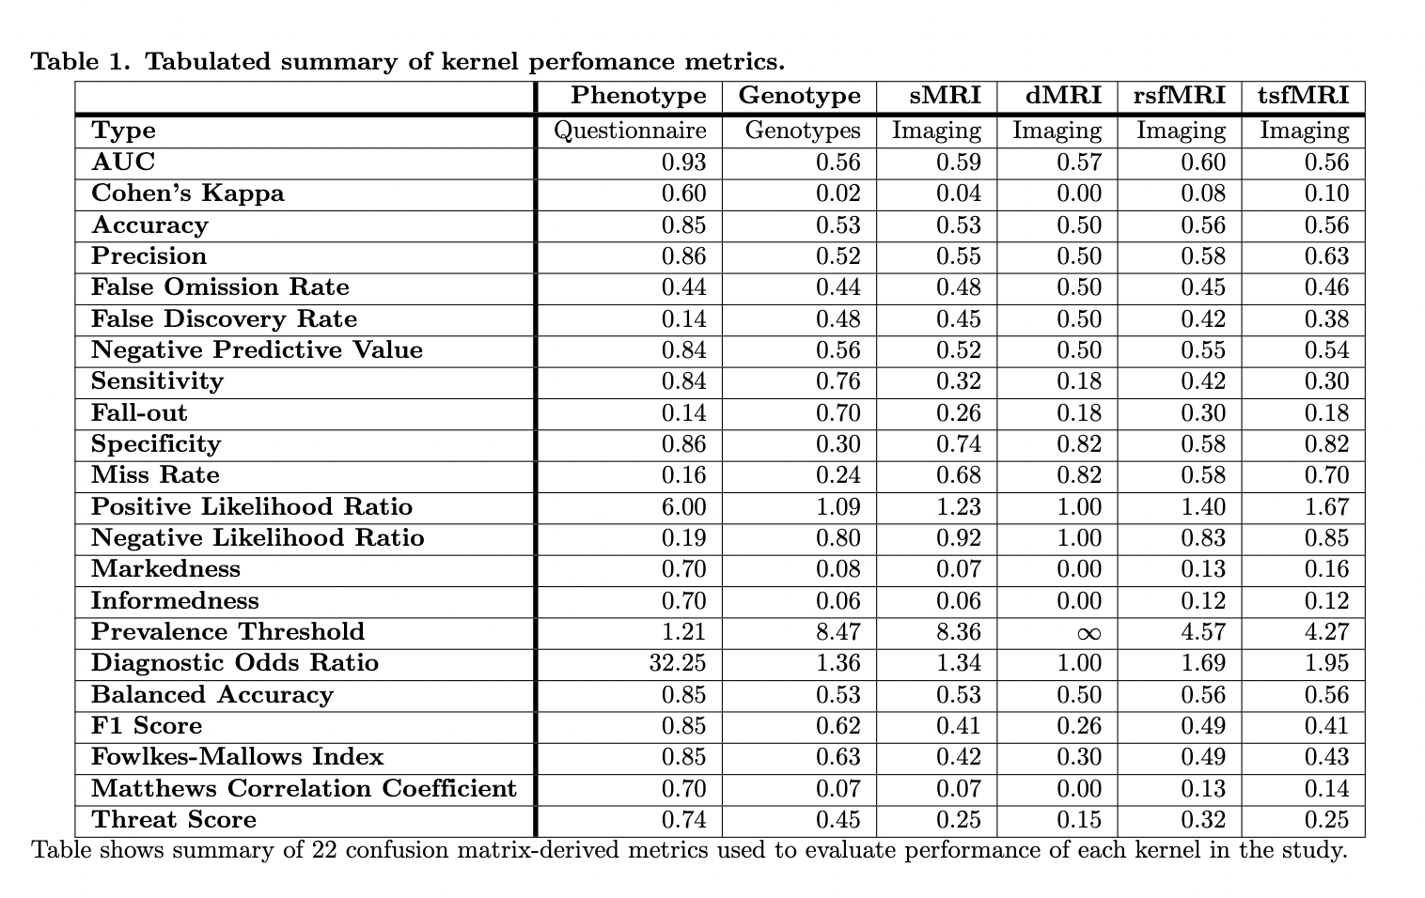
Table 1

Slide 13
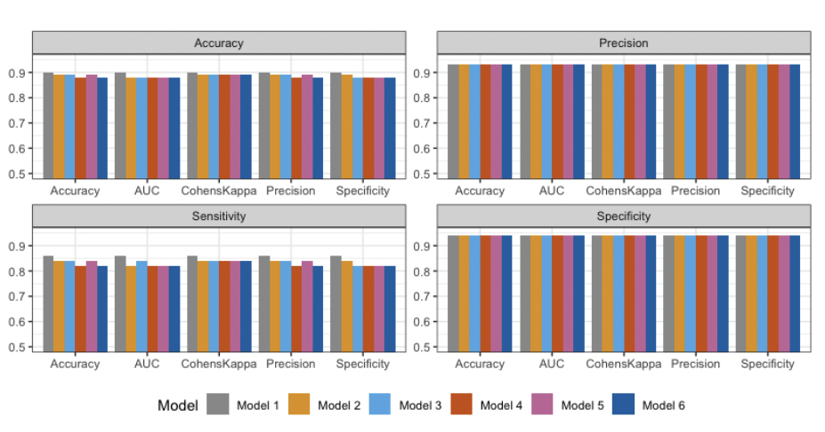
Figure 5
Chart summary of kernel and total performance. Accuracy, precision, sensitivity, and specificity metrics for model selection analysis. Models were based on weighing metric (accuracy, AUC, Cohen’s kappa, precision, specificity), where analyses were done eliminating one kernel at a time, based on performance. Model 1 has only the highest performing kernel in the specific weighing metric, model 6 includes all kernels. Full table with models, included kernels, and their weights, are shown in table S1

Slide 14
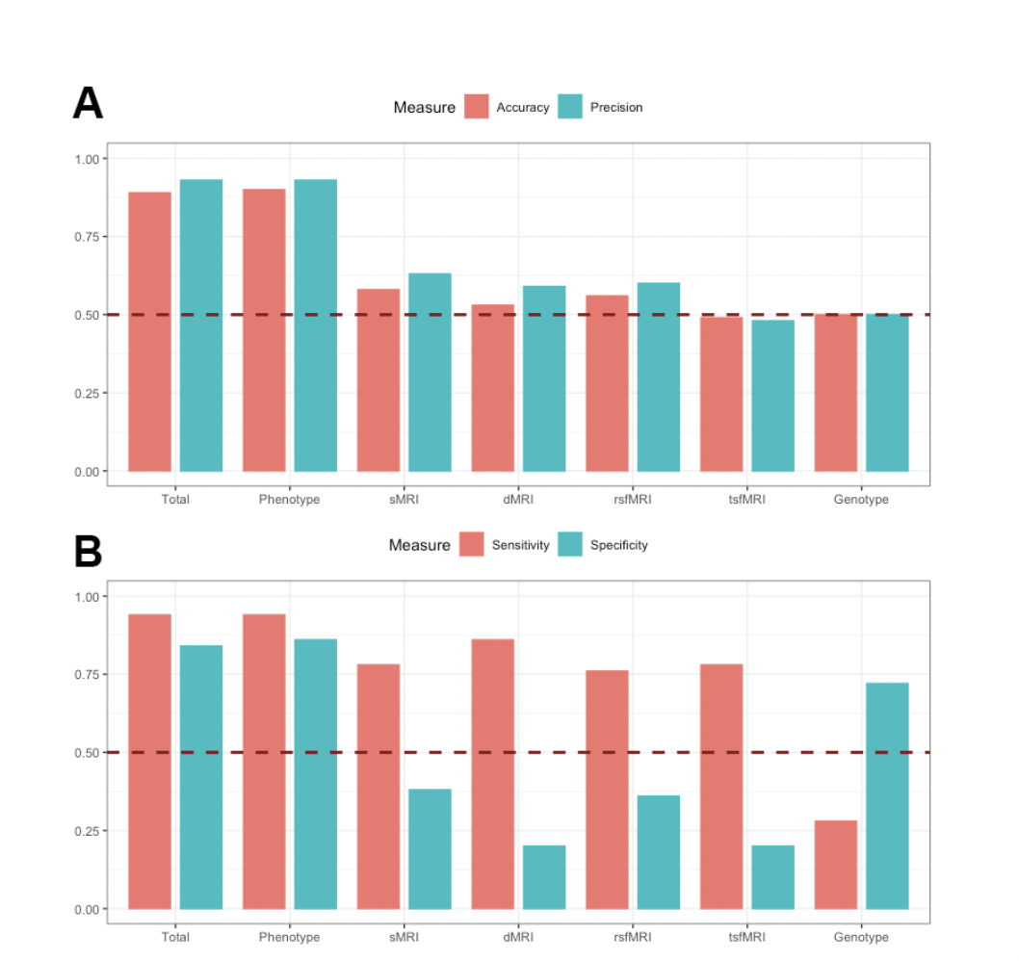
Figure 6
Test set analysis of kernels and final model. Accuracy and precision (A) and sensitivity and specificity (B) analysis of individual kernels and total model using test-set data.

Slide 15
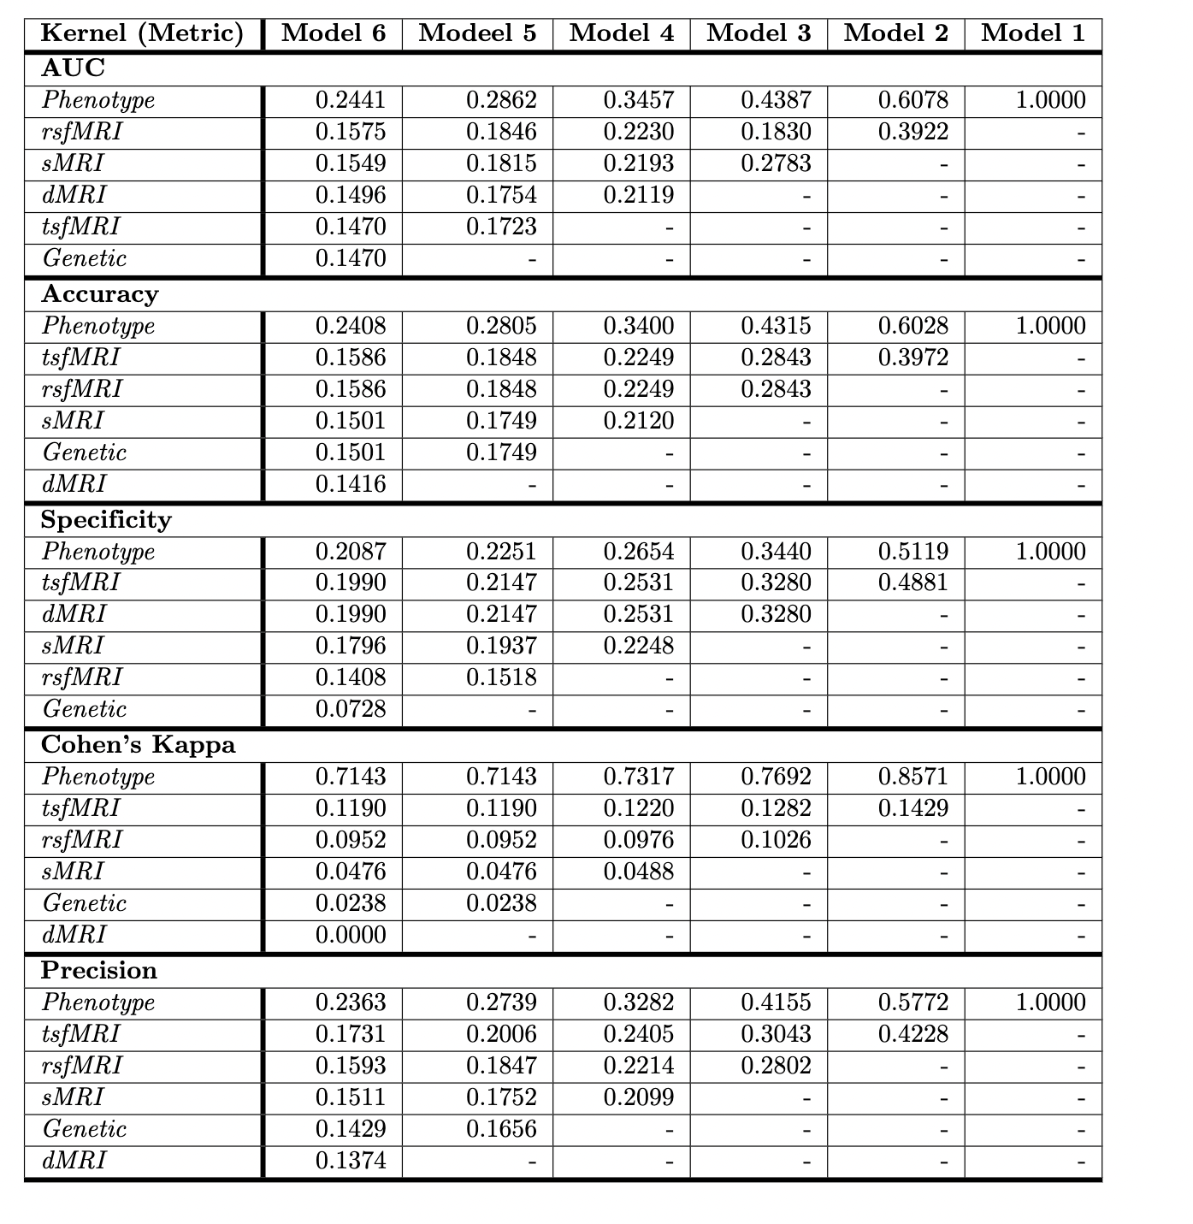
Table S1

Slide 16
Discussion
Total model (0.75) has substantially outperformed both individual kernels (phenotype kernel 0.60) and psychiatric field trials (0.41) in terms of cohen’s kappa. This is a preferred measure of inter-rater reliability and the field of psychiatric epidemiology.
Positive and negative iterations were also promising: Based on the total model, individuals who are assigned label of OCD positive have 14.40 – fold increase of having OCD. Conversely, individuals who are assigned a label of OCD negative have 6.67 - fold increase in odds of not having OCD. Diagnostic odds ratio of 96.24 is remarkably high indicating it a reliable tool for OCD diagnosis.
This multi-modal based machine learning approach for psychiatric diagnosis appears to be first of its kind. Here we show a promising potential to such models integrating multi-disciplinary data collections (psychiatric, psychological, neurobiological and genetic) to refine disease diagnosis.
Given these results, it would be interesting to analyze polygenic risk-scores of individuals who are predicted to have OCD and predicted to not have OCD and compare resulting distributions to individuals who do and do not have OCD (actual diagnosis).
Future work would include using minimally processed neuroimaging data instead of tabulated data to improve imaging kernel performance. Also, genetic kernel is also susceptible to ancestry affects, so additional work could help reduce such affects and improve generic kernel performance.

Slide 17
Conclusions
Aim: Develop a machine learning model that can utilize diverse sources of data (phenotype, genotype, brain imaging) to diagnose individuals with OCD.
Each modality varied in terms of performance given a specific metric (e.g. accuracy of phenotype modality being at 0.85 and genotype at 0.53), integration of these methods ultimately refined final predictions and yielded optimal results.
On an individual level, Cohen’s kappa is highest for Phenotype kernel at 0.60, whereas in total model, Cohen’s kappa is 0.75, showing utility of including non-phenotype modalities, even when those kernels have less than optimal performance.
Our model performed much better than literature-reported Cohen’s kappa for OCD of 0.41 showing evidence for its utility and promise of integrative multi-disciplinary approaches to improve accuracy of diagnosis of OCD and other psychiatric disorders.

Slide 18
References
Fawcett, EJ, Power H, Fawcett JM. Women are at greater risk of OCD than men: A meta-analytic review of OCD prevalence worldwide. J. Clin. Psychiatry. 2020; 81(4).
Ruscio AM, Stein DJ, Chiu WT, Kessler RC. The epidemiology of obsessive-compulsive disorder in the National Comorbidity Survey Replication. Mol. Psychiatry. 2010; 15(1), 53–63.
American Psychiatric Association. Diagnostic and statistical manual of mental disorders. 5th ed. American Psychiatric Association. 2013.
Strom NI, Soda T, Mathews CA, Davis LK. A dimensional perspective on the genetics of obsessive-compulsive disorder. Transl. Psychiatry. 2021; 11(401).
Reynolds T, Johnson EC, Huggett SB, Bubier JA, Palmer RHC, Agrawal A, et al. Interpretation of psychiatric genome-wide association studies with multispecies heterogeneous functional genomic data integration. Neuropsychopharmacology. 2021; 46(1):86-97.
Bjork JM, Straub LK, Provost RG, Neale MC. The ABCD study of neurodevelopment: Identifying neurocircuit targets for prevention and treatment of adolescent substance abuse. Curr. Treat. Options Psychiatry. 2017; 4(2):196-209.
Manchia M, Cullis J, Turecki G, Rouleau GA, Uher R, Alda M. The Impact of Phenotypic and Genetic Heterogeneity on Results of Genome Wide Association Studies of Complex Diseases. PLoS ONE. 2013; 8(10):e76295.
Freedman R, Lewis DA, Michels R, Pine DS, Schultz SK, Tamminga CA, et al. The Initial Field Trials of DSM-5: New Blooms and Old Thorns. Am. J. Psychiatry. 2013; 170(1):1-5.

Slide 19
Questions?

