Slide 1
COMPUTER NETWORKS
Design & Simulation of a Smart College Network Using VLANs
Packet Tracer simulation + Wireshark analysis · Static IP addressing · No DHCP
Student Name | USN
Aryan Inchal | 1RUA25CSE0084
Bellumkonda Sandilya | 1RUA25CSE0108
Bhuvan Tej U | 1RUA25CSE0119
Aryan S Jain | 1RUA25CSE0087
Linux host: wlo1 · 172.16.222.235/24

Slide 2



THE PROBLEM
A flat campus network leaves every trust group exposed
Problem
Objective
Tools
One broadcast domain means no isolation, unnecessary ARP/broadcast traffic, no policy enforcement point, and poor manageability.
Segment Students, Faculty, Admin, and Guests with VLANs, route through one 802.1Q trunk, and enforce access with ACLs.
Cisco Packet Tracer 8.x, Wireshark 4.x, Cisco 2960-24TT, Cisco ISR4331, Linux host.

Slide 3
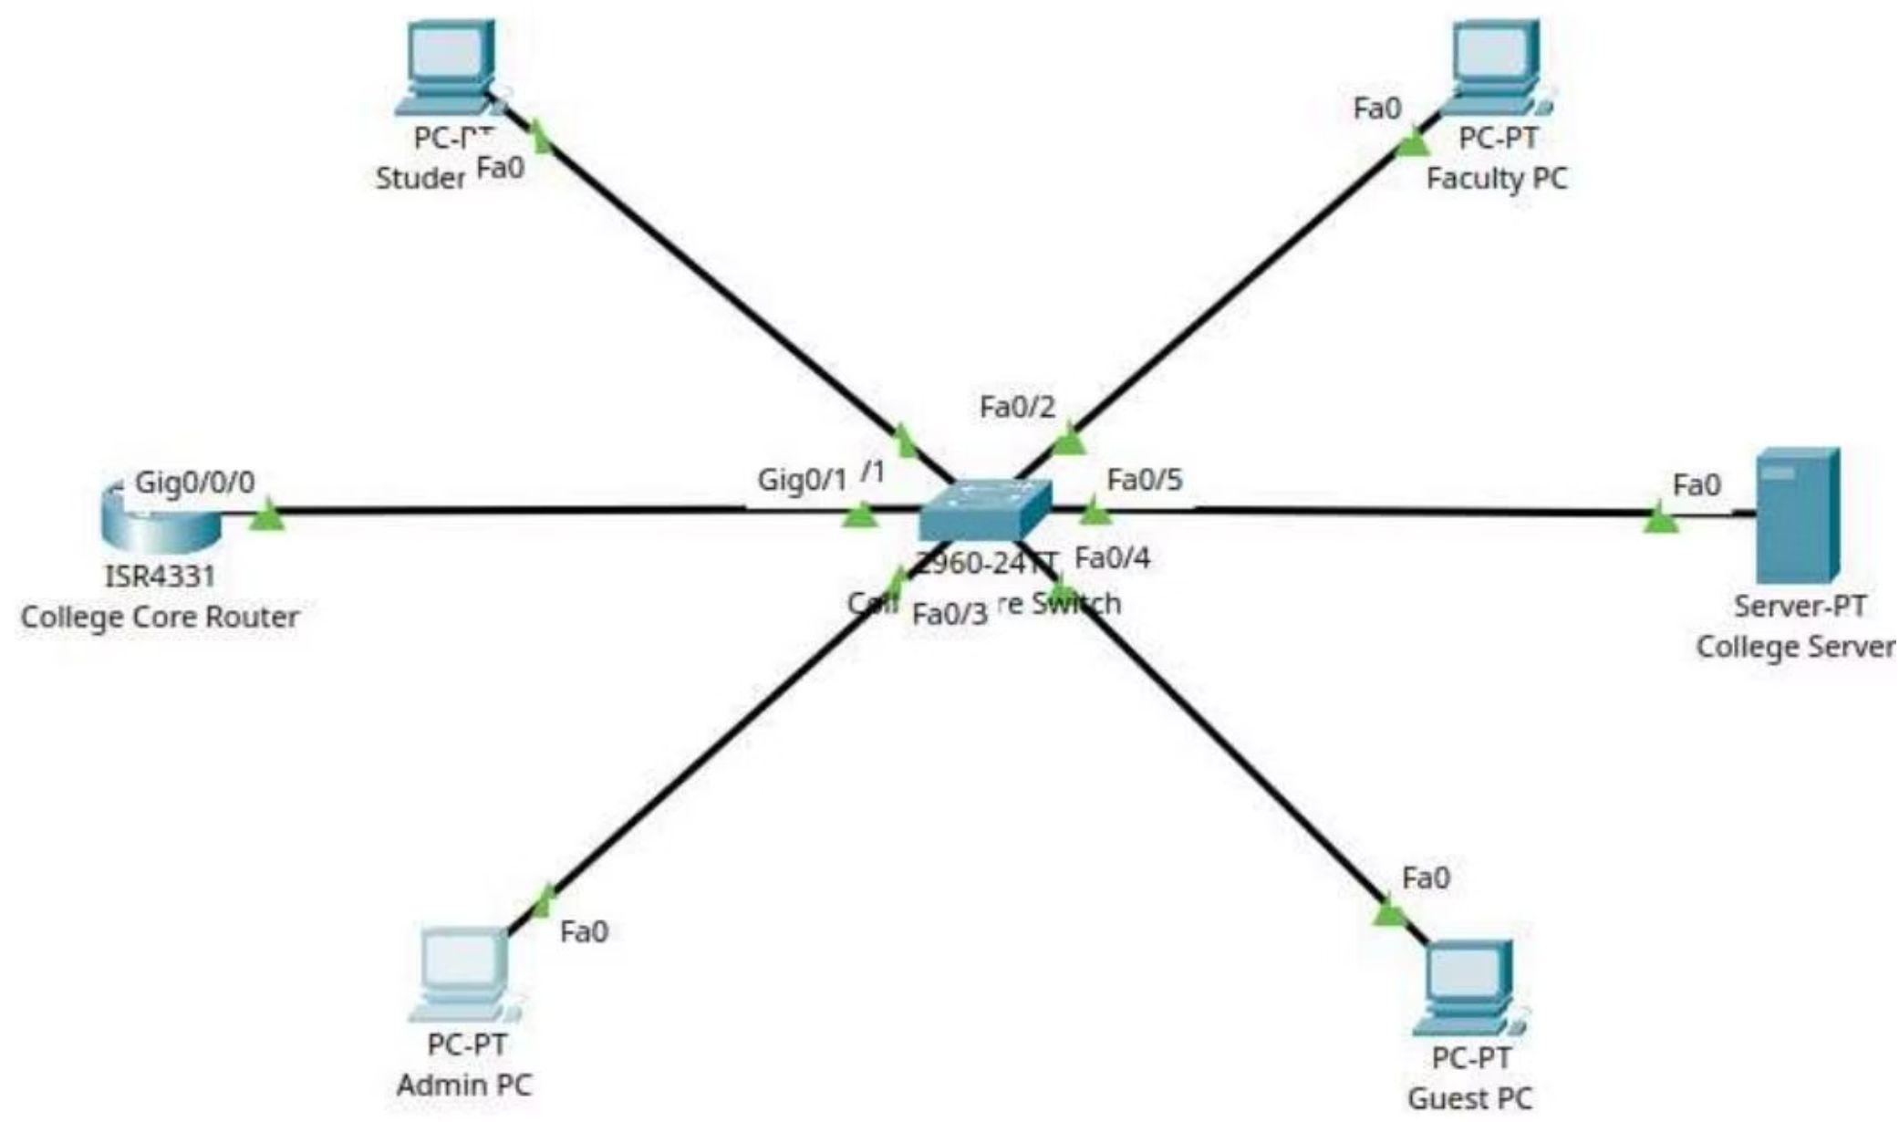
TOPOLOGY
One switch, one trunk, four controlled broadcast domains
PCs and Server connect to the 2960 switch on Fa0/1–Fa0/5. Switch Gig0/1 trunks to router g0/0/0.
Router-on-a-Stick provides inter-VLAN routing.
Fa0/1 Student; Fa0/2 Faculty; Fa0/3 Admin; Fa0/5 Server; Fa0/4 Guest; Gig0/1 trunk to Router g0/0/0.

Slide 4
ADDRESSING PLAN
The IP plan maps each group to one /24 network
VLAN | Group | Network | Gateway | Assigned hosts | Switch port
10 | STUDENTS | 192.168.10.0/24 | 192.168.10.1 | Student 192.168.10.10 · Fa0/1 | Fa0/1
20 | FACULTY | 192.168.20.0/24 | 192.168.20.1 | Faculty 192.168.20.10 · Fa0/2 | Fa0/2
30 | ADMIN | 192.168.30.0/24 | 192.168.30.1 | Admin 192.168.30.10 · Fa0/3 · Server 192.168.30.100 · Fa0/5 | Fa0/3 · Fa0/5
40 | GUESTS | 192.168.40.0/24 | 192.168.40.1 | Guest 192.168.40.10 · Fa0/4 | Fa0/4
Trunk Gig0/1 to Router g0/0/0 · Mask: 255.255.255.0 · DNS: 8.8.8.8 · all addresses static; no DHCP
Mobile hotspot gateway: 172.16.222.1 (Android 12+ uses the 172.16.x.x range) · Host wlo1: 172.16.222.235

Slide 5
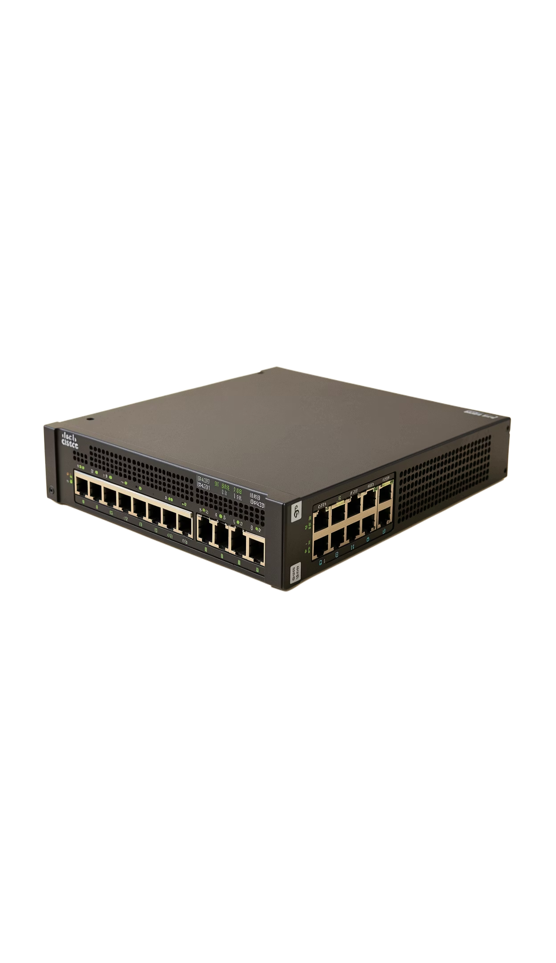
CONFIGURATION
Configuration turns the physical star into a routed VLAN fabric
Switch | VLANs 10/20/30/40; Fa0/1→10, Fa0/2→20, Fa0/3→30, Fa0/4→40, Fa0/5→30
Trunk | Gig0/1 uses switchport mode trunk
Router | g0/0/0.10–.40 use encapsulation dot1Q 10–40 with gateways .1
Inbound ACLs | STUDENT-ACL on g0/0/0.10; GUEST-ACL on g0/0/0.40

Slide 6
ACCESS CONTROL
Security is selective: protect Admin without breaking useful access
Permitted
Blocked
Students → Server 192.168.30.100: Allow
Faculty → all: Allow; no ACL on g0/0/0.20
Students → Admin network: Blocked, except the server host
Guests → Students, Faculty, Admin: Blocked
Rule order matters: STUDENT-ACL permits host 192.168.30.100 before denying the rest of 192.168.30.0/24. GUEST-ACL denies 10/20/30 before its final permit.
Commands used: ipconfig (static 192.168.10.10, no DHCP), ping 192.168.10.1, ping 192.168.30.100 Allow, ping 192.168.30.10 Blocked timeout, show access-lists hits, show ip interface brief.
Mobile-hotspot gateway: 172.16.222.1 (Android 12+ uses the 172.16.x.x range); host wlo1 172.16.222.235/24. A valid static address is confirmed by manual ipconfig, not a DHCP lease.

Slide 7
VALIDATION BOUNDARY
Observed route
Wireshark validates real traffic beside the simulated campus
Default via 172.16.222.1 on wlo1. Ping to 172.16.222.1 failed, while external connectivity worked.
Capture interface: Linux wireless adapter wlo1.
Interface wlo1 (Linux Wireless = Wi-Fi on Windows); Host 172.16.222.235/24; Gateway 172.16.222.1; File Day5_Wireshark_wlo1_172.16.pcapng; Filters: arp 16 packets, icmp 8 packets, dns 94 packets, tcp - as captured on wlo1.
Static IP: a valid address means manual ipconfig confirmation, not a DHCP lease.
What the split means
Wireshark cannot capture Packet Tracer’s internal traffic directly. The project combines Simulation Mode with a real wlo1 capture.

Slide 8
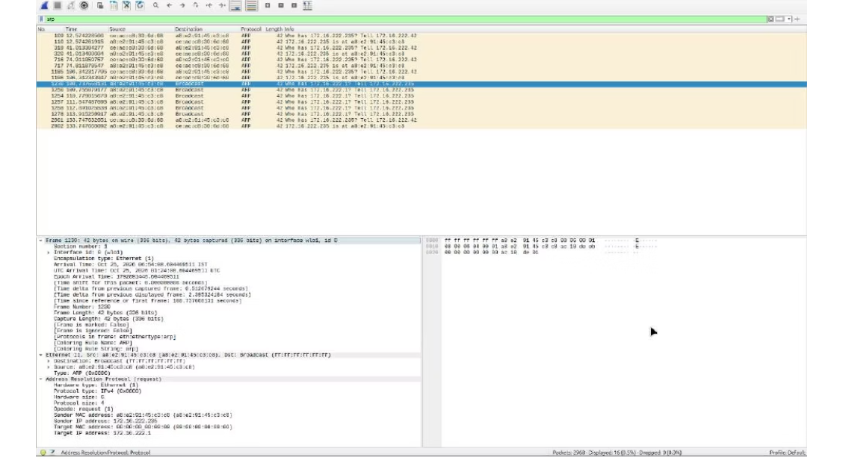
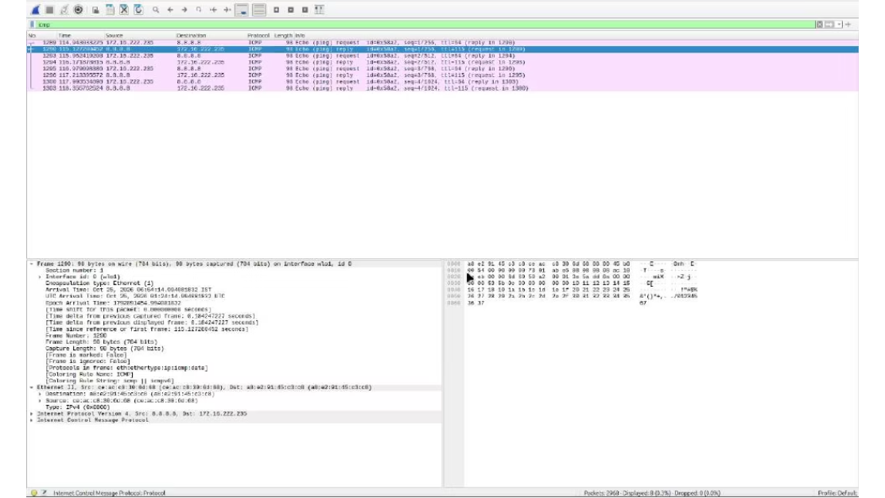
PACKET EVIDENCE
Five filters expose the request, reply, and resolution path
dns
94 packets. A, AAAA, and HTTPS queries. nslookup google.com resolved to 142.250.183.174.
arp · 16 packets
icmp · 8 packets
tcp
udp
SYN, SYN-ACK, ACK to port 443.
DNS on port 53.

Slide 9


FINAL TESTS
All six final tests matched the intended policy
Pass
Pass
Student static IP 192.168.10.10 · Student gateway 192.168.10.1
Student → Server 192.168.30.100 · Faculty → Server 192.168.30.100
Blocked as expected
Blocked as expected
Student → Admin 192.168.30.10
Guest → 192.168.10.10, 192.168.20.10, and 192.168.30.100
Static verification: “valid address” means manual ipconfig confirmation, not a DHCP lease.
Commands used: ipconfig (static 192.168.10.10, no DHCP), ping 192.168.10.1, ping 192.168.30.100 Allow, ping 192.168.30.10 Blocked timeout, show access-lists hits, show ip interface brief.
Mobile hotspot gateway: 172.16.222.1 (Android 12+ uses the 172.16.x.x range). Host: wlo1 172.16.222.235.

Slide 10
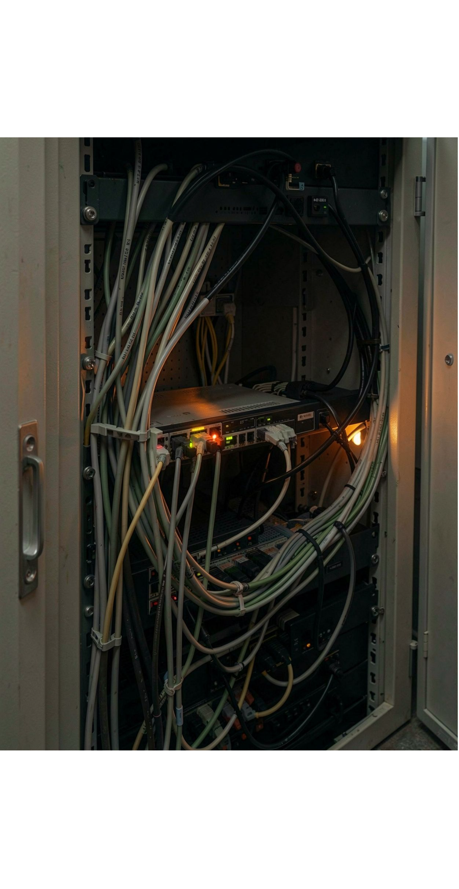
NEXT VERSION
From lab fixes to a stronger next version
Troubleshooting: rewired Fa0/6 and Fa0/8 to Fa0/3 and Fa0/5; fixed router flapping by trunking Gig0/1; used router-appropriate verification commands; cleared ARP with arp -d and clear arp-cache; selected wlo1 for Wireshark.
Limitations: static IPs, wired-only design, no direct Wireshark bridge, ACL coverage only on Student and Guest, single switch/router path, simulated performance.
Future: DHCP pools, WLC + APs, IoT VLAN, IEEE 802.1X, Packet Tracer Cloud bridge, redundant links and a second switch.
Conclusion: VLANs + Router-on-a-Stick + ACLs isolate user groups while preserving permitted communication.
No DHCP used - All addresses static verified via ipconfig, not lease

