Slide 1

A HYBRID MULTI-MODEL BASED APPROACH FOR HEART DISEASE DETECTION AND CLASSIFICATION
UNDER THE GUIDANCE OF - Dr Premanand V BY Anandakrishnan A- 21BCE1682
Aryan Sanjay Matte- 21BCE5850
Notes:
A study on hybrid model based..

Slide 2

GUIDE APPROVAL

Slide 3
OUTLINE
INTRODUCTION
PROBLEM STATEMENT
RESEARCH OBJECTIVES
PROPOSED SYSTEM
IMPLEMENTATION
CONCLUSION AND FUTURE WORK
RESEARCH PAPER STATUS
REFERENCES

Slide 4

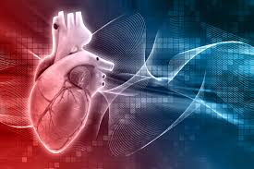
INTRODUCTION
HEART DISEASE DETECTION
The heart is the body's main organ whose main purpose is to move oxygenated blood through all the capillaries and arteries in the body, which in turn helps to sustain life. Any illness or ailment that limits a person from performing this task can be considered to be a cardiac disease, which is a sub type of coronary heart disease (CHD) . Thus, Cardio Vascular disease (CVD) is the world's leading cause of death, and is responsible for some 17 million deaths annually, a significant percentage of the problem a year resulting in death. Heart diseases remain one of the leading causes of death worldwide. As a result, early and accurate diagnostics have become an urgent need for treatment and management. Most of the conventional methods adopted tend to have major drawbacks: the issues of accuracy, interpretability, and feature representation
PROBLEM

Slide 5

PROBLEM STATEMENT
Existing diagnostic solutions for heart diseases are often too specialized, expensive, or limited in scope, making comprehensive and early detection challenging in primary healthcare settings. This project aims to develop a scalable, cost-effective, and portable solution that leverages machine learning and advanced hardware to detect a wide range of heart diseases using ECG, PPG (Photoplethysmogram) and PEG (Pulse Electrogram) models, the system enhances heart disease prediction, making it more efficient and accurate. This multi-signal approach improves early detection capabilities, ensuring better accessibility and reliability in healthcare diagnostics.

Slide 6
RESEARCH CHALLENGES
1. Most common problem is dataset quality and availability because often in datasets related to heart disease, data is either missing or noisy or inconsistent, which impacts the model immensely. There could be incomplete data for some factors, such as age, gender, cholesterol levels, or blood pressure. Poor data quality and unreliable predictions can hinder the building of accurate models for heart disease detection.
2. Most heart disease datasets suffer from class imbalances, where the majority of cases are non-diseased and number a lot more than the diseased cases. This can lead to biased models that perform well on the majority class but poor in detection of heart disease cases. The model may fail to identify true heart cases.
3. Many existing data sets used in training machine learning algorithms may often restrict to specific population groups, including age, regions, or other ethnic backgrounds-this can affect the applicability of the machine learning model and its ability to generalize to diverse populations. That may cause samples not to behave as well among patients from another demographic background.
4. Collecting and using medical data for machine learning purposes raises serious ethical and privacy concerns, especially with sensitive health information. Informed consent and patient confidentiality are important considerations because misuse of personal health data can lead to legal and ethical consequences.
5. The evaluation of machine learning models is inherently complex, particularly in the context of medical data. Relying on metrics such as accuracy may be inadequate; thus, incorporating additional metrics like precision, recall, and F1-score is essential, especially when addressing class imbalances. Inaccurate or superficial evaluations can lead to an overestimation of a model’s efficacy, which may ultimately result in erroneous diagnoses.
6.Deploying machine learning models in real-time clinical settings is challenging mainly because of the high computational complexity of the models and the demand for rapid predictions. Delayed predictions can be disastrous in situations where time is crucial, and huge models may not be appropriate to be integrated with healthcare systems which have limited computing resources.

Slide 7
RESEARCH OBJECTIVE
The objective of this research is to design and implement a machine learning-based system for the identification of heart disease, utilizing both historical patient data and rea ECG signal acquisition and other clinical datas that include PPG,PCG. By extracting critical features from ECG waveform images and combining them with clinical parameters, the study aims to develop an accurate and efficient predictive model that supports early diagnosis. Additionally, the research seeks to integrate ECG data with other diagnostic data like PPG,PCG, enabling dynamic and continuous monitoring for timely detection of cardiac abnormalities. The overarching goal is to provide a scalable and user-friendly solution that aids healthcare professionals in making informed and timely decisions, ultimately improving patient outcomes.

Slide 8
Proposed System Introduction
The suggested system analyzes ECG, PPG, and heart sounds for improved detection of heart disease. As raw signals tend to include noise and artifacts, the system uses preprocessing methods like deionizing, denoising, resampling, and segmentation. Deionizing and denoising eliminate undesirable distortions, resampling normalizes signals, and segmentation extracts important waveform components. This yields clean and reliable data for further processing.
Following preprocessing, vital features are derived from ECG and PPG waveform signals for detecting patterns associated with cardiac conditions. These features are then input to deep learning models such as EfficientNet, ResNet50, Vision Transformers, and a CNN Hybrid model. EfficientNet achieves optimal performance while saving computations, ResNet50 extracts fine details in waveforms, and Vision Transformers examine signal dependencies. The CNN Hybrid system improves feature learning by coupling convolutional layers and transformer-based models for higher precision. With several signals combined together and cutting-edge AI models incorporated, the machine facilitates efficient and accurate heart disease detection at a primary healthcare stage.

Slide 9
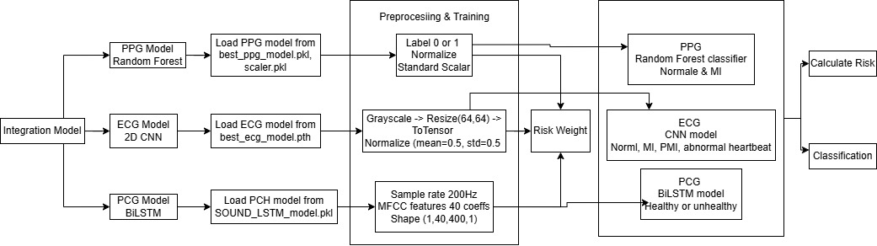
Proposed System-DIAGRAM

Slide 10
Proposed System-ALGORITHMS AND MODULES
ML Models Used:
Random Forest – A robust ensemble learning model that improves classification accuracy.
Deep Learning Models Used:
2D CNN – A 2D Convolutional Neural Network is a deep learning model that extracts spatial features from image data using convolutional layers, making it ideal for ECG image classification in our model
BiLSTM (Bidirectional Long Short-Term Memory)-BiLSTM processes data in both forward and backward directions. This helps in learning contextual information from both past and future time steps. Especially useful in heart sound classification, where patterns are cyclic
EfficientNet- EfficientNet is a deep convolutional neural network (CNN) architecture designed for image classification. It is optimized for high accuracy with fewer parameters compared to older architectures (e.g., ResNet, VGG)
ResNet50: Uses residual connections to prevent the vanishing gradient problem. Can capture deeper spatial features missed by EfficientNet.Pretrained on ImageNet (leverages learned patterns from large datasets)
Multilayer Perceptron (MLP) (Classifier):Classifies concatenated features into heart disease categories.

Slide 11
Proposed System-ALGORITHMS AND MODULES
Preprocessing Techniques Used:
Deionizing & Denoising – Removes noise and unwanted distortions.
Resampling – Standardizes signal data for uniform analysis.
Segmentation – Isolates key waveform components for precise feature extraction.
Mel-Frequency Cepstral Coefficients (MFCC) -extraction involves several steps to transform raw audio signals into meaningful features for machine learning models. Below are the step-by-step details
Dataset Links:
ECG: https://www.kaggle.com/datasets/evilspirit05/ecg-analysis
PPG: https://www.kaggle.com/datasets/ucimachinelearning/photoplethysmography-ppg-dataset
PCG:https://www.kaggle.com/datasets/swapnilpanda/heart-sound-database

Slide 12
DATASETS USED AND THEIR DEFINITION:
Feature | PCG (Phonocardiography) | PPG (Photoplethysmography) | ECG (Electrocardiography)
Definition | Records heart sounds using a microphone. | Measures blood volume changes via light absorption. | Records electrical activity of the heart.
Primary Use | Detecting heart murmurs & valvular diseases. | Monitoring blood circulation & SpO₂ levels. | Diagnosing arrhythmias, ischemia, and heart conditions.
Suitability for ML Models | Moderate – requires audio feature extraction. | High – simple time-series classification. | High – rich features for deep learning.

Slide 13
IMPLEMENTATION
TYPE OF DATASET USED | ML MODELS USED
1)PPG | Random Forest Algorithm
2)ECG | Modified 2D CNN
4)PCG Dataset Details:PhysioNet/CinC Challenge Dataset 2016 | Bidirectional Long Short-Term Memory (Bi-LSTM)
5)ECG Dataset for Cardiovascular Research and Diagnostics | Hybrid Model (EfficientNetB0 and ResNet50) AND Multilayer Perceptron (MLP) (Classifier)

Slide 14
Architecture
Hybrid 2D CNN
1. Data Preprocessing
The ECG images are saved in train and test directories within the ecg dataset folder.
Images are loaded and preprocessed with ImageDataGenerator with rescale=1./255.
Images are resized to 128x128 pixels and are converted to grayscale.
Data is divided into training (80%) and validation (20%) subsets.
2. CNN-Based Feature Extractor
Convolutional Layers: Extract spatial features from ECG images.
Max-Pooling Layers: Reduce dimensionality while preserving key patterns.
Layer Normalization: Normalizes inputs both before and after MHSA.
Global Average Pooling: Obtains the most significant feature representations.
3. Classification Head
Dense Layer: Projects features down to 128 neurons with ReLU activation.
Softmax Layer: Provides probabilities for four classes.
5. Model Training & Prediction
The model is trained with Adam optimizer and Sparse Categorical Cross entropy loss.
The model is saved as ecg_hybrid_model.h5 after training.
For prediction, an ECG image is preprocessed, input into the trained model, and classified into one of the four categories.

Slide 15
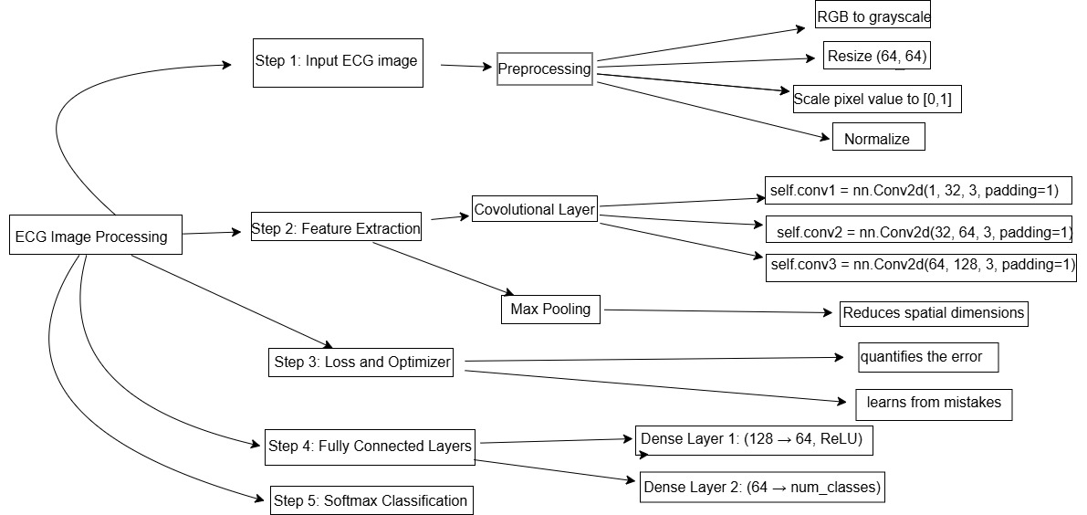

Slide 16
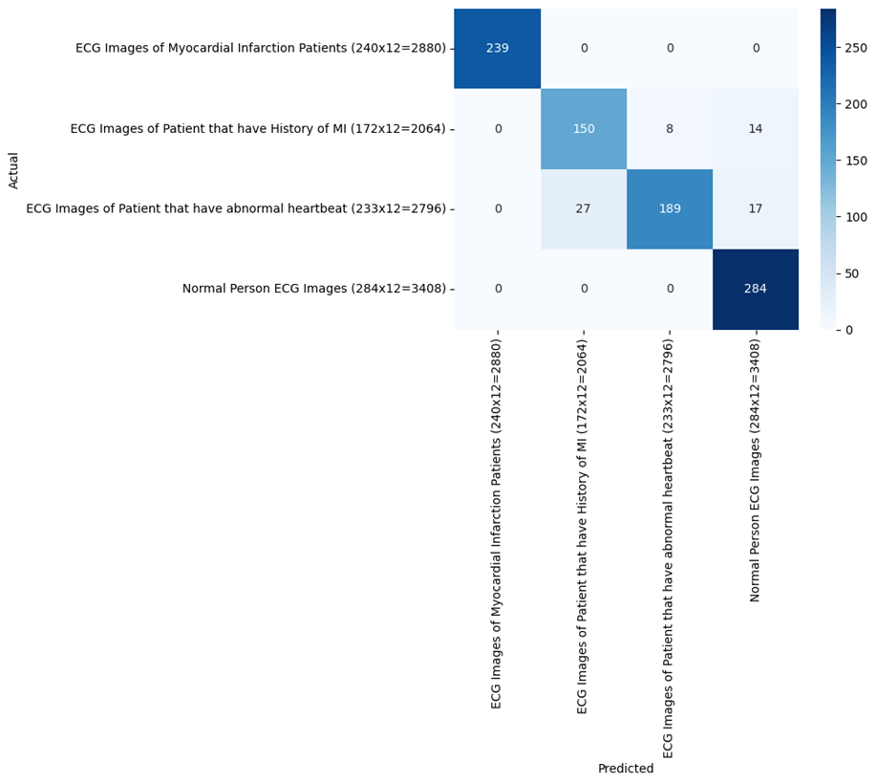
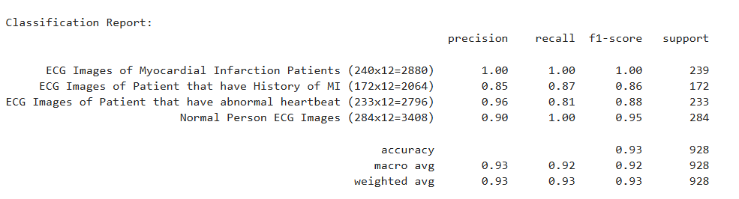
Result
The confusion matrix and classification report demonstrate the strong performance of ECG-based 2D CNN model. It achieved overall accuracy of 93% which achieved excellent classification for Myocardial and also better in other classifications. The high macro and weighted averages for precision, recall and F1-score validate the models robustness and reliability for real world ECG classification.

Slide 17
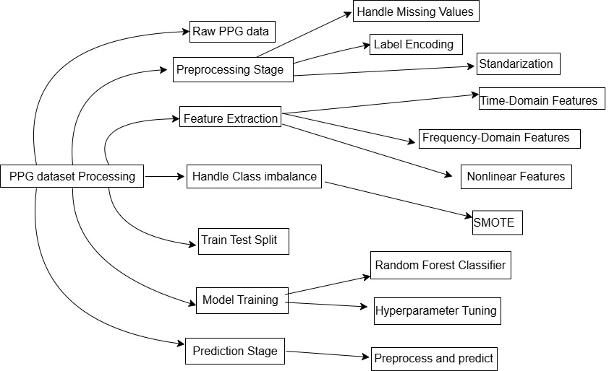
ARCHITECTURE
The architecture diagram for PPG based classification model represents structured data preprocessing, feature extraction and classification using random forest model. It begins with taking raw PPG data and then preprocess it for noise removal, normalization and handling missing values. To prevent any class imbalance SMOTE is applied before splitting the dataset into train and test sets. The random forest classifier is trained on processed data and then used for classification. The final prediction is made indicating cardiovascular condition based on PPG data.

Slide 18
WORKFLOW DIGRAM
2. Random Forest Algorithm
Data Preprocessing
Load PPG_Dataset.csv and print dataset information.
Verify missing values and take care of them if any.
2. Feature Selection & Normalization
Split features (X) from the target label (y).
Use StandardScaler to scale feature values for improved model accuracy.
3. Train-Test Split
Split data into 80% for training and 20% for testing using train_test_split.
Specify random_state=42 for reproducibility.
4. Model Training - Random Forest Classifier
Train a Random Forest Classifier with 100 decision trees (n_estimators=100).
The model is trained to recognize patterns from the training data in order to classify PPG signals.
5. Model Prediction & Evaluation
Predict results on test dataset.
Monitor performance using accuracy score, classification report, and confusion matrix.
Visualize the confusion matrix using a Seaborn heatmap to interpret it easily.

Slide 19
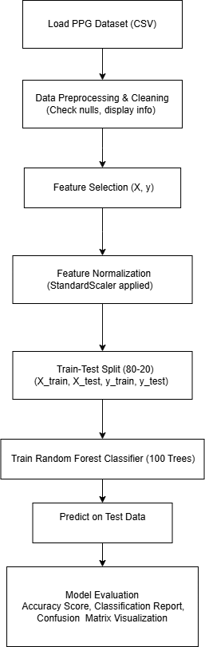
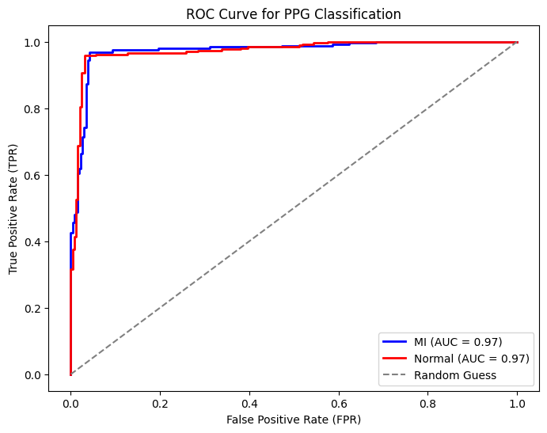

Slide 20
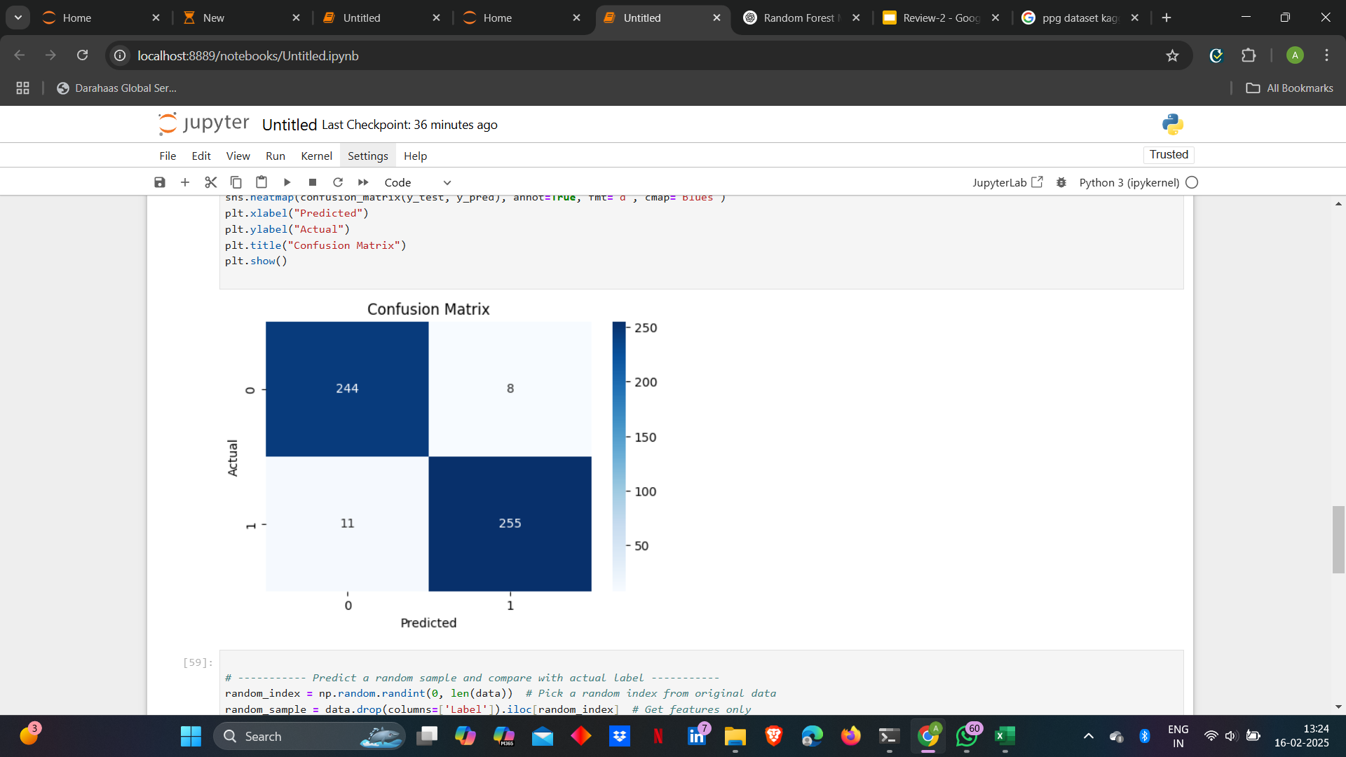
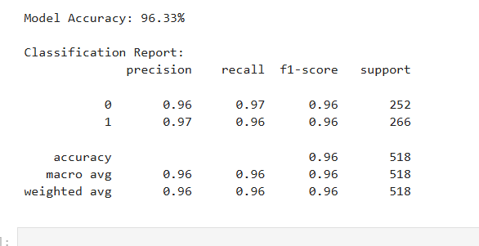
Result
The model achieved a high accuracy of 96.33%, demonstrating strong classification ability between myocardial infarction (label 1) and normal cases (label 0). The confusion matrix shows minimal misclassifications, with precision, recall, and F1-scores all at 96-97%, indicating a well-balanced and effective performance. These results highlight the reliability of the Random Forest classifier in analyzing normalized PPG signals for heart condition detection.

Slide 21
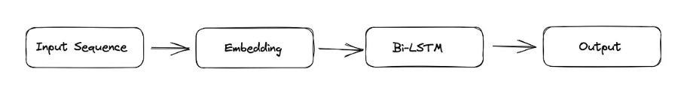
This heart disease detection model is based on Bidirectional Long Short-Term Memory (Bi-LSTM) and processes heart sound recordings to classify them as healthy or unhealthy.
DATASET USED: PhysioNet/CinC Challenge Dataset 2016 Feature Extraction using MFCCs (Mel-Frequency Cepstral Coefficients) : Librosa is used to load .wav files. MFCCs (40 coefficients) are extracted to represent the audio signals as numerical features. Padding or truncation ensures consistent feature length (40 × 400) for LSTM input Data Preprocessing: Splitting: The data is split into training (X_train, y_train), validation (X_val, y_val), and test sets (X_test, y_test). Reshaping for LSTM: The extracted MFCC features are reshaped into (samples, time steps, features) format for sequential data processingodel Architecture - Bidirectional LSTM . M Model Compilation & Training Model Evaluation & Performance Metrics

Slide 22
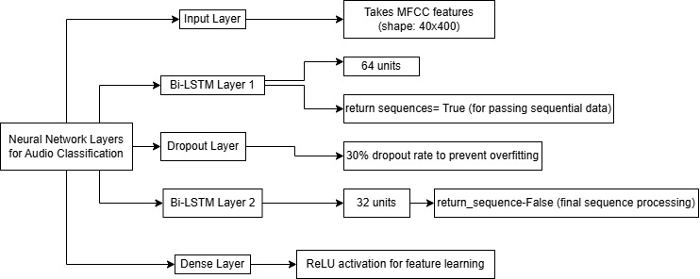
Model Architecture - Bidirectional LSTM

Slide 23
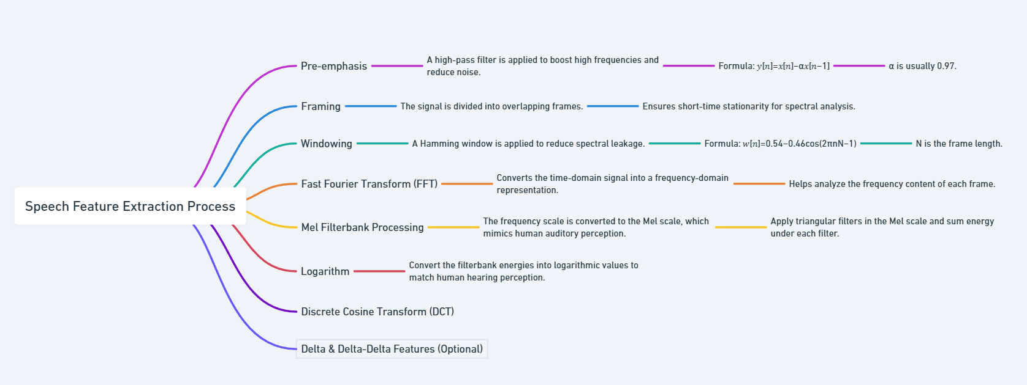
EACH STEPS IN MFCC ARCHITECHTURE

Slide 24
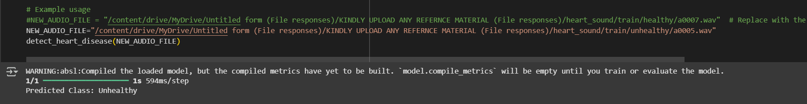
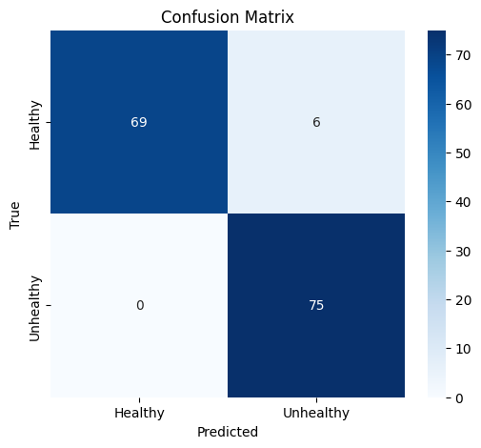
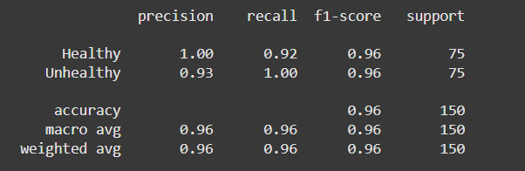
RESULTS

Slide 25
Hybrid Model for ECG Disease Detection-combining EfficientNetB0 and ResNet50 to extract deep features from ECG images. These extracted features are then used as input to an MLP classifier
1)Dataset Preparation: kagglehub.dataset_download() to fetch the dataset.
2)Preprocessing & Label Encoding: Extracts class names from the dataset. Uses LabelEncoder() to convert class names into numerical labels. Converts labels into one-hot encoded format for multi-class classification.
3)Hybrid Feature Extraction
EfficientNetB0: Extracts low-level to high-level features.Uses include_top=False to remove the final classification layer. pooling='avg' ensures global average pooling.
ResNet50: Extracts hierarchical features using residual connections. include_top=False to remove the last fully connected layers. pooling='avg' to reduce feature maps to a feature vector.
Extract features using both EfficientNetB0 and ResNet50.Concatenates feature vectors from both models to get a comprehensive feature representation.
MLP CLASSIFIER: Once feature vectors are extracted, they are passed to an MLP classifier for final prediction.
Model Training & Evaluation:
Explainability (Grad-CAM):To make the model more interpretable, Grad-CAM (Gradient-weighted Class Activation Mapping) is implemented:Computes gradients of the output class with respect to the feature maps of the last convolutional layer.Generates a heatmap showing which regions contributed most to the prediction.Overlays the heatmap on the original ECG image.
Final Prediction Pipeline:Loads the trained MLP model.Loads the label encoder.Accepts new ECG images for prediction.Extracts hybrid features from EfficientNetB0 & ResNet50.Uses the MLP classifier to make the final disease prediction. Returns the predicted class.

Slide 26
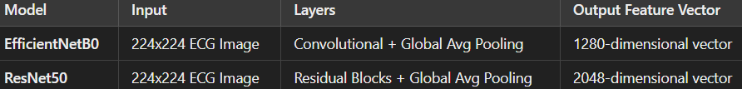
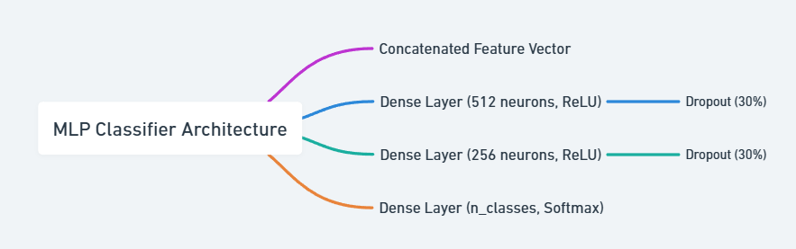
HYBRID MODEL ARCHITECHTURE:

Slide 27
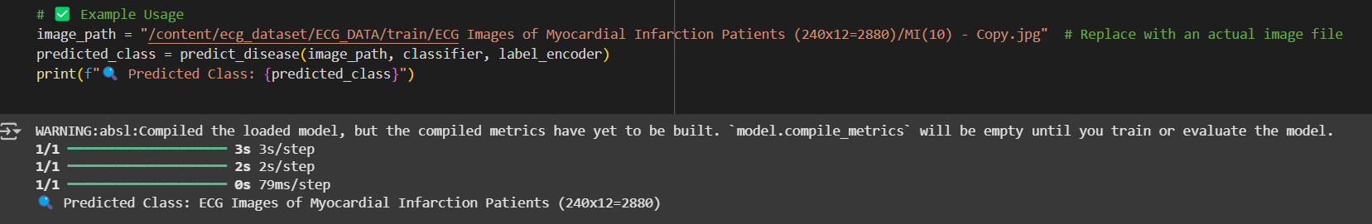
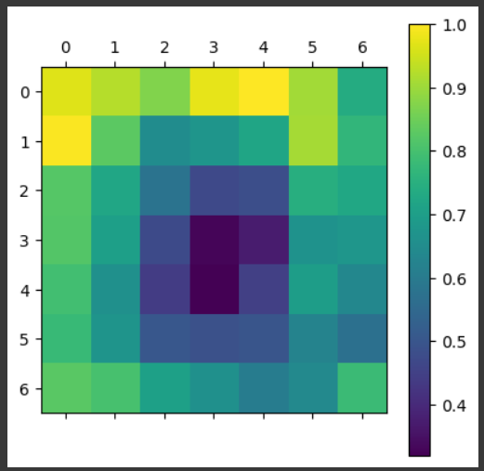
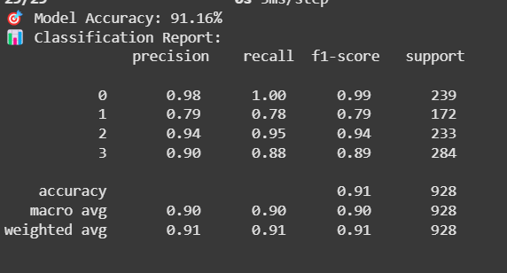
RESULTS: MODEL EVALUTAION AND GRAD CAM

Slide 28
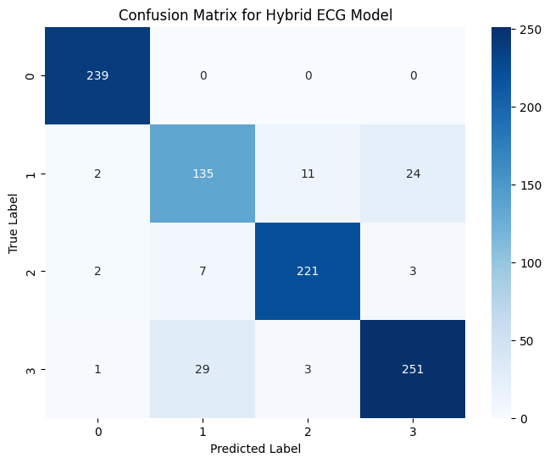
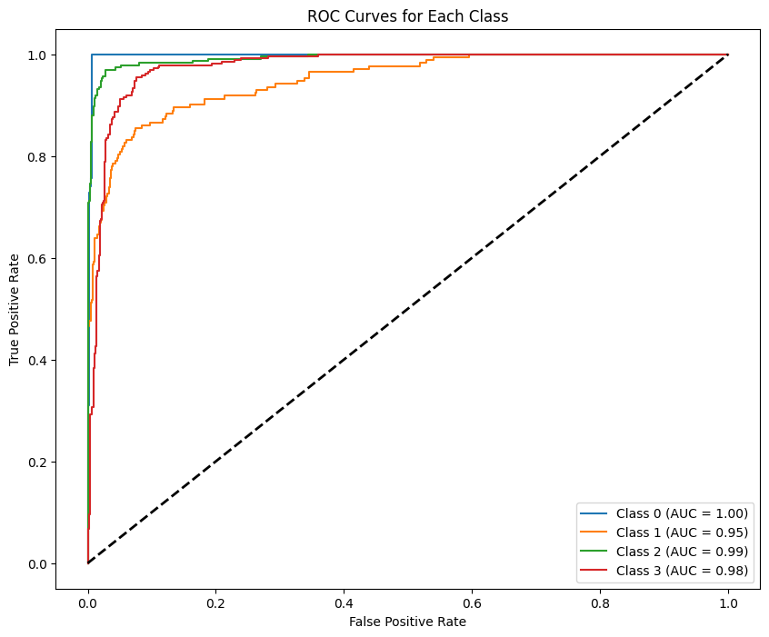
CONFUSION MATRIX AND GRAPHS

Slide 29
FINAL IMPLEMENTATION
The proposed system integrates three physiological signals—PPG, ECG, and PCG—using a specialized model pipeline. Each modality undergoes dedicated preprocessing: PPG signals are normalized and classified using a Random Forest classifier; ECG images are grayscale-converted, resized to 64×64, normalized, and passed through a 2D CNN; PCG audio is sampled at 200 Hz, converted to MFCC features, and processed via a BiLSTM network. The outputs from these models are weighted based on their diagnostic importance, allowing higher priority for signals most indicative of heart risk. The final risk score and classification label are generated through an integration layer for robust decision-making.

Slide 30
FINAL IMPLEMENTATION
RISK WEIGHTS AND OUTPUTS
ECG | PCG | PPG | RISK SCORE
IMAGES OF MI | HEALTHY | NORMAL | 34
IMAGES OF MI | UNHEALTHY | NORMAL | 60
IMAGES OF MI | HEALTHY | MI | 31.3
IMAGES OF MI | UNHEALTHY | MI | 76.4
IMAGES OF PATIENTS THAT HAVE HISTORY OF MI | HEALTHY | NORMAL | 25
IMAGES OF PATIENTS THAT HAVE HISTORY OF MI | UNHEALTHY | NORMAL | 52.3
IMAGES OF PATIENTS THAT HAVE HISTORY OF MI | HEALTHY | MI | 23.6
IMAGES OF PATIENTS THAT HAVE HISTORY OF MI | UNHEALTHY | MI | 47
IMAGES OF PATIENTS THAT HAVE ABNORMAL HEARTBEAT | HEALTHY | NORMAL | 22.6
IMAGES OF PATIENTS THAT HAVE ABNORMAL HEARTBEAT | UNHEALTHY | NORMAL | 44.3
IMAGES OF PATIENTS THAT HAVE ABNORMAL HEARTBEAT | HEALTHY | MI | 20.3
IMAGES OF PATIENTS THAT HAVE ABNORMAL HEARTBEAT | UNHEALTHY | MI | 58.8
NORMAL PERSON ECG IMAGE | HEALTHY | NORMAL | 8.6
NORMAL PERSON ECG IMAGE | UNHEALTHY | NORMAL | 36.3
NORMAL PERSON ECG IMAGE | HEALTHY | MI | 17
NORMAL PERSON ECG IMAGE | UNHEALTHY | MI | 30.6
Multi Modal Fusion-Combines three independent AI models. Confidence-Based Decision Fusion- Adjusts risk based on each model’s certainty, avoiding over dependency on any one modality. Provides a Risk Score instead of ClassificationScalable and Interpretable- Can be scaled on further datasets. Unlike other modalities our project mimics how cardiologists diagnose heart disease-analysing multiple physiological signals together as most AI-based heart disease detection models focus on a single modality.
CLASS | RISK ANALYSIS
0-23.6 | LOW RISK
23.6-52.3 | MODERATE RISK
>52.3 | HIGH RISK

Slide 31
APPLICATION WORKFLOW
The application is a web-based heart disease diagnostic system that allows users to upload ECG images, PPG datasets, and PCG audio files for analysis using a hybrid model. The frontend, built using HTML, CSS, and JavaScript. Animations using GSAP and hover effects enhance user experience and responsiveness. On the backend, a Flask server receives uploaded files via a POST request triggered by the JavaScript predict() function. Each input is processed by a specialized model: a CNN for ECG, a Random Forest for PPG, and an LSTM for PCG. Their individual predictions contribute to a final risk score, which is returned as a JSON response and dynamically displayed on the frontend. This seamless integration of frontend and backend provides an intuitive, fast, and interactive diagnostic workflow.

Slide 32
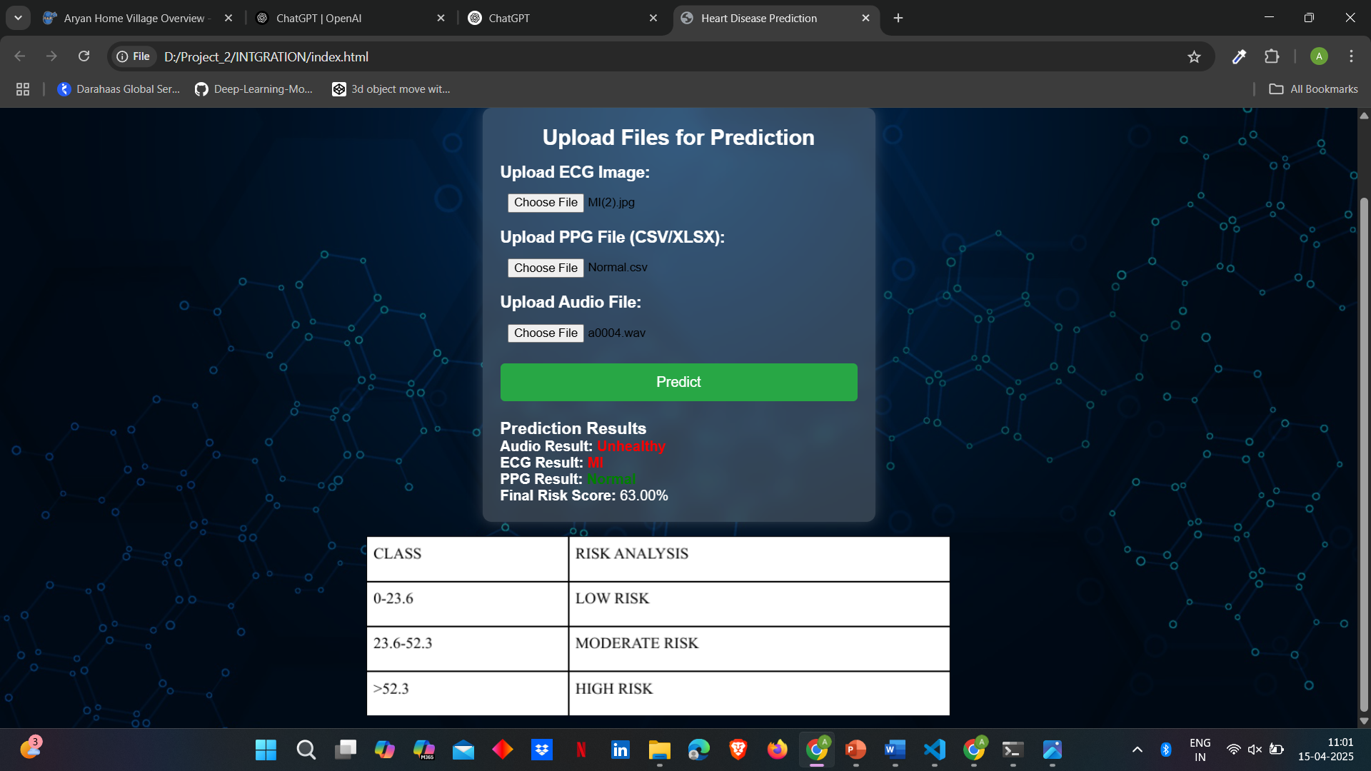
RESULT

Slide 33
CONCLUSION
The proposed hybrid model approach for heart disease detection and classification effectively integrates Electrocardiogram (ECG), Photoplethysmogram (PPG) and Phonocardiogram (PCG) to improve accuracy and reliability of cardiac disease classification and detection. By using deep learning and machine learning models the system ensures a complete evaluation of cardiac health condition. The study showed that multi-model approach significantly enhances prediction accuracy compared to individual. It also ensures that each model contributes to final risk score minimizing errors that may arise in single models. The model is similar to approach of medical professionals where patient undergo various tests to come to a final conclusion of heart condition.
This model shows the importance of integrating multiple models to improve heart disease detection and sets a foundation for future advancement in AI driven world. The promising results of the model also indicate a potential use in real world deployments in clinical or remote monitoring system offering non-invasive, efficient and early diagnostic of patients. Further new advancements and improved datasets will continue to refine and enhance this model in practical healthcare conditions.

Slide 34
FUTURE WORK
The future work for this model includes few areas to improve accuracy, efficiency and real-world application. Firstly, improving integration of ECG, PPG and PCG through advance fusion techniques such as multi-modal frameworks could significantly increase performance of the model. Implementing transformer-based algorithm for feature extraction and optimizing model using techniques like Bayesian optimization and genetic algorithms may further improve our model. For noise reduction techniques like wavelet transforms and adaptive filtering can be utilized. Expanding the dataset by using real world data and updated data’s which maybe published in future and clinical sources will ensure model generalization across diverse patients of the world.
Further, real-time deployment of the model by using edge AI optimization and cloud-based integration can provide continuous and remote heart disease monitoring. More advancement may also include using multi class classification for various other diseases which directly or indirectly cause heart related conditions. With increase in AI in every field there is also a scope for adapting AI tools in our model for individual patients improved diagnostic according to their need and helpful for long time monitoring. By integrating this improvements model may become a real time, accurate and early heart detection sufficient for patients.

Slide 35
RESEARCH PAPER STATUS-

Slide 36
REFERENCE
Heart Disease Detection Using Machine Learning and Deep Learning - Mrs. B. Lalitha Rajeswari1, Dt., Andhra Pradesh. M. Naga Nandini2,M. Venkata Gopi Jayaram3, P. Lokesh4, P. Divya Sri5 (2012)
Prediction of Heart Disease Using Machine Learning - Sangya Ware and Shanu k Rakesh (2019)
Heart Disease Detection Using Machine Learning - Chithambaram T , Logesh Kannan N, Gowsalya M (2020)
Machine Learning Technology-Based Heart Disease Detection Models - Umarani Nagavelli, Debabrata Samanta and Partha Chakraborty (2022)

Slide 37

THANK YOU

