Slide 1
Seasonal Autoregressive Integrated Moving Average (SARIMA) Model for Forecasting Electrical Load of Chhattisgarh State
Paper ID - 24
This work delves into forecasting electrical load, which is essential for effective energy management and infrastructure planning, using the SARIMA model.
Presented by: Aryan Soni , B.tech. 3rd year ,
Department of Biomedical Engineering , NIT Raipur

Slide 2
Table of Contents:
Introduction
Aim
About Input Data
Reason to choose SARIMA
Model Representation
Components of SARIMA
Review Points
Methodology
Result

Slide 3
1) Introduction :
Electrical load value forecasting for Chhattisgarh state has been accomplished using the Seasonal Autoregressive Integrated Moving Average (SARIMA) model.
The input dataset comprises electricity load data for the years 2021, 2022, and 2023. This data is utilized to predict the load values for the year 2024 and 2025.
Seasonal Autoregressive Integrated Moving Average (SARIMA) model stands as an exceptional forecasting tool, leveraging its instantaneous average-based architecture to predict future values with high accuracy.
The model’s performance was evaluated using standard statistical metrics, ensuring accurate and reliable predictions.

Slide 4
2) Input Data :
The very first step is taking monthly electricity load values.
The load values is collected at every 15 minutes interval, thus in every single hour in a day, 4 load value points are collected which results in 96 value points for one day. For one complete month (31 days’ count) we have 2976 load value points.
For forecasting the load value for January of 2024, previous three years load value points of similar month are taken as input for SARIMA model i.e. for January 2021,2022 and 2023. Collectively 8928 (2976 X 3) electricity load values are taken.

Slide 5
3) Aim:
The primary aim of this study is to develop an accurate forecasting model for electricity load values in Chhattisgarh state, with predictions generated at 15-minute intervals.
The forecast horizon has been strategically pre-defined to span a one-week time period, encompassing a total of 672 future time points (96 intervals per day × 7 days).
This approach ensures precise forecasting of electricity demand for the subsequent week.

Slide 6
4) Reason to choose SARIMA :
Small Dataset Handling:SARIMA performs well with smaller datasets, whereas deep learning models like LSTM, CNN, and ANN require large datasets for effective training and generalization.
Low Computational Complexity:SARIMA is computationally less intensive and faster to implement, making it ideal for projects with limited resources or tight timelines
Focus on Time Series:SARIMA explicitly incorporates time series features like seasonality, trend, and noise into its design, eliminating the need for extensive feature engineering.
Avoidance of Overfitting:Unlike deep learning models, which risk overfitting when the dataset is small or noisy, SARIMA uses a simpler structure that generalizes well.

Slide 7
5) Working Representation :
Seasonal Autoregressive Moving Average (SARIMA) model
Uses the concept of moving average and forecast horizon to predict values
Predictions for the year 2024 and 2025
Load data value of years 2021 , 22 , 23.

Slide 8
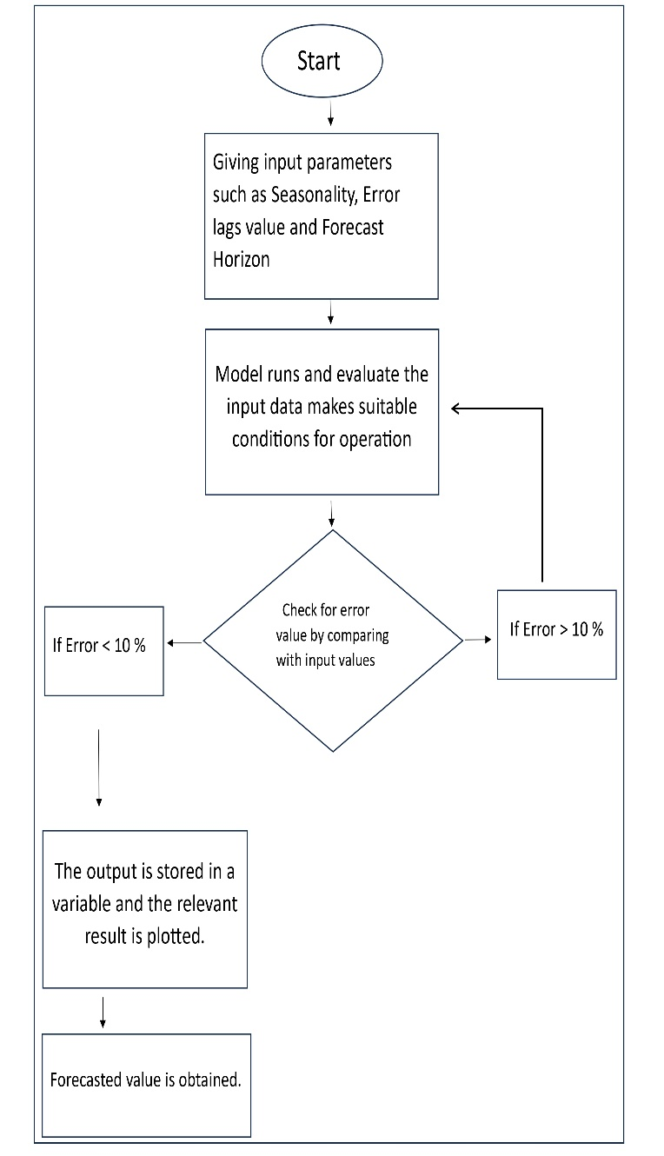
Flowchart of the Model:

Slide 9
6) Components of SARIMA:
Seasonal Component: The "S" in SARIMA represents seasonality, which refers to repeating patterns in the data. This could be daily, monthly, yearly, or any other regular interval. Identifying and modelling the seasonal component is a key strength of SARIMA.
Autoregressive (AR) Component: The "AR" in SARIMA signifies the autoregressive component, which models the relationship between the current data point and its past values. It captures the data's autocorrelation, meaning how correlated the data is with itself over time.
Integrated (I) Component: The "I" in SARIMA indicates differencing, which transforms non-stationary data into stationary data. Stationarity is crucial for time series modelling. The integrated component measures how many differences are required to achieve stationarity.

Slide 10
Continued…
3) Moving Average (MA) Component: The "MA" in SARIMA represents the moving average component, which models the dependency between the current data point and past prediction errors. It helps capture short-term noise in the data.
SARIMA = SEASONALITY + ARIMA

Slide 11
7) Review Points:
Seasonality handling of electricity load data typically exhibits strong seasonal patterns, with variations depending on the time of day, week, or year. Regarding interpretability, SARIMA models are relatively straightforward compared to complex machine learning models like LSTMs or CNNs.
The computational complexity of SARIMA models is less intensive than deep learning models. This makes SARIMA suitable for real-time forecasting, where quick updates are essential.
SARIMA combines trend and seasonal components seamlessly, allowing it to capture both long-term trends and short-term seasonal variations in electricity load value.

Slide 12
8) Methodology:
Model Operation:
Differencing the time series to achieve stationarity, using both non-seasonal (d) and seasonal (D) differencing.
Applying autoregressive (AR) and moving average (MA) components to the differenced series to model the underlying process.
Including Seasonal AR (SAR) and seasonal MA terms to capture seasonal dependencies.

Slide 13
9) Result (2024 only):

Slide 14
10) Result (2025) :

Slide 15
Limitations:
High Dependence on Parameter Tuning : Parameter selection is often manual or computationally intensive, requiring significant domain knowledge or trial-and-error.
Sensitivity to Outliers : Outliers can skew predictions and degrade model accuracy significantly.
Not Suitable for Real-Time Applications : Difficult to use for real-time or high-frequency energy management applications.
Ineffectiveness with Sparse or Missing Data : Requires interpolation or imputation, which might introduce errors.

Slide 16
Future Applications:
Energy Storage Optimization
Energy Pricing and Market Strategies
Integration of Electric Vehicles (EVs)
Cold-Chain Logistics Energy Management
Urban Cooling and Heating Systems
Behavioral Energy Consumption Modeling

Slide 17
Any queries and suggestions please….
Thank You

