Slide 1
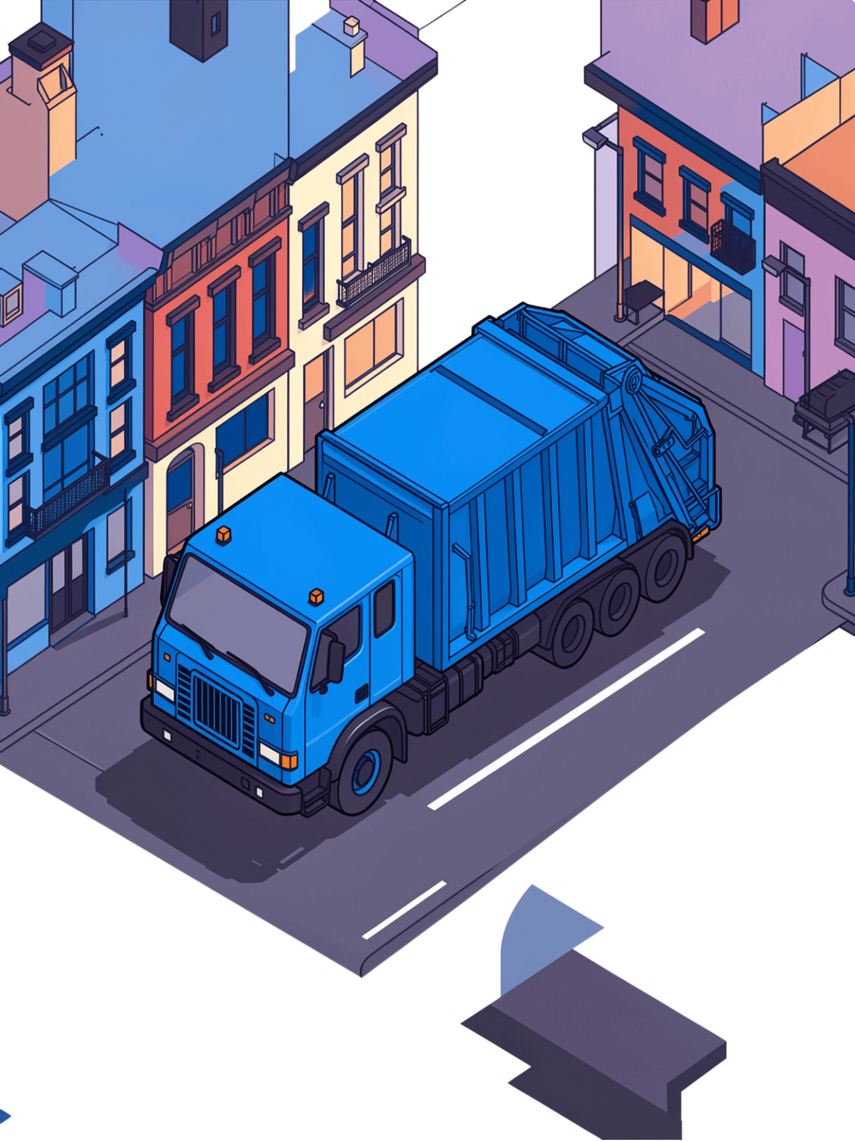
Municipal Waste Collection Optimizer
A Java-based system for intelligent waste bin management and collection routing

Slide 2
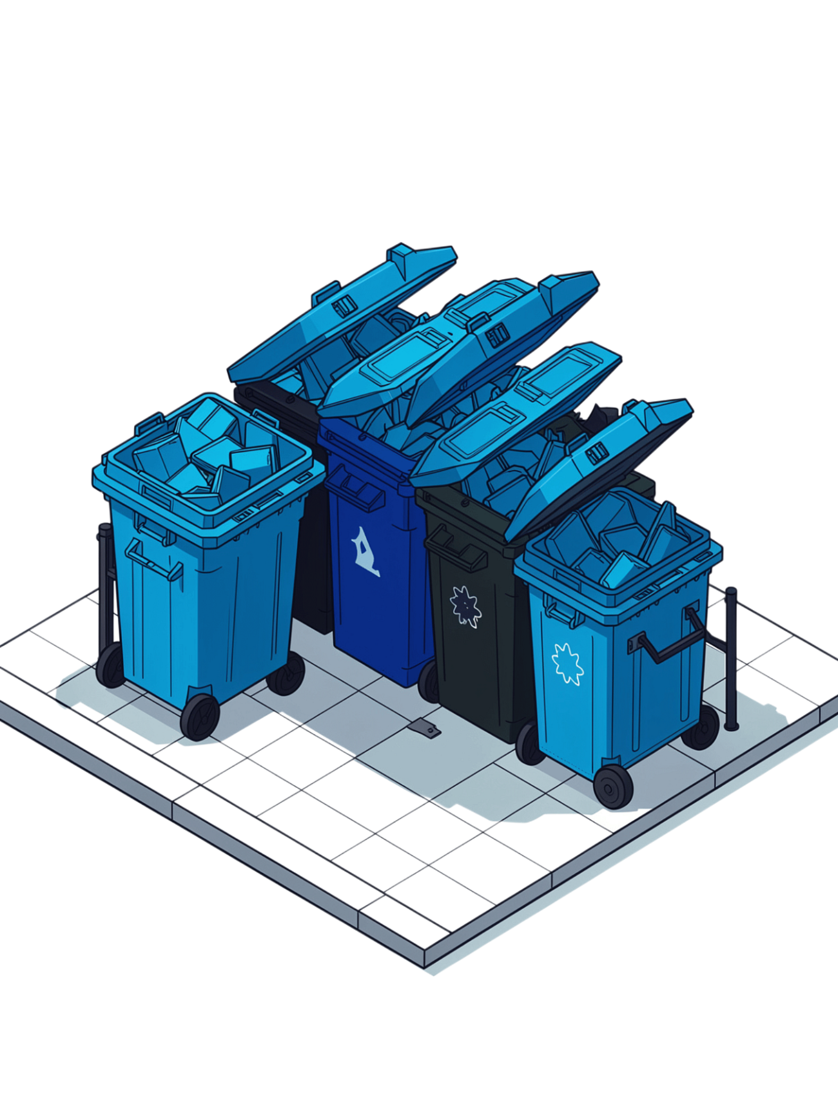
The Problem
Inefficient Collection
Blind Routes
Manual waste collection is costly and relies on guesswork rather than data
Drivers have no visibility into which bins actually need pickup
Wasted Resources
Trucks run unnecessary routes, consuming fuel and driver time

Slide 3
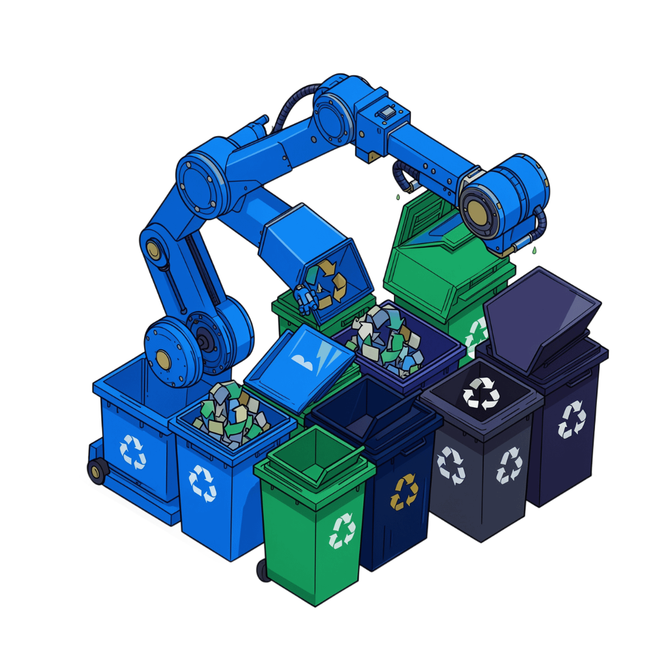
The Solution
1
Monitor Fullness
2
Categorize Waste
Automated system tracks bin fill levels in real-time
Classifies waste by type — organic, plastic, or metal
3
Optimize Routes
Assigns the most efficient collection routes instantly

Slide 4

How It Works: Input Phase
Enter bin count
Number of bins to monitor
Input Phase Overview
Collect bin data
Fullness % and waste type
The program uses Java's Scanner class to read all input from the console, looping through each bin to collect its two key data points.

Slide 5
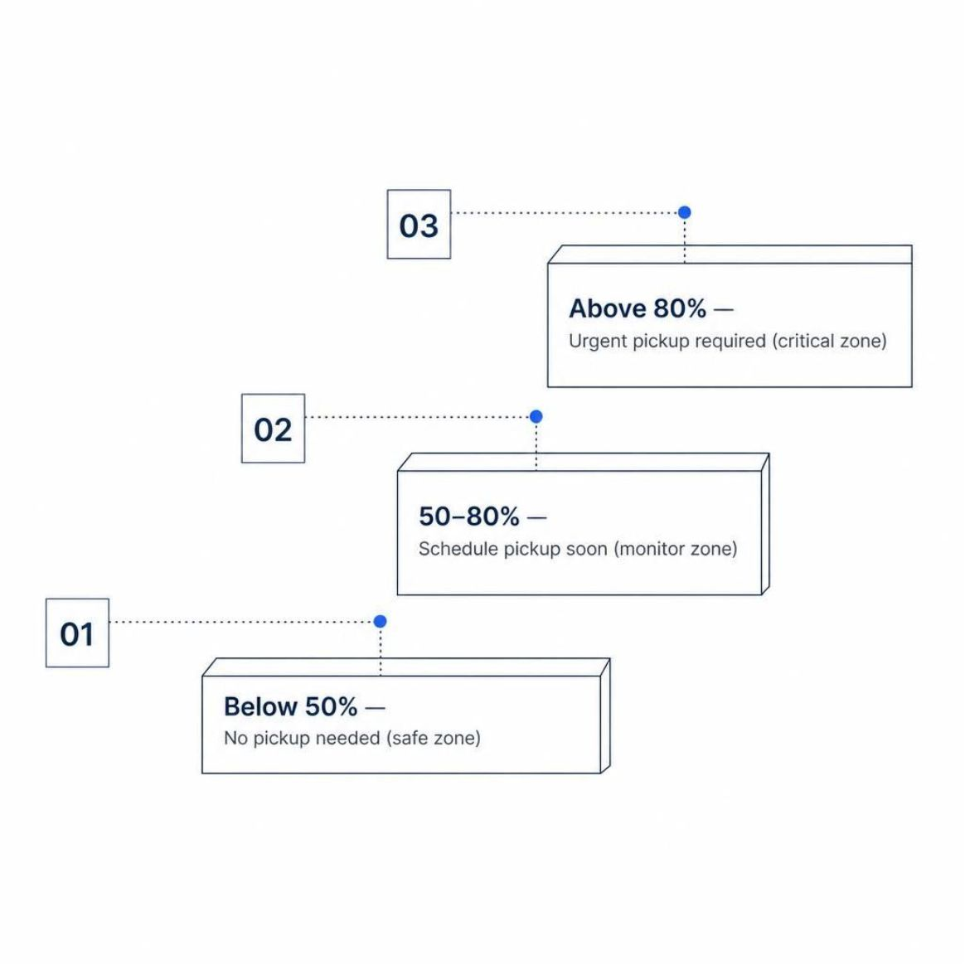

Fullness Assessment Logic
If/Else Conditional Logic
The program evaluates each bin's fullness percentage against three thresholds:
Below 50%
50 – 80%
Above 80%
No pickup needed — bin is within safe capacity
Schedule pickup soon — bin is filling up
Urgent pickup required — immediate action needed

Slide 6


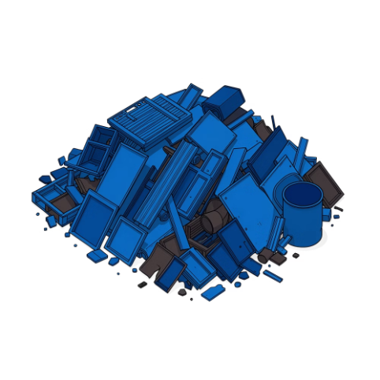
Waste Type Classification
A switch statement routes each bin to the correct specialized collection truck based on its declared waste type.
Type 1 — Organic
Type 2 — Plastic
Type 3 — Metal
Dispatches the organic waste truck for food scraps and biodegradable material
Dispatches the plastic waste truck for recyclable plastic materials
Dispatches the metal waste truck for scrap and metallic refuse

Slide 7





Key Technical Features
Scanner Class
Handles all console-based user input for bin count, fullness, and waste type
If/Else Conditionals
Evaluates fullness thresholds to determine pickup urgency for each bin
Switch Statement
Routes each bin to the correct specialized truck based on waste category
Loop Structure
Iterates over all bins efficiently, processing each one in a single pass

Slide 8


Output & Results
What the System Produces
Pickup Priority
Truck Assignment
Each bin is flagged as no action, scheduled, or urgent — enabling data-driven dispatch decisions
The correct specialized collection vehicle is assigned to each bin by waste type
Optimized Daily Route
All bin data is consolidated into an efficient collection plan for the day

