Slide 1
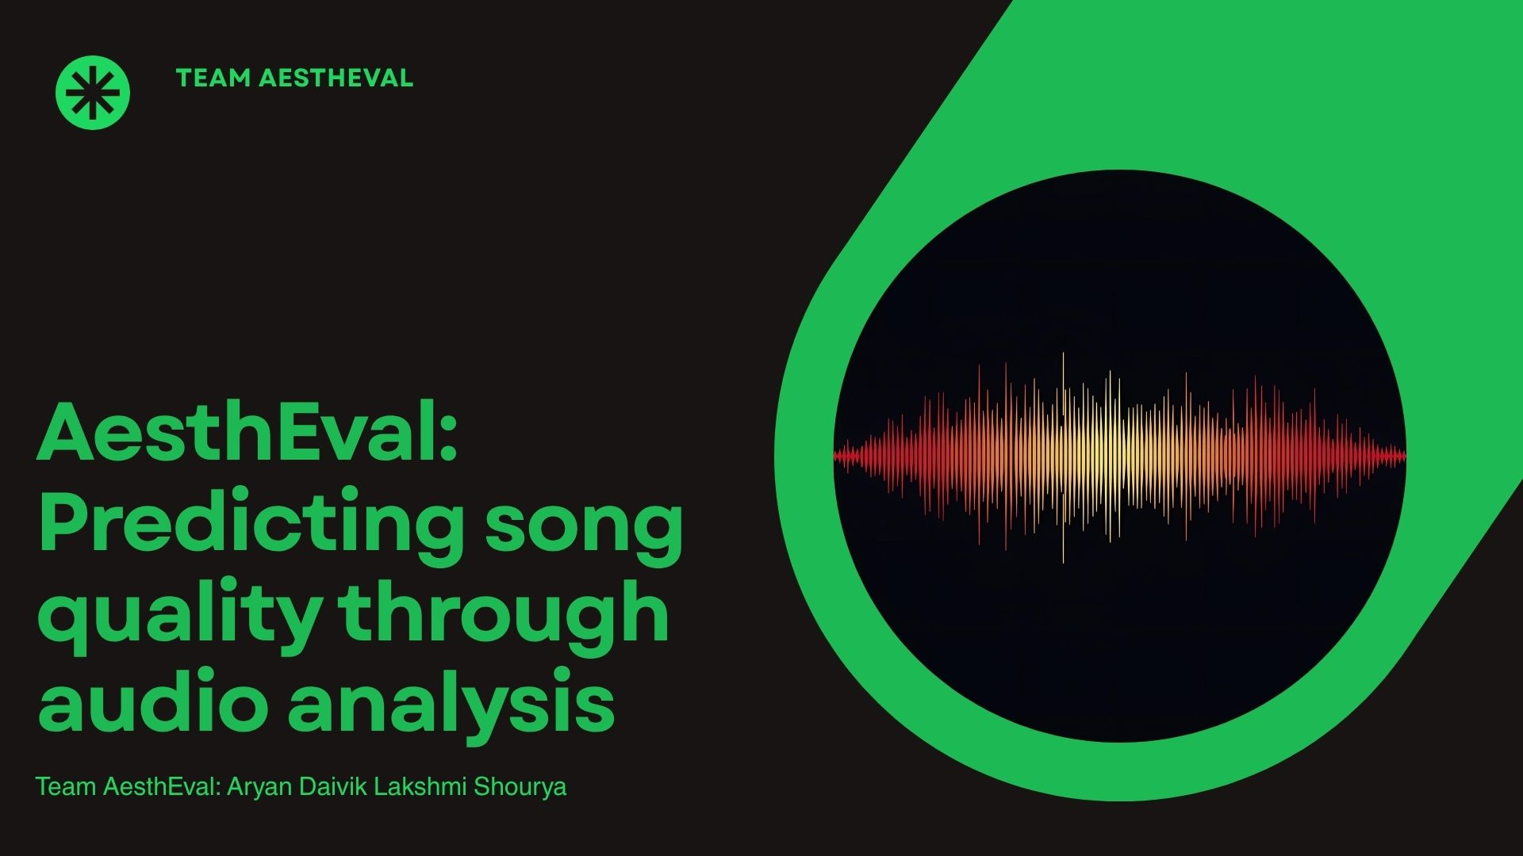
AesthEval
Predicting Song Quality Through Audio Analysis
Shourya Goyal • Aryan Gupta • Lakshmi C • Daivik Gupta
DA321: Multimodal Data Processing and Learning-I

Slide 2


Problem Statement
The Challenge
Why It Matters
How do you predict if a song sounds "good" just by analyzing the audio itself? No reading lyrics, no checking who the artist is, no user data like streaming numbers just the audio features.
Small Independent Creators and AI composers need automatic quality assessment to evaluate their output without need of expensive pro feedback
Real-World Impact
Scientific Goal
Spotify gets over 100,000 new songs uploaded every single day. Having human experts listen to each one is impossible but this is needed to help new artists understand what's working, and assist music labels in discovering talent.
Decoding which measurable sound properties drive quality perception. Is it smoothness of the vocals, the rhythmic precision, or the melodic structure ?

Slide 3

Objectives & Scope
We want to figure out which parts of a song matter most for quality. and to develop a robust framework for multi-dimensional assessment.
01
02
03
Complete Processing Pipeline
Test Different Ways to Merge Information
Find What Matters Most
Develop an audio processing pipeline by taking any song, breaking it down into its building blocks (vocals, instruments, drums), and extracting meaningful measurements from each part.
We're testing three approaches: Early Fusion (mix everything upfront), Late Fusion (analyze separately, then vote), and Hybrid (a smart middle ground).
Identify which audio features: vocal characteristics, harmonic content, or rhythmic patterns are most predictive of perceived quality across five aesthetic dimensions.

Slide 4

Related Work
Existing Approaches
Most music recommendation systems work like this: "People who liked Song A also liked Song B, so you'll probably like it too." That's collaborative filtering.
While these approaches work well for personalized recommendations, they don't explain why certain songs are perceived as high quality from an acoustic perspective, basically we need something objective also but something that also tells us what the people like.
Some existing work for music evaluation
For Collaborative Filtering & Music Recommendation:
Schedl et al. (2018) - "Current Challenges and Visions in Music Recommender Systems Research"
For Hit Song Prediction:
Pachet & Roy (2008) - "Hit Song Science Is Not Yet a Science"
Our Contribution
There's surprisingly little research that breaks songs into their musical components (vocals, harmony, rhythm) and asks: "Which elements contribute most to perceived quality?" Most studies either analyze whole songs or focus on technical tasks like genre classification rather than quality prediction, or they use user data like streaming number

Slide 5

Methodology: Dataset
Our project is built on the SongEval Dataset, a comprehensive data collection specifically designed for music perception quality assessment.
Dataset Scope
Expert Annotations
2,399 complete songs spanning approximately 140 hours of audio content across 9 distinct musical genres.
16 expert annotators with musical training have rated each song on a 5-point scale, ensuring reliable ground-truth labels.
Five Aesthetic Dimensions
Coherence
Musicality
Memorability
Structural unity and flow
Melody & harmony quality
Catchiness & recall
Clarity
Naturalness
Section distinctness
Vocal realism

Slide 6
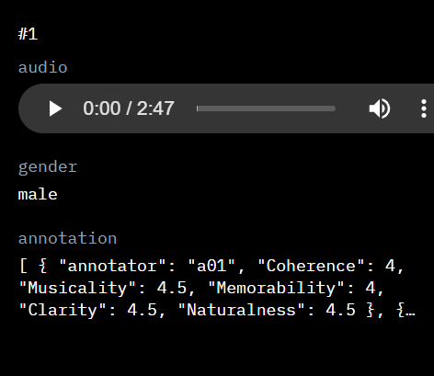
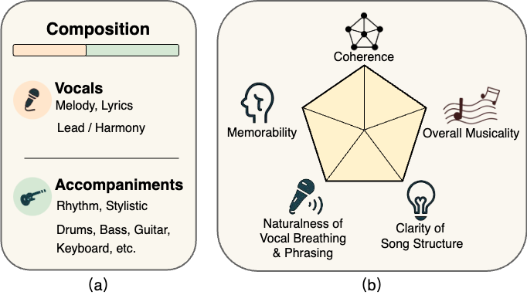
One row looks like:-

Slide 7





Methodology: Processing Pipeline
We employ a systematic 4-step pipeline to transform raw audio into aesthetic quality predictions.
Source Separation
Decompose the audio into vocals, accompaniment, harmonic, and percussive tracks for focused analysis using libraries like Spleeter and librosa.
Feature Extraction
Extract key acoustic features like MFCCs, Chroma, Spectral Centroid, Zero Crossing Rate from each separated track using specialized libraries.
Multimodal Fusion
Integrate feature vectors from different sources using early, late, or hybrid fusion, maximizing information from all modalities.
Quality Prediction
Train regression models to predict the 5 aesthetic ratings using scikit-learn ensemble methods.

Slide 8





Work Plan – Train – Test Split
Shourya Goyal
Aryan Gupta
Data Pipeline & Feature Extraction
Source Separation & Model Training
Build data loading infrastructure because of the big size
Configure Spleeter for stem separation
Implement feature extraction
Train regression models – Polynomial, KNN-based, RF
Optimize hyperparameters using skopt
Lakshmi C
Daivik Gupta
Fusion Strategies & Analysis
Evaluation & Documentation
Implement fusion techniques
Design evaluation protocols
Analyze modality importance
Document findings and results
Per-dimension Analysis
Compare strategy performance

Slide 9

Deliverables & Evaluation
Project Deliverables
Evaluation Methodology
01
Primary Metric
Runnable Python Pipeline
Root Mean Square Error (RMSE) will measure prediction accuracy against human expert scores for each aesthetic dimension.
A complete, documented codebase capable of processing any audio file and extracting all multi-modal features.
Validation Approaches
Cross-validation: 5-fold cross-validation to ensure robust performance estimates.
02
Modality Analysis Report
Per-dimension Analysis: Evaluate performance separately for each aesthetic dimension to identify strengths and weaknesses.
Comprehensive analysis identifying which features are most predictive (e.g., "Vocal features strongly predict Naturalness scores").
03
Fusion Strategy Comparison
Quantitative comparison showing performance differences between fusion approaches.

Slide 10

Challenges & Mitigation Strategies
We have identified three primary technical challenges and developed mitigation approaches for each.
140+ HOURS AUDIO
POOR FEATURES
OVERFITTING
Computational Cost
Separation Quality
High Dimensionality

Slide 11
Challenges & Mitigation Strategies
We have identified three primary technical challenges and developed mitigation approaches for each.
Computational Cost
Separation Quality
High Dimensionality
Challenge:
140 hours of audio: High computational resources & time.
Risk: Development delays.
Mitigation:
Parallel Processing (multi-core).
Cache extracted features (disk reuse).
Prioritize efficient algorithms.
Challenge:
Source Separation Imperfections
Risk: Artifacts (bleeding, phase distortion) may affect feature quality.
Mitigation:
Select features known to be robust to separation artifacts.
Validate separation quality on a subset before full-scale processing.
Challenge:
Large feature vectors (many features, multiple stems).
Risks: Overfitting.
Mitigation:
Feature Selection techniques.
Dimensionality Reduction (e.g., PCA).
Apply Regularization.

Slide 12
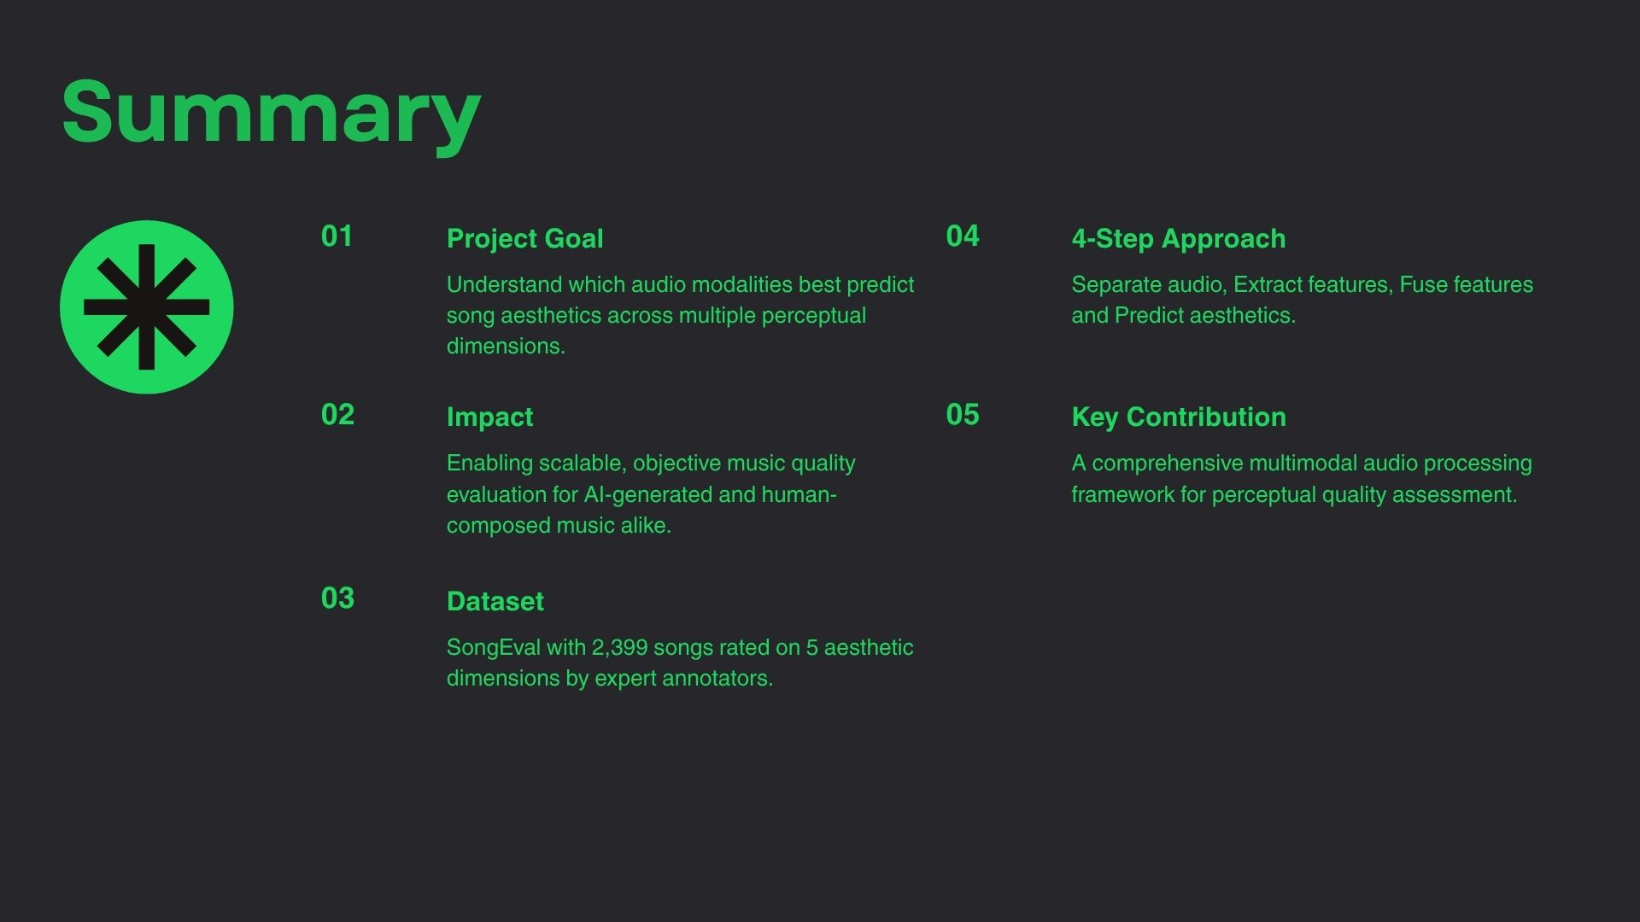











Summary
Dataset
Project Goal
SongEval with 2,399 songs rated on 5 aesthetic dimensions by expert annotators.
Understand which audio modalities best predict song aesthetics across multiple perceptual dimensions.
4-Step Approach
Separate audio, Extract features, Fuse features and Predict aesthetics.
Impact
Enabling scalable, objective music quality evaluation for AI-generated and human-composed music alike.
Key Contribution
A comprehensive multimodal audio processing framework for perceptual quality assessment.
AesthEval provides insights into what makes music sound good.

Slide 13


