Slide 1


SMART INDIA HACKATHON 2024
MINISTRY OF EDUCATION
DropOutZero and LearnX – Web Application
Problem Statement ID | 1661
Problem Statement Title | Implement Software Solutions to Reduce Student Dropout Rates at Various Educational Stages
Theme | Smart Education
PS Category | Software
Team ID
Team Name | Innov8tive

Slide 2

Innov8tive
This solution aims to develop innovative software tools designed to identify at-risk students, provide personalized support, and engage communities in addressing dropout rates. By leveraging cutting-edge technology, the initiative seeks to enhance student retention, align with NEP 2020’s goals, and promote a holistic approach to education.
Website (DropOutZero)
Community Learning Hub Platform
Parental Engagement Portal
Financial Support Management System
Counselling resources
Mobile Application (LearnX)
Flexible Schooling Management System
Student Support and Engagement App

Slide 3
TECHNICAL APPROACH
Innov8tive
Estimated Budget
Front-End Framework: React.js
Mobile Development: Flutter and Flutter Flow
Software Solution | Technology/Service | Estimated Cost (INR)
AI-Driven Early Warning System | Development (Python, Django) | 30,000
 | Hosting (Heroku Free Tier) | 10,000
Mobile Learning Application | Development (Flutter) | 30,000
 | Content Management (Firebase) | 5,000
Parental Engagement Portal | Development (React.JS) | 15,000
 | Hosting (Shared Hosting) | 5,000
Counselling Support Platform | Development (MERN) | 20,000
 | Real-Time Chat Integration (Firebase Free Tier) | 10,000
 | Hosting and Domain (Shared Hosting) | 10,000
Back-End Framework: Node.js (with Express)
Database:
MongoDB & Firebase
Payment Gateway:
Razor Pay API
CI/CD Pipeline:
GitHub Actions
Data Visualization Tool:
Tableau
Communication API:
Twilio
TOTAL ESTIMATED COST = ₹1,00,000

Slide 4
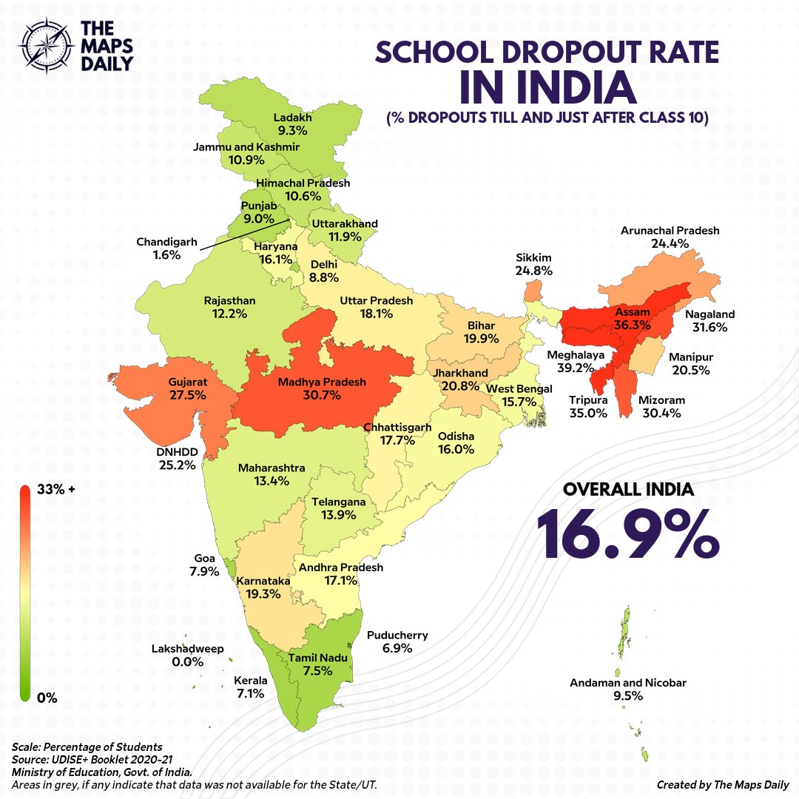
Innov8tive
WHAT ARE OUR CURRENT DEFICIENCIES?
Strengthen program implementation and monitoring.
Expand financial aid and support.
Invest in school infrastructure.
Improve teacher training and resources.
Address social and cultural barriers.
Offer flexible learning options.
The primary factor we are currently lacking is...
KNOWLEDGE
&
REACH

Slide 5





Innov8tive
FEATURES
DropOutZero
(Main Portal)
ADMIN SIDE
USER
AUTHETICATION
Personalized Learning Paths
Offline Access
Progress Tracking and Reports
Counseling and Support Services
Notifications and Reminders
Interactive Community Forums
Multilingual Support
Flexible Schooling Management
Data Security and Privacy
User-Friendly Interface
AI Warning
Artificial Intelligence Based model
LearnX
Education
Application
OTHER SITES
WEBSITES
Linked with Main Site
DPP & Tests
Video Lecture
Roadmap
Planned for 1st to Degree students
Community Interaction Hub
Parental Engagement Portal
Counselling Support Platform

Slide 6


Innov8tive
Benefits of the Solution
The solution reduces dropout rates through early intervention, enhances educational outcomes with personalized support, empowers parents and communities, and improves access to education for underserved students.
Social Benefits
Economic Benefits:
Equitable Education
Community Engagement
Improved Mental Health
Higher Earning Potential
Economic Growth
Reduced Financial Strain
Increased Retention Rates
Improved Educational Outcomes
Empowerment of Parents and Communities
Enhanced Access to Education
“Reducing dropout rates requires a holistic approach that addresses students' academic, social, and emotional needs. These software solutions provide a comprehensive suite of tools to support students' well-being”
– Team Innov8tive

